Slide 1


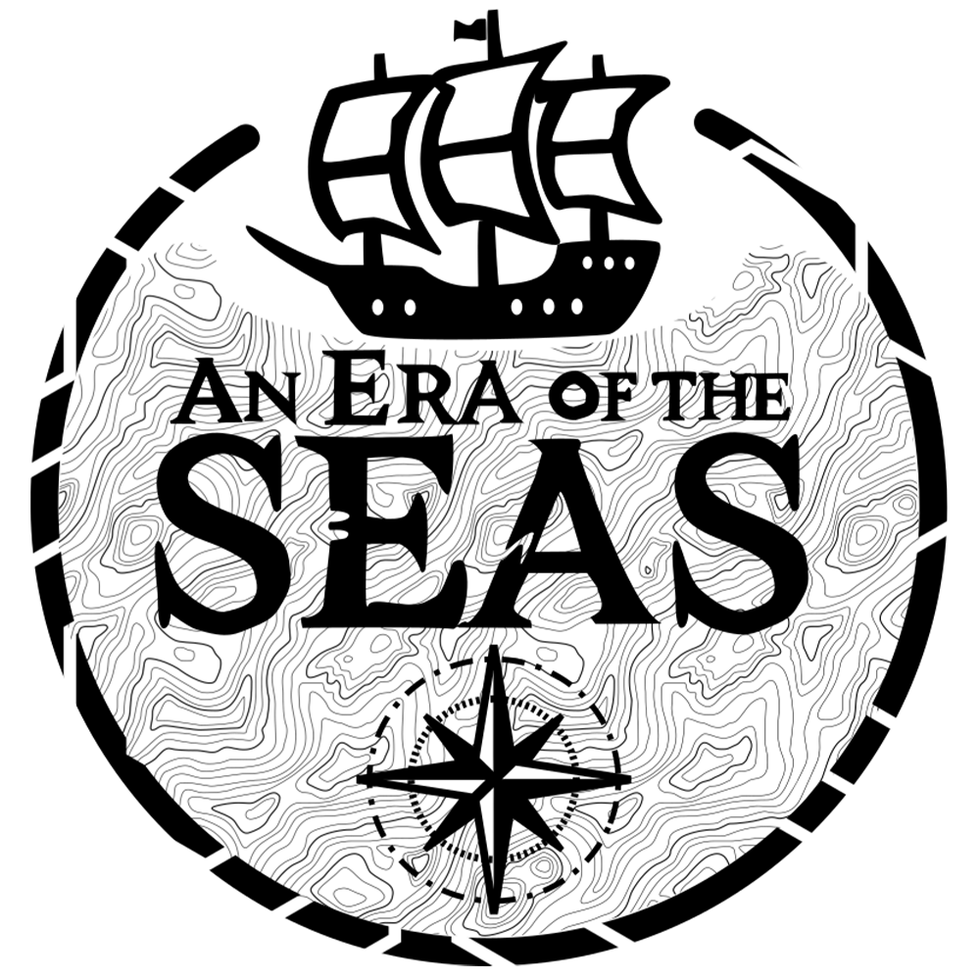

Jérôme Lin – Achref Ben Abdallah – Ethan Bruno – Joseph Devin

Slide 2
Progress
Tasks | Current progress | Planned progress
Menu & UI | 100% | 100%
Water Simulation | 100% | 100%
Movements (Boat & Player) | 100% | 100%
AI | 100% | 80%
3D Map | 13% | 30%
System of localization | 0% | 100%
Stats Items | 100% | 100%
Fishing system | 0% | 0%
Hunger system | 0% | 70%
Network | 80% | 100%
Multiplayer | 0% | 50%
Story | 20% | 50%
Quests | 0% | 30%
Design of entities | 60% | 80%
Animation of entities | 100% | 80%
SFX | 80% | 80%
Music | 100% | 80%

Slide 3
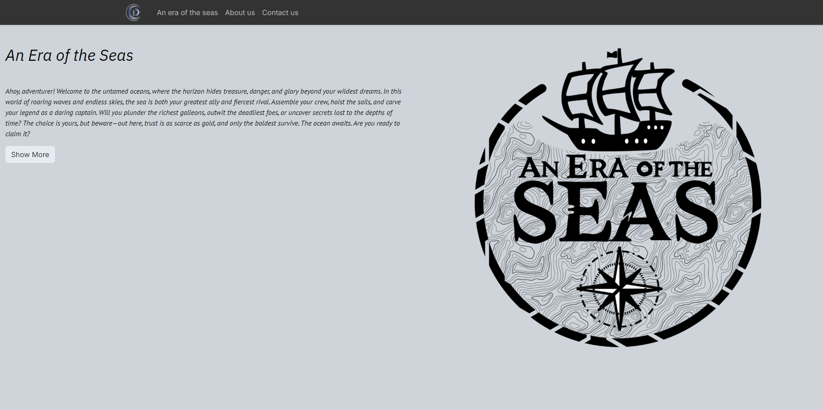
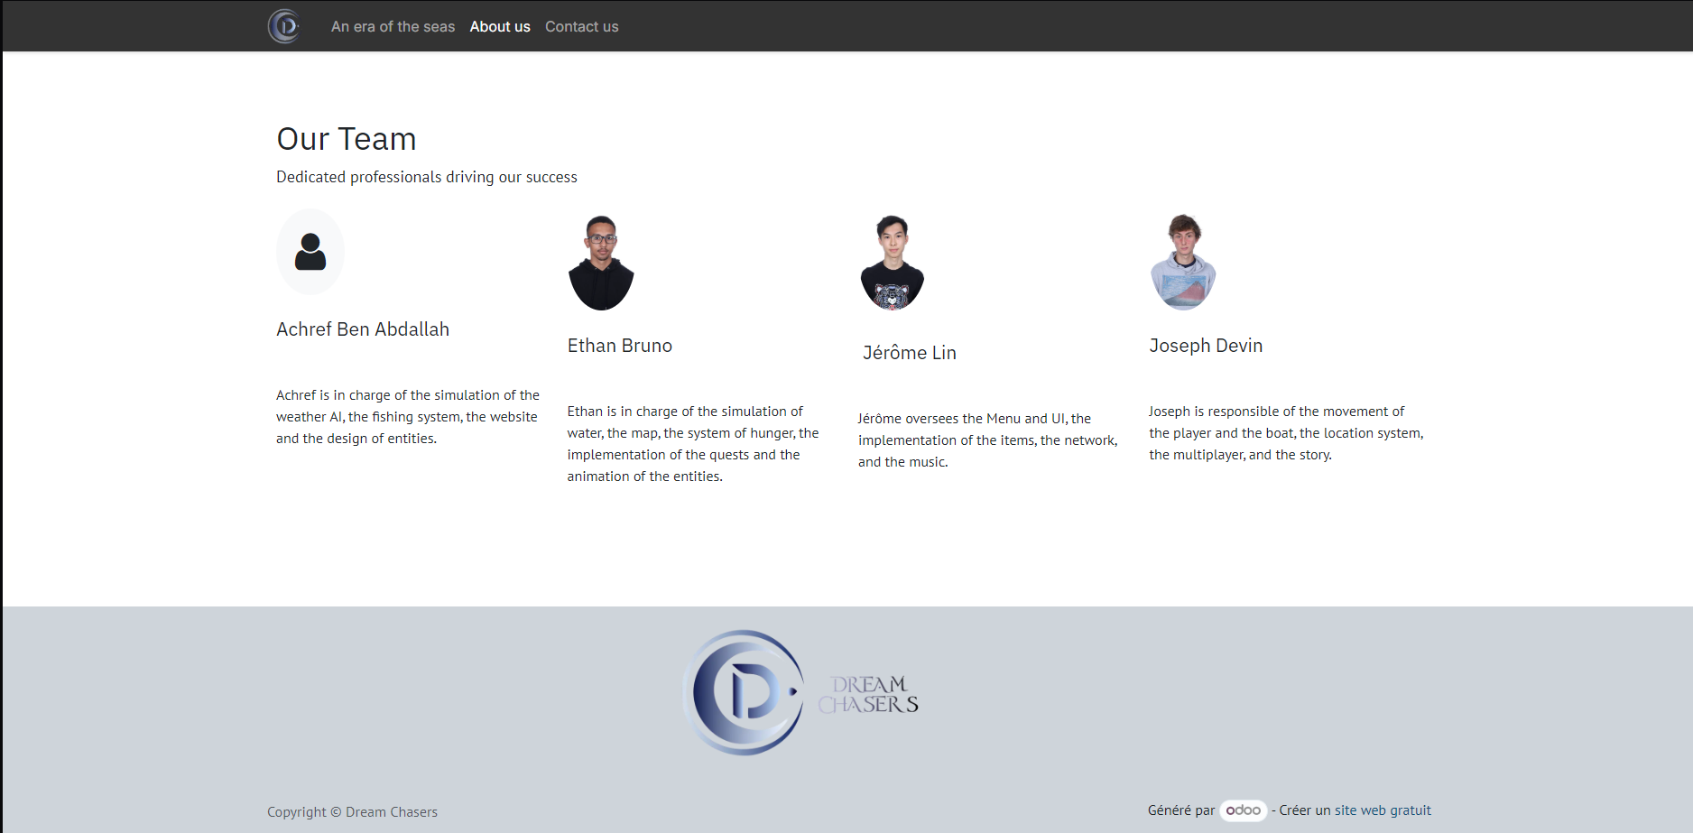
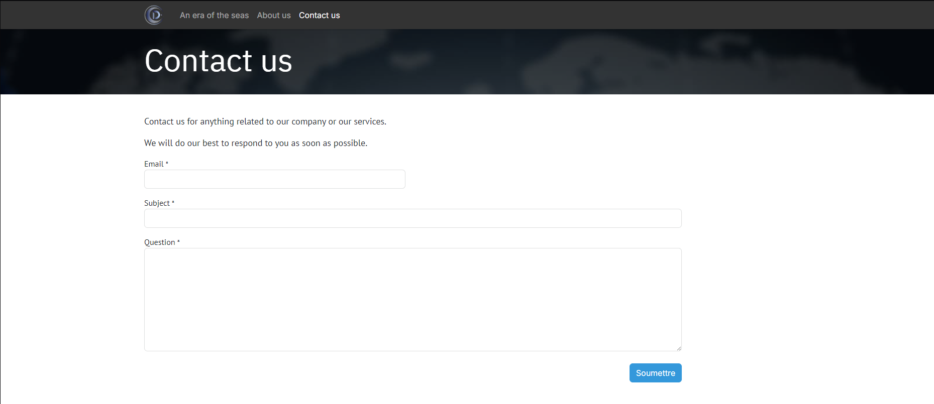

Slide 4
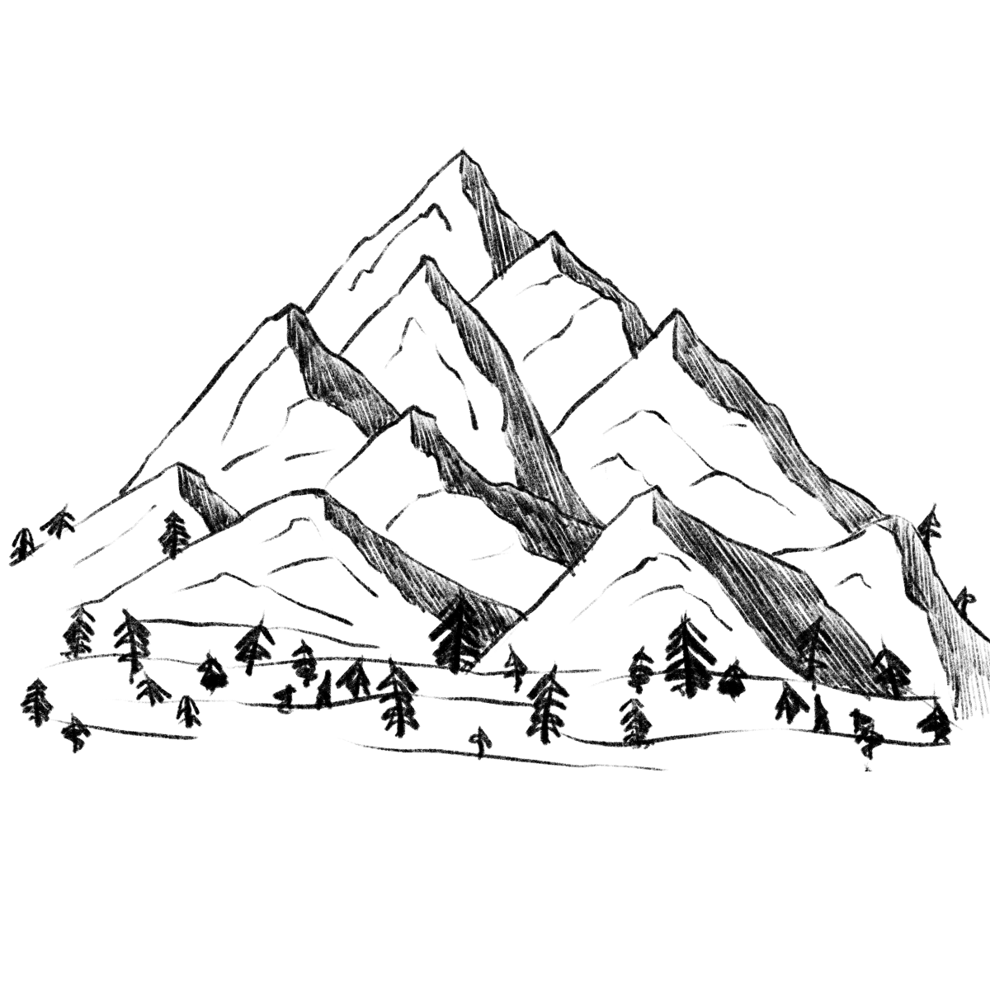


Map Creation

Slide 5
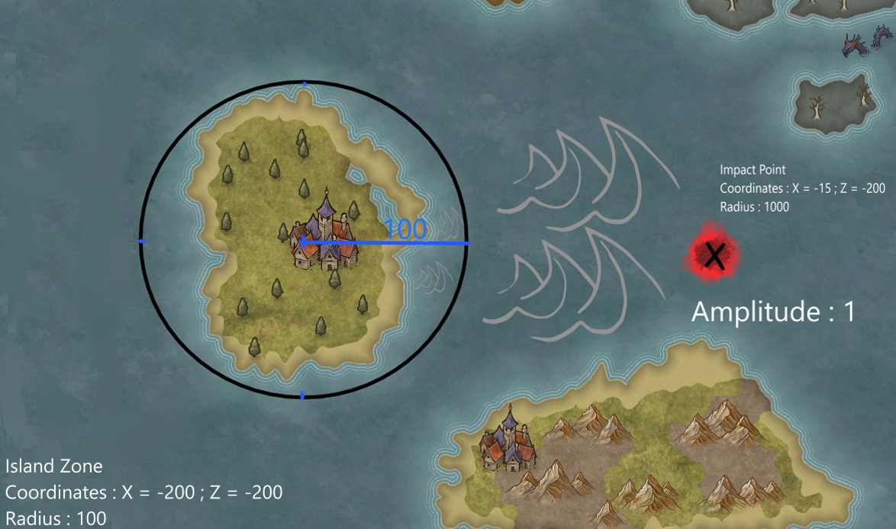
Water Simulation

Slide 6
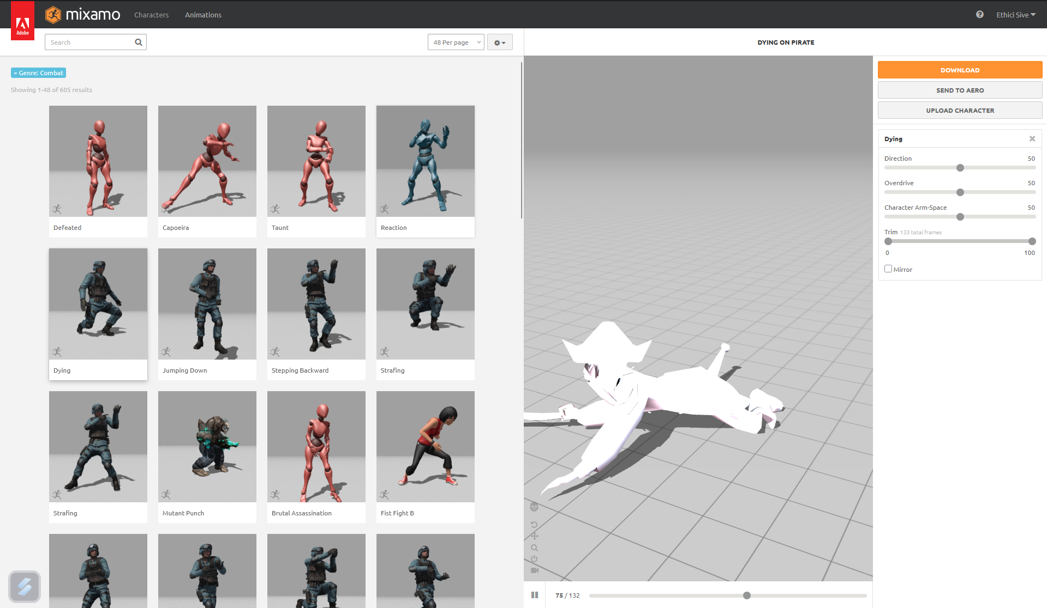
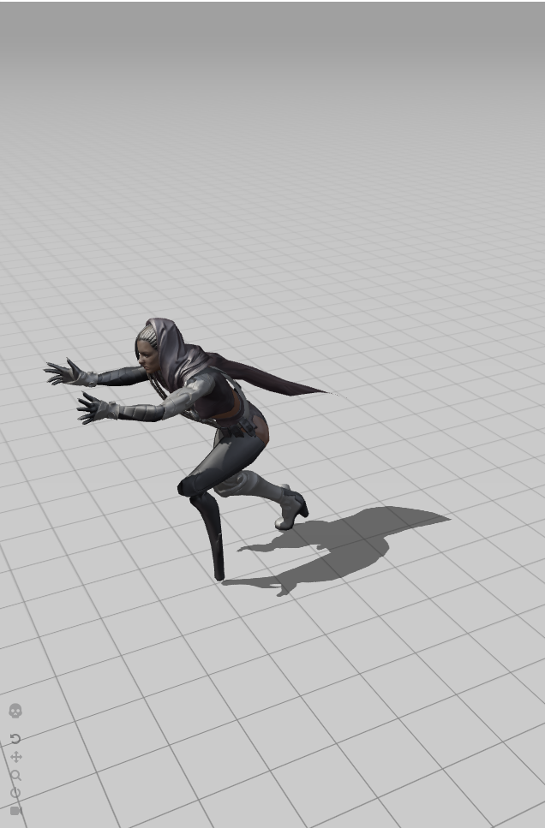
Entity Animation

Slide 7
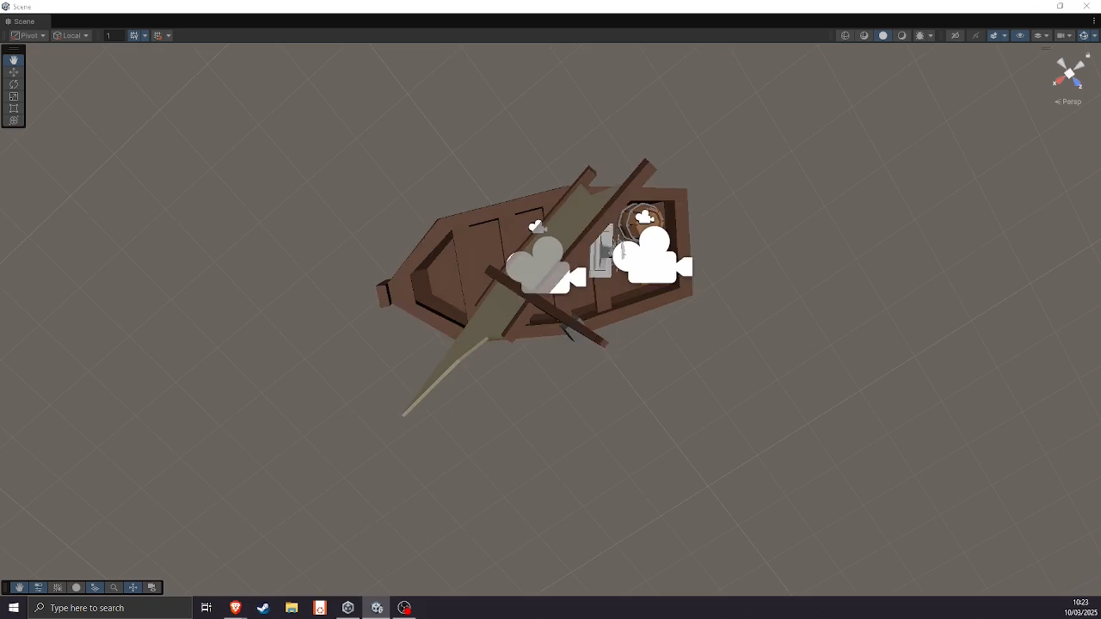
Wind simulation

Slide 8
Conclusion
Done | In progress | To do
Menu & UI Items 2D map Water simulation Movements (boat, player) Movement AI (enemies, attack) Animation of the entities Music | 3D map Network Weather simulation Design of the entities SFX | Localization system Fishing system Hunger system Multiplayer Story Quest

