Slide 1




Jérôme Lin – Achref Ben Abdallah – Ethan Bruno – Joseph Devin

Slide 2
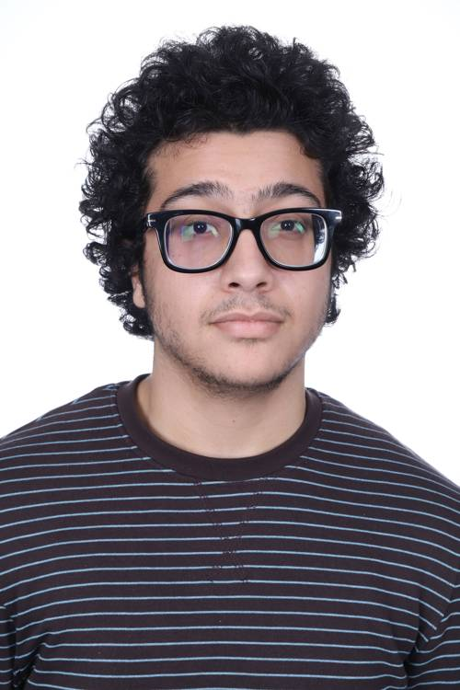
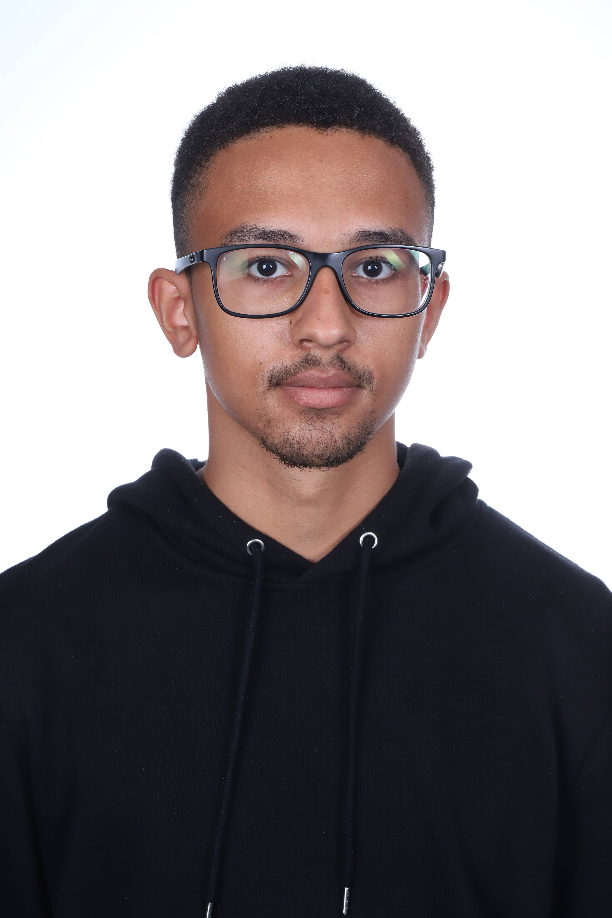
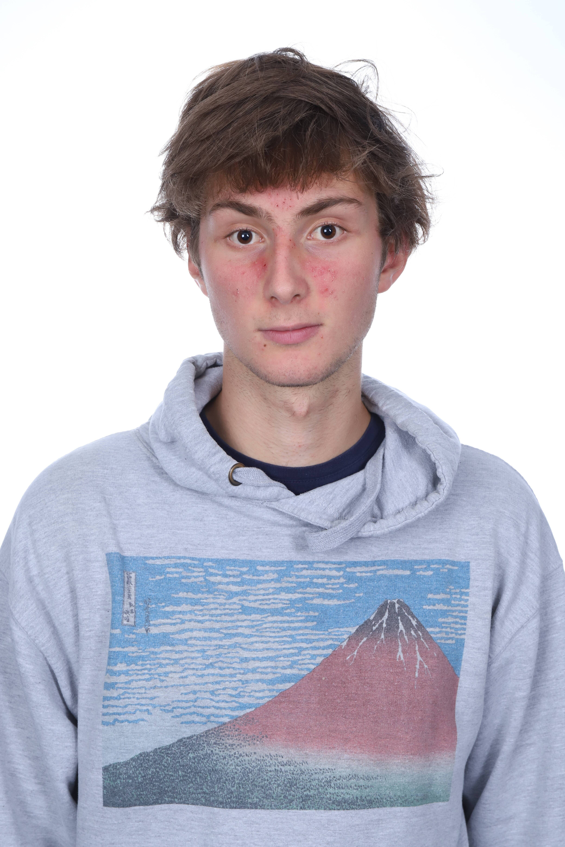
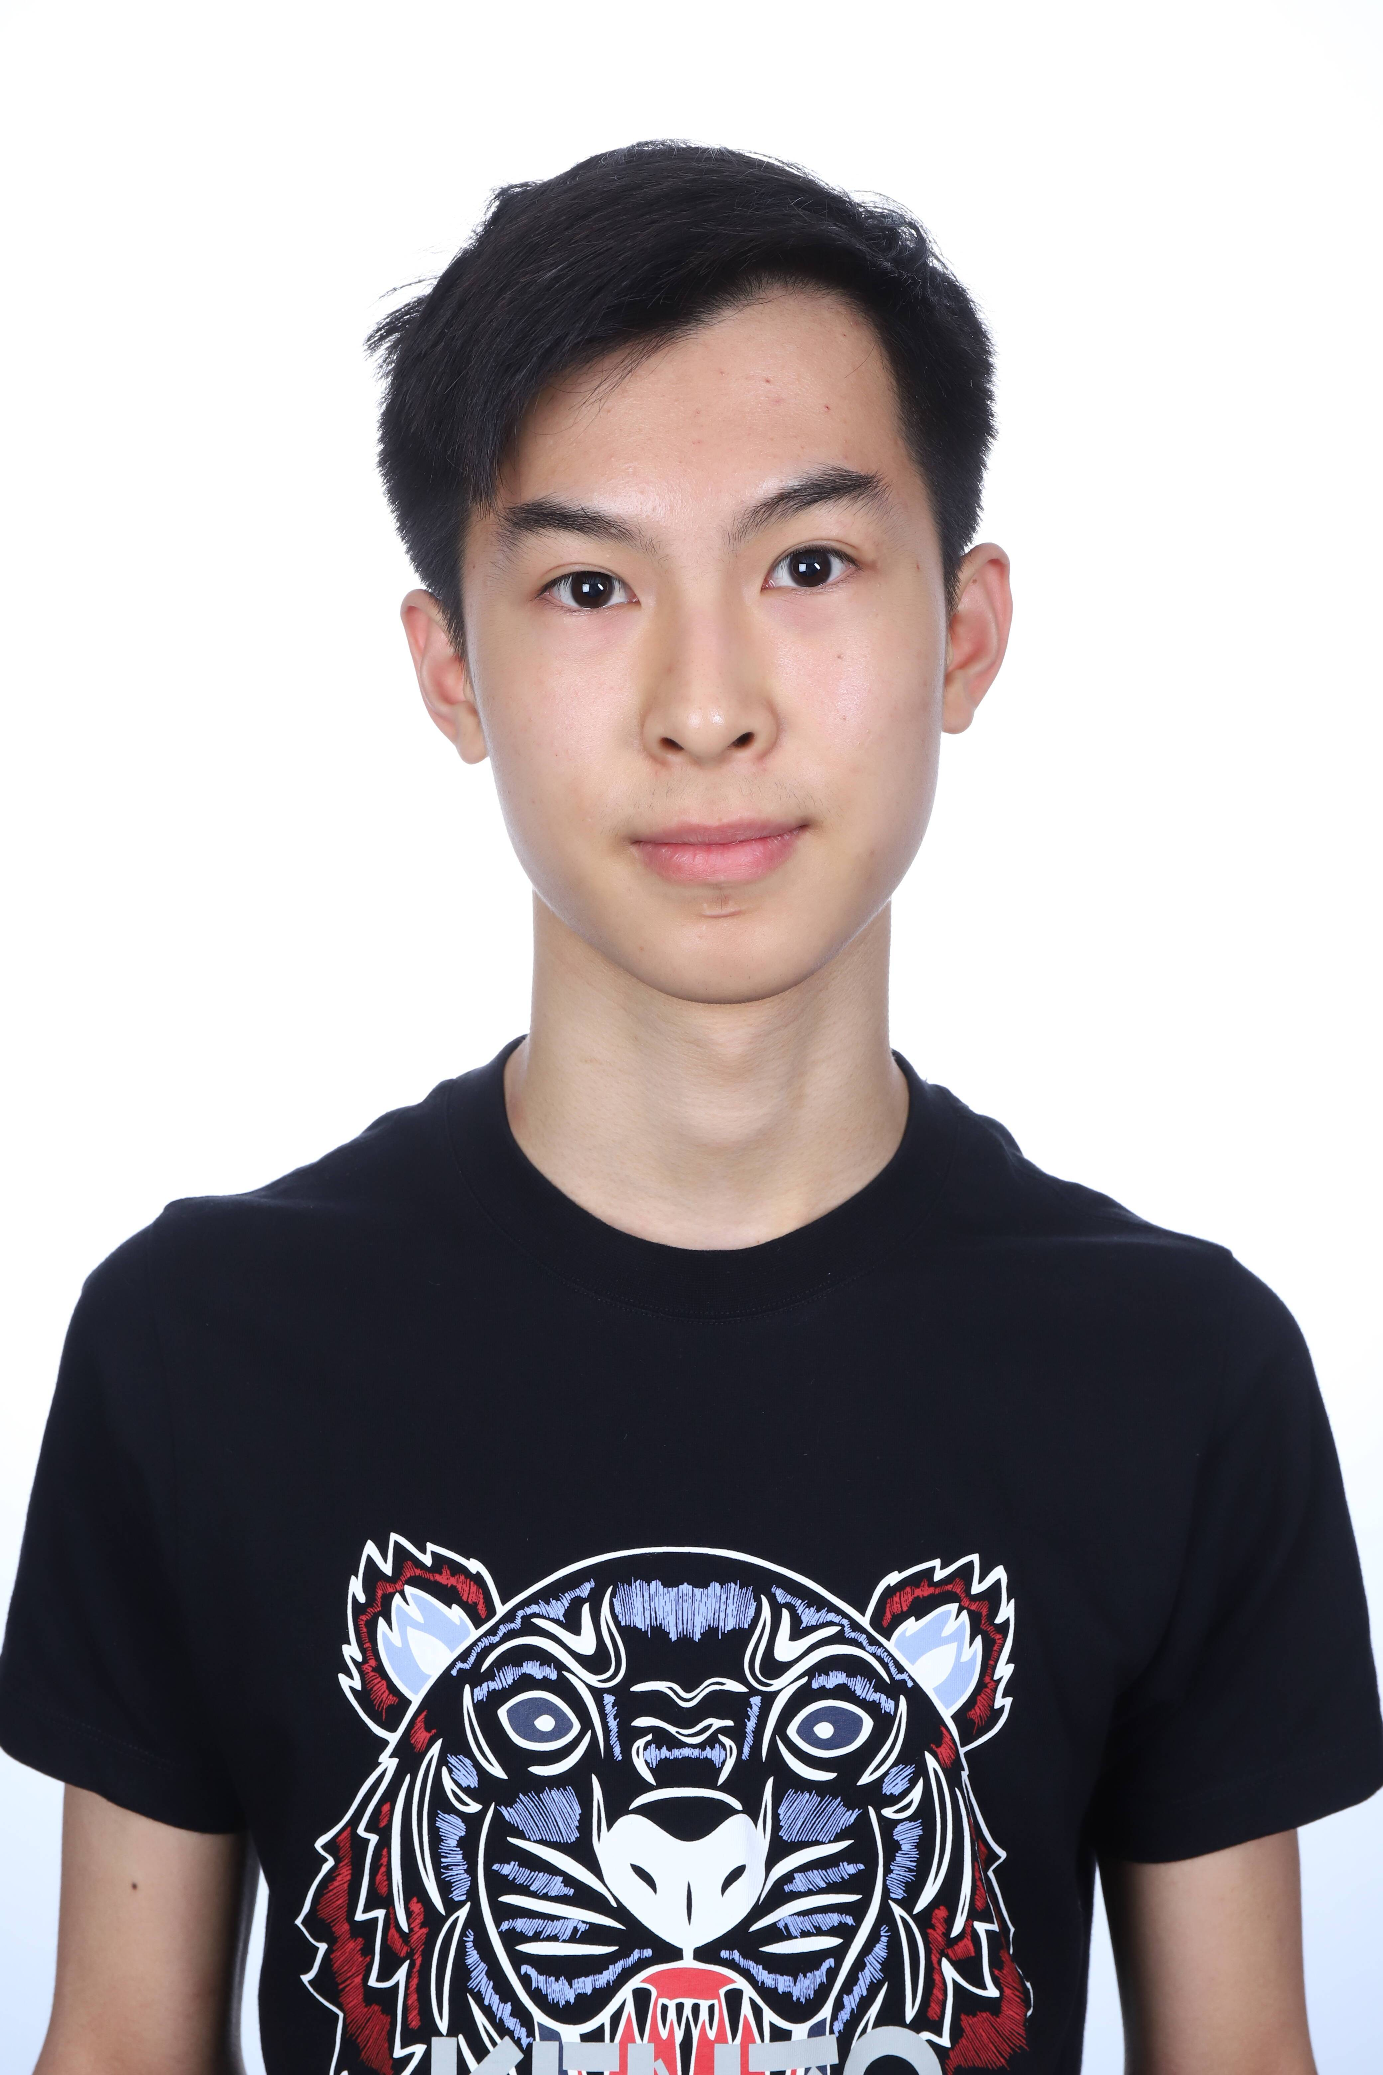
Members
Achref
Ethan
Joseph
Jérôme

Slide 3
Website
https://dream-chasers.odoo.com

Slide 4
Conclusion

