Slide 1
Business Overview

Slide 2
Problem Statement
Employee turnover is one of the most critical operational and financial challenges facing modern organizations. Beyond the direct costs of recruiting, hiring, and onboarding replacements, excessive attrition drains institutional knowledge, disrupts team dynamics, and lowers overall productivity.
For this project, the organization faced an underlying high attrition rate across its workforce of 1,470 employees. Rather than relying on guesswork, leadership required a rigorous, data-driven investigation to uncover the root causes of employee departures and identify high-risk segments before turnover occurs.

Slide 3
Project Objectives
Identify core attrition drivers: isolate the primary structural, financial, and behavioural factors pushing employees to leave the company.
Bridge financial metrics and risk: unpack complex financial variables (such as base compensation versus administrative rates) to reveal how salary tiers influence retention.
Map behavioural and environmental stressors: quantify the impact of daily workplace conditions, including overtime demands, business travel frequency, and commute distances.
Lay the foundation for predictive modelling: deliver a fully cleansed, transformed, and feature-engineered dataset ready to power phase 5 machine learning classification models.

Slide 4
Scope and Analytical Approach
Utilizing python (pandas, NumPy) alongside advanced visualization suites (seaborn, matplotlib), the project executed a multi-staged exploratory workflow:
Data hygiene and validation: conducted rigorous data validation, stripping out zero-variance columns (such as `standard hours`) and handling skewness in continuous financial distributions.
Feature transformation: applied custom salary binning (from entry-level brackets to executive tiers) to correct non-linear skewness and accurately capture financial push/pull dynamics.
Data exploration:
  Univariate analysis: evaluated class balance, feature distributions, and baseline demographic metrics across the entire workforce.
  Bivariate analysis: investigated relationships between individual predictors and target attrition, isolating major push/pull factors like salary tiers, overtime, and travel frequency.
  Multivariate analysis: combined correlation matrices, categorical crosstab heatmaps, and binned correlation analyses (handling zero-variance columns and income skewness) to decode how variables interact to affect employee longevity.

Slide 5
Strategic Value and Impact
This exploratory analysis bridges the gap between raw human resources data and actionable business strategy. By pinpointing exact risk indicators - such as entry-level income vulnerability and burnout triggers like mandatory overtime-this project provides leadership with the diagnostic clarity needed to transition from reactive troubleshooting to proactive retention planning.

Slide 6
Data Understanding

Slide 7
Data Cleaning/Preparation
Insights:
Data appeared to be in a tab separated format and was properly formatted
Some the columns data types are incorrect
There are no missing values
There are 1470 entries/captured employees
The dataset has 35 columns
After correcting the datatypes, there were still no missing values.
Some columns that would not be required were filtered out
Some features like monthly income, distance from home, age, etc. were categorized for analysis

Slide 8
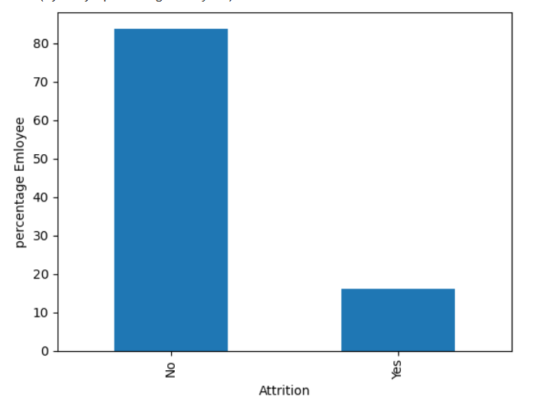
Target Variable
Insights:
237 total employees out of 1,470 employees have departed the company
Accounting for attrition rate of 16.12%
At a ratio of 5:1; for every 5 employee, one has exited

Slide 9
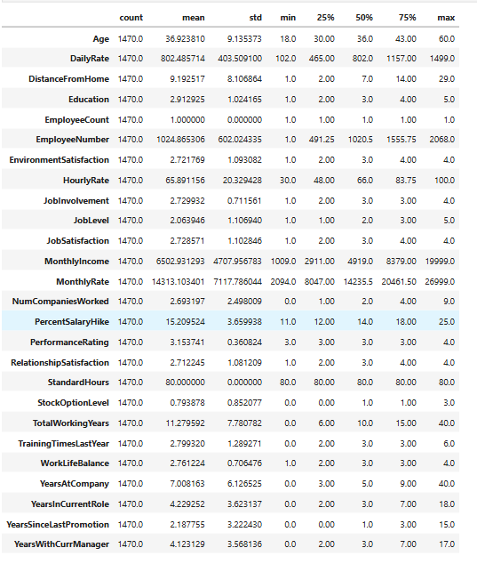
Initial Data Intuition
Initial insights:
Average age of employees is 37, with 75% of employees below 44 years, and the minimum age is 18 years
Max years of year since last promotion is 15 years
Longest tenure at the company is 40 years, while the longest an employee has been in a particular role is 18 years
Average daily rate is ~802.49 and standard work hours at 80 hrs.
Average monthly income is ~6,502.93$, and only 25% of the workforce earns above 8,379$, while more than 50% earns below 5,000$ which is above the companies average
75% of employees are mid to low level, and 25% put in below-average effort in their jobs and are dissatisfied.

Slide 10
Also, 75% of the workforce are university graduates and above
Work relationship/work-life balance/environment is almost average in satisfaction
Average years spent under a current manager is 4 years, with a maximum of 17 years, while 50% of the workforce has spent not more than 5 years under their current managers.
In a total of 6 trainings hosted, only 25% of the workforce managed to attend more than 3 of these trainings.
Half of the workforce covers 7km(30 minutes drive) to get to the office, while 25% cover more than 14km(1hr drive) to get to work
Overall performance ratings of employees are slightly above average
Only 25% of the workforce enjoys standard/entry option tier equity/stock option, while half are zero.

Slide 11
Univariate Analysis

Slide 12
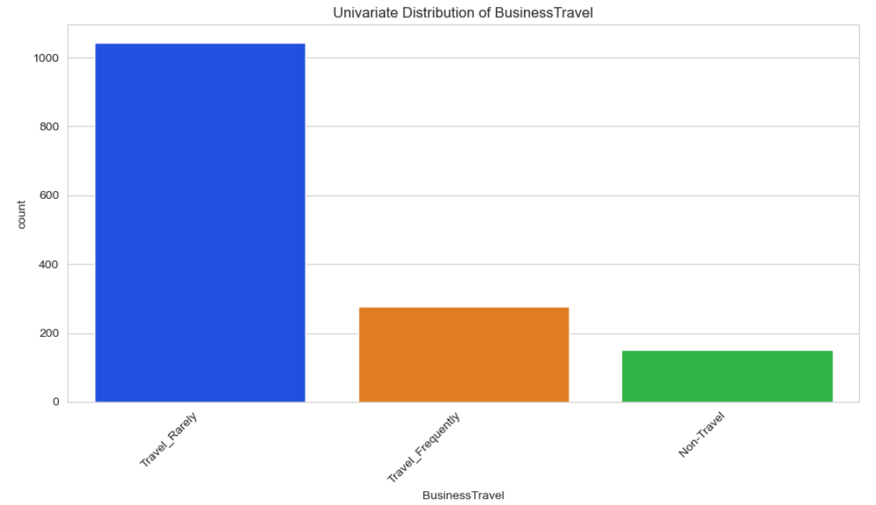
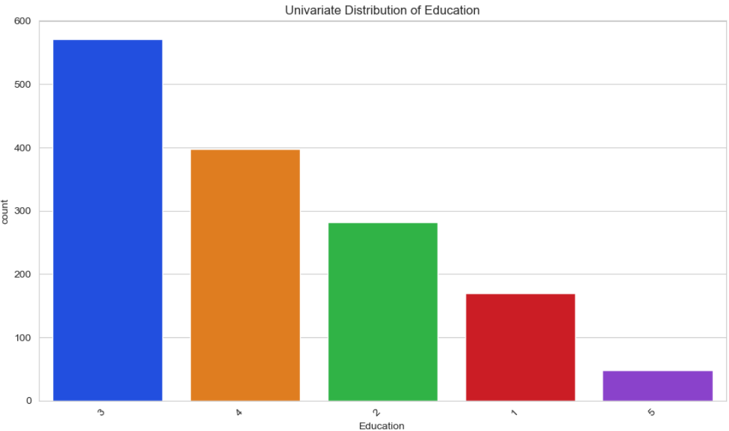
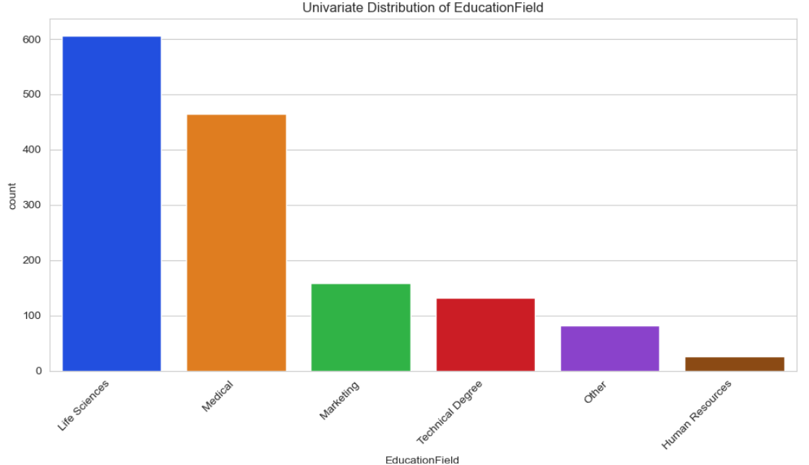
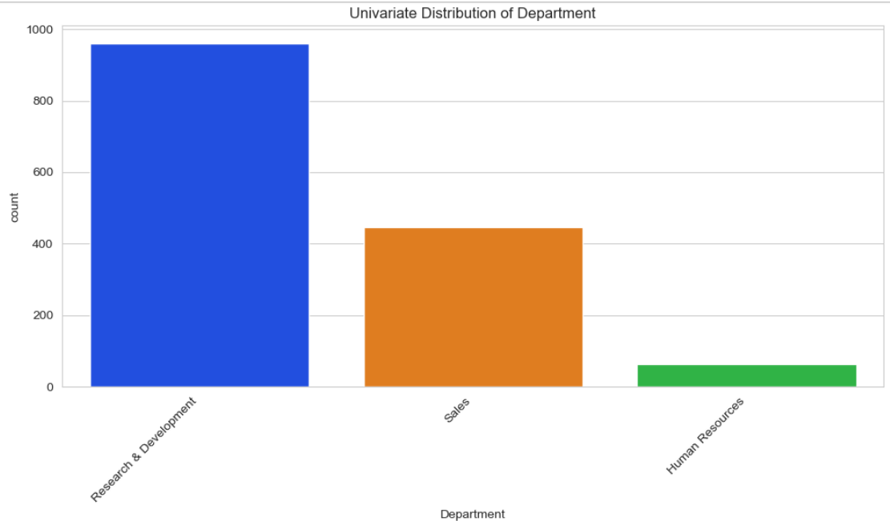
Insights:
About 69% of the staffs are rarely travels
Research and development is the largest department
More than half of the staffs have education level 3 and 4
Most of them are with life sciences and medical certificates

Slide 13
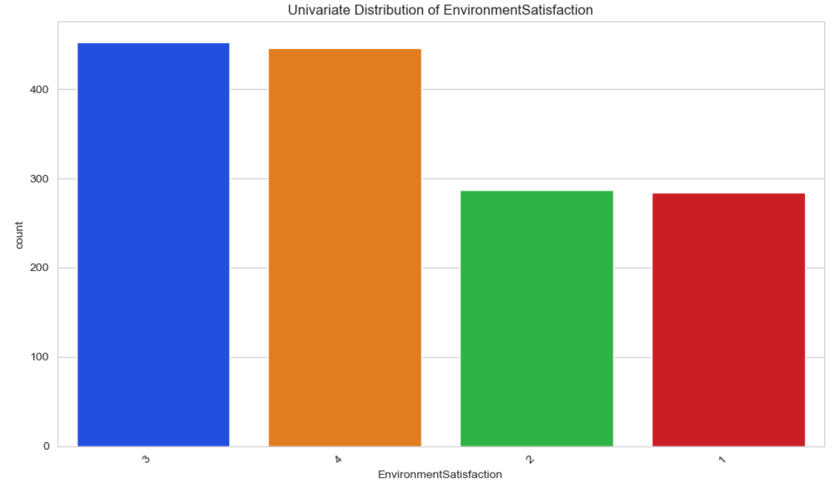
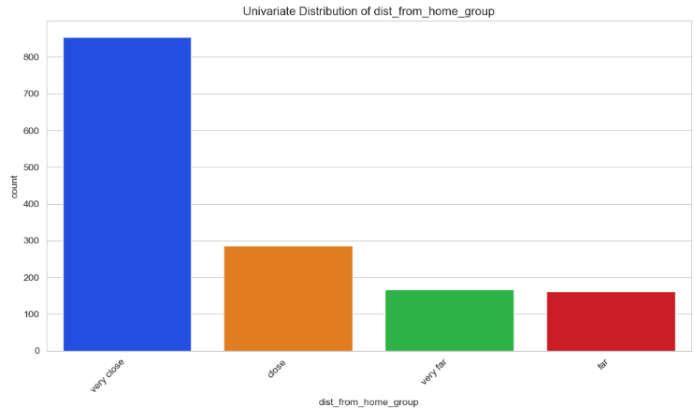
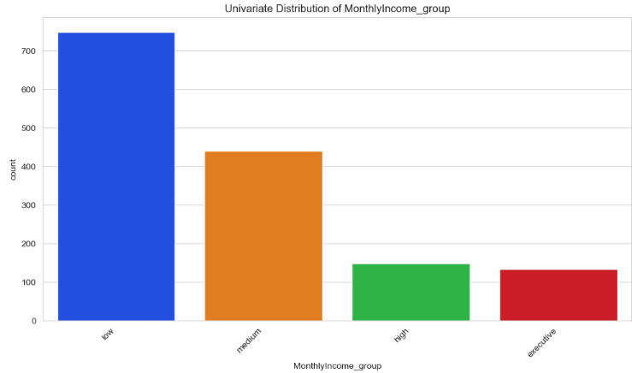
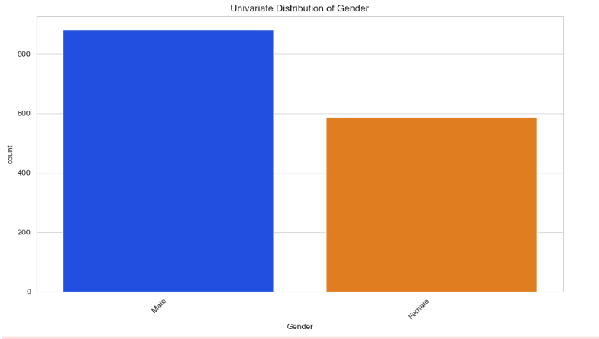
Insights:
More than half of the staff are satisfied with the working environment
About 60% are men
More than 75% of the staff earn low –medium salary
About 75% of them are living very close to the company

Slide 14
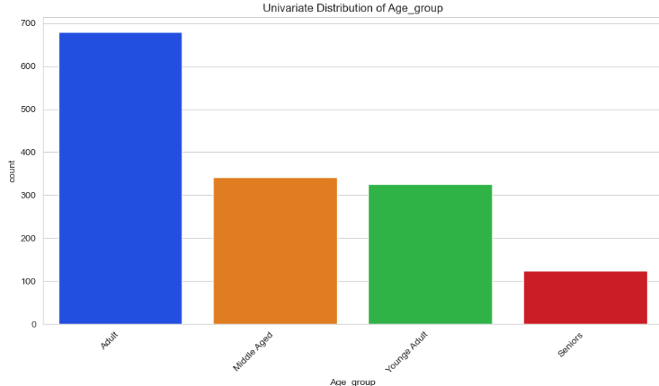
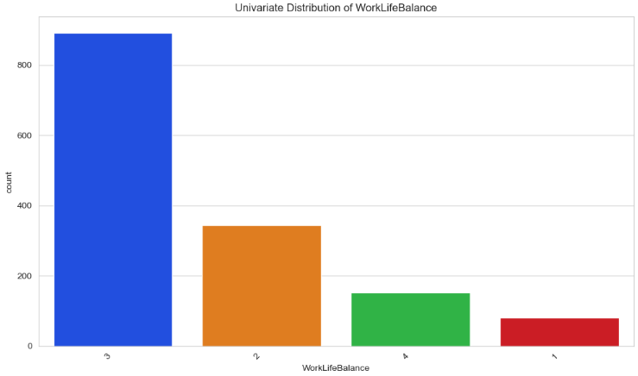
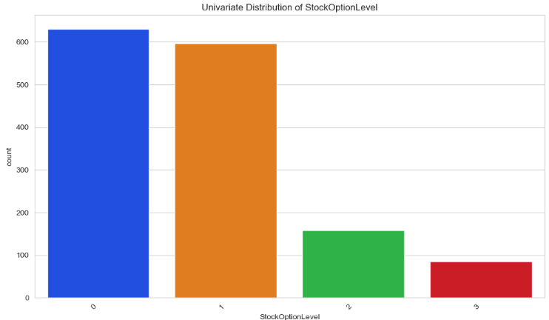
Insights:
The company consists of mostly of people below the age of 41
More than 60% of the staff average work life balance
More than 70% do not have stock options

Slide 15
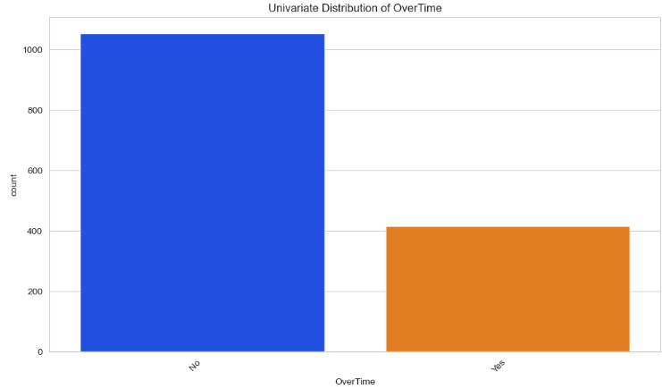
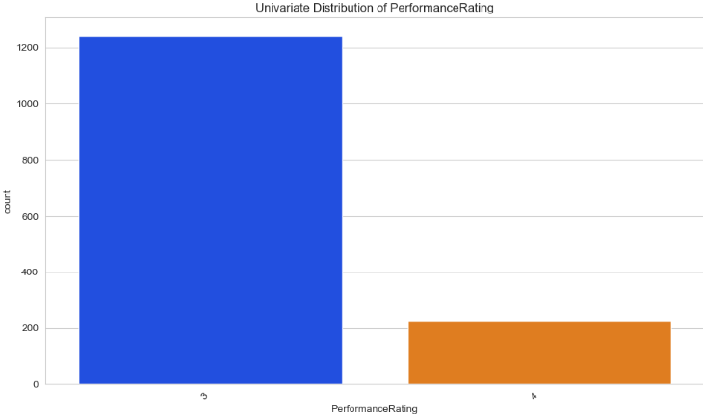
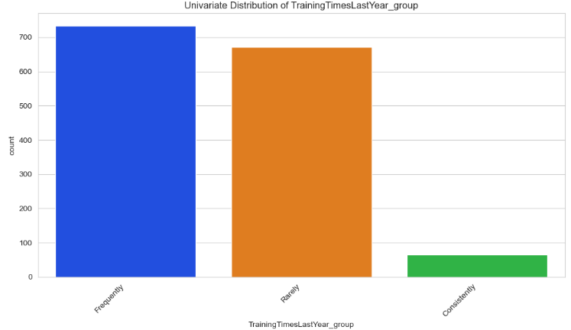
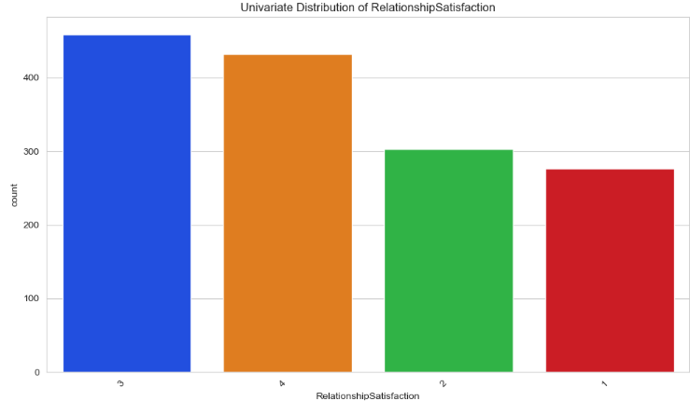
Insights:
More than 80% of the staff are performing at average level
While more than half have averagely good work relationships
About 30% of the staff work overtime
Only 4% of them consistently attend trainings

Slide 16
Bivariate Analysis

Slide 17
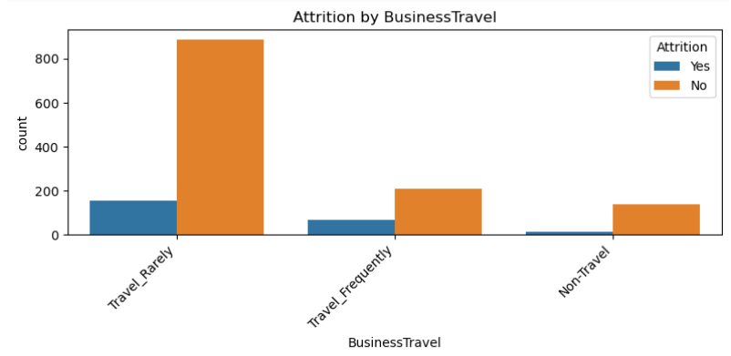
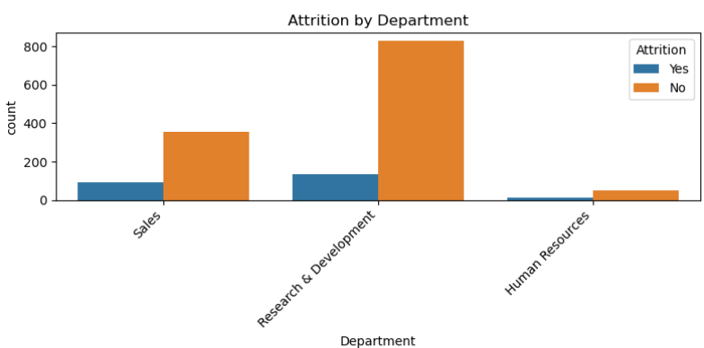
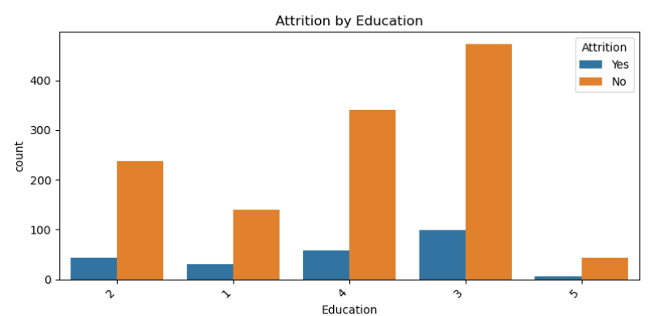
Rate of Attrition Distribution
Insights:
People who travel frequently are more likely to churn
People in sales and human resources department are more likely to leave
People with education levels 1 and 3 are more likely to leave

Slide 18
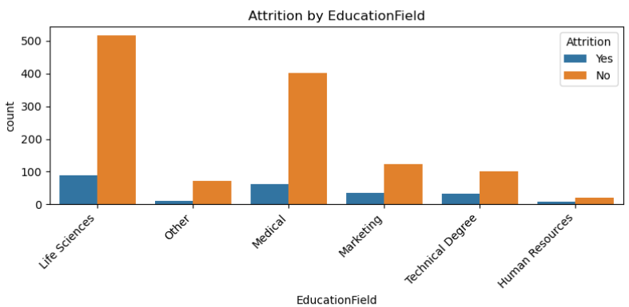
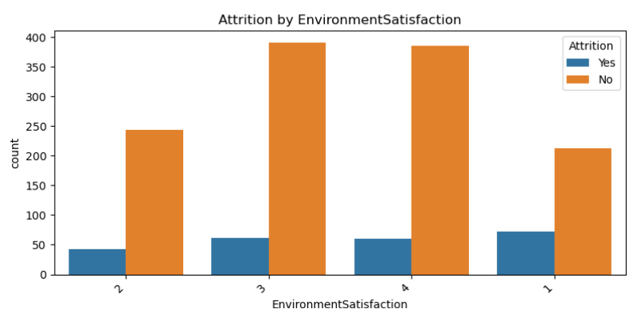
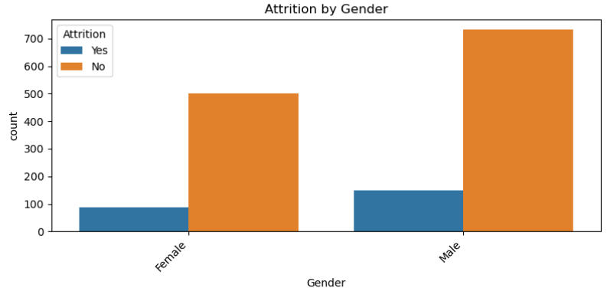
Rate of Attrition Distribution
Insights:
Those in technical, human resources, and other education fields are more likely to leave
Those least satisfied with the environment
Men exit just slight more than female

Slide 19
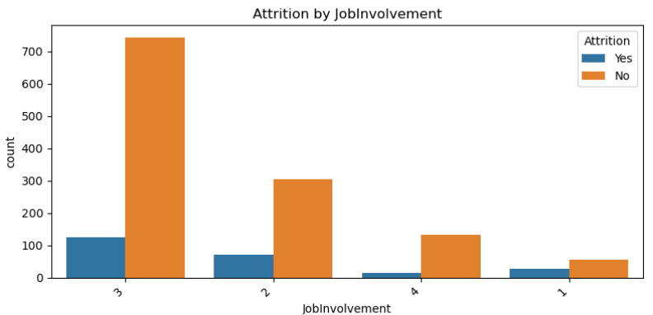
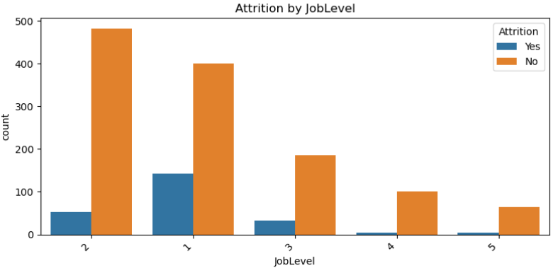
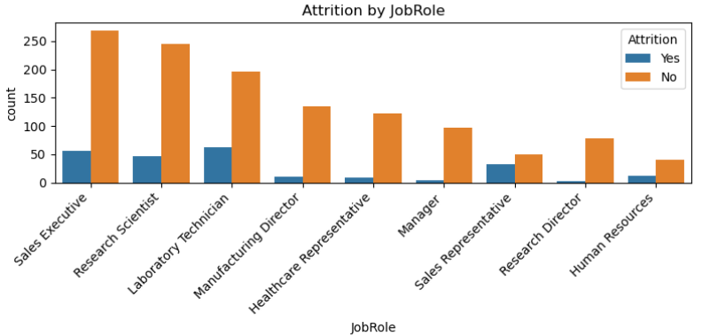
Rate of Attrition Distribution
Insights:
Staffs with least job involvement and job level
Job roles tend to exit more in this order: sales reps, human resources, laboratory tech, sales executives, research scientist

Slide 20
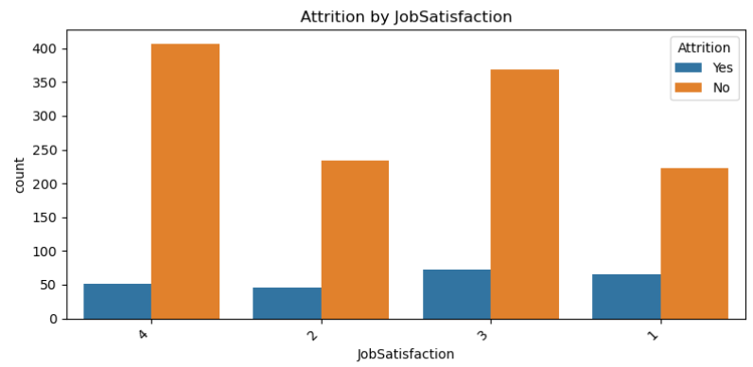
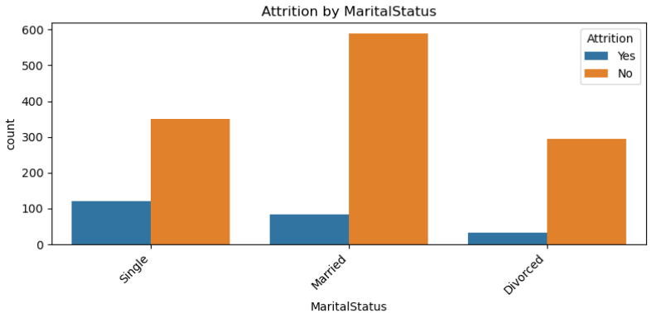
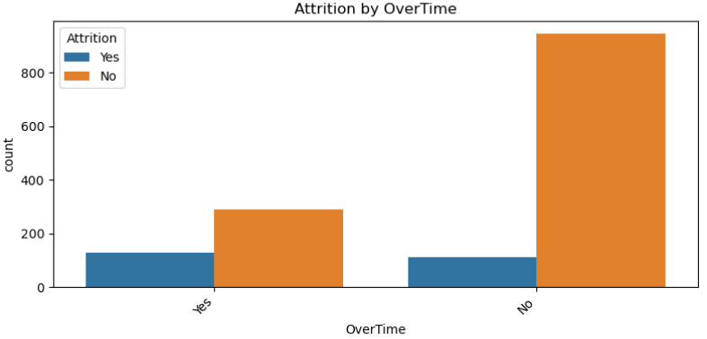
Rate of Attrition Distribution
Insights:
As job satisfaction drops, staffs are more likely to leave and least relationship satisfaction
Single staffs exit more
Those who do overtime are more likely to leave

Slide 21
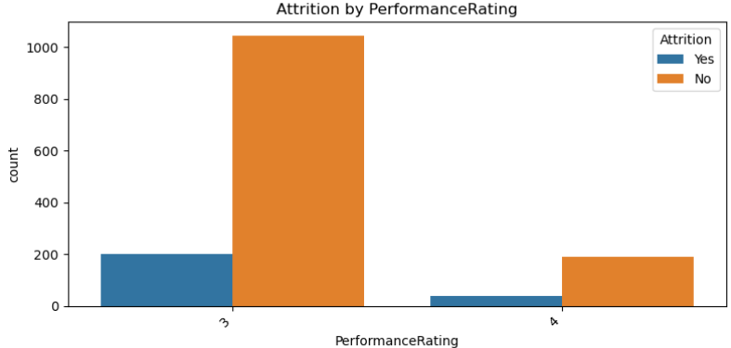
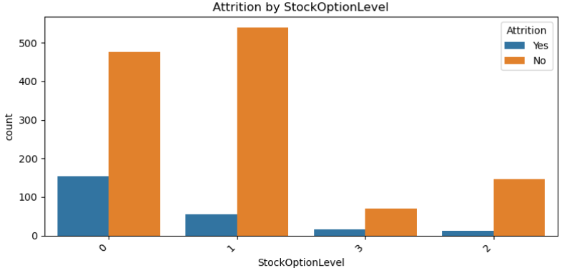
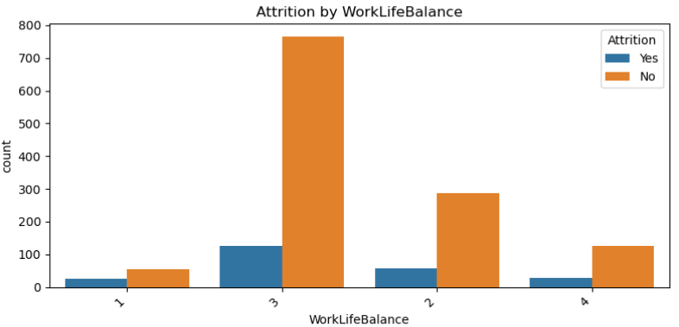
Rate of Attrition Distribution
Insights:
Those with high performance rating
Those with no stock options and those with stock option level 3
Those with the worst work-life balance

Slide 22
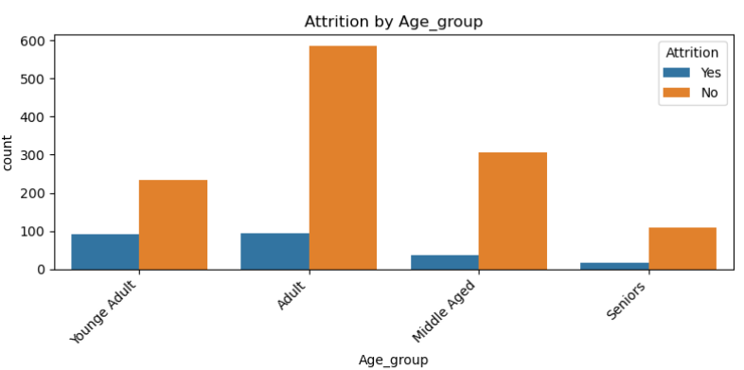
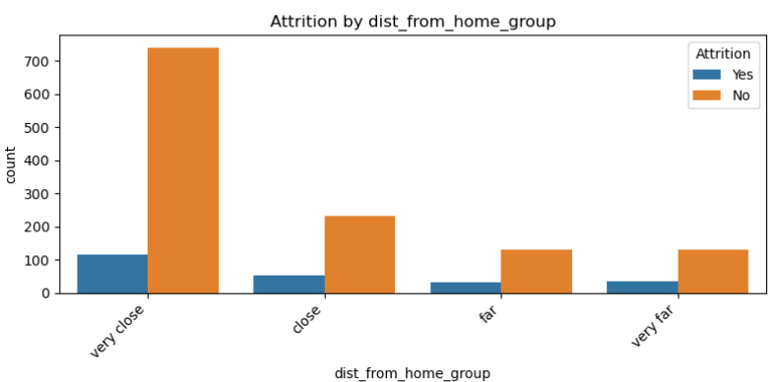
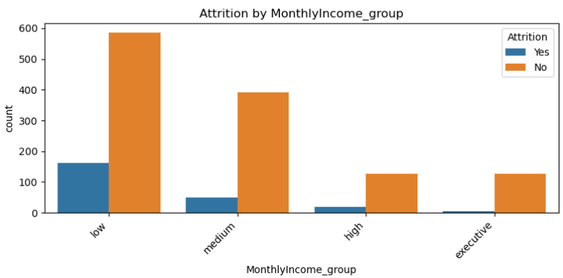
Rate of Attrition Distribution
Insights:
Young adults and seniors respectively tends to exit more
The farther the distance from home, the more they tend to exit
Staff who low earners category exit more along side with high earners category

Slide 23
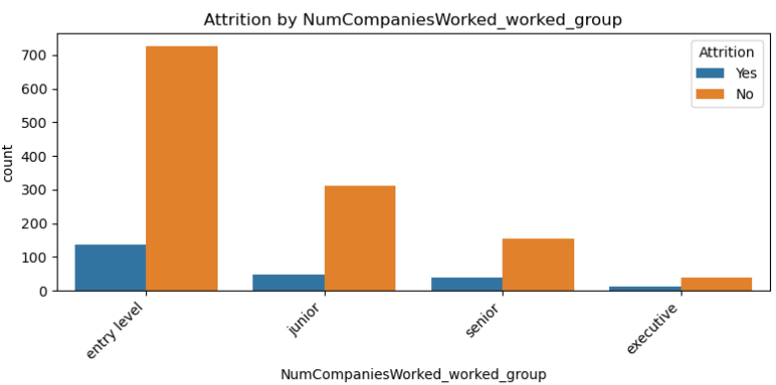
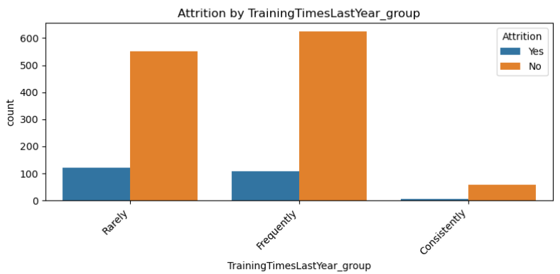
Rate of Attrition Distribution
Insights:
Staffs with more experience tends to exit more
Staffs who rarely attend trainings are more likely to exit

Slide 24
Numeric and Bivariate Analysis

Slide 25
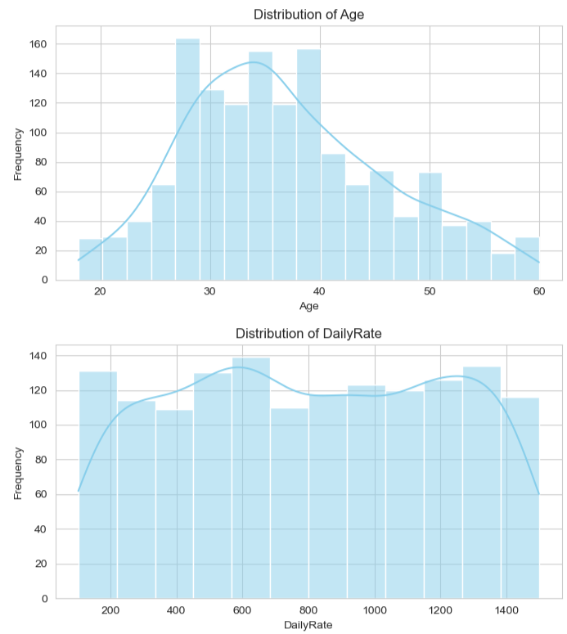
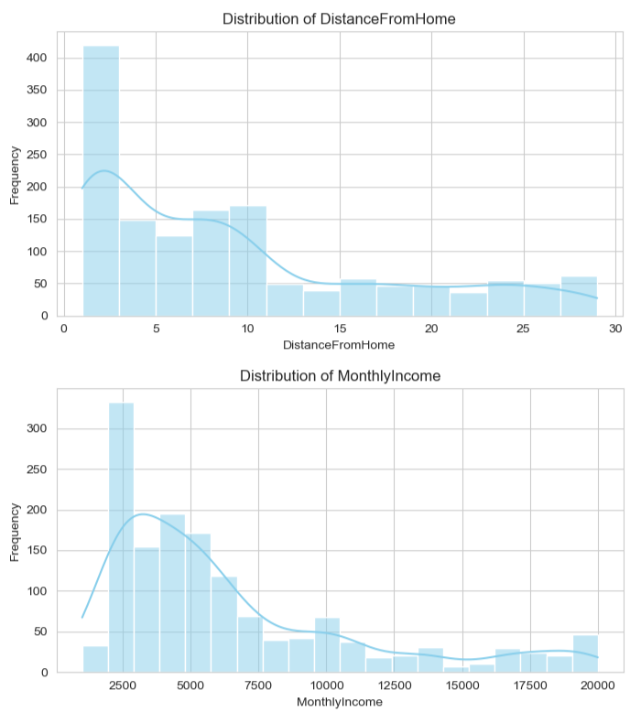
Insights:
The distribution of the numerical features are not are strongly skewed

Slide 26
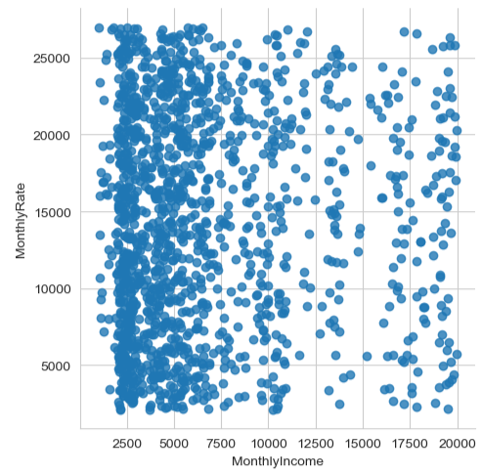
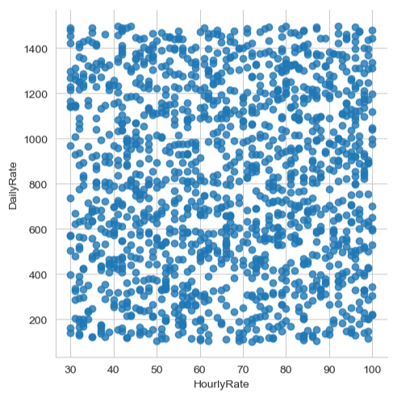
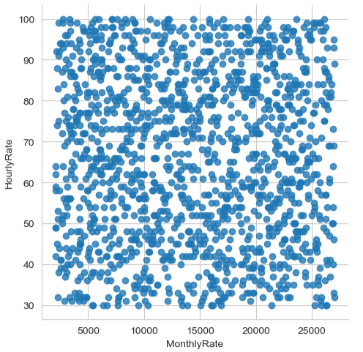
Insights:
Correlation plot of hourly rate and daily rate shows no relationships between between them
This can also be seen between monthly income and monthly rate as well as hourly rate and monthly income

Slide 27
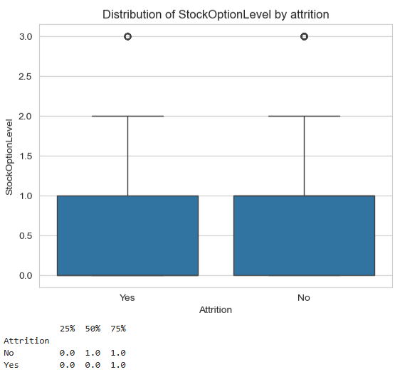
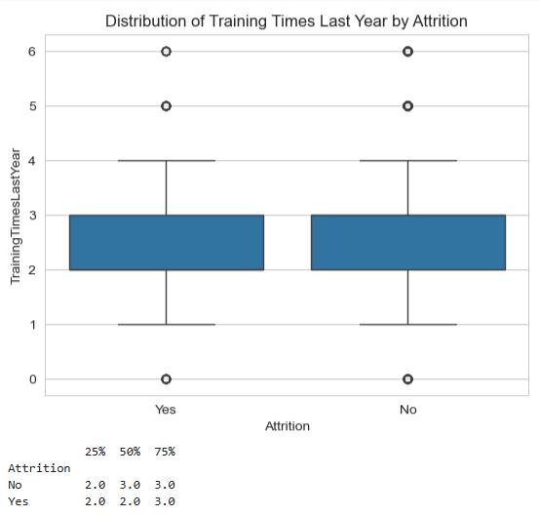
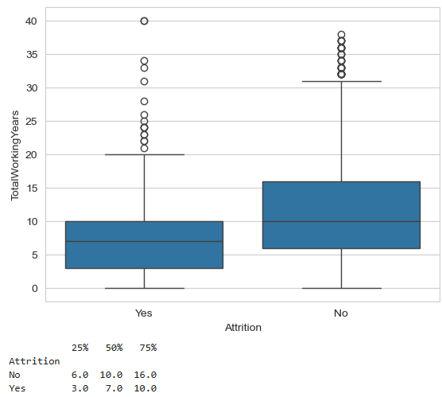
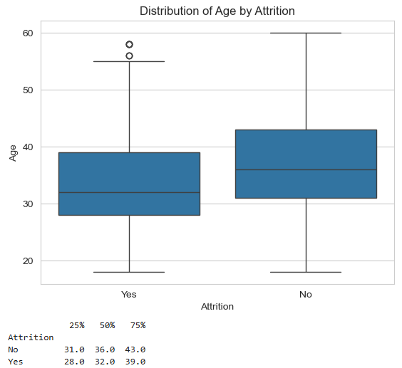
Insights:
50% of people that leave do not attend more than 2 training sessions which is ~30 fewer than those who remain
Younger staffs tend to leave more than older ones
Half the staff existing have no stock options
25% of existed staffs have only worked for 3 years (50% fewer than those that stayed) while 75% of them account for not more than 10 years (38% fewer than those that stayed)

Slide 28
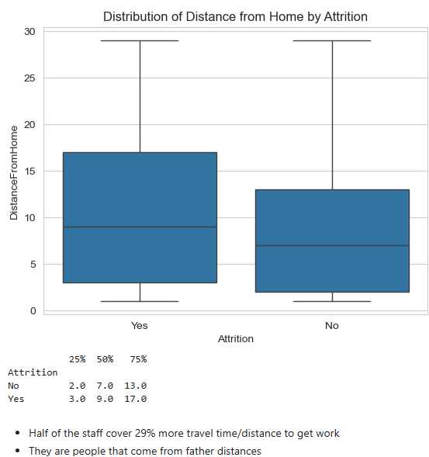
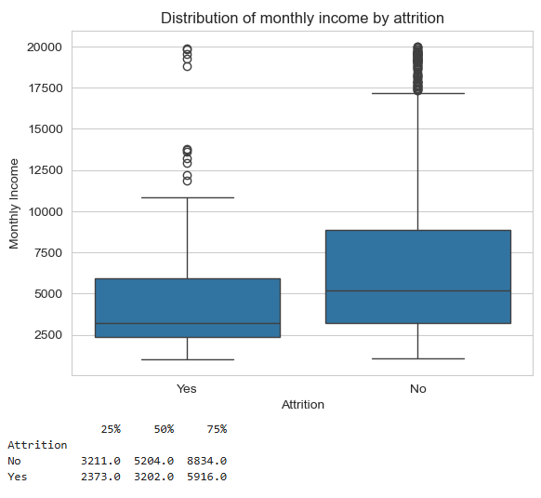
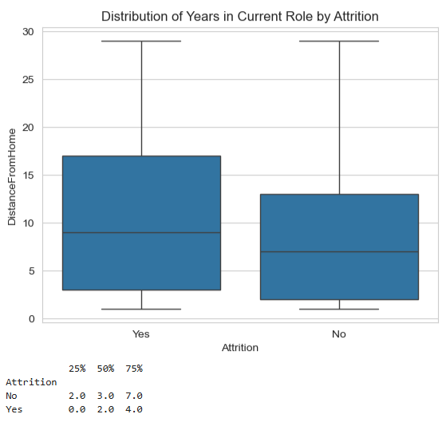
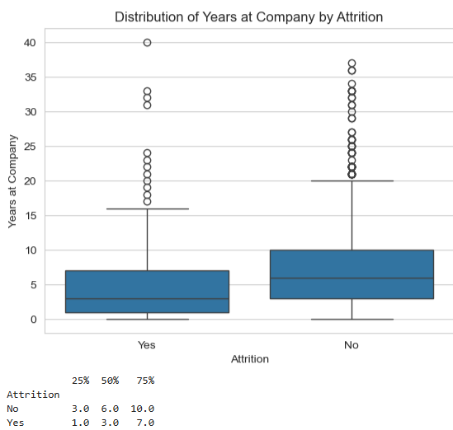
Insights:
The average monthly income of staff who leave the company is ~38% lower than that of retained staff at ~4787.09%. While 75% of them earn ~5916.0($) which is slightly above mean monthly salary of retained staffs ~5204.0. Hence, low salary is one of the reasons for attrition
Half of the people who leave the company spend 3 years. Half of the staff thereby spend 50% fewer years at the company
Half of the staff cover 29% more travel time/distance to get work. They are people that come from father distances
25% of staffs that leave do not spend up to 1 year in their current role. While of staffs that leave do not stay for more than 2 years in their current role. These means that staffs desire for growth/promotion

Slide 29



Insights:
KDE plot of monthly income also show that most staffs that exit are low earners
Tenure plot also show that about 75% of exiting staffs do not stay for more than 10 years
While work experience distribution shows that company tends to hire more of fresh graduate and majority of exiting staff are from that category as well

Slide 30

Insights:
Plot shows that about 22% of staffs that have left are low earners followed by high earners.

Slide 31
Multivariate Analysis

Slide 32

Insights:
Heatmap showing the relationships between each numerical features
As age increases so does total working years and monthly income
The more reddish shade the features have the stronger their correlation

Slide 33




Insights:
Sales representative, laboratory technician, human resources, sale executive, research scientist job roles respectively tends to leave the company more than others respectively
Sales and human resources departments loss staffs at the highest rate
Staffs that travel frequently are more likely to leave the company
Gender doesn’t show any significant difference between the two. Hence both exit relatively equally.

Slide 34



Insights:
Staffs that come from far and very far tend to leave the company more than others
Top 3 education field with highest attrition includes human resources, marketing and technical degree
Low earners have stronger exit impact

Slide 35

Insights
Correlation plot of all the features with respect to attrition using a threshold of 0.05
The top 10 impactful features include: overtime_yes , joblevel_1, stockoptionlevel_0, maritalstatus_single, age_group_young adult, jobrole_sales representative, monthlyincome_group_low, environmentsatisfaction_1, jobinvolvement_1, and businesstravel_frequently
It also shows top 10 features that impact negatively on attrition(eg: overtime_no, totalworkingyears, yearsincurrentrole, etc.

Slide 36




Insights
The rate at which:
Sales executives who do over time leave more as well healthcare managers and managing directors
Those who are least satisfied with their jobs, leave more. While those who are more satisfied and do overtime leave more
Those who are divorced and do overtime exit more
Those who are highest performing and do overtime tend to depart at a much more higher rate

Slide 37


Insights
Females who do overtime exit at a higher rate way more than those that don’t
Most of the senior and executive level employees who do over time exit at a more higher rate. This is because they tend to carry heavy operational demands or extended responsibilities.

Slide 38




Insights
The attrition rate of:
Those who do not have good relationship with their mates and do not do overtime are more likely to leave while those that are more
Those with high stock options and do overtime leave more
Those with poor work life balance and do not do overtime leaves more this also applies to those with excellent work life balance
Low daily rates who do not accept overtime tends to leave unlike the other categories

Slide 39




Insights
Sales executives who are medium earners depart at a more higher rate
Only low income earners in research scientist and sales rep role leave
Only high and executive earners who are best performing do not bother to leave
Young adults/adults who earn high to executive salaries do not exit the company
Seniors who earn medium salary wages are least likely to leave
As distance increases, executive and high earners tend to commit to staying unlike others

Slide 40




Insights:
Executive and medium earners who have stagnated do not leave
Most people that leave from human resources dept are those that are married or divorced
Most married staffs that have attained the highest level of education are mostly the ones that leaves compared to their counterparts
Executive earners who are divorced do not leave
Those who earn ‘high’ wage leaves at a higher rate.

Slide 41


Insights:
People that are single or married are more likely to exit
Single persons without stock options accounts for all the single staffs that exit the company
Divorced managers and research directors do not like to exit

Slide 42


Insights
People that leave from human resource department don’t do overtime
Men tend to exist more from research and development

Slide 43


Insights:
In research and development, laboratory technicians and research scientists exit more
Entry level research and development department tend to exit more
Sales exit more at other levels
Only job level 1 and 3 exit from human resource department

Slide 44


Insights:
Medium earners sales department exit more
Research and development tend to rarely attend trainings and tend to exit more

Slide 45
Final Thoughts and Recommendations

Slide 46
Likely cause
The burnout and overtime driver: mandatory overtime (`overtime_yes`) acts as the primary operational catalyst for turnover. When combined with high performance demands or specific roles, it drastically increases exit velocity. Hence, excessive reliance on overtime without compensatory support or rotational equity, leading to rapid emotional exhaustion and decreased job satisfaction across critical departments (sales, and research and ddevelopment department).
Strategic solution:
implement strict departmental caps on consecutive weeks of mandatory overtime.
Establish project-based workload balancing and conduct bi-weekly manager check-ins for high-overtime teams.

Slide 47
Likely cause:
Compensation and equity gaps: entry-level positioning (`joblevel_1`), low monthly income brackets (`monthlyincome_group_low`), and a complete lack of equity incentives (`stockoptionlevel_0`) create severe financial vulnerability, leaving employees exposed to external market pull factors. Hence, lower compensation brackets (`low` monthly income) combined with 75% of exiting staff holding zero stock options creates a perception of unrewarded labour and limited long-term upside.
Strategic solution:
perform an immediate salary banding audit for entry-level and low-income tiers to align base compensation closer to market medians.
Broaden equity participation (`stockoptionlevel` 1 or higher) beyond executive ranks to anchor long-term organizational commitment.

Slide 48
Likely cause:
Demographic vulnerability: single employees and young adults exhibit significantly higher propensity to leave, pointing to a need for targeted career-pathing during early tenure windows. This therefore makes new hires and entry-level staff reach a plateau within 1 to 3 years due to ambiguous progression milestones, prompting them to seek external growth opportunities. Also, specific high-turnover job families like sales representatives and laboratory technicians, suffer from promotional bottlenecks within the 1-to-3 year tenure span, driving voluntary resignations.
Strategic solution:
formalize clear 18-month career progression pathways for high-turnover roles like sales representatives and laboratory technicians.
Introduce internal mobility programs and mentorship structures to re-engage employees before they hit the critical exit window.

Slide 49
Likely cause
Employees residing at greater distances from the office face commuting fatigue that compounds daily stress and lowers retention.
Strategic solution:
given that employees facing longer commutes exhibit higher exit tendencies, introduce hybrid work arrangements or transportation stipends to ease distance-related friction.

Slide 50
Conclusion

Slide 51
Immediate Relief Interventions (0–3 Months) : Operational Relief Plan
Overtime audit and workload balancing: implement an immediate review of departments heavily reliant on overtime (specifically within sales and research and development). Establish caps on consecutive weeks of mandatory overtime to mitigate burnout risk.
Targeted retention for high-risk profiles: deploy pulse surveys and managerial check-ins for employees exhibiting top-tier risk markers: single employees, young adults in entry-level tiers (joblevel_1), and those with zero stock option allocations.

Slide 52
Mid-term Structural Strategies (3–6 Months) : Compensation And Growth Plan
Compensation benchmarking for low earners: review base pay structures for the low monthly income bracket to align closer with market medians, directly addressing the 21.8% attrition rate observed in this segment.
Stock option expansion: broaden equity eligibility beyond executive tiers. Providing baseline stock options (stockoptionlevel 1 or higher) anchors long-term commitment, given that 75% of exiting staff historically held zero stock options.
Clear promotion pathways: for high-turnover roles like sales representatives and laboratory technicians, formalize clear milestones for career progression to prevent stagnation in the 1-to-3-year tenure window.

Slide 53
Long-term Policy Adjustments (6–12 Months): Workplace Flexibility
Flexible commute and hybrid policies: given that employees facing longer commutes exhibit higher exit tendencies, introduce hybrid work arrangements or transportation stipends to ease distance-related friction.
Predictive retention modelling: leverage the cleansed, feature-engineered dataset established in this project to build a phase 5 machine learning classification model, enabling hr to score active employees for flight risk before resignation occurs.

