Slide 1

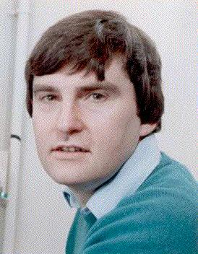

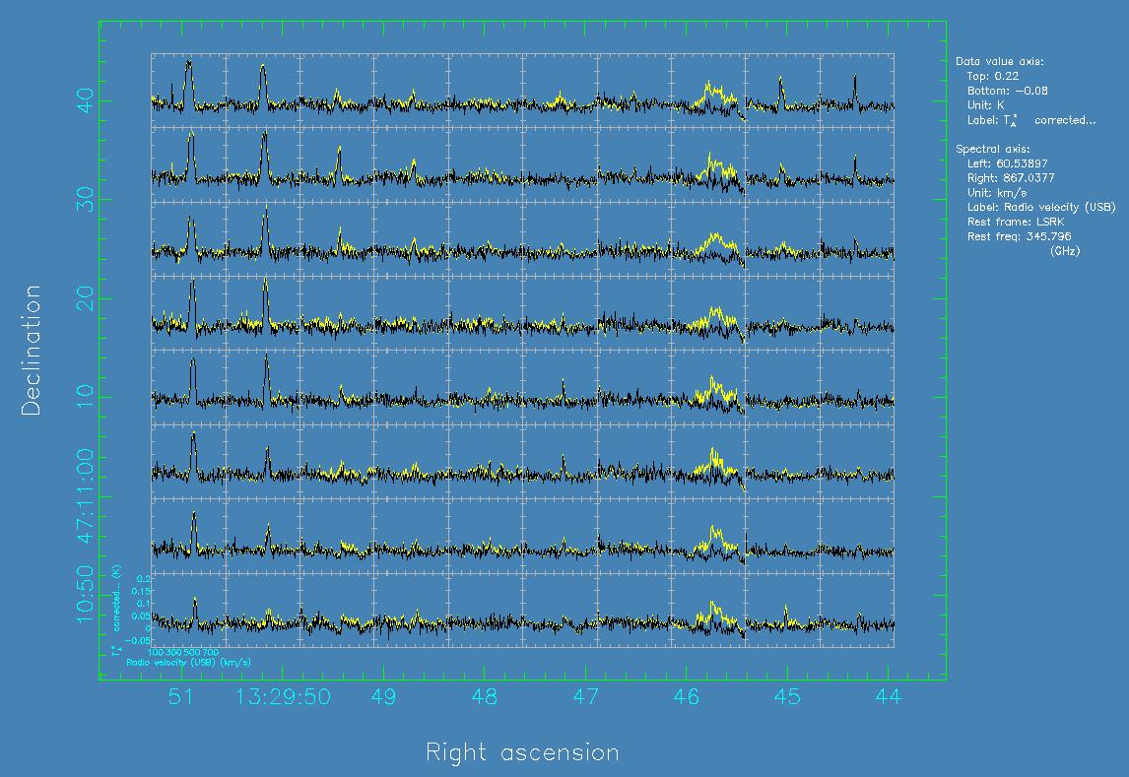
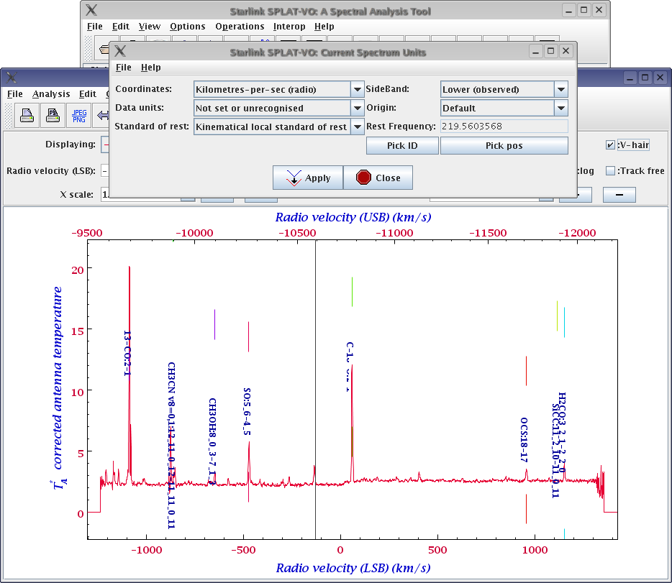
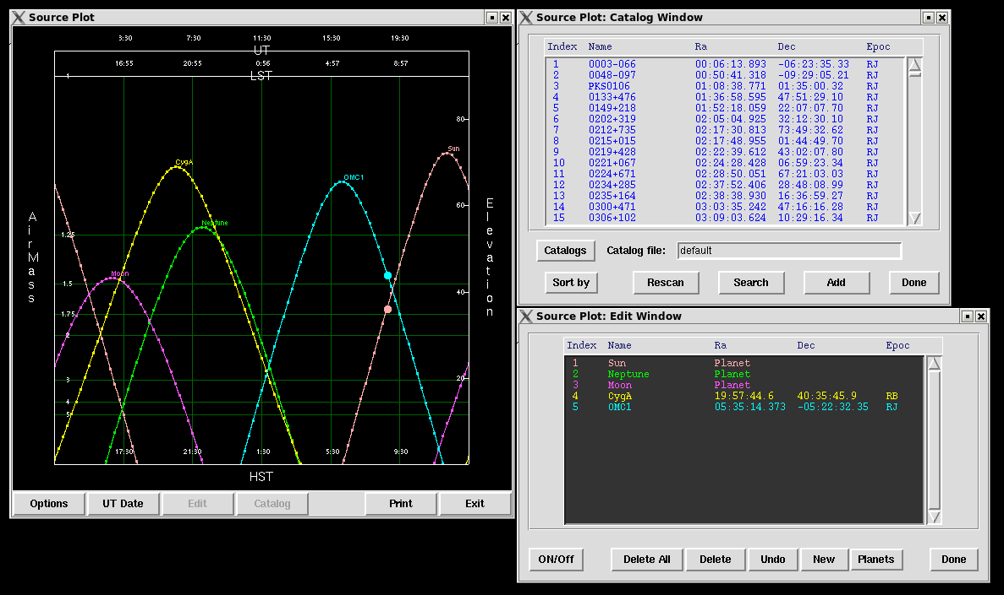

Starlink Software Developments
Malcolm J. Currie¹,
David S. Berry², Brad Cavanagh³, Peter W. Draper⁴, Tim Jenness³, Frossie Economou³
¹Rutherford Appleton Laboratory, UK; ²University of Central Lancashire, UK; ³Joint Astronomy Centre, Hawaii; ⁴Durham University, UK
mjc@star.rl.ac.uk
Introduction
In 2005 Starlink software came under the auspices of the Joint Astronomy Centre, Hawaii, where it plays a vital role in real-time data-reduction pipelines. The software has continued to be developed for the data reduction and analysis for new instruments at JAC, particularly for spectral cubes from the James Clerk Maxwell Telescope. This poster outlines the changes made since 2005, but not presented in other posters or at earlier ADASS conferences.
General
+ GPL licence
+ Builds with standard GNU autotools from an SVN repository
+ Works on 64-bit systems
+ Builds with g95 (GCC4.0+) and gfortran (GCC4.3)
+ Builds on Solaris 10 with the Studio 11 compilers (Intel and Sparc)
Data System
+ HDS supports files >2GB on 32-bit machines, and individual arrays
>2GB on 64-bit systems
+ 64-bit files created by default
+ Can include ".sdf" file extension when supplying the name of an HDS (such as an NDF) file
+ Scaled NDFs for compression
+ NDF sections can be specified using world co-ordinates, for example
cube(12:34:56.7,-41:52:09,400.0;650.0)
might extract a spectrum from a cube at the given sky position between
400 and 650 km/s, and
ifu(1h34m10.1s:1h34m12.4s,2d35m:2d35.5m,656.3)
specify a region of sky 2.3s by 0.5 arcminutes at Halpha from an IFU.
KAPPA – Kernel Package
Three-dimensional support:
CHANMAP plots a two-dimensional tiled map of channels from a cube
CLINPLOT draws a spatial grid of line plots for an axis of a cube
COLLAPSE many new estimators targetted at cube analysis
MFITTREND fits independent trends to data lines in a cube
Smoothing and rotation to all planes in a cube
SQORST can resample to specified WCS scales per pixel
Other new tasks:
BEAMFIT Fits up to five Gaussians to beam features with various
optional constraints such as width or separation
INTERLEAVE forms higher-resolution data by interleaving a set of files
WCSMOSAIC aligns and co-adds a group of NDFs using WCS information
Improved applications:
REGRID and WCSALIGN have optional flux conservation
Improved surface fitting:
Support for more co-ordinate systems
SURFIT uses SVD to obtain polynomial-fit errors
FITSURFACE and MAKESURFACE fit and evaluate bi-cubic splines
Statistics:
More ways to compute the mode with HISTAT
Reporting of positions of extreme values in world co-ordinates
Cumulative histogram in HISTOGRAM
Non-sticky changes to plotting style in some tasks
Support for AST SpecFrames and FluxFrames
Alignment of plots with old plots via any suitable co-ordinate system
An example of CLINPLOT. Each box shows a raw spectrum (in yellow) at the spatial position given by the outer axes. The annotations around the lower-left spectrum are the axes for each line plot. The dark-green curves overlaid have the line trends removed automatically (algorithms still under development). The combination of WCS knowledge and a graphic database allows different datasets to be compared on the same plot.
CONVERT – format conversion to and from NDFs
+ On-the-fly conversion of compressed FITS
+ NDF2FITS supports
* multi-NDF files
* writes CHECKSUM and DATASUM keywords
* converts in-line compressed images (RICE, GZIP, PLIO)
+ FITS converters:
Have AIPS++ and CLASS encodings
Scaled arrays are converted without loss of compression
+ SPECX2NDF can create NDFs with dual-sideband SpecFrame
DATACUBE – scripts for automating spectral cube analysis
Major overhaul and update including User Guide and Cookbook documentation reflecting the state of 3-D tools in early 2006.
+ Generalised to work for arbitrary datacubes not just optical IFUs
+ Support for NDF sections
+ All scripts improved and enhanced, notably VELMAP. Improvements include the map output in one of four velocity systems, recognition of
dual-sideband spectra and an optional velocity key
+ Addition GRIDSPEC averages and plots groups of neighbouring spectra
+ Addition VELMOMENT builds a velocity map from collapsed intensity-
weighted spectra, it also has optional spatial compression
+ Clearer spectral plots, and more control of contouring
SPLAT – spectral analysis
+ Fuller support for dual-sideband spectra (see the example to the right)
+ A synopsis of the properties of the current spectrum
+ More standard sub-millimetre lines
+ Interoperate with the VO, using SSAP Version 1 queries
+ PLASTIC support for sending and receiving spectra from other
PLASTIC-enabled applications
+ Support for data units, including transformations between common
flux systems
+ Region statistics tool
+ New smoothing filters, Hann, Hamming, Welch and Barlett
+ Useability improvements, mostly many more keyboard interactions
SPLAT displaying a dual-sideband (see P1.054) sub-millimetre spectrum from the JCMT, with the two sideband velocity systems shown. Standard lines have been overlaid and corrected for the source velocity. Note that the rest frequency can be trivially changed to that of one of the lines, or a picked velocity, as can the co-ordinate system and selected sideband.
ORAC-DR Data reduction pipeline
+ Support for infrared spectropolarimetry
+ Support for WFCAM, including automated astrometry correction
+ Support for ACSIS
GAIA – image display and analysis
Major upgrade to support three-dimensional data presented at a Forum last year, and also see P1.067 (P.W. Draper) for further developments. Some of the non-3D enhancements include the following.
+ Display of FITS in-line compressed images
+ PLASTIC enabled so can send and receive images and receive
catalogues
+ Various new default on-line catalogues available
+ Rotatable box item now available as a catalogue plotting symbol
Subroutine Libraries
AST: Major developments. See poster P1.054 (D.S.Berry)
ARD: Can refer to regions within time or spectral co-ordinate systems
GRP, HDS, and NDG have official C interfaces
Example SOURCEPLOT graphics that shows the positions of the Sun, Neptune, the Moon, Cygnus A, and OMC-1 from the JCMT for 2007 September 19. Also shown is the default source catalogue, which includes 383 astronomical sources. All of the planets, the Sun, and the Moon are available for plotting as well, and you can add your own sources or import your own catalogue.
For further details, and how to obtain the software, please visit
http://starlink.jach.hawaii.edu/
The puana release is available pre-built for the following operating systems:
+ 32-bit Linux glibc 2.3.4 (434MB .tar.gz)
+ 32-bit Linux glibc 2.5 (438MB .tar.gz)
+ 64-bit Linux (420MB .tar.gz)
+ PPC OS X Tiger (348MB .tar.gz)
+ Intel OS X Tiger (335MB .tar.gz)
Other systems, such as Solaris, may be provided given sufficient demand.
New Packages
CUPID: ClUmP IDentification in up to three dimensions, introduced at
ADASS XVI
SMURF: Sub-Millimetre User Reduction Facility. Its main task transforms raw time series into cubes. See P1.082 (T.Jenness et al.)
SOURCEPLOT plots astronomical objects in altitude and azimuth for a
supplied point on the Earth (example to the right)

