Slide 1
设计模式大作业
19001020609吴星昊

Slide 2
Contents
State pattern
Observer pattern
Template Method Pattern
Composite pattern
Iterator pattern
Strategy pattern
Adapter patten

Slide 3
Contents
State pattern
Observer pattern
Template Method Pattern
Composite pattern
Iterator pattern

Slide 4
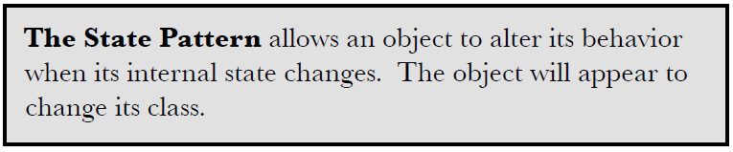
1.State pattern
Notes:
允许对象在内部改变时，改变它的行为，对象看起来好像修改了它的类

Slide 5
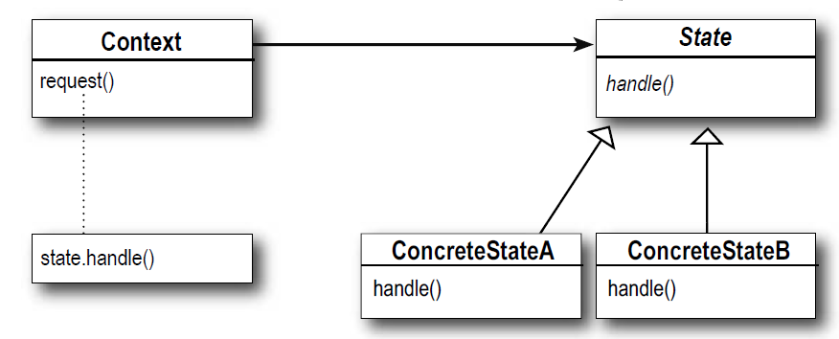
1.State pattern

Slide 6
1.State pattern

Slide 7
1.State pattern

Slide 8
Contents
State pattern
Observer pattern
Template Method Pattern
Composite pattern
Iterator pattern

Slide 9
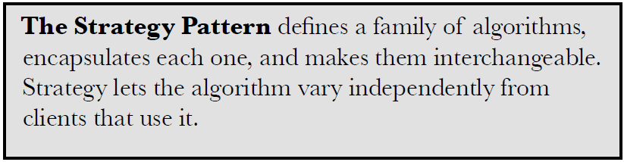


2.Observer pattern
Dalian Neusoft University of Information © Copyright

Slide 10
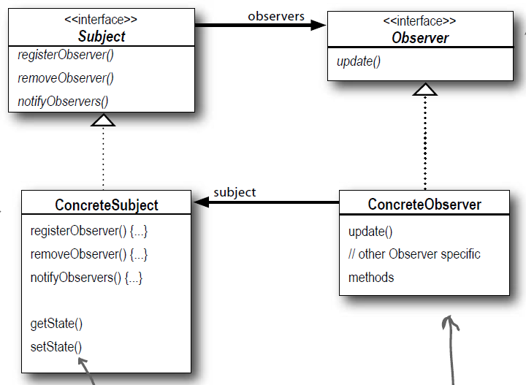
2.Observer pattern
Dalian Neusoft University of Information © Copyright

Slide 11
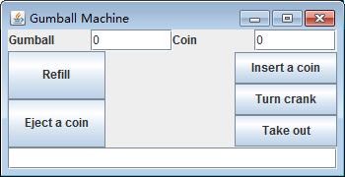
2.Observer pattern
运行效果

Slide 12
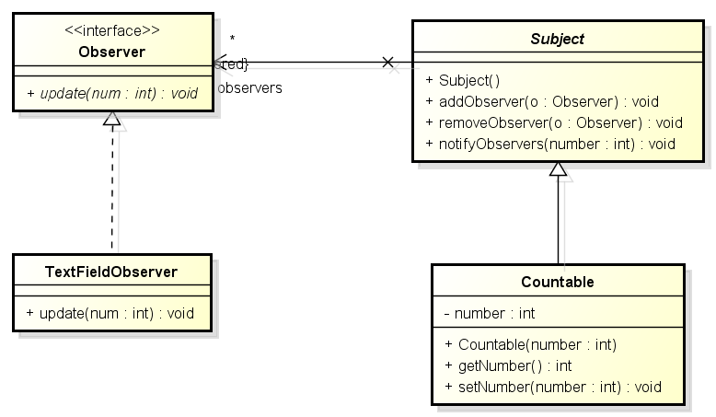
2.Observer pattern

Slide 13
Contents
State pattern
Observer pattern
Template Method Pattern
Composite pattern
Iterator pattern

Slide 14
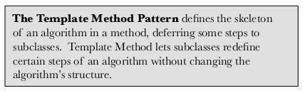
3.Template Method Pattern
Dalian Neusoft University of Information © Copyright

Slide 15
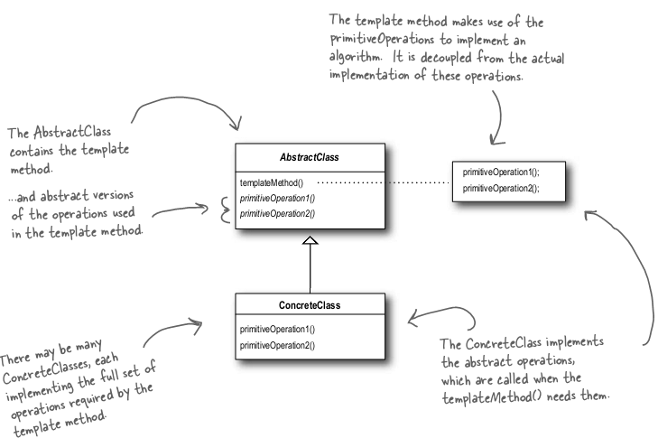
3.Template Method Pattern
the Template Method Pattern Class Diagram
Dalian Neusoft University of Information © Copyright

Slide 16
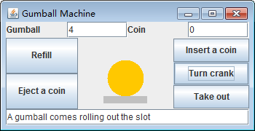
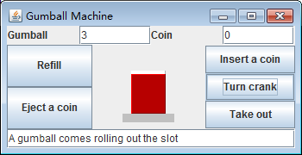
3.Template Method Pattern

Slide 17
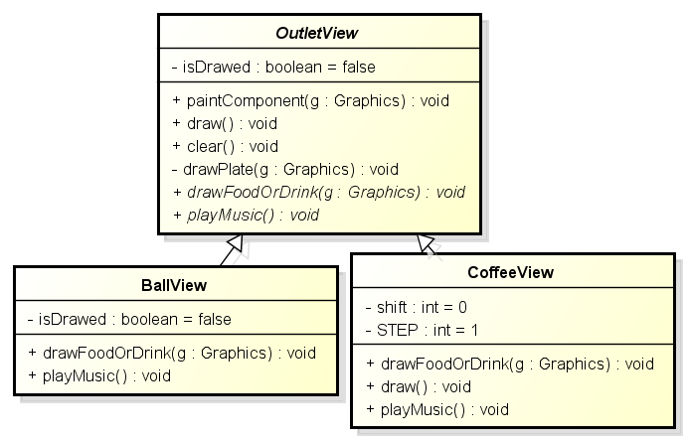
3.Template Method Pattern
模板方法

Slide 18
Contents
State pattern
Observer pattern
Template Method Pattern
Composite pattern
Iterator pattern

Slide 19
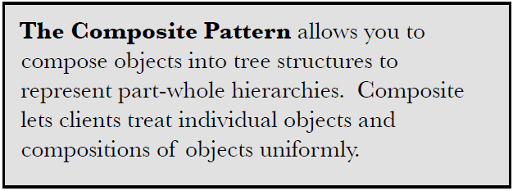
4.Composite Pattern

Slide 20
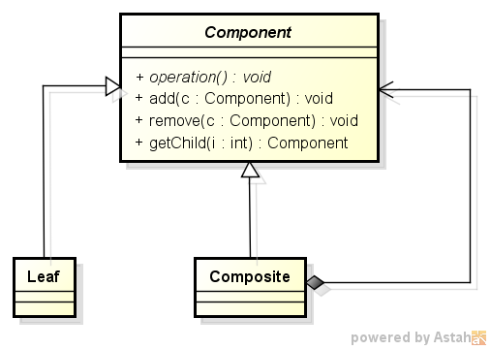
4.Composite Pattern
Composite Pattern
Dalian Neusoft University of Information © Copyright

Slide 21
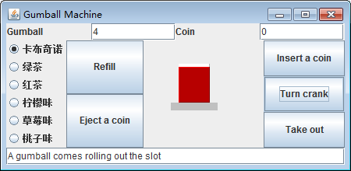

4.Composite Pattern

Slide 22
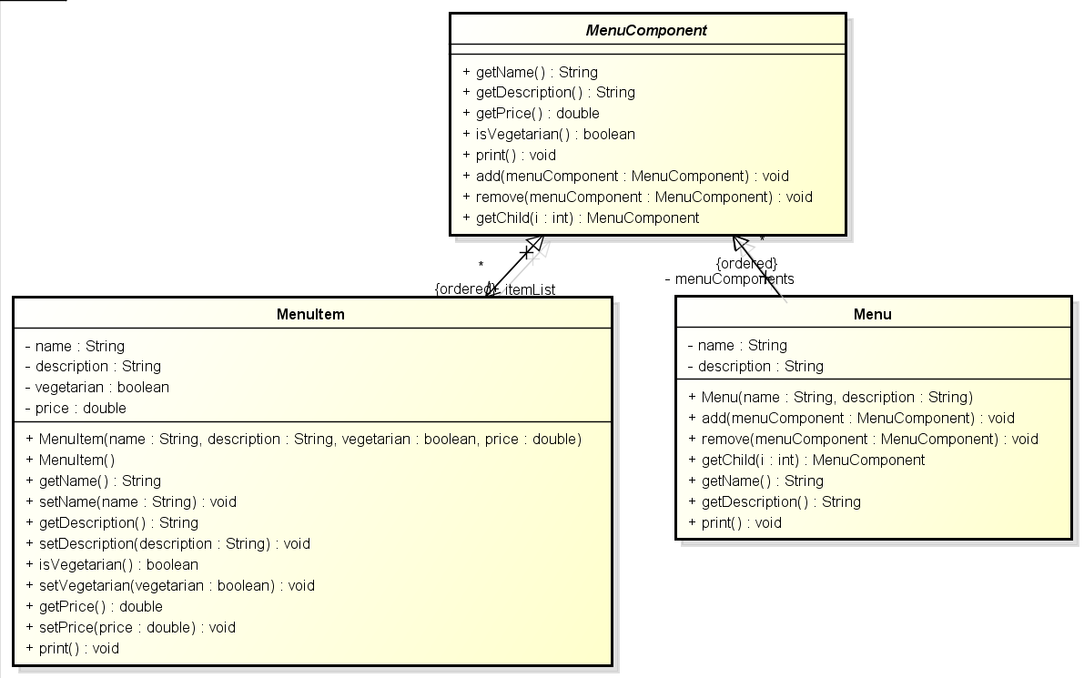
4.Composite Pattern

Slide 23
Contents
State pattern
Observer pattern
Template Method Pattern
Composite pattern
Iterator pattern

Slide 24
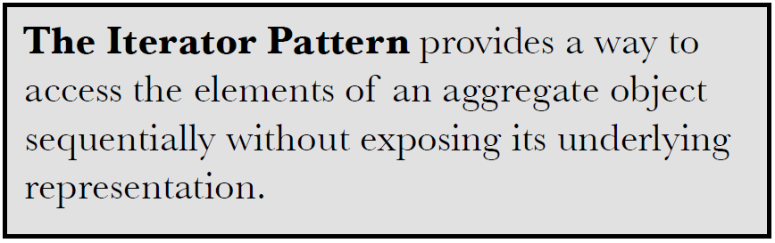
5.Iterator Pattern

Slide 25
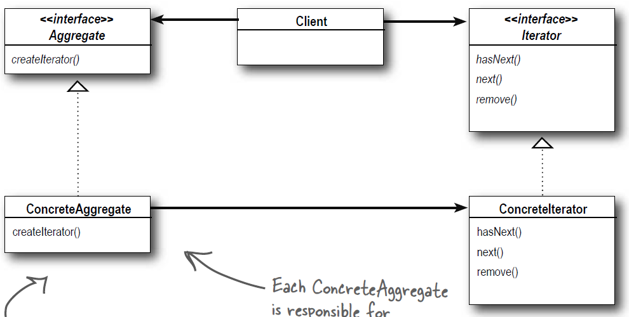
5.Iterator Pattern

Slide 26
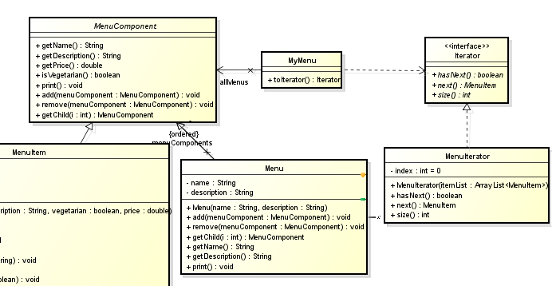
5.Iterator Pattern

Slide 27
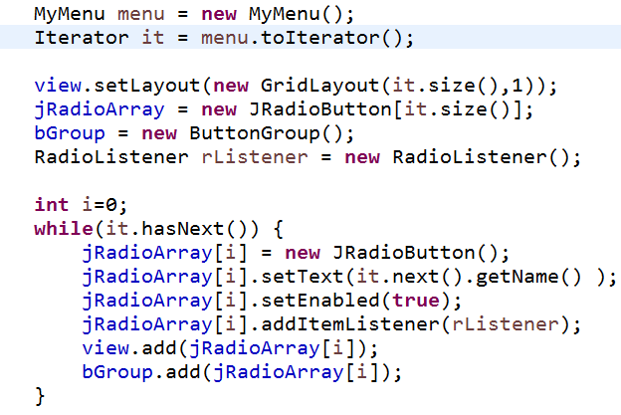
5.Iterator Pattern

Slide 28
5.Iterator Pattern

Slide 29
5.Iterator Pattern

Slide 30
5.Iterator Pattern

Slide 31
5.Iterator Pattern

Slide 32
5.Iterator Pattern

Slide 33
5.Iterator Pattern

Slide 34
5.Iterator Pattern

Slide 35
5.Iterator Pattern

Slide 36
Contents
State pattern
Observer pattern
Template Method Pattern
Composite pattern
Iterator pattern

