Slide 1
PPT Demonstration Explanation for Big Homework
Software Workers Class 16003 _Team1

Slide 2


1
Member information
2
Project brief introduction
3
4
Major function
Personnel division
5
Code parsing
6
Program effect
7

Slide 3
Xiang Chengda （TeamLeader） 13110600301
Shi Min 14110600601
Tan Hongxi 13110600607
Wang Jiaqi 16180600306
Huang Lei 16180600311
Chen Yingyu 15180600412
Team members

Slide 4
Project brief introduction
With the development of the times, people's life rhythm is faster and faster. Reservation has become an indispensable part of life. For example, when we want to get a cake according to our own ideas, we must book in advance, and then pick up the cake within the prescribed time. This not only facilitates us, but also saves time and improves the rhythm of life. When cake shops carry out promotional activities, customers can buy cakes at a discount. This system uses seven modes: simple factory mode, factory method mode, single case mode, facade mode, strategy mode, observer mode and agent mode to realize the system of ordering cake from cake shop.

Slide 5

Display ordering information function, ordering cake
function, calculating payable amount function,discount
function, cake making function, etc.

Slide 6
Personnel division
Xiang Chengda: Design and Implementation of Database Connection Using Facade Mode, Production of PPT and Video Recording
Shimin : Using simple factory mode to achieve the
successful results of cake making
Tan Hongxi : Learn a new design mode, agent mode to
realize the function of automatically informing
customers of successful cake making.

Slide 7
Appendix
Wang Jiaqi: Use factory mode to complete the cake making
process and complete. TXT member information
Huang Lei: Use strategy mode to complete discount function and wiki
Chen Yingyu: Uses the observer pattern to complete the customer information processing, and uses the singleton pattern to create the unique object.
(each completes the implementation of the corresponding class diagram)

Slide 8

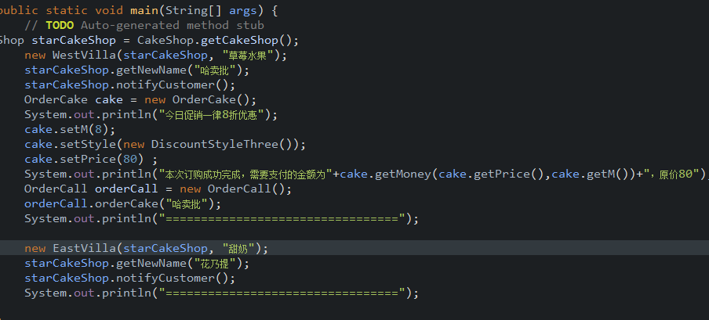
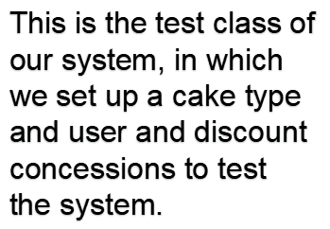

Slide 9
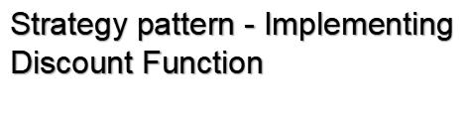
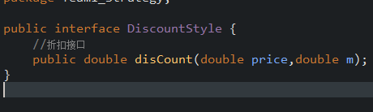
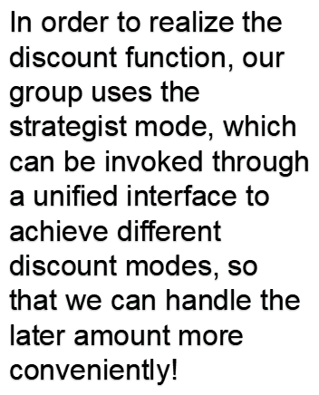
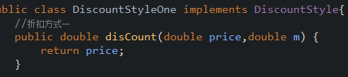
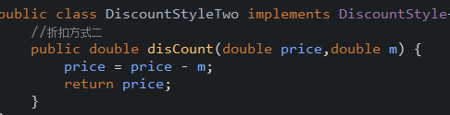
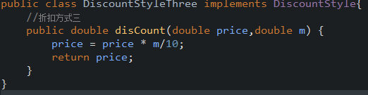

Slide 10

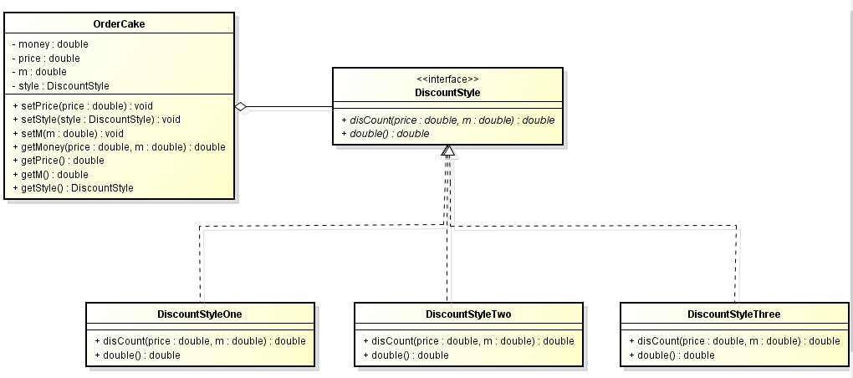

Slide 11

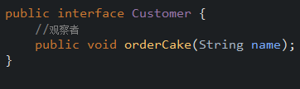
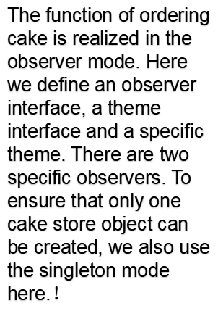
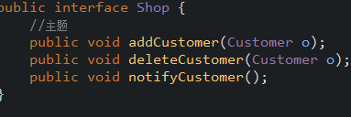
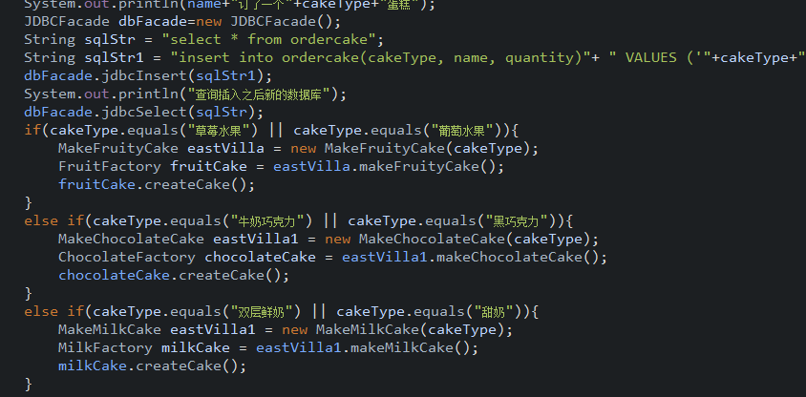

Slide 12
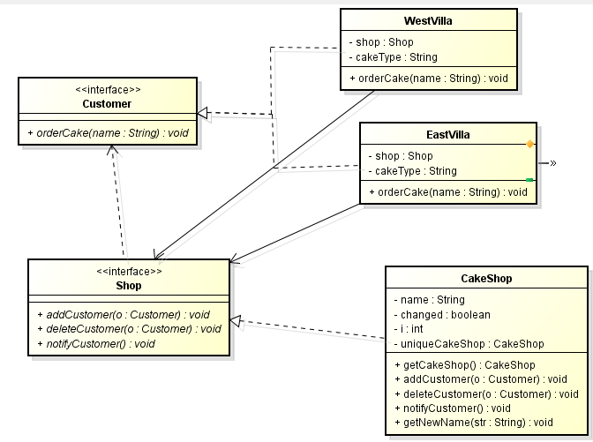
Class diagram

Slide 13

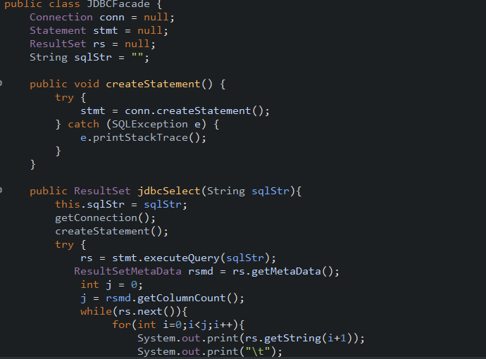
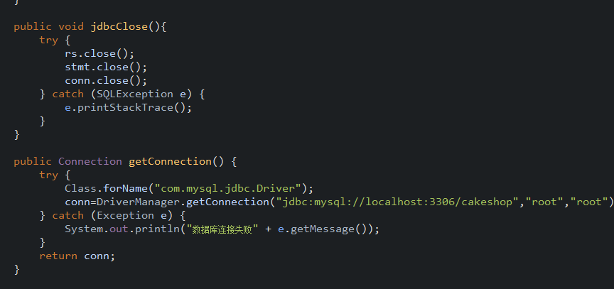

Slide 14
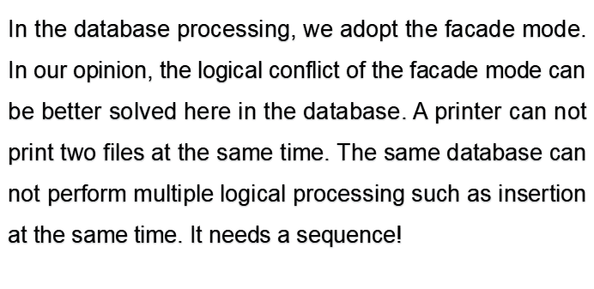

Slide 15
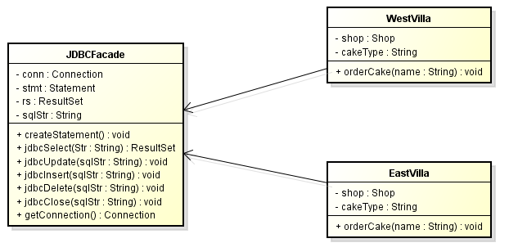
Class diagram

Slide 16

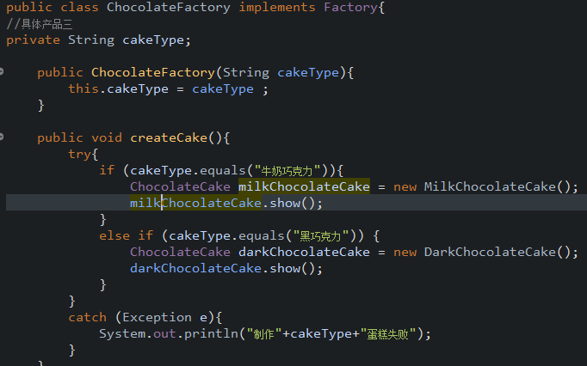
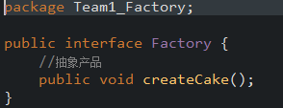

Slide 17

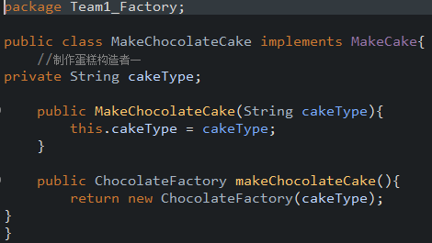
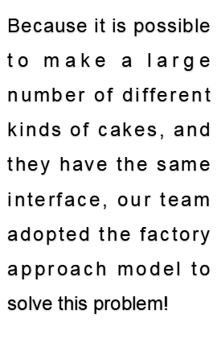
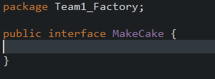

Slide 18
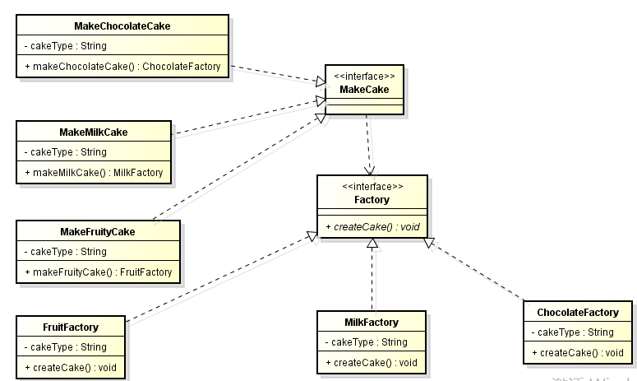
Class diagram

Slide 19


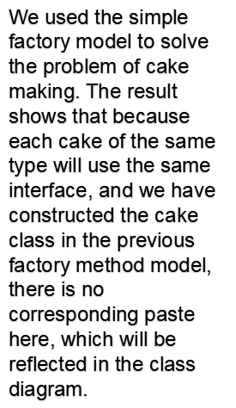
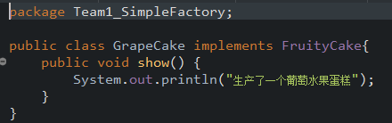



Slide 20
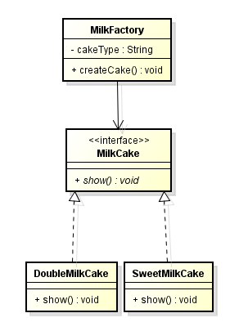
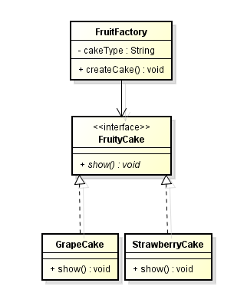
Class diagram

Slide 21

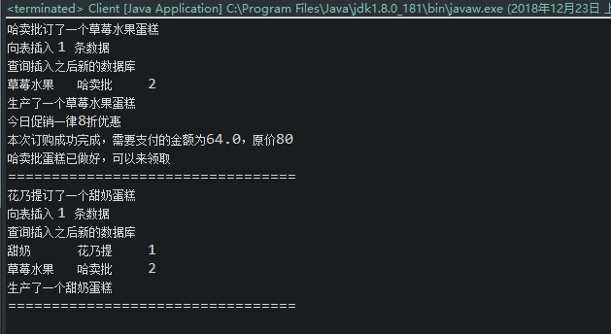

Slide 22
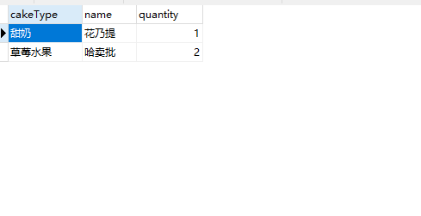

Slide 23


Slide 24
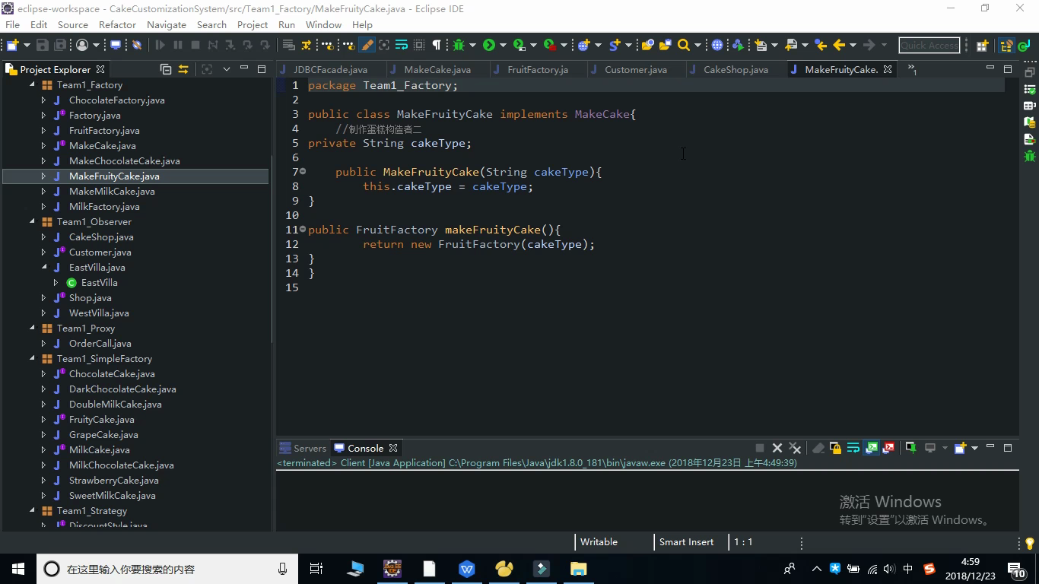

Slide 25
THANK YOU

