Slide 1
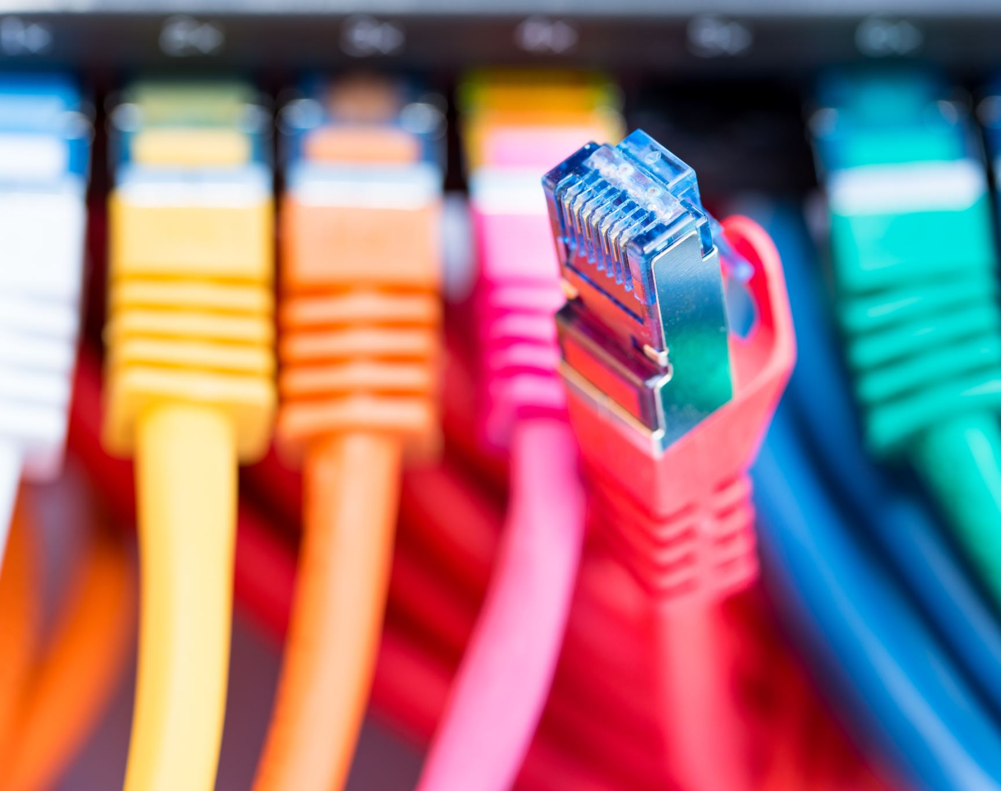
15CSE312- COMPUTER NETWORK
Online Food Ordering System
Group Number-17

Slide 2
Registration No | Name | Email ID | Contribution
CB.EN.U4CSE18155 | M.TEJASWINI ANUHYA | cb.en.u4cse18155@cb.students.amrita.edu | Why Networking is required for the application Software/Operating System used:
CB.EN.U4CSE18161 | V.SUREKHA | cb.en.u4cse18161@cb.students.amrita.edu | Problem statement Hardware/Devices used: Protocols in Online Food ordering system:
CB.EN.U4CSE18174 | D.HARSHA VARDHAN | cb.en.u4cse18174@cb.students.amrita.edu | Benefits of computer networks in Online Food ordering Server configuration and Web server software

Slide 3
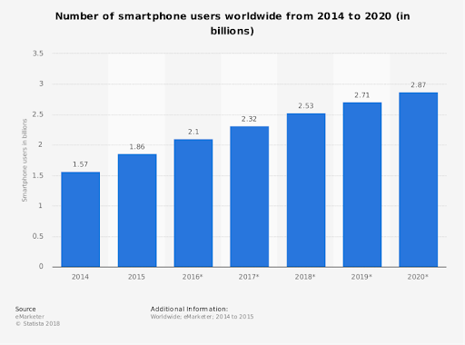
Why Networking is required for the application:
Smartphone Ownership:
As you can see from this data representation, the number of smartphone users and the number of people using mobile internet is steadily increasing. So clearly, one of the most common tools available to a large portion of the population is a smartphone with connectivity to the internet. This is why we need networking for Online food ordering system, because it helps connect everyone, in this case customers and delivery people, quickly and efficiently.

Slide 4
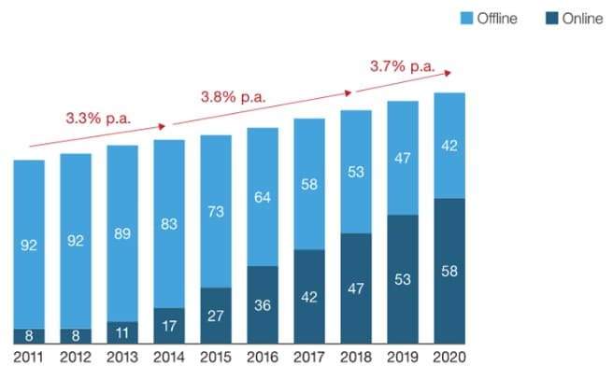
Why Networking is required for the application:
The Growing Food Delivery Market:​
Currently, out of the total traditional food ordering market, 47% is offline while 53% is conducted online. This figure is expected to flip in the next couple of years. Overall, this sector is growing at an annual rate of 3.7%, but interestingly online food ordering, and the delivery sector is expected to grow at 15-20% during the same period. There has been tremendous growth in the online food delivery sector in the past few years and is expected to grow at a rapid pace in the coming few years.​
To create mutual benefit between customer and delivery person

Slide 5
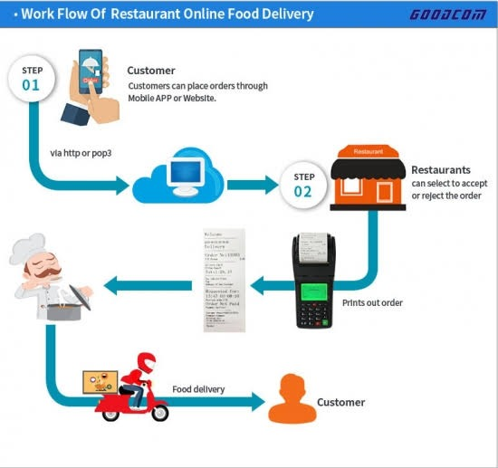
Case Study

Slide 6
Problem statement:
To study the working of online food ordering system (Zomato, Swiggy) and the role of networking in the operation of such services. In this case study, we try to understand how a delivery person is connected to a customer, via the internet.

Slide 7
Benefits of computer networks in Online Food ordering:
Supports Global Payments
Real-time tracking for orders
Make up for reduced foot traffic
Enhanced Productivity
Keep track of the orders and deliveries
Better management of Demand and operations

Slide 8
Protocols in Online Food ordering system:
Internet Protocols
Network Address Translation Protocol(NAT)
Hypertext Transfer Protocol(HTTP)
Simple object Access Protocol(SOAP)
Representative State Transfer Protocol(REST)

Slide 9
Software/Operating System used:
1) Operating System:
Operating System: Windows (Vista/7 or above)
Web Browser: IE 10 or above, Mozilla FF 31 and above or Google Chrome
Drivers: Java Runtime Environment
Integrated Development Environment: Eclipse J2EE or Apache Tomcat

Slide 10
Software/Operating System used:
2) Programming Languages:
Java Script
HTML
PHP
Python
Ruby

Slide 11
Hardware/Devices used:
Pentium Processor
60 MB of free hard-drive space
128 MB of RAM

Slide 12
Web server software:​
Apache HTTP Server​
Nginx
Server configuration:
Digital Ocean Cloud Services​
Amazon Web Services​
Linode​
Vultr​
Microsoft Azure​

Slide 13
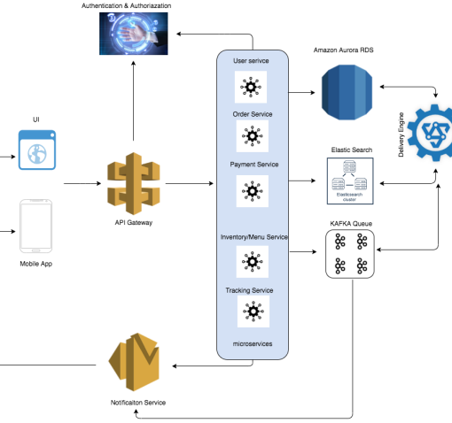
Architecture diagram:

Slide 14
Department Name /Sub Network Name | Student Roll No and Name
Restaurant Management | CB.EN.U4CSE18155 M.TEJASWINI ANUHYA
Online Ordering/Tracking | CB.EN.U4CSE18161 V.SUREKHA
Payment Management | CB.EN.U4CSE18170 D.HARSHA VARDHAN

