Slide 1
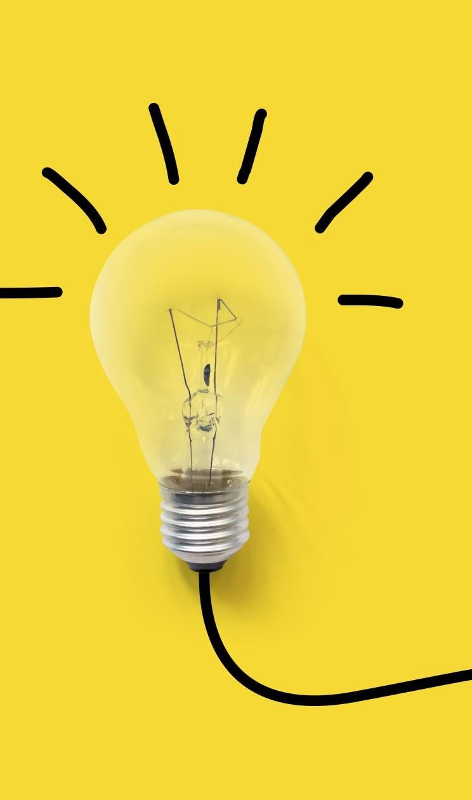


COMPUTATIONAL THINKING WITH PYTHON
LECTURE 0

Slide 2
Course Type: | Foundation |  | L | T | P | Credits
 |  |  | 3 | 1 | 6 | 5
COURSE CREDITS

Slide 3
COURSE OUTCOME
Solve | CLO1: Solve given problem in Python by using standard programming constructs.
Build | CLO2: Build programs using the features of object-oriented programming languages
Develop | CLO3: Make use of Python inbuilt APIs to write functions.

Slide 4
Components of Course Evaluation | Percentage
Continuous Lab Evaluation | 30
End Term Examination | 30
Surprise Quiz (Lectures) | 10
Tutorials | 10
Codathon | 10
Hackathon | 10
EVALUATION COMPONENT

Slide 5
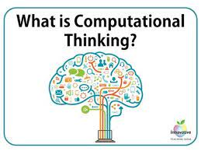

Slide 6
The Universal Machine
Almost everyone has used a computer at one time or another, like:
Computer games
Computer used to perform financial transactions.
Have you ever stopped to wonder how can one device perform so many different tasks?
These basic questions are the starting point for learning about computers and computer programming.

Slide 7
How do you define a modern computer?
“A machine that stores and manipulates information under the control of a changeable program."

Slide 8
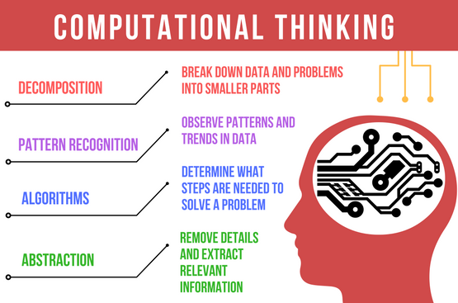

Slide 9
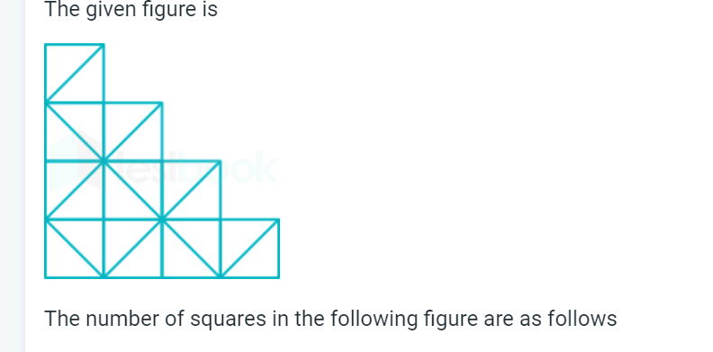

Slide 10
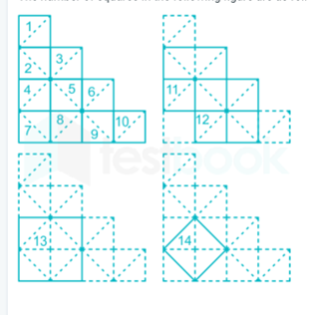
There are 14 squares are present in the figure

Slide 11
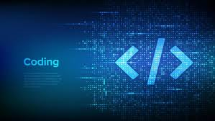

Slide 12
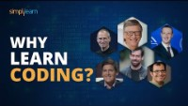
Why Learn Coding?
- Steve Jobs, Bill Gates, Mark Zuckerberg, Mark Cuban, Elon Musk |
Notes:
https://www.youtube.com/watch?v=YPE2dO5sII0

Slide 13
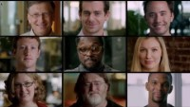
Code Stars
Short Film
Notes:
https://www.youtube.com/watch?v=dU1xS07N-FA

Slide 14
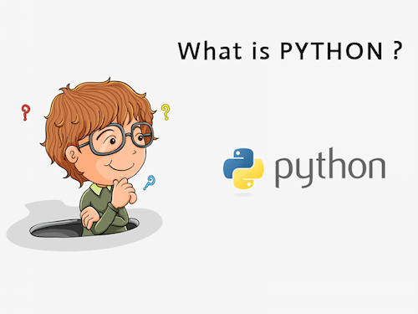
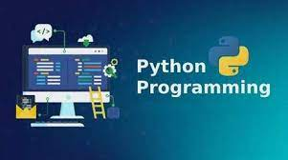

Slide 15
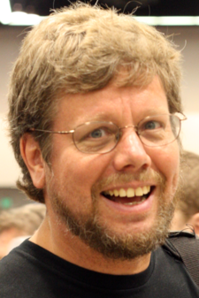
What is Python?
Python was created by Guido van Rossum, and released in 1991.
Python is an interpreted, object-oriented, high-level programming language.
Python is compatible with different platforms like Windows, Mac, Linux, Raspberry Pi, etc.
Python has a simple syntax as compared to other languages.

Slide 16
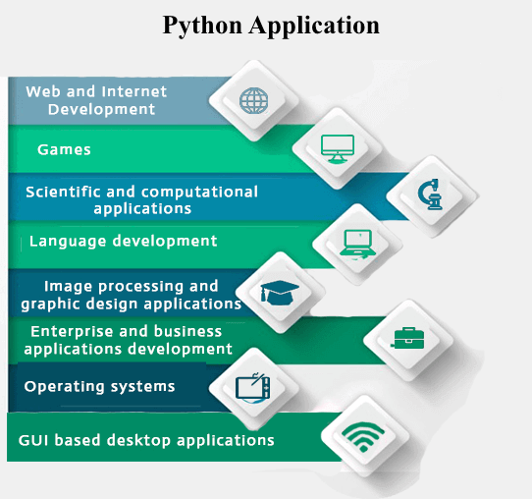

Slide 17
LAB TOOL
Lab Platform
CodeTantra (Continuous Labs & Codathon)
IDE
Jupyter Notebook (Anaconda Package)
Colab (Google)
Asure Notebook (Microsoft)

Slide 18
EDX COURSES
edX: CS50’s Introduction to Programming with Python (Harvard) https://cs50.harvard.edu/python/2022/
Coursera: https://www.coursera.org/specializations/python-3-programming

Slide 19
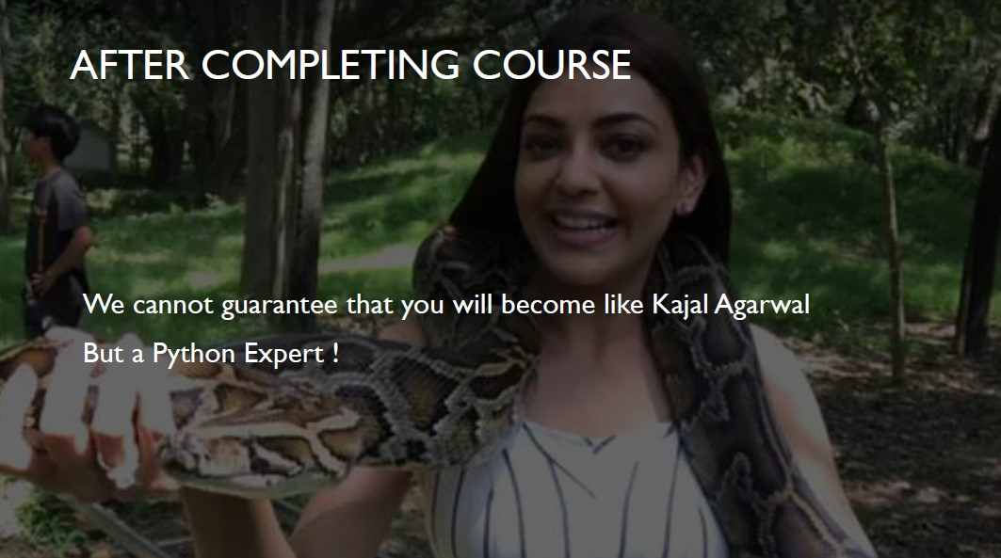

Slide 20
Thank You

Slide 21
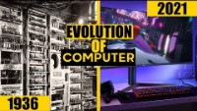
Evolution of Computers
Notes:
https://www.youtube.com/watch?v=6owLE0_GW8U

