Slide 1
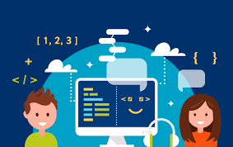
Computational Thinking and Programming
Introduction to Computer Science, Algorithm, H/W and S/W

Slide 2
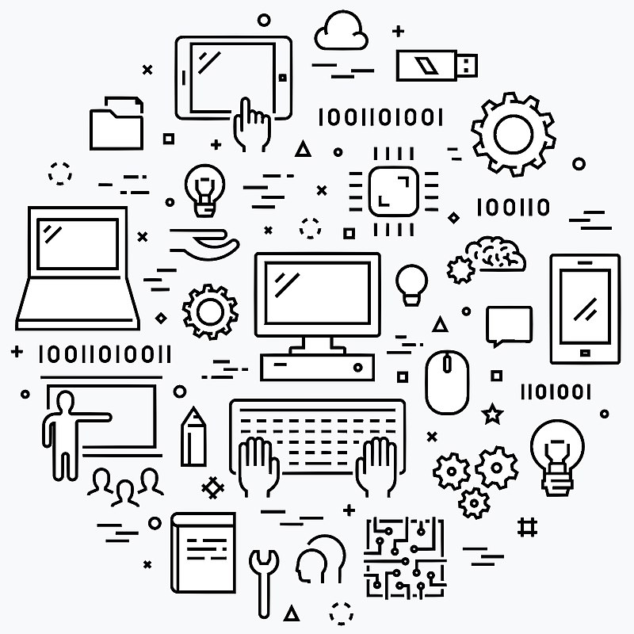
Agenda
Introduction to Computer Science
Algorithm
Hardware
Software
Programming Languages

Slide 3
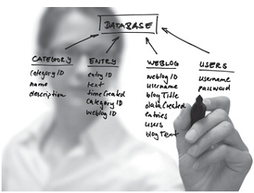
What is Computer Science?
Computer science is fundamentally about is computational problem solving.
Solving problems by the use of computation
Areas of study in computer science includes:
Software engineering, database management, computer networks, data mining, information security, programming language design, computer architecture, human–computer interaction, robotics, and artificial intelligence, among others.
Characterization of computation can be given by the notion of an algorithm.

Slide 4
Computational Problem Solving
Two things are needed to solve a problem computationally:
Representation: captures all the relevant aspects of the problem,
Algorithm: solves the problem by use of the representation

Slide 5

Example: Man, Cabbage, Goat, Wolf problem
A man lives on the east side of a river. He wishes to bring a cabbage, a goat, and a wolf to a village on the west side of the river to sell.
Constraints:
Boat can only hold himself, and either the cabbage, goat, or wolf.
Man cannot leave the goat/ wolf alone with Cabbage/goat, as the goat/wolf will eat the Cabbage /goat.

Slide 6
Solution
Simple algorithmic approach for solving this problem is trying all possible combinations of items that may be rowed back (called brute force).
Representation for this problem:
Relevant aspects of problem need to be represented, all irrelevant details can be omitted.
Relevant information is where each item is at each step, or what is state of each item at each step.

Slide 7


The start state of the problem can be represented as follows:

Slide 8
Limits of Computational Problem Solving
After the development of an algorithm for solving a given problem, an important question is,
“Can a solution to the problem be found in a reasonable amount of time?”
If not, then the particular algorithm is of limited practical use.

Slide 9
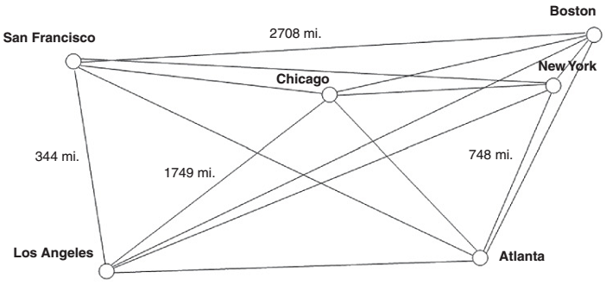
Example: Traveling Salesman Problem
The problem is to find the shortest Route of travel for a salesman needing to visit a given set of cities.

Slide 10
Brute force approach: The lengths of all possible routes would be calculated and compared to find the shortest one.
For 10 cities, the number of possible routes is 10!, whereas for 20 cities, the number of possible routes is 20!.
If a computer could compute the lengths of one million routes per second, it would take over 77,000 years to find the shortest route for twenty cities by this approach. Therefore, brute-force approach is impractical for this problem.
Any algorithm that correctly solves a given problem must solve the problem in a reasonable amount of time, otherwise it is of limited practical use.

Slide 11
MCQs
A good definition of computer science is “the science of programming computers.”
TRUE
FALSE
Which of the following areas of study are included within the field of computer science?
Software engineering
Database management
Information security
All of the above
In order to computationally solve a problem, two things are needed: a representation of the problem, and an _________ that solves it.

Slide 12
Leaving out detail in a given representation is a form of _______________.
5. A “brute-force” approach for solving a given problem is to:
Try all possible algorithms for solving the problem.
Try all possible solutions for solving the problem.
Try various representations of the problem.
All of the above
6. For which of the following problems is a brute-force approach practical to use?
Man, Cabbage, Goat, Wolf problem
Traveling Salesman problem
Chess-playing program
All of the above

Slide 13
A good definition of computer science is “the science of programming computers.”
TRUE
FALSE
Which of the following areas of study are included within the field of computer science?
Software engineering
Database management
Information security
All of the above
In order to computationally solve a problem, two things are needed: a representation of the problem, and an algorithm that solves it.

Slide 14
Leaving out detail in a given representation is a form of abstraction.
5. A “brute-force” approach for solving a given problem is to:
Try all possible algorithms for solving the problem.
Try all possible solutions for solving the problem.
Try various representations of the problem.
All of the above
6. For which of the following problems is a brute-force approach practical to use?
Man, Cabbage, Goat, Wolf problem
Traveling Salesman problem
Chess-playing program
All of the above

Slide 15
What is an Algorithm?
An algorithm is a finite number of clearly described, unambiguous “doable” steps that can be systematically followed to produce a desired result for given input in a finite amount of time. (that is, it eventually terminates).
Computer algorithms are central to computer science. They provide step-by-step methods of computation that a machine can carry out.
Example: Write an algorithm to check a given number is even or odd.

Slide 16
Let N be the number to check whether it is even or odd.
2. Divides the N by 2 and check the remainder
3. If N divided by 2 provides 0 remainder, then N is even,
4. Else N is odd.
Input N
Is N%2
equal to 0
N is Odd
N is Even

Slide 17
Computer Algorithms
The computation that a given computer performs is only as good as the underlying algorithm used.
Since computers can execute instructions very quickly and reliably without error, algorithms and computers are a perfect match.
Exercises:
Write an Algorithm to check whether a given number is prime
Write an algorithm for determining the day of the week for any date between January 1, 1800 and December 31, 2099.

Slide 18
MCQs
Which of the following are true of an algorithm?
Has a finite number of steps
Produces a result in a finite amount of time
Solves a general problem
All of the above
Algorithms were first developed in the 1930–1940s when the first computing machines appeared.
TRUE
FALSE

Slide 19
MCQs
Which of the following are true of an algorithm?
Has a finite number of steps
Produces a result in a finite amount of time
Solves a general problem
All of the above
Algorithms were first developed in the 1930–1940s when the first computing machines appeared.
TRUE
FALSE

Slide 20
MCQs
Algorithms and computers are a “perfect match” because: (Select all that apply.)
Computers can execute a large number of instructions very quickly.
Computers can execute instructions reliably without error.
Computers can determine which algorithms are the best to use for a given problem.
Which of the following is an example of an algorithm? (Select all that apply.)
A means of sorting any list of numbers.
Directions for getting from your home to a friend’s house.
A means of finding the shortest route from your house to a friend’s house.

Slide 21
MCQs
Algorithms and computers are a “perfect match” because: (Select all that apply.)
Computers can execute a large number of instructions very quickly.
Computers can execute instructions reliably without error.
Computers can determine which algorithms are the best to use for a given problem.
Which of the following is an example of an algorithm? (Select all that apply.)
A means of sorting any list of numbers.
Directions for getting from your home to a friend’s house.
A means of finding the shortest route from your house to a friend’s house.

Slide 22
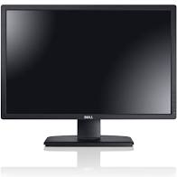
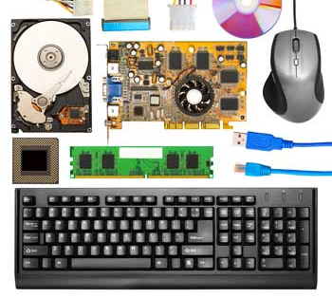
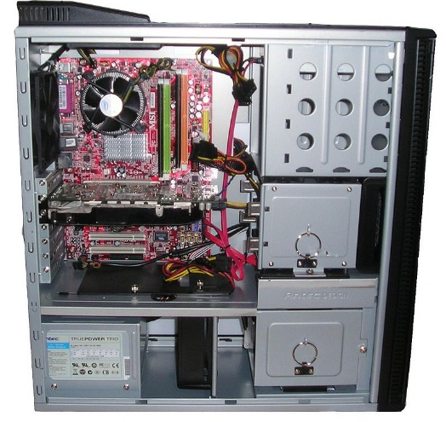
Computer Hardware
Computer hardware comprises the physical part of a computer system. It includes the all-important components of the central processing unit (CPU) and main memory.
It basically includes following peripheral components:
Input devices − keyboard, mouse, etc.
Output devices − printer, monitor, etc.
Secondary storage devices − Hard disk, CD, DVD, etc.
Internal components − CPU, motherboard, RAM, etc.

Slide 23
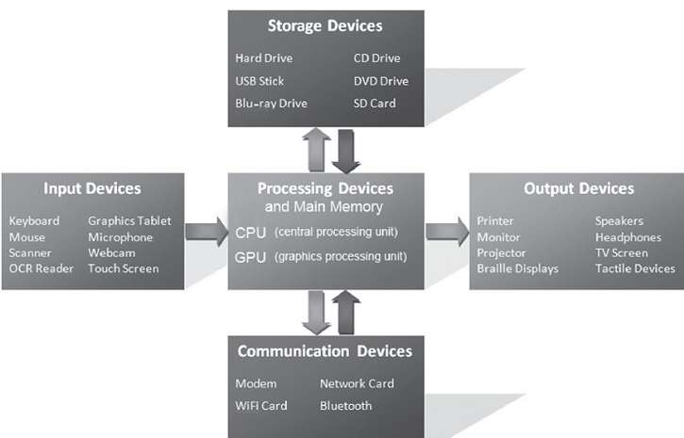
Fundamental Hardware Components

Slide 24
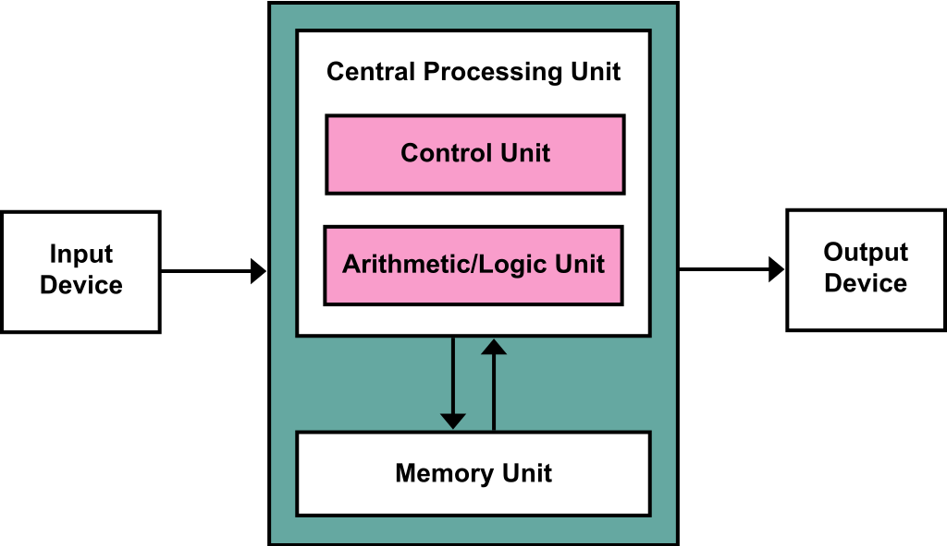
Bridging Hardware and Software
The central processing unit (CPU) is the “brain” of a computer, containing digital logic circuitry able to interpret and execute instructions.
Main memory is where currently executing programs reside, which the CPU can directly and very quickly access.
Secondary memory is nonvolatile, and therefore provides long-term storage of programs and data
Input/output devices include anything that allows for input or output.
Buses transfer data between components within a computer system, such as between the CPU and main memory.

Slide 25
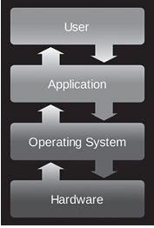
Bridging Hardware and Software
Hardware and software are mutually dependent on each other. Both of them must work together to make a computer produce a useful output.
An operating system is software that has the job of managing the hardware resources of a given computer and providing a particular user interface (interacting with the hardware resources).
An operating system is intrinsic to the operation of a computer, it is referred to as system software. Operating system acts as the “middle man” between the hardware and executing application programs
Limits of Integrated Circuits Technology:
Moore’s Law states that the number of transistors that can be placed on a single silicon chip doubles roughly every two years.

Slide 26
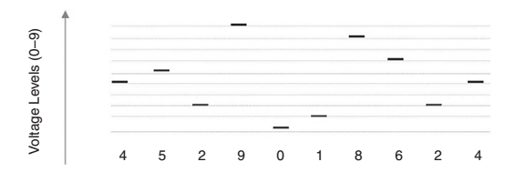
Digital Computing: Information Representation
In digital computing, all information is represented as a series of digits.
We are used to representing numbers using base 10 with digits 0–9. Since in current electronic computing, each digit is represented by a different voltage level, the information can be represented within a computer system as given follows
The more voltage levels (digits) that the hardware must utilize and distinguish, the more complex the hardware design becomes.

Slide 27
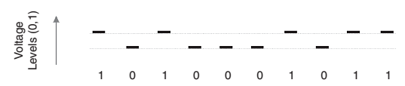
Information Representation
It is a fact of information theory, that any information can be represented using only two symbols.
Therefore, all information within a computer system is represented using only two digits, 0 and 1, called binary representation.
Computer hardware, therefore, is based on the use of simple electronic “on/off” switches called transistors that switch at very high speed.
Integrated circuits (“chips”), the building blocks of computer hardware, are comprised of millions or even billions of transistors.

Slide 28

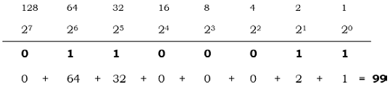
Binary Number System
For representing numbers, any base (radix) can be used. In base 10, there are ten possible digits (0, 1, . . ., 9), in which each column value is a power of ten, as shown below.
Other radix systems work in a similar manner. Base 2has digits 0 and 1, with place values that are powers of two, as given below.

Slide 29
The term bit stands for binary digit. Therefore, every bit has the value 0 or 1. A byte is a group of bits operated on as a single unit in a computer system, usually consisting of eight bits.

Slide 30
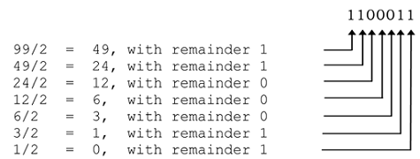
Conversion From Decimal to Binary
The algorithm for the conversion from base 10 to base 2 is to successively divide a number by two until the remainder becomes 0.
The remainder of each division provides the next higher-order (binary) digit
The binary representation of 99 to be 1100011.

Slide 31
MCQs
All information in a computer system is in binary representation.
TRUE
FALSE
Computer hardware is based on the use of electronic switches called _______________.
How many of these electronic switches can be placed on a single IC, or “chip”?
Thousands
Millions
Billions
The term “bit” stands for _______________.
A bit is generally a group of eight bytes.
TRUE
FALSE

Slide 32
MCQs
All information in a computer system is in binary representation.
TRUE
FALSE
Computer hardware is based on the use of electronic switches called transistors.
How many of these electronic switches can be placed on a single IC, or “chip”?
Thousands
Millions
Billions
The term “bit” stands for binary digit.
A bit is generally a group of eight bytes.
TRUE
FALSE

Slide 33
MCQs
The value of the binary representation 0110 is
12
3
6
The _______________ interprets and executes instructions in a computer system.
An OS manages the hardware resources of a computer system, as well as provides a particular user interface.
TRUE
FALSE
Moore’s Law predicts that the number of transistors that can fit on a chip doubles about every ten years.
TRUE
FALSE

Slide 34
MCQs
The value of the binary representation 0110 is
12
3
6
The CPU interprets and executes instructions in a computer system.
An OS manages the hardware resources of a computer system, as well as provides a particular user interface.
TRUE
FALSE
Moore’s Law predicts that the number of transistors that can fit on a chip doubles about every ten years.
TRUE
FALSE

Slide 35
What is Computer Software?
Computer software is a set of program instructions, including related data and documentation, that can be executed by computer.
Software can be in the form of instructions on paper, or in digital form.
Types of Software:
System Software: intrinsic to a computer system or platform for executing application software. Example: OS, Compiler, Interpreter, etc.
Application software: Fulfills users’ needs, such as a photo-editing program, MS office, etc.
Programming languages (called “artificial languages”) are languages just as “natural languages” such as English and Mandarin (Chinese).
Syntax and semantics are important concepts that apply to all languages.

Slide 36
Syntax, Semantics of Language
The syntax of a language is a set of characters and the acceptable sequences of those characters.
The semantics of a language is the meaning associated with each syntactically correct sequence of characters.
Example:
The most basic syntax follows a subject + verb + direct object formula.
That is, "Jillian hit the ball." Syntax allows us to understand that we wouldn't write, "Hit Jillian the ball."

Slide 37
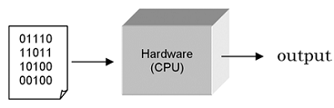
Program Translation
A central processing unit (CPU) is designed to interpret and execute a specific set of instructions represented in binary form (i.e., 1s and 0s) called machine code.
Only programs in machine code can be executed by a CPU.
Writing programs at this “low level” is tedious and error-prone. Therefore, most programs are written in a “high-level” programming language such as Python.
Since the instructions of such programs are not in machine code that a CPU can execute, a translator program must be used.
There are two fundamental types of translators: compiler and interpreter.

Slide 38
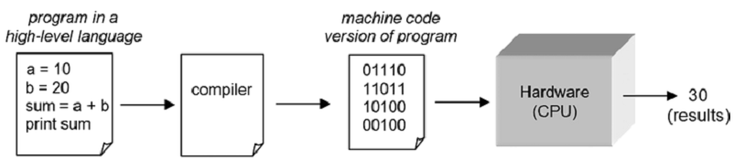
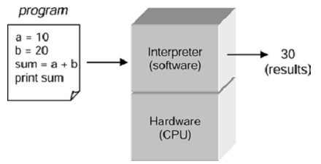
Program Translation
A compiler is a translator program that translates programs directly into machine code to be executed by the CPU.
An interpreter executes program instructions in place of (“running on top of”) the CPU. It can immediately execute instructions as they are entered.
Python, as we shall see, is executed by an interpreter.
Compiled programs generally execute faster than
interpreted programs.

Slide 39
Program Debugging
Program debugging is the process of finding and correcting errors ( “bugs”) in a computer program.
Syntax errors are caused by invalid syntax (for E.g., entering prnt instead of print)
Since a translator cannot understand instructions containing syntax errors, translators terminate when encountering such errors indicating where the problem occurred in program.
Semantic errors (generally called logic errors) are caused by errors in program logic. These errors cannot be automatically detected, as translators cannot understand the intent of a given computation.
Example: if a program computed the average of three numbers as follows,
(num1 + 1num2 + 1num3) / 2.0
A translator would have no means of determining that the divisor should be 3 and not 2.
Computers do not understand what a program is meant to do, they only follow the instructions given.

Slide 40

Procedural vs Object Oriented Programming
Procedural programming and object-oriented programming are two major programming paradigms in use today.
Each provides a different way of thinking about computation.
While most programming languages only support one paradigm.
Python supports both procedural and object-oriented programming

Slide 41
MCQs
Two general types of software are system software and _______________ software.
The syntax of a given language is,
the set of symbols in the language.
the acceptable arrangement of symbols.
both of the above
The semantics of a given language is the meaning associated with any arrangement of symbols in the language.
TRUE
FALSE
CPUs can only execute instructions that are in binary form called _______________.

Slide 42
MCQs
The two types of translation programs for the execution of computer programs are _______________ and _______________.
The process of finding and correcting errors in a computer program is called _______________.
Which kinds of errors can a translator program detect?
Syntax errors
Semantic errors
Neither of the above
Two major programming paradigms in use today are _______________ programming and _______________ programming.

Slide 43
MCQs
Two general types of software are system software and application software.
The syntax of a given language is,
the set of symbols in the language.
the acceptable arrangement of symbols.
both of the above
The semantics of a given language is the meaning associated with any arrangement of symbols in the language.
TRUE
FALSE
CPUs can only execute instructions that are in binary form called machine code.

Slide 44
MCQs
The two types of translation programs for the execution of computer programs are
compilers and interpreters.
The process of finding and correcting errors in a computer program is called program debugging.
Which kinds of errors can a translator program detect?
Syntax errors
Semantic errors
Neither of the above
Two major programming paradigms in use today are procedural programming and object-oriented programming.

Slide 45

THANK YOU
Dr. Sonal Kukreja
sonal.kukreja@bennett.edu.in

