Slide 1
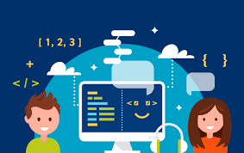
Computational Thinking With Python

Slide 2
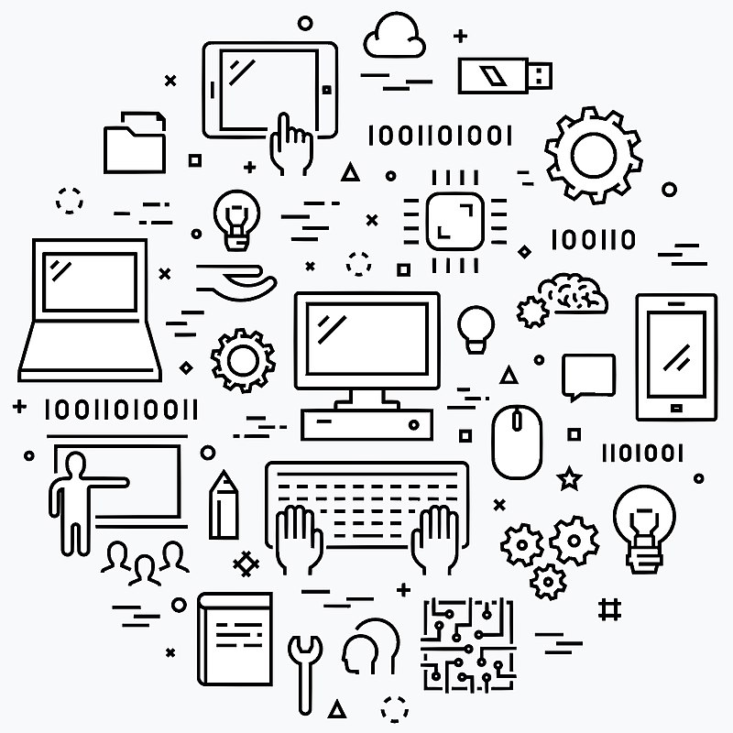
Agenda
Hardware
Software
Number Conversion
Programing Language
Procedural vs Object Oriented Programming

Slide 3
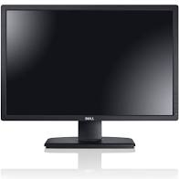
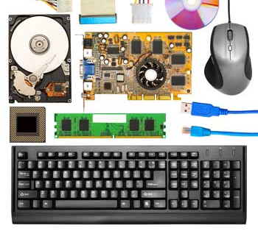
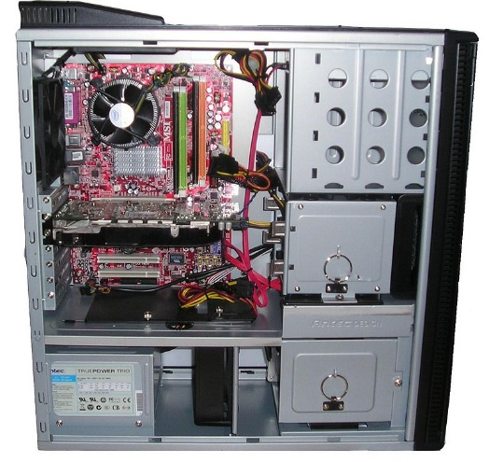
Computer Hardware
Computer hardware comprises the physical part of a computer system. It includes the all-important components of the central processing unit (CPU) and main memory.
It basically includes following peripheral components:
Input devices − keyboard, mouse, etc.
Output devices − printer, monitor, etc.
Secondary storage devices − Hard disk, CD, DVD, etc.
Internal components − CPU, motherboard, RAM, etc.

Slide 4
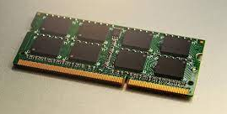
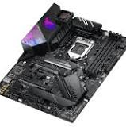
Motherboard
It's the circuit board that connects all of your hardware to your processor, distributes electricity from your power supply, and defines the types of storage devices, memory modules, and graphics cards (among other expansion cards) that can connect to your PC.
RAM stands for random-access memory. Your computer RAM is essentially short term memory where data is stored as the processor needs it. This isn't to be confused with long-term data that's stored on your hard drive, which stays there even when your computer is turned off.

Slide 5
Relationship between Hardware and Software
Hardware and software are mutually dependent on each other. Both of them must work together to make a computer produce a useful output.
Hardware | Software
Hardware without a set of programs to operate upon cannot be utilized and is useless. | Software cannot be utilized without supporting hardware.
Hardware is a one-time expense. | Software development is very expensive and is a continuing expense
Different software applications can be loaded on a hardware to run different jobs. | A software acts as an interface between the user and the hardware.

Slide 6
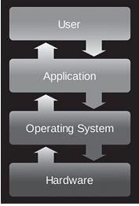
Bridging Hardware and Software
An operating system is software that has the job of managing the hardware resources of a given computer and providing a particular user interface (interacting with the hardware resources).
An operating system is intrinsic to the operation of a computer, it is referred to as system software. Operating system acts as the “middle man” between the hardware and executing application programs
Limits of Integrated Circuits Technology:
Moore’s Law states that the number of transistors that can be placed on a single silicon chip doubles roughly every two years.

Slide 7
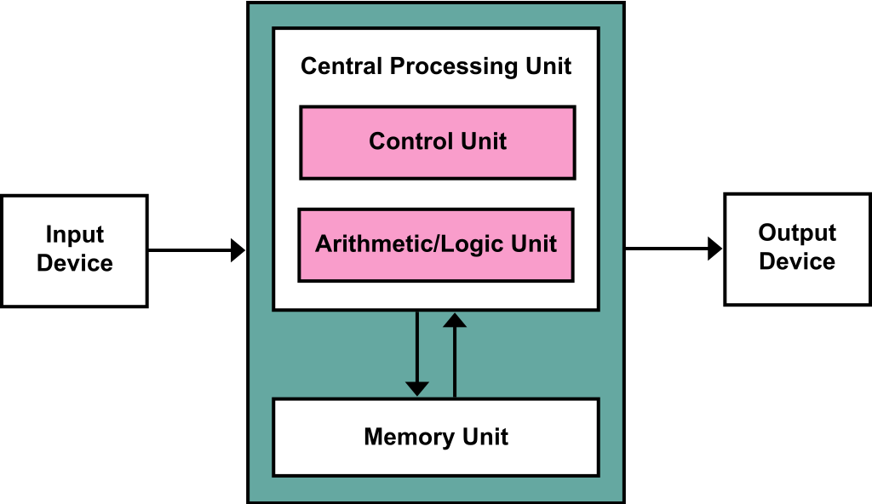
Bridging Hardware and Software
Input/output devices include anything that allows for input or output.
Central Processing Unit: Central processing Unit (CPU) is the main component or ‘brain’ of the computer which performs all the processing of input data. In micro computers, the CPU is built on a single chip or Integrated Circuit (IC) and is called Microprocessor. The CPU consists of the following distinct parts:
Arithmetic Logic Unit (ALU)
Control Unit (CU)
Registers
Buses
Clock

Slide 8
Central Processing Unit:
Arithmetic Logic Unit: The arithmetic logic unit is responsible for all arithmetic operations like addition, subtraction, multiplication and divisions as well as logical operations such as less than, equal to and greater than.
Control Unit: The control unit is responsible for controlling the transfer of data and instructions among other units of a computer. It is considered as the ‘Central Nervous System’ of computer as it manages and coordinates all the units of the computer. It obtains the instructions from the memory, interprets them and directs the operation of the computer.
Registers: Registers are small high-speed circuits which are used to store data, instructions and memory addresses, when ALU performs arithmetic and logical operations. Depending on the processor’s capability, the number and type of registers vary from one CPU to another.
Buses: Data is stored as a unit of eight bits in a register. Each bit is transferred from one register to another by means of a separate wire. This group of eight wires which is used as a common way to transfer data between registers is known as a bus. Bus is a connection between two components to transmit signal between them. Bus is of three major types namely data bus, control bus and address bus.
Clock: Clock is an important component of CPU which measures and allocates a fixed time slot for processing each and every micro-operation. CPU executes the instructions in synchronization with the clock pulse. The clock speed of CPU is measured in terms of Mega Hertz or millions of cycles per second. The clock speed of CPU varies from one model to another.

Slide 9
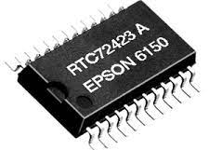
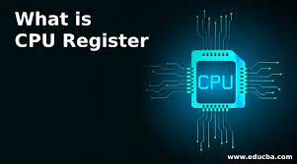
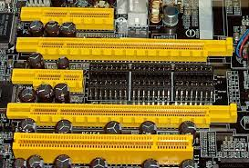
Register, Bus and Clock

Slide 10
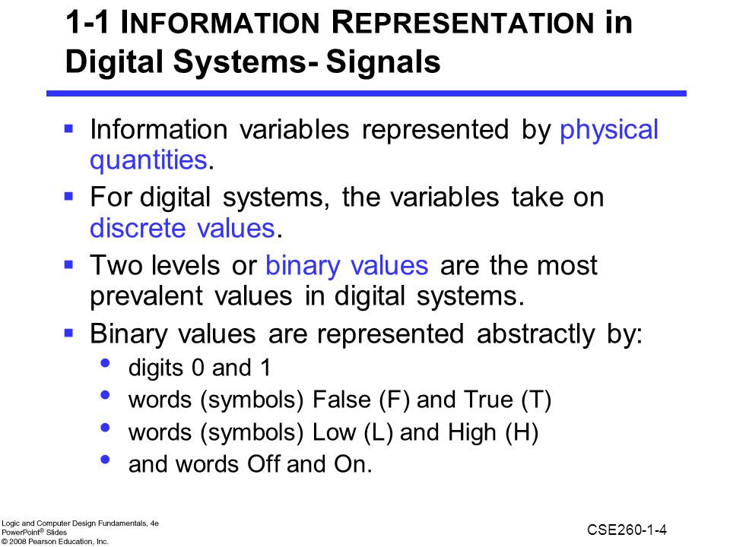

Slide 11
Digital Number System
The decimal system is the most widely used number system. However, computers only understand binary. Binary, octal and hexadecimal number systems are closely related, and we may require to convert decimal into these systems.
The decimal system is base 10 (ten symbols, 0-9, are used to represent a number) and similarly, binary is base 2, octal is base 8 and hexadecimal is base 16.
The decimal system is base 10 (ten symbols, 0-9, are used to represent a number) and similarly, binary is base 2, octal is base 8 and hexadecimal is base 16.

Slide 12
Decimal Number System
The number system that we use in our day-to-day life is the decimal number system. Decimal number system has base 10 as it uses 10 digits from 0 to 9.
In decimal number system, the successive positions to the left of the decimal point represents units, tens, hundreds, thousands and so on.
Each position represents a specific power of the base (10).
For example, the decimal number 1234 consists of the digit 4 in the units position, 3 in the tens position, 2 in the hundreds position, and 1 in the thousands position, and its value can be written as
(1×1000) + (2×100) + (3×10) + (4×l)
(1×103) + (2×102) + (3×101) + (4×l00)
1000 + 200 + 30 + 1
1234

Slide 13
The term bit stands for binary digit. Therefore, every bit has the value 0 or 1. A byte is a group of bits operated on as a single unit in a computer system, usually consisting of eight bits.

Slide 14
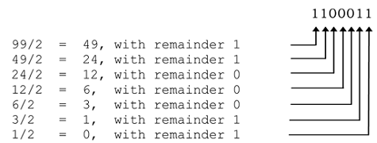
Conversion From Decimal to Binary
The algorithm for the conversion from base 10 to base 2 is to successively divide a number by two until the remainder becomes 0.
The remainder of each division provides the next higher-order (binary) digit
The binary representation of 99 to be 1100011.

Slide 15
MCQs
All information in a computer system is in binary representation.
TRUE
FALSE
Computer hardware is based on the use of electronic switches called _______________.
How many of these electronic switches can be placed on a single IC, or “chip”?
Thousands
Millions
Billions
The term “bit” stands for _______________.
A bit is generally a group of eight bytes.
TRUE
FALSE

Slide 16
MCQs
All information in a computer system is in binary representation.
TRUE
FALSE
Computer hardware is based on the use of electronic switches called transistors.
How many of these electronic switches can be placed on a single IC, or “chip”?
Thousands
Millions
Billions
The term “bit” stands for binary digit.
A bit is generally a group of eight bytes.
TRUE
FALSE

Slide 17
MCQs
The value of the binary representation 0110 is
12
3
6
The _______________ interprets and executes instructions in a computer system.
An OS manages the hardware resources of a computer system, as well as provides a particular user interface.
TRUE
FALSE

Slide 18
MCQs
The value of the binary representation 0110 is
12
3
6
The CPU interprets and executes instructions in a computer system.
An OS manages the hardware resources of a computer system, as well as provides a particular user interface.
TRUE
FALSE

Slide 19
What is Computer Software?
Computer software is a set of program instructions, including related data and documentation, that can be executed by computer.
Software can be in the form of instructions on paper, or in digital form.
Types of Software:
System Software: intrinsic to a computer system or platform for executing application software. Example: OS, Compiler, Interpreter, etc.
Application software: Fulfills users’ needs, such as a photo-editing program, MS office, etc.
Programming languages (called “artificial languages”) are languages just as “natural languages” such as English and Mandarin (Chinese).
Syntax and semantics are important concepts that apply to all languages.

Slide 20
Syntax, Semantics of Language
The syntax of a language is a set of characters and the acceptable sequences of those characters.
The semantics of a language is the meaning associated with each syntactically correct sequence of characters.
Example:
The most basic syntax follows a subject + verb + direct object formula.
That is, "Jillian hit the ball." Syntax allows us to understand that we wouldn't write, "Hit Jillian the ball."

Slide 21
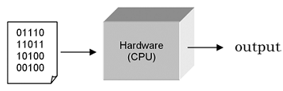
Program Translation
A central processing unit (CPU) is designed to interpret and execute a specific set of instructions represented in binary form (i.e., 1s and 0s) called machine code.
Only programs in machine code can be executed by a CPU.
Writing programs at this “low level” is tedious and error-prone. Therefore, most programs are written in a “high-level” programming language such as Python.
Since the instructions of such programs are not in machine code that a CPU can execute, a translator program must be used.
There are two fundamental types of translators: compiler and interpreter.

Slide 22
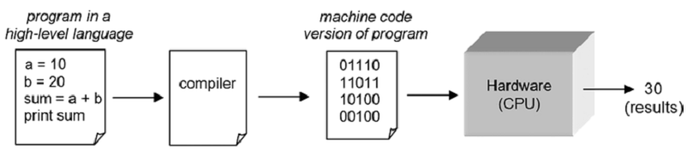
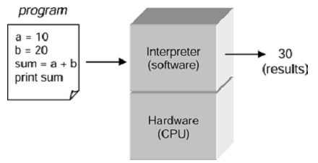
Program Translation
A compiler is a translator program that translates programs directly into machine code to be executed by the CPU.
An interpreter executes program instructions in place of (“running on top of”) the CPU. It can immediately execute instructions as they are entered.
Python, as we shall see, is executed by an interpreter.
Compiled programs generally execute faster than
interpreted programs.

Slide 23
Program Debugging
Program debugging is the process of finding and correcting errors ( “bugs”) in a computer program.
Syntax errors are caused by invalid syntax (for E.g., entering prnt instead of print)
Since a translator cannot understand instructions containing syntax errors, translators terminate when encountering such errors indicating where the problem occurred in program.
Semantic errors (generally called logic errors) are caused by errors in program logic. These errors cannot be automatically detected, as translators cannot understand the intent of a given computation.
Example: if a program computed the average of three numbers as follows,
(num1 + 1num2 + 1num3) / 2.0
A translator would have no means of determining that the divisor should be 3 and not 2.
Computers do not understand what a program is meant to do, they only follow the instructions given.

Slide 24

Procedural vs Object Oriented Programming
Procedural programming and object-oriented programming are two major programming paradigms in use today.
Each provides a different way of thinking about computation.
While most programming languages only support one paradigm.
Python supports both procedural and object-oriented programming

Slide 25
MCQs
Two general types of software are system software and _______________ software.
The syntax of a given language is,
the set of symbols in the language.
the acceptable arrangement of symbols.
both of the above
The semantics of a given language is the meaning associated with any arrangement of symbols in the language.
TRUE
FALSE
CPUs can only execute instructions that are in binary form called _______________.

Slide 26
MCQs
The two types of translation programs for the execution of computer programs are _______________ and _______________.
The process of finding and correcting errors in a computer program is called _______________.
Which kinds of errors can a translator program detect?
Syntax errors
Semantic errors
Neither of the above
Two major programming paradigms in use today are _______________ programming and _______________ programming.

Slide 27
MCQs
Two general types of software are system software and application software.
The syntax of a given language is,
the set of symbols in the language.
the acceptable arrangement of symbols.
both of the above
The semantics of a given language is the meaning associated with any arrangement of symbols in the language.
TRUE
FALSE
CPUs can only execute instructions that are in binary form called machine code.

Slide 28
MCQs
The two types of translation programs for the execution of computer programs are
compilers and interpreters.
The process of finding and correcting errors in a computer program is called program debugging.
Which kinds of errors can a translator program detect?
Syntax errors
Semantic errors
Neither of the above
Two major programming paradigms in use today are procedural programming and object-oriented programming.

Slide 29
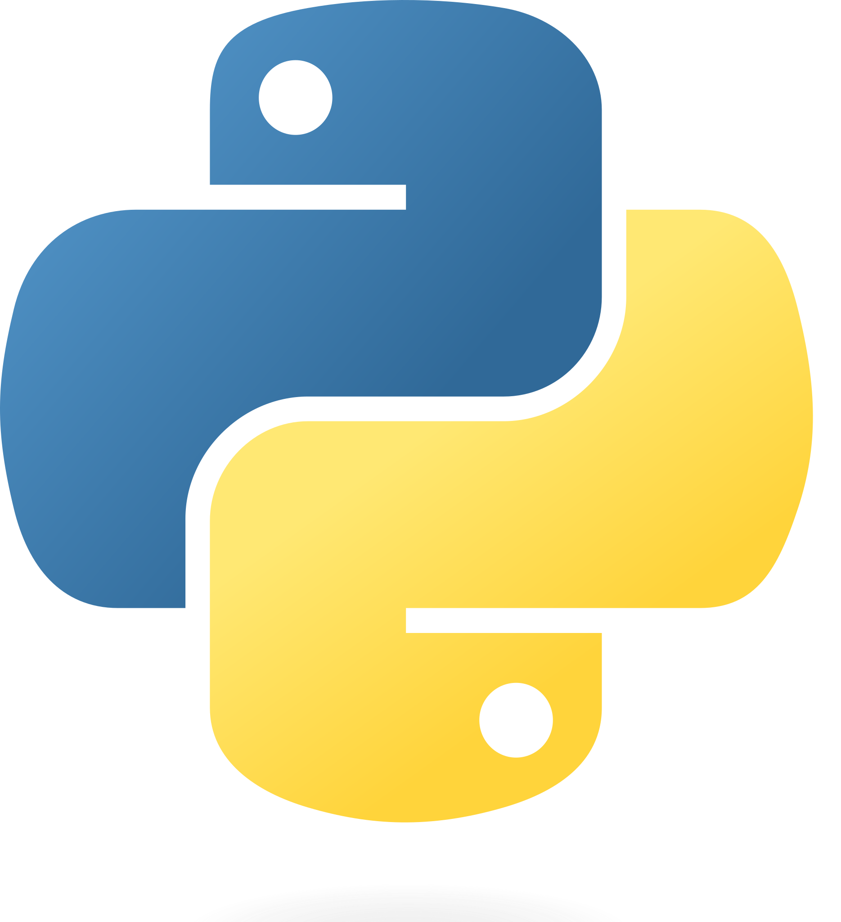
THANK YOU
Dr. Shachi Mall
Shachi.Mall@bennett.edu.in

