Slide 1
Computational Thinking with Python
Lecture-5

Slide 2
Content
Variables
Data Types
Operators

Slide 3
Variable
Variables are containers for storing data values.
Python is a dynamic-typed language, which means we don't need to mention the variable type or declare before using it
Before declaring a variable, we must follow the given rules.
The first character of the variable can not be an (_) underscore.
Special characters (@, #, %, ^, &, *) should not be used in variable name.
Variable names are case sensitive. For example - age and AGE are two different variables.
Reserve words cannot be declared as variables.

Slide 4
Let's understand the declaration of a few basic variables.
Creating Variables
Python has no command for declaring a variable.
A variable is created the moment you first assign a value to it.
Example
x = 5 y = "John" print(x) print(y)
Here X and Y are the two variables

Slide 5
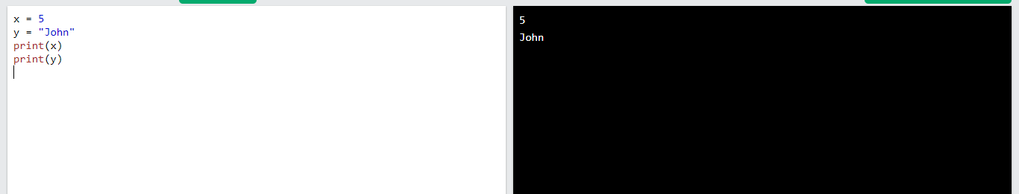
Output
https://www.w3schools.com/python/trypython.asp?filename=demo_variables1

Slide 6
Variable declaration
Variables do not need to be declared with any type and can even change type after they have been set.
Example
x = 4 # x is of type int x = "Sally" # x is now of type str print(x)
Output: Sally

Slide 7
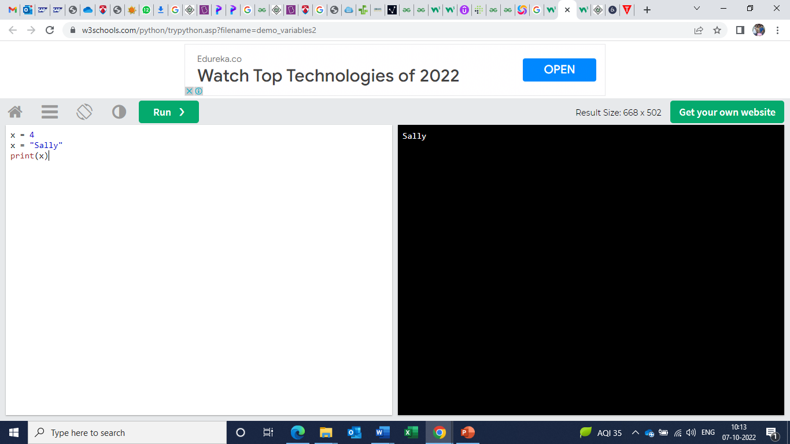
Output
https://www.w3schools.com/python/python_variables.asp

Slide 8
Python Data Types
In programming, data type is an important concept.
Variables can store data of different types, and different types can do different things.
Python has the following data types built-in by default, in these categories:

Slide 9
Cont.
Text Type: | str
Numeric Types: | int, float, complex
Sequence Types: | list, tuple, range
Mapping Type: | dict
Set Types: | set, frozenset
Boolean Type: | bool
Binary Types: | bytes, bytearray, memoryview
None Type: | NoneType

Slide 10
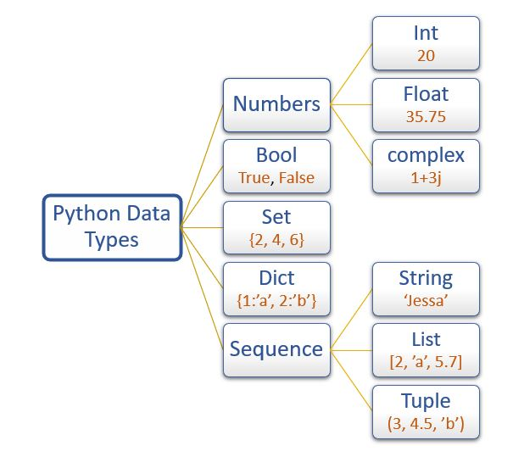

Slide 11
Getting the Data Type
You can get the data type of any object by using the type() function:
Example
Print the data type of the variable x:
x = 5
print(type(x))
Output: <class 'int'>
https://www.w3schools.com/python/python_datatypes.asp

Slide 12
In Python, the data type is set when you assign a value to a variable:
Example | Data Type | Try it
x = "Hello World" | str | Try it »
x = 20 | int | Try it »
x = 20.5 | float | Try it »
x = 1j | complex | Try it »
x = ["apple", "banana", "cherry"] | list | Try it »
x = ("apple", "banana", "cherry") | tuple | Try it »
x = range(6) | range | Try it »
x = {"name" : "John", "age" : 36} | dict | Try it »
x = {"apple", "banana", "cherry"} | set | Try it »
x = frozenset({"apple", "banana", "cherry"}) | frozenset | Try it »
x = True | bool | Try it »
x = b"Hello" | bytes | Try it »
x = bytearray(5) | bytearray | Try it »
x = memoryview(bytes(5)) | memoryview | Try it »
x = None | NoneType

Slide 13
Python Keywords
Python keywords are unique words reserved with defined meanings and functions that we can only apply for those functions
You'll never need to import any keyword into your program because they're permanently present.
You'll get a message of SyntaxError if you attempt to do the same.

Slide 14
Python contains thirty-five keywords in the most recent version, i.e., Python 3.8.
False | await | else | import | pass
None | break | except | in | raise
True | class | finally | is | return
and | continue | for | lambda | try
as | def | from | nonlocal | while
assert | del | global | not | with
async | elif | if | or | yield

Slide 15
Quiz
1. In Python, a variable must be declared before it is assigned a value:
TRUE
False
2. Which of the following statements assigns the value 100 to the variable x in Python:
let x = 100
x = 100
x ← 100

Slide 16
Answer
1. In Python, a variable must be declared before it is assigned a value:
False
Explanation- Variables need not be declared or defined in advance in Python. To create a variable, you just assign it a value.
2. 2. Which of the following statements assigns the value 100 to the variable x in Python:
x = 100

Slide 17
Quiz
3. In Python, a variable may be assigned a value of one type, and then later assigned a value of a different type:
TRUE
False
4. What gets printed?
kvps = {"user","bill", "password","hillary"}
Nothing. Python syntax error
User
Bill
Password
hillary

Slide 18
Answer
3. In Python, a variable may be assigned a value of one type, and then later assigned a value of a different type:
TRUE
Explanation -Variables are not statically typed in Python, as they are in some other programming languages.
4. What gets printed?
kvps = {"user","bill", "password","hillary"}
Nothing. Python syntax error

Slide 19
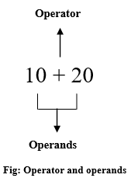
Python Operators
Operators are special symbols that perform specific operations on one or more operands (values) and then return a result.
For example, you can calculate the sum of two numbers using an addition (+) operator.

Slide 20
Python divides the operators in the following groups:
Arithmetic operators
Assignment operators
Comparison operators
Logical operators
Identity operators
Membership operators
Bitwise operators

Slide 21
Python Arithmetic Operators
Operator | Name | Example | Try it
+ | Addition | x + y | Try it »
- | Subtraction | x - y | Try it »
* | Multiplication | x * y | Try it »
/ | Division | x / y | Try it »
% | Modulus | x % y | Try it »
** | Exponentiation | x ** y | Try it »
// | Floor division | x // y | Try it »

Slide 22
Python Assignment Operators
Operator | Example | Same As | Try it
= | x = 5 | x = 5 | Try it »
+= | x += 3 | x = x + 3 | Try it »
-= | x -= 3 | x = x - 3 | Try it »
*= | x *= 3 | x = x * 3 | Try it »
/= | x /= 3 | x = x / 3 | Try it »
%= | x %= 3 | x = x % 3 | Try it »
//= | x //= 3 | x = x // 3 | Try it »
**= | x **= 3 | x = x ** 3 | Try it »
&= | x &= 3 | x = x & 3 | Try it »
|= | x |= 3 | x = x | 3 | Try it »
^= | x ^= 3 | x = x ^ 3 | Try it »
>>= | x >>= 3 | x = x >> 3 | Try it »
<<= | x <<= 3 | x = x << 3 | Try it »

Slide 23
Python Comparison Operators
Operator | Name | Example | Try it
== | Equal | x == y | Try it »
!= | Not equal | x != y | Try it »
> | Greater than | x > y | Try it »
< | Less than | x < y | Try it »
>= | Greater than or equal to | x >= y | Try it »
<= | Less than or equal to | x <= y | Try it »

Slide 24
Python Logical Operators
Logical operators are used to combine conditional statements:
Operator | Description | Example | Try it
and | Returns True if both statements are true | x < 5 and x < 10 | Try it »
or | Returns True if one of the statements is true | x < 5 or x < 4 | Try it »
not | Reverse the result, returns False if the result is true | not(x < 5 and x < 10)

Slide 25
Python Bitwise Operators
Bitwise operators are used to compare (binary) numbers:
perator | Name | Description
& | AND | Sets each bit to 1 if both bits are 1
| | OR | Sets each bit to 1 if one of two bits is 1
^ | XOR | Sets each bit to 1 if only one of two bits is 1
~ | NOT | Inverts all the bits
<< | Zero fill left shift | Shift left by pushing zeros in from the right and let the leftmost bits fall off
>> | Signed right shift | Shift right by pushing copies of the leftmost bit in from the left, and let the rightmost bits fall off

Slide 26
Thank You

