Slide 1
Python - Control structure
Lecture-6

Slide 2
Content
Python - Decision Making
Conditional statements
If
If-else
elif
Iterative Statement
While
for

Slide 3
Python - Decision Making
Decision making is conditions occurring while execution of the program and specifying actions taken according to the conditions.
Decision structures evaluate multiple expressions which produce TRUE or FALSE as outcome.
we need to determine which action to take and which statements to execute if outcome is TRUE or FALSE otherwise

Slide 4
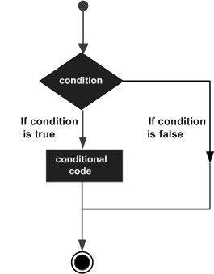
Following is the general form of a typical decision making structure

Slide 5
Control Flow in Python
Decision-making statements in Python programming languages decide the direction of the flow of program execution.
There comes situations in real life when we need to make some decisions and based on these decisions, we decide what should we do next.
Flow control describes the order in which statements will be executed at runtime

Slide 6
Conditional statements
Computer programs are said to be shaped into the control structures or the control flow that are nothing but a block of decisions that analyze the flow through instructions.
All the decisions are made based on two categories, the data and instructions to provide a particular response.
When you deal with data, you try to understand the nature of it (data type), and when you deal with instructions you need to understand on what basis are, they are being made on.

Slide 7
There are three types of Python control structures.
Selection
Sequential
Repetition (iteration).

Slide 8
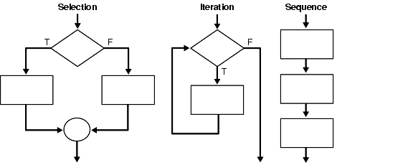

Slide 9
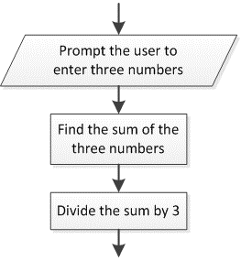
Python Sequential
Flow of a program that executes in an order, without skipping, jumping or switching to another block of code.

Slide 10
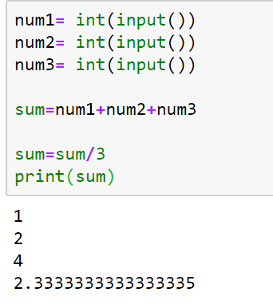

Slide 11
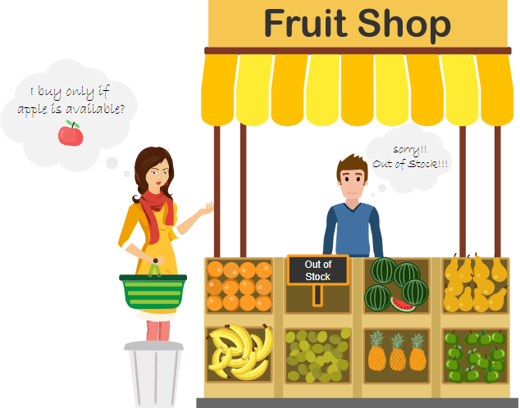

Slide 12
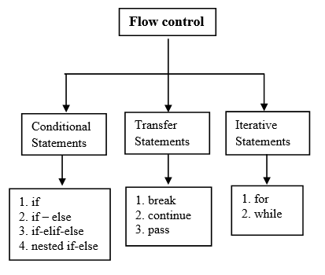

Slide 13
Conditional Statements
if statement
if statement is the most simple decision-making statement.
if a certain condition is true then a block of statement is executed otherwise not.
Syntax:
if condition:
# Statements to execute if
# condition is true

Slide 14
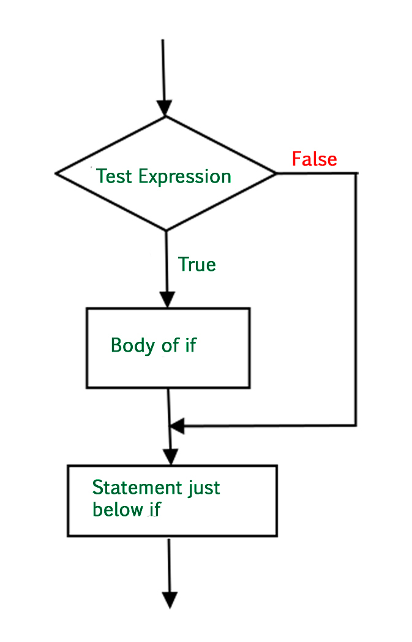
Flowchart of Python if statement

Slide 15
Example: Python if Statement
# python program to illustrate If statement
i = 10
if (i > 15):
print("10 is less than 15")
print("I am Not in if")
Output:
I am Not in if
https://www.geeksforgeeks.org/python-if-else/
Control Flow in Python – GeeksforGeeks

Slide 16
Python Conditions and If statements
Python supports the usual logical conditions from mathematics:
Equals: a == b
Not Equals: a != b
Less than: a < b
Less than or equal to: a <= b
Greater than: a > b
Greater than or equal to: a >= b
These conditions can be used in several ways, most commonly in "if statements" and loops.
An "if statement" is written by using the if keyword.

Slide 17
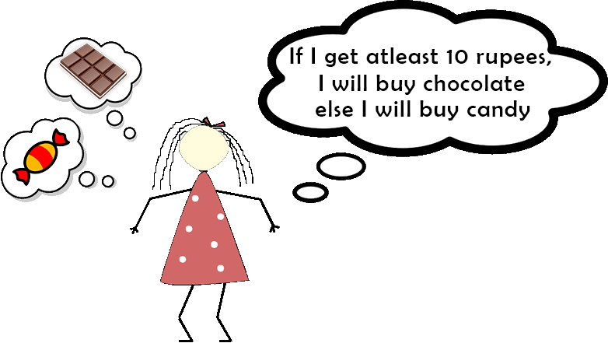

Slide 18
Example
If statement:
a = 33 b = 200 if b > a: print("b is greater than a")
Output: b is greater than a
Try it Yourself »

Slide 19
if-else
The if statement alone tells us that if a condition is true it will execute a block of statements and if the condition is false it won’t.
If we want to do something else if the condition is false.
We can use the else statement with if statement to execute a block of code when the condition is false.
Syntax:
if (condition):
# Executes this block if
# condition is true
else:
# Executes this block if
# condition is false

Slide 20
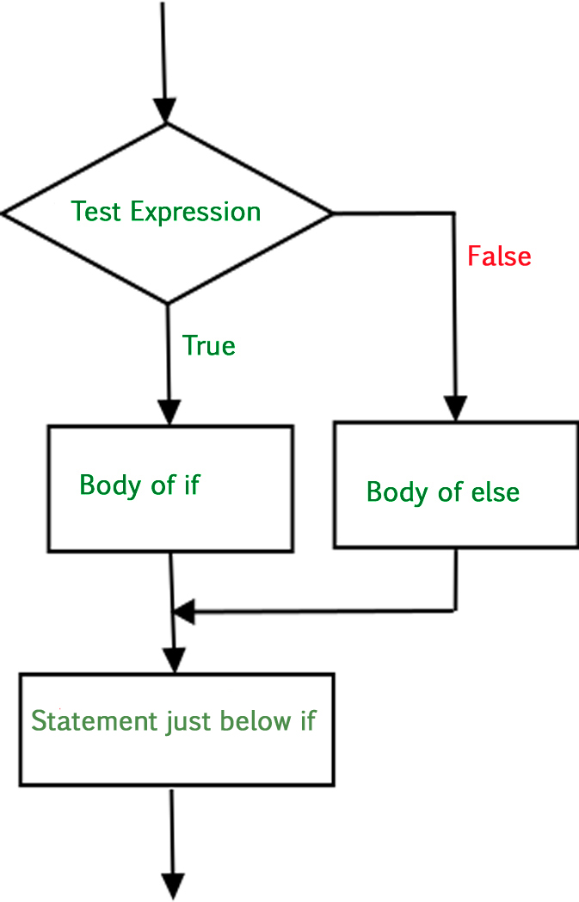
FlowChart of Python if-else statement

Slide 21
Example 1: Python if-else statement
# python program to illustrate If else statement
i = 20
if (i < 15):
print("i is smaller than 15")
print("i'm in if Block")
else:
print("i is greater than 15")
print("i'm in else Block")
print("i'm not in if and not in else Block")
Output:
i is greater than 15
i'm in else Block
i'm not in if and not in else Block
https://ide.geeksforgeeks.org/cd342068-bbfe-4561-8626-d2a7275580c1

Slide 22
nested-if
A nested if is an if statement that is the target of another if statement.
Nested if statements mean an if statement inside another if statement.
Python allows us to nest if statements within if statements. i.e, we can place an if statement inside another if statement.
Syntax:
if (condition1):
# Executes when condition1 is true
if (condition2):
# Executes when condition2 is true
# if Block is end here
# if Block is end here

Slide 23
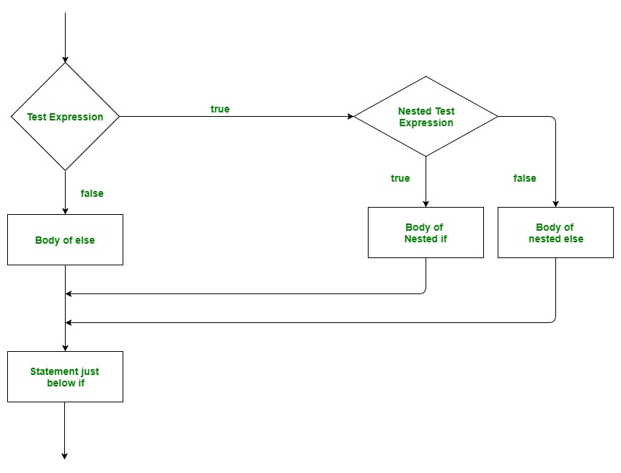
Flowchart of Python Nested if Statement

Slide 24
Example - python program to illustrate nested If statement
i = 10
if (i == 10):
# First if statement
if (i < 15):
print("i is smaller than 15")
# Nested - if statement
# Will only be executed if statement above
# it is true
if (i < 12):
print("i is smaller than 12 too")
else:
print("i is greater than 15")

Slide 25
Output:
i is smaller than 15
i is smaller than 12 too
https://ide.geeksforgeeks.org/070acf41-63ed-4161-b280-8ce98a96f0dd

Slide 26
if-elif-else
Here, a user can decide among multiple options.
The if statements are executed from the top down.
If none of the conditions is true, then the final else statement will be executed.
Syntax:
if (condition):
statement
elif (condition):
statement
.
.
else:
statement

Slide 27
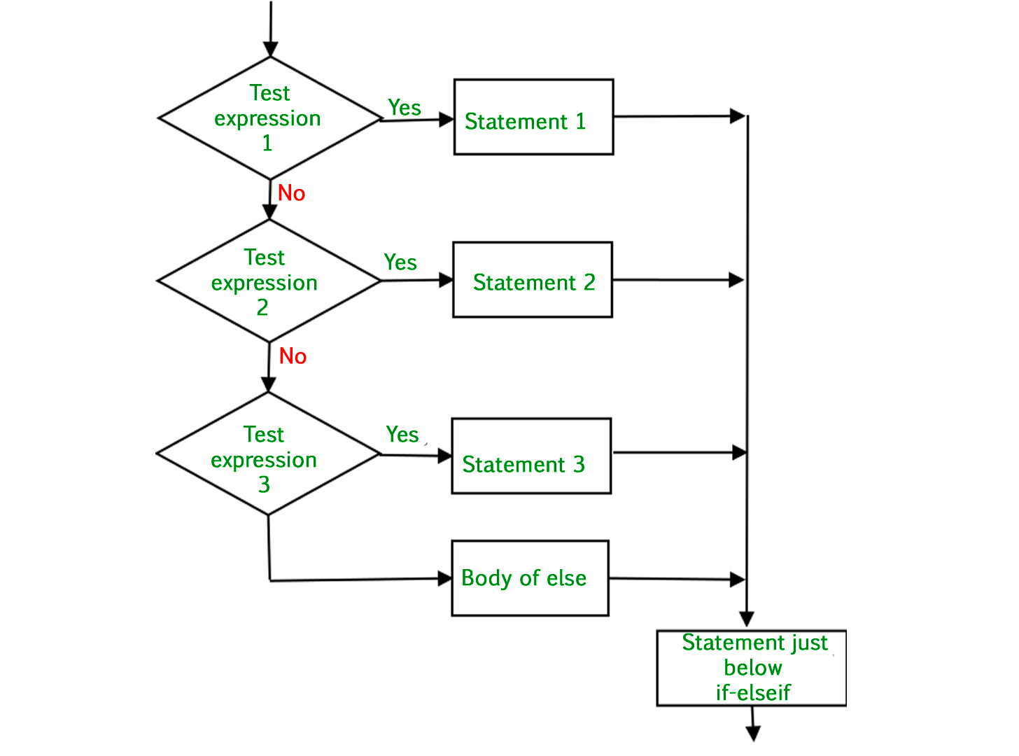
FlowChart of Python if else elif statements

Slide 28
# Python program to illustrate if-elif-else ladder
i = 20
if (i == 10):
print("i is 10")
elif (i == 15):
print("i is 15")
elif (i == 20):
print("i is 20")
else:
print("i is not present")
Output: i is 20
https://ide.geeksforgeeks.org/4f3f22eb-25d3-457b-ba34-277697694df0

Slide 29
The elif keyword is pythons way of saying "if the previous conditions were not true, then try this condition".
Example
a = 33 b = 33 if b > a: print("b is greater than a") elif a == b: print("a and b are equal")
Output: a and b are equal
Try it Yourself »

Slide 30


Slide 31
Python While Loops
Python Loops
Python has two primitive loop commands:
while loops
for loops
Python While Loop is used to execute a block of statements repeatedly until a given condition is satisfied.
And when the condition becomes false, the line immediately after the loop in the program is executed.
Syntax:
while expression:
statement(s)

Slide 32
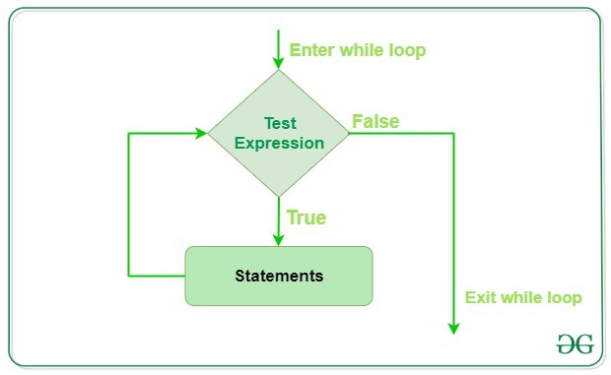
Flowchart of While Loop :

Slide 33
The while Loop
With the while loop we can execute a set of statements as long as a condition is true.
Example
Print i as long as i is less than 6:
i = 1 while i < 6: print(i) i += 1
Try it Yourself »
Output
1
2
3
4
5

Slide 34
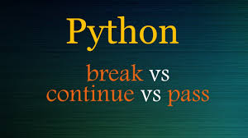

Slide 35
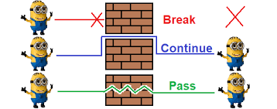

Slide 36
Python break statement
break statement in Python is used to bring the control out of the loop when some external condition is triggered.
It terminates the current loop
Python break is used to terminate the execution of the loop.
Python break statement Syntax:
Loop{
Condition:
break
}

Slide 37
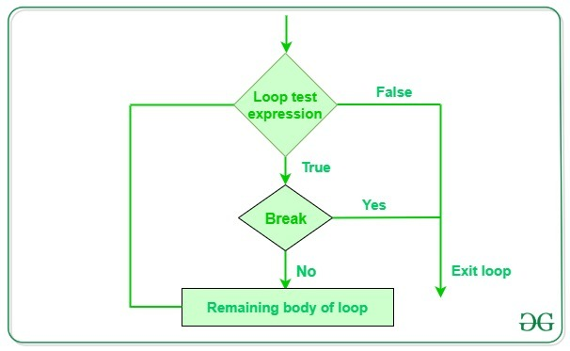

Slide 38
Example
Exit the loop when i is 3:
i = 1 while i < 6: print(i) if i == 3: break i += 1
Try it Yourself »
Output:
1
2
3

Slide 39
The continue Statement
With the continue statement we can stop the current iteration, and continue with the next:
Example- Continue to the next iteration if i is 3:
i = 0 while i < 6: i += 1 if i == 3: continue print(i)
Try it Yourself »
Output:
1
2
4
5
6

Slide 40
Python pass Statement
pass is used when the user doesn’t want any code to execute.
li =['a', 'b', 'c', 'd']
for i in li:
if(i =='a'):
pass
else:
print(i)
Output:
b
c
d
https://ide.geeksforgeeks.org/53770f01-8b56-46df-8c9f-32f4e819fd81

Slide 41
Python For Loops
Python For loop is used for sequential traversal i.e. it is used for iterating over an iterable like String, Tuple, List, Set or Dictionary.
The for keyword in other programming languages, and works more like an iterator method as found in other object-orientated programming languages.
for var in iterable:
# statements

Slide 42
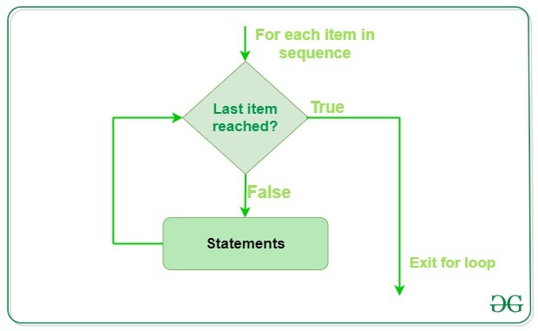

Slide 43
# Python Program to
# show range() basics
# printing a number
for i in range(10):
print(i, end=" ")
# performing sum of first 10 numbers
sum = 0
for i in range(1, 10):
sum = sum + i
print("\nSum of first 10 numbers :", sum)
Output:
0 1 2 3 4 5 6 7 8 9
Sum of first 10 numbers : 45
https://ide.geeksforgeeks.org/eb8cc6fc-31b2-4b84-a4b3-bbe52231325c

Slide 44
Thank you

