Slide 1
Study Hall Assignment

Slide 2
What Success Means
9th grader gets 2 sh, 10th 1
No section exceeds capacity nor underfilled
Spacing rules are respected unless explicitly relaxed (and documented)

Slide 3
Data model and structures
Block:
  Represents a `block` object with “D[X]B[X]”
  `get_distance()` that returns distance in days
Student:
  self.id
  self.free_blocks = set()
  self.availability = [] (ordered)
  self.scheduled_sh = []
  `set_availability()`; takes in sorted, ordered study hall sections data

Slide 4
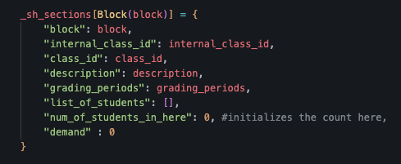
Variables
Internal variables holding data:
  _block_schedule = [list of 28 blocks]
  _students = [list of student objects]
  _sh_sections = [list of sh block objects, each object points to a dictionary]

Slide 5
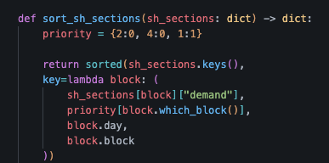
Engineering Designs
No lunch block used
Heat-map: Sections with lower demand are chosen first to spread load
Next preference: 2nd/4th block (weighted same) favored over block 1
Place students with fewer availabilities first; 9th graders first, then 10th
student.availability inherits the sorted order of sh sections →encoding the “fill low-demand first” preference into each availability list

Slide 6
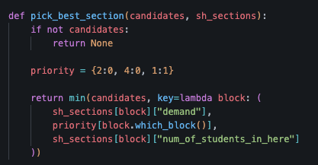
Core Loop and Action
First/second sh assignment:
  for s in 9th-graders:
  if s needs sh:
  candidates = get valid candidates(s, _sh_sections)
  best = pick best section
  update internal variables

Slide 7
Next - Capacity-based rescue and swap
For 9th graders that still need 2nd SH after second round placement
Need this potentially because during 2nd round placement, all availabilities at max
for s in targets:
for alt in s.alternatives:
check conditions, check if any donor can be moved out (another loop)
if ok:
bump donor to free up spot to move s in

Slide 8
Assign 10th graders
Same logic as 1st/2nd round placement of 9th graders

Slide 9
Last step: Underfilled Balancing
Und = list of underfilled sections (below min requirement)
Finds donor sections with ppl > 25 (adjustable)
For student in each donor section: check whether they can be moved to und; if not, skip
If not, break the while loop and just append a note saying underfilled effort failed.

Slide 10
Time Complexity
Let s = number of students, b = number of sections, a = average availability per student
Demand computation: O(s*b)
Building student availability: O(s*b)
Placement rounds: O(s*a)
Rescue & min enforcement: I’m not sure

