Slide 1
Collision‑Free Car Routing
10×10 grid simulation • algorithm walkthrough
Matthew Li
10×10 Grid • 500 cars • Collision-free routing
Notes:
Algorithm + deck generated from the project spec.
[Sources]
- User-provided runner showing tick order: CarSimulation.py (calls updateAll() then step() each tick).
[/Sources]

Slide 2
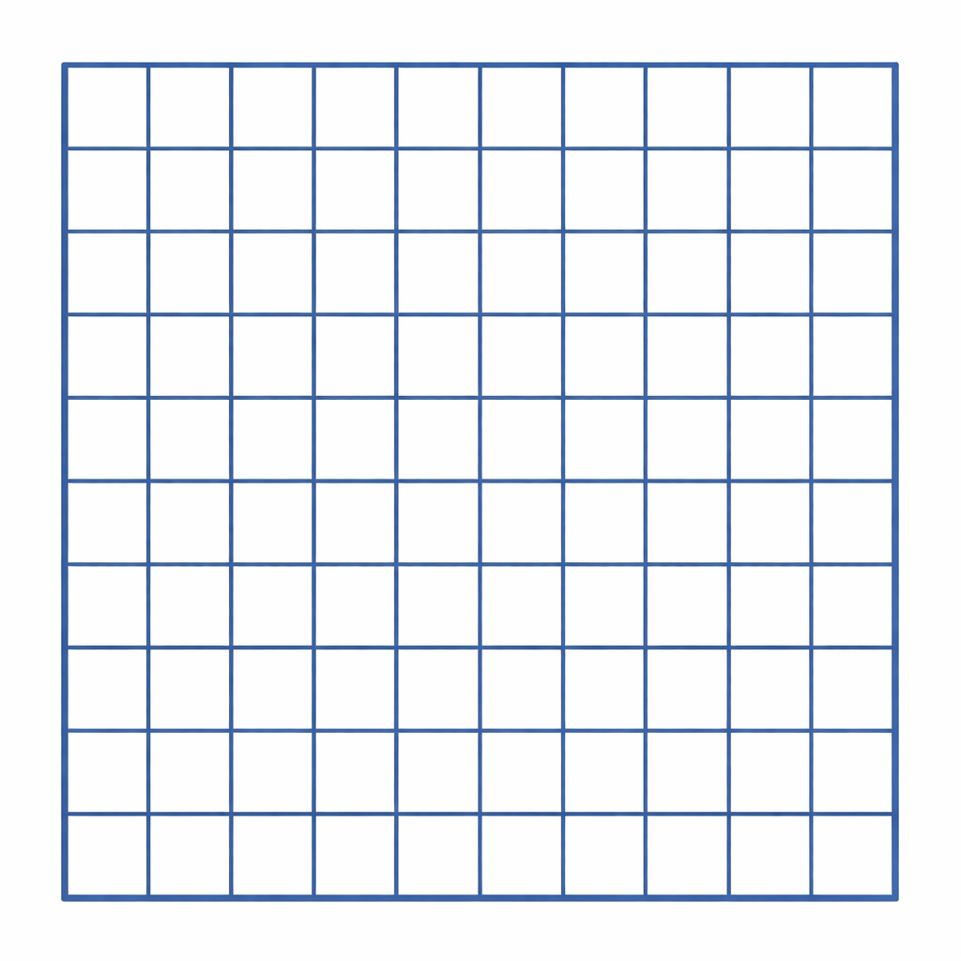
Problem setup
Route 500 cars to random goal cells
10×10 grid
What exists at t = 0
• A 10×10 grid of Locations
• Each Location has a queue of 5 cars waiting to enter
• Each car has a predetermined goal Location
Objective (score = ticks)
Minimize total ticks until all cars reach their goal, while preventing:
• Two cars in the same cell (crash)
• Any car moving off the grid
Key challenge: once activated, every car moves every tick.
Notes:
[Sources]
- Project rules as provided by user.
[/Sources]

Slide 3
Tick lifecycle
1) Activate cars
2) Set turns
3) Move forward
Bring any number
of waiting cars
onto the grid.
Turn any number
of active cars
(choose direction).
All active cars
move 1 cell
(every tick).
Design implication
Because movement is automatic, the only way to avoid collisions is to make sure the next cell for every active car is available and not occupied each tick. There are a few ways that we can achieve this.
Notes:
[Sources]
- Tick order in runner: updateAll() then step(): CarSimulation.py lines 14–16.
[/Sources]

Slide 4
updateAll(): main logic and (row, col, tick)
Here’s a clean way to illustrate the process of updateAll() at each tick
Phase A — Setup
Set Direction for all currently active cars. Look up future positions of each active car to store and reserve all cells.
Phase B — Choosing
Gather Candidates (usable cells) and and carefully select from them cars to form cohort that will be turned active.
;
Phase C — Collision Detection
Check each reserved cell against the future path of each candidates. If there is a cell that has collision, break the loop; otherwise, add the car’s path to the reserved pool.
Phase D — Update
Update global tick, make cars move.
Drop in a screenshot of your actual updateAll() next (see placeholder slides).
Notes:
[Sources]
- Tick order in runner: updateAll() then step(): CarSimulation.py lines 14–16.
[/Sources]

Slide 5
Selection: which cars to activate?
Critical Step
Typical inputs to the decision
Activation pseudocode (replace)
• Is the entry cell free?
• Is the entering car’s next cell for *this tick* safe?
• Can we somehow group cars based on a common shared “trait”—such as direction of motion?
for each candidate in candidates:
path = compute_its_path
has_conflict = False
for cell in path:
if cell in reserved_cells:
break
else:
add car to cohort
reserve its path
Fill this with YOUR rule
Select candidate cells by checking if it’s currently empty and if there’s a waiting car. Sort them by path length. Then, check each candidate against the reserved cell pool. If collision, abandon and skip that candidate cell.
Notes:
[Sources]
- “peek” rule comes from project prompt provided by user.
[/Sources]

Slide 6
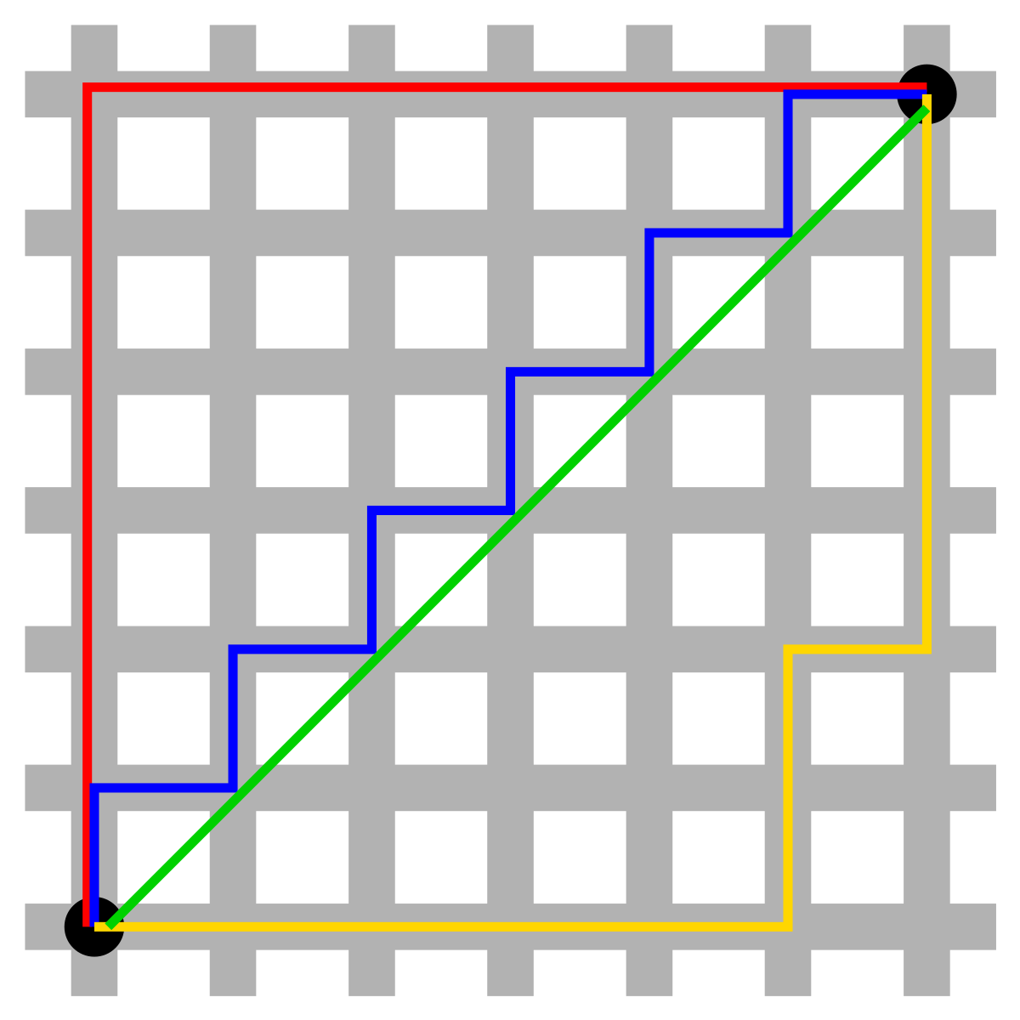
Movement
Route selection
Taxicab metrics.
Directionality
Horizontal movement first; then vertical

Slide 7
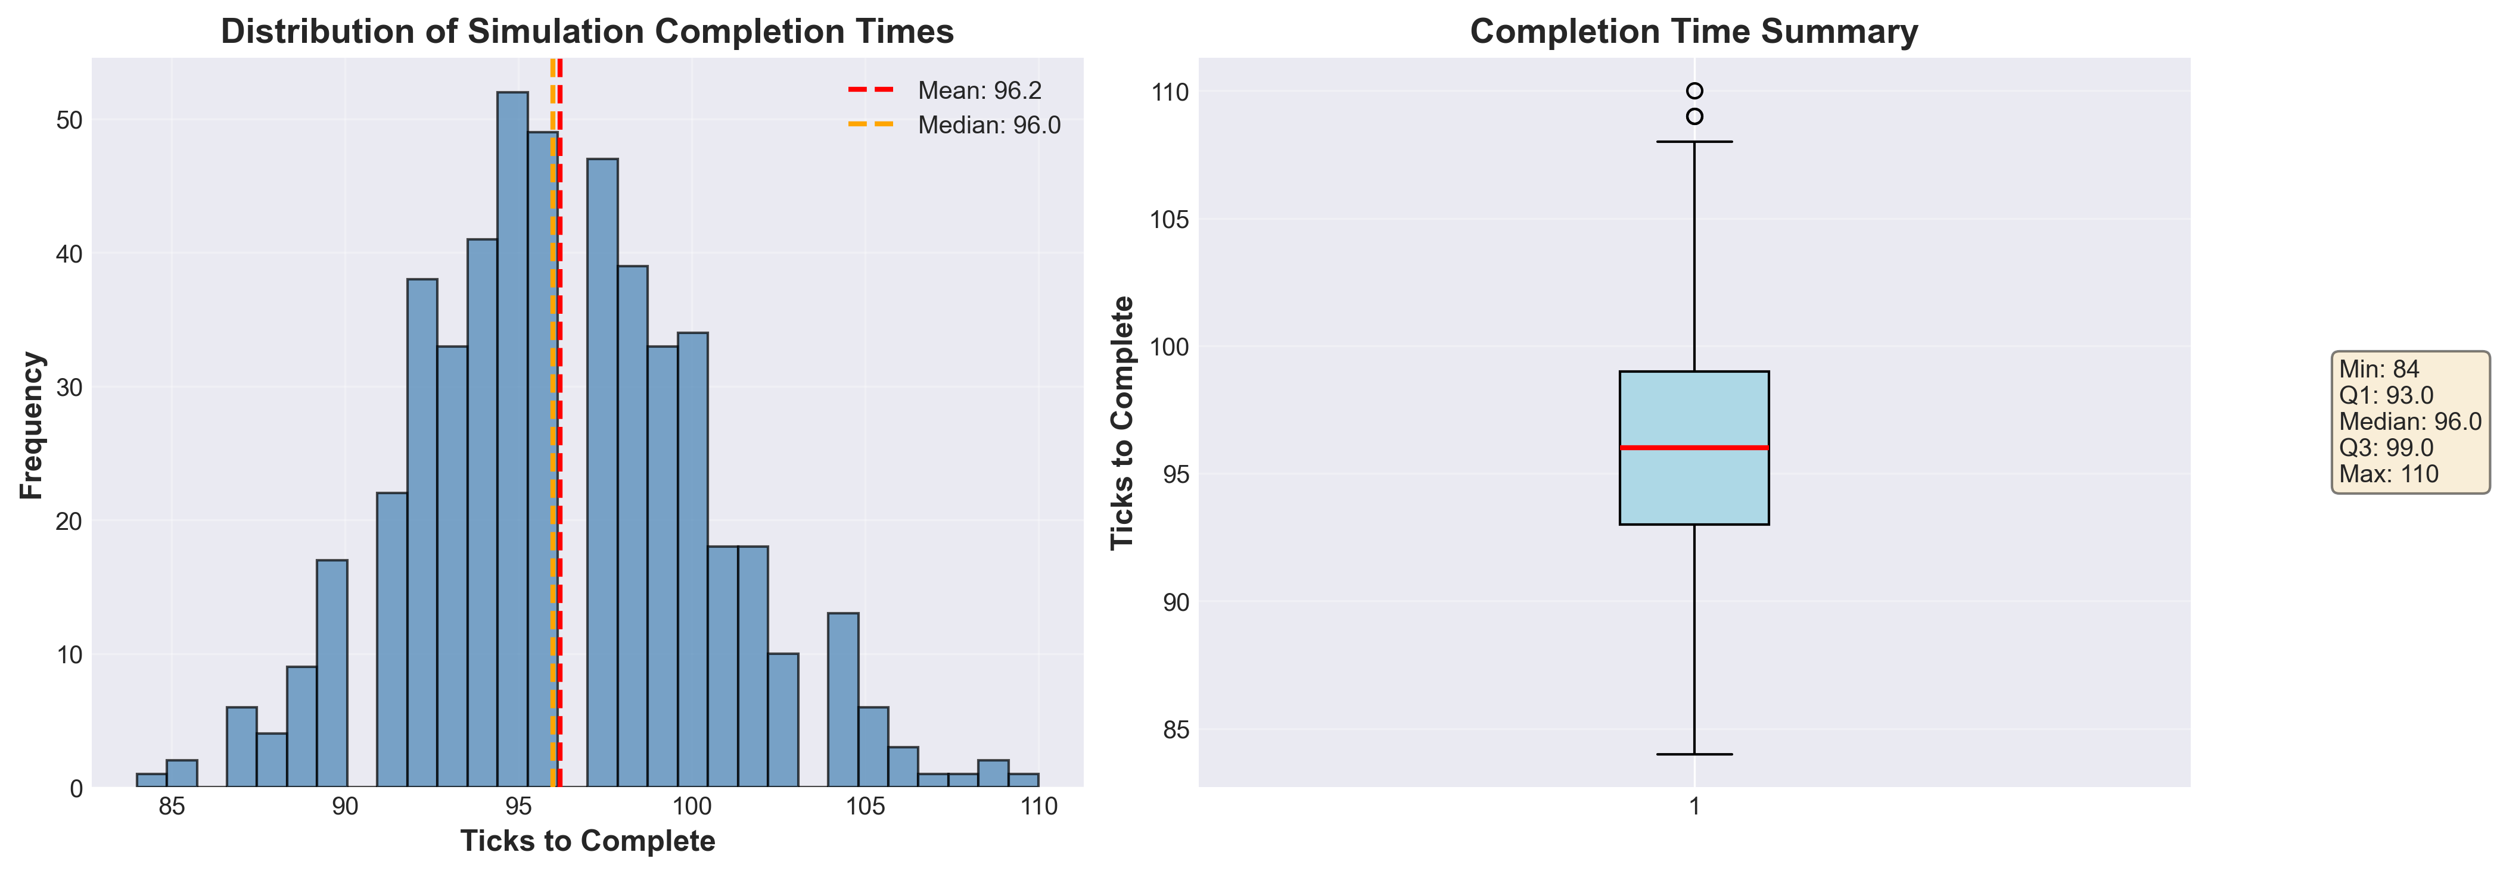
Some visualizations
Insert image / screenshot here
Tip: keep code at ≥ 20pt for readability

Slide 8
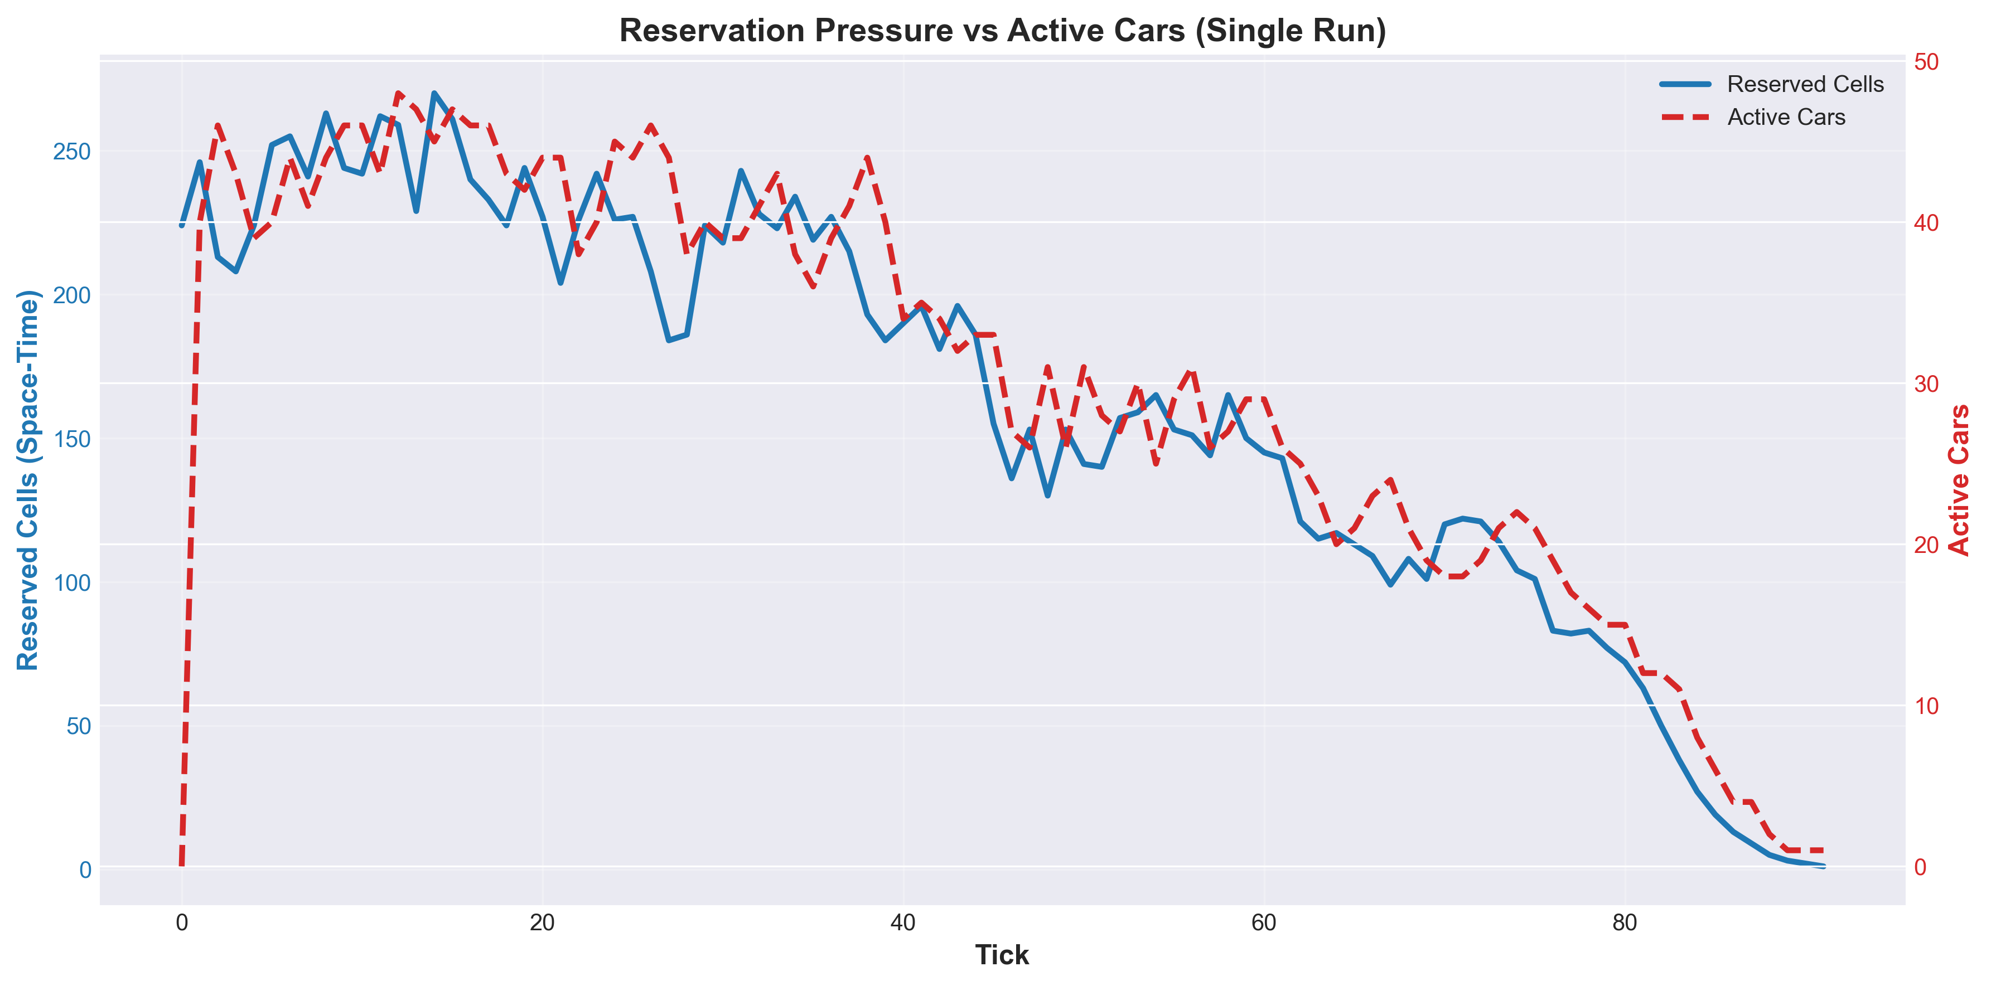
Some visualizations…continued
Insert image / screenshot here
Tip: keep code at ≥ 20pt for readability

Slide 9
Placeholder: simulation snapshot
Insert a screenshot/GIF frame showing cars moving (optional: annotate lanes)
Insert image / screenshot here
Tip: keep code at ≥ 20pt for readability

Slide 10
Results & performance
What tick count did your algorithm achieve?
Tick count (fill in)
My algorithm completed in: ______ ticks
Baseline (naïve one-car-at-a-time): ~3300 ticks (given in prompt)
Why it’s faster (fill in)
Failure modes you prevented
Examples to mention:
• Higher parallel throughput (more cars safely active)
• Fewer deadlocks / oscillations
• Smarter tie-breaking at conflicts
• Edge fall-off
• Head-on collisions
• Two cars merging into one cell
• Long-term gridlock
Notes:
[Sources]
- Baseline tick count (~3300) comes from project prompt provided by user.
[/Sources]

Slide 11
Q&A
Happy to walk through a tricky tick or conflict example
Backup slides you can add:
• A “worst-case” conflict and your tie-break
• A full tick trace (before → after)
• Why your activation policy avoids gridlock
10×10 Grid • 500 cars • Collision-free routing

