Slide 1
Wine Price Prediction
Coursera ‘Advanced Data Science’ Capstone

Slide 2
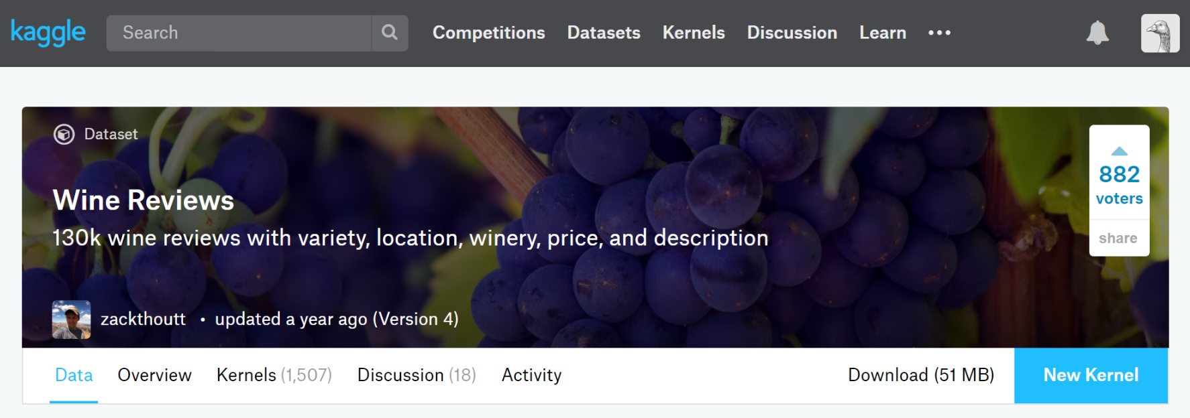
The Data Set
The dataset is "Wine Reviews - 130k wine reviews with variety, location, winery, price, and description" from Kaggle
This dataset contains around 130k of wine reviews with variety, location, winery, price, and description. The original data was scraped from Wine Enthusiast on November 22nd, 2017.

Slide 3
The Use Case
We use the wine reviews dataset to develop a model that predicts wine price for specified set of parameters, like wine variety, region, and desired quality.
Such model, may be integrated into an application that runs on a mobile device to suggest price range during wine shopping without need to do any on-line search.

Slide 4

The Solution
Pre-trained model that allows to predict wine price basing on the following parameters: country of origin, province, variety, year of harvest, and desired quality
The model is a Neural Network model created using Keras framework. Keras provides an abstraction layer on top of TensorFlow and allows to define MLP model in a quite simple and quick way.
The model is encapsulated behind a REST API and made available to be consumed as a API using IBM Watson Machine Learning service.

Slide 5
Architectural Choices
The dataset stored as a CSV file on IBM Cloud Object Storage
Watson Studio used as an IDE for the project
Jupyter Notebooks in Python with Numpy, Pandas, and scikit-learn used for data exploration, manipulation, and transformation
Matplotlib and Seaborn libraries used for data visualization
Keras with TensorFlow backend used to model Multi Layer Neural Network for regression
Watson Studio used to train the models
The final model is encapsulated behind a REST API and made available to be consumed as an API using IBM Watson Machine Learning.

Slide 6
Data Exploration and Quality Assessment
Jupyter notebooks with code in Python in Watson Studio
Numpy, Pandas, and scikit-learn libraries for data manipulation and calculations
Matplotlib and Seaborn for data visualization
Main steps
Checked number of missing values
Checked data for duplicates and number of unique values
Got an idea on the value distribution of the data using statistical measures and visualizations

Slide 7
Data Pre-processing
Data arrives already in CSV format
Added the Vintage Year extracted from the review title
Removed Duplicated reviews basing on the description
The result CSV file saved in the Cloud Object Storage

Slide 8
Feature Engineering
Data Cleansing
Removed all the records with missing values
Removed price outliers
Feature Engineering
Encoded Categorical Text Values
Encoded Review Points from 80-100 range into 5 categories
Encoded Vintage Year into 5 categories
One-hot encoding of all the categorical values for use with Neural Network algorithms

Slide 9
Model Performance Indicators
To assess model performance split the data into training and test sets. The model is trained only on the training set while the test set used to assess model performance.
Two metrics to evaluate
Mean squared error (MSE) measures the average of the squares of the errors—that is, the average squared difference between the estimated values and what is estimated. The MSE is a measure of the quality of an estimator — it is always non-negative, and values closer to zero are better. MSE has the same units of measurement as the square of the quantity being estimated.
Root-mean-square error (RMSE) measures the differences between values (sample or population values) predicted by a model and the values observed. RMSE expresses average model prediction error in units of the variable of interest.
Baseline - a naive model that groups data set by the model parameters and calculate average value for each set. If there is no data to calculate average for some parameters combination, I use average value for the whole dataset.
K Fold cross validation - to validate the stability, average the error estimation over trials to get total effectiveness of models.

Slide 10
Model Algorithm
Validated several architectures
Gradient Boosted Trees model using LightGBM framework
Simple Multilayer Perceptron (MLP) model using Keras
‘Deeper’ MLP model (3 dense layers plus dropout layers for generalization) using Keras
‘Wider’ MLP model (‘wide’ dense layers plus dropout layers for generalization) using Keras
The best results achieved with the ‘wider’ MLP model that chosen as the final one.
The final model is deployed on Watson Machine Learning service for demonstration properties.

