Slide 1
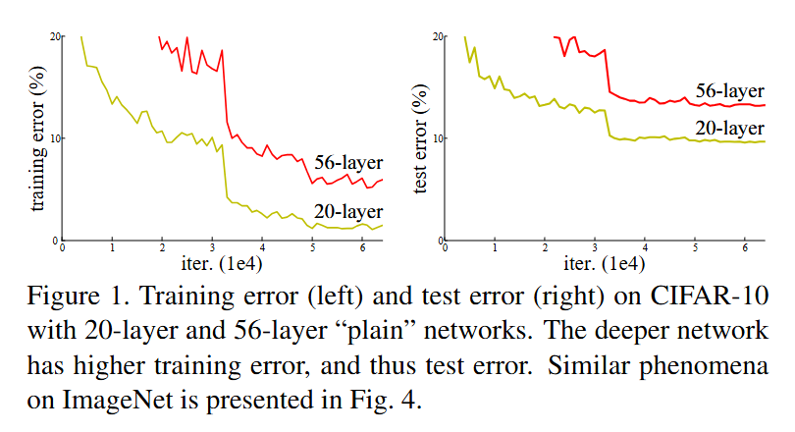
The Deep Learning Paradox (Pre-2015)
Theoretical Expectation: Deeper NN should perform better (universal approximation theorem)
Reality: Very deep networks performed worse than shallow ones
Key Problem: Not overfitting, but optimization difficulty
ReLU activations (2011) helped with vanishing gradients by providing linear segments
Normalized initialization, BatchNorm (2015) helped to reduce vanishing/exploding gradients
Dropout (2014) helped combat overfitting by randomly dropping units during training.
These innovations did allow training deeper networks (~20–30 layers) than before. However, they were not enough for extremely deep networks:
Even with careful initialization and batch normalization, adding many more layers started to degrade accuracy and convergence
The "Degradation Problem"
"Adding more layers to a suitably deep model leads to higher training error"
Deep Residual Learning for Image Recognition
https://doi.org/10.48550/arXiv.1512.03385

Slide 2
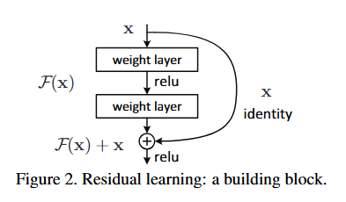


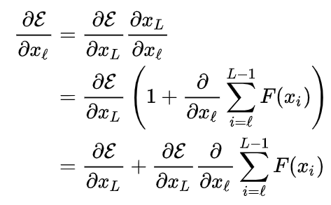
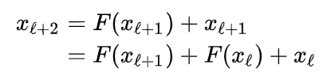
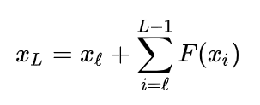
Late 2015: Deep Residual Networks (ResNet).
Parameter-free!
Residual mapping!
Теорема Цыбенко (Cybenko's theorem): Джордж Цыбенко,1989 год.
H(x)
H(x) - x
H(x) = F(x) + x -> F(x) = H(x) - x
Forward propagation
Backward propagation

Slide 3

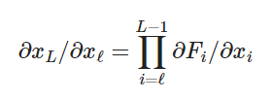

Why Skip Connections Solve Deep Network Problems
Mitigating Vanishing Gradients
ResNet:
PlainNet:
Avoiding the Degradation of Training Accuracy
PlainNet:
“degradation problem” – adding layers made training loss worse in plain nets
guaranteeing that extra layers can be bypassed if they are not needed.
ResNet:
additional layer cannot improve the loss
learn F(x) ≈ 0 and pass x unchanged
mimic a shallower network

Slide 4
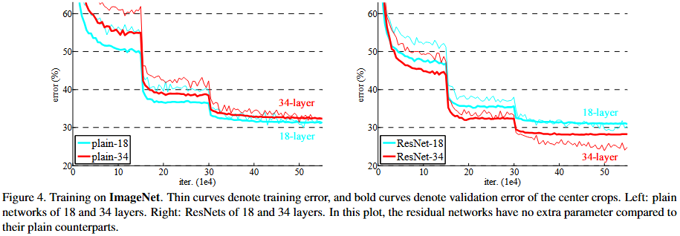
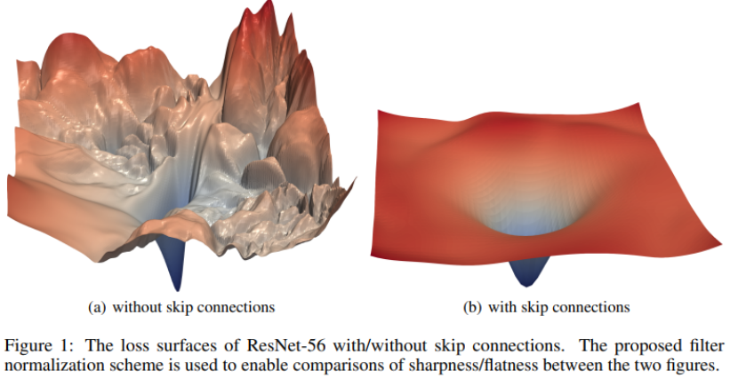
Why Skip Connections Solve Deep Network Problems
Faster Convergence
Deep Residual Learning for Image Recognition
https://doi.org/10.48550/arXiv.1512.03385
Hao Li, … Visualizing the Loss Landscape of Neural Nets, https://arxiv.org/pdf/1712.09913

Slide 5
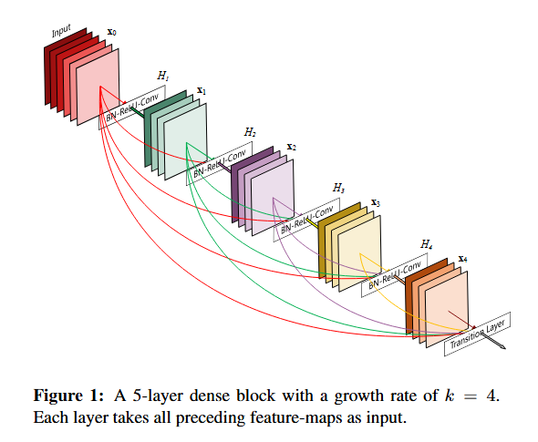
Why Skip Connections Solve Deep Network Problems
Improved Feature Propagation and Reuse
The input signal (and low-level features) get carried directly to deeper layers.
information flow forward
Deeper layers don’t have to relearn trivial identity-related features – they focus on new transformations
DenseNet: Densely Connected Convolutional Networks (2016, Gao Huang, …)

Slide 6
Why Skip Connections Solve Deep Network Problems
Mild Regularization Effect
Implicit Sparsity Promotion
Forces residual function F(x) to be small (close to zero)
Similar to L1/L2 regularization effect
Network prefers "simple" transformations over complex ones
Ensemble Effect
Creates multiple pathways of different depths through the network
Acts like training ensemble of shallow + deep models simultaneously
Reduces variance (classic regularization property)
Improved Optimization Stability
Prevents vanishing/exploding gradients
Enables smoother learning → less overfitting to noise
Reduces need for explicit regularization (e.g., dropout)
Noise Robustness
If a layer makes errors, skip connection preserves original signal
Acts as implicit data augmentation
Network learns to ignore irrelevant transformations
Skip connections do not replace Dropout – networks like ResNets can still overfit on small data, and Dropout or other regularizers are often used in conjunction!

