Slide 1
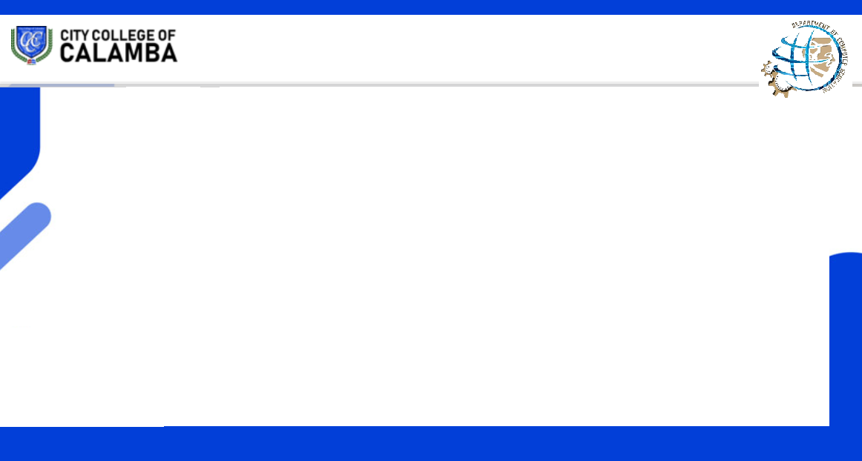
CS 333
Application Development and Emerging Technologies
LESSON 4
REQUIREMENTS GATHERING
Prepared by:
Prof. Rey-an V. Baricanosa, MSIT

Slide 2
Lesson Objectives
Understand the principle of requirements gathering and specifications
How and what requirements to gather.
Define the techniques in requirements gathering
Identify the importance of requirements gathering

Slide 3
What are requirements and its specifications?
A requirement is a statement about an intended product that specifies what it should do or how it should perform.
Goal: To make as specific, unambiguous, and clear as possible.
Functional Specifications: What the system should do
Non-Functional Specifications: what constraints there are on the system its development - (For example that a work processor runs on different platforms)

Slide 4
What requirements should be gathered?
Functional: What the product should do.
Data requirements: Capture the type, volatility, size/amount, persistence, accuracy and the amounts of the required data.
Environmental requirements:
a) context of use
b) Social environment (eg. Collaboration and coordination)
c) how good is user support likely to be d) what technologies will it run on
User Requirements: Capture the characteristics of the intended user group.
Usability Requirement: Usability goals associated measures for a particular product.

Slide 5
Data Gathering Techniques
Questionnaires: Series of questions designed to elicit specific information from us.
The questions may require different kinds of answers: some require a simple Yes/No, others ask us to choose from a set of pre-supplied answers.
Interviews: Interviews involve asking someone a set of questions.
Often interviews are face-to-face

Slide 6
Interviews:
Forum for talking to people
Structured, unstructured or semi-structured
Props, e.g. sample scenarios of use, prototypes, can be used in interviews
Good for exploring issues
But are time consuming and may be infeasible to visit everyone
Focus groups and workshops
Interviews tend to be one on one, and elicit only one person’s perspective. It can be very revealing to get a group of stakeholders together to discuss issues and requirements.

Slide 7
Naturalistic Observation
It can be very difficult for humans to explain what they do or to even describe accurately how they achieve a task.
Spend time with stakeholders in their day-to-day tasks, observing work as it happens
Gain insights into stakeholders’ tasks
Good for understanding the nature and context of the tasks
But it requires time and commitment from a member of the design team, and it can result in a huge amount of data
Ethnography is one form: entire class devoted to this.

Slide 8
Studying documentation:
Procedures and rules are often written down in a manual and these are a good source of data about the steps involved in an activity and any regulations governing a task.

Slide 9
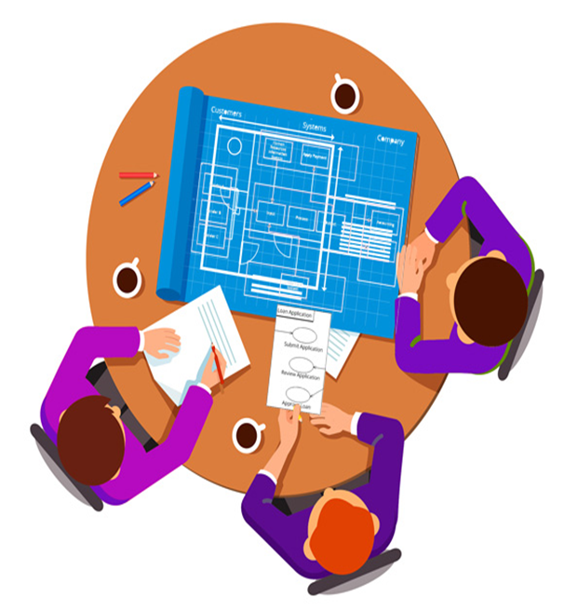
SDLC Model
Requirements Gathering
Requirements Gathering is a fundamental part of any software development project. It is the process of generating a list of requirements (functional, system, technical, etc.) from all the stakeholders (customers, users, vendors, IT staff) that will be used as the basis for the formal definition of what the project is

Slide 10
The importance of Requirements Gathering
The problem with the business customers is that the latter tends to expect software teams to deliver a solution based on unspoken, incomplete or unknown requirements
The problem with software teams is that they tend to assume that business customers will communicate exactly what they want as succinctly as possible.
Therefore, the requirements need to be formally captured in one document that can be used as a reference during software development.

Slide 11
The importance of Requirements Gathering
Good gathering, processing and management of requirements is important as it sets clear targets for everyone to aim for. It can be a lot of hard work, but it need not be a daunting task if you can keep some key points in mind.
Remember it’s all about the user. Consider always the user inputs. Find out how actual users complete their tasks and exactly how they get things done – and how they want to get things done. What do they need to do? How efficiently can we make that happen? And what sorts of flexibility might be required?

Slide 12

The User comes first
The requirements should detail how a user would accomplish what they want using the software being developed. Awareness of any technological preferences and existing system integration is also fundamental, as it can have a huge impact on the development path and subsequently impact on performance and user task efficiency.

