Slide 1


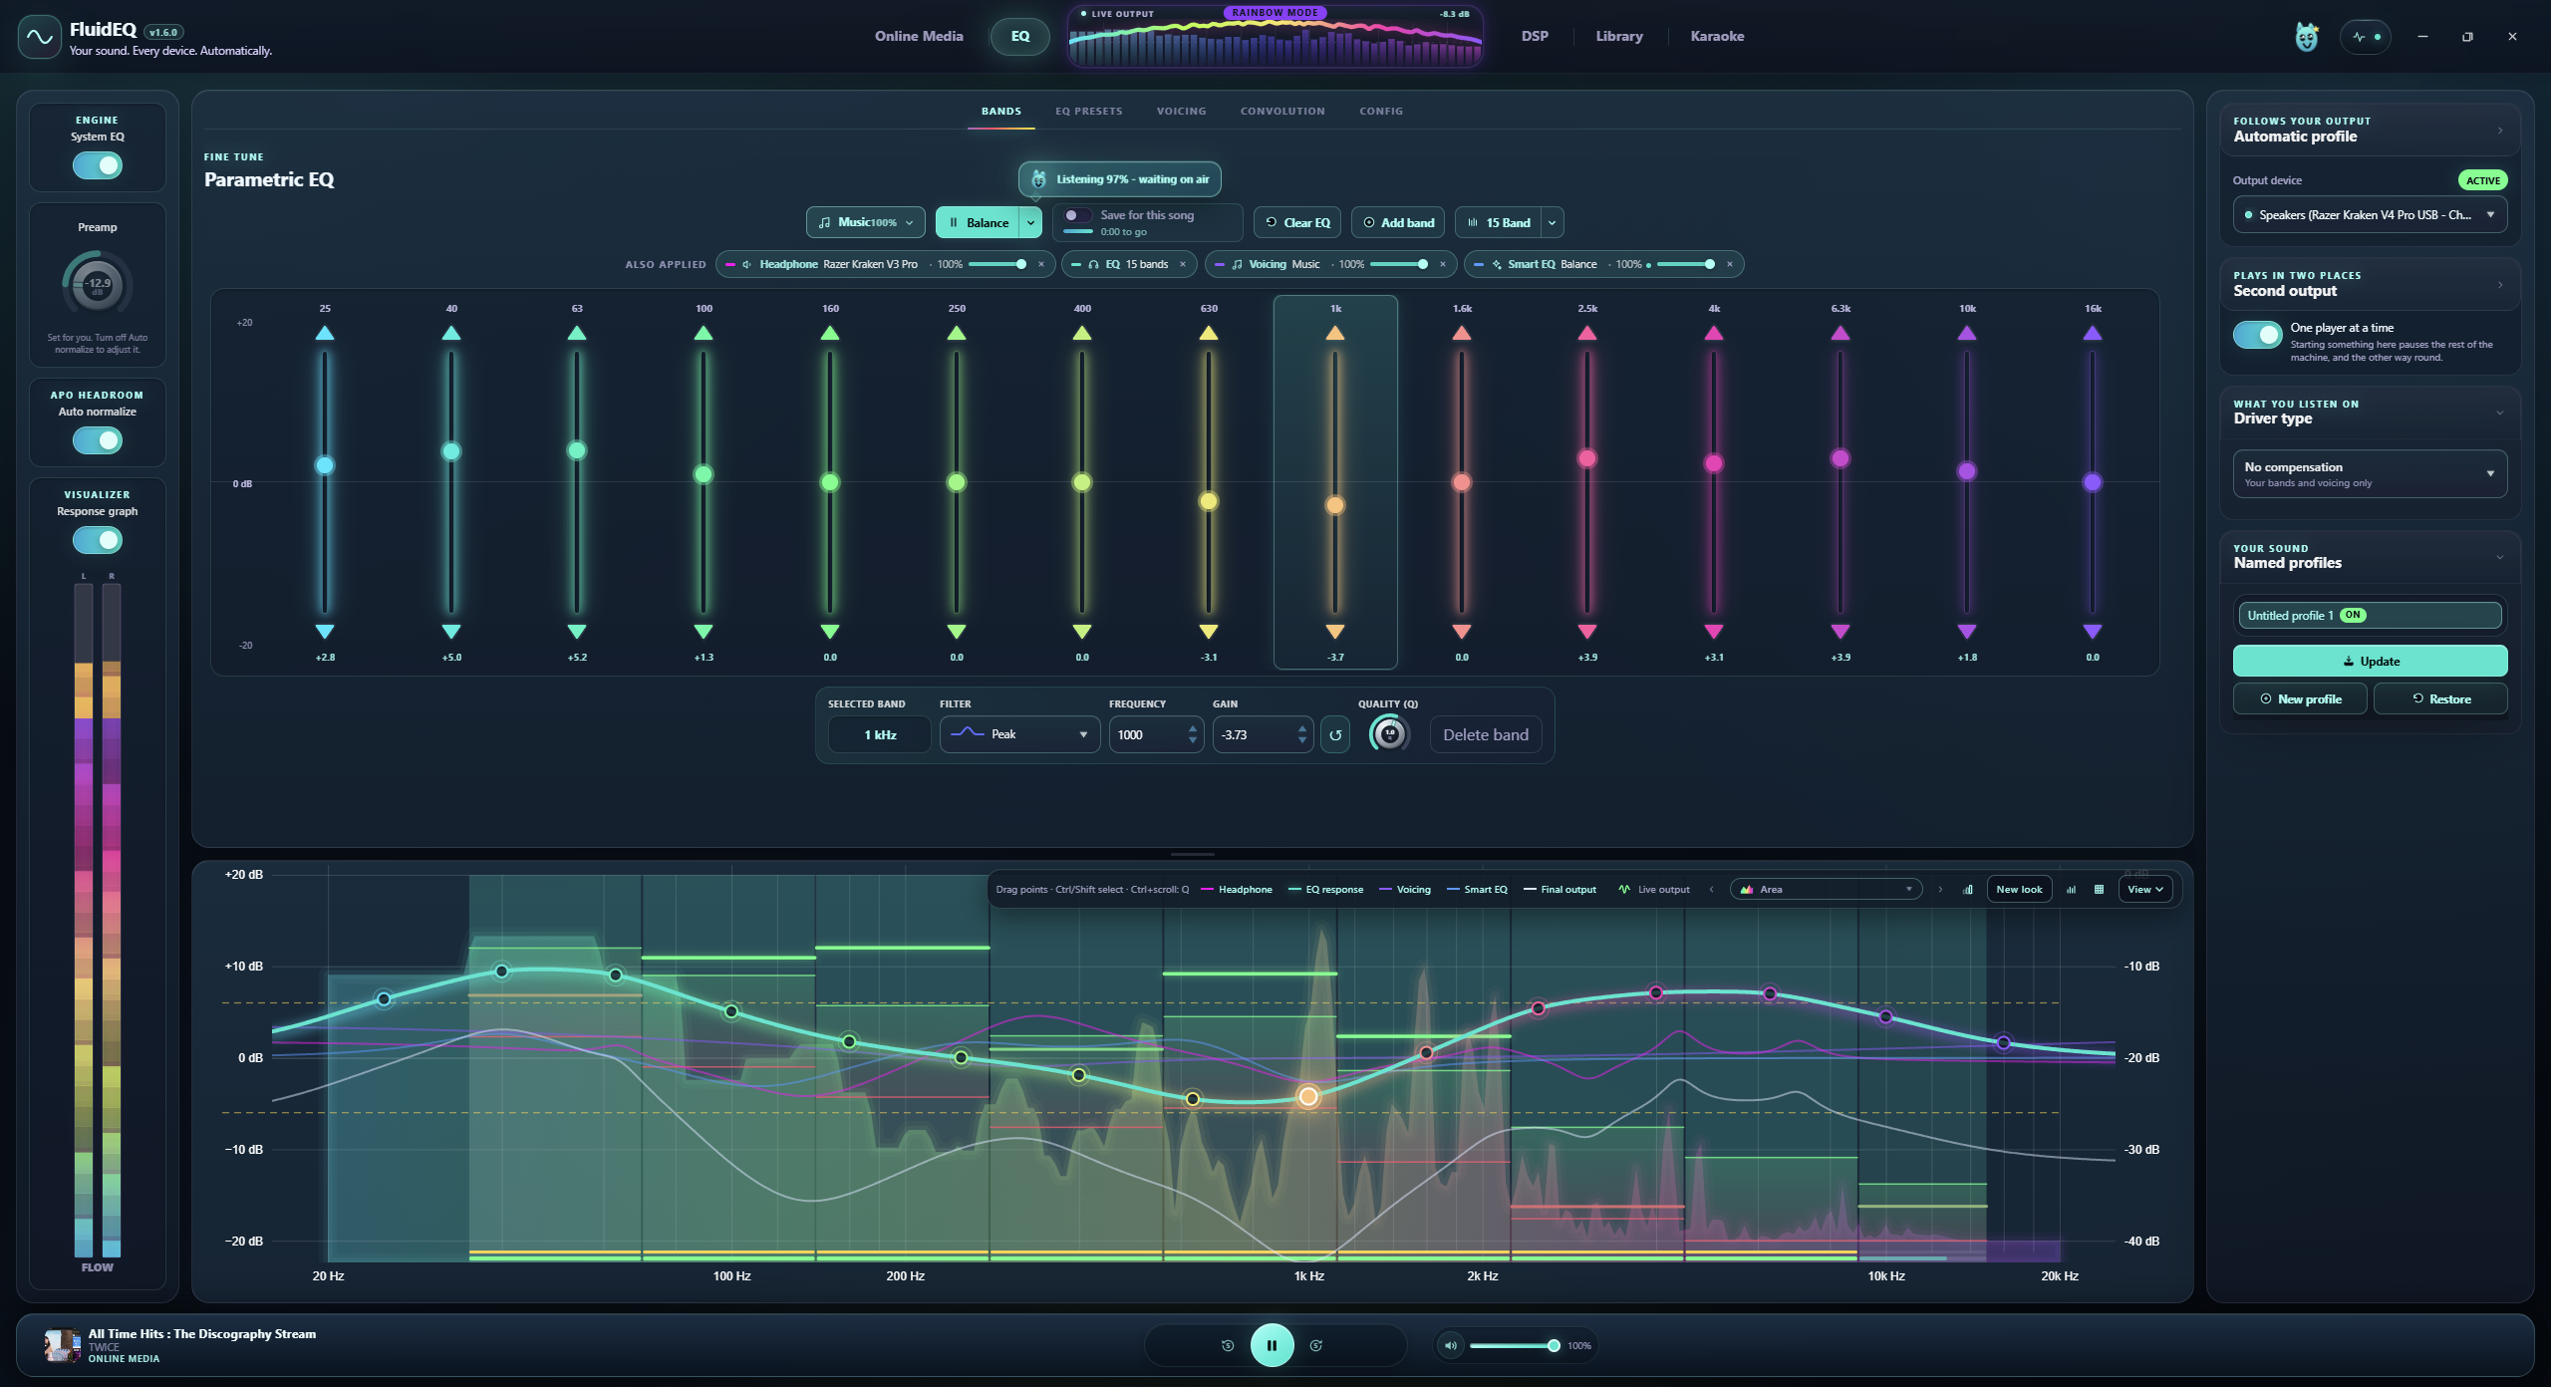
FluidEQ
Your sound, across
devices and computers
Second Output. Share Audio. System-wide EQ.
Free and open source
fluideq.com
01 / 11
Notes:
FluidEQ is an Equalizer APO interface with music playback and karaoke. Public Windows 10 and 11 download. No performance claims.
Feature evidence: repository README.md, What it does; Getting started; Supporting the work. Public cross-check: https://fluideq.com/ (5 September 2026). Screenshots are existing repository product captures. Displayed media belongs to its respective owners; no affiliation or included music is implied. Decorative cover/end background generated using OpenAI image generation; original FluidEQ logo preserved.

Slide 2
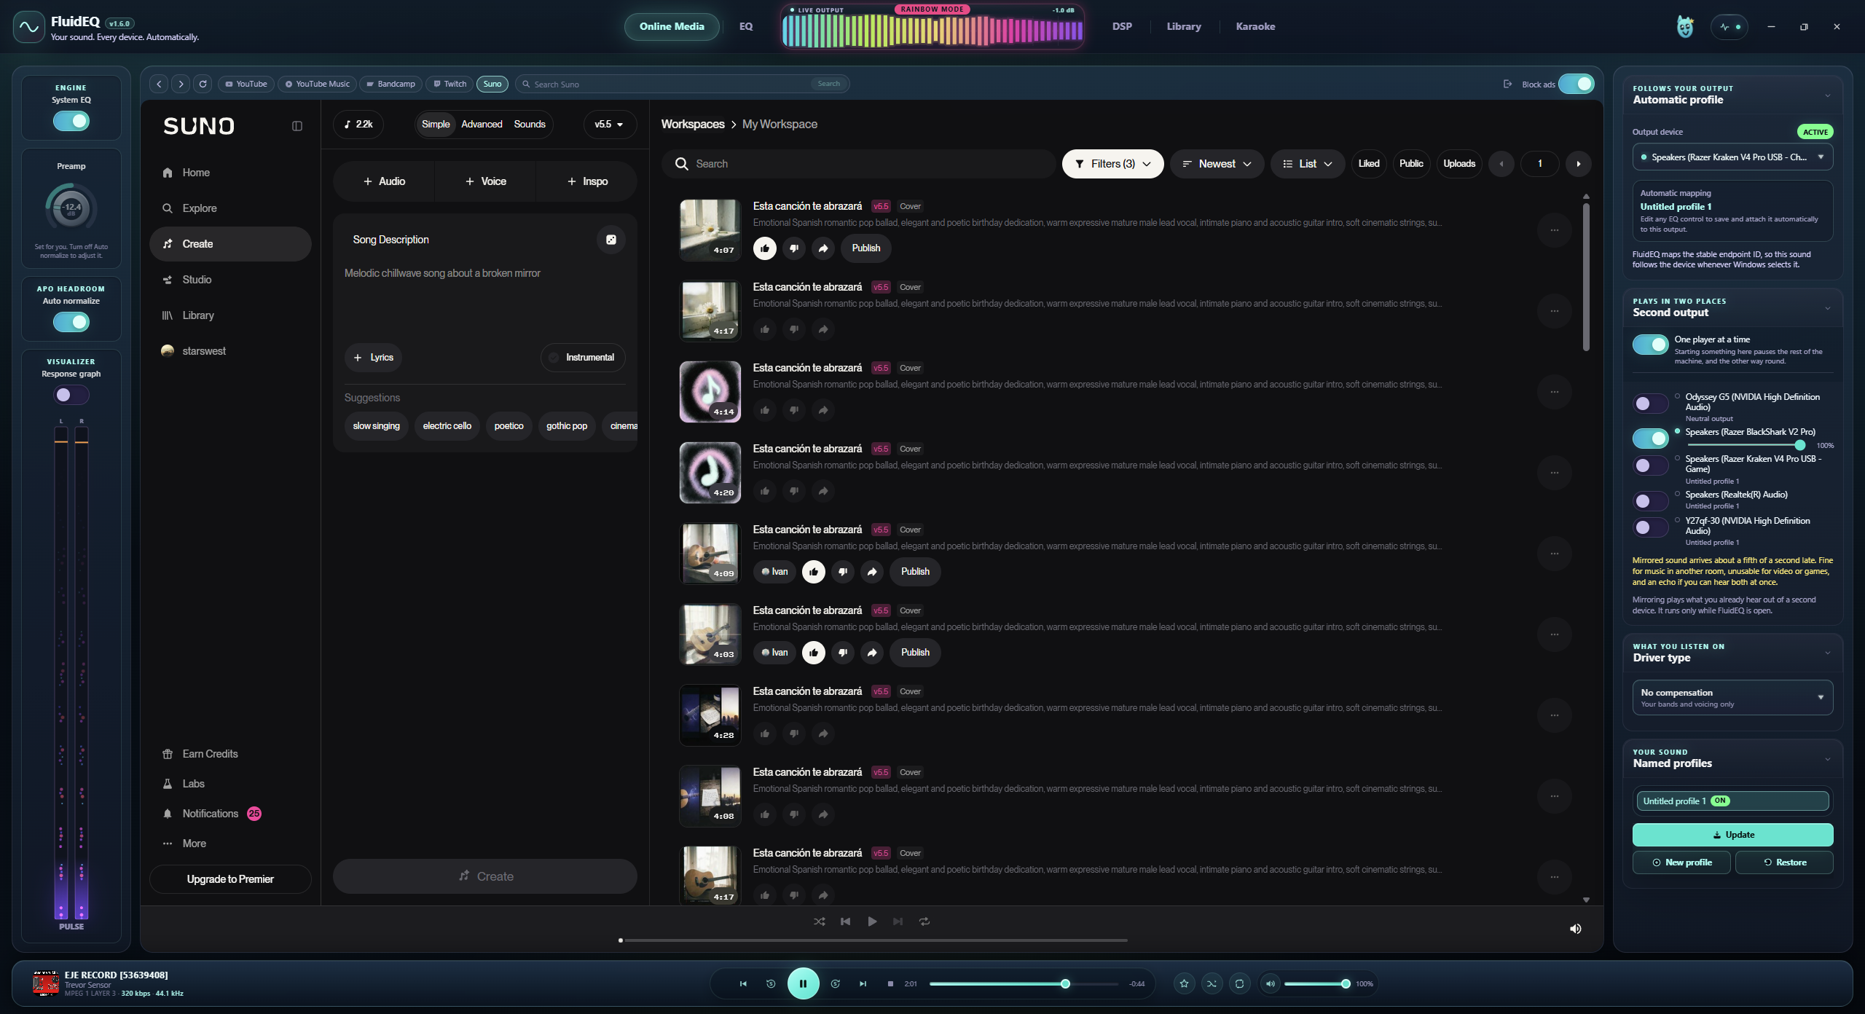
FluidEQ
Second Output
Sound in more places
Play through headphones and speakers at once.
Give each device its own level and EQ profile.
Separate devices. Separate tuning.
Mirroring runs while FluidEQ is open.
Playback delay depends on your devices.
fluideq.com
02 / 11
Notes:
Second Output mirrors playback to multiple devices with individual levels and saved EQ profiles. Each Windows output applies its own APO profile. FluidEQ must remain open. Device latency varies.
Feature evidence: repository README.md, Plays in two places at once. Public cross-check: https://fluideq.com/ (5 September 2026). Screenshots are existing repository product captures. Displayed media belongs to its respective owners; no affiliation or included music is implied. Decorative cover/end background generated using OpenAI image generation; original FluidEQ logo preserved.

Slide 3
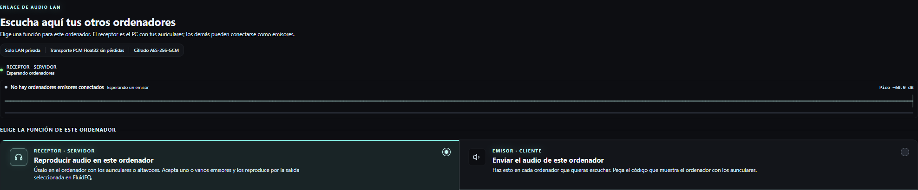
FluidEQ
Share Audio
Your PCs, heard together
Hear your other PCs through the computer
connected to your headphones or speakers.
Several senders, one receiver
Same private network.
Pair with a connection code.
Keep FluidEQ open on both ends.
Shared audio bypasses the local Library DSP rack.
fluideq.com
03 / 11
Notes:
Share Audio sends system audio between computers on the same private network. Multiple senders can mix at one receiver. Pairing uses a private connection code. Keep FluidEQ open on both ends. Received shared audio bypasses Library DSP.
Feature evidence: repository README.md, docs/USER-GUIDE.md: Share audio between computers; src/renderer/remoteAudio. Public cross-check: https://fluideq.com/ (5 September 2026). Screenshots are existing repository product captures. Displayed media belongs to its respective owners; no affiliation or included music is implied. Decorative cover/end background generated using OpenAI image generation; original FluidEQ logo preserved.

Slide 4
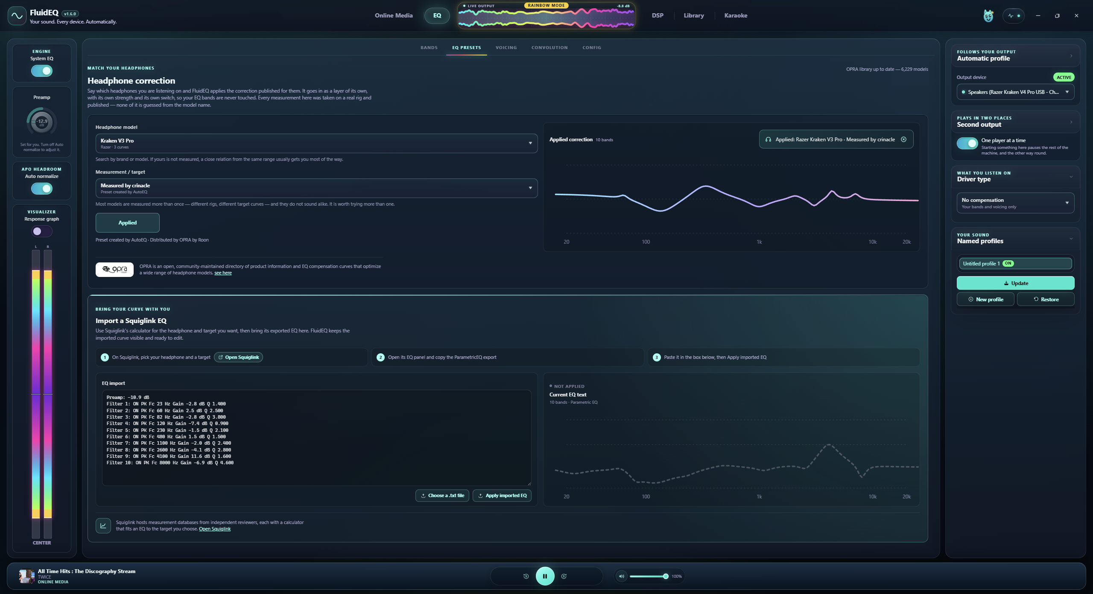
FluidEQ
Tuning that fits
your headphones
Start with a measured correction.
Then make the sound your own.
6,229
headphone models
in the offline OPRA library
fluideq.com
04 / 11
Notes:
The documented offline OPRA catalog contains 6,229 headphone models. Published correction remains independent of manual EQ. Count reflects supplied screenshots and documentation.
Feature evidence: repository README.md, Start from a measurement. Public cross-check: https://fluideq.com/ (5 September 2026). Screenshots are existing repository product captures. Displayed media belongs to its respective owners; no affiliation or included music is implied. Decorative cover/end background generated using OpenAI image generation; original FluidEQ logo preserved.

Slide 5
FluidEQ
Each device keeps
its own sound
Switch from headphones to speakers.
Your saved tuning follows the output.
Up to 128 EQ bands per output
System EQ on Windows, powered by Equalizer APO.
fluideq.com
05 / 11
Notes:
Per-device settings restore when switching outputs. System parametric EQ supports up to 128 bands and uses Equalizer APO. Second-output mirroring is visible in the existing screenshot.
Feature evidence: repository README.md, Follows your output; Six layers, one chain; Plays in two places at once. Public cross-check: https://fluideq.com/ (5 September 2026). Screenshots are existing repository product captures. Displayed media belongs to its respective owners; no affiliation or included music is implied. Decorative cover/end background generated using OpenAI image generation; original FluidEQ logo preserved.

Slide 6
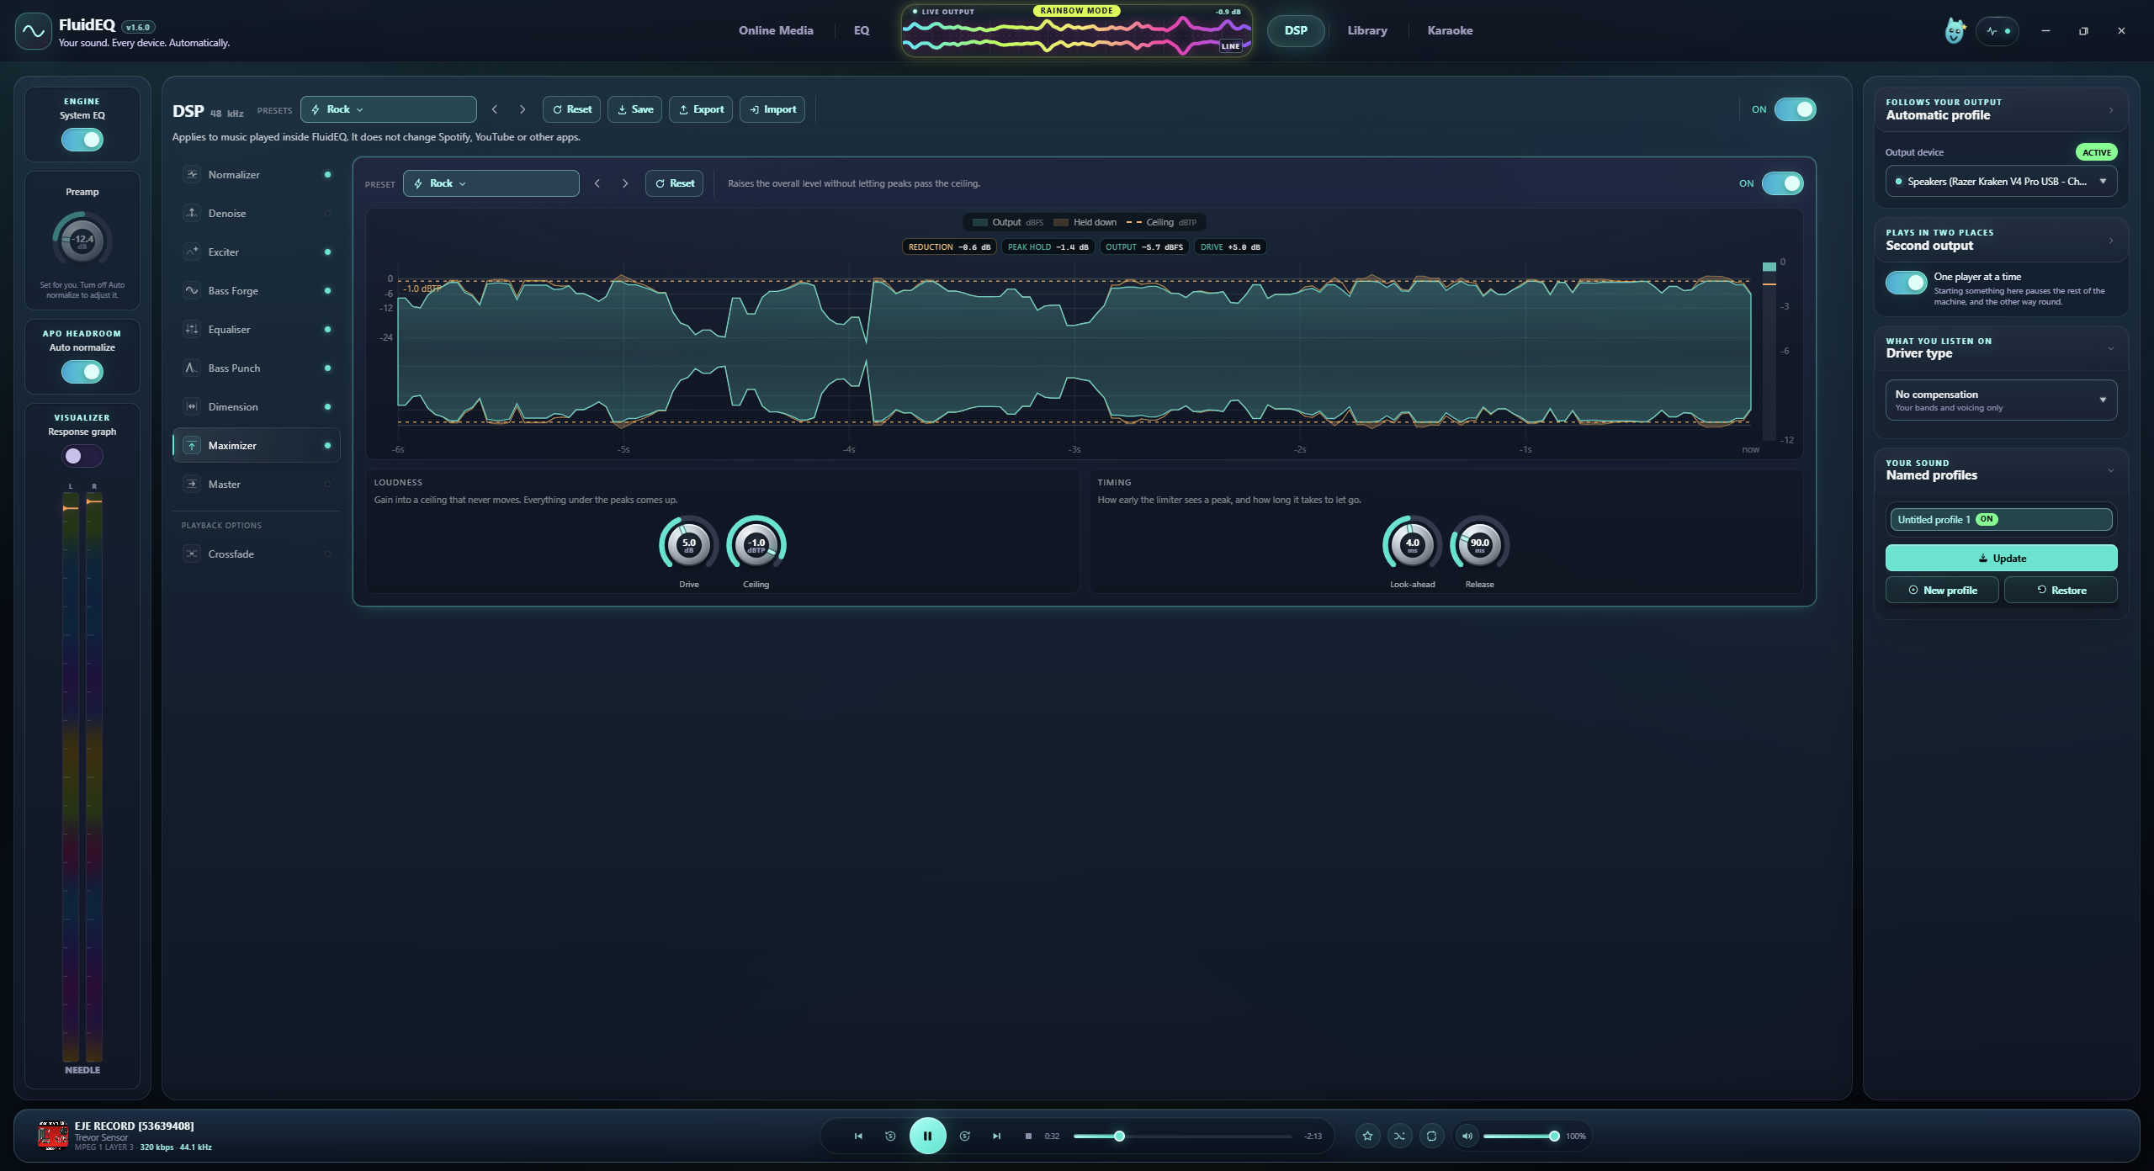
FluidEQ
More control over
your local music
Clean up noise, shape bass and control loudness.
Save the processing chain you like.
9 processing stages
DSP applies to FluidEQ's local player, not other apps.
fluideq.com
06 / 11
Notes:
Nine-stage native DSP rack applies to music played by FluidEQ's own local player. It does not process Spotify, YouTube or other apps. Individual stages and whole racks support saved settings.
Feature evidence: repository README.md, Shape what FluidEQ itself plays. Public cross-check: https://fluideq.com/ (5 September 2026). Screenshots are existing repository product captures. Displayed media belongs to its respective owners; no affiliation or included music is implied. Decorative cover/end background generated using OpenAI image generation; original FluidEQ logo preserved.

Slide 7
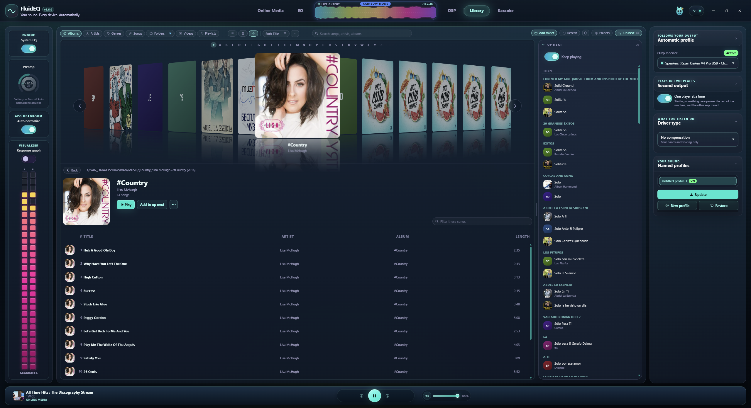
FluidEQ
Your collection,
back in the spotlight
Browse your albums in Cover Flow.
Build a queue from the music you already own.
A home for your local music
FLAC, MP3, WAV, M4A and more.
fluideq.com
07 / 11
Notes:
Library reads user-selected folders, provides album/artist/genre/song/folder/video browsing and Cover Flow, and builds the playback queue from the current view. Music is not included.
Feature evidence: repository README.md, Play what is already on the machine. Public cross-check: https://fluideq.com/ (5 September 2026). Screenshots are existing repository product captures. Displayed media belongs to its respective owners; no affiliation or included music is implied. Decorative cover/end background generated using OpenAI image generation; original FluidEQ logo preserved.

Slide 8
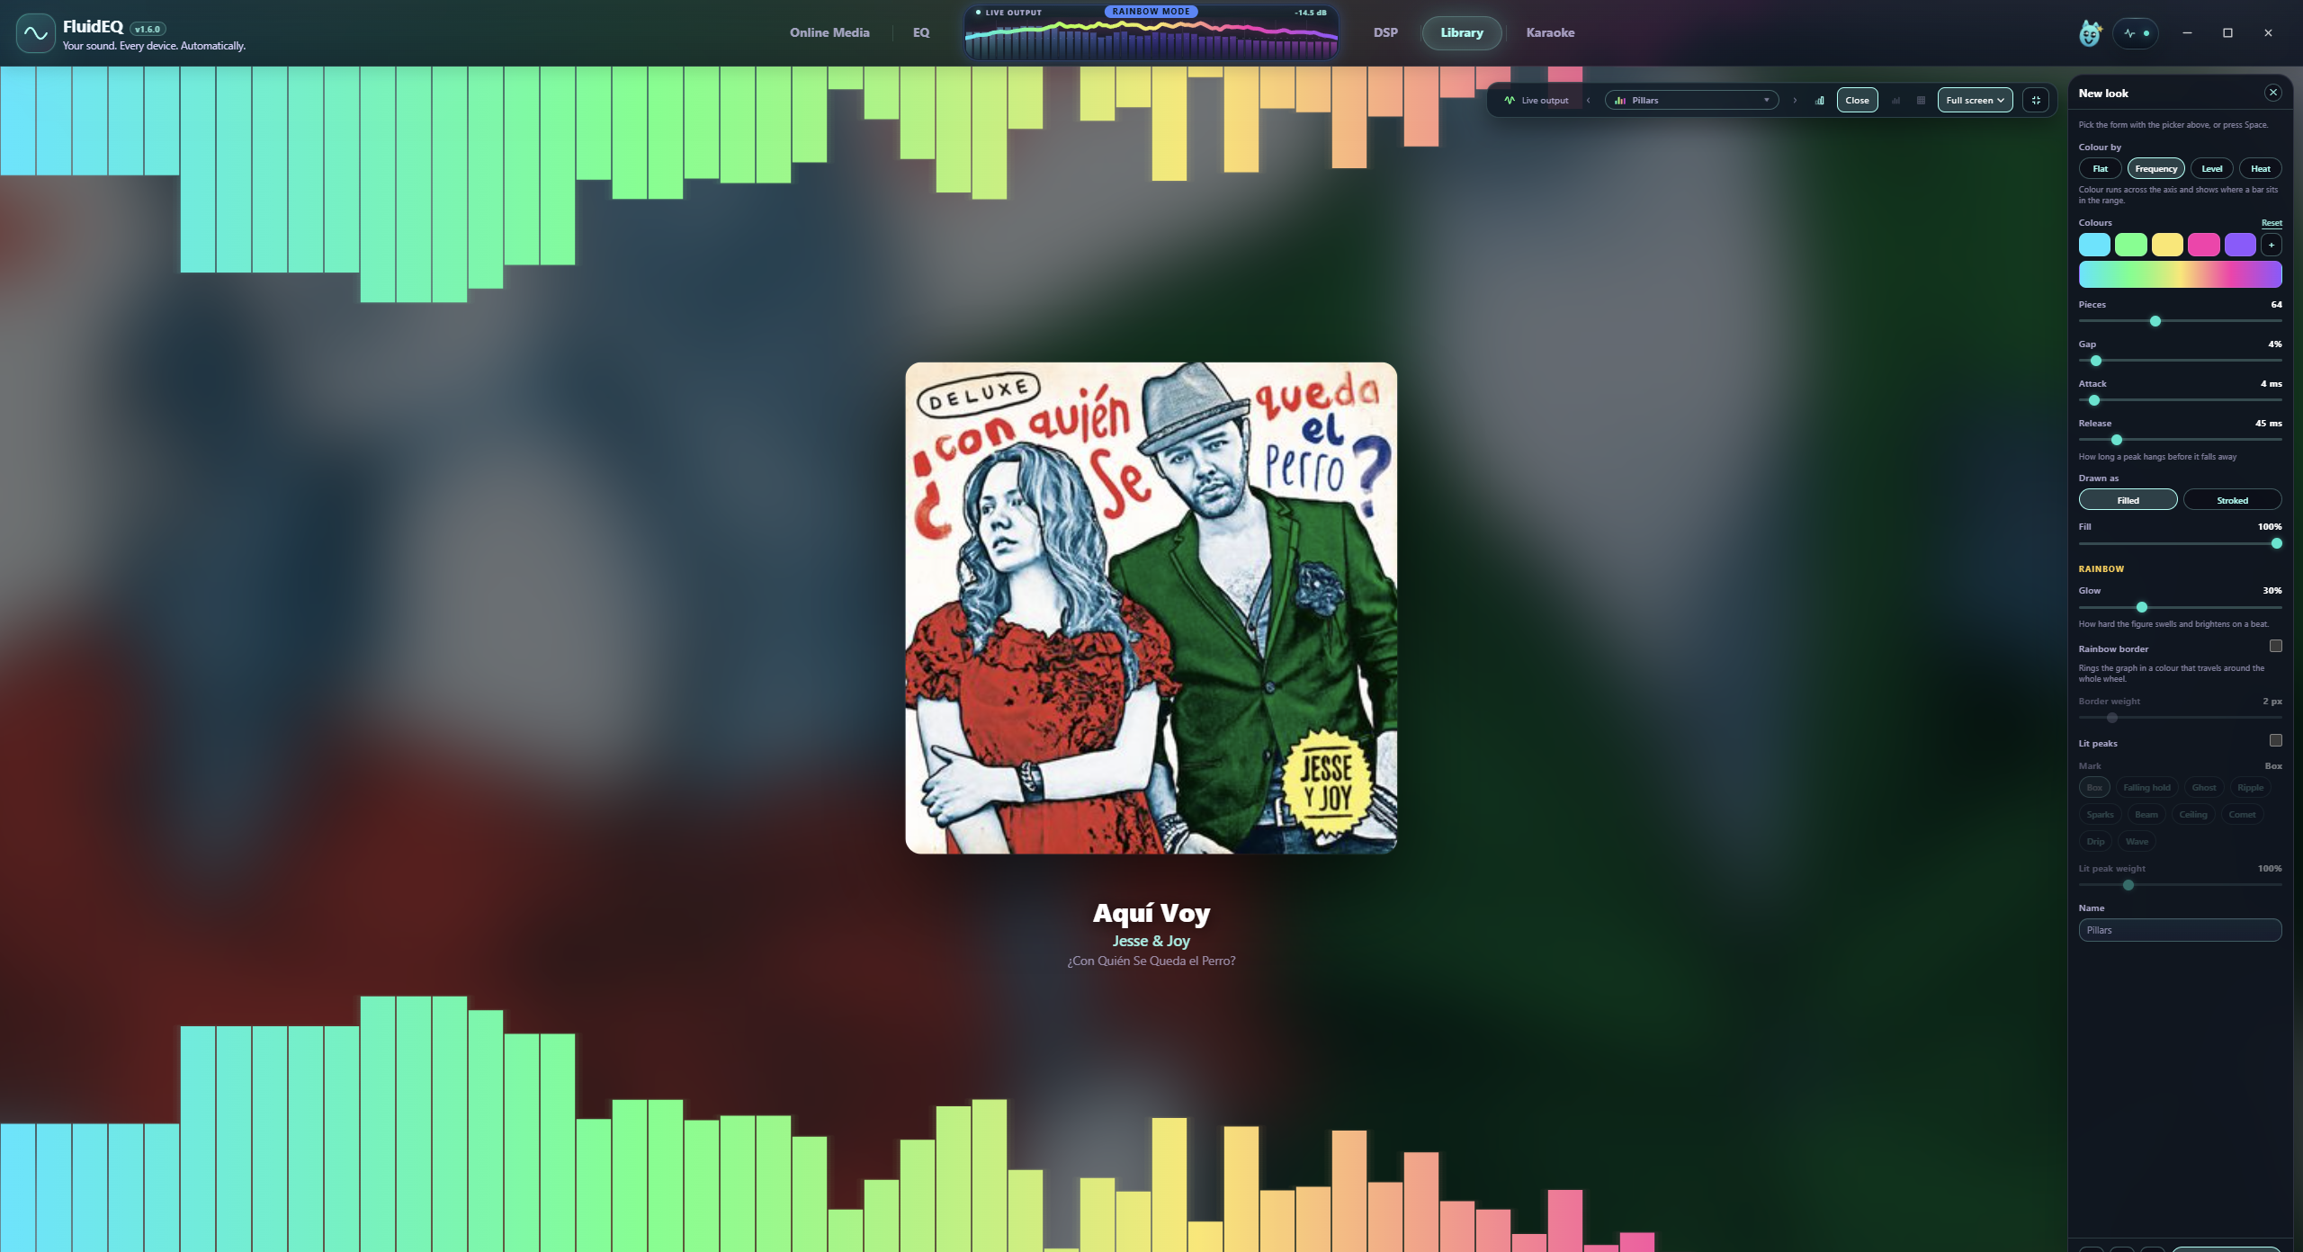
FluidEQ
A visualizer
with your signature
Choose a form. Adjust its color and glow.
Watch your music fill the screen.
Made to be personalized
Live controls for palette, density and motion.
fluideq.com
08 / 11
Notes:
Visualizer offers selectable forms, palettes and a designer for appearance parameters. No particular performance or refresh-rate claim. Album art is shown only within the existing app screenshot.
Feature evidence: repository README.md, Watch the sound, however you like to. Public cross-check: https://fluideq.com/ (5 September 2026). Screenshots are existing repository product captures. Displayed media belongs to its respective owners; no affiliation or included music is implied. Decorative cover/end background generated using OpenAI image generation; original FluidEQ logo preserved.

Slide 9
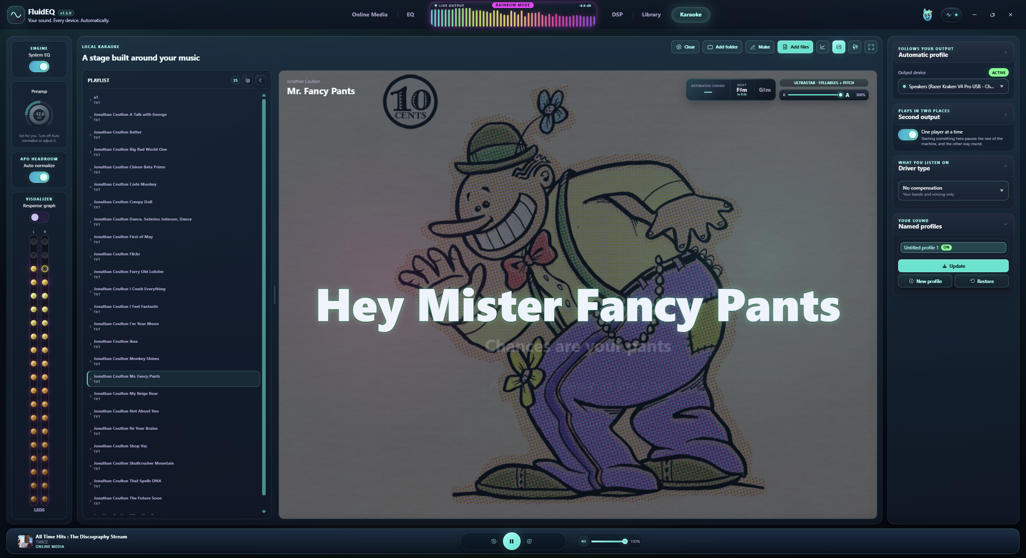
FluidEQ
Your next karaoke
night starts here
Bring your songs and timed lyrics.
Sing along on a full-screen stage.
Live pitch feedback
Connect a microphone. Target notes need
a compatible lyric file. Music is not included.
fluideq.com
09 / 11
Notes:
Karaoke supports synchronized lyrics and user-enabled microphone pitch feedback. Real target notes require a compatible UltraStar file. LRC lyrics alone do not supply target melody. No music ships with the app.
Feature evidence: repository README.md, Sing over what you already own. Public cross-check: https://fluideq.com/ (5 September 2026). Screenshots are existing repository product captures. Displayed media belongs to its respective owners; no affiliation or included music is implied. Decorative cover/end background generated using OpenAI image generation; original FluidEQ logo preserved.

Slide 10
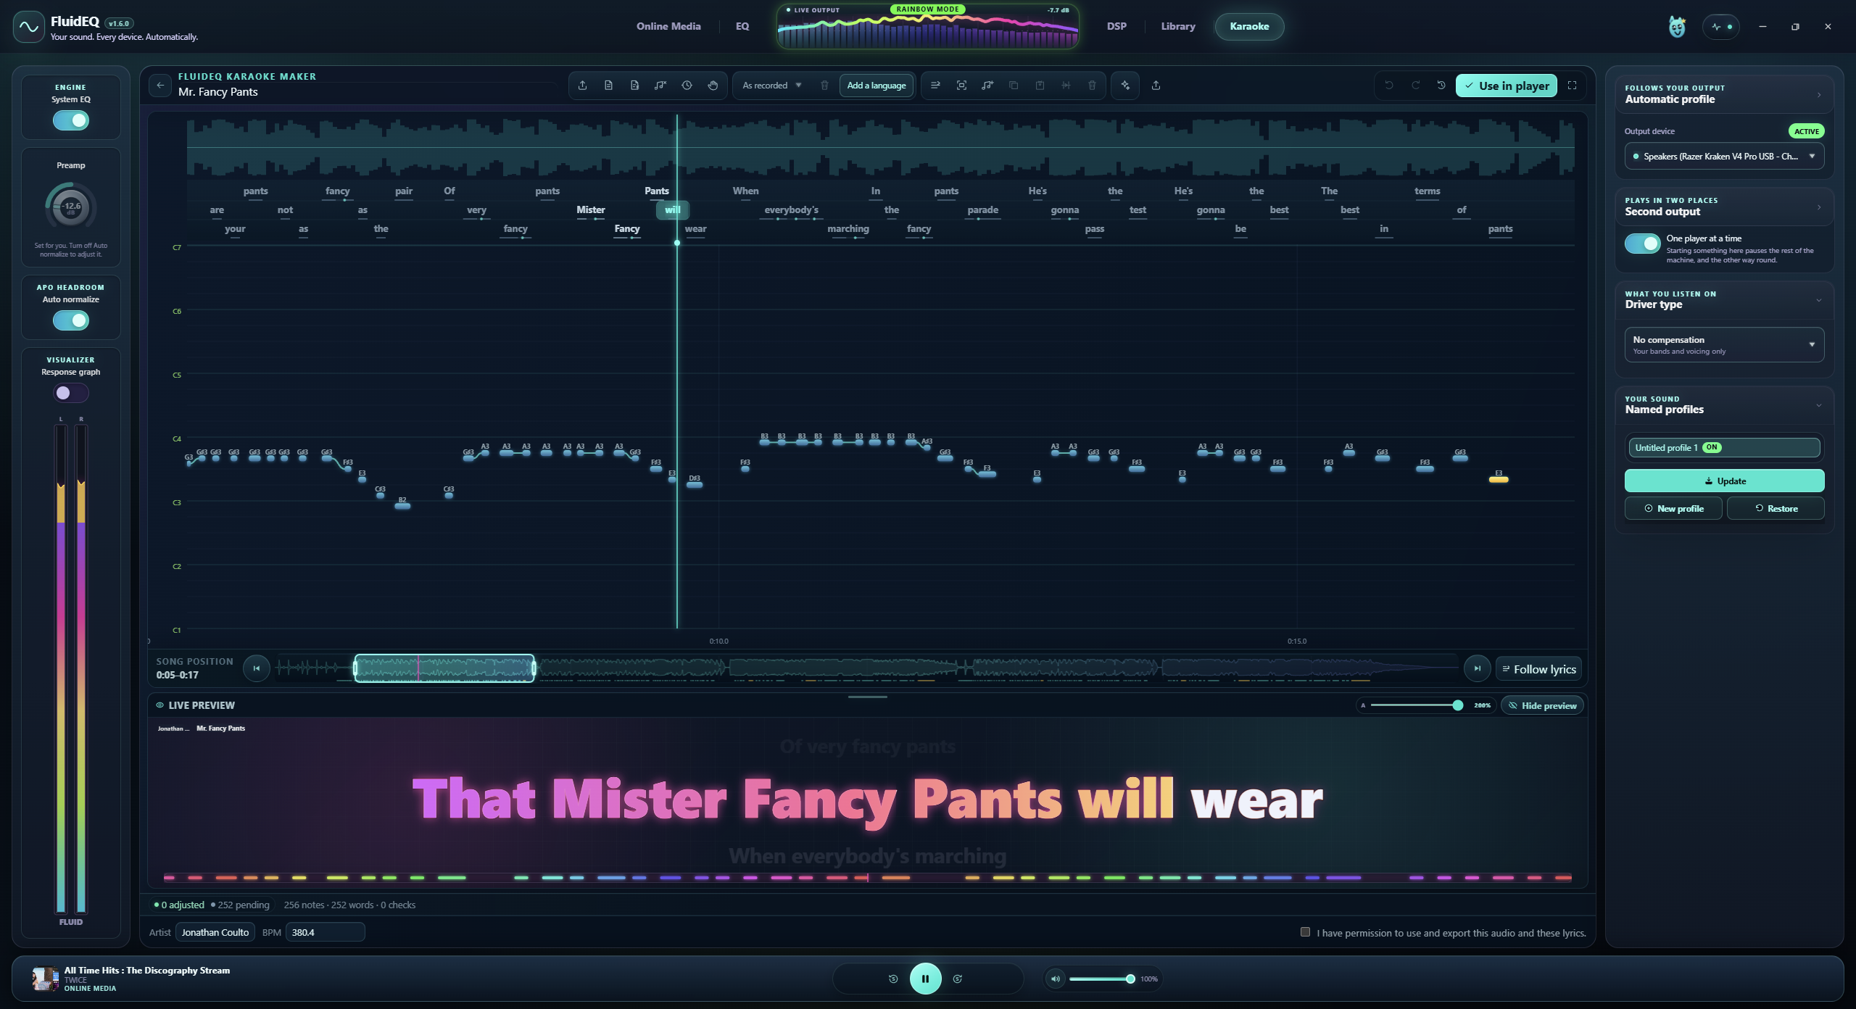
FluidEQ
A karaoke version
you can make yourself
Separate voice and backing. Edit lyric timing
and melody notes in Karaoke Maker.
Your audio stays on your PC
Optional AI tools download models once.
Use music and lyrics you have permission to use.
fluideq.com
10 / 11
Notes:
Separation, transcription and melody analysis run locally. Optional models require initial downloads. Separation is an estimate from a mixed recording and is not guaranteed to reproduce studio stems. Users supply authorized audio and lyrics.
Feature evidence: repository README.md, And make the file when the song does not have one; Local and account-free. Public cross-check: https://fluideq.com/ (5 September 2026). Screenshots are existing repository product captures. Displayed media belongs to its respective owners; no affiliation or included music is implied. Decorative cover/end background generated using OpenAI image generation; original FluidEQ logo preserved.

Slide 11
FluidEQ
Your next listen
could feel different
Free for Windows 10 & 11.
Open source. No FluidEQ account required.
fluideq.com
Built by Ivan Carmenates Garcia
What would you try first?
fluideq.com
11 / 11
Notes:
Free unsigned Windows 10/11 download, open source under GPL-3.0-or-later, no FluidEQ account. External media sites can have their own sign-in requirements. Creator attribution from repository README. Download destination verified on 5 September 2026.
Feature evidence: repository README.md, Getting started; Supporting the work. Public cross-check: https://fluideq.com/ (5 September 2026). Screenshots are existing repository product captures. Displayed media belongs to its respective owners; no affiliation or included music is implied. Decorative cover/end background generated using OpenAI image generation; original FluidEQ logo preserved.

