Slide 1
Planetary Gearbox Assembly Guide

Slide 2
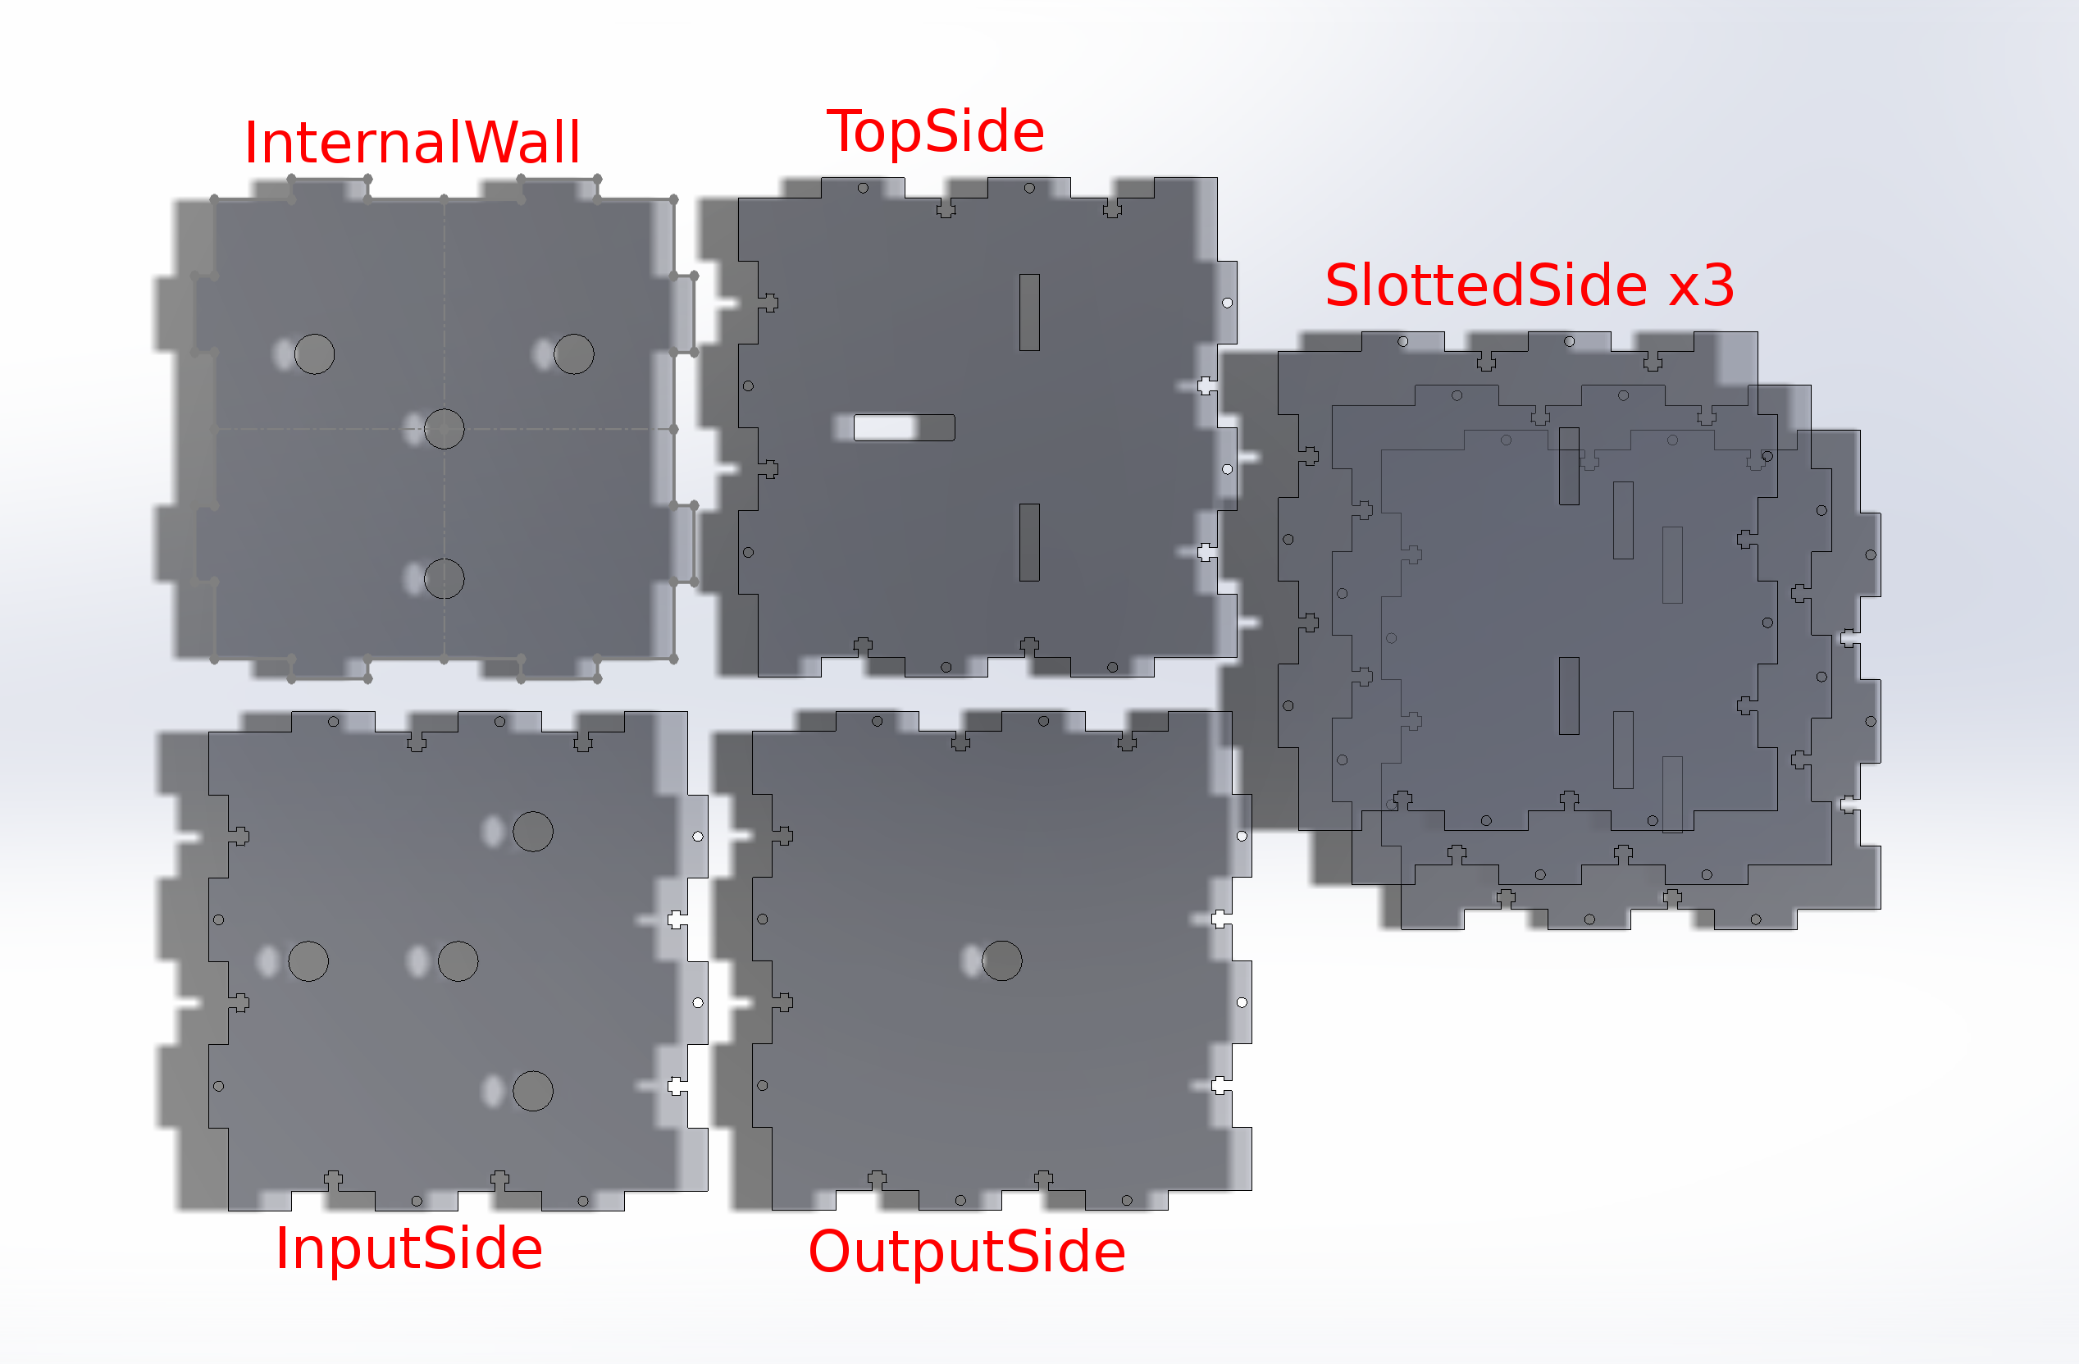
Lay Out Components

Slide 3
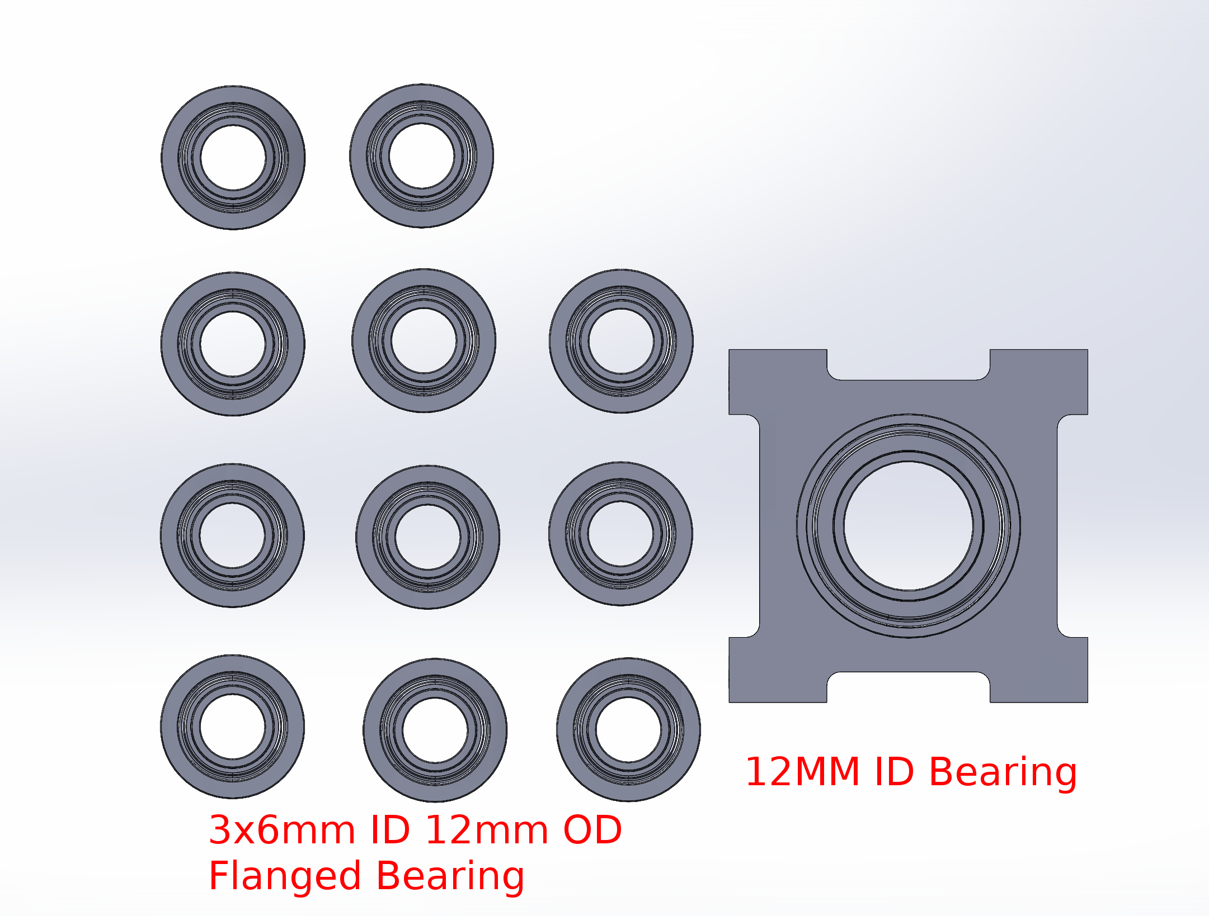
Lay Out Components
12mm ID Bearing:
https://www.servocity.com/12mm-bore-side-tapped-pillow-block/

Slide 4
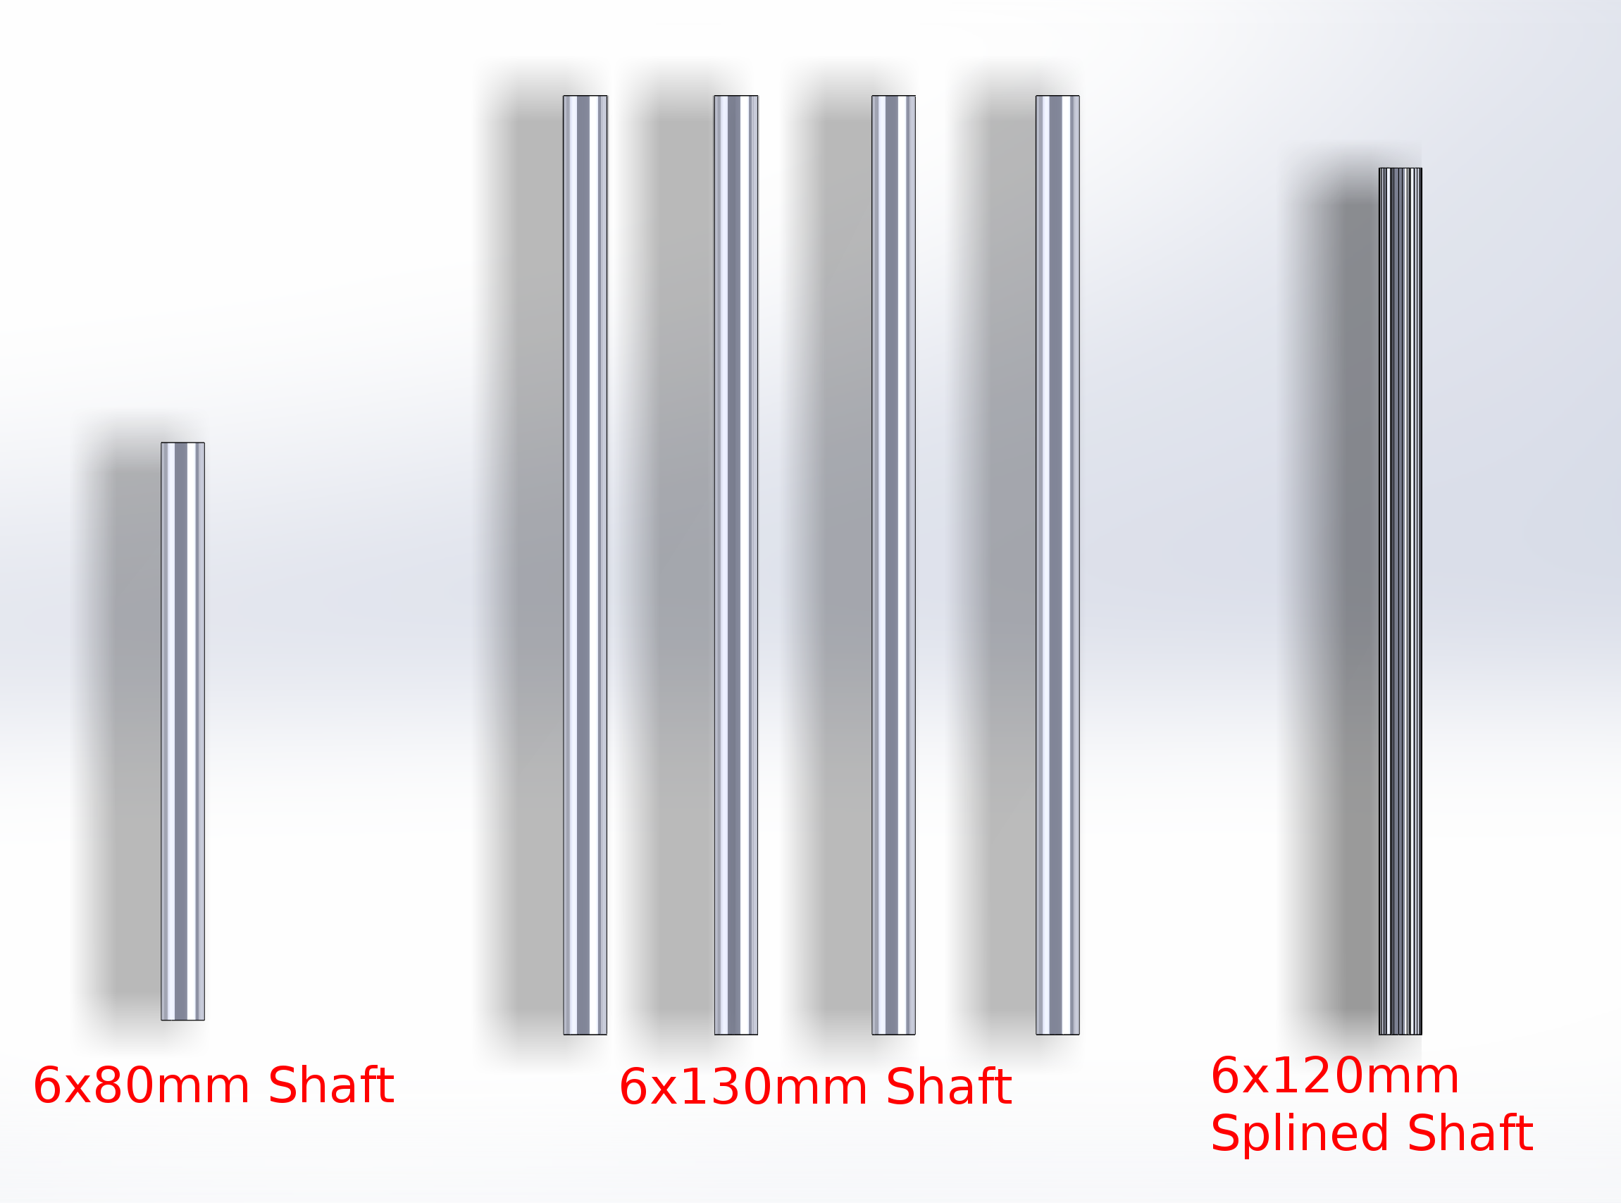
Lay Out Components
Total shaft needed: 720mm

Slide 5
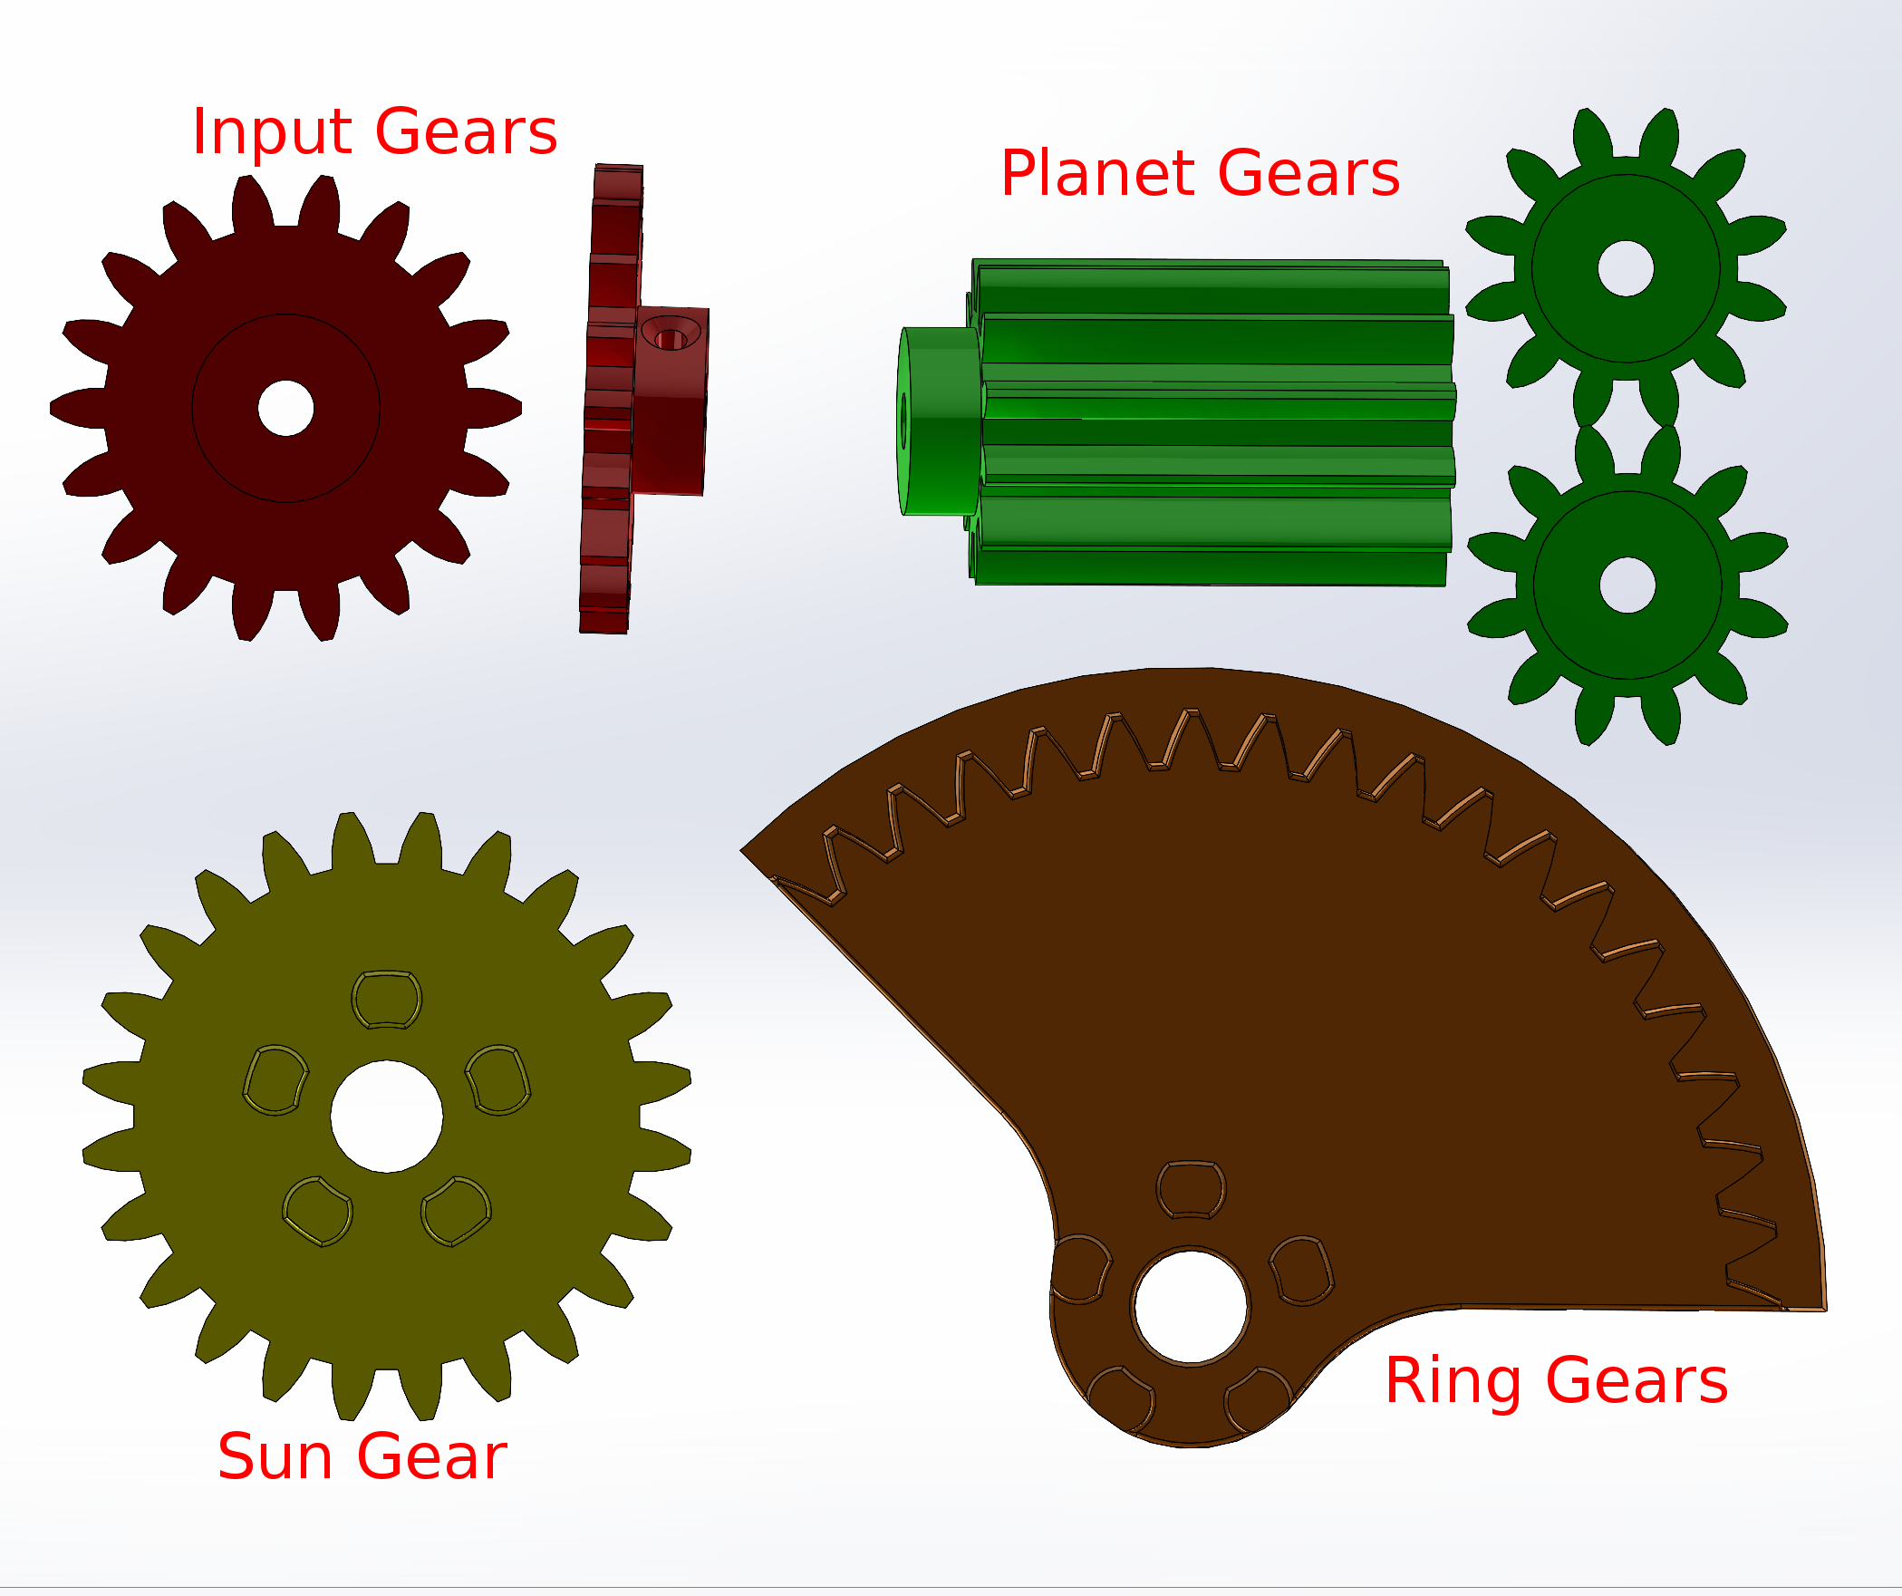
Lay Out Components

Slide 6
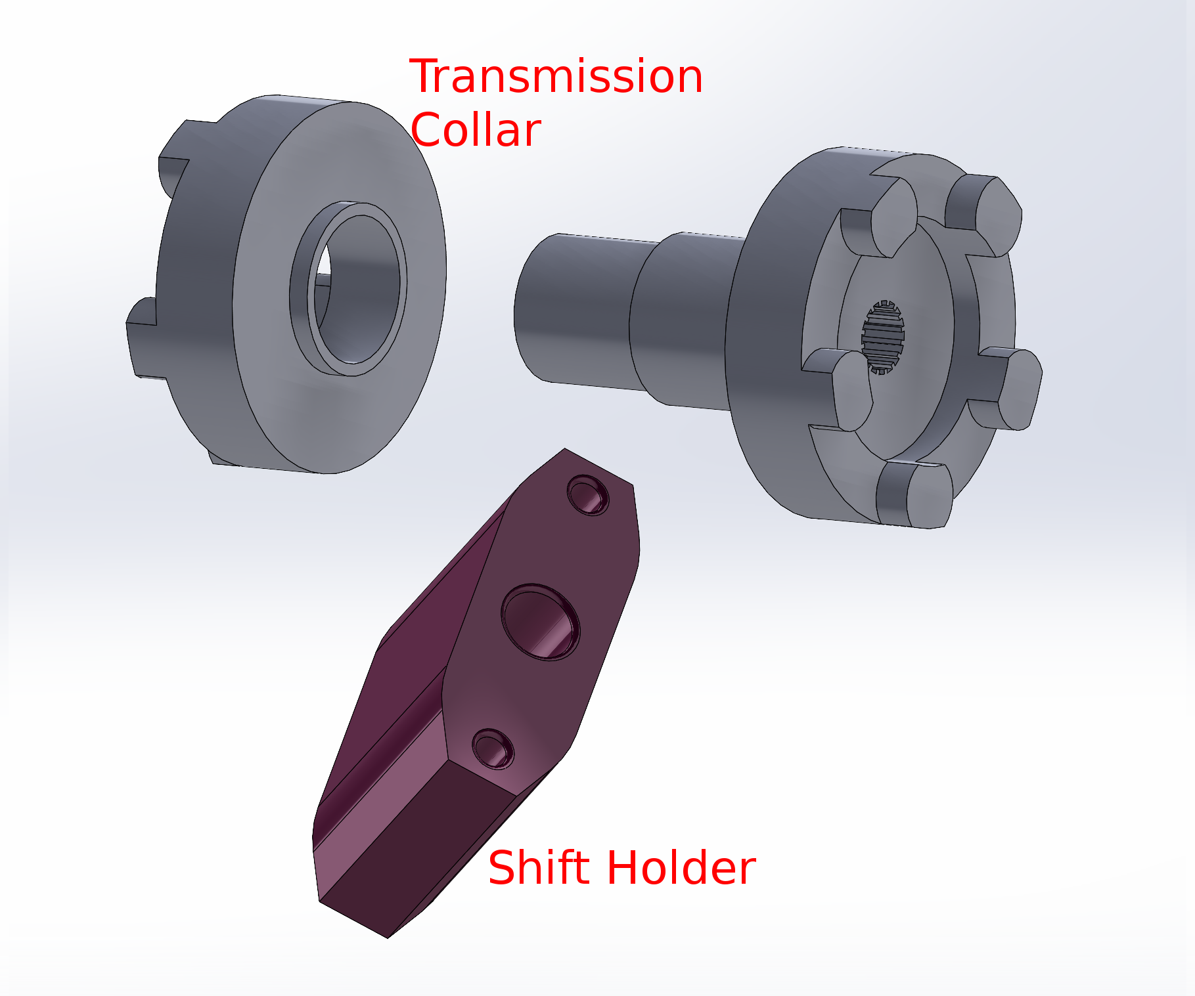
Lay Out Components

Slide 7
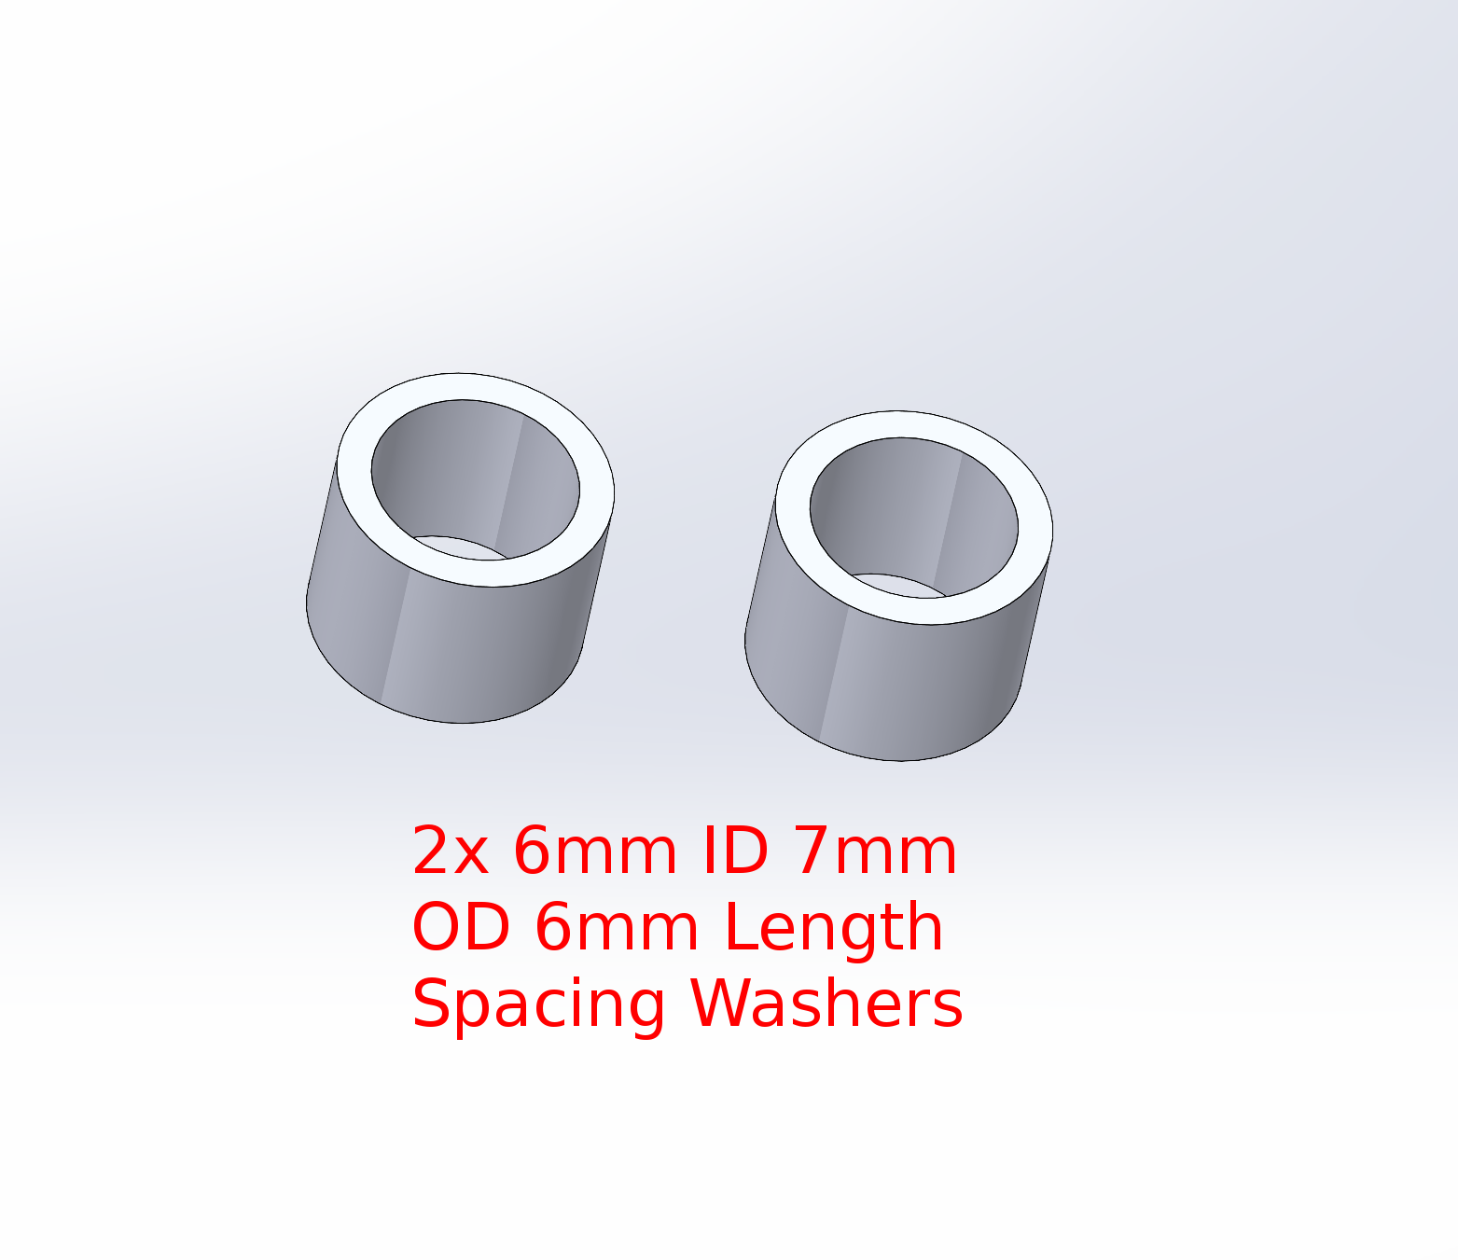
Lay Out Components

Slide 8
Lay Out Components
48x M3x12 screws
5x M3x16 screws
2x UNC 6-32 30mm screws (https://www.amazon.com/Phobya-UNC-6-32-30mm-Screws/dp/B004CLJLKI)
48 M3 nuts

Slide 9
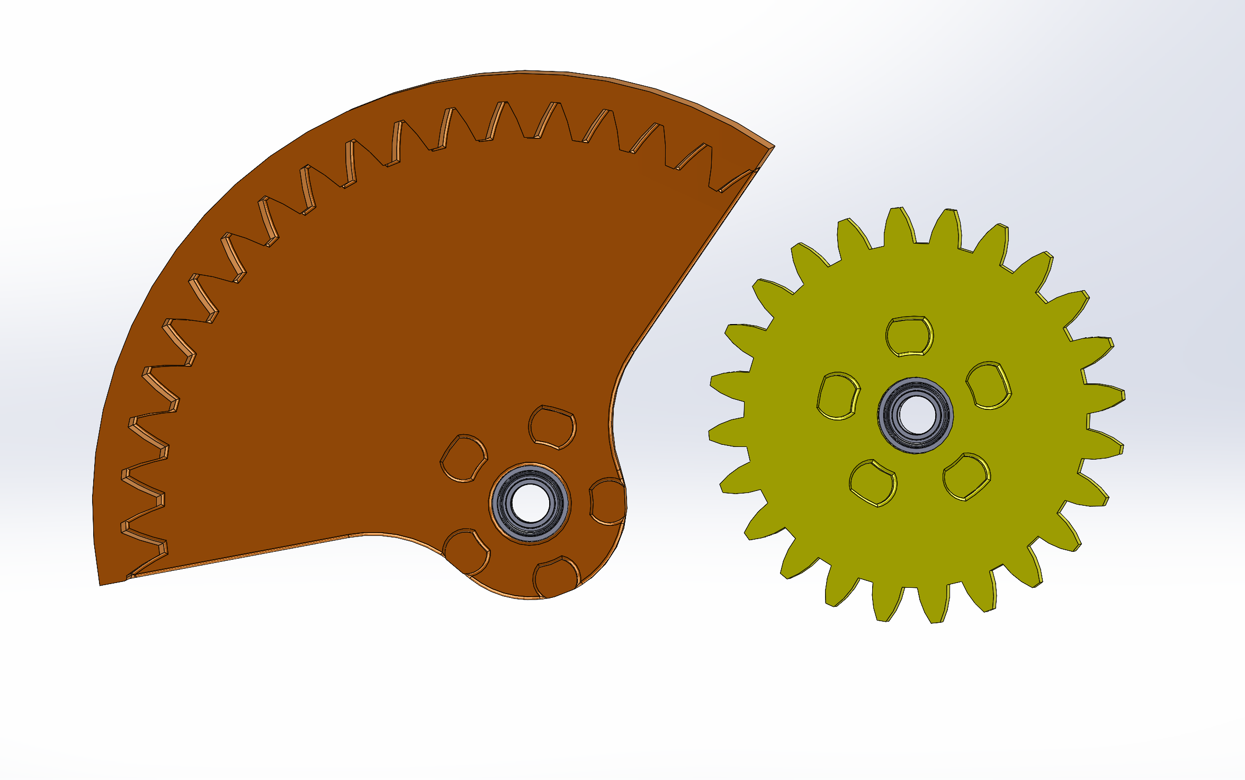
Put Bearings in Gears
Ensure the bearing flange is on the opposite side of the dog teeth as lateral forces push gear in that direction.

Slide 10
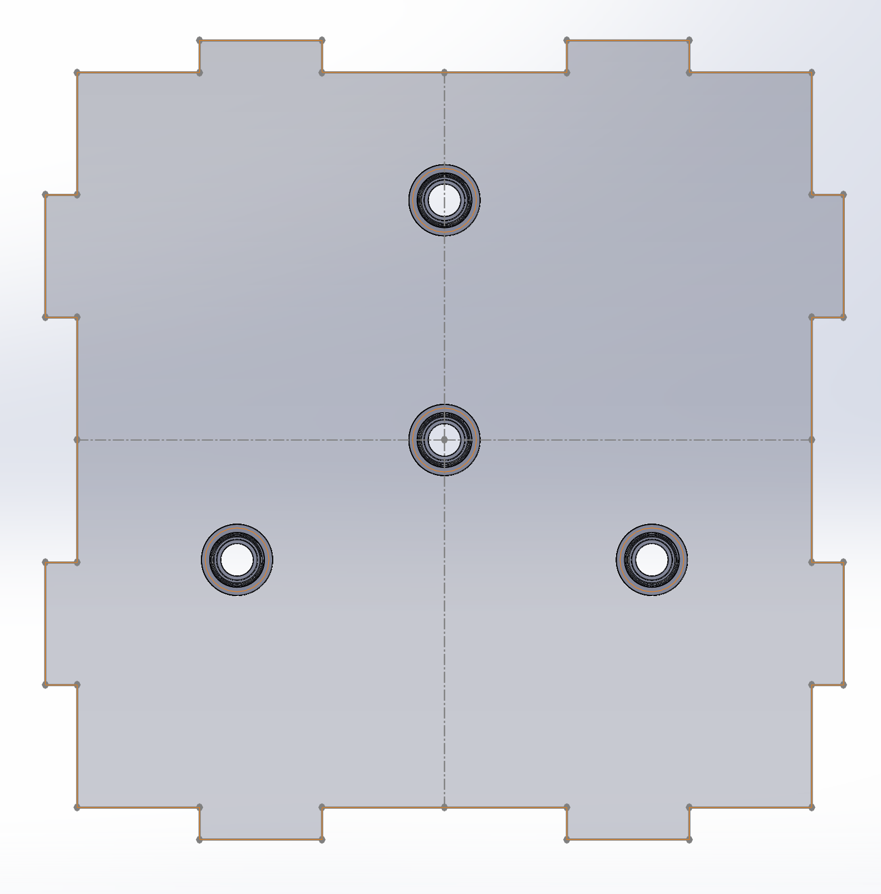
Put Bearings in Inner Wall
Inner Wall is reversible, bearing orientation irrelevant

Slide 11
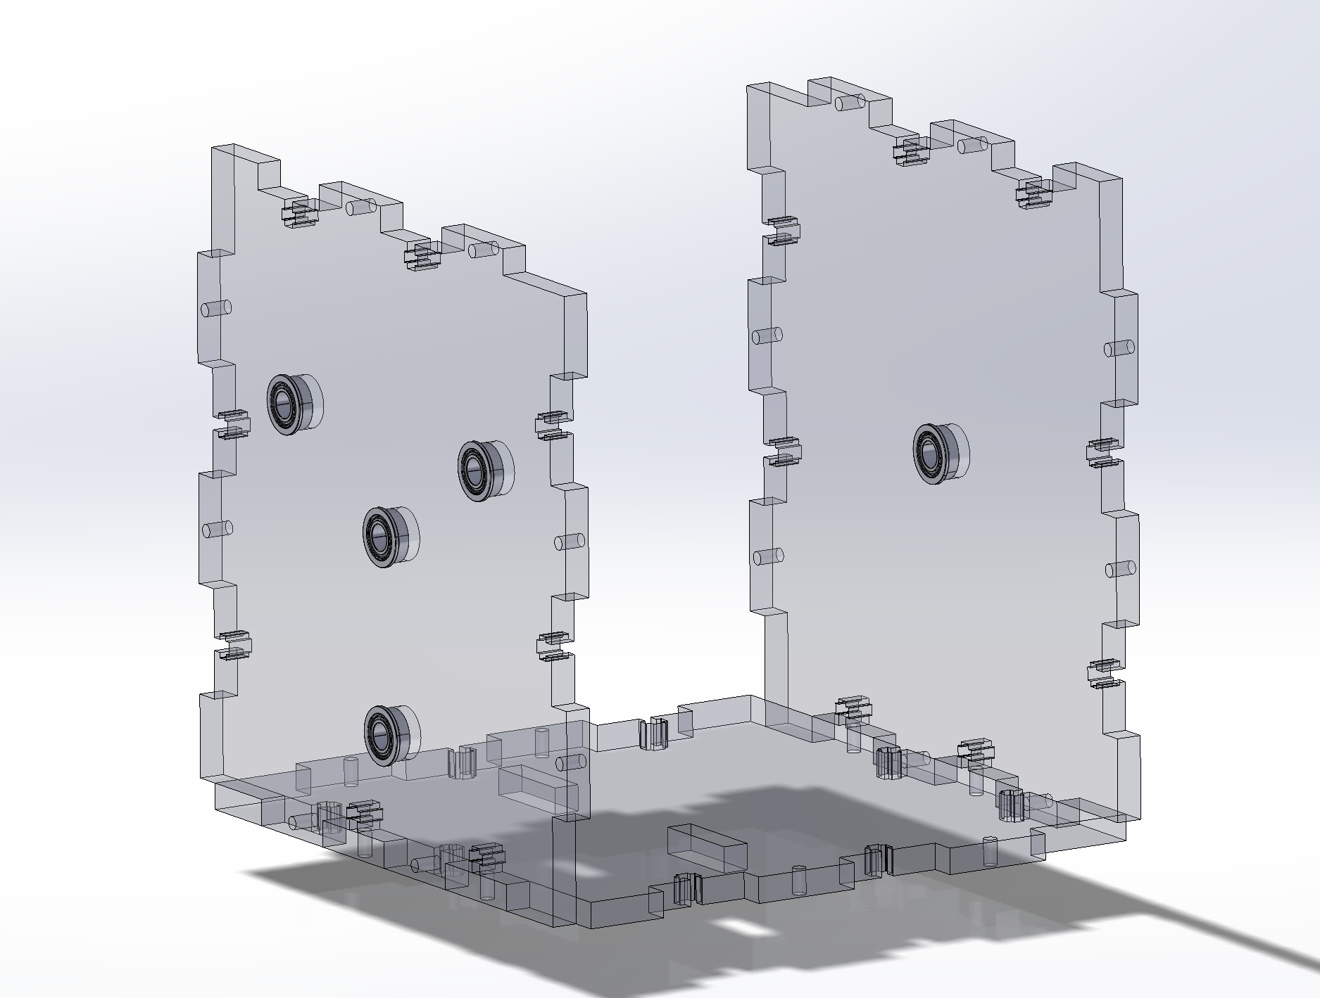
Put Bearings in Outer Walls
Test fit the input side and output side together.
Use slotted side as base, slots closer to input side.
Put bearings in walls with flanges facing out on the input side. (Looks prettier)
And the flange facing in on the output side. (Load Bearing)

Slide 12
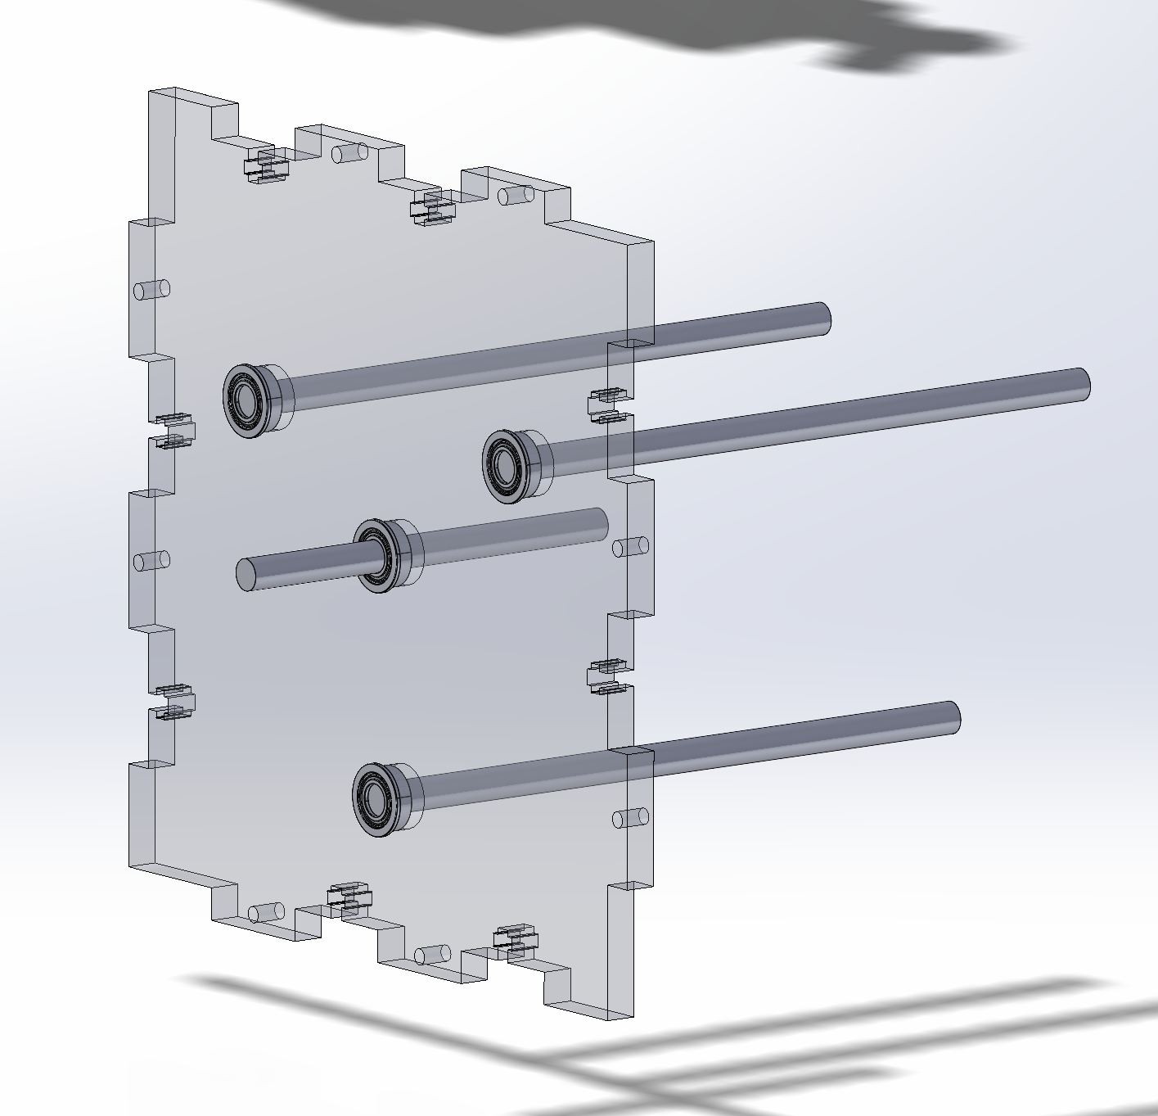
Assemble Input
Insert the 80mm shaft into the middle bearings. Sticking out 30mm.
Insert 3 130mm shafts into other bearings. Flush with exterior surface.

Slide 13
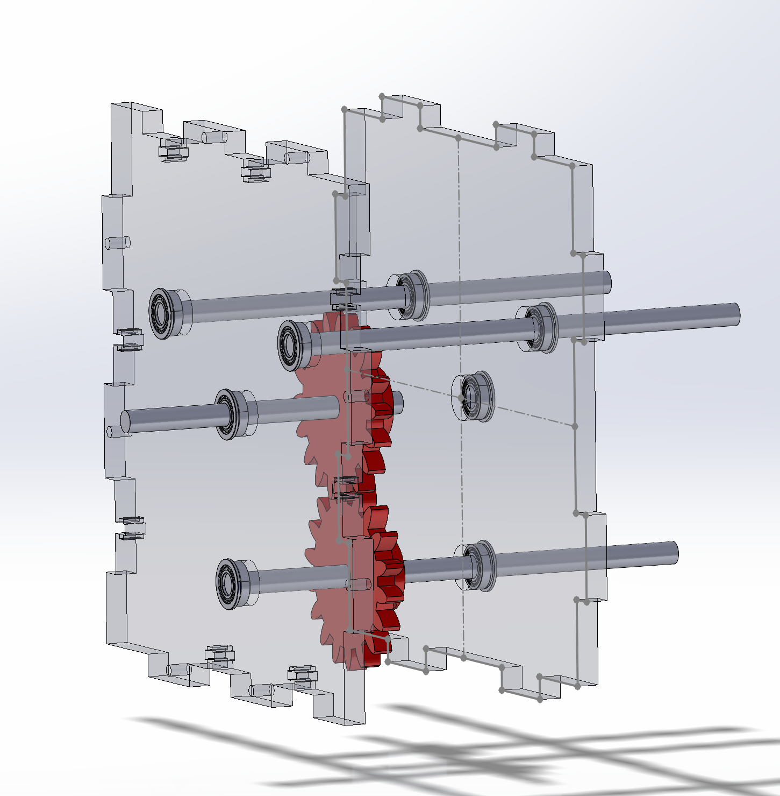
Assemble Input
Slide in Input Gears and Inner Wall.
Don’t screw in gears yet.
Inner Wall bearing flanges should face in the opposite direction as Input Walls

Slide 14
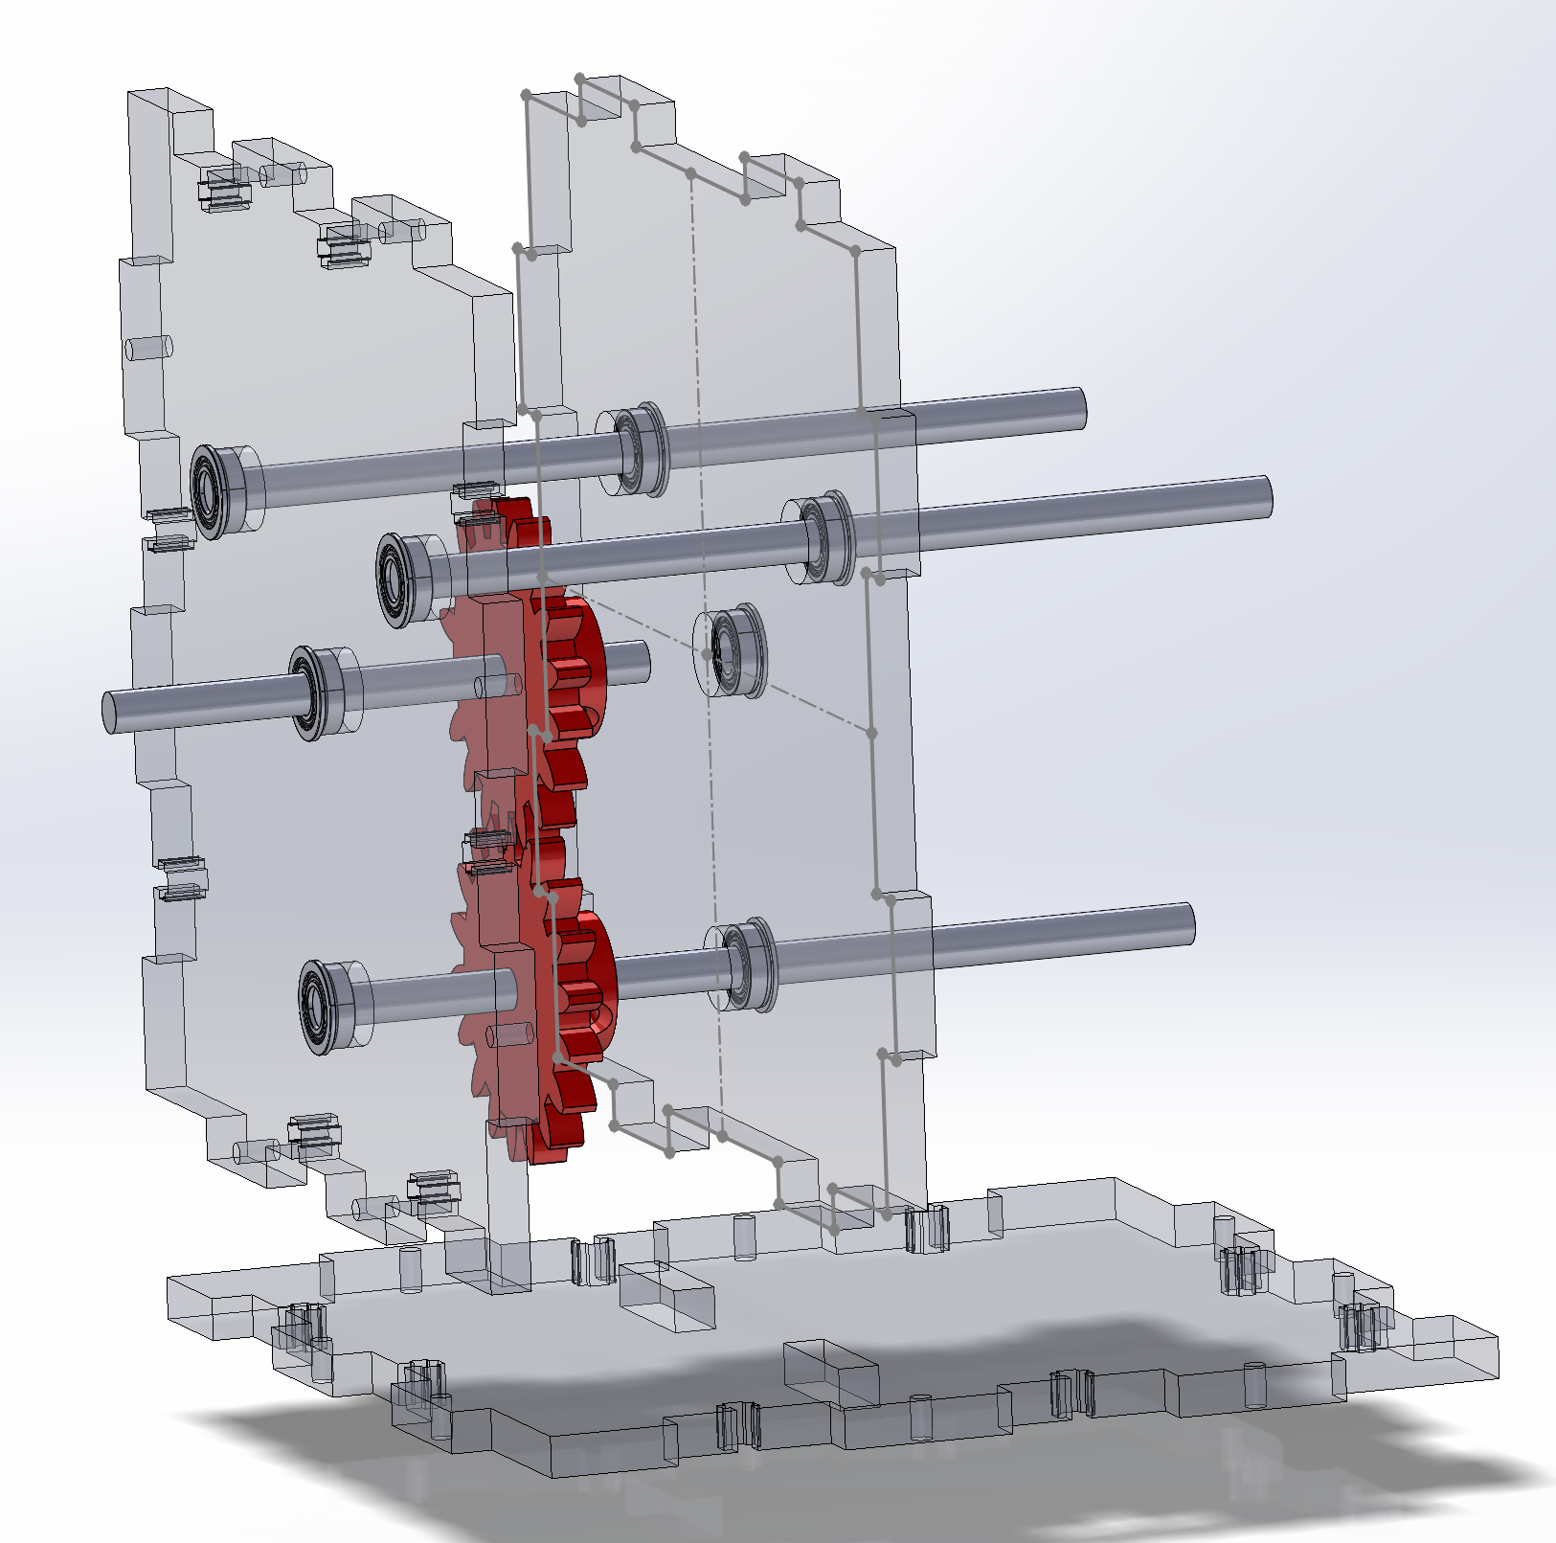
Assemble Input
Slot in input gear configuration from above.
Fix input wall to base with M3x12 screws.
Fix input gears to shaft in the middle of the walls with M3x16 screws.

Slide 15
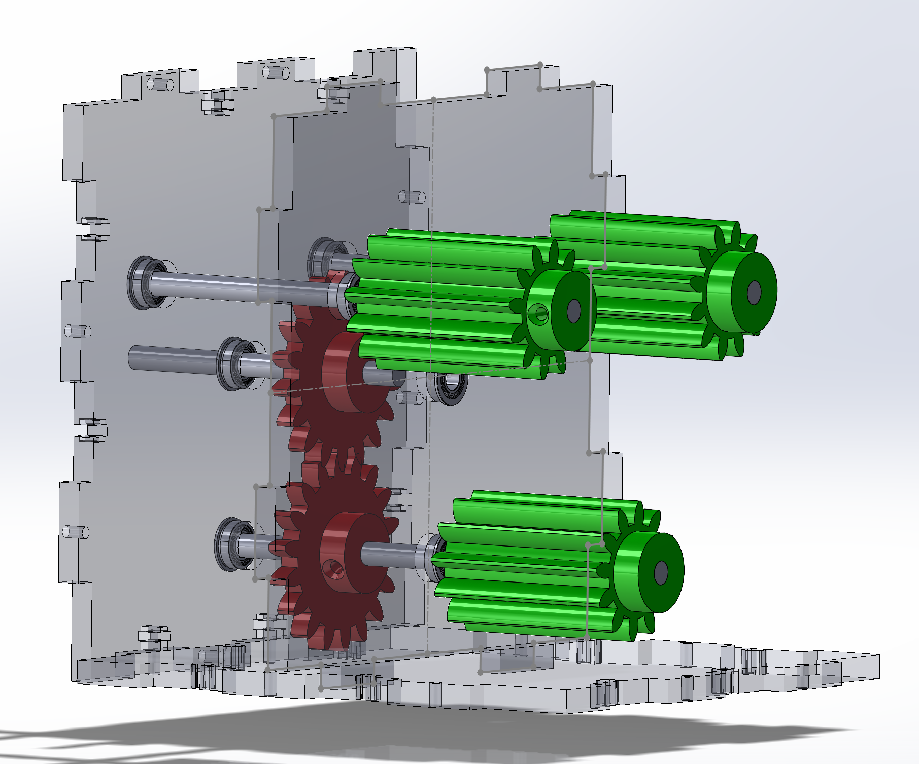
Assemble Planet Gears
Put planet gears on.
Fix flush to end of shaft with M3x16 screws.

Slide 16
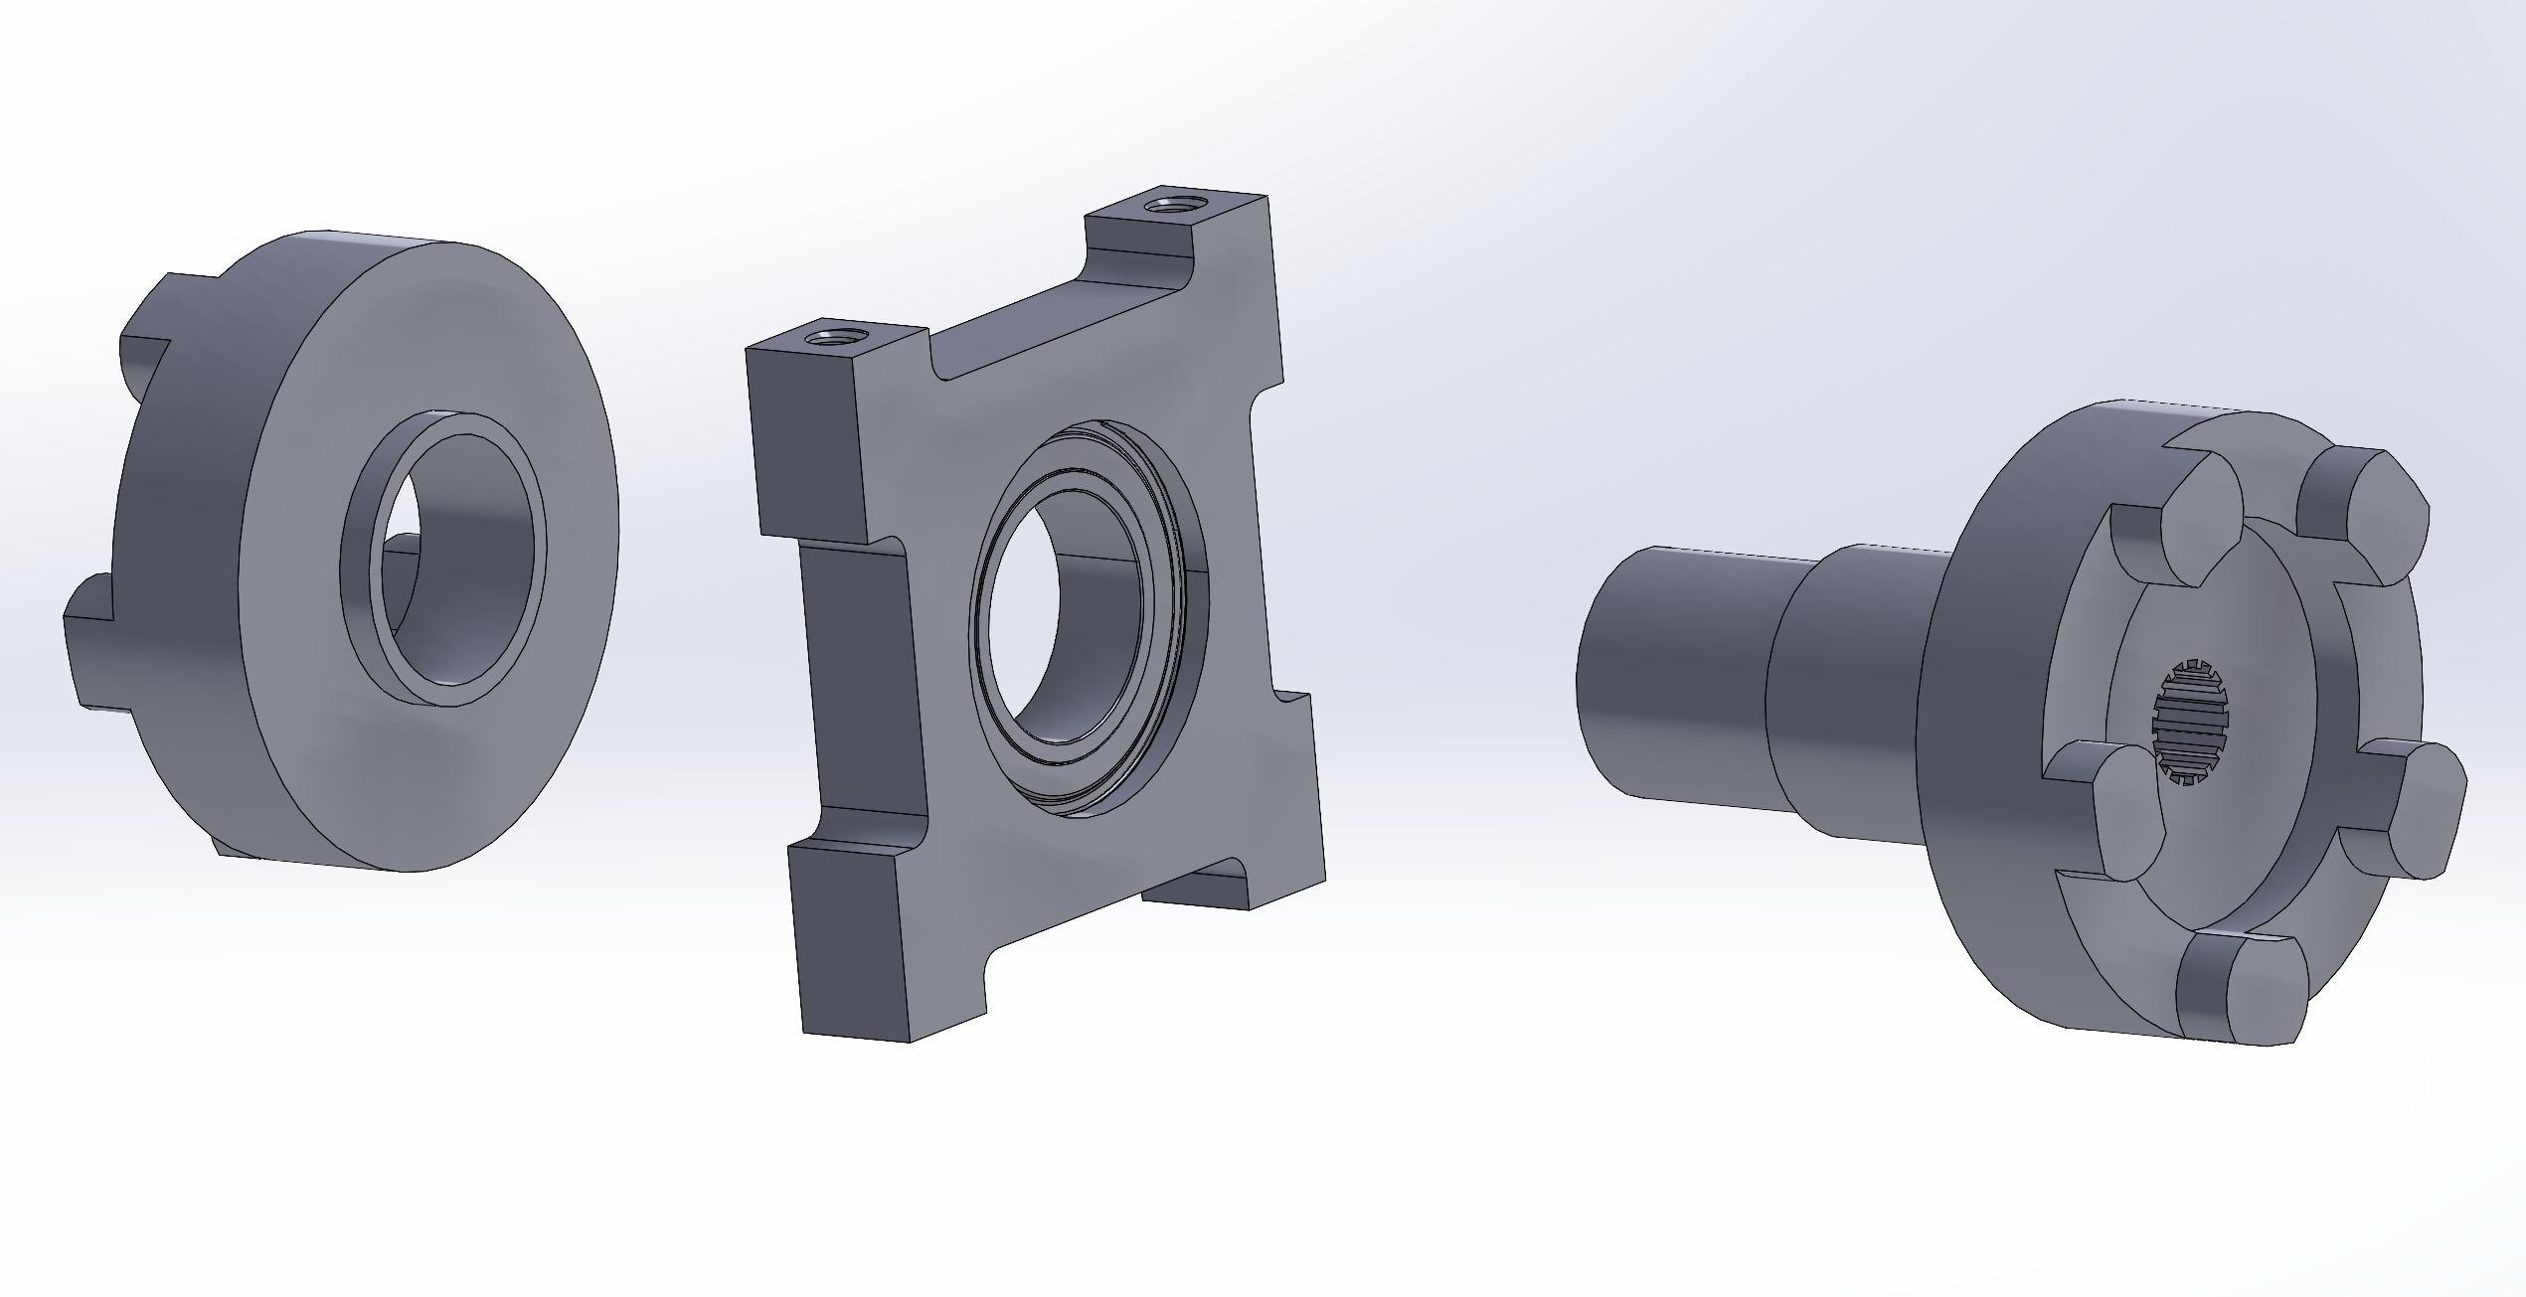
Assemble Transmission Collar
Assemble transmission collar like so.
Note the recessed side of 12mm ID bearing should face the shaft.
Use plastic cement to glue dog tooth cap onto shaft once attached.
No 12mm ID bearing? Just print out a linear bearing with a ~13mm ID and use that instead. Probably put a bunch of carbon dry lubricant in it. It wont be as good but it’ll probably be fine.

Slide 17
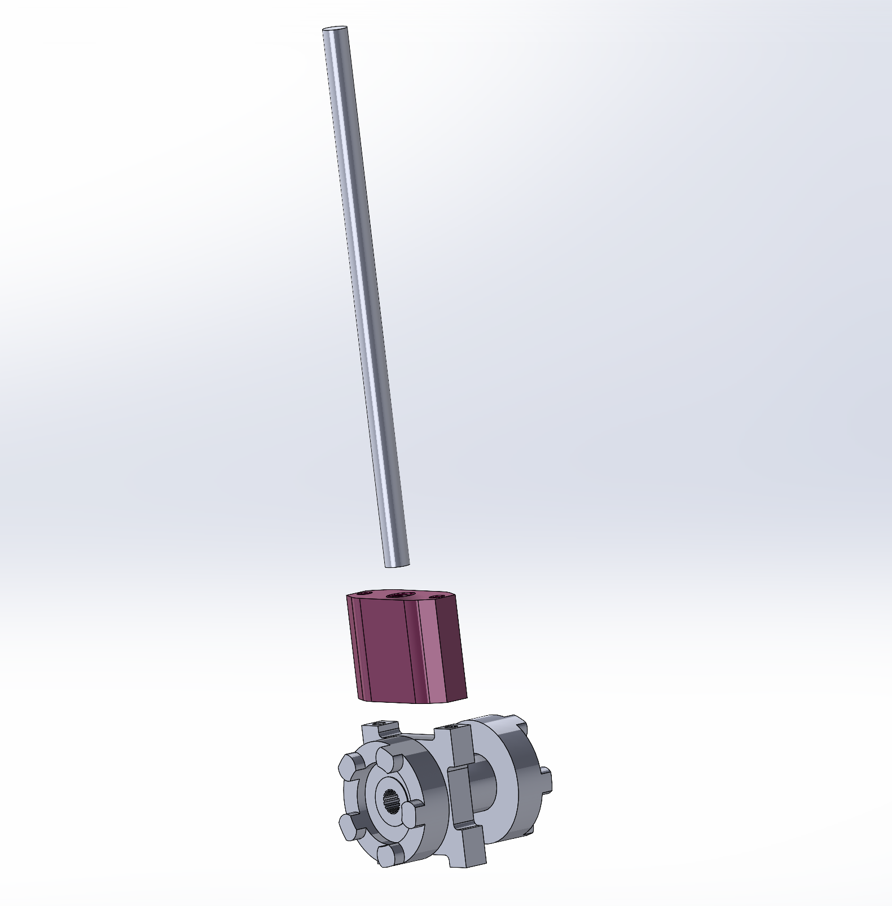
Assemble Transmission Collar
Screw shift holder into bearing with UNC 6-32 30mm screws.
Insert 6x130mm shaft into shift holder.

Slide 18
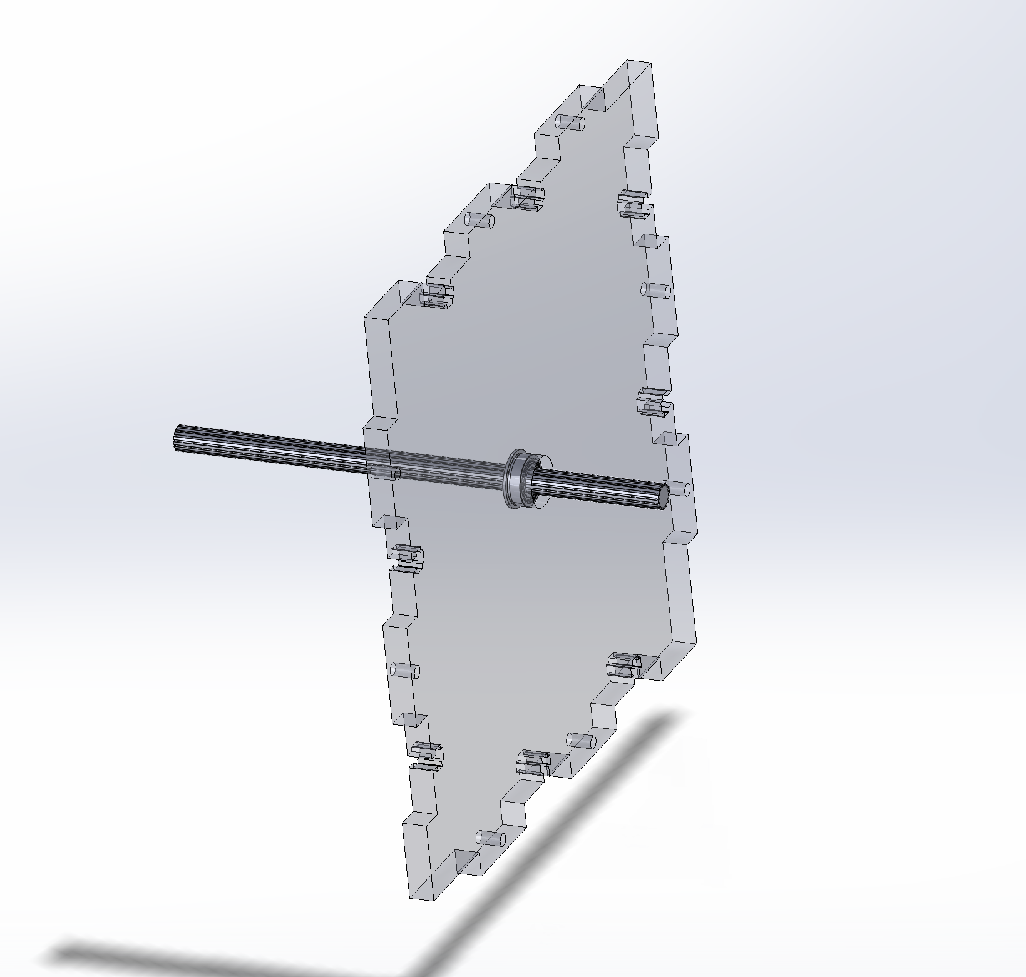
Assemble Main Gears
Attach splined shaft to output side sticking out 30mm.

Slide 19
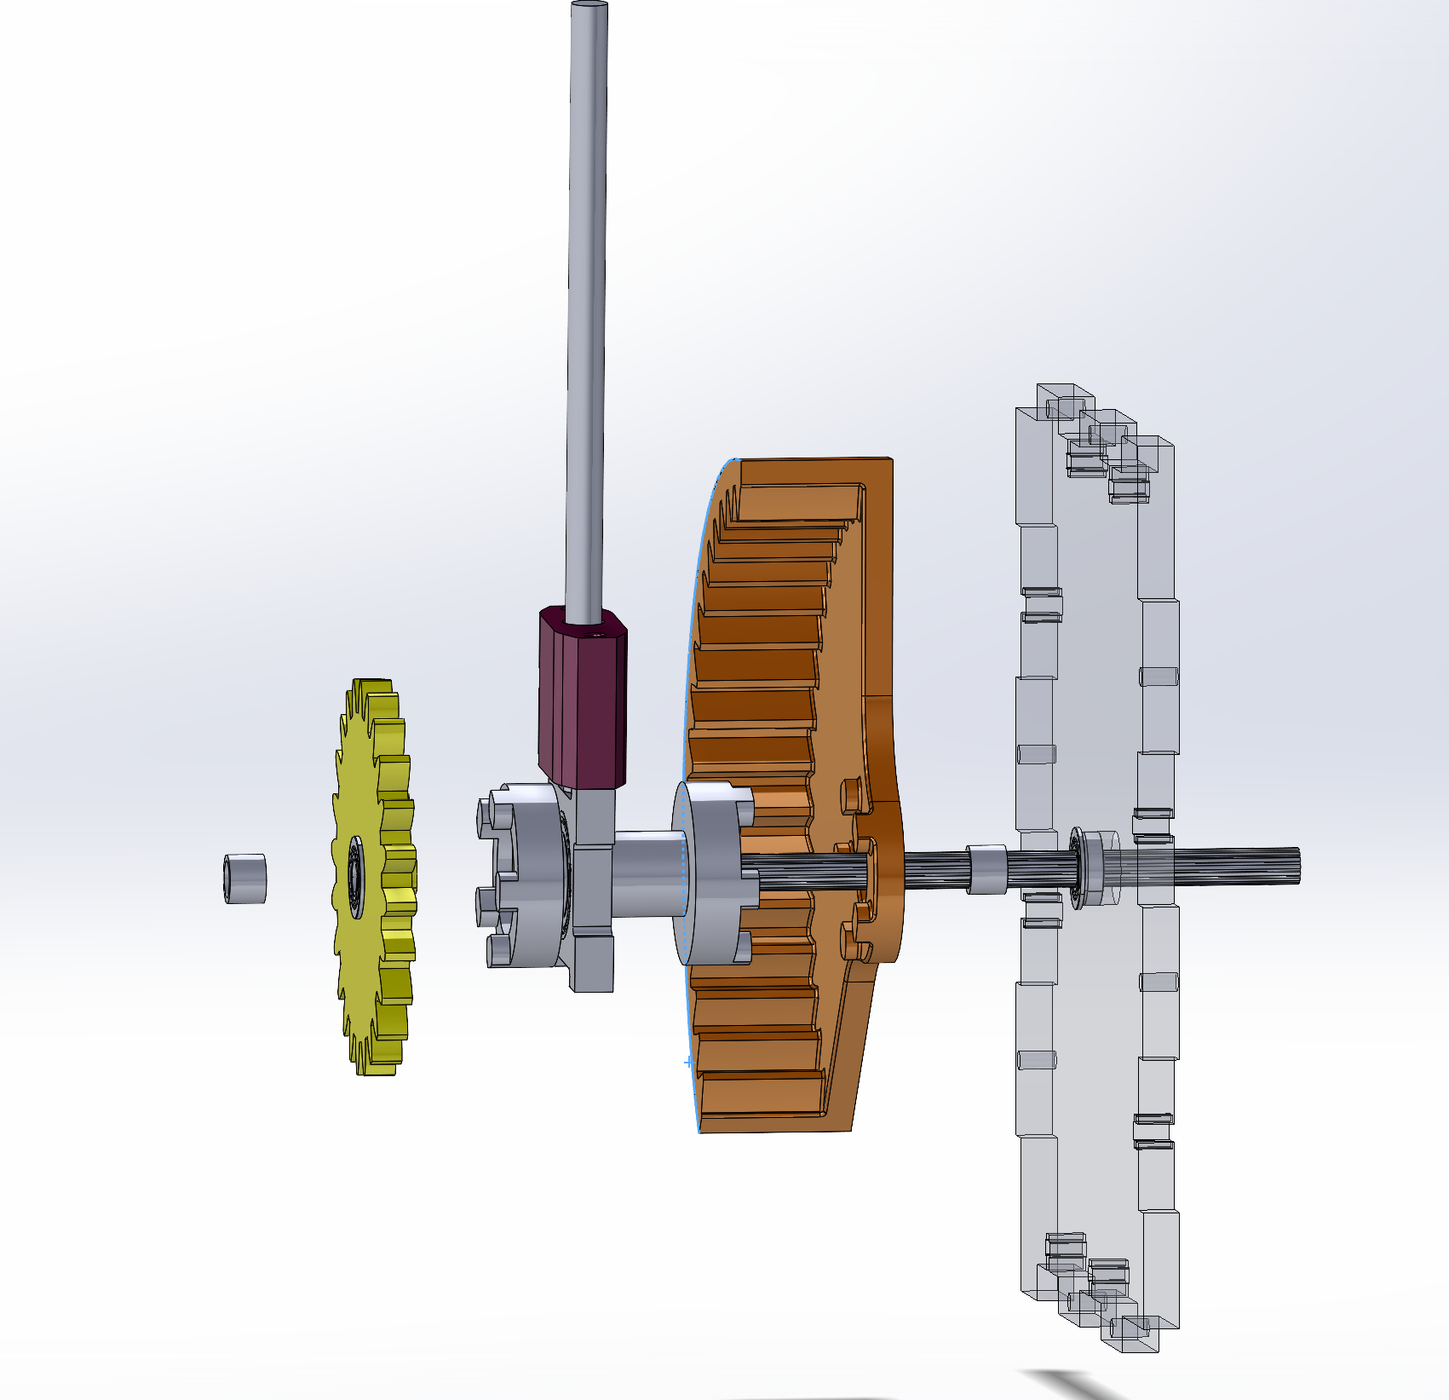
Assemble Main Gears
Assemble from right to left:
Spacing Washer
Ring Gear
Transmission Collar
Sun Gear
Spacing Washer

Slide 20
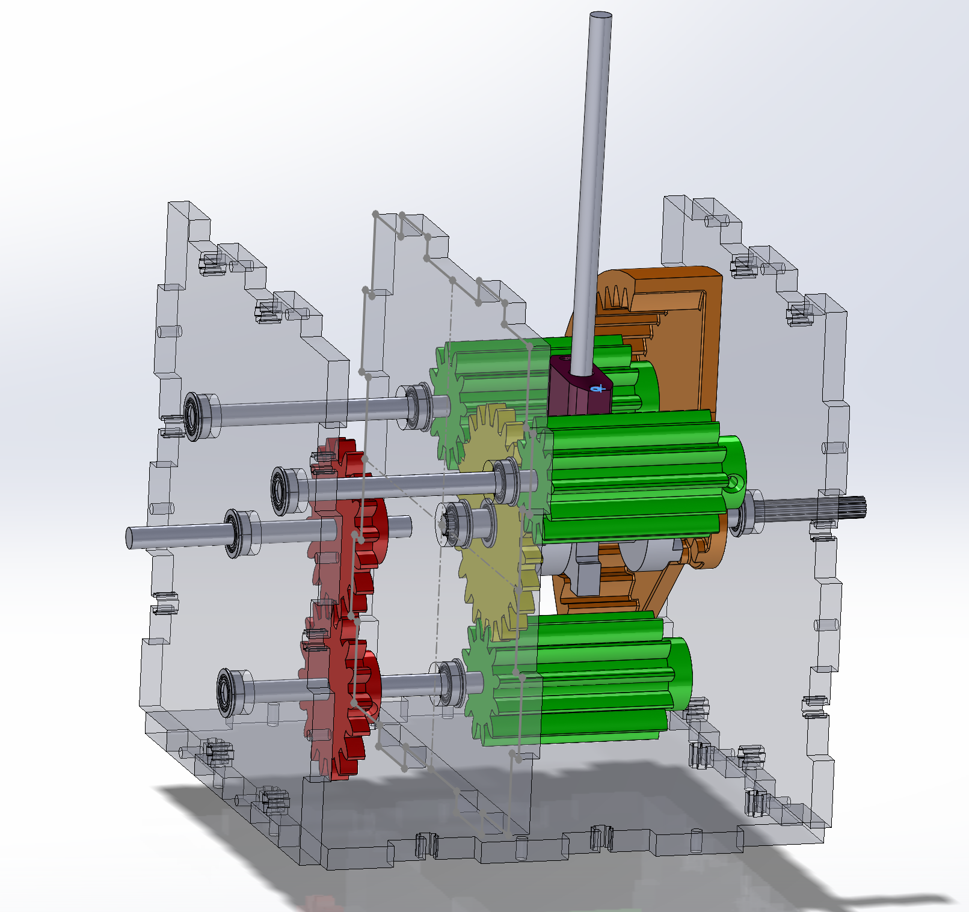
Assemble Main Gears
Stick the whole assembly into the rest of the box.
Fix Output Wall to base with M3x12 Screws

Slide 21
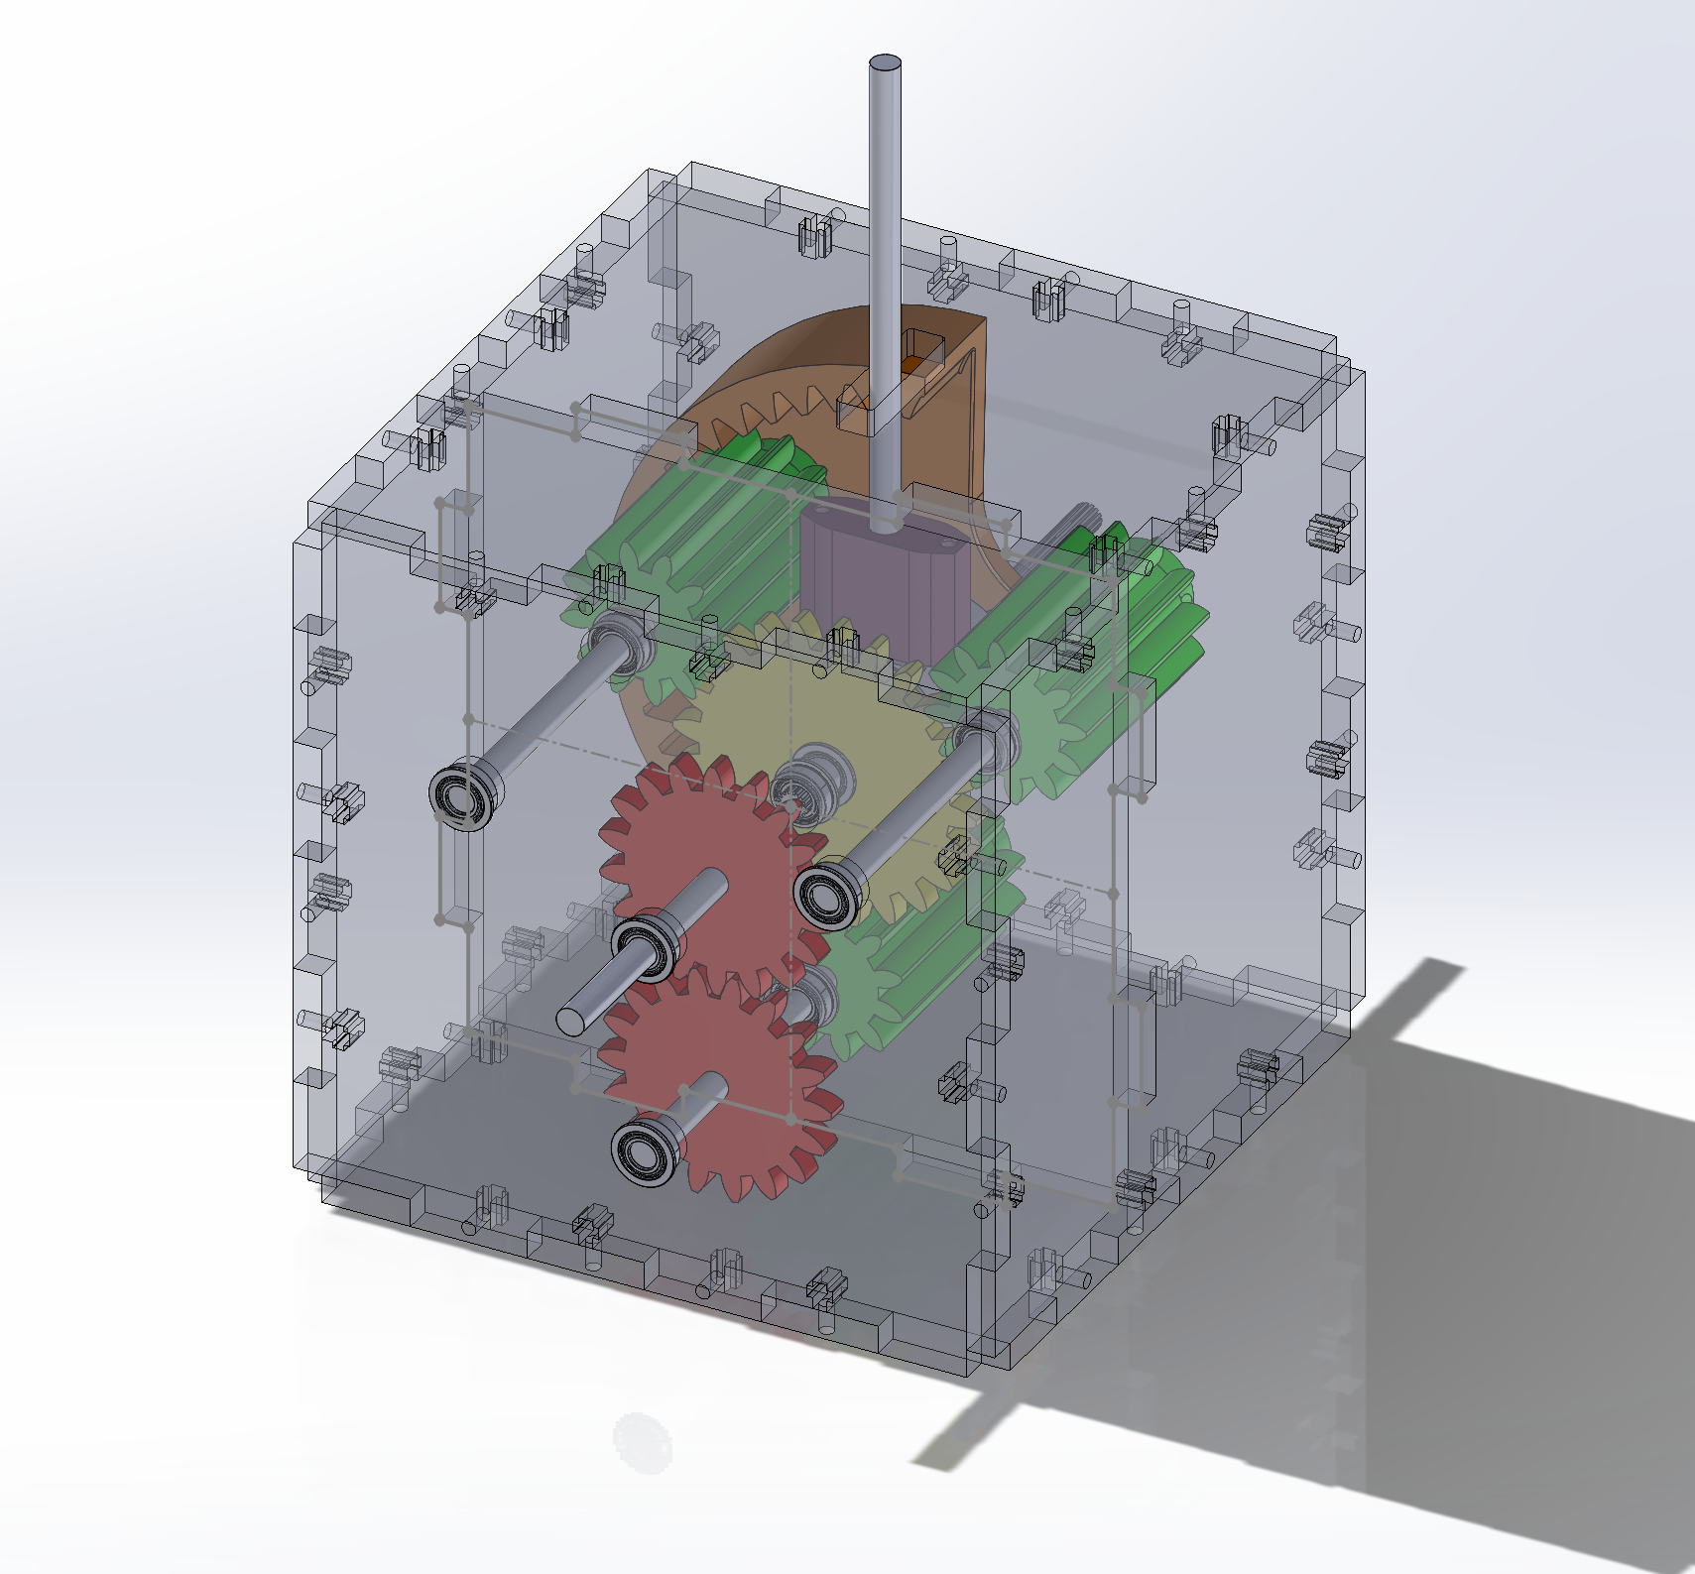
Assemble Box
Screw the rest of the box together

Slide 22

Decorate
https://www.amazon.com/SPACE-Self-adhesive-Reflective-Decorative-Scrapbook/dp/B076CWYRM2/ref=sr_1_3
Stick at least a rocket ship sticker on the ring gear. That way it will look like a rocket ship going around the planets and will be sick
Maybe an alien on the sun

