Slide 1

EDUCATION FOR THE INNOVATION ECONOMY

Slide 2
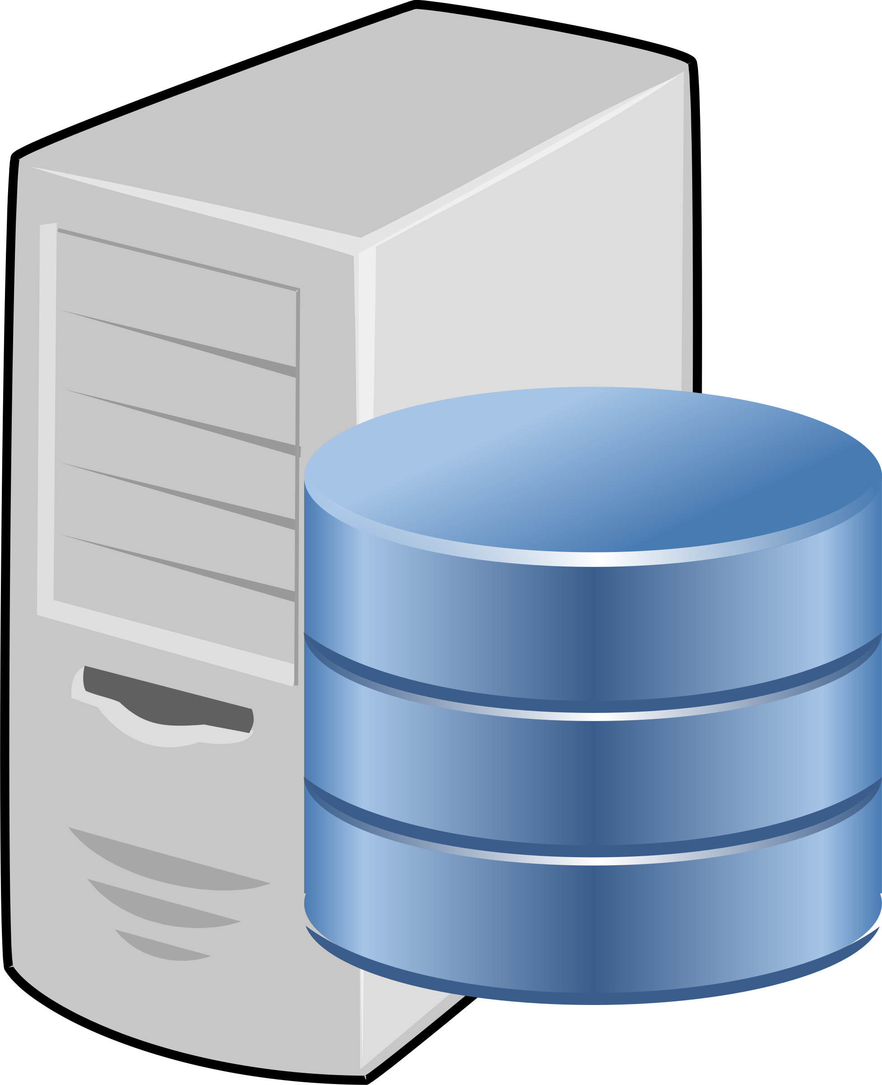
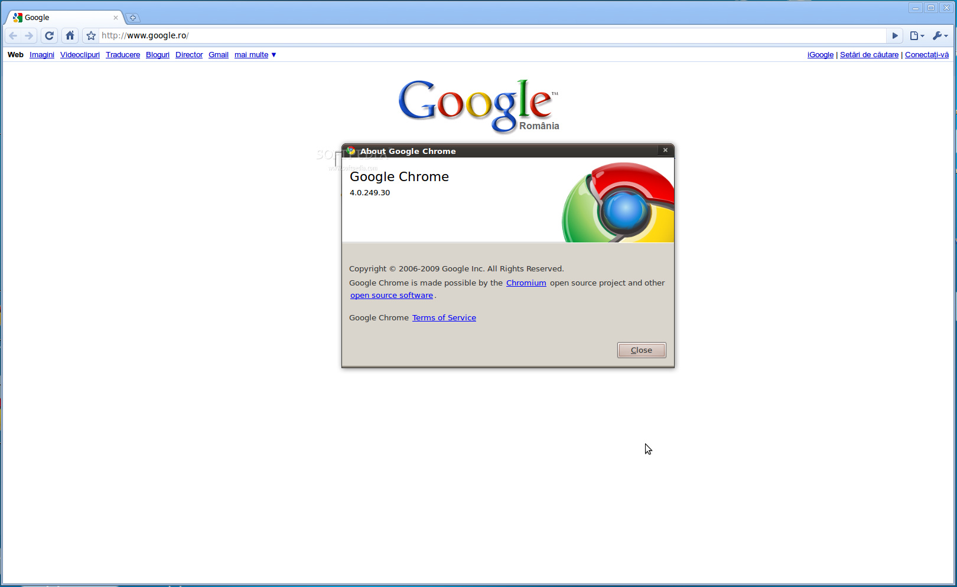

Request
Client
Response
Server
Notes:
The web is a two-tiered architecture, you’ve got the client and the server. The client sends a request via the HTTP protocol which is received by the server. The server then sends a response back to the client. Many companies use full stack developers, meaning the developer is responsible for the code that runs on the server as well as the code that runs client-side in the browser. Other companies will split these two responsibilities having a group of front-end engineers and a separate group of back-end engineers. The decision will be based on the technology in use, team size and methodology used internally.

Slide 3
Front End Development
Languages:
HTML
CSS
JavaScript
Popular Frameworks
Boot Strap, Foundation (CSS)
Angular, React, Ember (JavaScript)
Notes:
The code that runs client side in the browser is made up of HTML (information layout), CSS (look and feel) and JavaScript (page behavior). Developing on the front end is all about crafting a positive user experience.

Slide 4
Back End Development
Languages:
Ruby
Python
PHP
Java
JavaScript
Popular Frameworks
Rails
Django
Flask
Node
Notes:
Server-side development is typically focused heavily on processing data that will be used on the front-end. Developers are typically focused on performance and data integrity when developing server-side.

Slide 5
Hyper Text Transfer Protocol
GET / HTTP/1.1
Host: www.startupinstitute.com
User-Agent: curl/7.43.0
Accept: */*
Notes:
Browsers and servers communicate using the Hyper Text Transfer Protocol or HTTP. Each HTTP exchange is made up of one request and one response. When a user types an address into their URL bar in the browser, a request like we see here is created and sent along the network to the appropriate server. The request contains information about what resource we are seeking and what software we are using to make the request. This is important for the server to send the appropriate response back. What does that response look like?

Slide 6
cURLing Me Softly
cURL is a tool for client-side URL transfers which supports multiple protocols including HTTP
> curl –i https://www.startupinstitute.com
Notes:
In order to see the raw response we can use a tool like cURL. Let’s try it, open a terminal and use the cURL command (installed by default on Mac). We will set the –i option which tells cURL to include the headers so we see a full response.

Slide 7
Hyper Text Transfer Protocol
HTTP/1.1 200 OK
Connection: keep-alive
Server: gunicorn/0.16.1
Date: Sun, 09 Oct 2016 22:14:32 GMT
Transfer-Encoding: chunked
X-Frame-Options: DENY
Content-Type: text/html; charset=utf-8
X-Xss-Protection: 1; mode=block
Vary: SI_REGION, Cookie, Host
Strict-Transport-Security: max-age=1
X-Content-Type-Options: nosniff
Set-Cookie: csrftoken=8jJL0hjUdTdO20eCZFu3tdZNwRHz2004; expires=Sun, 08-Oct-2017 22:14:32 GMT; Max-Age=31449600; Path=/
Via: 1.1 vegur
Notes:
Our response begins with the headers, this is information for the browser to process. We see that the response code is a “200 OK” which means our request was processed correctly. See see a Set-Cookie header which tells our browser to store information in a cookie. We also see that the type of content being sent is HTML. After the header we then see the entire HTML and JavaScript of the page. Were this a browser being used to make the request, it would process this HTML and JavaScript to show us the page, cURL is giving us a look under the hood of what happens every time we request a webpage in a browser.

Slide 8
What About REST APIs?
curl –i http://jsonip.com
HTTP/1.1 200 OK
Server: nginx/1.10.0 (Ubuntu)
Date: Mon, 10 Oct 2016 14:31:58 GMT
Content-Type: application/json; charset=utf-8
Transfer-Encoding: chunked
Connection: keep-alive
Vary: Accept-Encoding
Access-Control-Allow-Origin: *
Access-Control-Allow-Methods: GET
Strict-Transport-Security: max-age=31536000; includeSubDomains
{"ip":"67.186.134.136","about":"/about","Pro!":"http://getjsonip.com"}
Notes:
Not all servers respond with HTML. Many back-end applications are written as APIs. This means they return structured data, typically JSON (JavaScript Object Notation) but other formats such as XML are possible. Let’s use cURL to send a request to the JSON IP service. As we can see (click to show response) we get a similar header giving us information about the server we are communicating with but this time out response Content-Type is JSON. And we can see in the response body a chunk of JSON which includes an entry for our IP address.

Slide 9
HTTP Methods
GET / HTTP/1.1
Host: www.startupinstitute.com
User-Agent: curl/7.43.0
Accept: */*
POST /signup HTTP/1.1
Host: www.startupinstitute.com
Content-Type: application/x-www-form-urlencoded
email=jlcarmic%40gmail%2Ecom
Notes:
Both of the requests we’ve made here are called GET requests. But this is only one of many HTTP methods used to communicate between client and server. You’ve all likely seen the two most common which are GET and POST. As we saw a GET is issued every time we enter an address in a URL, click on a link on a page or load an external resource in our code such as an image, CSS or JavaScript file. Let’s say we filled in a signup form to receive emails from SI. This form submission would likely utilize a POST request. (Click to show POST) A POST request is similar to a GET, the difference is that a POST request has a body which contains data that is required to process the request. While you can send data in a GET request in the form of URL parameters this is typically used only for identifying which resource we are requesting. For example we may see a parameter containing a unique ID or slug when requesting a specific blog post. However when submitted user information in a form it is best practice to use a POST so that the data is included in the body of the request. There are a number of reasons for this, most specifically security of the user’s information.

Slide 10
HTTP Methods
GET – Requests a representation of the specified resources (data retrieval)
POST – Requests that the server accept the entire enclosed in the request as a new subordinate of the web resource identified by the URI (ex. a message for a bulletin board or an item to add to a database).
HEAD – Asks for the response identical to the one that would correspond to a GET request, but without the body.
PATCH – Applies partial modifications to a resource.
PUT – Requests that the enclosed entity be stored under the supplied URI.
DELETE – Deletes the specified resource.
TRACE – Echoes back the received request so that a client can see what changes have been made by intermediate servers.
OPTIONS – Returns the HTTP methods that the server supports for the specified URL.
CONNECT – Converts the request connection to a transparent TCP/IP tunnel, usually to facilitate SSL-encrypted communication through an unencrypted HTTP proxy.
Notes:
There are however many HTTP methods used in the protocol. The most commonly used in web applications are GET, POST, PATCH, PUT and DELETE. Typically you will see these mapped to data CRUD operations. POST is used to Create, GET is used for Reading, PUT and PATCH are used for Updating with PATCH used for partial updates and PUT used for complete overwriting and DELETE is for Deleting data.

Slide 11
HTTP Status Codes
Informational – 1xx
Successful – 2xx
Redirection – 3xx
Client Error – 4xx
Server Error – 5xx
Notes:
The responses we have seen so far have had a status code of 200. This is a standard HTTP response code for a successful request/response cycle. But there are many possible response codes. These codes are broken down into types which are designated by the first number in the code. I’m sure we’ve all come across a 404 message before. Also any developer working with server side code has likely come across a 500 error when they have an error in their code. It is important to know that these response codes are very specific, it can often aid in debugging an issue.

Slide 12
HTTP Status Codes
400 Bad Request – The request code not be understood by the server due to malformed syntax.
404 Not Found – The server has not found anything matching the Request-URI.
https://httpstatuses.com/
Notes:
For example, while a 404 means the resource can’t be found which is likely the bad unique ID or page name, a 400 is a bad request typically meaning there is something in the data being sent that is causing an error. These are two very different situations and likely point to different areas of code that should be investigated. While you are likely to become familiar with some status codes over time, the site httpstatuses.com is a handy resource for looking up status codes to know the exact meaning.

Slide 13

Ruby on Rails
Rails Router
Controller
Model
DB
View
Notes:
Rails is a framework for building web applications in Ruby. It follows a model, view, controller or MVC architecture. In this architecture the model directly manages the data, logic and rules of the application. The view is the external representation of the data. This representation may be an HTML page presented to a user or a blog of JSON consumed by another application. Finally, the controller is the go between for the view and the model. The controller is responsible for translating view interactions into commands executed by the model.

Slide 14
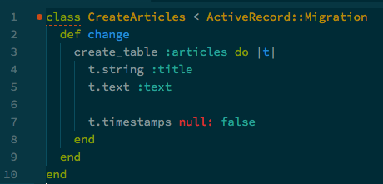

Ruby on Rails
> bin/rails generate model Article title:string text:text
db/migrate/20161010210922_create_articles.rb
app/models/article.rb
Notes:
We can generate our models using the Rails generate command. Here we see we run the command to create a model called Article that is made up of two fields, a title which is a string and some text which is of type text. When we run this command we are automatically given a few files. The first is called a migration. Migrations are used for making changes to the underlying data store, most often a database. This migration will create a table called articles which will store the data for every article we create, allowing us to perform all of the CRUD activities on those articles.
We are also given the beginning of a model file. This is where the logic for our articles will live. Any sorting, filtering or manipulation that happens on an article will be defined here within the model.

Slide 15

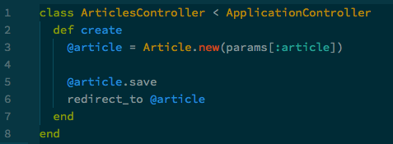
Ruby on Rails
> bin/rails generate controller Articles
app/controllers/articles_controller.rb
app/controllers/articles_controller.rb
Notes:
To handle the interactions between the views and the model we would need to create a controller which we can also generate. Calling the rails generator for Articles will give us our empty class. The controller is where we would place our CRUD methods. For example we would have a create method which took parameters passed from the view which it would use to create and save a new Article record via the model. We would then redirect the use to that article for viewing. This of course would require a view.

Slide 16
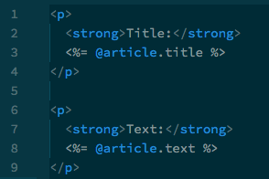
Ruby on Rails
app/views/articles/show.html.erb
Notes:
Views are typically created using ERB which is HTML with embedded Ruby. This allows us to create the appropriate layout with HTML but to have access to data as well as flow of control such as branching and looping for defining how the data will be presented. Here we simply take the article in question and display its title and text with some spacing and labeling.

Slide 17

Ruby on Rails
config/routes.rb
> bin/rake routes
You don’t have any routes defined!
Please add some routes in config/routes.rb
For more information about routes, see the Rails guide: http://guides.rubyonrails.org/routing.html.
Notes:
Tying all of these concepts together is the routes file. The routes file defines how each request type is handled and which function is called.

Slide 18

Ruby on Rails
config/routes.rb
> bin/rake routes
Prefix Verb URI Pattern Controller#Action
articles GET /articles(.:format) articles#index
POST /articles(.:format) articles#create
new_article GET /articles/new(.:format) articles#new
edit_article GET /articles/:id/edit(.:format) articles#edit
article GET /articles/:id(.:format) articles#show
PATCH /articles/:id(.:format) articles#update
PUT /articles/:id(.:format) articles#update
DELETE /articles/:id(.:format) articles#destroy
Notes:
When we add resources for articles we see we are now provided with paths for the standard actions typically taken on a resource. Here we see that issuing a GET request for the path /articles will call the index method in the articles controller. By defining these methods in our controller we will be able to handle the types of request that would be made by a view. So we would likely see a workflow such as:
A user clicks on a new article button which sends a GET to the path /articles/new
Because of our routing that request will call the new method within the articles controller
The new method will do any setup necessary and then the new.html.erb view will be returned
This view would be a form requesting all the information needed for creating a new article
Submitting this form will send a POST to the path /articles which we see calls the create method in the articles controller
As we previously defined the create method will take the parameters passed and create a new instance of an article which it then saves to the database
Once the article is saved we are redirected to that article which will issue a GET to the path /articles/id (with the new article’s id) which we see calls the show method
The show method will look up the article corresponding to that ID and then render the show.html.erb view with that data
TADA the user sees the article they just created

Slide 19
Review
The web is a two-tiered architecture consisting of a client and a server.
The HTTP protocol governs the way requests and responses are exchanged between the client and server.
Each request has an HTTP method such as GET or PUT which governs the way it expects to interact with the server.

Slide 20
Review
Each response includes a status code such as 200 or 404 which provides information about the way the request was handled.
Rails is an MVC architecture made up of models, views and controllers.
Rails utilizes the various HTTP methods in order to route requests to specific functions in the controller.

Slide 21
Review
Models represent application data and contain the business logic for interacting with that data.
Views are front end representations of data state which may be user-focused HTML or machine-focused structured data such as JSON.
Controllers map user actions from the views to the appropriate logic implemented in models.

