Slide 1
Illustrative sample data
CONTENTS
ZOLOMON KALISER
01
Competitive landscape
Market assessment
02
Market sizing
Early-stage medical device Illustrative sample data · prepared for founder review
03
Reimbursement & pricing
04
Five-year revenue model
Notes:
Opening frame. Zolomon Kaliser market assessment for early-stage medical device founders. All figures shown are illustrative sample data.

Slide 2
Illustrative sample data
01 · COMPETITIVE LANDSCAPE · ILLUSTRATIVE
Cleared devices, United States
DEVICE
PATHWAY
PRICE
POSITION
SOURCE NOTES
Cardiotek Vantage
510(k)
$14,200
Incumbent
FDA 510(k) clearance database, Q2 2025. n = 14 cleared devices in scope.
Nuvelle A2
De Novo
$9,800
Challenger
Price is published list from three IDN contracts; net of rebate not disclosed.
Perisys One
510(k)
$11,400
Value
Orbis Meridian
PMA
$26,500
Premium
Position assigned from labelled indication and share of cath-lab installs.
Halden Loop
510(k) exempt
$6,100
Entrant
Zolomon Kaliser · Market assessment
01 / 04
Notes:
Competitor matrix: five cleared devices with regulatory pathway, list price and market position, plus the source notes behind each column.

Slide 3
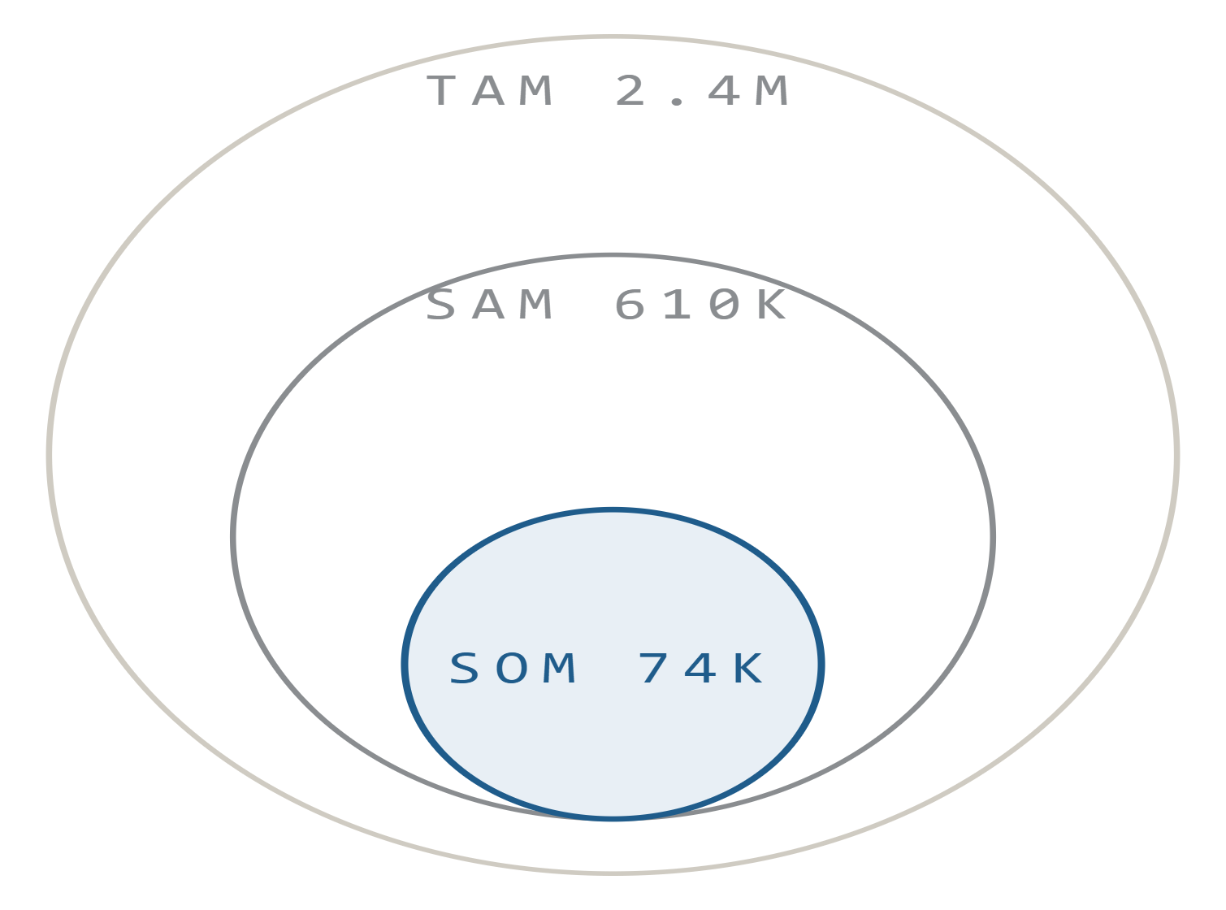
Illustrative sample data
02 · MARKET SIZING · ILLUSTRATIVE
Total, served and obtainable
2.4M patients
$1.8B
TAM
US prevalence, CDC WONDER 2024 × $740 blended device ASP.
610K patients
$462M
SAM
26% managed in hospital cath-lab settings (NIS 2023).
74K patients
$58M
SOM
12.6% of SAM by year five across 340 target centers.
Zolomon Kaliser · Market assessment
02 / 04
Notes:
TAM, SAM and SOM with the sourced assumption line beneath each figure, showing the math narrowing from total US prevalence to the obtainable segment.

Slide 4
Illustrative sample data
03 · REIMBURSEMENT & PRICING · ILLUSTRATIVE
Coding and payment pathway
CODE
DESCRIPTOR
SETTING
NAT'L AVG
COMMERCIAL PAYER COVERAGE
33999
Unlisted cardiovascular proc.
HOPD
$1,284
Covered 58%
Prior auth 27%
Not covered 15%
C9762
Cardiac MR w/ strain imaging
HOPD
$968
$842
93356
Myocardial strain, add-on
Facility
$312
Average allowed amount per procedure, blended across sites of service. CMS OPPS Addendum B, CY2025.
0623T
Coronary plaque quant.
Cat. III
Carrier-priced
Zolomon Kaliser · Market assessment
03 / 04
Notes:
Coding and payment pathway: CPT and HCPCS codes with national average payment, commercial payer coverage split, and the blended average allowed amount per procedure.

Slide 5
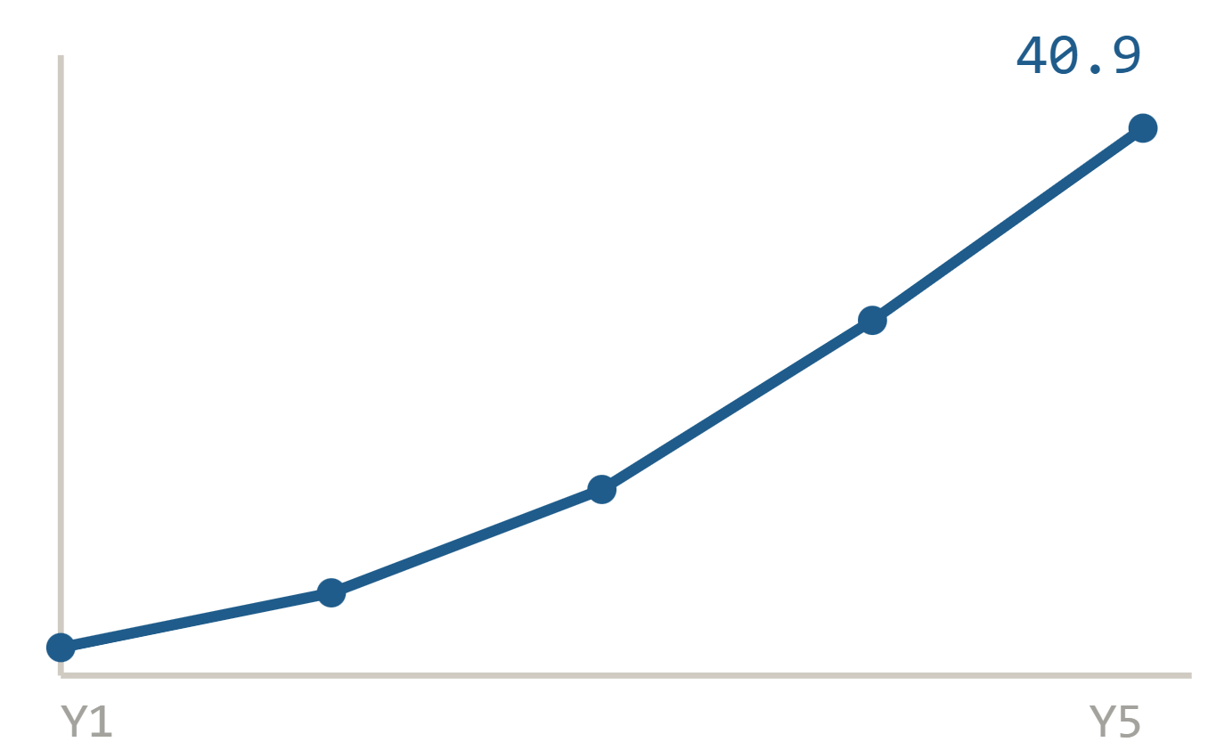
Illustrative sample data
04 · FIVE-YEAR REVENUE MODEL · ILLUSTRATIVE
Base case, US direct sales
Y1
Y2
Y3
Y4
Y5
REVENUE, $M
Units
210
640
1,480
2,900
4,600
ASP
9,800
9,650
9,400
9,150
8,900
Revenue $M
2.1
6.2
13.9
26.5
40.9
COGS $M
1.0
2.7
5.6
10.1
14.7
Gross margin %
52
56
60
62
64
Illustrative sample data. Assumes 340 target centers and 3.4% annual ASP erosion.
Zolomon Kaliser · Market assessment
04 / 04
Notes:
Five-year base case: units, ASP, revenue, COGS and gross margin, with the revenue curve alongside. Assumes 340 target centers and 3.4% annual ASP erosion.

