Slide 1
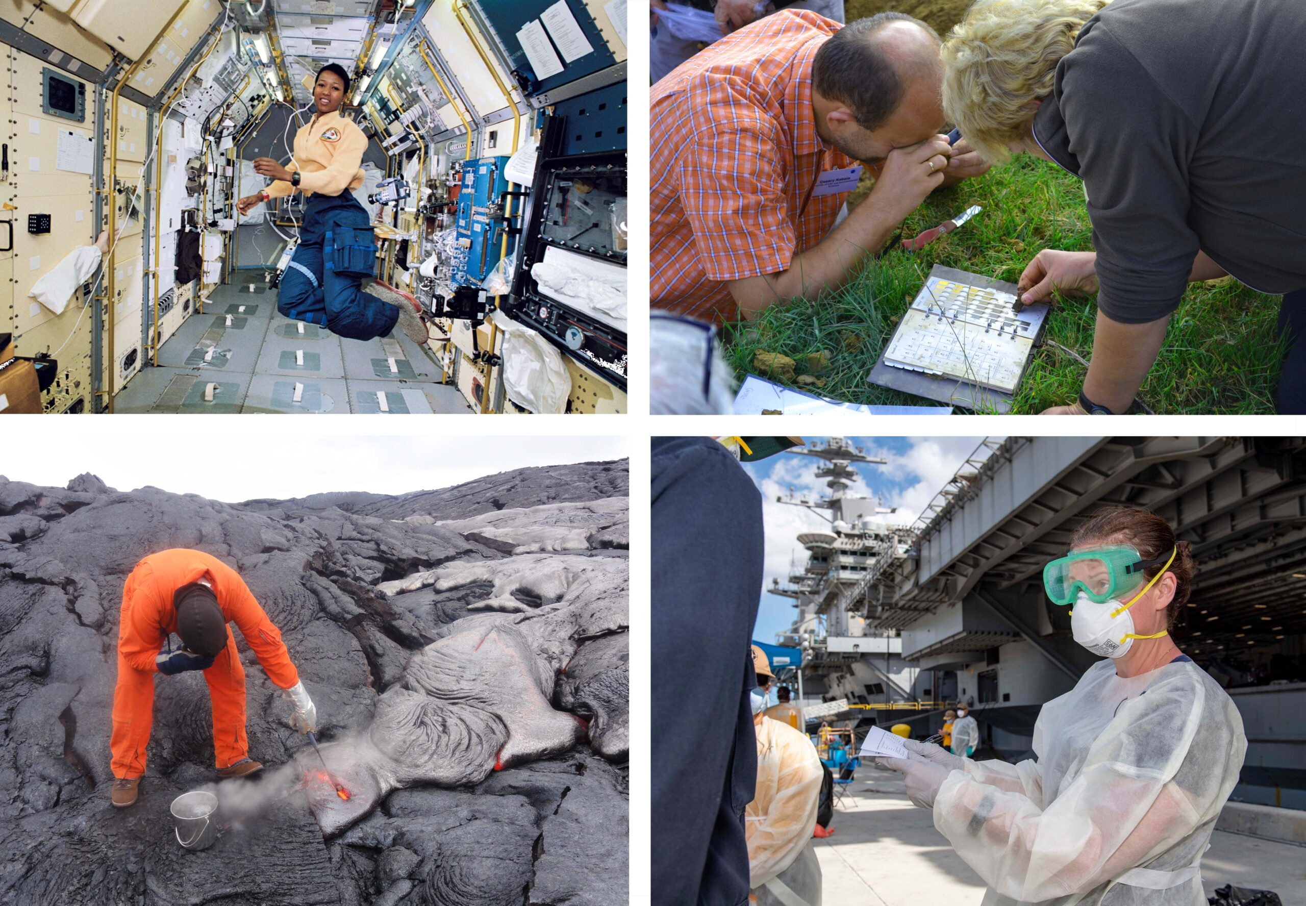
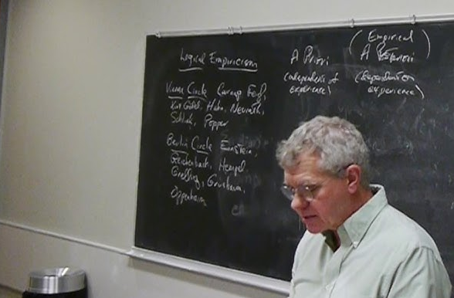

Research Programmes, Communities and Revolutions
Science as a Socio-Historical Practice:
TA: Luka Vinck 10 September 2026
Philosophy of Science Tutorial 2

Slide 2
Today’s Plan
Project
Kuhn on Scientific Revolutions
Lakatos on the Demarcation Problem
Longino on Values and Objectivity in Science

Slide 3
Project
Questions?

Slide 4
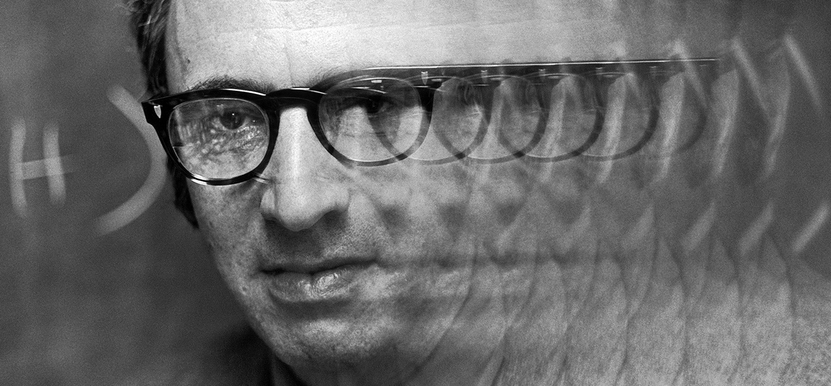
Kuhn – Nature and Necessity of Scientific Revolutions
Normal Science
(Within Paradigm)
Revolution:
New Paradigm
Stubborn Anomalies
Crisis:
Extraordinary Science

Slide 5
Kuhn – Nature and Necessity of Scientific Revolutions
Normal Science
(within paradigm)
[…] cumulative acquisition of novelty is not only rare in fact but improbable in principle (p. 89).
Discuss with the person next to you:
Why does Kuhn argue this, and do you agree?

Slide 6
Kuhn – Nature and Necessity of Scientific Revolutions
Crisis:
Extraordinary Science
Like the choice between competing political institutions, that between competing paradigms proves to be a choice between incompatible modes of community life. (p. 88)
Discuss with the person next to you:
  Why does Kuhn say that arguments in the debate about paradigm choice are necessarily circular?
  Why does Kuhn say that subsequent paradigms are incommensurable, and do you agree?

Slide 7
Kuhn – Nature and Necessity of Scientific Revolutions
Question:
What is the necessity of scientific revolutions?

Slide 8
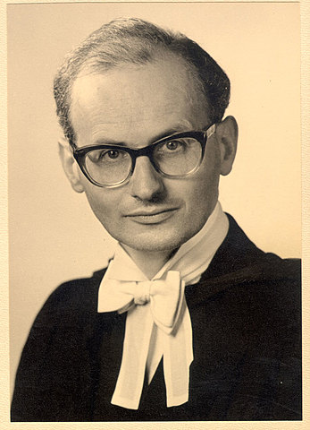
Lakatos – Science and Pseudoscience
1922-1974

Slide 9
Lakatos – Science and Pseudoscience
Problem of demarcation: not solved by Popper or Kuhn
Popper: naive, scientists typically do not abandon a theory when confronted with alternative facts
Kuhn: science proceeds by irrational change in commitment, no demarcation possible
➔ Should study science in terms of research programmes

Slide 10
Lakatos – Science and Pseudoscience
Discuss in groups of 3-4:
What makes a research programme scientific according to Lakatos?
How does Lakatos nuance Popper’s falsificationism?
And how does he modify Kuhn’s idea of scientific revolutions?
Do you agree that scientific value is an ‘objective’ property of a theory?

Slide 11

Longino – Values and Objectivity
The objective character of science is a consequence of it being a social enterprise
Discuss in groups of 3-4:
What produces, according to Longino, scientific knowledge? And how can this be objective?
What are necessary conditions for the possibility of objectivity?

Slide 12
Longino – Values and Objectivity
Objectivity is characteristic of a community’s practice of science
  Dependent on the depth and scope of transformative interrogation (cf. Kuhn)
  Not different from non-empirical sciences (contra logical empiricists)

