Slide 1

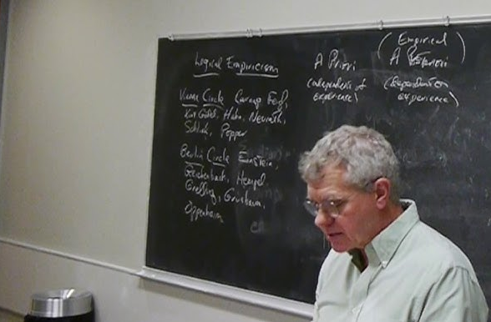

Underdetermination and Holism
+ Writing Workshop
TA: Luka Vinck 17 September 2026
Philosophy of Science Tutorial 3

Slide 2
Today’s Plan
Writing Workshop
Break
Text discussion: Quine and Laudan on Underdetermination

Slide 3

Writing Tutorial

Slide 4


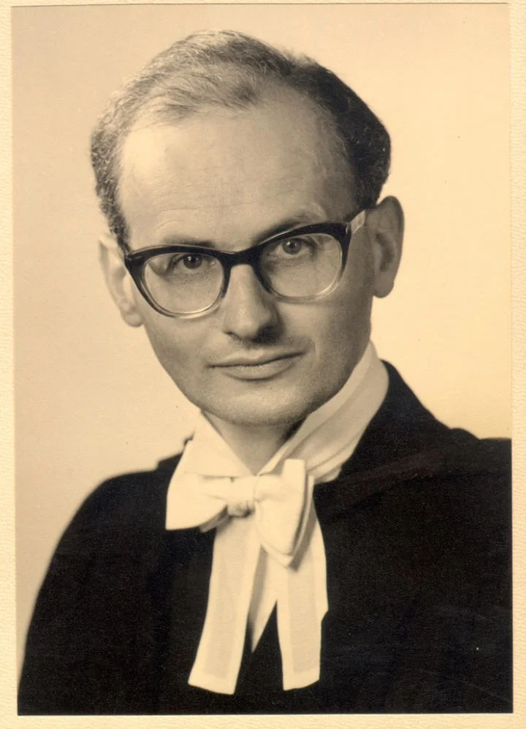
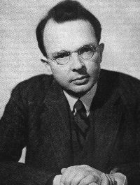
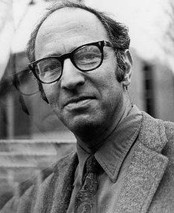
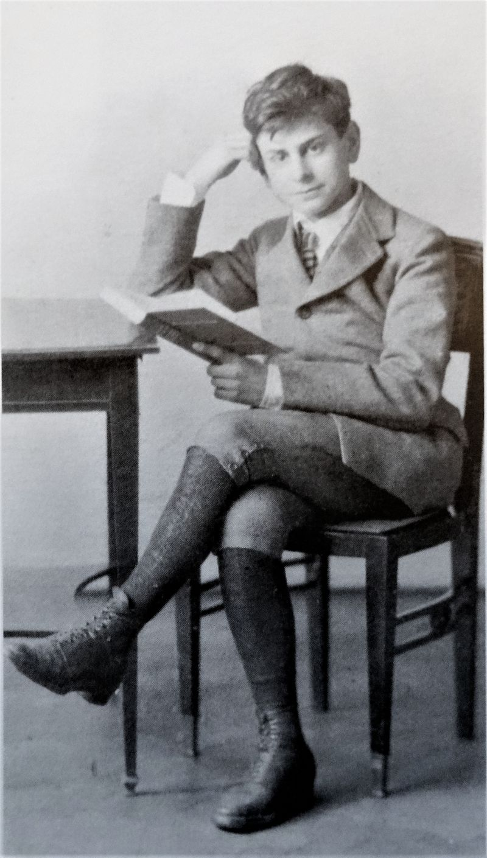
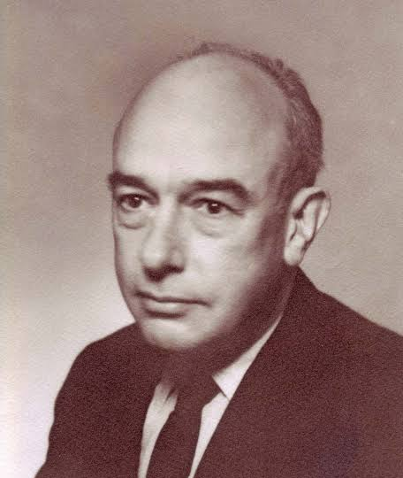
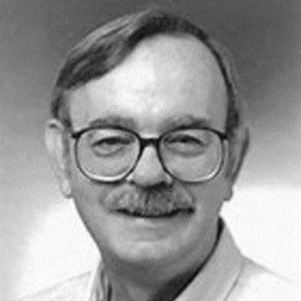
Longino
Godfrey-Smith
Lakatos
Carnap
Kuhn
Popper
Quine
Laudan
Was there any author whose style you particularly (dis)liked?

Slide 5
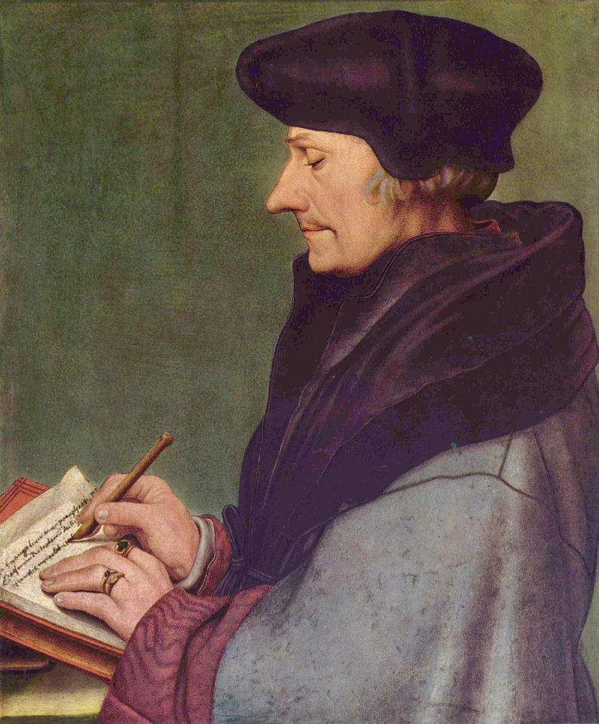
Practical References
Erik Curiel (2025), “Notes on Learning Philosophy”
Harvard’s “A Brief Quide to Writing a Philosophy Paper”

Slide 6
Writing a Philosophy Paper
Analytic Philosophy: Argumentation is Everything
Your paper should:
Have a clear thesis
Be well-structured
Appropriately explain concepts and arguments
Use clear and concise language

Slide 7
Writing a Philosophy Paper
Thesis
Is the start of everything!
Should not be too ‘big’
Should be relevant and well-embedded in the literature: take an existing discussion as your starting point

Slide 8
Writing a Philosophy Paper
Structure
Start by making an argumentation scheme = structure of your paper
Use clear sections and paragraphs
  Each paragraph should contain one ‘point’

Slide 9
Writing a Philosophy Paper
Structure
Introduction: state your position, outline the route to the conclusion, demarcate
Beginning of a section: explain the role in the overall structure
Beginning of an argument: state underlying assumptions, define the technical terms
End of argument: Consider possible limitations and objections
Conclusion: summarise your argument, indicate consequences and future directions

Slide 10
Writing a Philosophy Paper
Explaination
Two aims:
  To make sure your reader understands
  To show that you understand
Help the readers often
Explain for the target audience

Slide 11
Writing a Philosophy Paper
Language
Be clear and concise!
Be precise: take a moment to think what you actually want to say
Avoid overstatements (e.g. ‘completely’, ‘extremely’, ‘absolutely’, etc.)

Slide 12
Hands-On
In groups:
If you have a topic but no thesis:
Select a small number of (recent) papers on your topic that you find interesting and summarise in your own words their main point of argument. How are they related, and can you develop a position with respect to them?
If you have thesis and selected literature:
Make a draft of your argumentation structure that will be the outline of your paper. Include for each of your arguments the relevant literature.

Slide 13
Break

Slide 14
Underdetermination and Holism
Question
What is the problem of underdetermination according to Quine (in short)?
And according to Laudan?
Why does Quine say that underdetermination is a thesis about the world?

Slide 15
Underdetermination and Holism
Discuss in groups
What is a ‘theory’ according to Quine?
  Reconstruct Quine’s principle of individuation for theories
  What is the logical relation between theory and empirical data?
  Bonus: why does Quine say that there is no ‘extra-theoretic’ truth?

Slide 16
Underdetermination and Holism
Discuss in groups
Why does Quine argue that the Duhem-Quine thesis (holism) lends credence to the underdetermination thesis?
And why does Laudan argue that it doesn’t?
  Reconstruct Laudan’s critique on Quine

Slide 17
Next Week: Explanation and Understanding
Friday 25 september deadline Project Proposal

