Slide 1
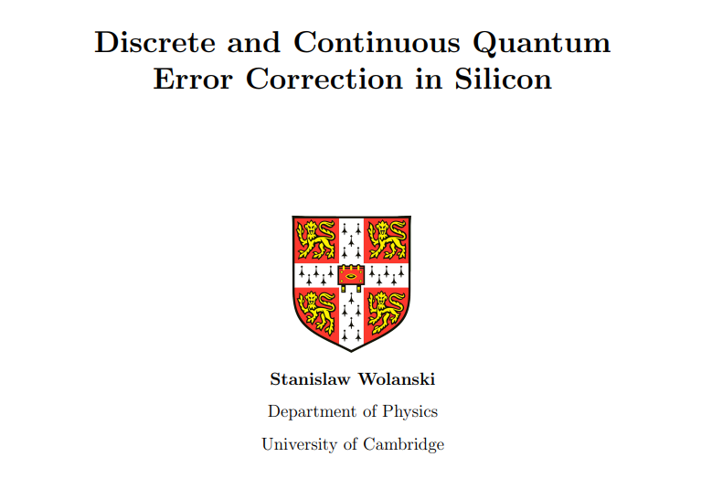

Slide 2
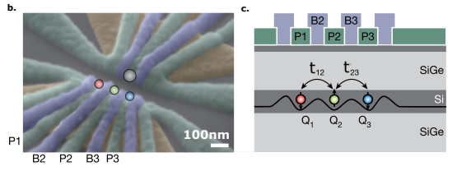
Quantum Dot arrays as a Quantum Computer

Slide 3


Errors!

Slide 4
Error correction?

Slide 5
Error correction?

Slide 6


Error correction?

Slide 7







Error correction!

Slide 8
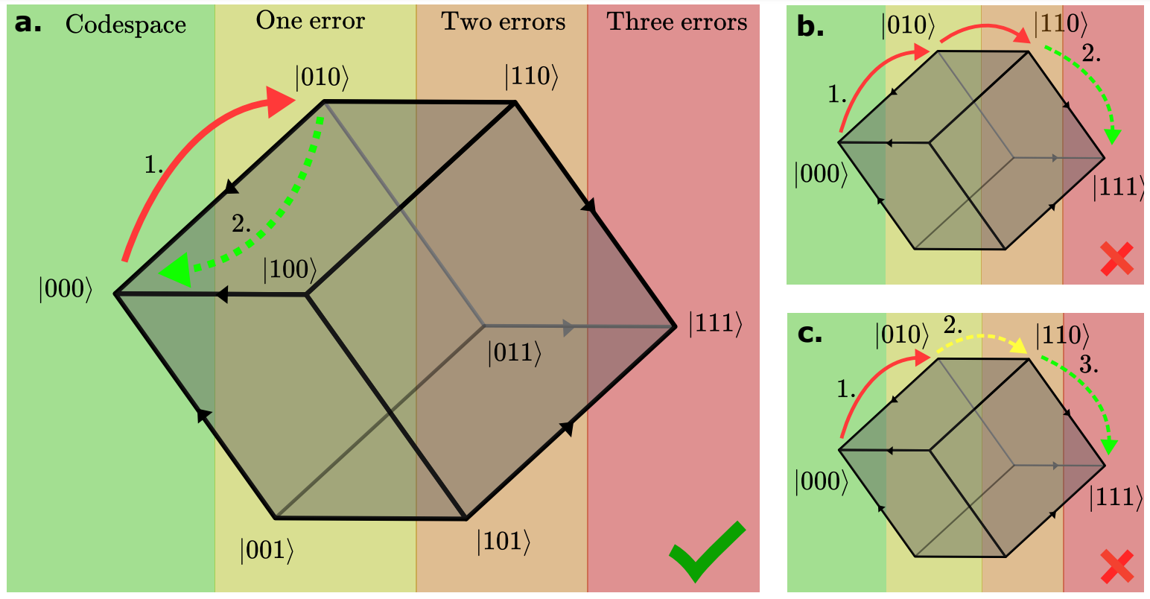

Slide 9
How does this:
Relate to this:

