Slide 1
APPLICATION OF DIFFUSION TENSOR IMAGING TO UNDERSTANDING PROGRESSION IN MULTIPLE SCLEROSIS: A 5-YR LONGITUDINAL STUDY
Stasson Lea

Slide 2
PROJECT WORKFLOW
Data acquisition
• Undergo MRI scans including T2 flare (DWI)
• Gather relevant clinical data from patients with standardise medical testing
Image pre-processing
• Convert file type (dcm to nii)
• Identify artifacts an anomalies that require attention
• Reorient brain scan and perform region segmentation
DTI processing
• Perform DTI analyse on DWI pre-processed image
• Obtain DTI parameter data
Data corrections
• Identify outliers from clinical and DTI data
• Confirm legitimacy of undertake corrective action
Statistical analysis
• Identify input and output variables from collected data
• Undergo data analysis using R
• Utilise GLMnet to fit generalized linear models
Clinical results interpretation
• Assess how the deduced models predict changes in MS patients severity by comparing prediction results with known future data (5 year clinical data.

Slide 3
RESEARCH QUESTION
CAN BRAIN DTI (AND OTHER) METRICS PREDICT CHANGE IN CLINICAL OUTCOMES IN MS PATIENTS OVER 5 YRS USING MACHINE LEARNING?

Slide 4
Study Design (Fincog substudy)
MS patients included (n=43)
Measures taken at baseline and 5 year follow-up
Clinical measures
Tx group (Fing, Tec, Inj)
Disease duration, age of onset, age, sex
EDSS, ARCS, SDMT, MFIS, DASS
MR measures
Volumetric (inc. lesion)
MRS (12 metabolites in 3 brain regions - hippo, PFC and PCC)
DTI (4 parameters)

Slide 5
INPUT INFORMATION
Computational Analysis
Clinical Outcomes
DTI Data
Brain Regions
MRS Data
Hippocampus
Vol. Data
Multifactor Linear Regression via penalised feature selection
R Data Analysis Package: GLMnet
Change over 5 yrs:
tARC (Cognition)
EDSS (Severity)
DASS21 (Mental)
SDMT (Cognition)
MFIS (Fatigue)
DTI Data
Pre-Frontal Cortex
MRS Data
Vol. Data
DTI Data
Posterior Cingulate Cortex
MRS Data
Vol. Data
Clinical Data
Including Age, sex, age at onset, disease duration and treatment.
Validation and Accuracy testing of best prediction model
Notes:
Analysis workflow
Input variables are baseline measures (n=?)
multiple models will be run starting with DTI parameters only. Then others will be added in to maximise predictive accuracy of clinical outcomes

Slide 6
Preliminary Results

Slide 7
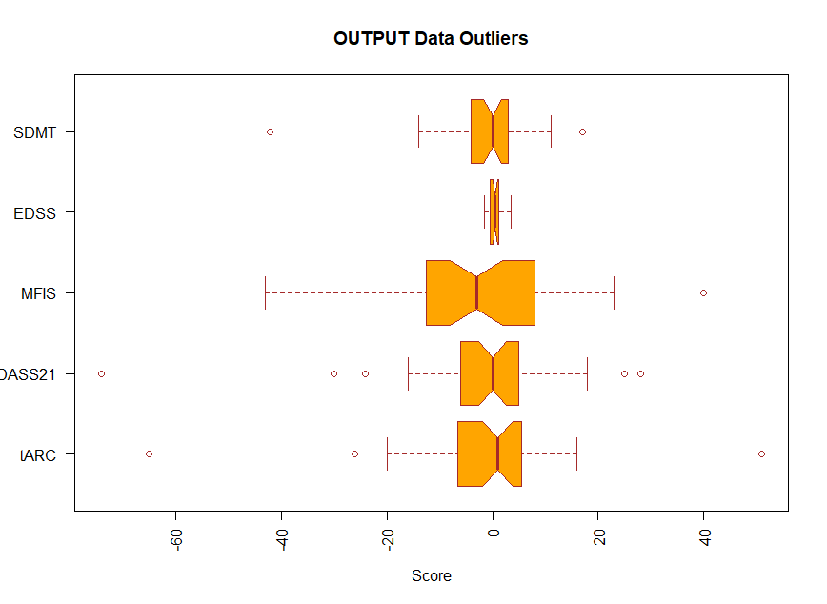
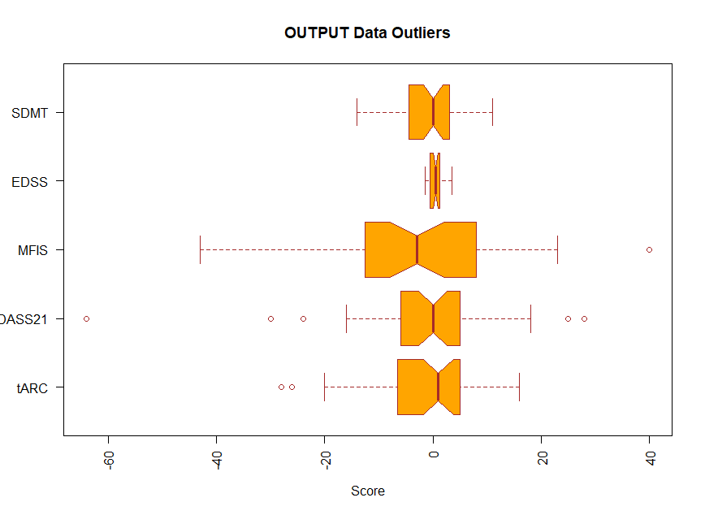
Identifying outliers in clinical outcomes
Unclean
Clean

Slide 8
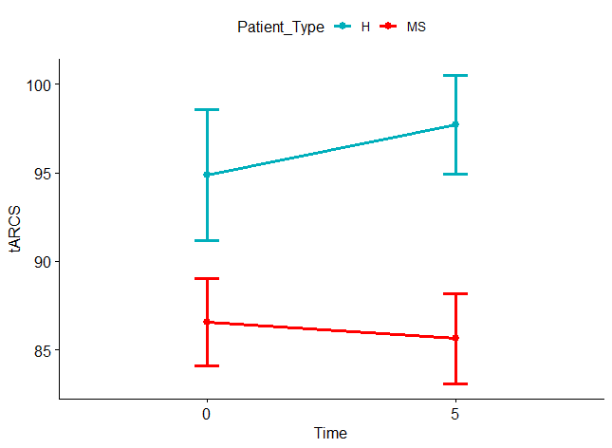
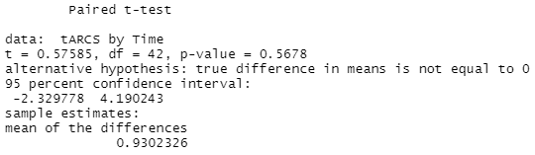
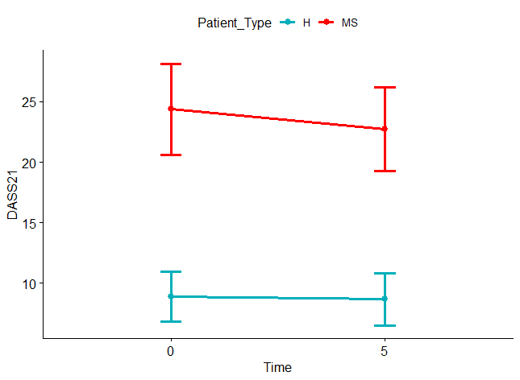
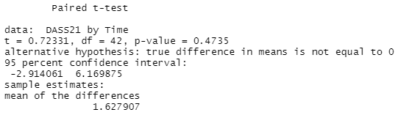
Change in Clinical Parameters
tARCS
DASS21

Slide 9
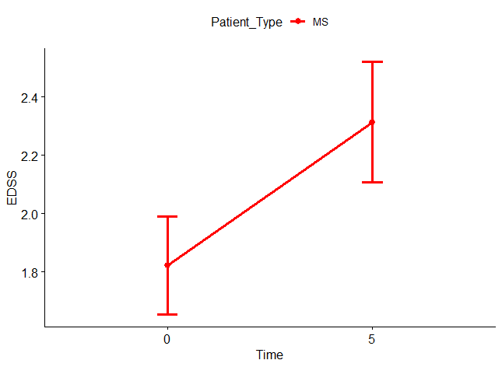
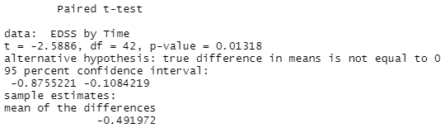
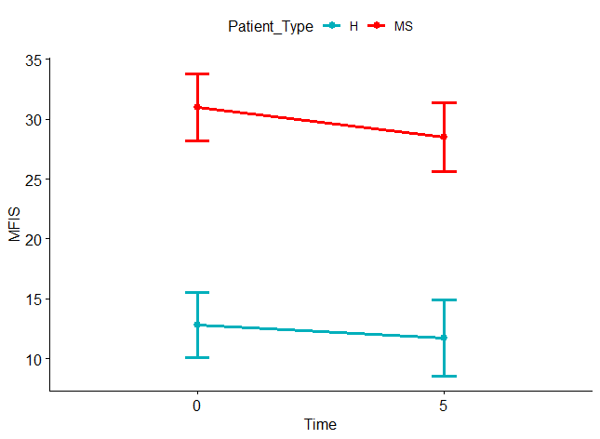
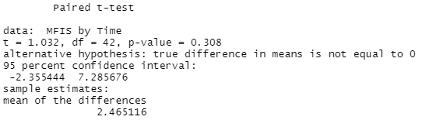
EDSS
MFIS

Slide 10
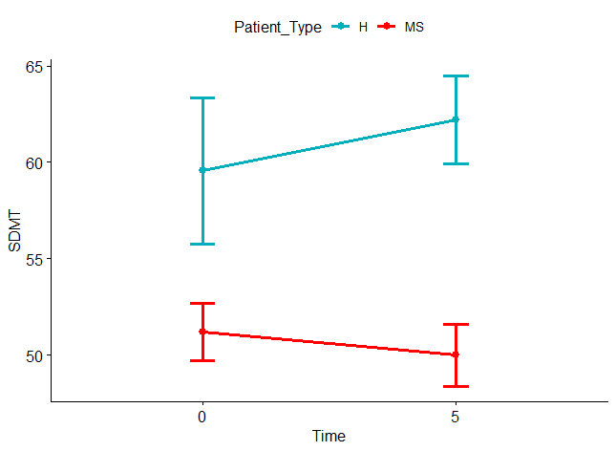
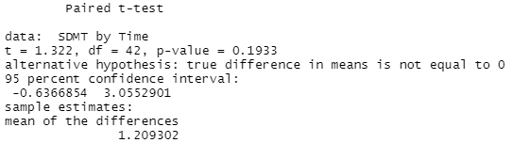
SDMT

Slide 11
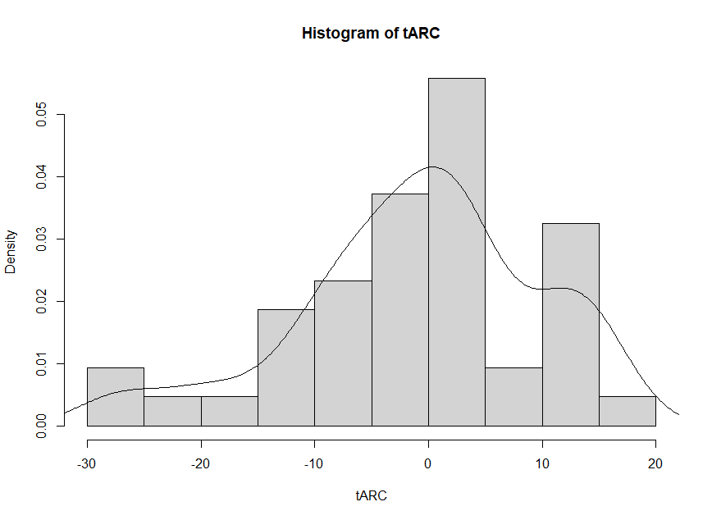
Variation in delta tARCS
Notes:
Make the point that there is variation in the delta scores for tARCS (cog) among patients over time.

Slide 12
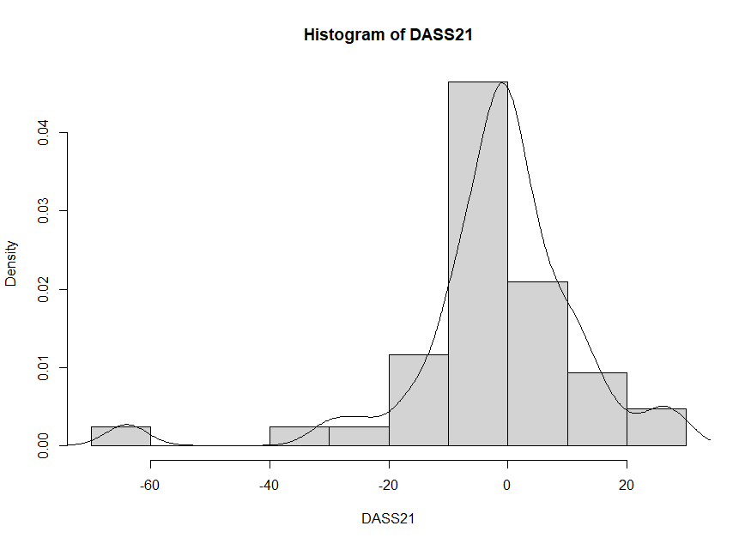
Histogram DASS21

Slide 13
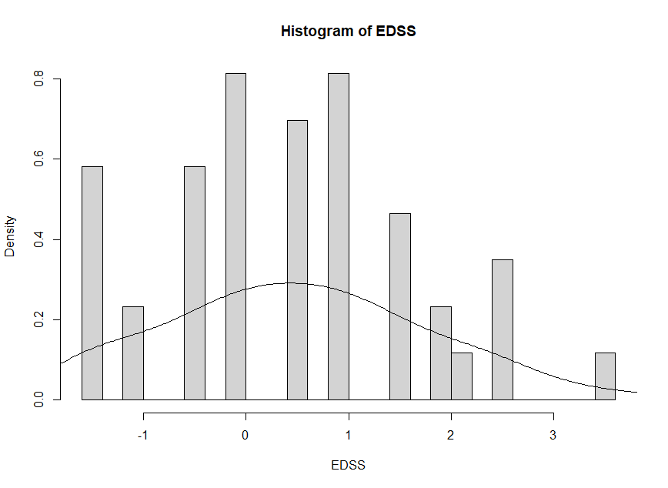
Histogram EDSS

Slide 14
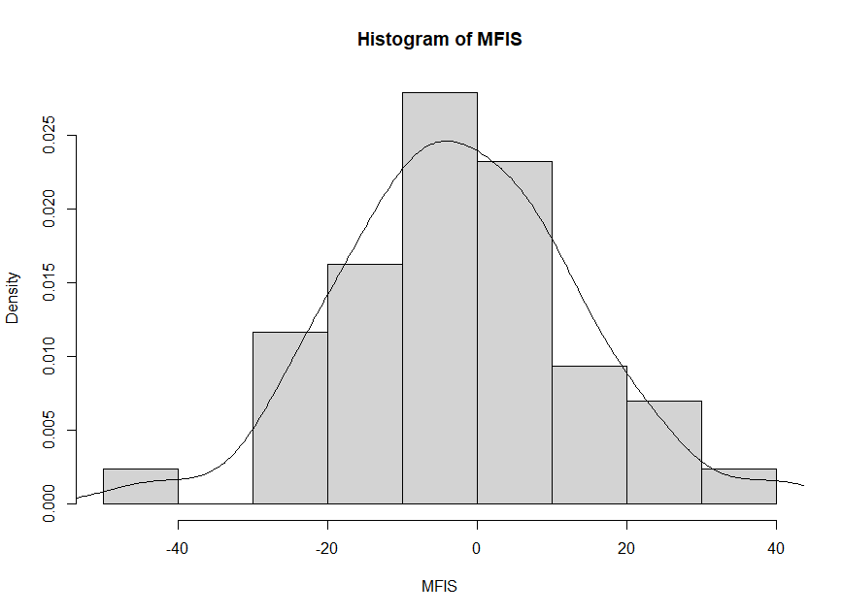
Histogram MFIS

Slide 15
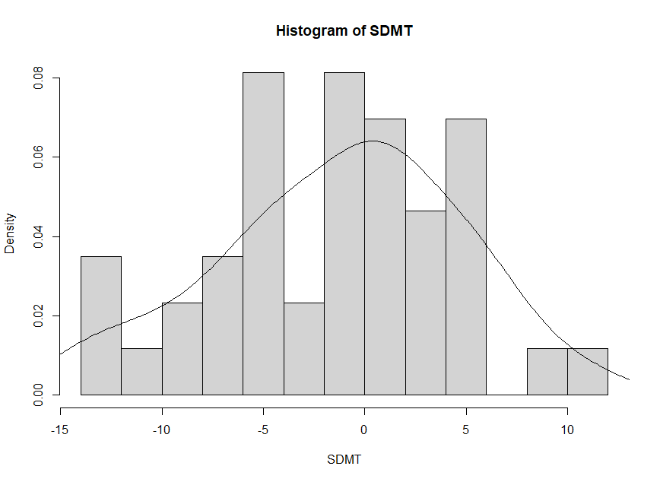
Histogram SDMT

Slide 16
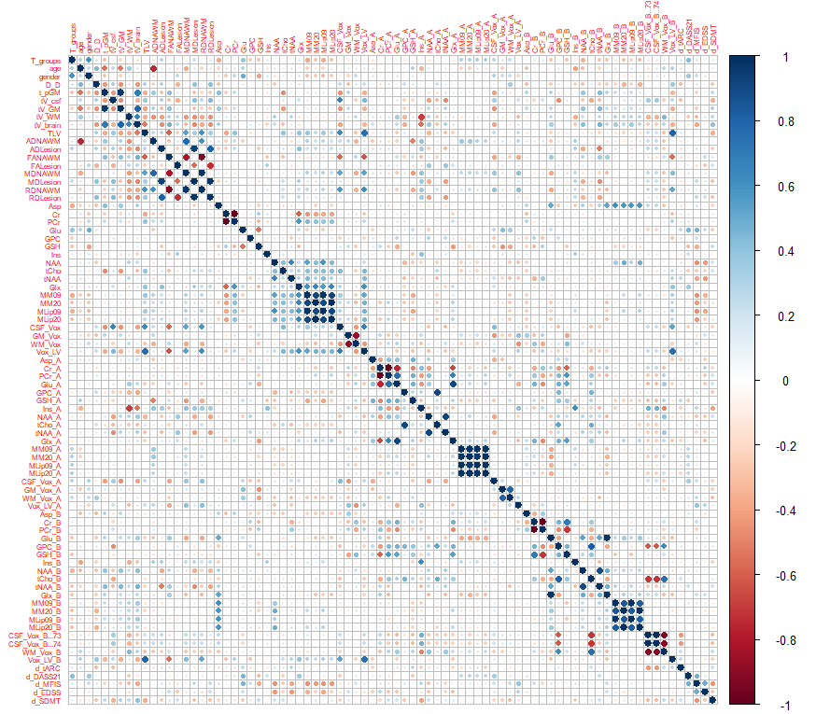
Exploring the data space through Bivariate Correlations
Notes:
A pre-requisite of GLMNet is that there is some evidence of linear correlations between input ant outcome variables

Slide 17
What’s next?
Check some patient data points for DTI
Set up GLMnet analysis pipeline
Run machine learning models
DTI metrics only
Add in other MR metrics (MRS, Volumetric)
Add in clinical metrics (Tx, disease duration, age, sex etc)
Maybe try “non-linear” ML technique (XGBoost)
Write up results and submit for publication
Timeline June 30th

Slide 18
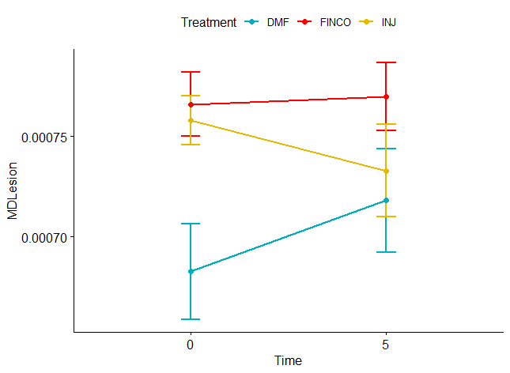
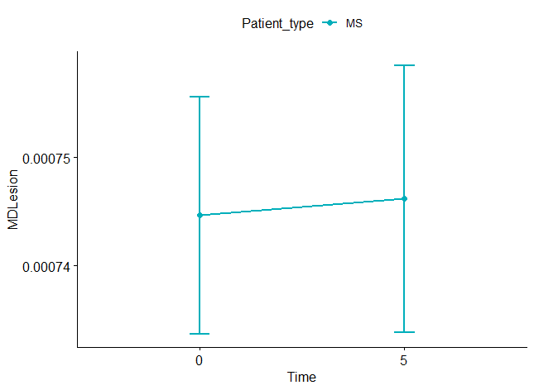
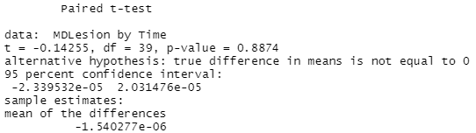
Change in MD Lesion

Slide 19
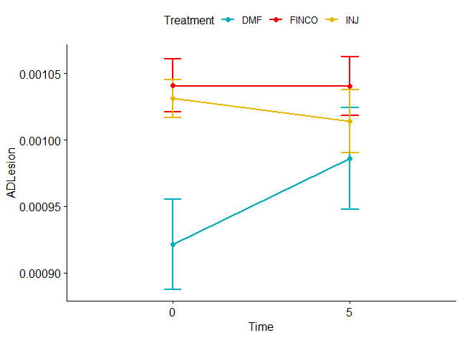
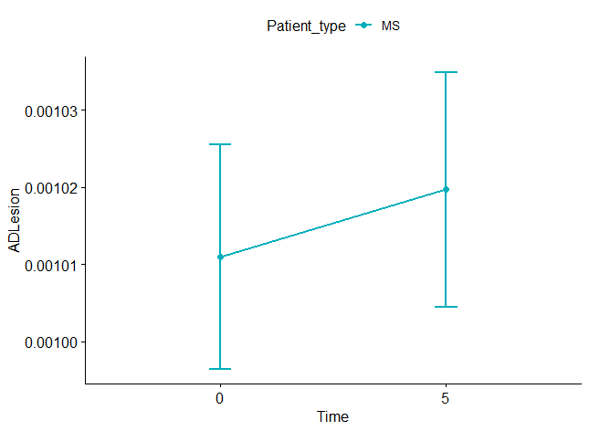
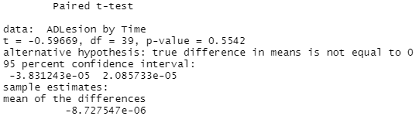
Change in AD Lesion

Slide 20
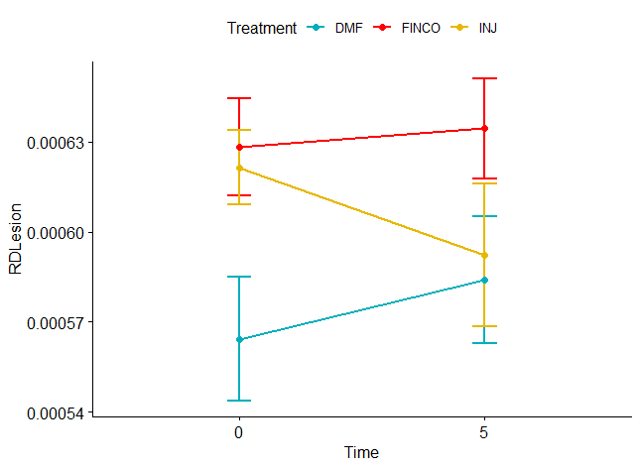
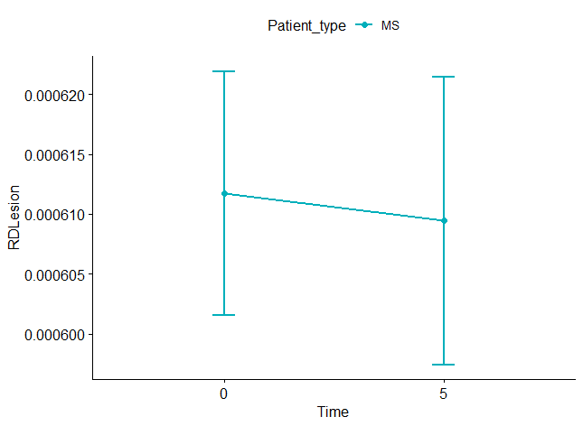
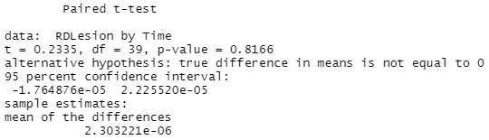
Change in RD Lesion

Slide 21
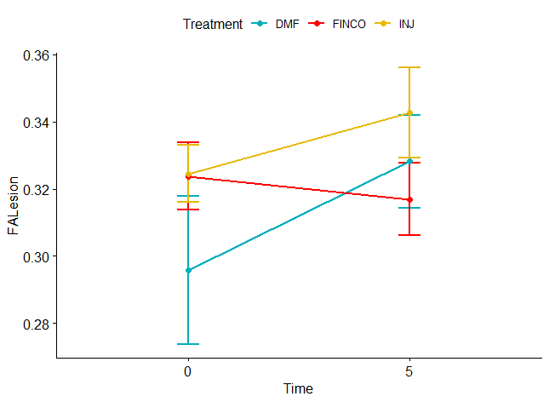
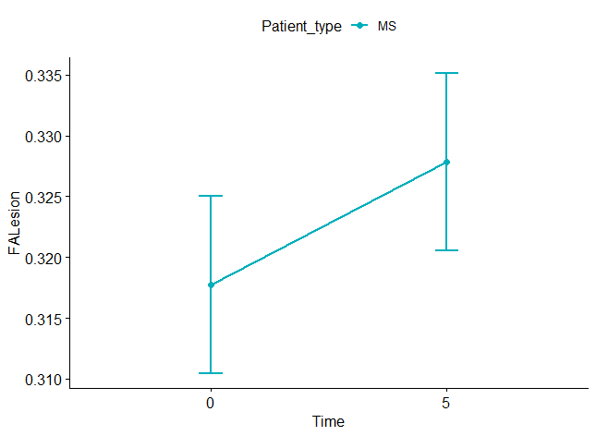
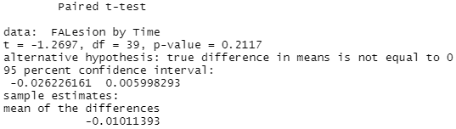
Change in FA Lesion

