Slide 1
Cotton and Cottonseed Price Trends (1910-1938)
Ananya Drishti, Ekansh Bharadwaj, Hannah Wu
For – Final Project of Stat 184,
Section 01, Fall 2024

Slide 2
DATA
Time Period
Data Sources
Analysis Tools
Analysis covers 1910 to 1938
Cotton wholesale prices and cottonseed prices
R scripts for data processing and visualization
SOURCE: https://www.nber.org/research/data/nber-macrohistory-iv-prices
Cotton Wholesale Prices (1910–1938): Tracks historical cotton prices.
Cottonseed Prices (1910–1938): Captures complementary market data.
Merged Dataset: Combines cotton and cottonseed prices for comparative analysis.

Slide 3
INSIGHTS
PRICING TRENDS:
General trends observed over analysed period.
Cotton prices have steadily increased, reflecting inflation and rising demand.
SEASONABILITY & VARIABILITY: Identified through boxplots and histograms
Prices peak during harvest months, showing seasonal demand.
PRICE RELATIONSHIPS:
Correlations between cotton and cottonseed prices
Cottonseed prices are positively correlated with wholesale prices, suggesting that seed cost is a strong predictor of market behavior.
A strong correlation between cotton and cottonseed prices. Economic events like market crashes or agricultural policies significantly affected both commodities simultaneously.
Market shocks during certain periods (e.g., wars or economic downturns) caused abrupt price changes. (NEEDS TO BE EXPLORED FURTHER)

Slide 4
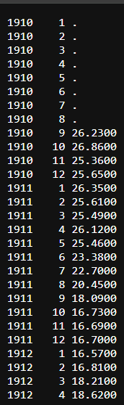
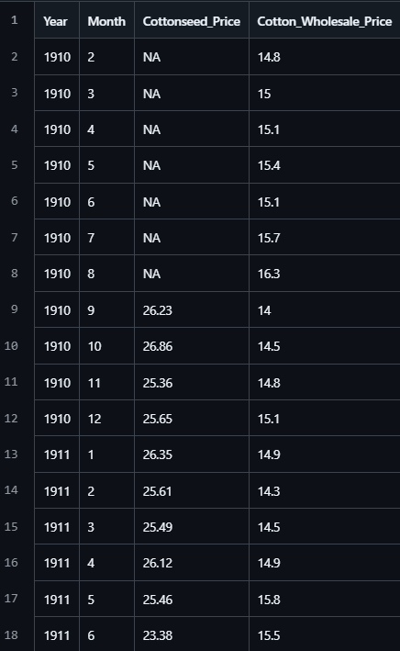
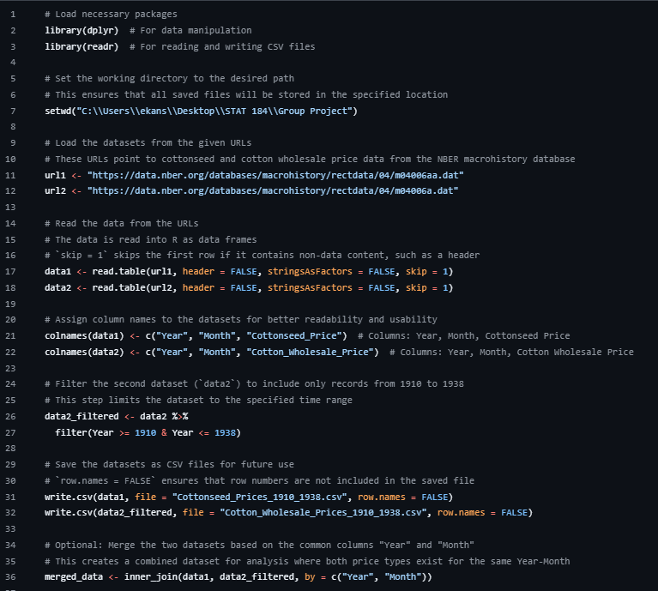
CHALLENGES
Issue 1: Inconsistent Data Intervals
Missing records, particularly in the early 1920s, made year-over-year calculations challenging.
This required additional processing to interpolate or adjust the data.
Issue 2: Data Format
The dataset was in .dat format, which required conversion to a more accessible format like .csv for analysis.
Filtering and tidying were necessary to clean the data and make it usable.
How It Was Addressed:
Applied filtering techniques and cleaned the dataset to address missing information.
Reformatted the .dat files into a structured dataset.
Code
Before
After

Slide 5
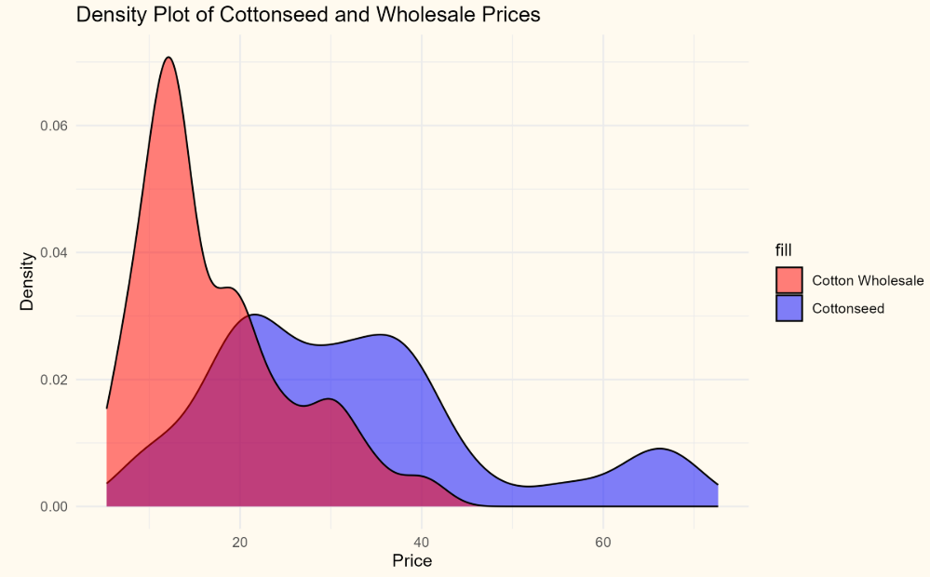
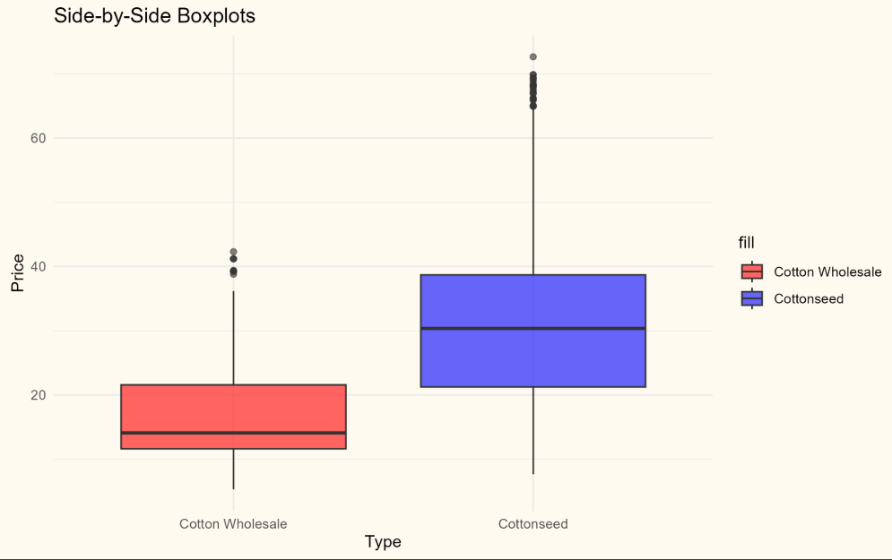
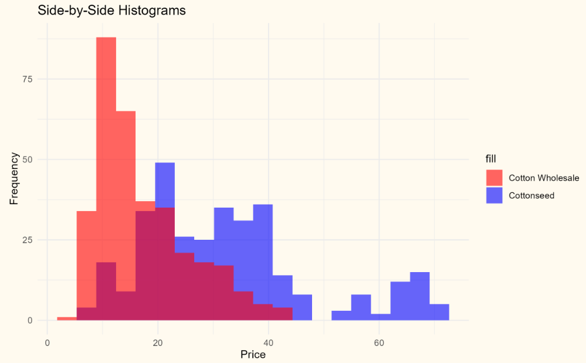
Progress/ Future Plans
Progress Made
Data cleaning and formatting from .dat to .csv.
Initial exploratory data analysis (e.g., trends identified in cotton prices).
Identified correlations between cotton and cottonseed prices.
Perform detailed statistical analysis (e.g., regression analysis to confirm price correlations).
Address the missing data by interpolation or estimation techniques.
Develop visuals, such as trend graphs and distribution plots, to support insights.
Future Plans
Develop visuals, such as trend graphs and distribution plots, to support insights.
Prepare final conclusions and recommendations based on your findings.

