Slide 1
World Happiness Index
By: Shania, Sree, and Lauren

Slide 2
What We Are Exploring
World Happiness Index Data Set (2015 - 2019)
World Bank World Development Indicators

Slide 3
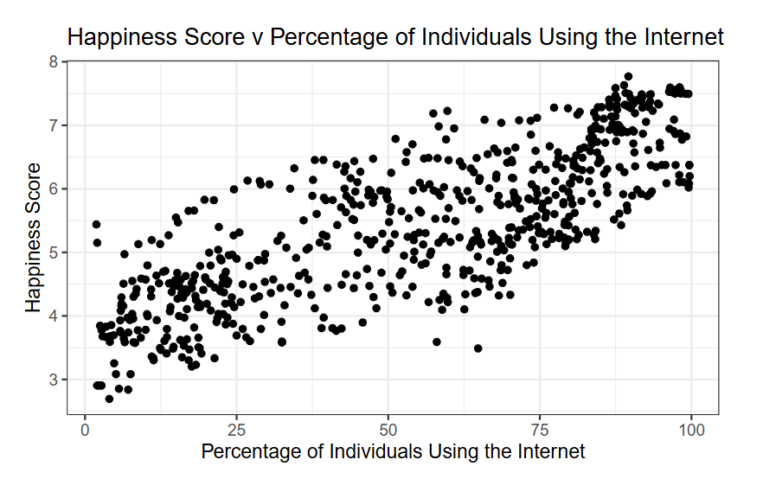

Slide 4
Challenges
World Happiness Index data missing regions, but want to use regions in EDA/final visualization

