Slide 1
Where CS2 Teams Win
A Map-by-Map Look at the Top 5 Teams in 2025
Vitality Falcons Spirit
FURIA MOUZ
Data: HLTV.org | Big Events, Jan–Dec 2025

Slide 2
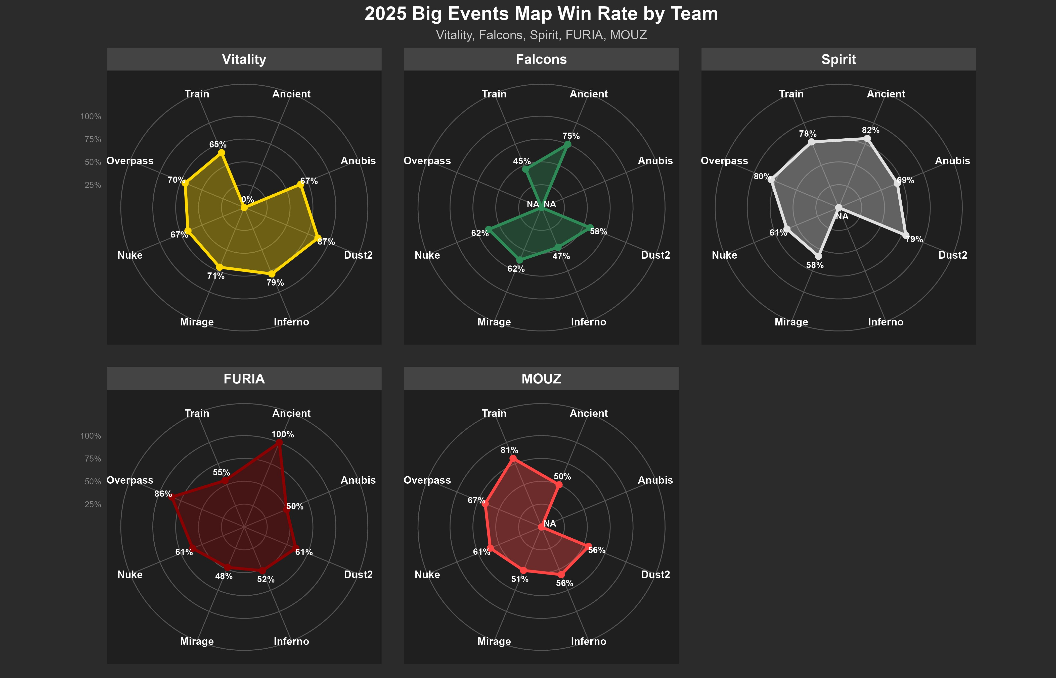
Each Team Has Its Own Shape
A balanced team fills the radar evenly. Specialists have spikes and valleys.

Slide 3
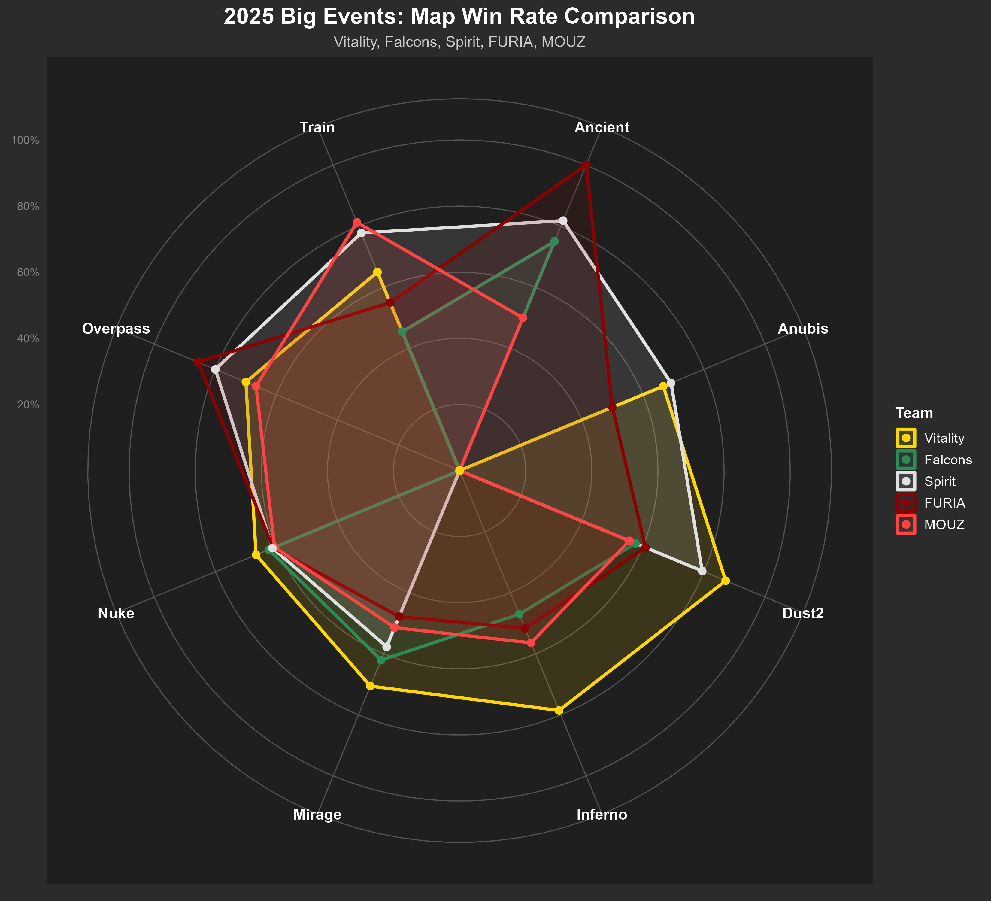
Head to Head, All Five Teams
Where teams overlap is where map vetoes get interesting.
Best Team by Map
Dust2 — Vitality (87%)
Inferno — Vitality (79%)
Mirage — Vitality (71%)
Ancient — FURIA (100%, 1 map)
Anubis — Spirit (69%)
Nuke — Vitality / MOUZ (67% / 61%)
Overpass — FURIA (86%)
Train — MOUZ (81%)

Slide 4
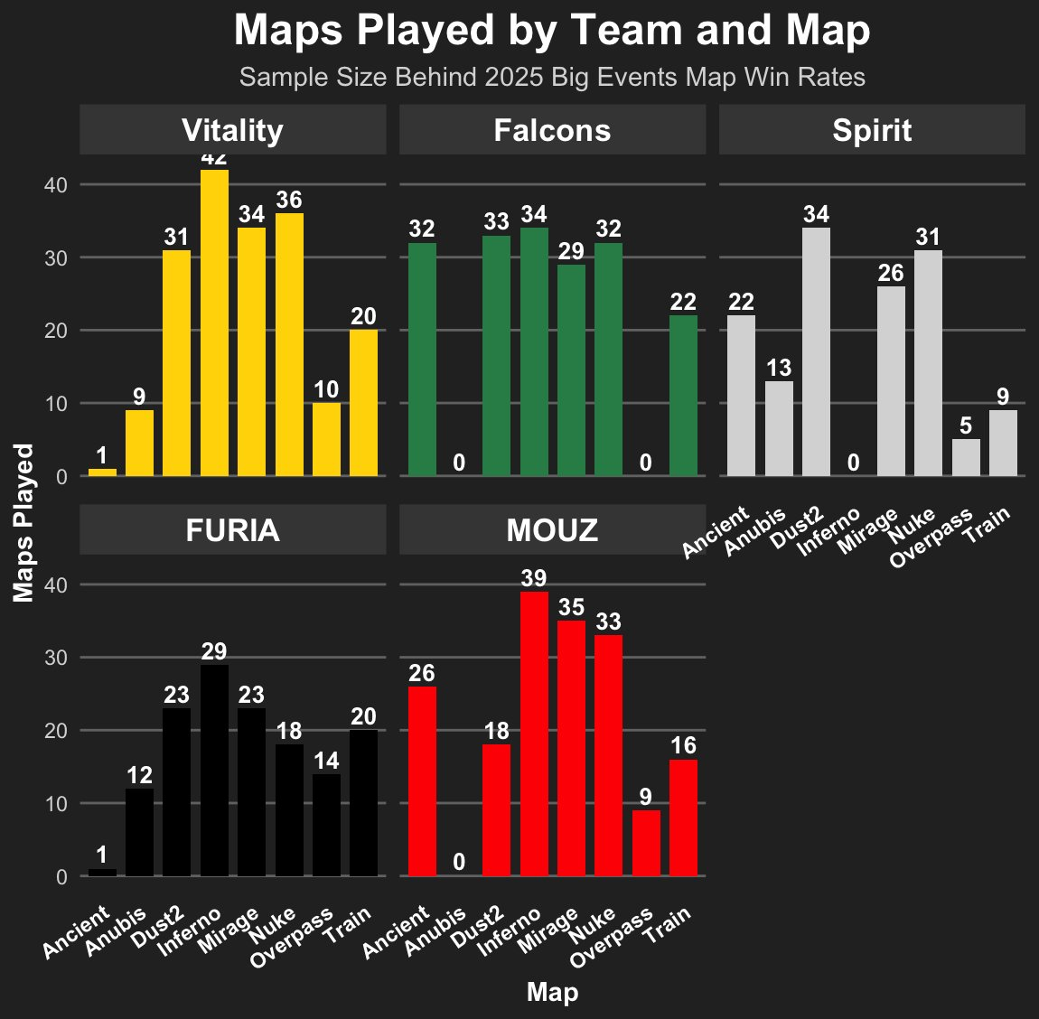
How Often Each Map Was Played
Sample size matters. A 100% win rate from one map is not the same as 80% from thirty.
Inferno, Mirage and Nuke are core picks for almost every team
Spirit and MOUZ both ban Inferno permanently (0 maps played)
Falcons ban Anubis and Overpass
Vitality and FURIA almost never let Ancient through
Vitality has played Inferno 42 times — the largest single-map sample of any team
Key Observations

Slide 5
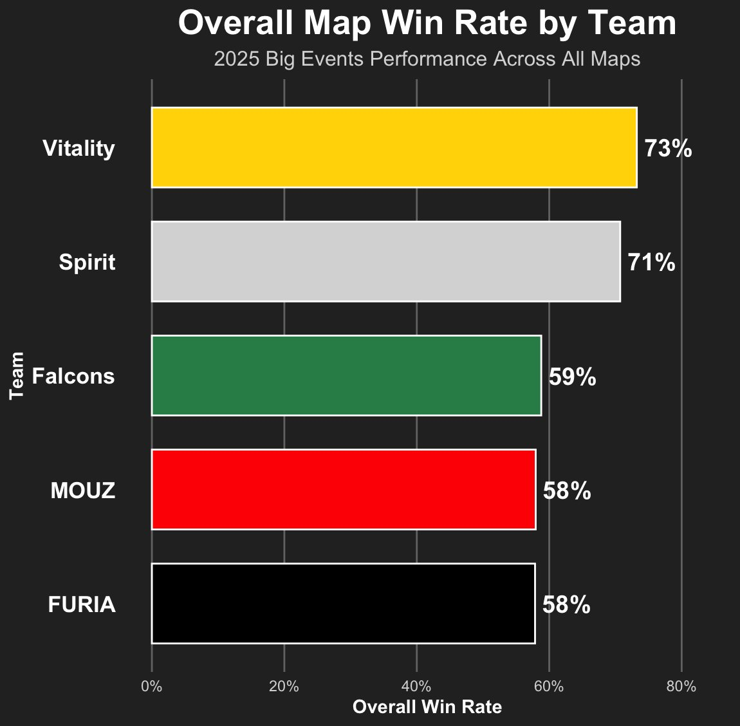
Vitality and Spirit Lead the Pack
Overall map win rate across the active map pool, all big events in 2025.
Big Three
Vitality and Spirit sit in their own tier above the rest. A 12+ point gap to MOUZ and FURIA is huge over a 100+ map sample — this is not noise.
Why So Close at the Bottom?
Falcons, MOUZ and FURIA all sit between 58–59%. To separate them, we need to look at how they perform on each map individually.

Slide 6
So What Did We Learn?
Three takeaways from a year of CS2 map data.
1
2
3
Vitality is Genuinely Dominant
Map Pools Tell a Story
Sample Size Warning
73% overall win rate, top performer on Dust2, Inferno and Mirage. Their lowest map (Train, 65%) is still better than most teams' best maps.
Spirit and MOUZ permanently ban Inferno. Falcons skip Anubis and Overpass entirely. These choices show real preference — and create matchup opportunities.
FURIA's 100% on Ancient is one map. Falcons' 0 plays on Overpass tells us nothing about how they would perform there. Always check the count before the rate.
Source: HLTV.org match results, 2025 Big Events

Slide 7
Challenges & Next Steps
What was hard, and where this project goes from here.
Challenges
Next Steps
Data scraping was slow
HLTV blocks automated requests, so we had to fall back to manual collection. A reminder that data security matters - sites protect their data for good reasons, but it makes legitimate research harder.
Iterating on the radar charts
Making the R plots both complete (handling NA values, sample size differences) and visually clean took several rounds of tuning - colors, labels, scales, and layout.
Build a map pool depth score
Layer additional metrics on top of the radar charts - round win %, performance against top-10 teams, recent form - to score how deep each team's map pool really is.
Produce a final 2025 ranking
Use that depth score to build a data-driven year-end ranking of the five teams - something that goes beyond raw win rate and reflects how reliably a team can win across the whole map pool.
Source: HLTV.org match results, 2025 Big Events

