Slide 1
Exploring Daily Weather Patterns in State College, Pennsylvania
By: Qihaohan, Ata, Jincheng
2026-04-27

Slide 2
What We’re Exploring
Daily weather patterns in State College, PA
NOAA station data for State College, PA
Main variables: maximum temperature, minimum temperature, precipitation, snowfall, and snow depth

Slide 3
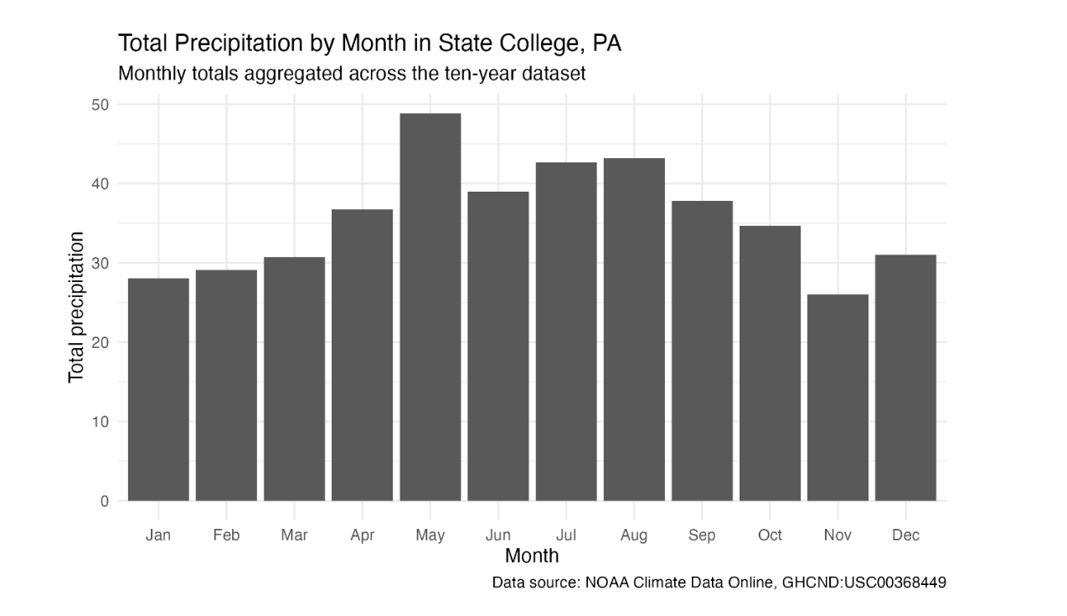
One Insight So Far
Precipitation happens year round in State College
Spring and summer months appear wetter overall
May shows the highest total precipitation in our summarized data

Slide 4
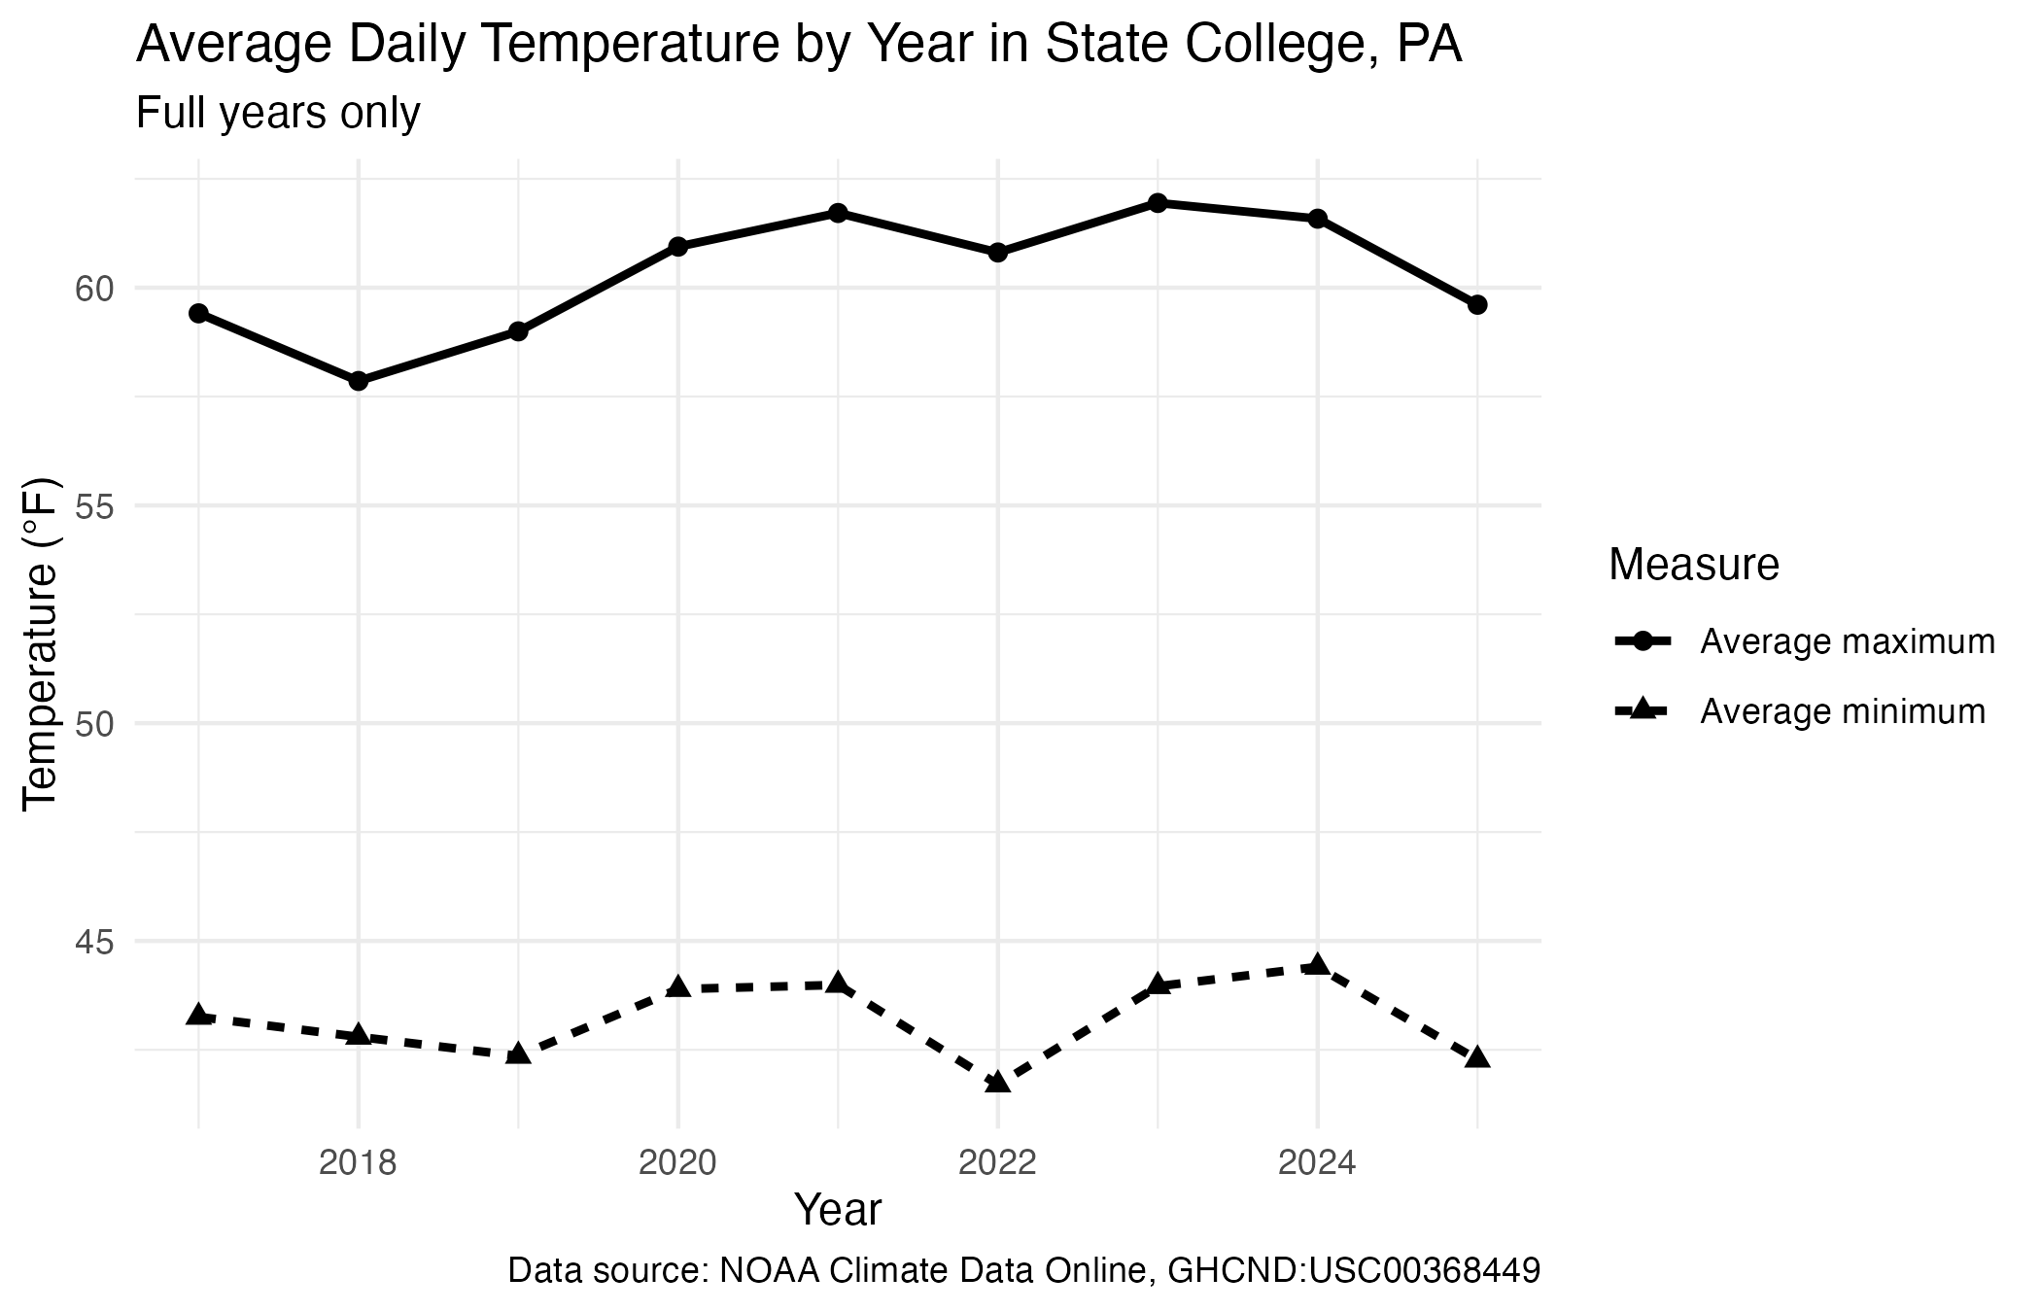
Challenge: Partial Years Can Mislead
2016 and 2026 are partial years, not full calendar years
Including them can distort annual comparisons
The sharp 2026 drop does not mean a true climate shift
For presentation purposes, we compare full years only

