Slide 1
Recommender System
Yanan Huo, Yaqi Zhou, Kejia Shi, Li Luo

Slide 2

Content-based Filtering Recommender
Collaborative Filtering Recommender
  Random recommender
  Popular recommender
  User-based collaborative filtering
  Item-based collaborative filtering
  PCA
  SVD
Hybrid Collaborative Filtering Algorithm
  users’ rating
  users’ demographic characteristics
  users’ preference
Notes:
Some associations exist between users’ demographic characteristics and users’ preference

Slide 3
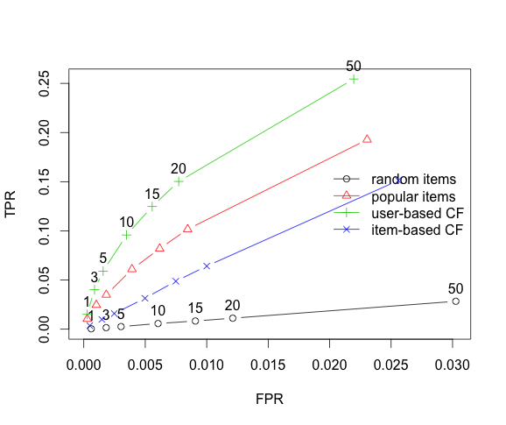

Slide 4
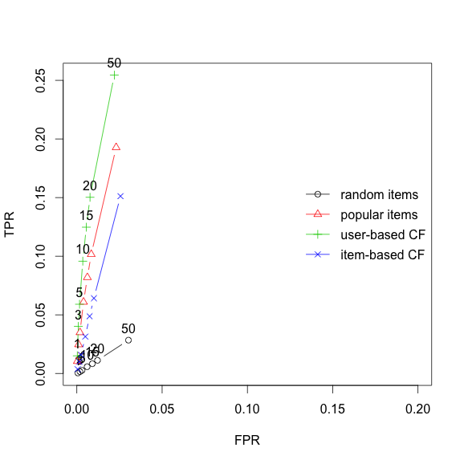

Slide 5
 | 1st | 2nd | 3rd | 4th | 5th
UBCF | Empire Strikes Back, The (1980 | Shawshank Redemption, The (1994) | Return of the Jedi (1983) | Raiders of the Lost Ark (1981) | Braveheart (1995)
 | 4.350 | 4.330 | 4.328 | 4.280 | 4.210
IBCF | French Twist (Gazon maudit) (1995) | Taxi Driver (1976) | Hoop Dreams (1994) | Madness of King George, The (1994) | Priest (1994)
 | 5.000 | 3.523 | 3.067 | 2.798 | 2.530
RANDOM | Go Fish (1994) | New Jersey Drive (1995) | War, The (1994) | My Fair Lady (1964) | Star Trek: Generations (1994)
 | 4.981 | 4.62 | 2.179 | 0.915 | 0.566
POPULAR | Godfather, The (1972) | Raiders of the Lost Ark (1981) | Titanic (1997) | Schindler's List (1993) | Shawshank Redemption, The (1994)
 | 5.000 | 4.969 | 4.400 | 4.370 | 3.410

Slide 6
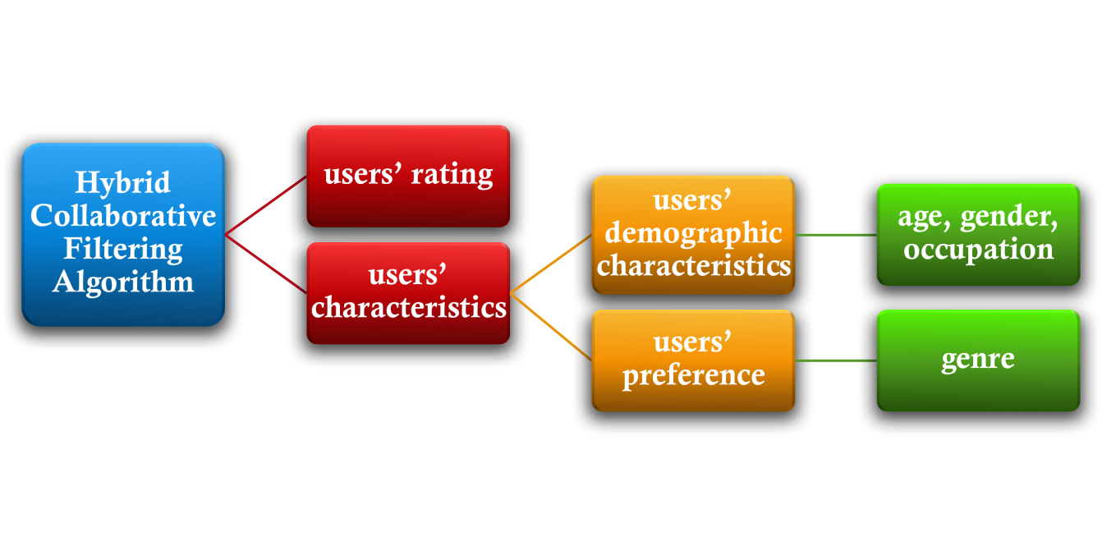
Challenges of CF Recommender:
  data sparsity
  cold-start
Notes:
Data sparsity: We compute similarities and thus recommend films based on the users-items rating matrix. But the number of films that users have rated are very small comparing to the total number of all films released → hard to compute the similarity between users or between items → recommendation accuracy decreases
Cold start: a special case of data sparsity. 1) When there’s a new item in the systems, there’ no rating for this item, recommender cannot recommend it to people who need it; 2) when there exists a new user, this user has no records of rating → impossible to find similar users based on the rating → accuracy decreases, again
Not only the rating for the items show the similarities between users, users’ own characteristics, such as users’ demographic characteristics and users’ preference for some properties of items contribute the similarities between users. Thus, we consider calculating similarities between users using three aspects and take the weighted average of three as users’final similarities

Slide 7
users’ demographic characteristics users’ preference
We thus want to create corresponding information database and if there’s a new user, we can predict his/her preference based on his/her demographic characteristics
This deals with the cold-start challenge to some extent
Notes:
Some associations exist between users’ demographic characteristics and users’ preference

Slide 8
Putting Work on CHTC
Learned how to submit jobs with Linux commands
Installed R and R packages
Learned CHTC server computing power
  More cores and more memories
  Parallel computing rather than a single fast core
Performed the offline clean and recommender lab package on CHTC

Slide 9
Scaling-up: from 100k to 20m
Challenging Parts
  1. Dimension Change
  2. Valid and reasonable methods to divide
  3. Coding for CHTC adaptation
 | 100k | 20m
User Number | 943 | 138,493
Item Number | 1,682 | 27,278
Ratings | 100,000 | 20,000,263

Slide 10
What we have done so far?
Finished bridging offline works with CHTC servers
Data Cleaning
    Wrote code for building a giant rating matrix
    Had our recommender lab code prepared and adapted for CHTC
Used random selection of users and movies and try on the method
We are actively seeking valid methods to divide and slice the total dataset into pieces in order to improve prediction accuracy.

Slide 11
What we are going to do?
Finishing up methods in dividing
Focus on accuracy

