Slide 1
Private ML Track
UNECE Input Privacy Preserving Project

Slide 2
Introduction
Pilot’s goal:
Build a simulated environment to validate the concept of multi party privacy preserving Machine Learning (PPML) for both training and inference.
Project’s scope:
Investigate best practice and open source tools for distributed and collaborative ML training among multiple organisations in a low trust environment whilst mutually benefitting from the outcomes (the final model) or allowing safe 3rd party access.
Environment:
Simulated multi organisational set-up with several NSOs gathering data from individuals (sensors) to predict their activities (time use and well-being surveys).

Slide 3
Introduction
Architecture:
Distributed containerized PPML architecture utilising Federated Learning to train a NN model and enable inference whilst protecting data security, privacy and confidentiality.
Data:
Moderately sensitive - collected by wearable/smart devices using accelerometers, e.g. smart/sports watches. Open data used in the pilot.
Method:
ML toolset - a typical ML classification task (i.e. to predict human activities starting from accelerometer data)

Slide 4
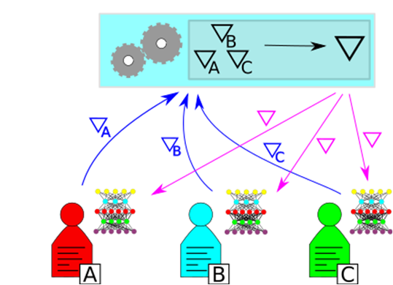
Federated Learning
In FL, each party (e.g. NSO) holds a neural network that would like to train.
After each round of the training, the parties send their weights (or parameters) to a central authority.
Central authority aggregates the weights and send instructions to parties to update their local models.
This process is repeated several times. Note that only the accumulated weights are shared among parties.
The final model can be used locally by parties for inference on new data.
FL protects the privacy of the input data by ensuring that the data never leaves the clients’ devices.
https://www.statcan.gc.ca/eng/data-science/network/privacy-preserving

Slide 5
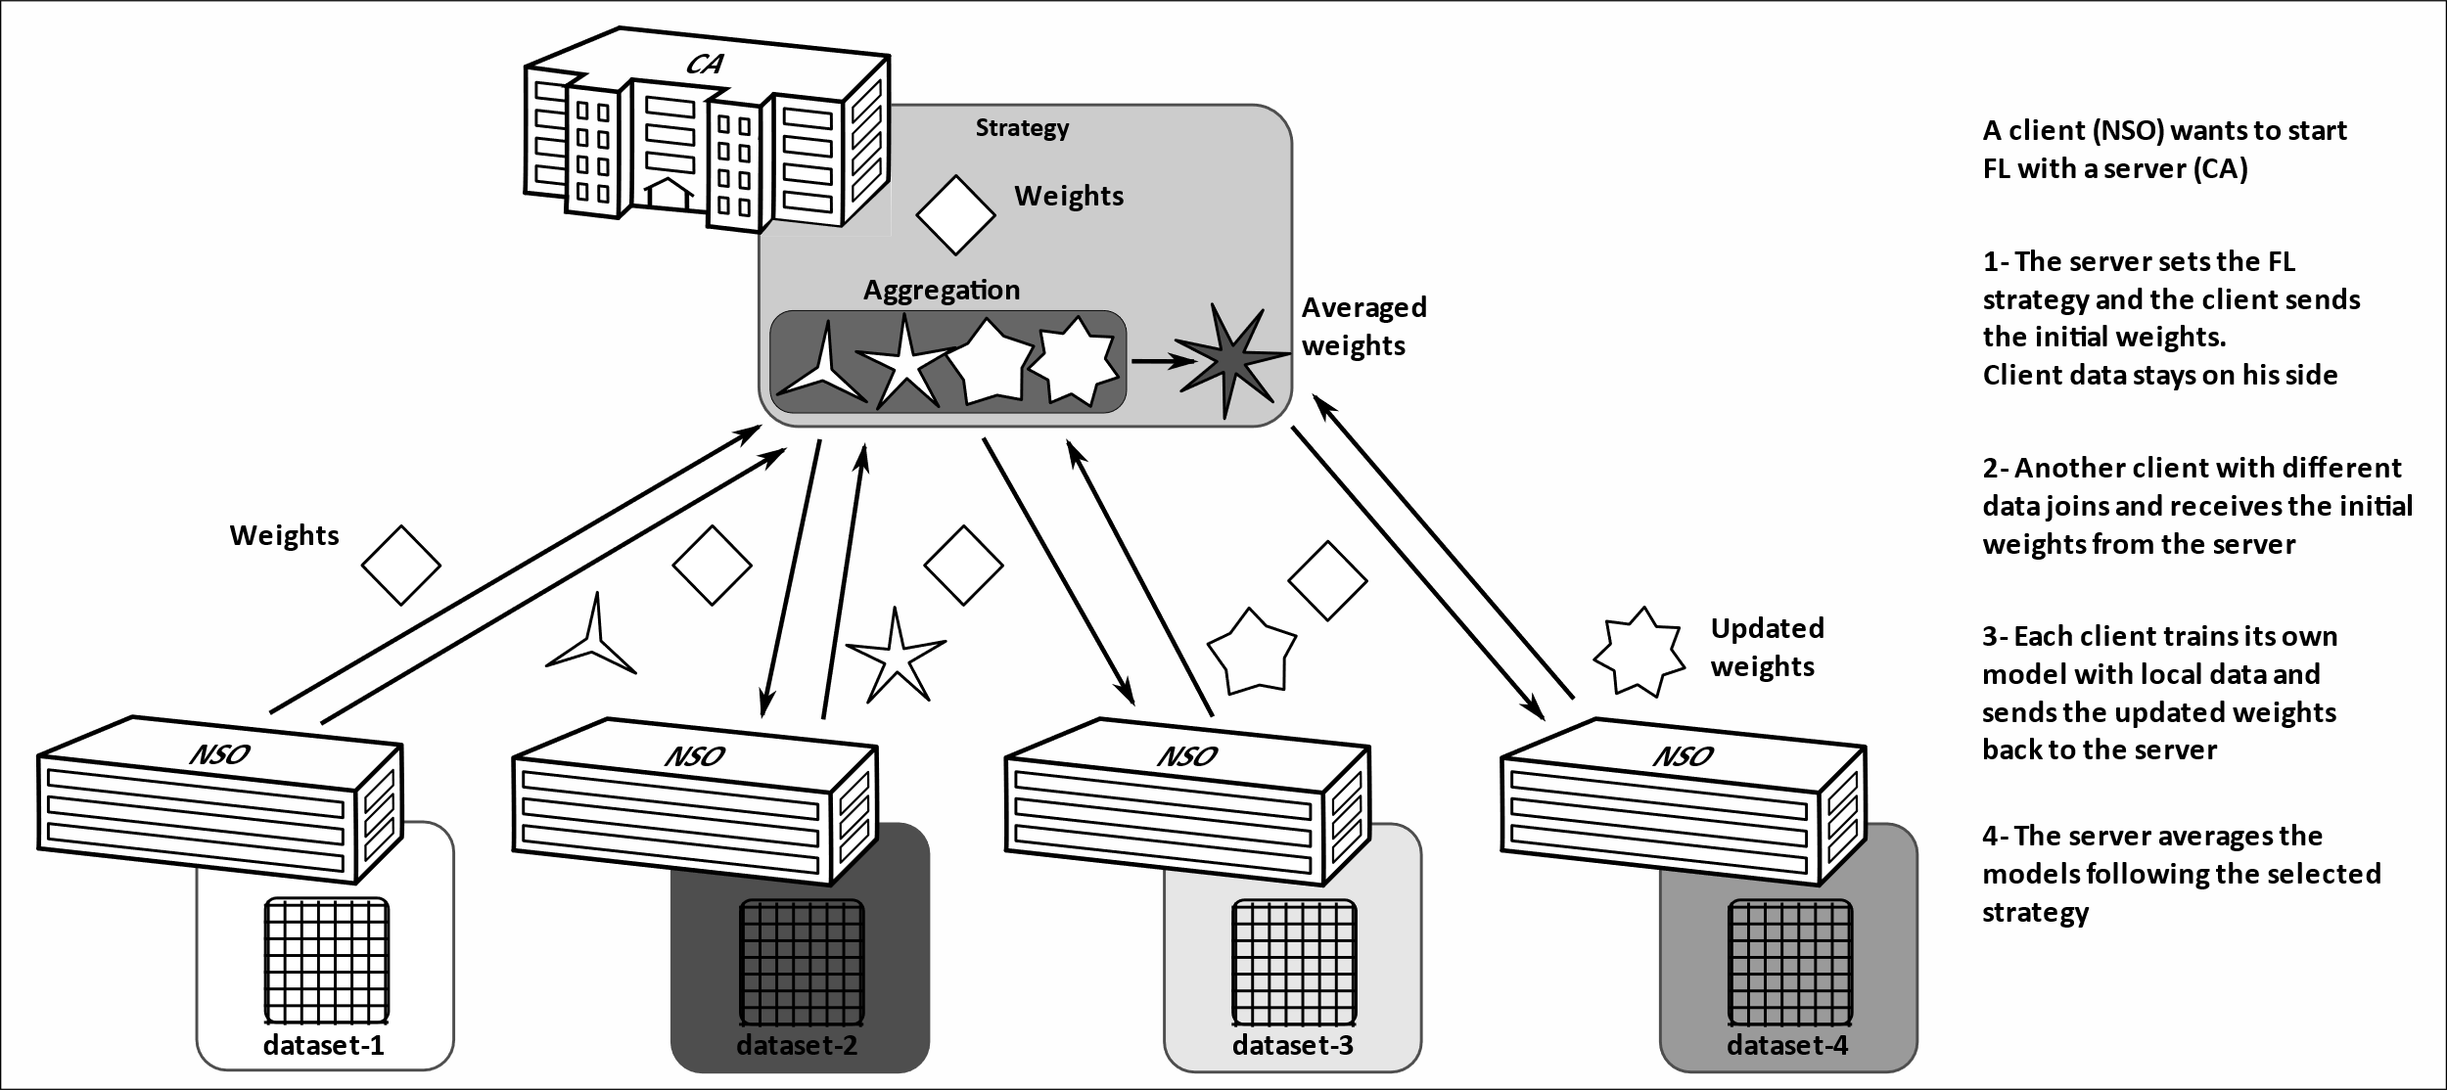
Simulated Environment (Scenario 1)
Notes:
In this scenario, the server never learns the model properties, e.g. the layers, activations, …
Server decides the aggregation strategy, i.e. FedAvg
Every client starts with the same set of initial weights. First client that connects sets the initial weights.
Every client shares the model code base.
This is more appropriate for propriety models.
The process is repeated for a certain number of rounds until desired accuracy is reached.

Slide 6
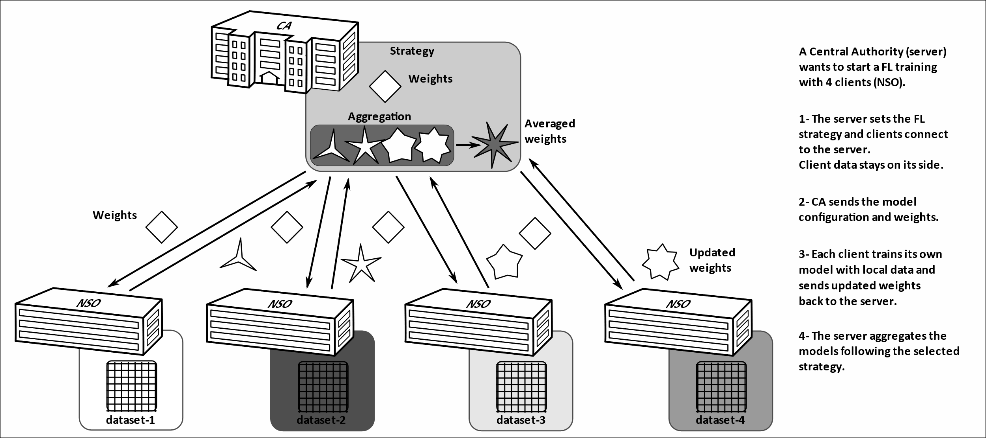
Simulated Environment (Scenario 2)
Notes:
Server sets the aggregation strategy, configuration, …, including the initial weights and the model (# and type of layers and activations)
Clients only connect and join the training process. Clients process the model recipe from server.

Slide 7
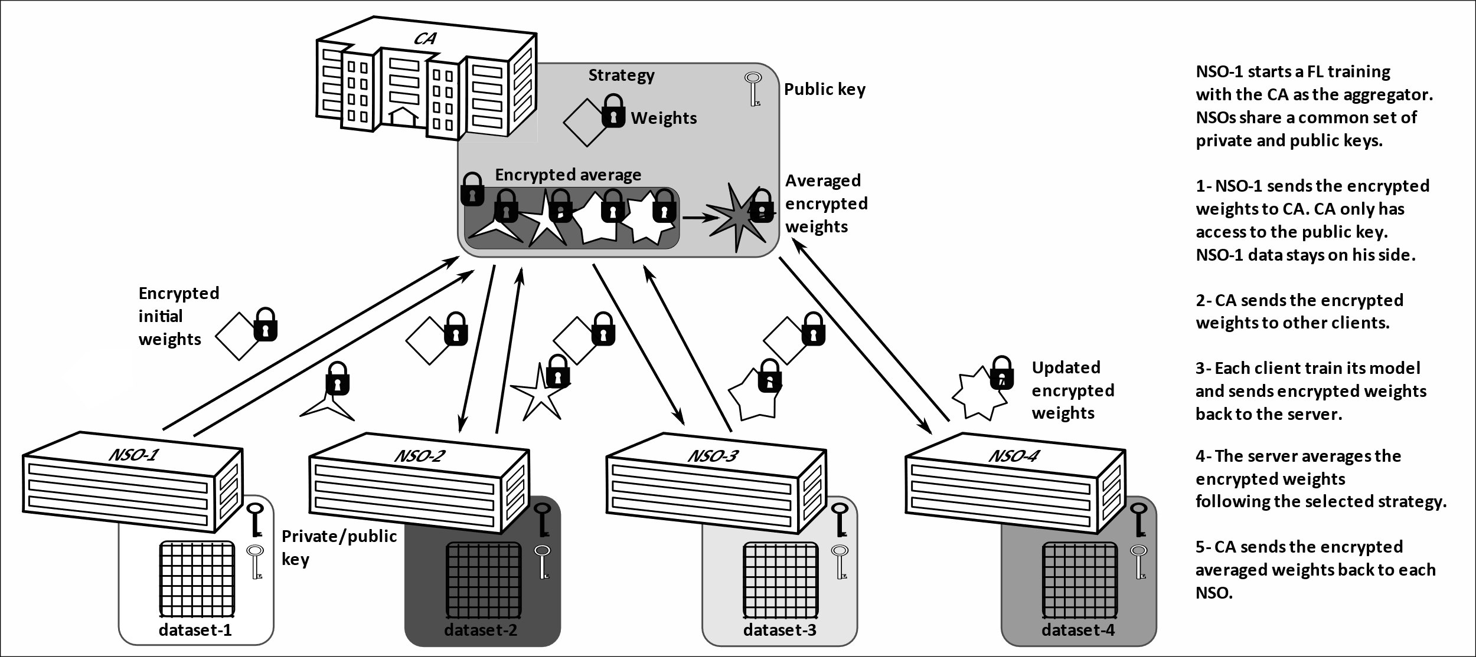
Simulated Environment (Scenario 3)
Notes:
Similar to the first scenario, but the aggregation is done on the encrypted weights.
Clients have similar HE key pairs.
The last layer and activations are encrypted.
CA sends back the updated model (not shown in the figure) for each training round.
Local training is done on the clear / one decryption/encryption step by round
At the end of training rounds clients get the final updated model.

Slide 8
Simulated Environment (Data & Model)
Human activity recognition using smart devices’ accelerometer and gyroscope data*, after pre-processing.
The goal is to classify the data into 6 classes: WALKING, WALKING_UPSTAIRS, WALKING_DOWNSTAIRS, SITTING, STANDING, LAYING.
The data was split into four subsets, one for each NSO (i.e. STATCAN, ONS, ISTAT and CBS), in the experiments.
A neural network (Multi-Layer Perceptron with linear layers and ReLU activations) is used for the purpose of classification.
* D. Anguita, A. Ghio, L. Oneto, X. Parra and J. L. Reyes-Ortiz. A Public Domain Dataset for Human Activity Recognition Using Smartphones. 21th European Symposium on Artificial Neural Networks, Computational Intelligence and Machine Learning, ESANN 2013. Bruges, Belgium 24-26 April 2013.

Slide 9
Simulated Environment (Architecture)
A unified Federated Learning library called Flower* is used to simulate the environment.
Only updated weights are transferred between the central authority and other NSOs during the training.
Transferred weights are aggregated on server side after each round. The averaged weights are sent to clients (FedAvg). In the encrypted version, the average is computed on encrypted weights using the Paillier cryptosystem.
This approach is very customizable: # training rounds, epochs, and network architecture can be changed.
It is possible to use encryption at rest and in transit, using certificates with latest flower development for secure communication.
* https://flower.dev

Slide 10
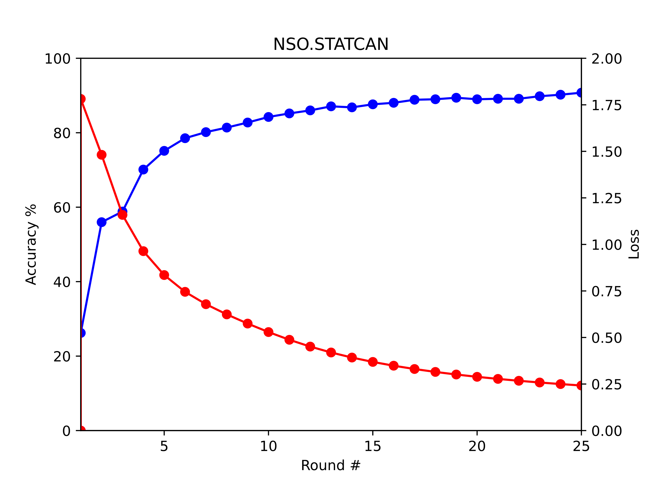
Federated averaged weights strategy results
Test accuracy
Loss
Notes:
These are the plots for the second scenario.
The server broadcasts the last updated model to all clients.

Slide 11
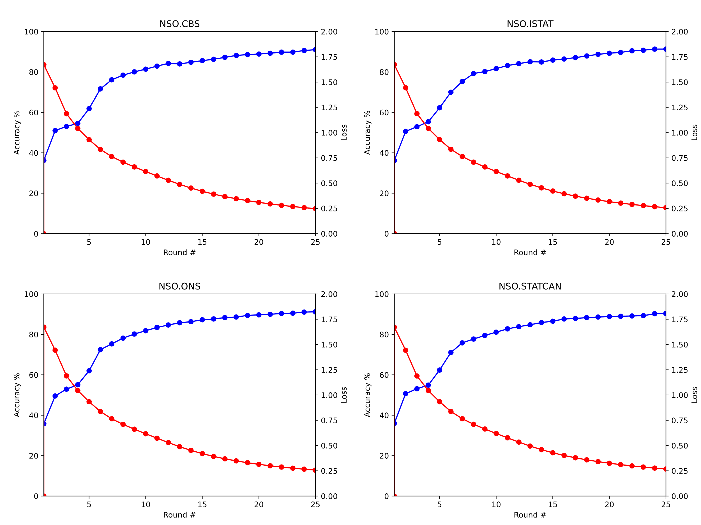
Encrypted Federated Learning
Test accuracy
Test accuracy
Loss
Loss
Test accuracy
Test accuracy
Loss
Loss
Notes:
The plaintext fedavg is 2x faster 8 minutes against 16 minutes (both locally).

Slide 12
Conclusions and Results
This experiment had a simplified scope and was performed in simulation environment.
We have built a community of NSOs in the area of privacy enhancing technologies with link to open source community, industry and academia.
There is a direct link to sustainability, when it comes to collaboration among NSOs, namely new ways of collaboration, driven by privacy requirements and technological constraints.

Slide 13
Challenges and Lessons Learned
Open source software stack support for this particular scenarios.
In reality, inconsistent data formats across multiple NSOs.
Unbalanced and outlier data points and lack of sufficient and good-quality data. Different aggregation strategy can be tested and used to mitigate this.
Pre-processing steps to take into account different international labelling and standards in distributed ML for deployment.

Slide 14
Next Steps
Extend the scope to more complex models and other distributed data related to members of HLG-MOS, e.g. social media, border stats ...
A systematic review of the open source tools and their maturity.
Incorporate Secure Multi-party Computation for secure aggregation of weights during training, as well as inference.
Integrate Differential Privacy as part of the protocol to protect output privacy.
Collaborate with the OpenMined community to use their software stack, with requirements.
Onboard the project to the UN PET-Lab infrastructure.

