Slide 1
Accessing the Amazon Elastic Compute Cloud (EC2)
Angadh Singh
Jerome Braun

Slide 2
Data
Climate data available on NOAA’s website
NCEP/NCAR Reanalysis-1
  Gridded model output of meteorological variables (Temperature, pressure etc.).
  Available daily, 6 hourly etc.
  73×144 (2.5° lat, 2.5° lon), over 10⁴ variables.
  Yearly files (~ 500MB) for 1948-present.
Big Data ?! (Probably.)
http://www.esrl.noaa.gov/psd/data/gridded/data.ncep.reanalysis.html

Slide 3
Data Format
Network Common Data Form (NetCDF)
  Software libraries and machine independent data formats.
  Data access libraries provided in JAVA, C/C++, Fortran, Perl etc.
Developed and supported by unidata
http://www.unidata.ucar.edu/software/netcdf/docs/faq.html#whatisit

Slide 4
Data Access – R packages
The netCDF interface extracts parts of large data.
R (MATLAB) packages simplify the interface to gory low-level routines.
R packages
  RNetCDF
  ncdf
Also extracts descriptions, creation history and other important attributes.

Slide 5
Amazon’s Elastic Compute Cloud (EC2)
Amazon web services for computing
  EC2
  Elastic Map Reduce (EMR).
Data storage solutions (DynamoDB, RDS, S3 or EBS).
Hope to use multiple features for storing input/output files and perform intensive computations.

Slide 6
EC2 instances
A virtual computing environment with a web interface.
Create and configure an “instance” (Amazon Machine Image)
Example: Extra large instance (standard)
  15GB of memory
  8 EC2 Compute Units (4 virtual cores)
  1690GB of local storage
  64 bit platform
Also offers cluster compute instances
Example
  Cluster Compute Eight Extra large with 60GB memory, 88 EC2 units, 3370 local storage, 64-bit platform, 10 Gigabit Ethernet.

Slide 7
EC2 Instances
Operating system Windows Server, Ubuntu Linux, Red Hat Enterprise linux etc.
Currently using AWS’s free usage tier (Getting started!)
Pay for the capacity actually consumed (http://aws.amazon.com/ec2/#pricing).
Regional Servers located in 8 regions (US East, US West, EU, Asia Pacific etc)
Currently running a t1.micro instance
  Ubuntu Server version 11.10 (Oneiric Ocelot) 64-bit.

Slide 8
Analysis Goals
Calculate seasonal mean temperature and pressure fields for the entire globe.
Two-pressure levels (500 and 1000-hPa).
Plot the seasonal averages as contour plots using mapping packages in R.
Advanced learning (Cluster Analysis, Classification etc?)

Slide 9
Online Tutorials
There are many tutorials for getting started
Jeffrey Breen has a three-part series called “Big Data Step-by-Step”
The second tutorial installs Rstudio Server
http://www.slideshare.net/jeffreybreen/big-data-stepbystep-infrastruture-23

Slide 10
So Many Choices!
Free is good, the t1.micro
Just for fun, try a High-CPU Medium Instance
2 cores, so we can use the ‘multicore’ package

Slide 11
ami-7385461a
Distributed by RightScale
64-bit CentOS
8 GB storage
Other AMI’s exist with R, RStudio Server, bioconductor, and so on already installed

Slide 12
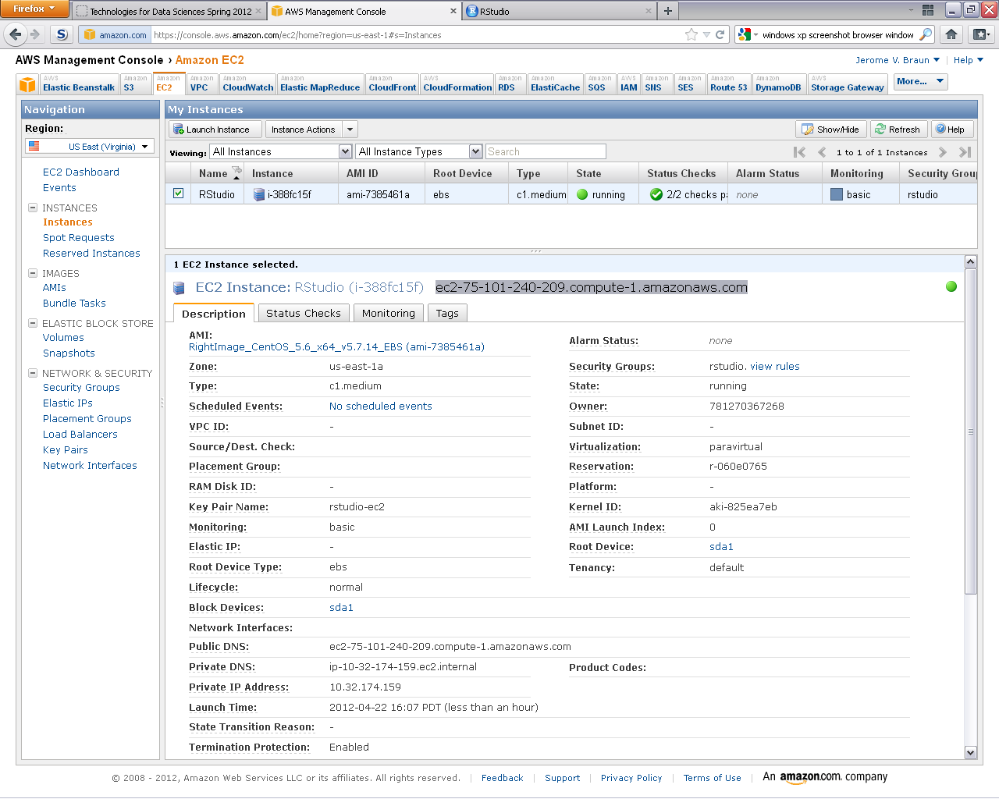
AWS Management Console

Slide 13
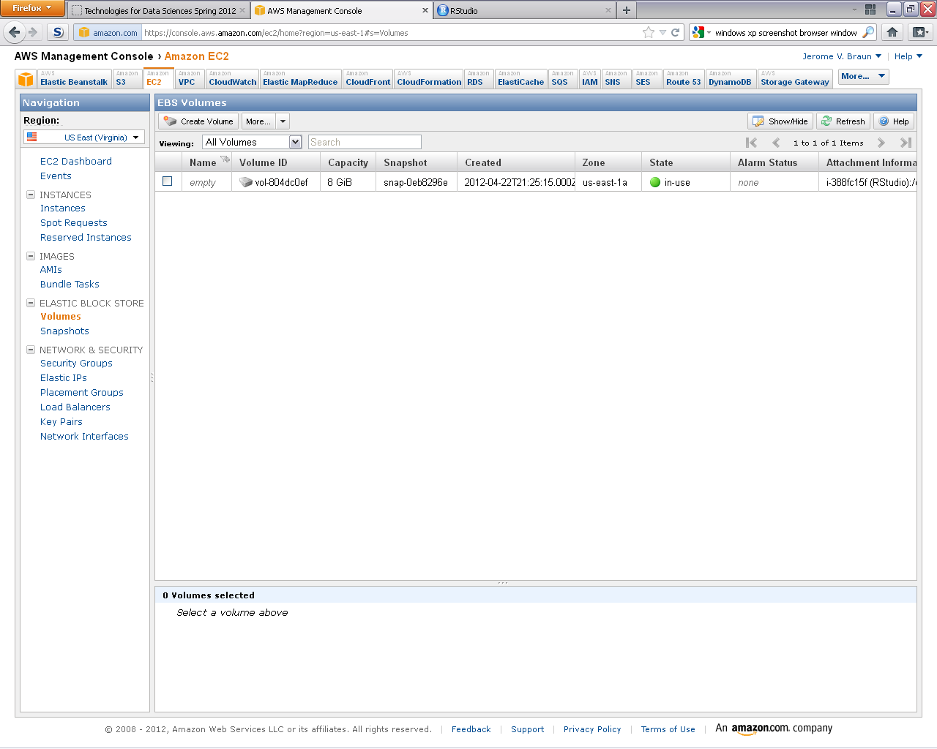
EBS Volumes

Slide 14
Installation Gotchas
Installing RStudio Server was hampered by unfulfilled dependencies upon several libraries.
Also, R needs to be installed…
yum install –y R
rpm –Uvh --nodeps <rstudio-server rpm>

Slide 15
RNetCDF notes
Errors out of the box on installation.
yum install –y netcdf
yum install –y netcdf-devel
yum install –y udunits
yum install –y udunits-devel
install.packages("RNetCDF",configure.args="--with-netcdf-include=/usr/include/netcdf-3")

Slide 16
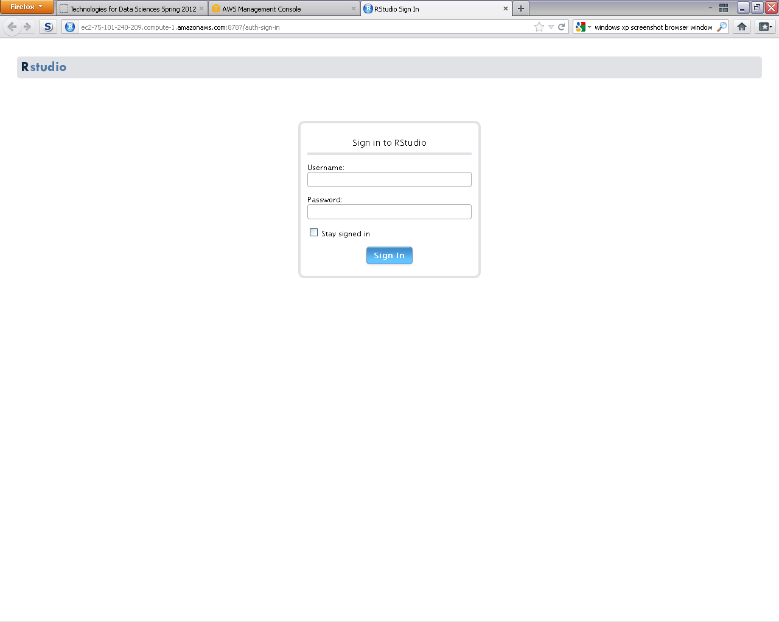
Point Browser at RStudio Server

Slide 17
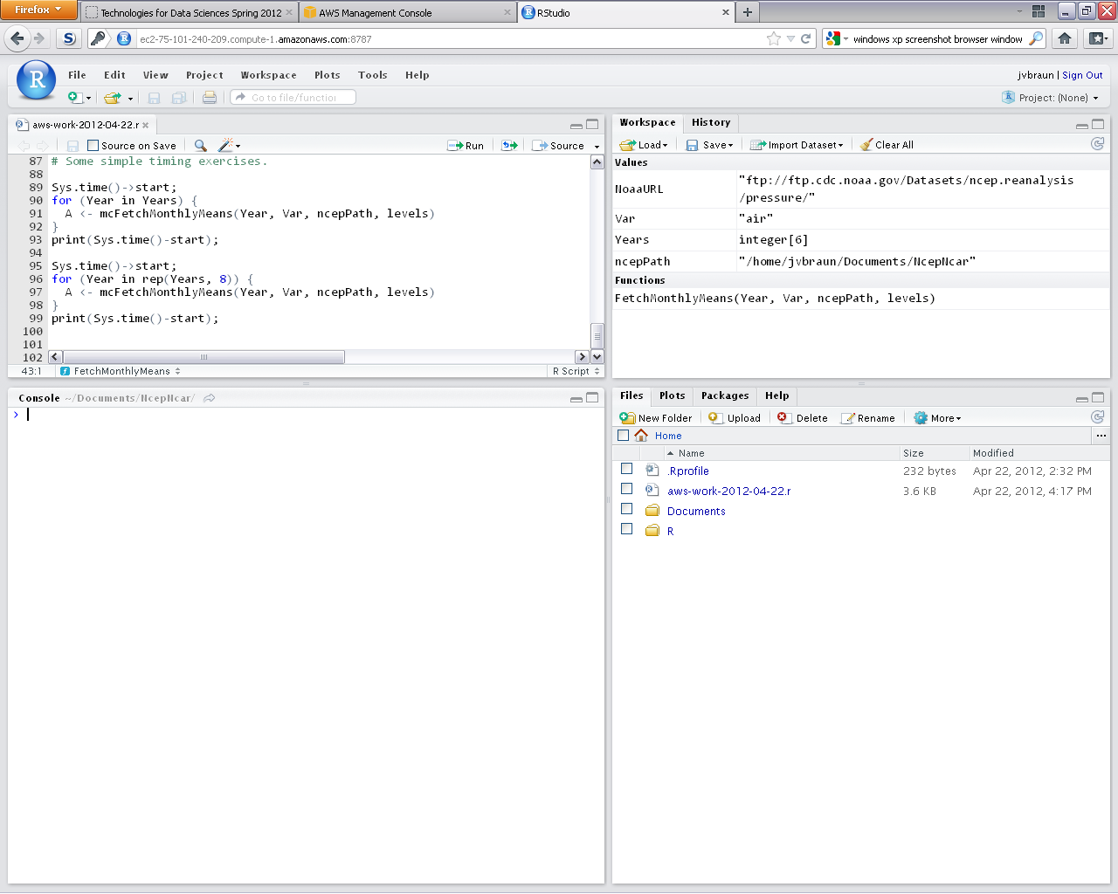
RStudio Server

Slide 18
Some Simple Timing
Download six ½ GB datasets ~ 2 min
Calculate monthly means eight times for six data sets using lapply ~ 4.8 min
Calculate monthly means eight times for six data sets using mclapply ~ 3.9 min

Slide 19
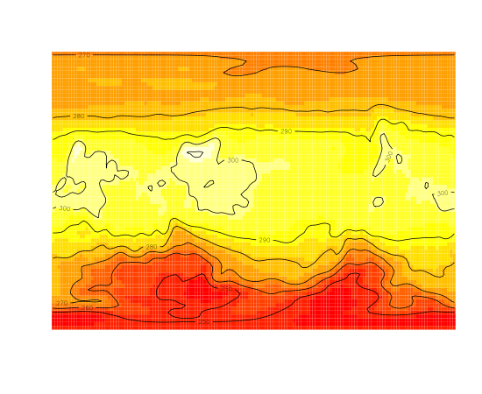
Month 0 of 2011

Slide 20
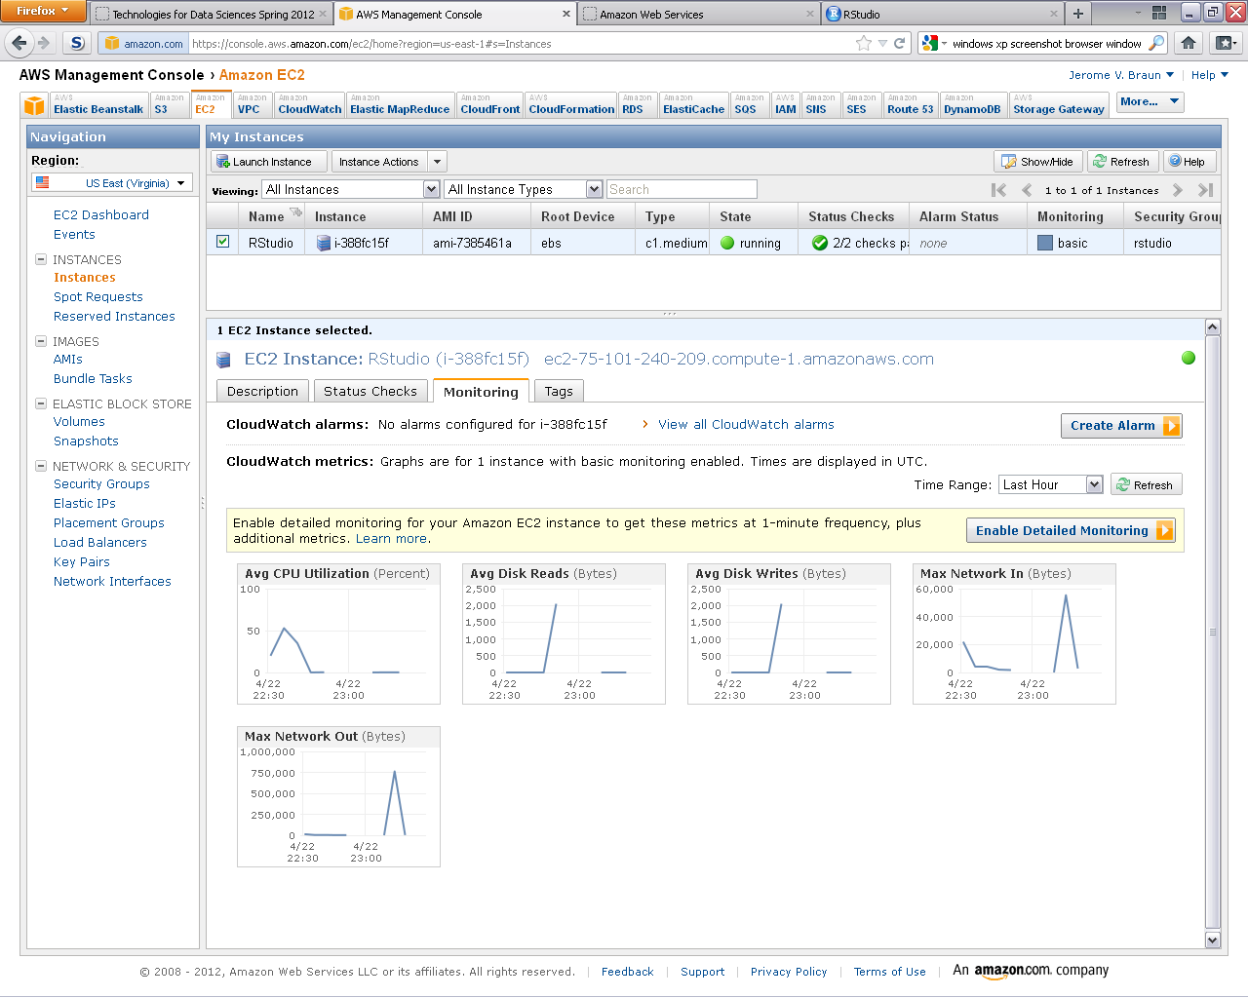
Activity

Slide 21
Stop the Machine
Sign out of RStudio Server. It will maintain state till next time.
Terminate or stop the instance.

Slide 22
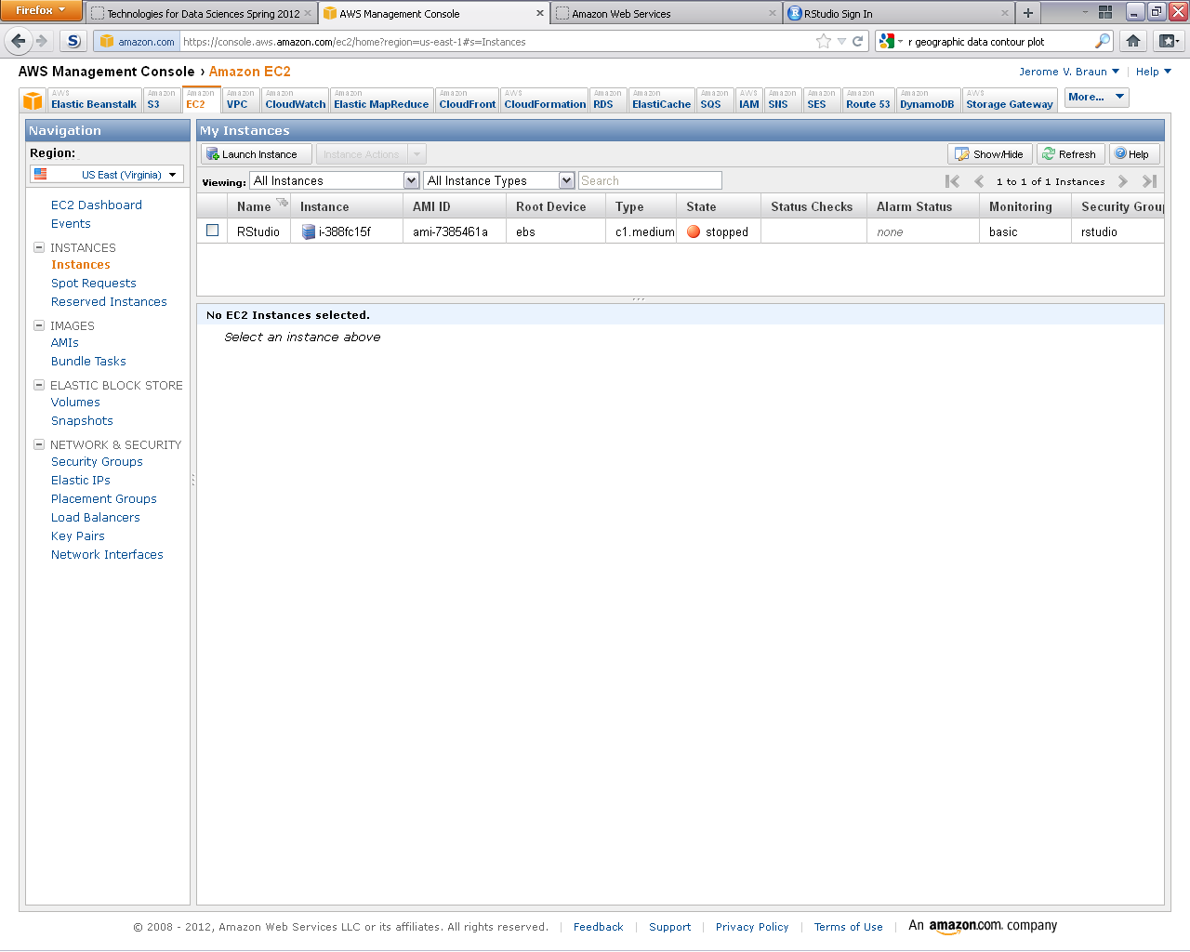
Double Check

Slide 23
Growing the EBS
This AMI has a drive size of 8 GB
It can be “grown”
Take a snapshot, launch a new EBS instance using the snapshot, and

Slide 24
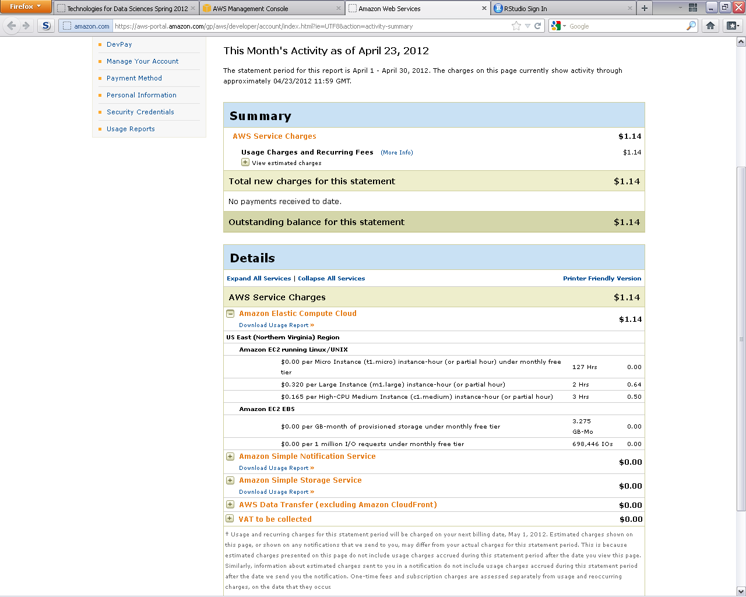
Cost? Minimal…

Slide 25
So, Basic Set-up
Get an Amazon AWS account
Start up a t1.micro using an available AMI
SSH to the machine as root to set up R and RStudio Server
Use the browser to connect to RStudio Server on the now-running machine
Operate as if on the desktop

Slide 26
Future Work
Scale up and compare performance using
  Standard instance (Medium).
  High-Memory instances.
  RHadoop with Cluster Compute instances.

