Slide 1


Genotype Coding
DNA Sequences at a SNP Position (T is risk allele)
Individual 1 | Individual 2 | Individual 3 | Individual 4 | Individual 5
CC | TT | CT | CC | CC
Genotype Coding Models $X_{raw}$
Coding Model | Individual 1 | Individual 2 | Individual 3 | Individual 4 | Individual 5 | mean
Additive (0,1,2) Count risk alleles | 0 | 2 | 1 | 0 | 0 | 0.6
Dominant (0,1,1) 1 if any risk allele | 0 | 1 | 1 | 0 | 0 | 0.4
Recessive (0,0,1) 1 if both alleles are risk alleles | 0 | 1 | 0 | 0 | 0 | 0.2
The additive model is particularly valuable as genetic effects often scale with the number of risk alleles.
Standardized Genotype Vector $X=\frac{X_{raw}−mean}{sd}$
Model | Individual 1 | Individual 2 | Individual 3 | Individual 4 | Individual 5 | mean | sd
Additive | -0.67 | 1.57 | 0.45 | -0.67 | -0.67 | 0.6 | 0.89
Why standardize? Standardization rescales all genetic variants to have mean zero and standard deviation one, ensuring no variant dominates the analysis simply due to its allele frequency.

Slide 2
Minor Allele Frequency (MAF)
Step 1: Raw Genotype Data
Individual 1 | Individual 2 | Individual 3 | Individual 4 | Individual 5
CC | TT | CT | CC | CC
C (Cytosine)
T (Thymine)
Step 2: Count Alleles
All alleles extracted from genotypes from all individuals:
CC TT CT CC CC
Count:
C: 7 (70%)
T: 3 (30%)
Step 3: Calculate MAF
Major allele: C (70%)
Minor allele: T (30%)
Minor Allele Frequency (MAF) = 0.3

Slide 3


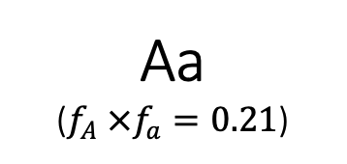


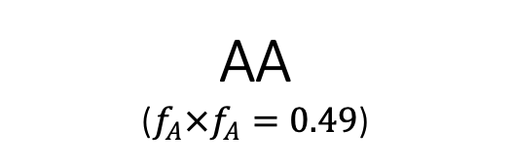

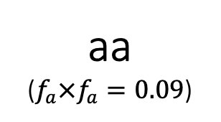

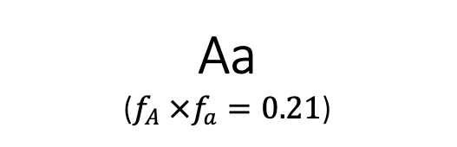

Hardy-Weinberg Equilibrium
$$f_{A}=0.7$$
$$f_{a}=0.3$$
AA
($f_{A}×f_{A}=0.49$)
Aa
($f_{A} ×f_{a}=0.21$)
$$f_{A} =0.7$$
Aa
($f_{A} ×f_{a}=0.21$)
aa
($f_{a}×f_{a}=0.09$)
$$f_{a}=0.3$$
AA (Homozygous dominant)
Aa (Heterozygous)
aa (Homozygous recessive)
$$f_{A}^{2}=0.49$$
$$2f_{A}f_{a}=0.42$$
$$f_{a}^{2}=0.09$$
$${(f_{A}+f_{a})}^{2}={f_{A}}^{2}+2f_{A}f_{a}+{f_{a}}^{2}=1$$
$$0.49+0.42+0.09=1$$

Slide 4
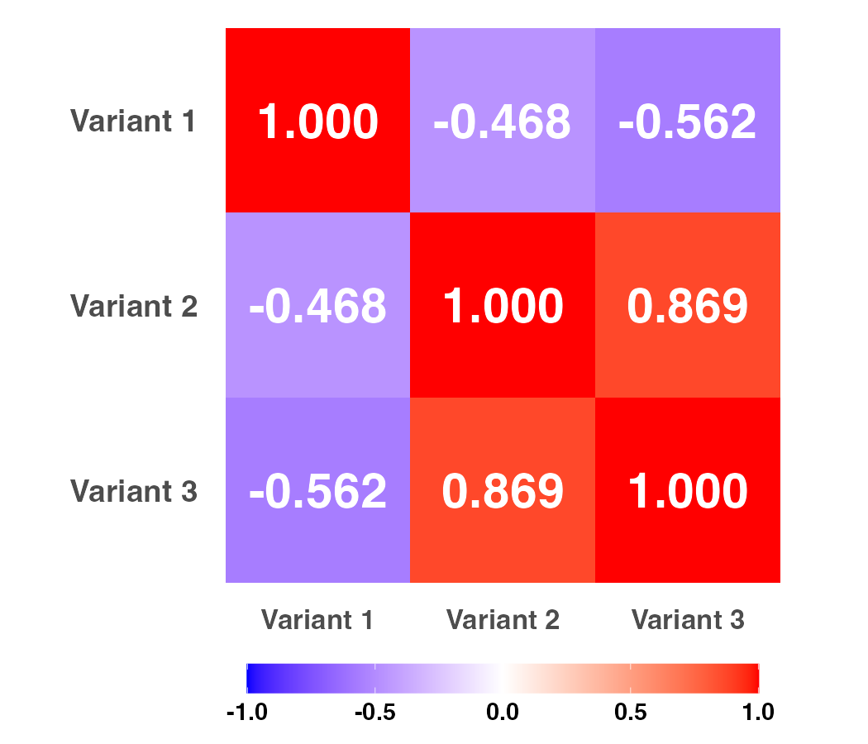


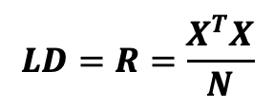
Linkage Disequilibrium (LD)
Non-random association between alleles at different genetic loci,
where certain combinations occur more or less frequently than expected by chance
Raw Genotype Matrix $X_{raw}$
Standardized Genotyped Matrix $X$
 | Variant 1 | Variant 2 | Variant 3
Individual 1 | CC | CT | AT
Individual 2 | TT | TT | AA
Individual 3 | CT | CT | AA
Individual 4 | CC | TT | AA
Individual 5 | CC | CC | TT
 | Variant 1 | Variant 2 | Variant 3
Individual 1 | -0.671 | 0.239 | 0.447
Individual 2 | 1.565 | -0.956 | -0.671
Individual 3 | 0.447 | 0.239 | -0.671
Individual 4 | -0.671 | -0.956 | -0.671
Individual 5 | -0.671 | 1.434 | 1.565
Standardize
$$LD=R=\frac{X^{T}X}{N}$$
-1
0
1
Perfect negative LD
(never appear together)
Strong negative LD
Moderate negative LD
Independent SNPs
(no correlation)
Moderate positive LD
Strong positive LD
Perfect (positive) LD
(always appear together)
LD Matrix (correlation)
LD blocks: regions of the genome with consistently high LD among SNPs (SNPs inherited together as haplotypes)
Block size: typically a few kb to >100 kb
Allow efficient tagging: genotype fewer SNPs to capture maximum information
Population difference:
African: Shorter blocks (~5-15 kb) due to older, larger ancestral population
European: Intermediate blocks (~15-50 kb) from out-of-Africa bottleneck
East Asian: Longer blocks (>50 kb) from recent bottlenecks
Isolated populations (Finnish, Sardinian): Most extensive LD from founder effects

Slide 5
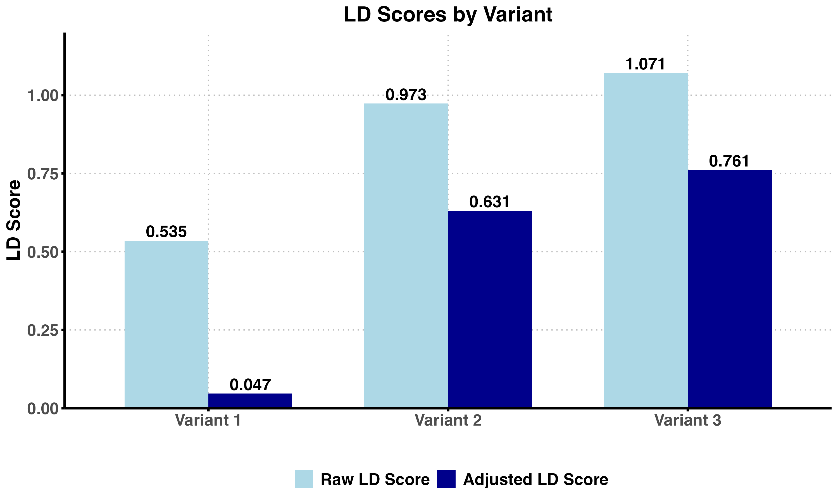

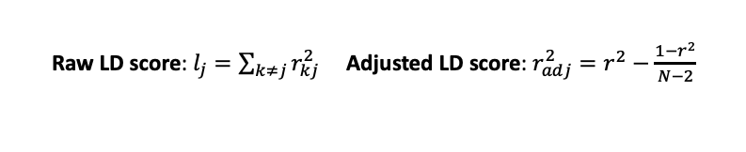



Linkage Disequilibrium (LD) Scores
LD matrix (correlation)
 | Variant 1 | Variant 2 | Variant 3
Individual 1 | CC | CT | AT
Individual 2 | TT | TT | AA
Individual 3 | CT | CT | AA
Individual 4 | CC | TT | AA
Individual 5 | CC | CC | TT
Squared Correlations ($r^{2}$)
$$r^{2}=0.219$$
$$r^{2}=0.754$$
1
2
3
$$r^{2}=0.316$$
1
2
3
Variants
LD Scores
Raw LD score: $l_{j}=\sum_{k≠j}{r_{kj}^{2}}$ Adjusted LD score: $r_{adj}^{2}=r^{2}−\frac{1−r^{2}}{N−2}$
Applications
LD score regression (LDSC) and stratified LDSC (s-LDSC): estimate SNP heritability, genetic correlation, and heritability enrichment across functional annotations
LDAK: LD-weighted heritability estimation and polygenic risk score construction
Genomic SEM: multivariate genetic architecture modeling across traits
High-Definition Likelihood (HDL): improved genetic correlation estimation

Slide 6
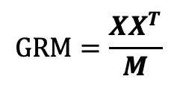
Genetic Relationship Matrix (GRM)
Quantifying Genetic Similarity Between Individuals
Population with 5 individuals
Standardized Genotyped Matrix X
 | Variant 1 | Variant 2 | Variant 3
Individual 1 | -0.671 | 0.239 | 0.447
Individual 2 | 1.565 | -0.956 | -0.671
Individual 3 | 0.447 | 0.239 | -0.671
Individual 4 | -0.671 | -0.956 | -0.671
Individual 5 | -0.671 | 1.434 | 1.565
Genetic Relationship Matrix (GRM)
 | Individual 1 | Individual 2 | Individual 3 | Individual 4 | Individual 5
Individual 1 | 0.236 | -0.526 | -0.181 | -0.026 | 0.498
Individual 2 | -0.526 | 1.271 | 0.307 | 0.105 | -1.157
Individual 3 | -0.181 | 0.307 | 0.236 | -0.026 | -0.336
Individual 4 | -0.026 | 0.105 | -0.026 | 0.605 | -0.657
Individual 5 | 0.498 | -1.157 | -0.336 | -0.657 | 1.652
$$GRM=\frac{{XX}^{T}}{M}$$

Slide 7
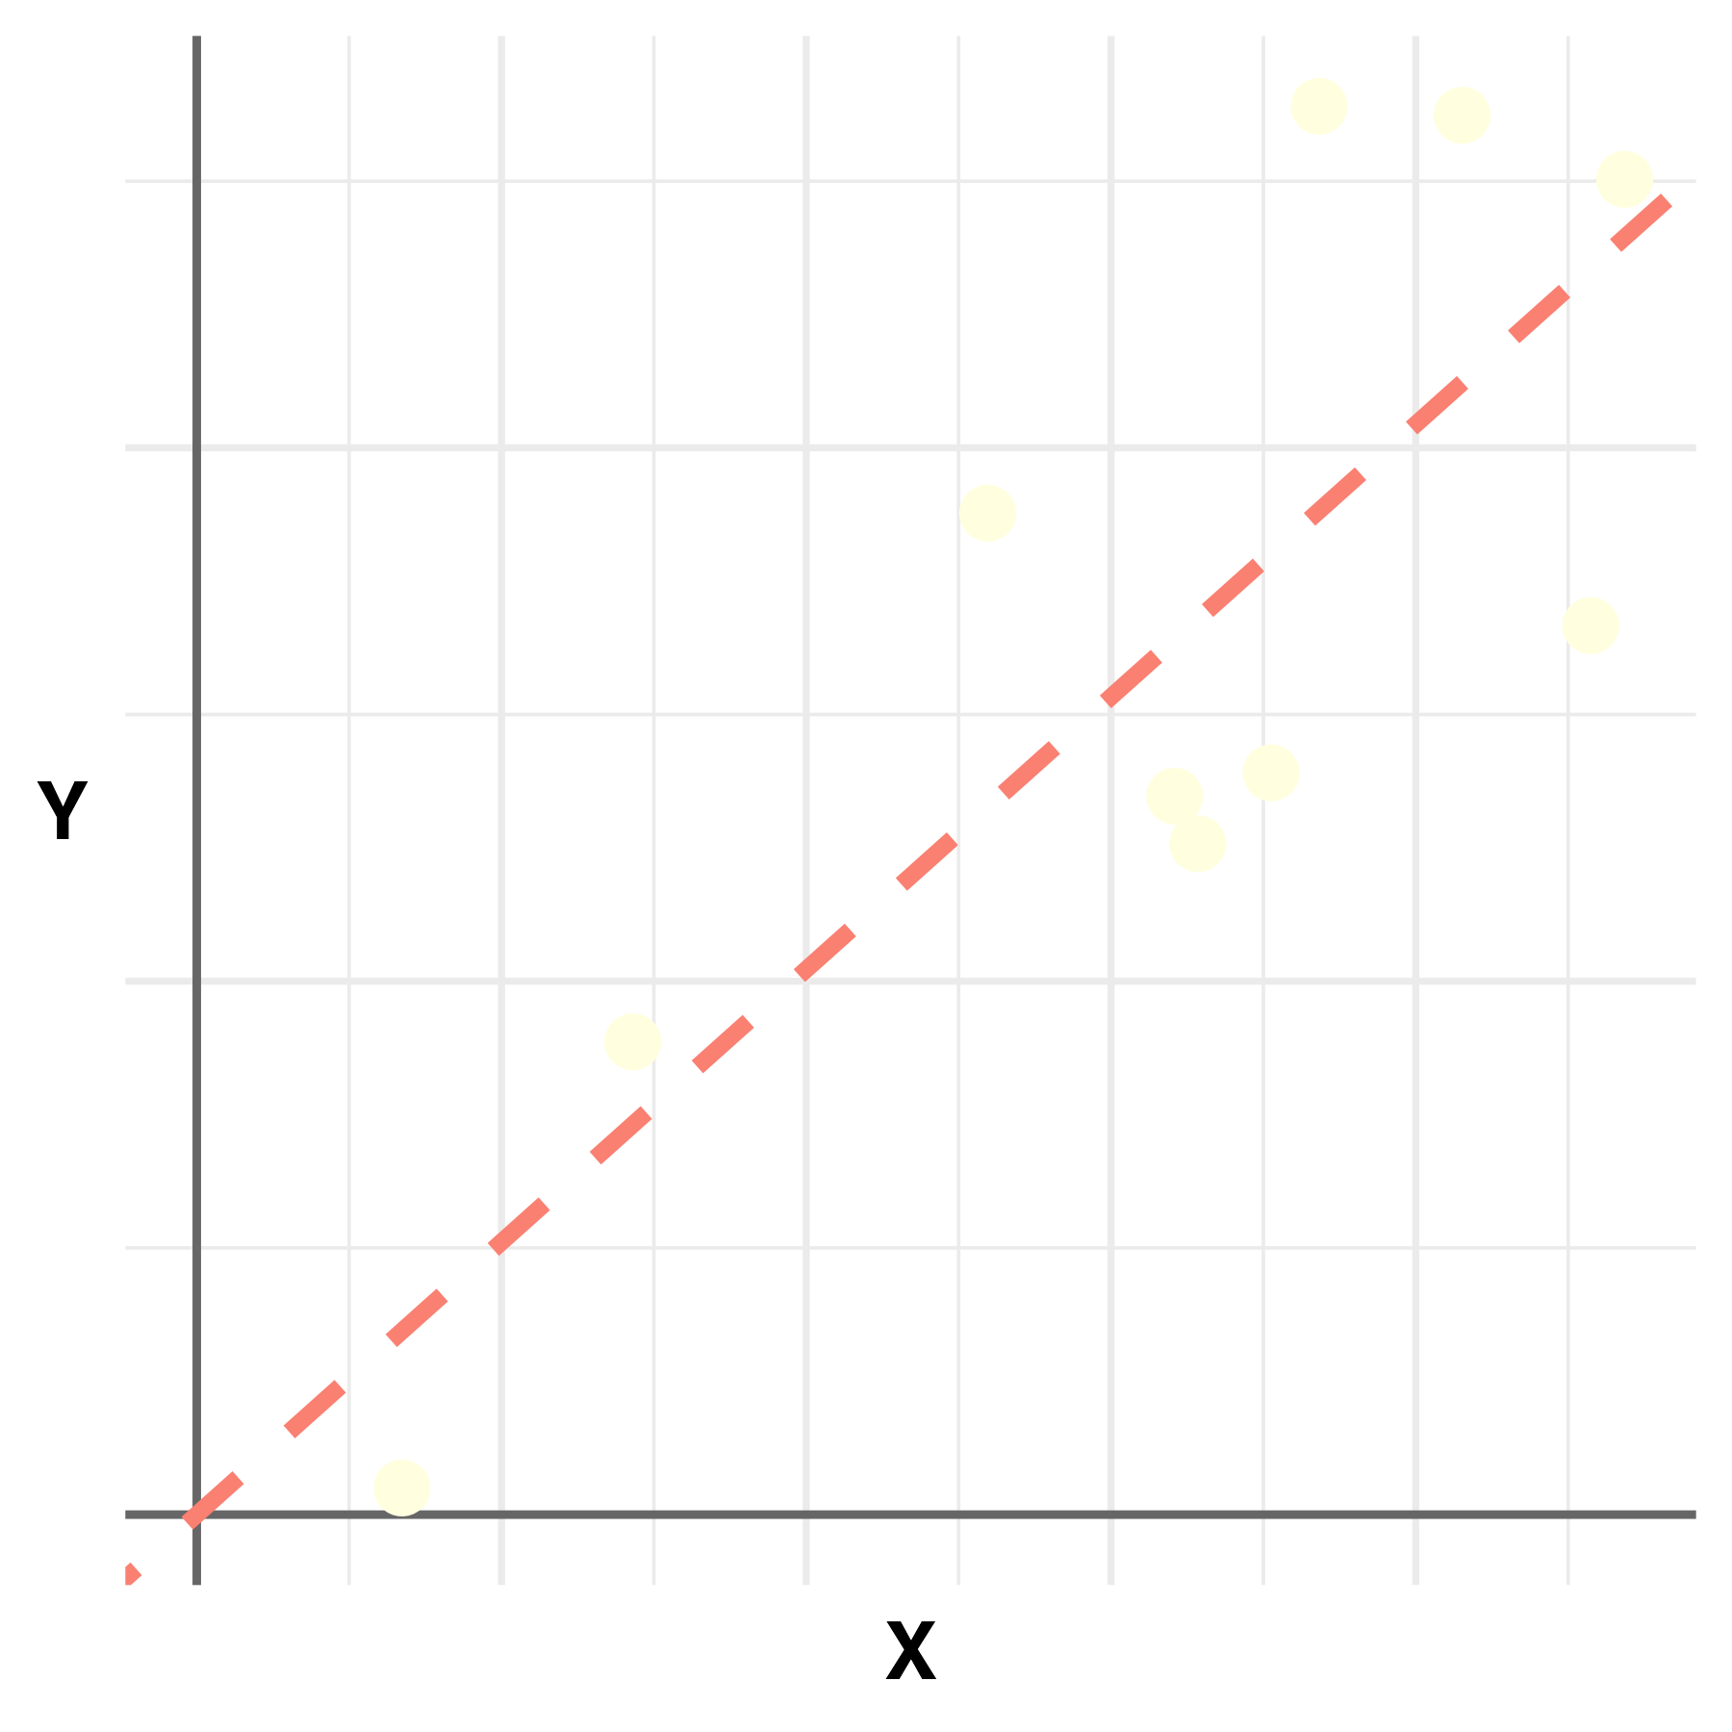
























Single Marker Linear Regression and OLS
Single Variant Regression
Ordinary Least Squares (OLS)
$$ε$$
$${\hat{β}}_{OLS}={(X_{j}^{T}X_{j})}^{−1}X_{j}^{T}Y$$
$$X_{j}$$
$$Y$$
=
$$×$$
$$β$$
+
$$\hat{β}$$
=
$$X_{j}^{T}$$
$$Y$$
$$×$$
$$×$$
$${(X_{j}^{T}X_{j})}^{−1}$$
$$N×1$$
Trait
$$N×1$$
Genotype
scalar
Genetic
Effect
$$N×1$$
Error
scalar
Genetic
Effect
Scalar
(scale for X)
$$N×1$$
Transpose of $X_{j}$
$$N×1$$
Trait
Ordinary Least Squares Visualization
Geometry Intuition
$${\hat{β}}_{OLS}$$
$$Y$$
$${\hat{β}}_{OLS}={(X_{j}^{T}X_{j})}^{−1}X_{j}^{T}Y$$
$$=\frac{|X_{j}||Y|cosθ}{{|X_{j}|}^{2}}=\frac{|Y|cosθ}{|X_{j}|}$$
$$θ$$
$$X_{j}$$
$X_{j}^{T}Y$: inner product of $X_{j}$ and $Y$
describes how $X_{j}$ and $Y$ align
projects $Y$ to the direction of $X_{j}$
$X_{j}^{T}X_{j}$: squared length of $X_{j}$
Scale so that it is independence of ${|X}_{j}|$
OLS finds $\hat{β}$ that minimizes the sum of the squared residuals.

Slide 8
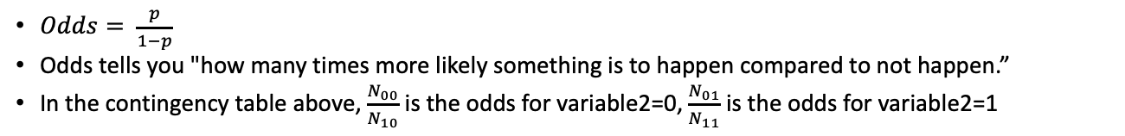

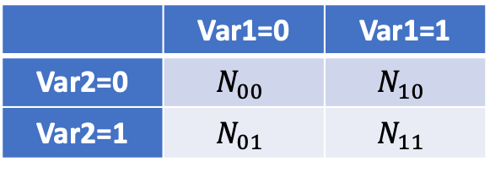
Odds, Odds Ratio and Logistic Regression
Odds ratio measures how strongly two binary variables are associated with each other.
Question
Assume that we have two binary variables, are they associated with each other?
In other words, if I see 1 for the first variable, am I more likely to see 1 for the second variable?
Contingency Table
 | Var1=0 | Var1=1
Var2=0 | $$N_{00}$$ | $$N_{10}$$
Var2=1 | $$N_{01}$$ | $$N_{11}$$
Interpretation:
OR = 1: No association – two variables are independent with each other
OR > 1:
00 and 11 appears more often than 10 and 01
Positive association between two variables
OR < 1:
01 and 10 appears more often than 00 and 11
Negative association between two variables
$$OR=\frac{N_{00}×N_{11}}{N_{10}×N_{01}}$$
Examples
Hardy-Weinberg Equilibrium: Are maternal allele and paternal allele choices independent across the population?
Disease Studies: Are exposure (1/0) and disease status (1/0) independent?
Pathway Enrichment: Are pathway membership (1/0) and overexpression (1/0) associated?
GWAS: Are genetic variants (1/0) and trait presence (1/0) associated?
…
What is Odds?
$Odds= \frac{p}{1−p}$
Odds tells you "how many times more likely something is to happen compared to not happen.”
In the contingency table above, $\frac{N_{00}}{N_{10}}$ is the odds for variable2=0, $\frac{N_{01}}{N_{11}}$ is the odds for variable2=1

Slide 9
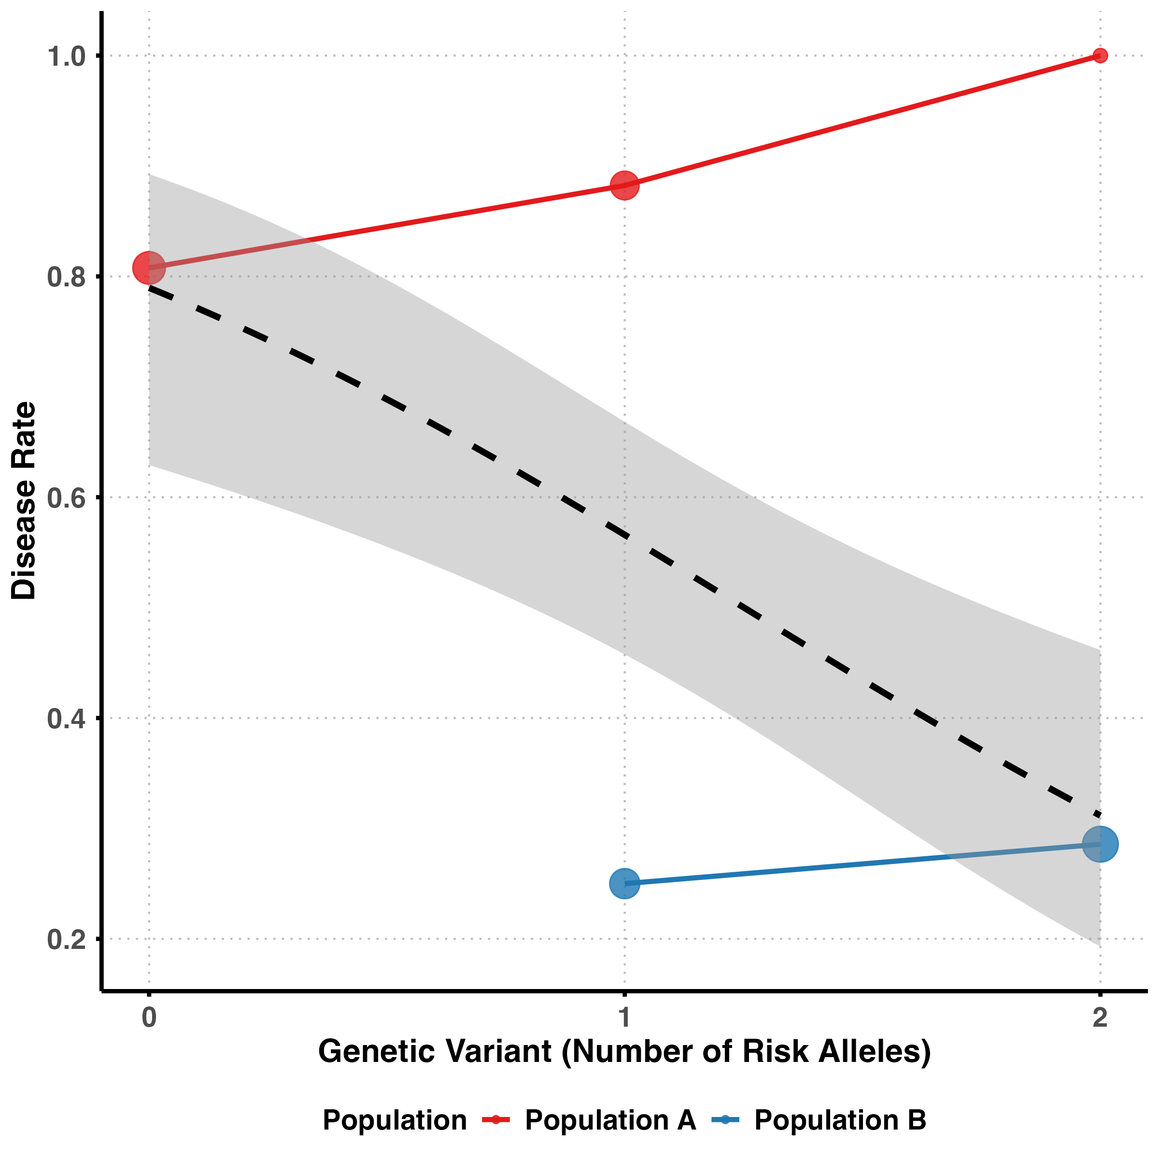


















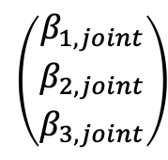






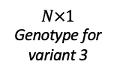










Marginal vs. Joint Effects
Marginal Effects
(Three separate models, $Y=X_{j}β_{j}+ε_{j}$)
Joint Effects
(One model with all variables, $Y=Xβ+ε)$
$$X_{13}$$
$$ε$$
$$X_{11}$$
$$X_{12}$$
$$X_{11}$$
$$X_{22}$$
$$X_{21}$$
$$X_{21}$$
$$X_{23}$$
$$\left(\begin{matrix}β_{1,joint} \\ β_{2,joint} \\ β_{3, joint}\end{matrix}\right)$$
$$X_{32}$$
$$Y$$
=
$$X_{31}$$
$$×$$
$$β_{1}$$
+
$$ε_{1}$$
$$Y$$
=
$$X_{31}$$
$$X_{33}$$
+
…
…
…
…
$$X_{N2}$$
$$X_{N1}$$
$$X_{N1}$$
$$X_{N3}$$
$$N×1$$
Trait
$$N×1$$
Genotype for variant 1
A scalar
Genetic
Effect
$$N×1$$
Error
Accounts the correlations between variables (i.e., LD)
…
Example: Simpson’s Paradox
$$X_{13}$$
$$X_{23}$$
$$Y$$
=
$$X_{33}$$
$$×$$
$$β_{3}$$
+
$$ε_{3}$$
…
$$X_{N3}$$
$$N×1$$
Trait
$$N×1$$
Genotype for variant 3
scalar
Genetic
Effect
$$N×1$$
Error
Each variable is analyzed independently.

Slide 10
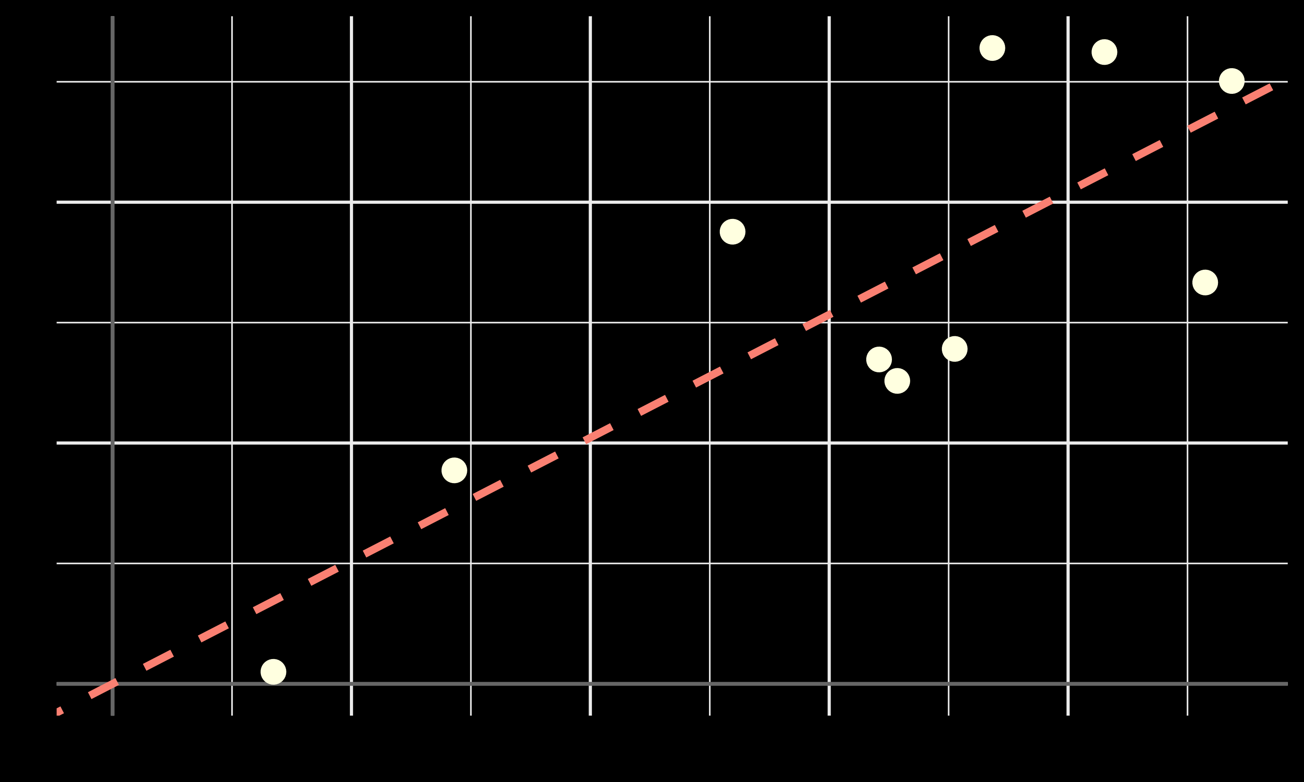
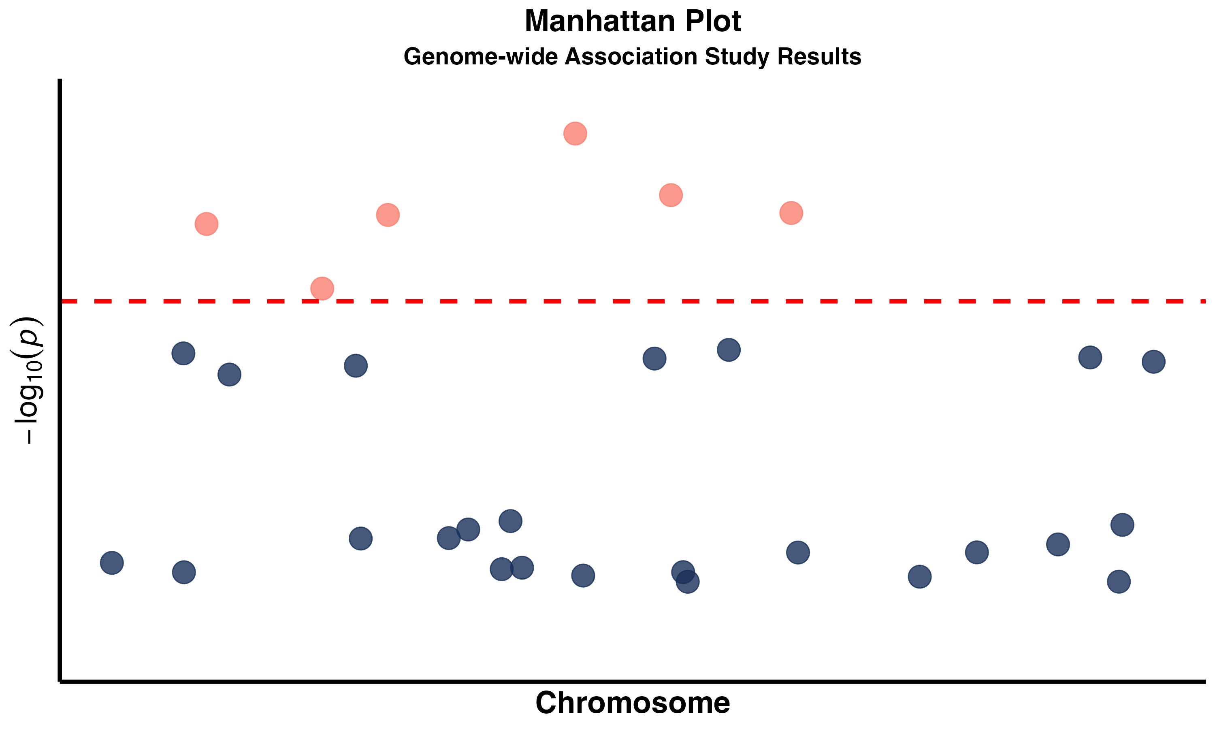



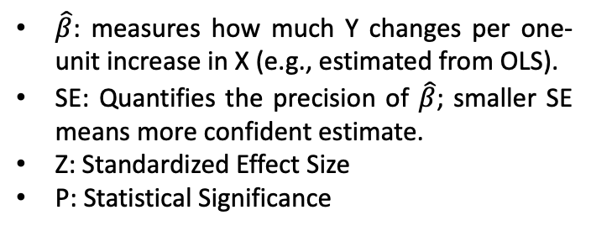
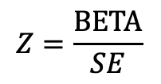



Summary Statistics
Individual-level Data
Summary Statistics
SNP | BETA | SE | Z | P | MAF
rs1 | 0.85 | 0.32 | 2.64 | 0.02 | 0.40
rs2 | -0.31 | 0.28 | -1.10 | 0.27 | 0.30
rs3 | 0.42 | 0.30 | 1.40 | 0.16 | 0.25
$$X$$
$$X_{1}$$
$$X_{2}$$
$$X_{3}$$
…
$$X_{M}$$
Test one
at a time
(marginal effect)
$$Z=\frac{\text{BETA}}{SE}$$
Millions of SNPs
$${SNP}_{1}$$
$${SNP}_{3}$$
$${SNP}_{2}$$
$${SNP}_{M}$$
Summary statistics summarizes the key information in the individual-level data
and servers as data input for many downstream analysis.
BETA, Z and P
$\hat{β}$: measures how much Y changes per one-unit increase in X (e.g., estimated from OLS).
SE: Quantifies the precision of $\hat{β}$; smaller SE means more confident estimate.
Z: Standardized Effect Size
P: Statistical Significance
Compact Storage
MB vs. GB-TB
Privacy Protection
Fewer Constraints
Association Information
P below $5×{10}^{−8}$

Slide 11
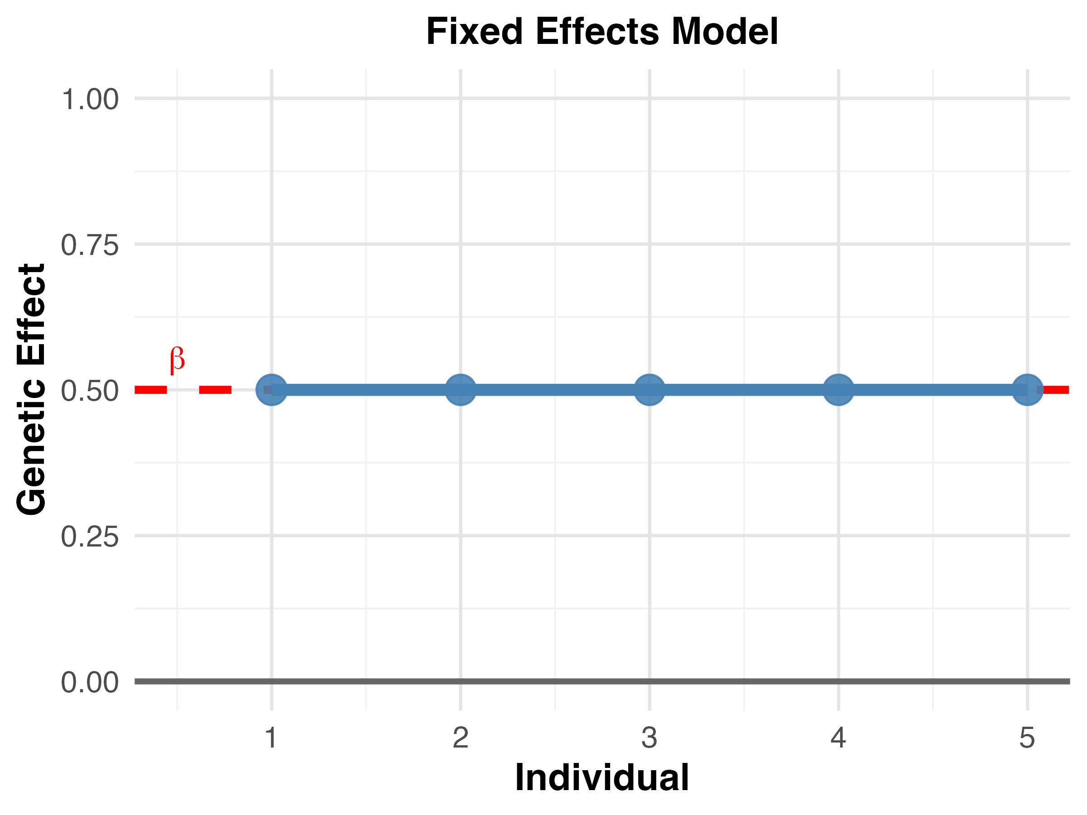
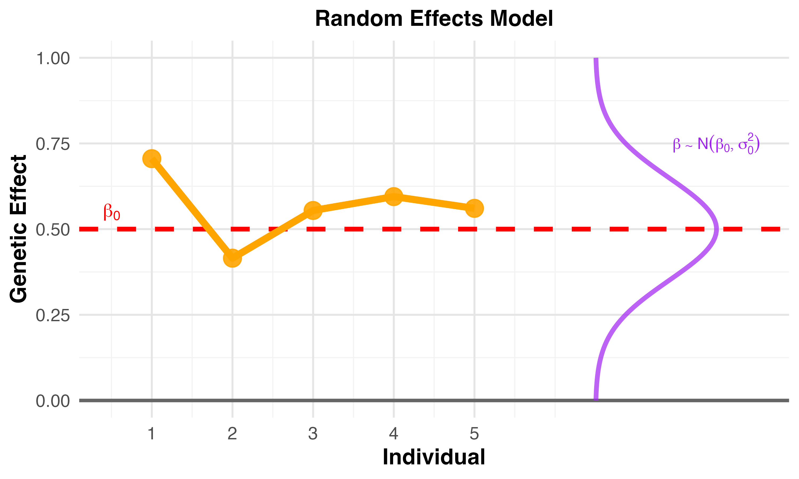

















Random Effects
Fixed Effects
Assuming that we can condition on all factors
Random Effects
Account for the uncertainty that we can never condition on all factors
$$X_{11}$$
$$X_{11}$$
$$X_{21}$$
$$X_{21}$$
=
$$X_{31}$$
+
$$ε_{1}$$
=
$$X_{31}$$
+
$$ε_{1}$$
$$Y$$
$$×$$
$$β_{1}$$
$$Y$$
$$×$$
$$β_{1}$$
…
…
$$X_{N1}$$
$$X_{N1}$$
$$N×1$$
Trait
$$N×1$$
Genotype
$$N×1$$
Error
$$N×1$$
Trait
$$N×1$$
Genotype
$$N×1$$
Error
Perfect conditioning -> Fixed effects
Pros: ideal, simple
Cons: not realistic, especially for polygenic traits
Incomplete conditioning -> Random effects
Pros: Realistic for complex traits, models uncertainty
Cons: more complex to interpret

Slide 12
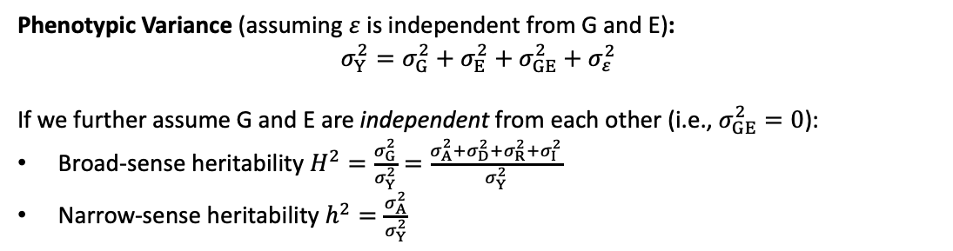
Proportion of Variance Explain (PVE) and Heritability
measures how much of the total variation in a trait (like height or disease risk) can be attributed to specific variables in the statistical model (e.g., genetic variants).
An Example of Partition of Phenotypic Variance
PVE and Heritability
Phenotypic Variance (assuming $ε$is independent from G and E):
$$σ_{Y}^{2}=σ_{G}^{2}+σ_{E}^{2}+σ_{GE}^{2}+σ_{ε}^{2}$$
If we further assume G and E are independent from each other (i.e., $σ_{GE}^{2}=0$):
Broad-sense heritability $H^{2}=\frac{σ_{G}^{2}}{σ_{Y}^{2}}=\frac{σ_{A}^{2}+σ_{D}^{2}+σ_{R}^{2}+σ_{I}^{2}}{σ_{Y}^{2}}$
Narrow-sense heritability $h^{2}=\frac{σ_{A}^{2}}{σ_{Y}^{2}}$

Slide 13











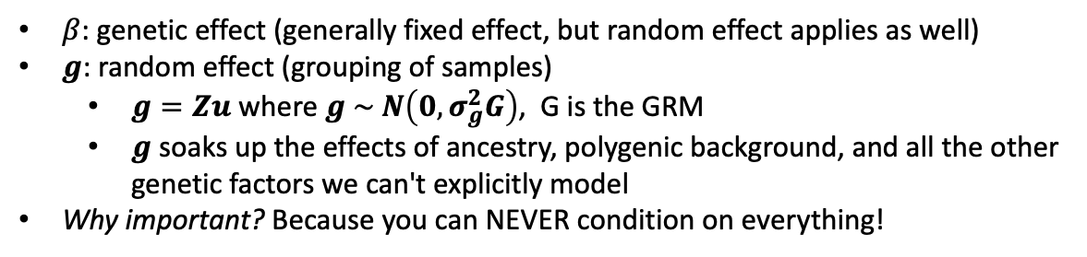


Linear Mixed Model
A practical solution to estimate genetic effect $β$:
use a random effect $g$based on genetic similarity to absorb all unmeasured heterogeneity
Key Formula
$$Y=Xβ+g+ε$$
$β$: genetic effect (generally fixed effect, but random effect applies as well)
$g$: random effect (grouping of samples)
$g=Zu$ where $g \sim N\left(0,σ_{g}^{2}G\right)$, G is the GRM
$g$ soaks up the effects of ancestry, polygenic background, and all the other genetic factors we can't explicitly model
Why important? Because you can NEVER condition on everything!
$$X_{11}$$
$$g_{1}$$
$$ε$$
Recall GRM…
$$X_{21}$$
$$g_{2}$$
Captures the relatedness between samples, where family/ancestry reflects shared genetics!
$$X_{31}$$
$$β_{1}$$
$$g_{3}$$
$$Y$$
=
+
+
…
…
1 | 0.5 | 0.5 | 0 | 0
0.5 | 1 | 0.5 | 0 | 0
0.5 | 0.5 | 1 | 0 | 0
0 | 0 | 0 | 1 | 0.5
0 | 0 | 0 | 0.5 | 1
$$X_{N1}$$
$$g_{N}$$
What information does $g$ include?
Population structure and ancestry differences
Polygenic effects from thousands of small-effect variants
Family relationships and shared genetic background
Gene-gene interactions we haven't discovered
Any other source of genetic similarity between individuals

Slide 14
Confounder
Influences both the exposure and outcome independently,
creating a misleading association between them that doesn't represent a true causal relationship if not considered
Example
Confounder
(Ancestry)
Allele
frequency
Environmental factors
Genetic Variant
Trait
(Height)
Incorrect
Association
When genetic ancestry is not controlled for in the analysis, it might create a misleading association between genotype and trait.
Common Confounders in Genetics Study
Solutions for Confounder Control
Population stratification/genetic ancestry
Different allele frequencies and trait values between populations (e.g., Europeans vs East Asians)
Age
Both allele frequencies and disease risk change with age; birth cohort effects
Sex
Hormonal differences, X-chromosome effects, and sex-specific genetic associations
Batch effects
Technical variation from samples processed at different times or laboratories
Principal Components Analysis (PCA) Controls for population stratification by including top principal components as covariates in regression models
Linear Mixed Models (LMM) Uses genetic relationship matrices to account for population structure and cryptic relatedness simultaneously
Stratified Analysis Performs separate analyses within homogeneous ancestry groups, then meta-analyze results across populations
Covariate Adjustment Includes known confounders (age, sex, batch) as fixed effects in regression models
Family-based Tests Uses transmission disequilibrium tests (TDT) or within-family analyses to control for population stratification

Slide 15
Collider
Influenced by two other variables of interest,
creating a spurious association between them when included in the analysis
Example
Collider
(Height)
Affect height
Males are generally
taller than females
Genetic Variant
Trait
(biological sex)
Misleading association
We should NOT control for collider in analysis.
When the collider is controlled for in the analysis, it might create a misleading association between genotype and trait.
Collider bias
Common Colliders in Genetic Studies
Collider structure: G → Collider ← Y
Conditioning effect: When you control for the collider, you're selecting specific combinations of G and Y
Induced association: This selection creates an artificial association between X and Y
Study Participation/Selection:
Genetic Risk → Study Participation ← Disease
Hospital Admission:
Variant → Hospital Admission ← Disease Severity
Survival to Study Age:
Protective Alleles → Survival ← Disease Resistance
(Studying only elderly survivors can bias estimates of genetic effects on longevity)

Slide 16
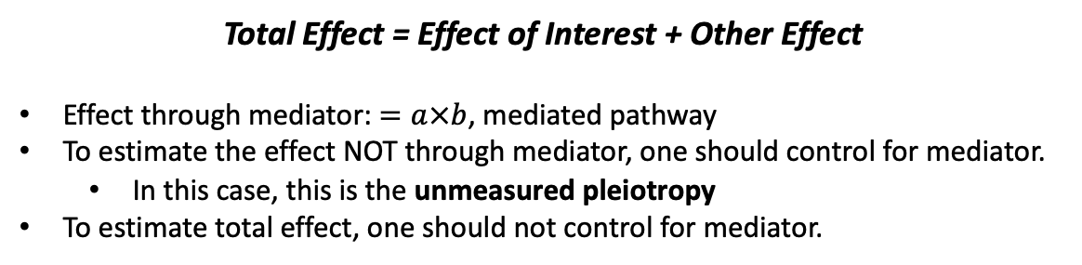


Mediator
Explains HOW a genetic variant affects an outcome by lying in the causal pathway between them
Example
Genetic Variant
𝑎
Mediator
(Growth Hormone)
$$b$$
Trait
(Height)
Regulate
hormone production
Promotes
growth
Other Effect (e.g., through nutritional absorption)
Total Effect = Effect of Interest + Other Effect
Effect through mediator: $=a×b$, mediated pathway
To estimate the effect NOT through mediator, one should control for mediator.
In this case, this is the unmeasured pleiotropy
To estimate total effect, one should not control for mediator.
How to Detect Mediator
Common Mediators in Genetic Studies
Test total effect of G on Y
(should be significant)
$$Y \sim G$$
2. Add mediator (M) in the model:
$$Y \sim G + M$$
if the effect of G reduces
→ partial mediation
if the effect of G disappears
→ complete mediation
Why it matters: identifies the biological mechanism — not just that a variant is associated, but how it works
Complete vs. partial: a mediator can explain all or only part of the genetic effect
Common Examples:
G → gene expression → disease
G → protein abundance → trait
G → methylation → expression → trait
G → metabolic intermediate → disease
The product of coefficients (G-M and M-Y) quantifies the mediated effect (G-M-Y).

Slide 17

Modifier
Changes the magnitude or direction of the effect of an exposure on an outcome
Example
Modifier
Genetic Variant
(Smoking)
Trait
(Height)
The modifier serves as the interaction term in the linear/logistic regression.
$$Y=Gβ_{1}+Eβ_{2}+G×Eβ_{3}+ε$$
The same variant can have different effects in different groups (E):
If the sample smokes (E=1), then the effect of G on Y becomes ($β_{1}+β_{3})$
If the sample doesn’t smoke (E=0), then the effect of G on Y becomes $β_{3}$
E doesn’t have to be binary --- it can also change the magnitude/strength of the arrow between G and Y.
Comparison of Covariates
 | DAG Structure | Association | What to Do
Confounder | G ← C → Y | Creates spurious association between G and Y | Control for it
Collider | G → C ← Y | G and Y are initially independent | Do NOT control for it
Mediator | G → M → Y | Part of the true causal effect of G on Y | Depends on the context
Modifier | G & E → Y | Effect of G on Y differs by M | Stratify or add interaction term

Slide 18



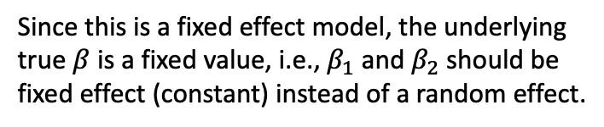


Meta-Analysis Fixed Effect
Synthesizes statistical evidence across multiple independent studies using weighted averaging techniques
Several Independent Cohorts
Sumstats 1
$$β_{1}$$
$${SE}_{1}$$
$$N_{1}$$
$$…$$
Study 2
N2=8,000
Sumstats 2
$$β_{2}$$
$${SE}_{2}$$
$$N_{2}$$
$$…$$
Study 1
N1=5,000
What we believe about $β_{1}$ and $β_{2}\text{?}$
Since this is a fixed effect model, the underlying true $β$ is a fixed value, i.e., $β_{1}$ and $β_{2}$ should be fixed effect (constant) instead of a random effect.
Meta-Analysis
Equivalent to:
Merged set
N=13,000
Equivalent to merging individuals from two studies together
$\hat{β}=\frac{\sum_{k}{w_{k}{\hat{β}}_{k}}}{\sum_{k}{w_{k}}}$
$w_{k}$ is the weight for study $k$, for example, Inverse Variance Weighting (IVW):
$$w_{k}=\frac{1}{{SE}_{k}^{2}}$$

Slide 19

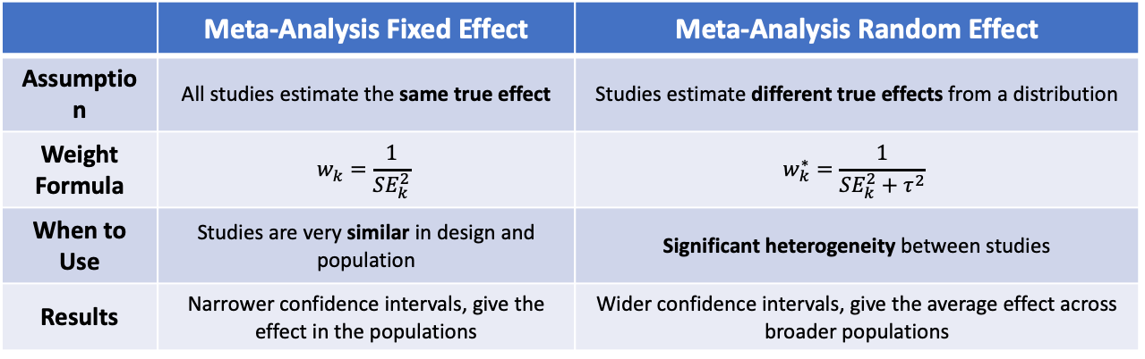
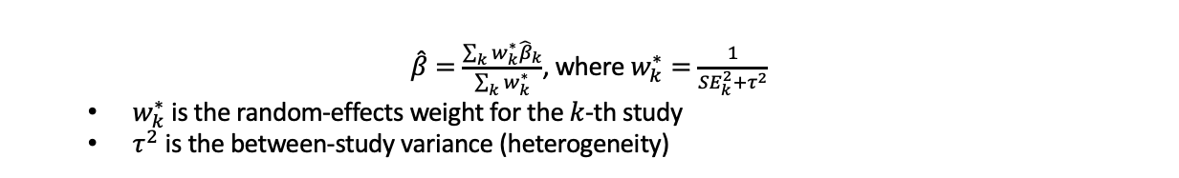
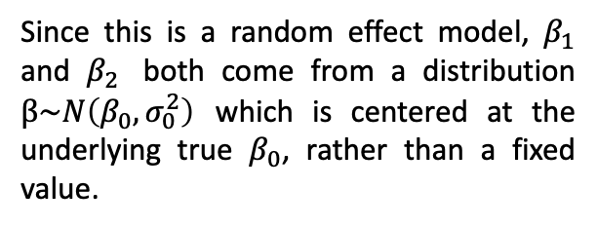

Meta-Analysis Random Effect
Synthesizes statistical evidence across multiple independent studies assuming the true effect is random
Several Independent Cohorts
Sumstats 1
$$β_{1}$$
$${SE}_{1}$$
$$N_{1}$$
$$…$$
Study 2
N2=8,000
Sumstats 2
$$β_{2}$$
$${SE}_{2}$$
$$N_{2}$$
$$…$$
Study 1
N1=5,000
What we believe about $β_{1}$ and $β_{2}\text{?}$
Since this is a random effect model, $β_{1}$ and $β_{2}$ both come from a distribution $β\sim N\left(β_{0},σ_{0}^{2}\right)$ which is centered at the underlying true $β_{0}$, rather than a fixed value.
Meta-Analysis
$\hat{β}=\frac{\sum_{k}{w_{k}^{∗}{\hat{β}}_{k}}}{\sum_{k}{w_{k}^{∗}}}$, where $w_{k}^{∗}=\frac{1}{{SE}_{k}^{2}+τ^{2}}$
$w_{k}^{∗}$ is the random-effects weight for the $k$-th study
$τ^{2}$ is the between-study variance (heterogeneity)
 | Meta-Analysis Fixed Effect | Meta-Analysis Random Effect
Assumption | All studies estimate the same true effect | Studies estimate different true effects from a distribution
Weight Formula | $$w_{k}=\frac{1}{{SE}_{k}^{2}}$$ | $$w_{k}^{∗}=\frac{1}{{SE}_{k}^{2}+τ^{2}}$$
When to Use | Studies are very similar in design and population | Significant heterogeneity between studies
Results | Narrower confidence intervals, give the effect in the populations | Wider confidence intervals, give the average effect across broader populations

Slide 20
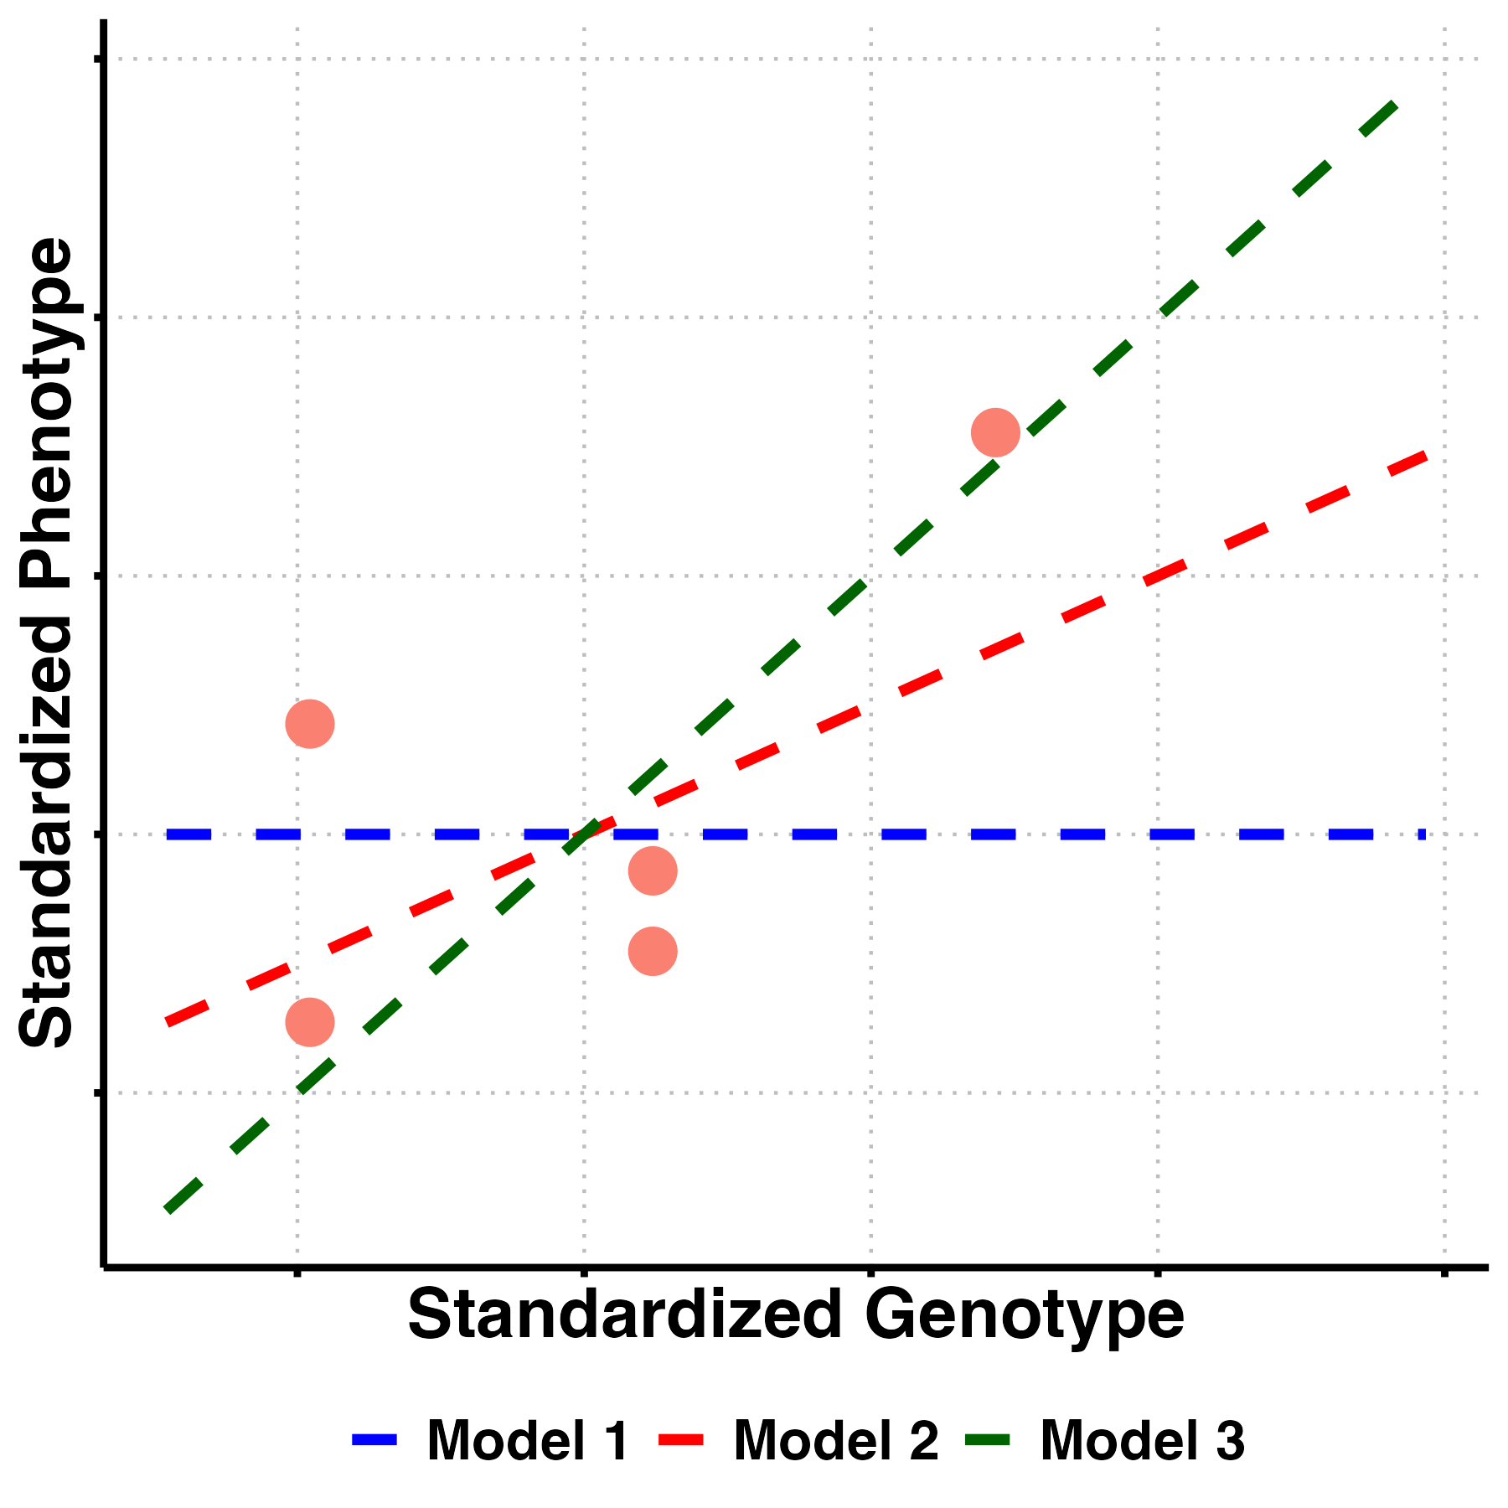
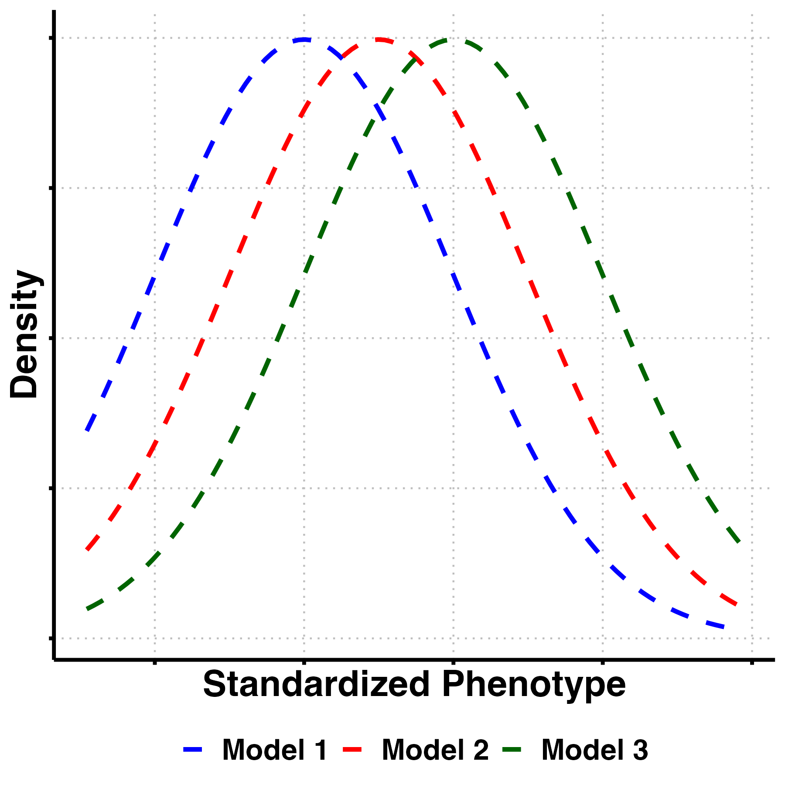







Likelihood
Finding the best model to explain the data
1. Three Competing Models
2. Observe Data
$$M_{3}$$
Model 1
$$β=0$$
No effect
$$M_{2}$$
Model 2
$$β=0.5$$
Moderate effect
$$M_{1}$$
Model 3
$$β=1.0$$
Strong effect
3. Likelihood Function
4. Likelihood Calculation
$$ℒ\left(M | D\right):=P\left(D | M\right)$$
$ℒ$: the likelihood function for model $M$ under data $D$
$M$: the model
$D$: the observed data
$P\left(D | M\right)$: the probability of observing data D given the model $M$

Slide 21
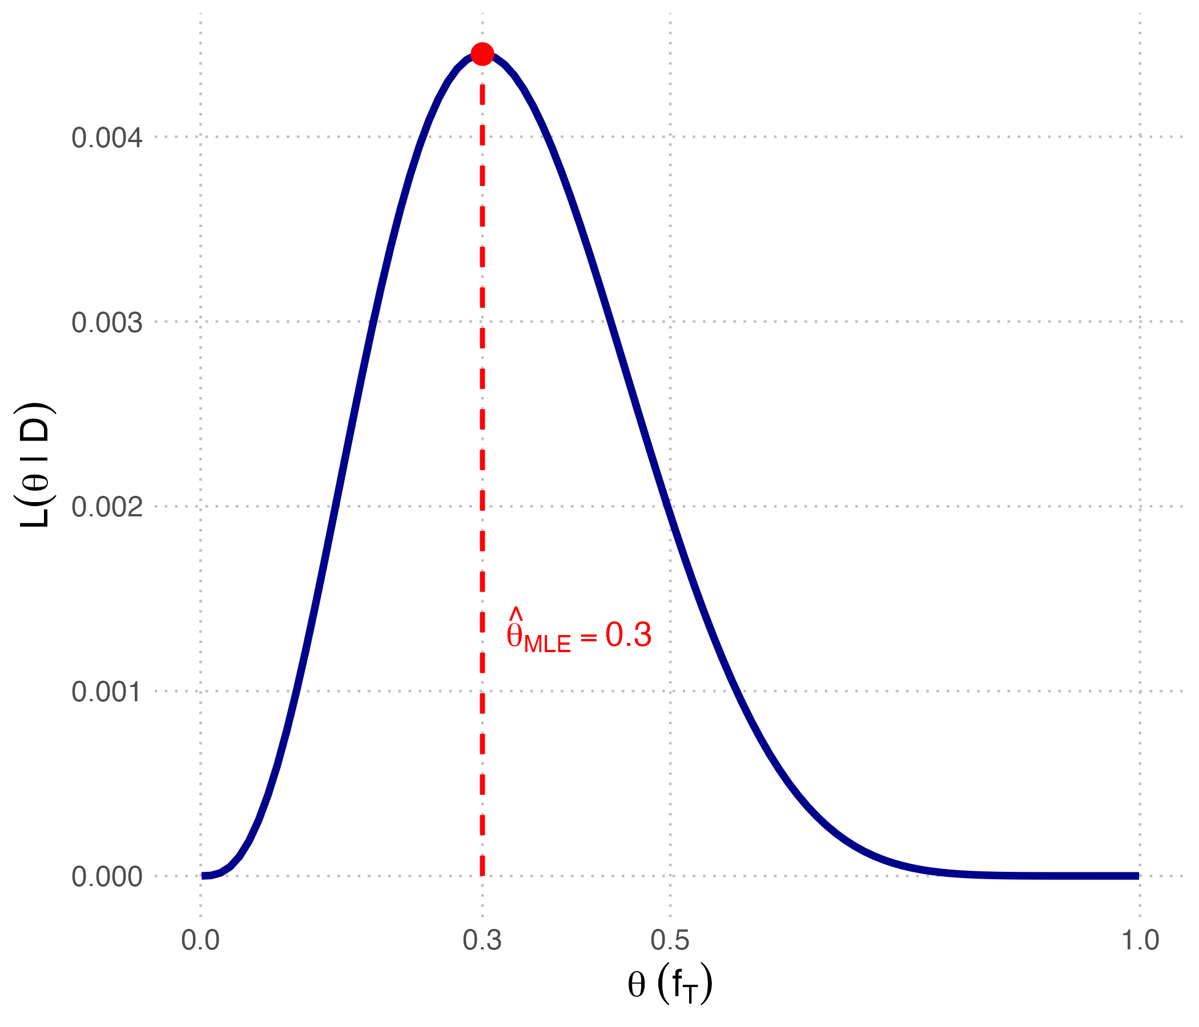
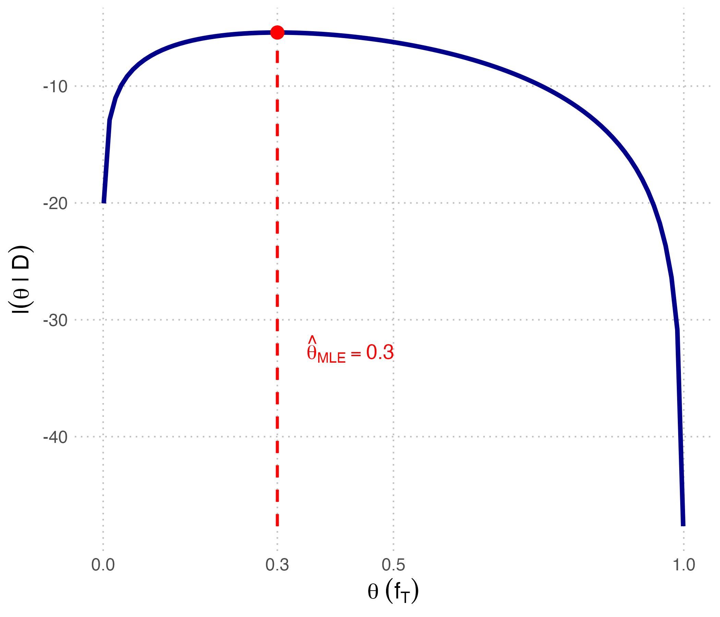
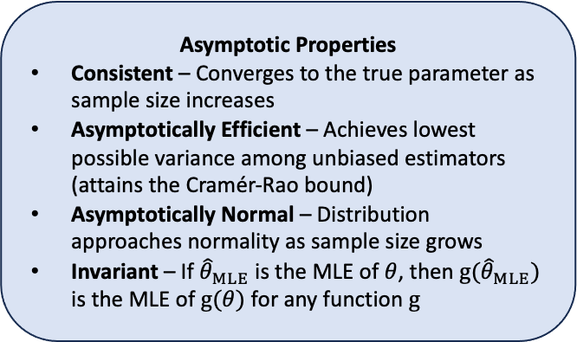
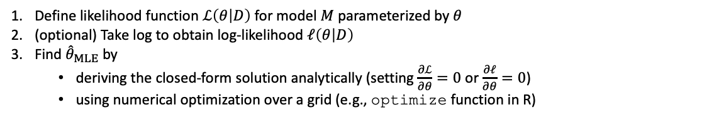
Maximum Likelihood Estimation (MLE)
Find parameter values that maximize the likelihood function
MLE in Likelihood and Log-likelihood functions
Likelihood function
Log-likelihood function
Key Steps
Define likelihood function $ℒ\left(θ | D\right)$ for model $M$ parameterized by $θ$
(optional) Take log to obtain log-likelihood $ℓ\left(θ | D\right)$
Find ${\hat{θ}}_{MLE}$ by
deriving the closed-form solution analytically (setting $\frac{∂ℒ}{∂θ}=0$ or $\frac{∂ℓ}{∂θ}=0$)
using numerical optimization over a grid (e.g., optimize function in R)
Asymptotic Properties
Consistent – Converges to the true parameter as sample size increases
Asymptotically Efficient – Achieves lowest possible variance among unbiased estimators (attains the Cramér-Rao bound)
Asymptotically Normal – Distribution approaches normality as sample size grows
Invariant – If ${\hat{θ}}_{MLE}$ is the MLE of $θ$, then ${g(\hat{θ}}_{MLE})$ is the MLE of $g(θ)$ for any function $g$
Practical Considerations
No Closed-Form in General – Often requires numerical optimization methods
Grid Search – Simple but computationally expensive approach for finding MLE
Numerical Optimization – Common algorithms include Newton-Raphson and gradient descent, but may encounter convergence issues
Starting Values – Good initial values can improve convergence and avoid local maxima

Slide 22










Likelihood Ratio and Likelihood Ratio Test
Compare the likelihoods for two models
1. Two Competing Models
2. Which Model Fits Best?
$$M_{2}$$
Model 1
$$β=0$$
No effect
$$M_{1}$$
Model 2
$$β=0.5$$
Moderate effect
3. Likelihood Ratio Calculation
Likelihood Ratio Test
$$Λ=−2\log{\frac{ℒ(M_{0}|D)}{ℒ(M_{1}|D)}}=−2[ℓ{{(M}_{0}|D)}−ℓ{{(M}_{1}|D)}]$$
$ℒ(M_{0}|D)$: likelihood of $M_{0}$ given data $D$ (null)
$ℒ(M_{1}|D)$: likelihood of $M_{1}$ given data $D$ (alternative)
Likelihood Ratio:
$$LR=\frac{ℒ(M_{1}|D)}{ℒ\left(M_{2} | D\right)}$$
or equivalently, calculate log-likelihood
$$\log\left(LR\right)$$
Must be nested models
$Λ$ asymptotically follows $χ^{2}$ distribution
Degree of freedom (df) is
$$\dim\left(Θ_{1}\right)−\dim\left(Θ_{0}\right)$$
Compare $Λ$in LRT to the critical value based on significance level to reject $H_{0}$
$LR>1$ or $\log\left(LR\right) <0$: Model 1 better explains the data
$LR<1$ or $\log\left(LR\right) >0$: Model 2 better explains the data

Slide 23





Expectation-Maximum (EM) Algorithm
The EM algorithm estimates parameters when data is incomplete by alternating between guessing the missing values based on current parameters (E-step) and updating parameters based on those guesses (M-step) until convergence.
Background
Data = Observed data $X$ + unobserved latent data $Z$
Parameters (unknown): $θ$
Goal: we want to compute the MLE of $θ$:
$$L\left(θ;X\right)=Pr\left(X | θ\right)=\int{P(X,Z|}θ)dZ=\int{P(X|}θ,Z)P\left(Z | θ\right)dZ$$
Why difficult? Both $Z$ and $X$ are unknown!
If $θ$ is known, usually the values of the $Z$ can be found by maximizing the log-likelihood over all possible values of $Z$, either simply by iterating over $Z$ or through certain algorithms for hidden Markov models.
If $Z$ is known, then we can find $θ$ fairly typically by grouping $X$ according to the value of the associated latent variable and averaging the values, or some function of the values, of the points in each group.
Motivation: $θ$ and $Z$ can be updated iteratively and reaches a (local) maximum!
EM algorithm
Step 1: Initialization
Initialize the parameters $θ$ to some random values
Step 2: Expectation (E) step
Compute the probability of each possible value of $Z$ given
the current$θ^{\left(t\right)}$
Step 3: Maximum (M) step
Use the just-computed values of $Z$ to compute a better estimate for the parameters$θ^{\left(t+1\right)}$
Iterate steps 2 and 3 until convergence.
E
M
Guess missing data $Z$
Update parameters $θ$
Application | Parameter ($θ$) | Latent variable ($Z$) | Software
MAF Estimation with Genotyping Errors | MAF; genotyping error rate | True genotypes at each individual | GATK
Local Ancestry Inference | Allele frequencies in ancestral populations; ancestry transition rates along chromosome | Local ancestry state (which ancestral population) at each genomic position for each haplotype | ELAI RFMix
Ancestry Estimation | Allele frequencies in each ancestral population | Ancestry proportion for each individual | STRUCTURE ADMIXTURE

Slide 24





Bayes’ Rule
Start with what you believe (prior), update it with what you see (likelihood), and get a new belief (posterior).
Bayes' rule arises when you want to make statements about an unknown quantity (e.g., a parameter, hypothesis, or event) given everything you know about a specific situation (data, and generative model for the data) so you can condition on all the knowns and treat the unknown as distributions, scaled by the overall likelihood of data to calibrate.
Key formula
$$P\left(θ | D\right)=\frac{P(D|θ)×P(θ)}{P(D)}$$
$P\left(θ | D\right)$: the posterior (probability of parameter $θ$given data $D$)
$P\left(D | θ\right):$ the likelihood (probability of observing data $D$ given parameter $θ$)
$P\left(θ\right):$ the prior (initial belief about parameter $θ$)
$P(D)$: the evidence/marginal likelihood (total probability of observing $D$)
Prior
$$×$$
Data
Posterior
Bayes’ Rule Components: Prior, Likelihood, Posterior
Prior belief favored moderate effect and large effect slightly: Started with 20% confidence in Model 1 ($β=0$), 40% in Model 2 ($β=0.5$) and 40% in Model 3 ($β=1$)
Data supported moderate effect: Likelihood was highest for Model 2 ($β=0.5$)
Posterior balanced both sources: Updated belief supports Model 2 over the other two
Conclusion: Despite Models 2 and 3 having equal priors, Model 2 becomes most probable because the data strongly favor it over Model 3
Bayes rule shows how prior knowledge and new data combine to update our belief of the models.

Slide 25


Bayes Factor
The ratio of two marginal likelihoods of model families, which generalizes the likelihood ratio by integral
Definition
The Bayes factor compares the average evidence across one family of models (weighted by priors) to that of another family, while likelihood ratios compare the evidence for one specific model at specific parameter values to another.
Key Formula
$${BF}_{12}=\frac{L(M_{1}|D)}{L(M_{2}|D)}=\frac{\int{P\left(θ_{1} | M_{1}\right)}P⁡(D|θ_{1},M_{1})ⅆθ_{1}}{\int{P\left(θ_{2} | M_{2}\right)P⁡(D|}θ_{2},M_{2})ⅆθ_{2}}$$
P$(D|M_{i})$: the marginal likelihood (evidence) for model family $i$ given data $D$
$θ_{i}$: parameters under model family $i$
$P\left(θ_{i} | M_{i}\right)$: the prior distributions over parameters $θ_{i}$ under model family $i$
$P⁡(D|θ_{i},M_{i})$ $:t$he likelihood of data $D$ given parameters $θ_{i}$ under model family $i$
Bayes Factor vs. Likelihood Ratio
 | Bayes Factor (BF) | Likelihood Ratio (LR)
Definition | Ratio of marginal likelihoods (integrated over priors) | Ratio of likelihoods at specific parameter values
Formula | $$\frac{\int{P\left(θ_{1} | M_{1}\right)}P⁡(D|θ_{1},M_{1})ⅆθ_{1}}{\int{P\left(θ_{2} | M_{2}\right)P⁡(D|}θ_{2},M_{2})ⅆθ_{2}}$$ | $$\frac{L(θ_{1}|D)}{L(θ_{2}|D)}$$
Treatment of Parameters | Integrates over parameter space using prior $P\left(θ | M\right)$ | Uses specific parameter values (often MLEs for LRT)
Prior Information | Yes (incorporates prior distributions) | No
Model Complexity Penalty | Automatic (via integration over parameter space) | None (unless using penalized likelihood)
Interpretation | Strength of evidence for one model family vs. another | Relative support for models at given parameter values
Model Comparison Type | Bayesian | Frequentist

Slide 26









p-value and Bayesian Hypothesis Testing
Frequentist
p-value is the probability of reject $H_{0}$ given that $H_{0}$ is correct
$H_{0}$: Null hypothesis
$H_{a}$: Alternate hypothesis
 |  | $$H_{0}$$ | $$H_{a}$$
Action | Reject | Type I error (p-value)
 | Fail to reject |  | Type II error (1-power)
Type I error = Pr($H_{0}$ is rejected| $H_{0}$)
Type II error = Pr($H_{0}$ is failed to be rejected| $H_{a}$)
Permutation test can generate empirical p-value.
p-value
Observed
data point
Fail to reject $H_{0}$
Reject $H_{0}$
Choose H1
Choose H2
p=0.002
p=0.0215
p=0.1094
p=0.3438
p=0.7539
p=1
Multiple Testing
All 30 samples generated under the null hypothesis (a point being red/blue with equal probability of 0.5).
Testing at $α=0.05$, we should expect 5% false positives (≈1-2 significant results by chance), as the purple box shows.
This illustrates the multiple testing problem.
Solution: Apply correction methods to control error rates:
Family-wise error rate (FWER): e.g., Bonferroni correction (more stringent)
False discovery rate (FDR): Benjamini-Hochberg procedure (more powerful)

Slide 27


Bayesian Normal Mean Model
Posterior = our prior belief about a normal distribution's mean + observed data
The Bayesian normal mean model treats the unknown mean parameter as a normally distributed random variable reflecting our uncertainty, then updates this normal distribution by conditioning on observed data to yield a posterior normal distribution with reduced uncertainty.
Model Setting
$$Y=Xβ+ε$$
$Y$: phenotype vector (i.e., height)
$X$: genotype vector (considered as just a coefficient of $β$ because for each individual it is fixed)
$β$: genetic effect size (unknown, to be estimated) and the prior distribution is $β \sim 𝒩\left(β_{0},σ_{0}^{2}\right)$ and $τ_{0}=\frac{1}{σ_{0}^{2}}$
The posterior distribution is $β|Y \sim 𝒩(β_{1},σ_{1}^{2})$ where $β_{1}=σ_{1}^{2}(\frac{1}{σ^{2}}X^{T}Y+\frac{1}{σ_{0}^{2}}β_{0})$, $σ_{1}^{2}={(\frac{1}{σ^{2}}X^{T}X+\frac{1}{σ_{0}^{2}})}^{−1}$
Prior, Likelihood and Posterior

Slide 28


Bayesian Multivariate Normal Mean Model
Correlated variables share information - observing one informs our beliefs about others through the covariance structure
The Bayesian multivariate normal mean model extends the univariate case by treating multiple unknown mean parameters as jointly uncertain through a multivariate normal distribution, then conditioning on observed data while accounting for correlations between parameters, which allows uncertainty about one parameter to inform and reduce uncertainty about others in ways that independent analyses cannot achieve.
Key Formula
In the bivariate normal mean model, if the prior is
$$β=\left({β_{a} \atop β_{b}}\right)\sim 𝒩\left(\left({β_{a,0} \atop β_{b,0}}\right), \left(\begin{matrix}σ_{a,0}^{2} & ρ_{0}σ_{a,0}σ_{b,0} \\ ρ_{0}σ_{a,0}σ_{b,0} & σ_{b,0}^{2}\end{matrix}\right)\right)$$
With observed data $D$, the posterior is:
$$β|D=\left({β_{a} \atop β_{b}}\right)|D\sim 𝒩\left(\left({β_{a,1} \atop β_{b,1}}\right), \left(\begin{matrix}σ_{a,1}^{2} & ρ_{1}σ_{a,1}σ_{b,1} \\ ρ_{1}σ_{a,1}σ_{b,1} & σ_{b,1}^{2}\end{matrix}\right)\right)$$
Example
• Bayesian learning: Prior beliefs update to posterior after observing data
• Uncertainty reduction: Posterior contours are tighter, showing less uncertainty
• Balanced compromise: Posterior mean balances prior beliefs with data evidence
• Correlation structure: Elliptical shape captures parameter relationships
• Learning from data: Posterior moves closer to true effects

Slide 29

Bayesian Model Comparison
quantifies uncertainty about competing explanations by computing how well each model predicts the data
Bayesian model comparison quantifies uncertainty about which model generated our data by computing marginal likelihoods for each competing model, where each marginal likelihood measures how well the model predicts the observed data after integrating over all possible parameter values weighted by their prior probabilities.
Workflow
Prior
Posterior
Model
Comparison
Data
+
• Model Selection: Posterior odds = Bayes Factor × Prior odds. With equal priors, BF directly gives model preference
• Conjugate Case: When prior and likelihood are conjugate, marginal likelihood has closed-form solution
• Non-conjugate Case: Requires numerical integration (grid methods, MCMC, variational Bayes, etc.)
• Computational Challenge: Real GWAS with millions of variants needs efficient approximation methods

Slide 30



Bayesian Mixture Model
A probabilistic model where observed data comes from a mixture of underlying distributions,
with parameters estimated using Bayesian inference with prior distributions
A Bayesian mixture model arises when we cannot condition on which component generated the data, so we treat component memberships as latent random variables and quantify uncertainty about the underlying heterogeneous structure through joint inference over both memberships and parameters.
Key Formula
$$p\left(β\right)=\sum_{c=1}^{C}{π_{c}p_{c}(β)}$$
$β$ comes from a weighted sum of $C$ different distributions (components), each with weight $π_{c}$
$π_{c}$: mixture weight for the $c$-th component, $\sum_{c=1}^{C}{π_{c}}=1$
$p_{c}\left(β\right)$: probability density function of the $c$-th component
Why important? Genetic architectures naturally have multiple classes of effects.
Example

Slide 31








Factor Analysis
Discovers the hidden factors that cause the pattern of the observed variables
Factor 1
Variable 1
Variable 2
Variable 3
Factor 2
Variable 4
Variable 5
Latent factors
(unobserved, to be inferred)
Observed variables
$$X=L^{T}F+E$$
$X$ ($N×p$): each row is an observed variable and each column is a sample
$L$ ($k×N$): loading matrix (the underlying factor values of each sample)
$F$ ($k×p$): factor matrix (loading of each factor on the observed variables)
$E$ ($N×p$): unobserved stochastic error term
$$X$$
$$L^{T}$$
$$F$$
$$E$$
=
+
Example (ADMIXTURE):
Each row of $L$sum up to 1 (e.g., proportion of ancestry), and all elements are between 0 and 1
All elements in $F$ is between 0 and 1 (e.g., allele frequency)
Different factor analysis methods essentially impose
different constraints on $L$ and/or $F$ to achieve a unique solution.

Slide 32














Principal Component Analysis (PCA)
Finds the directions where your data varies the most, allowing you to reduce dimensions while preserving maximum information
PCA is a special case of factor analysis
$$X=L^{T}F+E=U_{k}Σ_{k} W_{k}^{T}+E$$
$L^{T}=U_{k}Σ_{k}$; $F=W_{k}^{T}$
$X$ needs to be scaled first (PCA is sensitive to scaling)
It turns many correlated variables into fewer orthogonal “summary” variables ($W_{k}^{T})$
Loadings $U_{k}Σ_{k}=XW_{k}$(called PC scores) are generally used to control for confounders.
$$X^{T}X$$
$$Σ$$
$$Σ$$
$$W^{T}$$
$$X$$
$$U$$
$$Σ$$
$$W^{T}$$
=
=
$$W$$
Singular Value Decomposition
(SVD) of $X$ (genotype matrix)
Eigen Decomposition of $X^{T}X$
($LD=\frac{1}{N}X^{T}X$)
Properties
Columns of $U_{k}$ are orthogonal unit left singular vectors of $X$
Column of $W_{k}$ are orthogonal unit right singular vectors of $X$
The diagonal elements of $Σ_{k}$ is the singular values of $X$, and $σ_{1}≥σ_{2}≥…≥σ_{k}>0$
Proportion of variance explained (PVE) by each PC:
$$\frac{σ_{j}^{2}}{\sum_{j=1}^{p}{σ_{j}^{2}}}$$
Proportion of variance explained (PVE) by the top $k$ PCs:
$$\frac{\sum_{j=1}^{k}{σ_{j}^{2}}}{\sum_{j=1}^{p}{σ_{j}^{2}}}$$
Applications
Mixture analysis (population structure)
Identify ancestry clusters in datasets
Visualize genetic diversity — e.g., PC1 vs PC2 plots that resemble geographic maps
Correction for population stratification in GWAS
Genetic ancestry differences can confound association tests
Top PCs can be included in the model as covariates:
Trait ∼ SNP + PCs + covariates
Quality control (QC) (identify outlier samples)
mislabeled ancestry, contamination

Slide 33

















Hidden Markov Model (HMM)
HMMs figure out what's happening behind the scenes by watching what you can actually see,
knowing that hidden states tend to persist from one position to the next
Markov Chain
…
$$Z_{1}$$
$$Z_{2}$$
$$Z_{3}$$
$$Z_{4}$$
…
For a sequence of random variables $Z_{1}, Z_{2}, …, Z_{T}$, the Markov property states that the future state depends only on the current state, not on the past history:
$$P\left(Z_{t+1} | Z_{1}, Z_{2}, …, Z_{t}\right)=P\left(Z_{t+1} | Z_{t}\right)$$
Hidden Markov Model
$$X_{1}$$
$$X_{2}$$
$$X_{3}$$
$$X_{4}$$
$$Z_{t}$$
Hidden state at time $t$
…
$$Z_{1}$$
$$Z_{2}$$
$$Z_{3}$$
$$Z_{4}$$
…
$$X_{t}$$
Observation at time $t$
HMM extends the Markov Chain by adding observations $X_{1},X_{2}, …,X_{T}$ while the underlying states $Z_{1}, Z_{2}, …, Z_{T}$ are hidden (unobservable), but at each time $t$ we observe $X_{t}$ that depends only on the current hidden state $Z_{t}$.
Posterior = Forward * Backward
Applications of HMM
Forward Probability
$$α_{t}\left(k\right)≔P\left(z_{t}=k,x_{1:t}\right)$$
$$α_{t+1}\left(k\right)=P\left(x_{t+1}|z_{t+1}=k\right)\sum_{j}{α_{t}\left(j\right)∙P\left(z_{t+1}=k|z_{t}=j\right)}$$
Backward Probability
$$β_{t}\left(k\right)≔P\left(x_{t+1:T}|z_{t}=k\right)$$
$$β_{t}\left(k\right)=\sum_{j}{β_{t+1}\left(j\right)∙P\left(z_{t+1}=j|z_{t}=k\right)∙P\left(x_{t+1}|z_{t+1}=j\right)}$$
Posterior Distribution
$$P\left(z_{t}=k | x_{1:T}\right)=\frac{α_{t}\left(k\right)∙β_{t}\left(k\right)}{\sum_{k^{′}}{α_{t}\left(k^{′}\right)∙β_{t}\left(k^{′}\right)}}$$
 | Genotype Imputation | Local Ancestry Inference
What’s hidden? | Reference haplotype | Population ancestry
What’s observed? | Subset of genotypes | All genotypes
What do we infer? | Missing genotypes | Ancestry labels for variants
Reference panel | From same population | From ancestral populations
Forward probability
Backward probability
1
t
T
Information from
past observations
Information from
future observations

