Slide 1
Pattern Recognition for Payment Integrity
From rules to reasoning agents
Topic: Clinical Decision Making and Pattern Recognition in Health Care
Penghua Wang | Ph.D. Candidate, Data Science and Analytics, University of Oklahoma
Prepared for Cotiviti, Inc. | September 2026
Notes:
Hi, I'm Penghua Wang. I'm a PhD candidate in data science with a master's in statistics, and this is my Cotiviti intern assessment. I chose the topic clinical decision making and pattern recognition in health care, and I focused it on payment integrity: how statistics, machine learning, and now reasoning agents find the claims and providers that deserve a closer look. I'll cover the report in about two minutes, then show a working proof of concept.

Slide 2
Why it matters
Improper payment is not a measure of fraud; fraud alone is estimated at 3-10% of spending (NHCAA)
$14.6B
Intended loss in the 2025 National Health Care Fraud Takedown: 324 defendants; proactive analytics stopped about $4.4B
95%
of appealed Medicare Advantage skilled-nursing prior-authorization denials were overturned (OIG, 2026)
Sources: CMS (2026) Fiscal Year 2025 Improper Payments Fact Sheet; U.S. Department of Justice (2025); HHS-OIG (2026) OEI-09-24-00331; NHCAA.
Notes:
CMS estimated improper payments of 28.8 billion dollars in Medicare fee-for-service and 37.4 billion in Medicaid for fiscal 2025. Improper does not mean fraudulent, but fraud alone is estimated at three to ten percent of spending, and enforcement is now analytics-led: the 2025 national takedown charged 324 defendants with 14.6 billion in intended loss. And when skilled-nursing denials were appealed, OIG found Medicare Advantage plans overturned 95 percent of them, which is why overturn rate matters later in this talk.

Slide 3
The concept: five questions, one stack
Pattern recognition for treatment, payment and operations (TPO)
1
Classification Is this claim payable as billed?
The new layer: chain reasoning
2
Prediction Which claims will fail a medical record review?
LLM agents that retrieve policy, read records and draft findings (Wei et al., 2022; Yao et al., 2023).
Detectors find the signal. The agent assembles the evidence and the policy citations. A human auditor makes the determination.
3
Inference Does this provider differ from peers by more than chance?
4
Clustering Which providers share a billing profile?
5
Time series When did a provider's behavior change?
Notes:
The topic breaks into five questions. Classification: is this claim payable as billed? Prediction: which claims will fail a record review? Inference: is this provider different from peers by more than chance? Clustering: who shares a billing profile? And time series: when did behavior change? The new layer on top is chain reasoning, where a language model with tools assembles evidence and explains it.

Slide 4
Trends: from rules to reasoning agents
Past, present and future of pattern recognition in payment integrity
Past
Present
Future
Deterministic rules
Statistical models
Reasoning agents
Coding edits, bundling logic, frequency limits
Precise and auditable
Blind to patterns across claims, providers and months
Supervised triage on audited outcomes
Explainable unsupervised ensembles: 5x lift in overlap with DOJ-action hospitals (Shekhar et al., 2026)
Earlier intervention: Cotiviti's Proactive COB acts at enrollment (2026)
LLMs encode clinical knowledge (Singhal et al., 2023)
Coder + critic agents (Yin et al., 2026); the same pattern for policy citations
Coexistence, not replacement: rules, ranking, agent, critic, human
Notes:
Rules came first: precise, but blind across claims and months. Today, statistical models rank providers, and a 2026 study on seven million Medicare claims showed explainable ensembles give a five-fold lift in targeting. The future is coexistence, not replacement: rules, statistical ranking, an agent that assembles evidence, a critic that checks it, and a human who decides.

Slide 5
Opportunities and threats
Opportunities
Threats
Explainable triage: rule hits, peer z-scores and change points in one evidence packet
Emerging-scheme discovery where no rule exists yet
Cross-payer signal across 100+ payers, within contracts and de-identification
False positives cost reviewer time and provider goodwill
Automation bias: browser agents almost never withheld a deficient prior-auth submission (Nie et al., 2026)
AI-assisted denials are in court and before Congress (Raza et al., 2026); 95% of appealed SNF denials overturned (OIG, 2026)
Notes:
The opportunities: explainable triage, emerging-scheme discovery, audit copilots, and cross-payer signal. The threats: false positives cost reviewer time and provider goodwill; agents push work through, and a 2026 study found frontier browser agents almost never withheld a deficient submission; bias can cluster flags on safety-net practices; and AI-assisted denials are already in court.

Slide 6
Three deltas on what Cotiviti already has
Not new products: extensions of 360 Pattern Review, Clinical Chart Validation and the AI governance program
Option
Already at Cotiviti
Proposed delta
Pilot gate
1. Evidence-and-abstention layer
Clinical Chart Validation: ML-prioritised charts, specialist review; 360 Pattern Review leads
Agent returns cited facts and missing-evidence checks for a lead; critic verifies; packet marked REVIEW or WITHHOLD; never a determination
6-week shadow mode: citation coverage, unsupported-claim rate, reviewer minutes, edit rate, overturn rate
2. Time-aware change-point signals
360 Pattern Review: provider scoring with AI and expert rules, prepay and postpay
Rolling-window volume and change-point detectors added to peer scoring; rank by detector agreement
Leads accepted by FWA experts per quarter; precision of leads at audit
3. Release gate for models and agents
AI Governance Committee since 2023; AI Risk Management Framework; AI Center of Excellence
Product-level harness: pre-registered acceptance criteria, blinded and external validation, drift monitoring, overturn-rate audit
Precision at K; recall on known schemes; false-positive cost; overturn rate
Recommendation: start 3 and 1 together; Option 1 runs six weeks in shadow mode before any reviewer acts on its output.
Notes:
Cotiviti already runs 360 Pattern Review, Clinical Chart Validation, and an AI governance program, so my options are deltas, not new products. One: an evidence-and-abstention layer for existing leads, run in shadow mode, that returns cited facts and marks each packet review or withhold. Two: time-aware change-point signals added to provider scoring. Three: a release gate for every model and agent, with overturn rate as the headline metric, because OIG found Medicare Advantage plans overturned ninety-five percent of appealed skilled-nursing denials. Start with three and one together.

Slide 7
Proof of concept: Claims Anomaly Radar
A small version of Options 2 and 1, built to prove the pattern, not to ship
Synthetic claims
295K lines, 240 providers x 24 months, 15 injected anomalies
Provider features
E/M mix, level-5 share, modifier-25 rate, duplicates, de-duplicated volume, variability, paid per visit
Three complementary detectors
A: peer-group robust z B: time series (spikes, level shift) C: Isolation Forest
Consensus rank
Detectors agreeing, then signal strength; evidence packet per provider
Critic and disposition
Explainable signal, baseline, claim volume, corroboration, governing policy: REVIEW or WITHHOLD
Auditor brief + scorecard
Plain-English brief with policy and evidence to request; precision against ground truth
One Python file, four dependencies, about six seconds per run, six tests. No PHI, no API keys. Ground truth is used only for scoring, never for detection.
Notes:
The proof of concept is a small version of options two and one, on synthetic claims. It generates about 295 thousand claim lines for 240 providers over 24 months, with fifteen injected anomalies. Three complementary detectors run: peer-group robust z-scores within specialty, time-series spike and change-point tests, and an Isolation Forest. Providers rank by how many detectors agree. Then a deterministic critic checks every packet and marks it review or withhold. The scorecard uses the injected ground truth only for scoring: fourteen of fifteen designed anomalies in the top fifteen on this seed. That is a wiring check, not production accuracy, so the robustness mode reports the spread across twenty seeds.

Slide 8
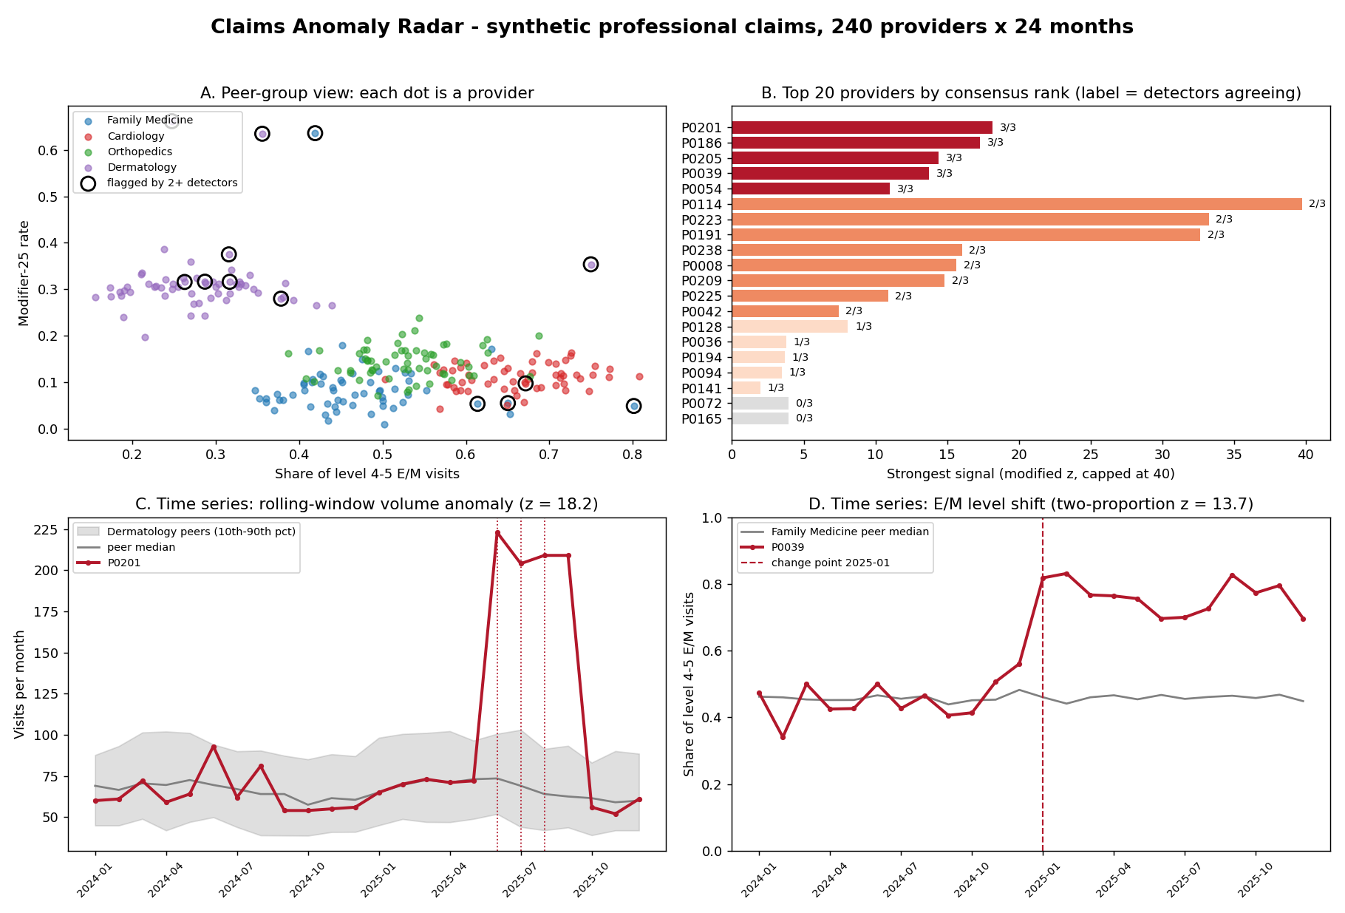
What the radar finds
A
Peer view within specialty; providers flagged by two or more detectors are circled
B
Consensus ranking; label shows how many detectors agree
C
A four-month volume spike that a snapshot would miss
D
An E/M level shift with the detected change point
Notes:
The dashboard shows the same story. Panel A is the peer view, with flagged providers circled. Panel B is the consensus ranking. Panel C is a volume spike that a snapshot would miss, and panel D is an E/M level shift with the detected change point.

Slide 9
What the auditor sees
python claims_radar.py --provider P0039 | python claims_radar.py --provider P0036
14 / 15
designed anomalies in the top 15 (fixed seed)
P0039 (Family Medicine), 3 of 3 detectors. Disposition: REVIEW
Primary pattern: share of level 4-5 E/M visits rose from 0.45 to 0.76 starting 2025-01 (two-proportion z = 13.7).
Governing policy: CMS Claims Processing Manual Ch. 12 Sec. 30.6; AMA 2021 E/M guidelines.
Evidence to request: documentation for 30 level 4-5 visits dated after the change point.
A human reviewer decides.
0.93
median precision@15 over 20 seeds [0.93, 0.95]; p@10 = 1.00
0.99
median average precision over 20 seeds
P0036 (Family Medicine), 1 of 3 detectors. Disposition: WITHHOLD
Failed check: corroborated (2+ detectors or one signal with z >= 8). No case is opened; re-evaluate with next month's data. This was the only non-anomalous provider in the top 15.
~6 s
per run; 6 tests; no effect of contamination 0.03-0.10
A wiring check on designed anomalies, not production accuracy; real claims need calibration on audited outcomes.
Notes:
This is what an auditor sees for a withheld packet: the pattern, the governing policy, the failed check, and no case opened. A review packet adds the evidence to request and a next step. With the optional LLM flag, a model writes the prose, but only for packets the critic passed, and the statistics still decide.

Slide 10
Takeaways
Payment integrity is moving from rules to models to reasoning agents
The winners will explain every flag, measure every model, and give agents a critic and a withhold path
A useful anomaly radar fits in one Python file; the hard part is calibration and governance
Report, code, slides and video: github.com/StatGuyOU/cotiviti-intern-assessment
Thank you | Penghua Wang
Ph.D. Candidate, Data Science and Analytics, University of Oklahoma | M.S. Statistics
Notes:
Payment integrity is moving from rules to models to reasoning agents. The winners will explain every flag, measure every model, and give agents a critic and a withhold path. Everything, including report, code, slides, and this video, is in the repository at github.com/StatGuyOU/cotiviti-intern-assessment. Thank you.

