Slide 1
COM506 Data Management Term Paper
To make data bases from Daangn Market
Name: Mincheol Kim

Slide 2
[Introduction]
Section #
Introduction
- What are the problem and plan to solve?
Statement of Problem
Plan to Solve the Problem
Problem
Many people have a hard time deciding which of my used products to sell
There are many people who want to buy what they want outside the scope of certification of Daangn Market.
What to do in this project
We will provide data on which item categories people in the area are most interested in through data.
Such a service can induce users to participate in a transaction with their used goods, and can also increase the participation rate of those who are far away.
Collect
I will crawl the data from specific website by using Python
Juju-si popular item URL: https://han.gl/kllec
Seogwipo-si, popular item URL: https://han.gl/kvJlh
Process
Many people have a hard time deciding which of my used products to sell
There are many people who want to buy what they want outside the scope of certification of Daangn Market.
Store
CSV files are sent to and stored in databases of SQLite and Elasticsearch.
Query
After data is properly stored in the database, the data is accessed and processed through query statements.
Subheading Large style, Arial font, 12pts
Normal text without a bullet style – equivalent of PB Body Large, Arial font, 12pts
First bullet is in Arial font, 12pts, and starts with a capital letter. It uses black square (wingdings), sized 80% of text for bullets
second level bullet is Arial font 12pts. It uses black, en-dash (Arial), sized 100%
third level bullet is Arial font 12pts. It uses black, en-dash (Arial), sized 100%
Note: Notes are placed either directly beneath the object to which they apply, or at the bottom of the page
Source: Sources appear either directly beneath the object to which they apply, or at the bottom of the page, next to the Deutsche Bank logo as illustrated. There are 2 spaces after the colon
[1] https://it.donga.com/32081/

Slide 3
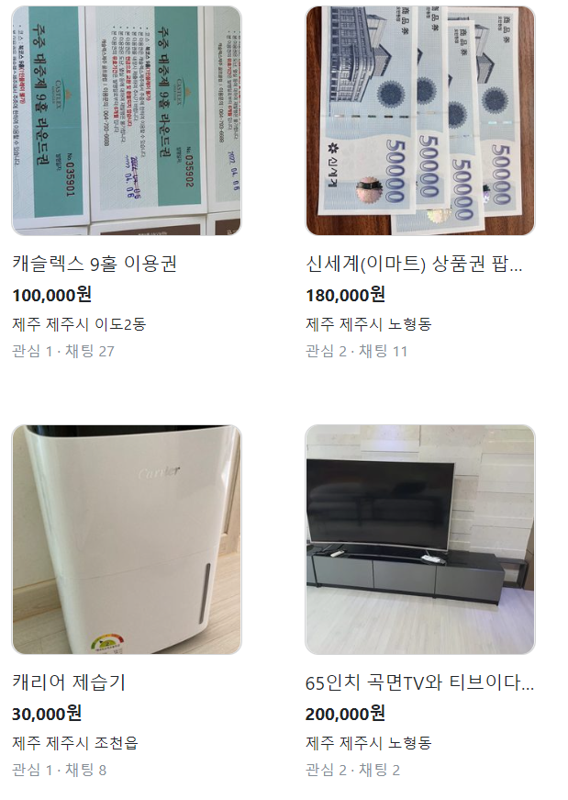
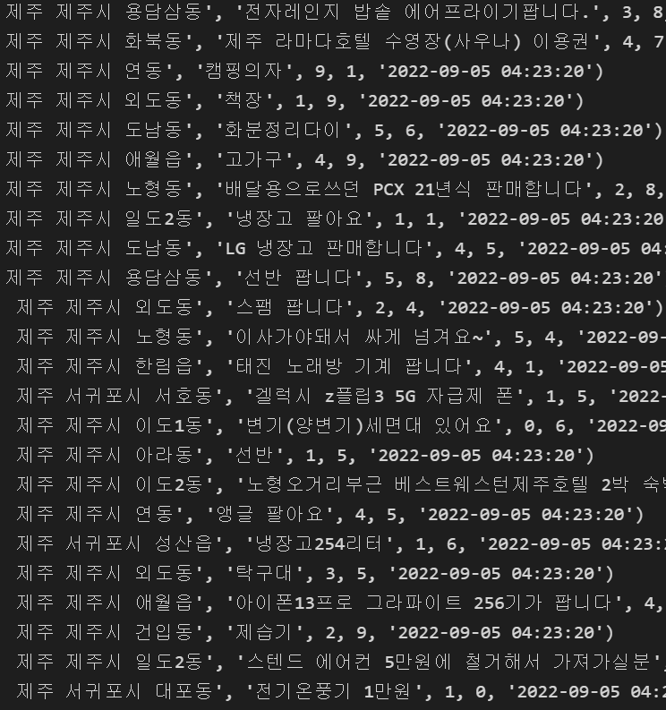
[Introduction]
Section #
Method & Results
- Packages for SQL and NoSQL
Method
Results
Packages
For crawling, I used BeautifulSoup and requests modules.
From the Daangn Market website's collection of popular products, the product names, regions, chats (trade attempts and inquiries), and likes were taken.
SQLite
I created a database using SQLite, which can be used lightly by individual users, and created a table by inputting csv data.
Elasticsearch
Converted CSV file to JSON file. We used Elasticsearch to handle this.
Enter data into Elasticsearch and create an index
Data
SQL & NoSQL
Customers using Daangn Market mentioned not only products but also gift certificates and categories, or omitted product names with pictures.
Not only that, customers were looking for the goods or services they needed.
Subheading Large style, Arial font, 12pts
Normal text without a bullet style – equivalent of PB Body Large, Arial font, 12pts
First bullet is in Arial font, 12pts, and starts with a capital letter. It uses black square (wingdings), sized 80% of text for bullets
second level bullet is Arial font 12pts. It uses black, en-dash (Arial), sized 100%
third level bullet is Arial font 12pts. It uses black, en-dash (Arial), sized 100%
Note: Notes are placed either directly beneath the object to which they apply, or at the bottom of the page
Source: Sources appear either directly beneath the object to which they apply, or at the bottom of the page, next to the Deutsche Bank logo as illustrated. There are 2 spaces after the colon

Slide 4
[Introduction]
Section #
Discussion
- Interpretations and Implications
Interpretation of Results
Implications for the Field
Interpretation
People are not simply using the Daangn Market app for second hand trading. Users also find the services they need in their lives in the app.
There are many types of product names. It is not easy to categorize because it refers to various products.
When posting through a mobile phone, users must select a category, but measurement errors may exist.
Implication1
We can use the category information in each item's post to showcase popular category products in your area.
Implication2
If you set a category for demand rather than supply, you will be able to increase the customer's transaction participation rate.
Subheading Large style, Arial font, 12pts
Normal text without a bullet style – equivalent of PB Body Large, Arial font, 12pts
First bullet is in Arial font, 12pts, and starts with a capital letter. It uses black square (wingdings), sized 80% of text for bullets
second level bullet is Arial font 12pts. It uses black, en-dash (Arial), sized 100%
third level bullet is Arial font 12pts. It uses black, en-dash (Arial), sized 100%
Note: Notes are placed either directly beneath the object to which they apply, or at the bottom of the page
Source: Sources appear either directly beneath the object to which they apply, or at the bottom of the page, next to the Deutsche Bank logo as illustrated. There are 2 spaces after the colon

