Slide 1
Multivariate Rainfall Prediction
Yuhang Huang Haochen Ni Shiqi Li
12213015 12213027 12211031

Slide 2
Content
Introducion
Methods
Empirical Analysis
Conclusion
Future Work
References

Slide 3
Introducion

Slide 4
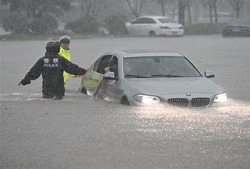
1.1 Background
Importance:
Critical for agriculture, transportation, water management, energy production, disaster mitigation, and emergency response.
Helps reduce economic losses, protect the environment, and improve quality of life.
Purpose:
Uses meteorological data to forecast
precipitation likelihood in a specific region.
https://www.tanmizhi.com/img/allimg/07/28-210H11K211-51.jpg

Slide 5
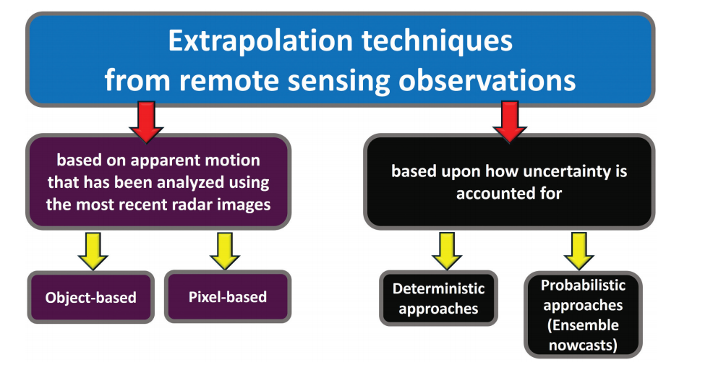
1.2 Literature Review
De Luca, D. L., Napolitano, F., Kim, D., Onof, C., Biondi, D., Wang, L. P., … Marconi, F. (2025). Rainfall nowcasting models: state of the art and possible future perspectives. Hydrological Sciences Journal, 1–20. https://doi.org/10.1080/02626667.2025.2490780

Slide 6
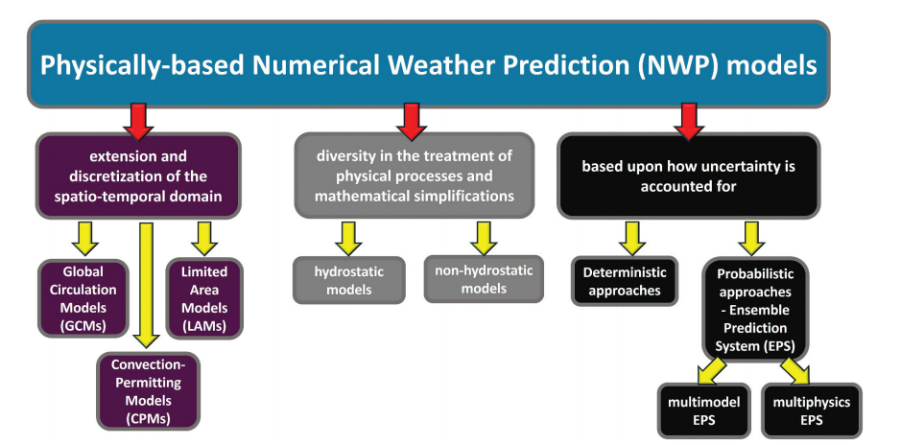
1.2 Literature Review

Slide 7
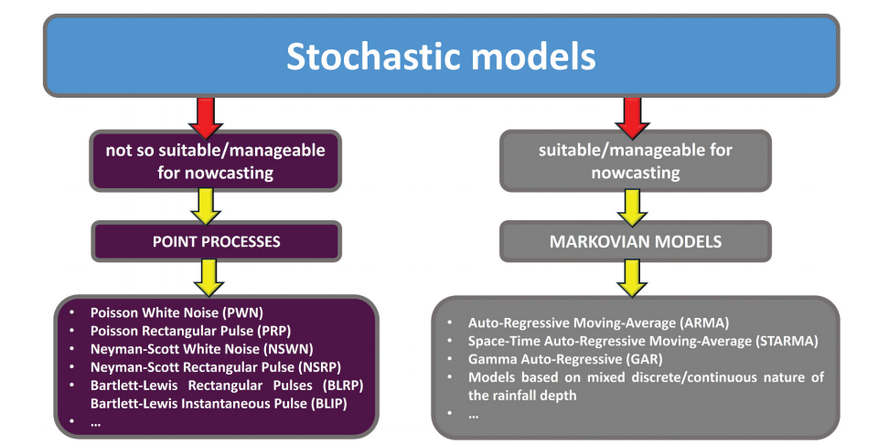
1.2 Literature Review

Slide 8
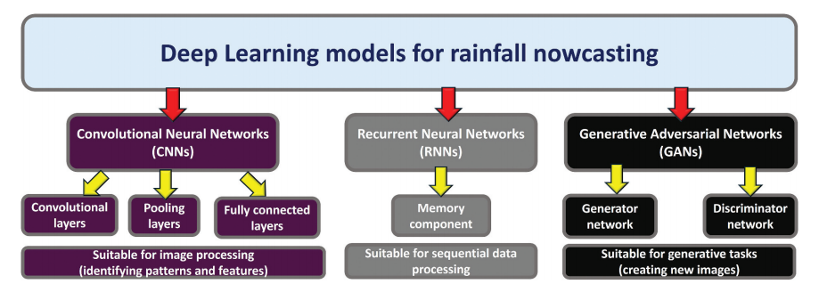
1.2 Literature Review

Slide 9
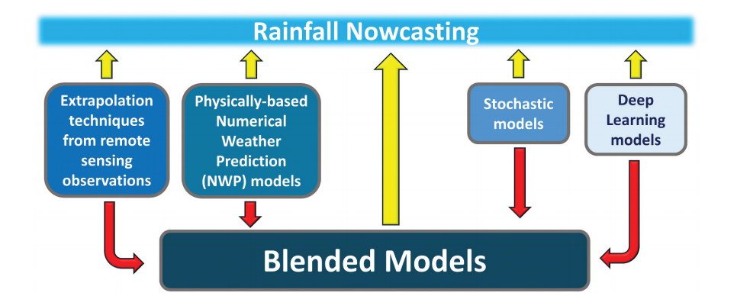
1.2 Literature Review

Slide 10
Methods

Slide 11
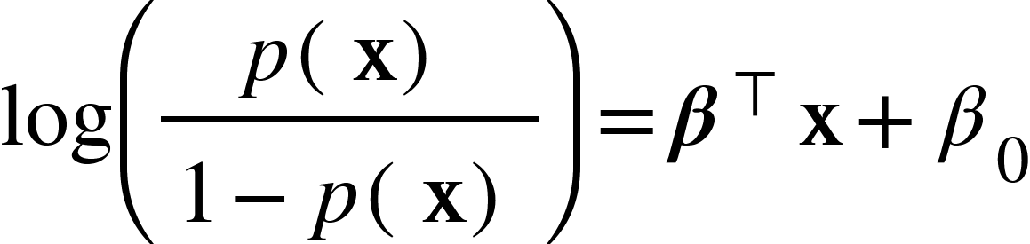
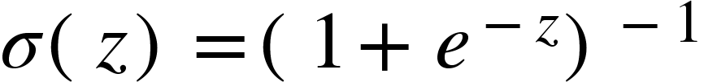

Principal Component Analysis (PCA)
Factor Analysis
Using maximum likelihood estimation to find extract factors
K-means Clustering
Logistic Regression
Logistic Function ; log odd
Support Vector Machines (SVM)
Binary Classification Neural Network

Slide 12
ReLU
Dropout: 0.3
ReLU
Dropout: 0.2
ReLU
Sigmoid
·
·
·
1
·
·
·
·
·
·
·
·
·
·
·
·
0
input(10)
hidden(128)
hidden(64)
hidden(32)
output(2)

Slide 13
Empirical Analysis

Slide 14

3.1 Data Description
This study analyzes a dataset sourced from the Kaggle competition titled
“Binary Prediction with a Rainfall Dataset”.
The dataset comprises 2191 meteorological observations.Each record includes various meteorological features such as temperature, humidity, atmospheric pressure, wind speed, wind direction. Additionally, each sample is accompanied by a binary response variable indicating whether rainfall occurred .
Binary Prediction with a Rainfall Dataset | Kaggle

Slide 15
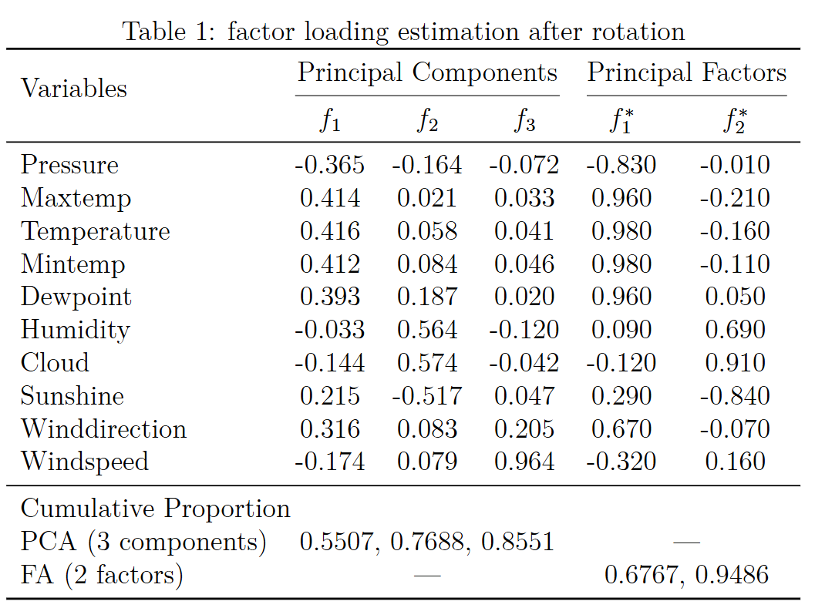
3.2.1 Dimensionality Reduction

Slide 16
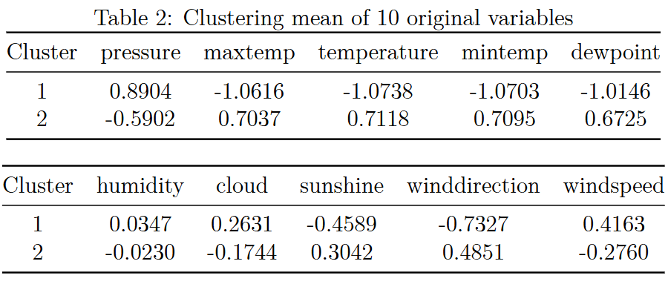
3.2.1 Kmeans clustering
By performing K-means clustering on the original data, we can observe the mean values of various variables within each cluster.

Slide 17
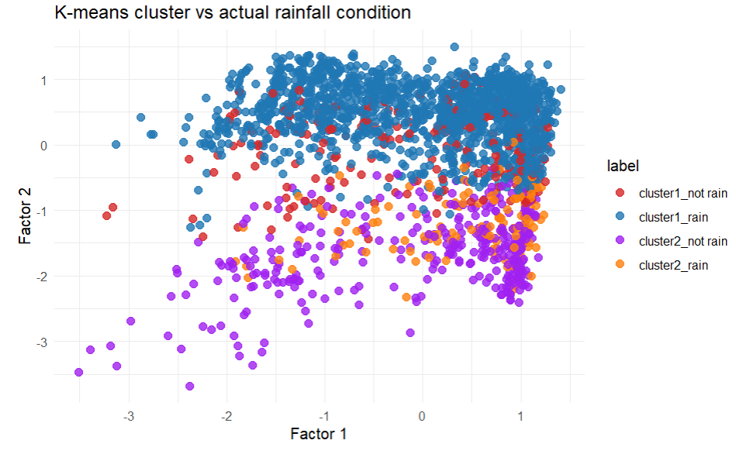
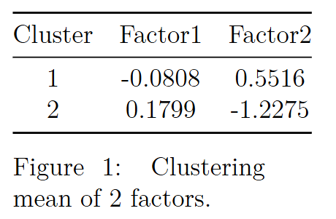
3.2.1 Kmeans clustering
"By conducting K-means clustering on the two factors derived from factor analysis, we can observe the mean values of these two factors within each cluster."

Slide 18
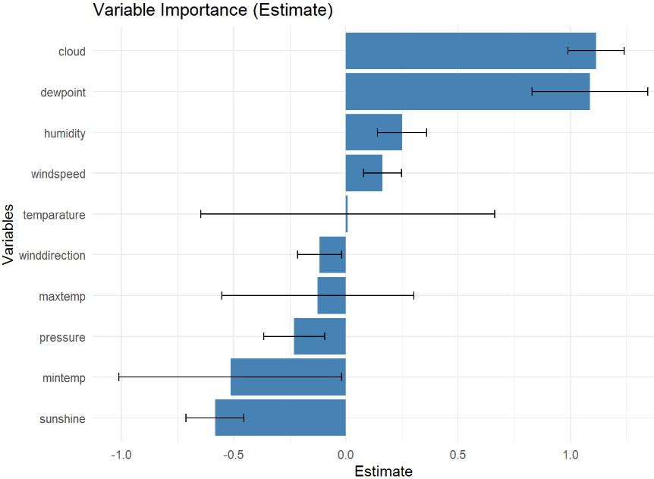
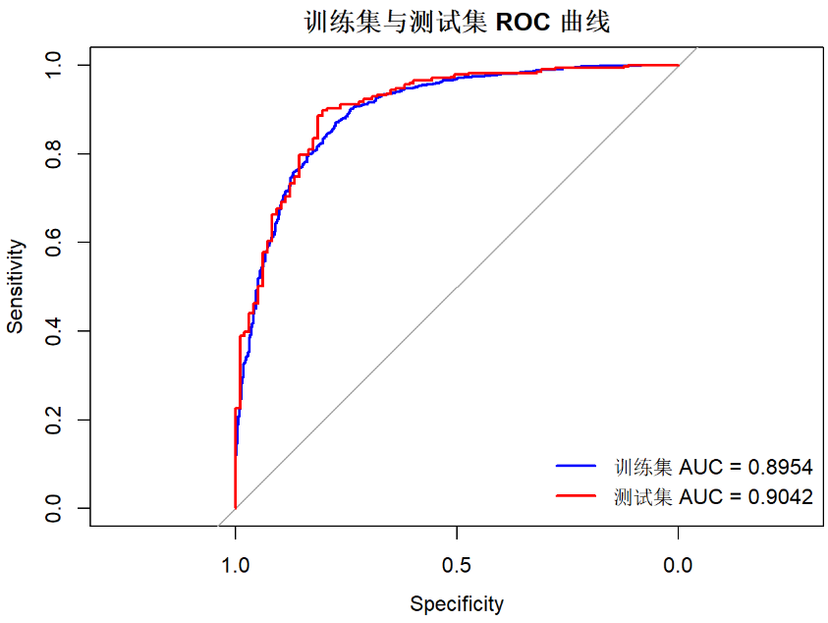
3.2.3 Prediction Analyze
logistic regression model of original data and its variable importance plots

Slide 19
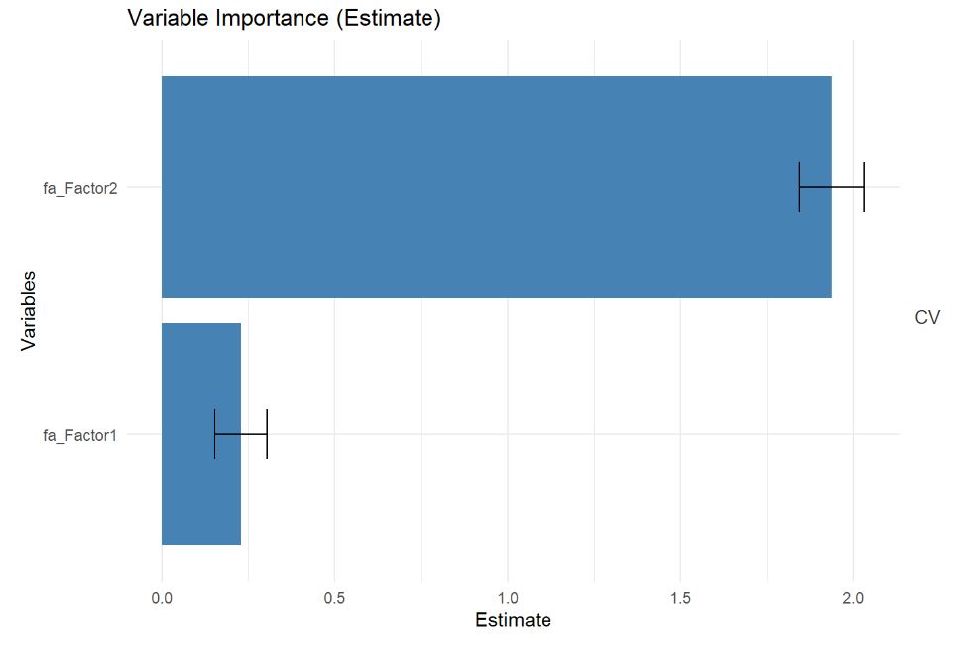
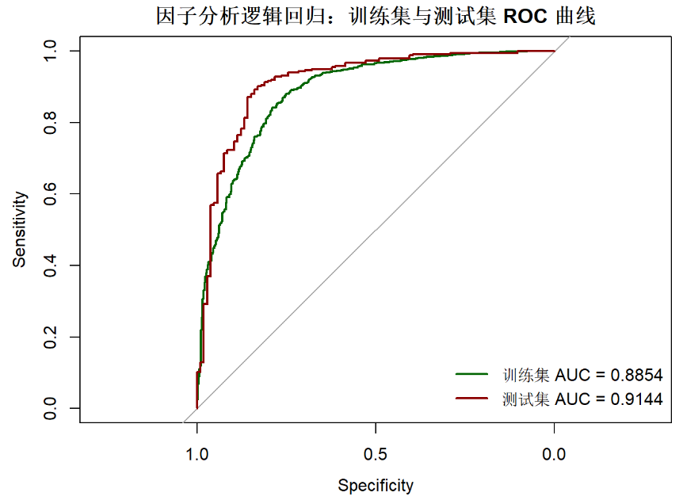
3.2.3 Prediction Analyze
logistic regression model of two factors and its variable importance plots

Slide 20
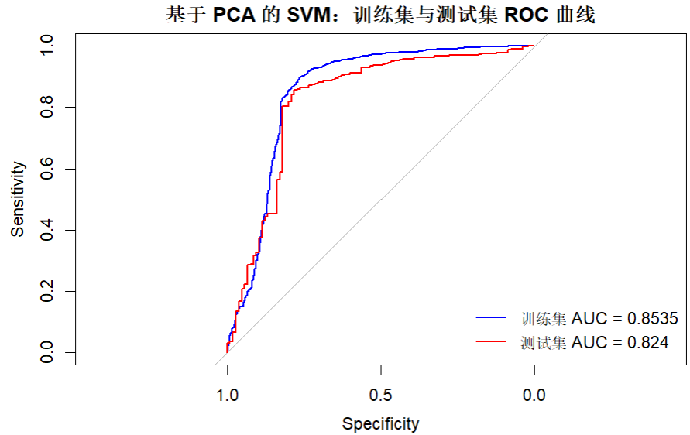
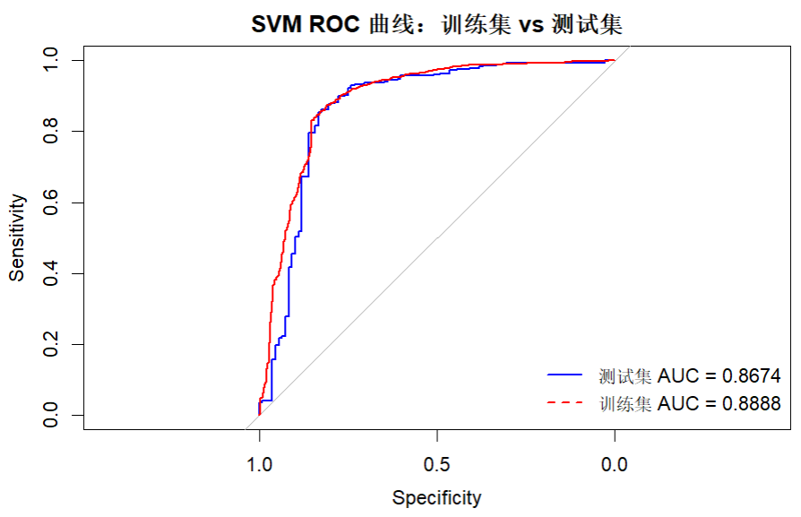

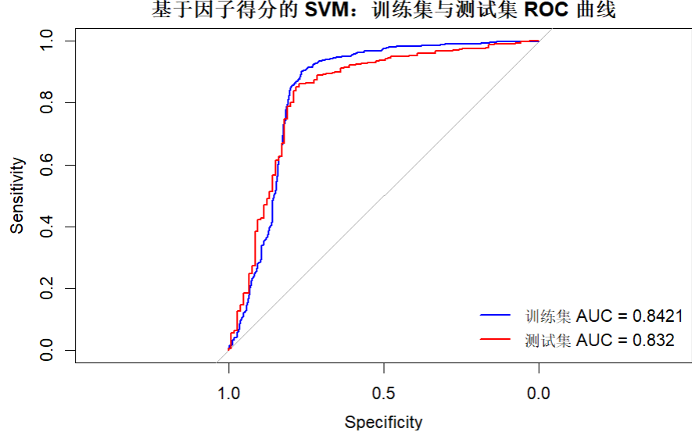

3.2.3 Prediction Analyze
SVM
Based on PCA
Based on original data
Based on factor analysis

Slide 21
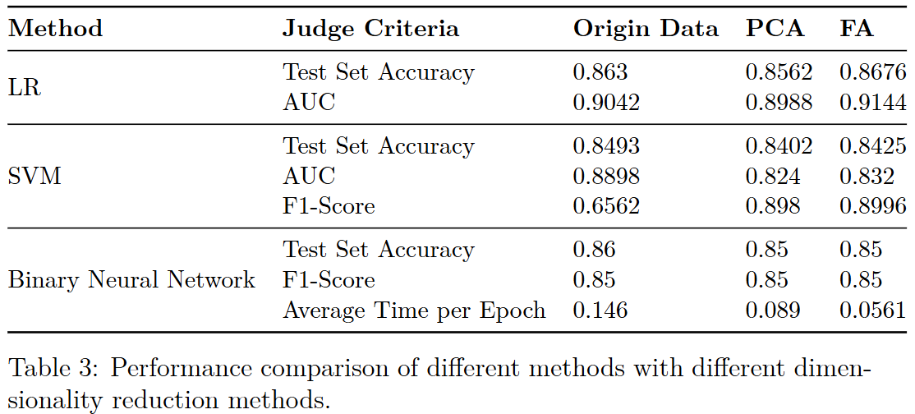
3.2.3 Prediction Analyze
FA demonstrates consistent advantages in most scenarios, especially for tasks requiring high precision and eﬀiciency.
logistic regression model performs the best among the three models

Slide 22
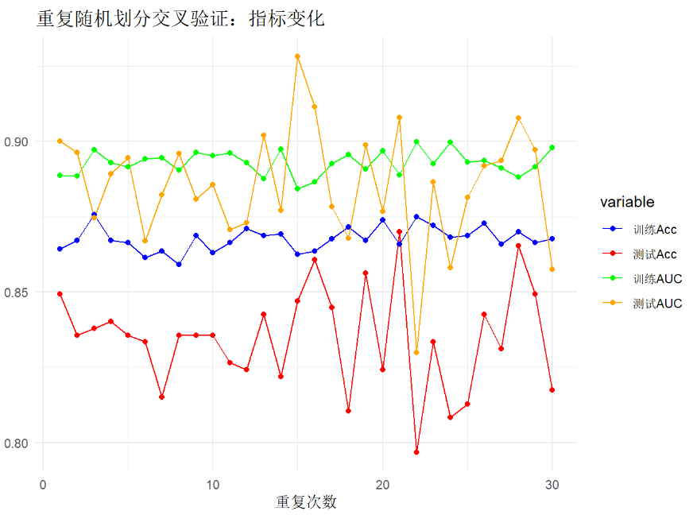
3.3 Verification of results
Model feasibility is assessed through the implementation of cross-validation

Slide 23
4.1 Conclusion
This study systematically evaluated the application of PCA and FA combined with machine learning models for predicting rainfall probability.
PCA successfully retained 85% of the total variance through three principal components. Factor analysis identified two interpretable latent factors: the “Temperature Factor” and the “Humidity Factor”.
Logistic Regression emerged as the optimal approach, SVM revealed a compromise between benefits and drawbacks, Neural Networks demonstrated robustness across all data representations, with FA significantly improving computational eﬀiciency.
K-means clustering revealed significant differences in meteorological patterns: the rainfall cluster was associated with high humidity, cloud cover, and specific wind directions, whereas the non-rainfall cluster exhibited characteristics of high sunshine and temperature.

Slide 24
4.2 Limitations and Future Directions
The study focuses on binary rainfall prediction, extending it to intensity prediction could enhance its practicality.
The interpretability of the FA factors needs to be verified by meteorological experts to strengthen the domain relevance.
Hybrid approaches should be explored to balance data-driven insights with physical laws.

Slide 25
References
[1] Sarmad Dashti Latif, Nur Alyaa Binti Hazrin, Chai Hoon Koo, Jing Lin Ng, Barkha Chaplot, Yuk Feng Huang, Ahmed El-Shafie, and Ali Najah Ahmed. Assessing rainfall prediction models: Exploring the advantages of machine learning and remote sensing approaches. Alexandria Engi neering Journal, 82:16–25, 2023.
[2] Michael Dixon and Gerry Wiener. Titan: Thunderstorm identification, tracking, analysis, and nowcasting—a radar-based methodology. Journal of Atmospheric and Oceanic Technology, 10(6):785– 797, 1993.
[3] M. Grecu and W.F. Krajewski. A large-sample investigation of statis tical procedures for radar-based short-term quantitative precipitation forecasting. Journal of Hydrology, 239(1):69–84, 2000.
[4] Stefano Sebastianelli, Fabio Russo, Francesco Napolitano, and Luca Bal dini. On precipitation measurements collected by a weather radar and a rain gauge network. Natural Hazards and Earth System Sciences,13:605–623, 2013.

Slide 26
References
[5] Shejule Priya Ashok and Sreeja Pekkat. A systematic quantitative re view on the performance of some of the recent short-term rainfall fore casting techniques. Journal of Water and Climate Change, 13(8):3004 3029, 07 2022.
[6] World Meteorological Organization (WMO). Standardized Precipitation Index User Guide. Geneva, 24 2012. Accessed: [Insert Date].
[7] Davide De Luca and A. Petroselli. Storage (stochastic rainfall gener ator): A user-friendly software for generating long and high-resolution rainfall time series. Hydrology, 8, 05 2021.
[8] Davide De Luca. Rainfall Nowcasting Models for Early Warning Sys tems. 01 2013.
[9] A. Bárdossy and G. G. S. Pegram. Copula based multisite model for daily precipitation simulation. Hydrology and Earth System Sciences, 13(12):2299–2314, 2009.

Slide 27
References
[10] Anthony Lawrance and P. Lewis. A new autoregressive time series model in exponential variables (near(1)). Advances in Applied Probability, 13:826–845, 12 1981.
[11] F. Cioffi, L. Tieghi, M. Giannini, and S. Pirozzoli and. Flash flood prediction in st. lucia island through a surrogate hydraulic model. Journal of Applied Water Engineering and Research, 12(3):297–310, 2024.
[12] Jared Willard, Xiaowei Jia, Shaoming Xu, Michael Steinbach, and Vipin Kumar. Integrating scientific knowledge with machine learning for engineering and environmental systems. ACM Comput. Surv., 55(4), November 2022.
[13] Kaggle. Playground series- season 5, episode 3. https://www.kaggle.com/competitions/playground-series-s5e3, 2025. Accessed: 2025 05-23.

