Slide 1
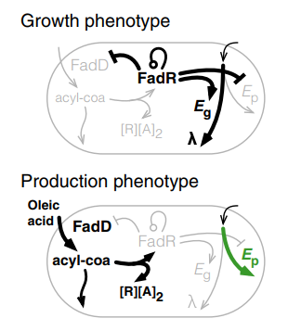
Oleic acid
fadD
Oleoyl-coa
fadR
fadO
P_{fadR}
P_{fadB}

