Slide 1
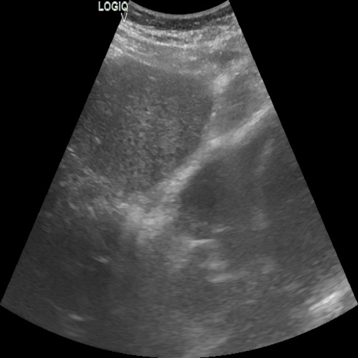
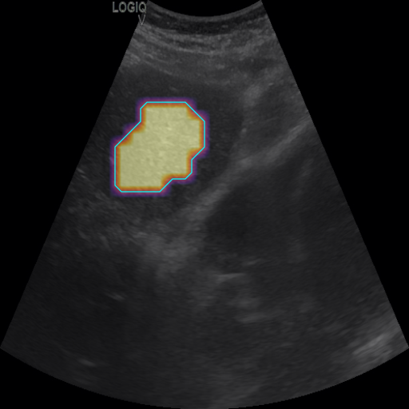
a
Shared representation and spatial guidance
1 × 1 projection
Training labels
P
Score, view
and weak boxes
Ultrasound
Shared encoder
Spatial features C
Local features Z
ROI, 512 × 512
ResNet-50
1,024 × 32 × 32
128 × 32 × 32
H_{c}
Context b
a = σ(L(C))
V = softplus(S(Z))
Global h
Weak localization
Learned support
2,048
H_{v}
View q
sg
×
V / max(∑V, ε)
softmax
λ = 1; ε = 10⁻⁸; Dᵥ = 0 if ∑V ≤ ε
wᵤ
b
View-specific local evidence before pooling
Six parallel paths, v = 1,…,6
Z
wᵤ
b
Tᵥ
∑
+
softmax
View
adapter
Shared
local MLP
Local logits
s_{v,u} ∈ ℝ³⁶
Weighted
sum
Dᵥ
pᵥ
p₁,…,p₆
q
sg
p = ∑ᵥ sg(qᵥ) pᵥ
ŷ = ∑ₖ (k/10) pₖ
Soft probability mixture
36 bins
Fine-grained fibrosis score
c
Image-only predictions with reference annotation
Reference annotation
Weak localization
View probabilities
Fibrosis score
Predicted
2.36
Reference
2.20
Not an inference input
0
1
Test set
SFibAI → VCRE-Fib
R_{final} 0.201180 → 0.186865 (−7.115%)
View acc. 66.81% Dice@0.5 0.360312
4,107 images / 240 patients / 4 centers
Seed 2026; validation-selected, frozen checkpoints. Weak-target Dice: n = 4,035.
Notes:
Figure 1. View-conditioned regional evidence for ultrasound grading.
(a) ResNet-50 supplies spatial C (1024 x 32 x 32) and global h (2048). A 1x1 projection maps C to Z (128 x 32 x 32). Hc gives 36 context logits b. Hv followed by softmax gives six view probabilities q. Localization a=sigmoid(L(C)) and learned support V=softplus(S(Z)) give w_u=V_u*sg(a_u)/max(sum(V),epsilon); lambda=1, epsilon=1e-8. D_v=0 when total support <= epsilon.
(b) Six offset sheets repeat the entire per-view computation in parallel. Each adapter is a 128-to-128 pointwise convolution with GELU. The shared pointwise MLP f is 128-to-64-to-36. Uniform tensor cells and abbreviated network nodes show structure, not activation measurements or literal channel counts. s_v,u has 36 local grading logits. D_v=sum_u w_u*s_v,u is a regional logit correction. Each p_v=softmax(b+D_v) is computed before p=sum_v sg(q_v)*p_v. q does not select an adapter. Repeated Z,w,b,q continue the quantities from panel a. The expected score uses k=0..35, g_k=k/10, giving the 0.0-3.5 scale.
Grading consumes detached a and q, while auxiliary losses update their heads and the shared encoder. The context, local-evidence and support paths learn from grading. Grading loss agrees with SFibAI, with weights 1,0.02,0.02 and real-score MSE/boundary terms; view and weak-box objectives each have weight 0.1.
(c) One test image with reference score 2.200000047683716 and predicted score 2.363889217376709; true view 3, predicted view 2. q=[0.045715056359767914,0.3986959755420685,0.27056270837783813,0.13788659870624542,0.06516483426094055,0.0819748193025589]. Its ROI, annotations, probabilities, score and localization have been reconciled to current exported evidence, bound to checkpoint SHA-256 856ff4998e2007b731933d575684d4fa1a15a859cce58ef96d115d2261b14904. The localization overlay is rendered from the saved canonical attention array, fixed [0,1] inferno, opacity 0.55, cyan contour at 0.5. Reference boxes are not inference inputs. Localization is not a causal contribution or complete lesion contour.
Current test summary: aligned comparison aligned_ablation_20260926, seed 2026, 4107 images, 240 patients, 4 centers. SFibAI R_final=0.2011795911962847; VCRE-Fib R_final=0.18686508159513773; relative delta=-7.115289138439865930774620412%. VCRE view accuracy=0.668127587046506; weak-target Dice@0.5=0.3603119432485329 on 4035 eligible images. Validation-selected epochs are 65 and 47, respectively. Results are single-seed observations, without significance or isolated-component claims.
Sources: current bilingual method and implementation appendix, the main-results and auxiliary-output tables, results/aligned_ablation_20260926/test CSVs and the checkpoint-bound exported case data. Visual reference: https://www.nature.com/articles/s41467-026-76287-9/figures/1 and author-provided editable reference. All diagram elements are native PowerPoint objects.

