Slide 1
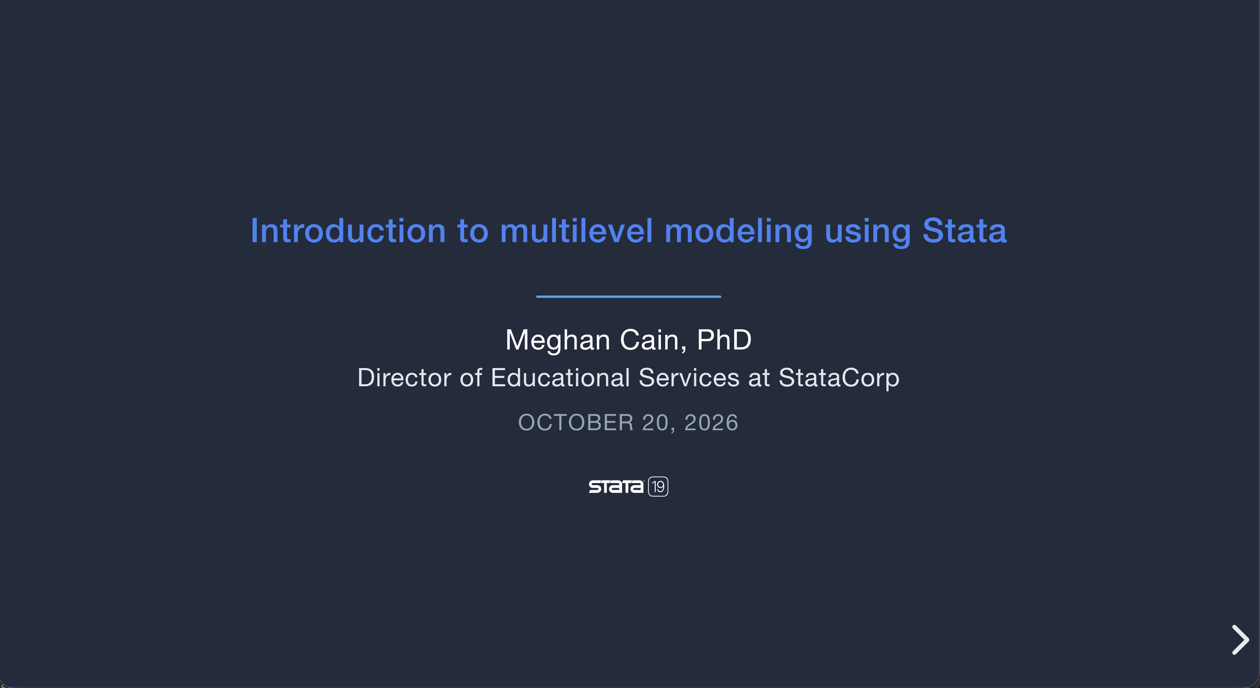
Access the slides: https://statameghan.github.io/MLMM-webinar/

