Slide 1
Presentation about currency application
Create by: Mukhin E.D.
Co-author: Bukovsky M.V.

Slide 2
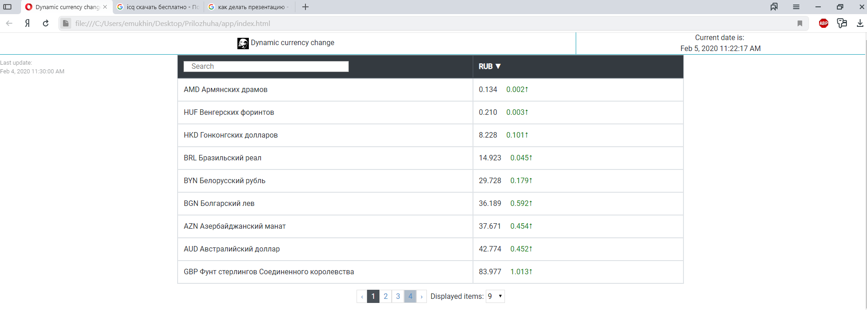
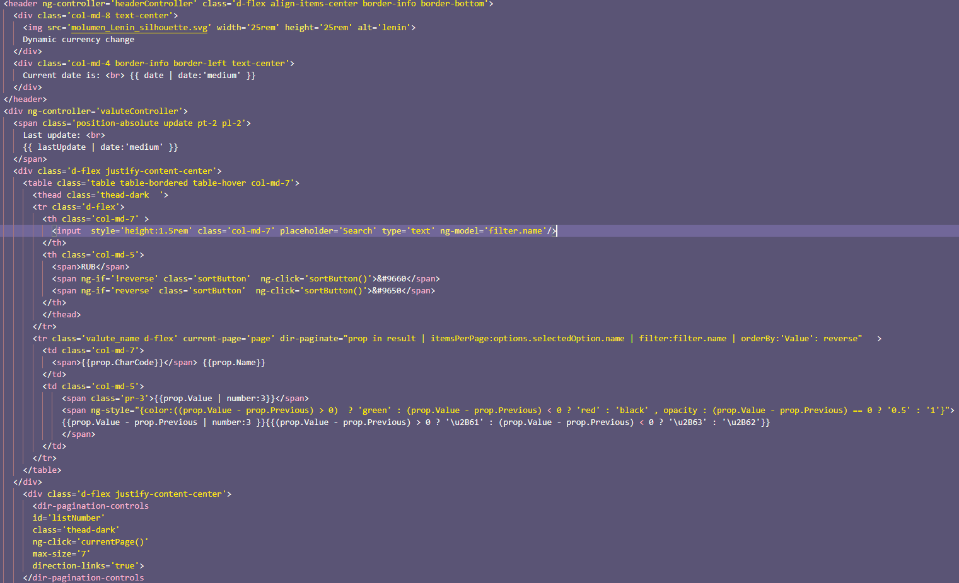
Created with AngularJS, Jquery, MomentJs, Lodash, Bootstrap.

Slide 3
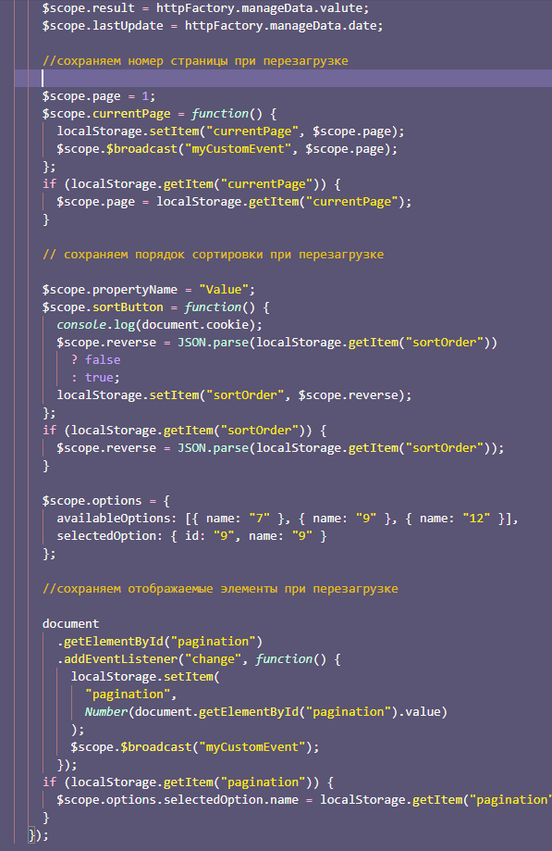

Slide 4
