Slide 1


Spring Cloud Data Flow
An Overview

Slide 2

Spring Cloud Data Flow
DevOps, Data and Software trends
Task & Message Microservices
What is Spring Cloud Data Flow?
What is SCDF for?
Replatforming and Modernization
Why SCDF on PCF?
Customers
Where to find out more?

Slide 3
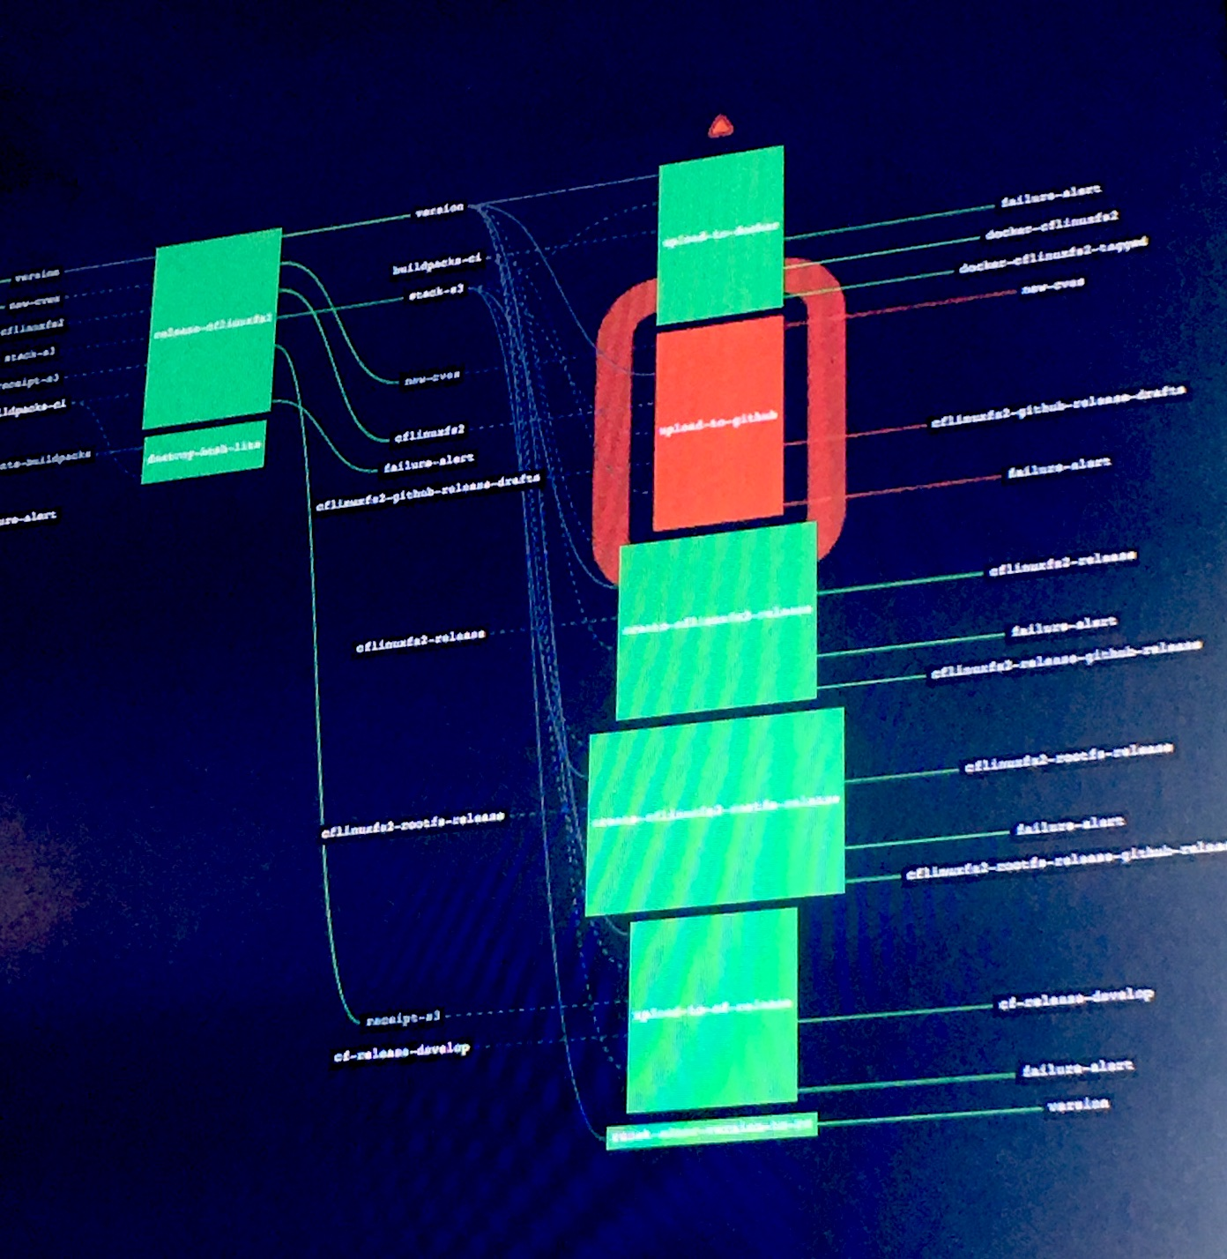
Trends
Enterprises are adopting DevOps practices in their transition into software and data-driven businesses.
ETL integration with existing systems, and modernization efforts are still very important.
Continuous Event processing is becoming mainstream.
Organizations are finding new ways to integrate IoT data flows and Machine Learning.

Slide 4
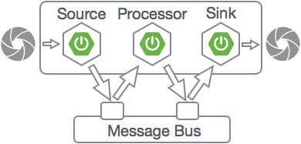
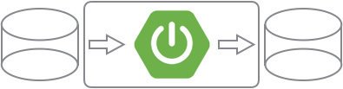
Microservices are not just for REST & Web apps
Spring Cloud Task
Tasks are finite Boot Microservices
They connect to data/storage
System tracks invocations, exit-status
Useful for ETL e.g. between DBMS and analytics clusters like Hadoop
Spring Cloud Stream
Message based Microservices
Loose coupling via pub/sub topics
Pluggable message bus Kafka or RabbitMQ
For integration and stream processing
Notes:
Microservices are not just for REST services and Web apps.
They can also be used as components in batch processing and stream processing pipelines.
Spring Cloud Task enables Batch-Integration Microservices by providing Spring developers with a Task abstraction.
Tasks are simple processes
They start, do some some work by connecting to databases or file storage, and then they finish.
Tasks can be composed by chaining them together in series, or running them in parallel.
Spring Cloud Stream enables Messaging Microservices by providing Spring developers with Stream abstractions.
Stream processing apps "bind" to topics on a message bus like RabbitMQ or Kafka,
They publish or subscribe to events flowing through that topic.
The pub/sub contract is useful because it decouples message consumers from producers.
Each stage in the pipeline can be independently scaled.
Besides serving as a model for data integration, Streaming Microservices form the basis for building Next-Gen Real-time Streaming Applications.

Slide 5
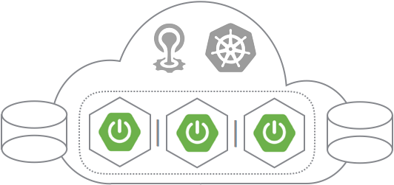
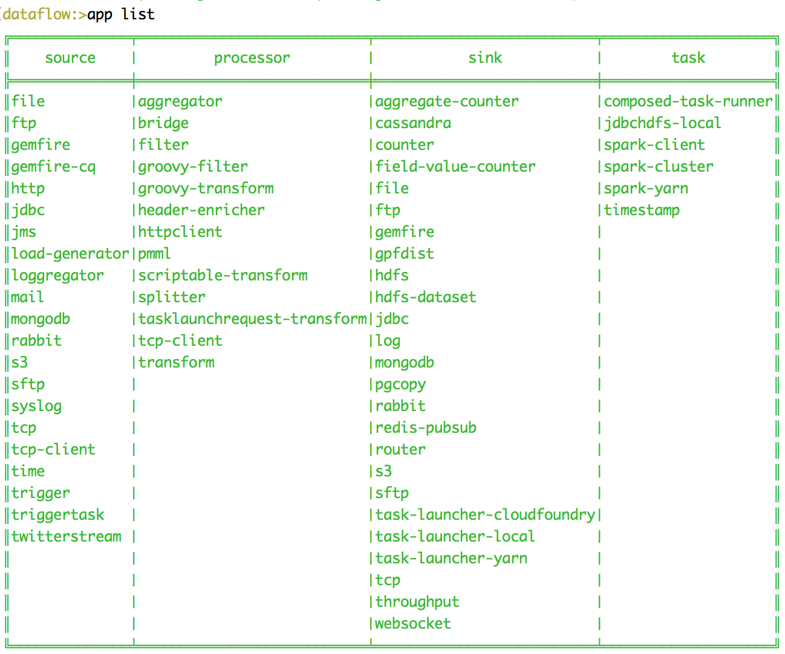
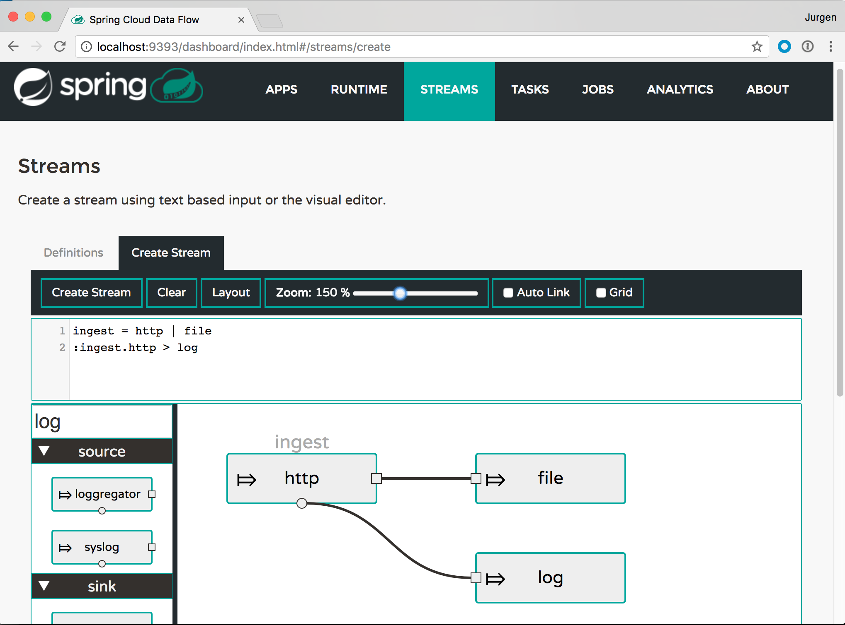
What is Spring Cloud Data Flow?
Spring Cloud Data Flow is a Microservices toolkit for building data integration and real-time data processing pipelines.
Pipelines consist of Spring Boot apps, using Spring Cloud Stream for events or Spring Cloud Task for batch processes.
The Data Flow server provides interfaces to compose and deploy pipelines onto platforms like Cloud Foundry.

Slide 6
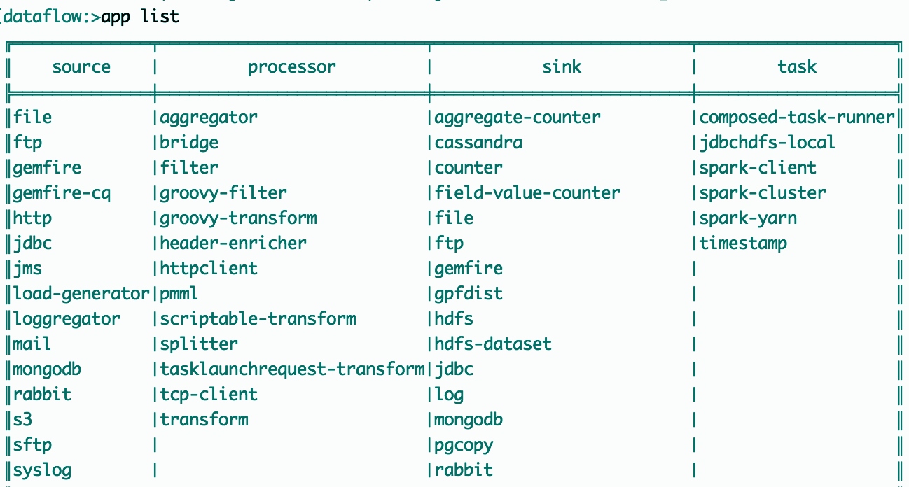
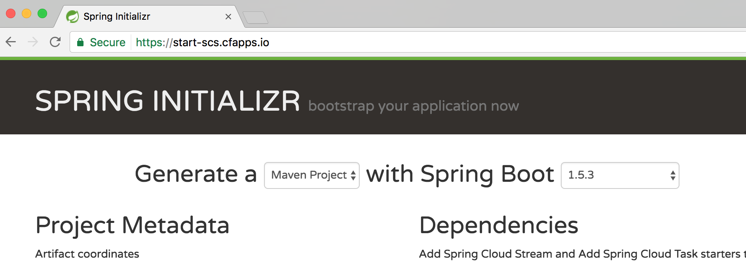
Don't start from scratch!
Choose from one of the App Starters Or generate a custom project using the Data Flow Initializr.

Slide 7
What is SCDF used for?
Progression of data-intensive use cases
All sharing a common Spring Boot
Microservices architecture.
Next-Gen Data Workloads
IoT, Machine Learning
Event Stream Processing
Integration
Messaging
Batch, DBMS, files
Modernization
and
Replatforming
Notes:
No matter where your business is today in its transformation to digital,
Spring Cloud Data Flow offers developers a place to start working with data.
From replacing how you move data between existing systems,
to setting up scalable endpoints for ingesting new data streams,
to operationalizing machine learning models for real time decisions.
The common underlying Spring Boot microservices architecture
means that learning can be shared and developers can iterate quickly.

Slide 8
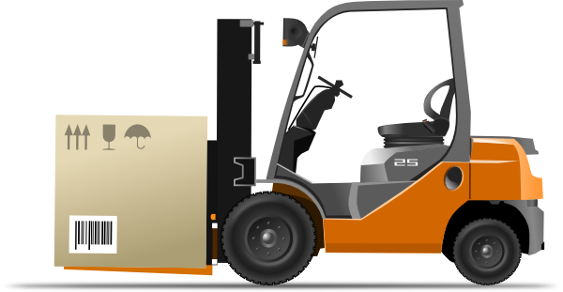
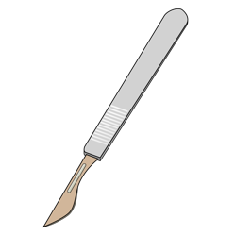
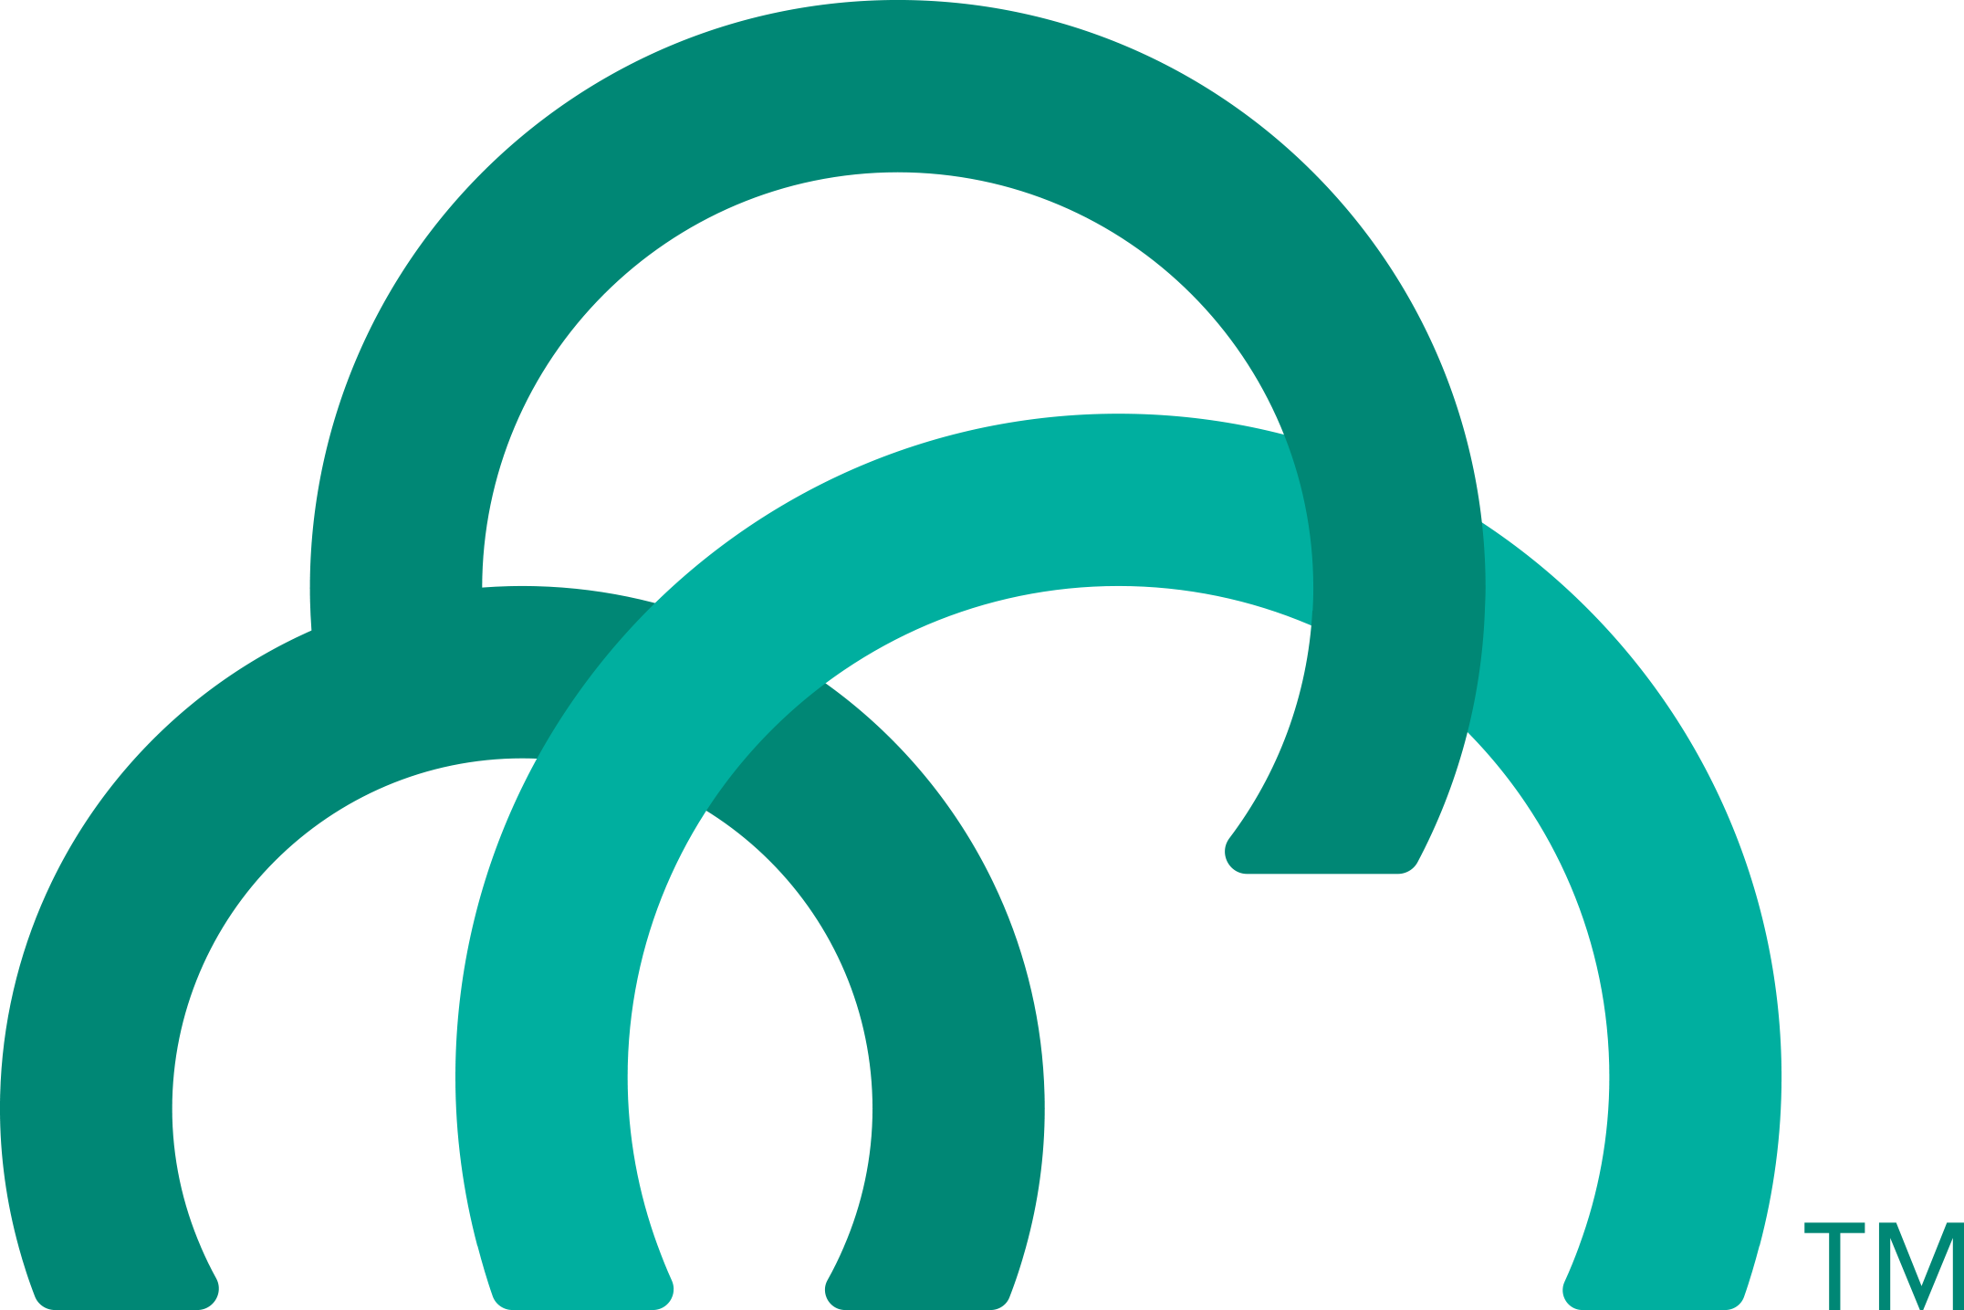
Replatforming
Modernization
SQL EAI/ESB
µService
APP
APP
APP
APP
µService
APP
APP
APP
µService
Move Java applications running integration workloads
From App servers on dedicated bare-metal hosts or VMs
To event-driven, or on-demand task oriented Java Microservices, deployed on a Cloud Native platform.
Refactor Monolithic ETL workloads Migrate SQL stored procedures Rewrite Shell scripts
From EAI and ESB servers
To Java Microservices, deployed on a Cloud Native platform.

Slide 9

Why SCDF on PCF?
Spring Boot Microservices
Build production-ready Java apps
Choose from curated starters
The Spring Ecosystem
Mature, actively maintained libraries
Trusted, helpful community
Pivotal Cloud Foundry
Open source PaaS for DevOps & Ci/CD
Heavy Lifting: Elastic scale, HA, Secure
For on-premise & cross-cloud

Slide 10
Customers using SCDF
Telecommunications (Comcast) | Data ingest, stream processing, integration with Spark and Hadoop
Real Estate Analytics (Core Logic) | Dataflow modernization, consolidation of legacy apps onto PCF (details...)
Health Care (HCSC) | ETL modernization, change data capture Event stream processing, GemFire (details...)
Banking | Integration pipelines Batch and near-real-time
Insurance (Inovalon) | Rules-engine modernization (.NET) Offload DBMS and Data Warehouse to microservices
© Pivotal – Internal and Confidential – DO NOT SHARE without consulting jleschner@pivotal.io

Slide 11
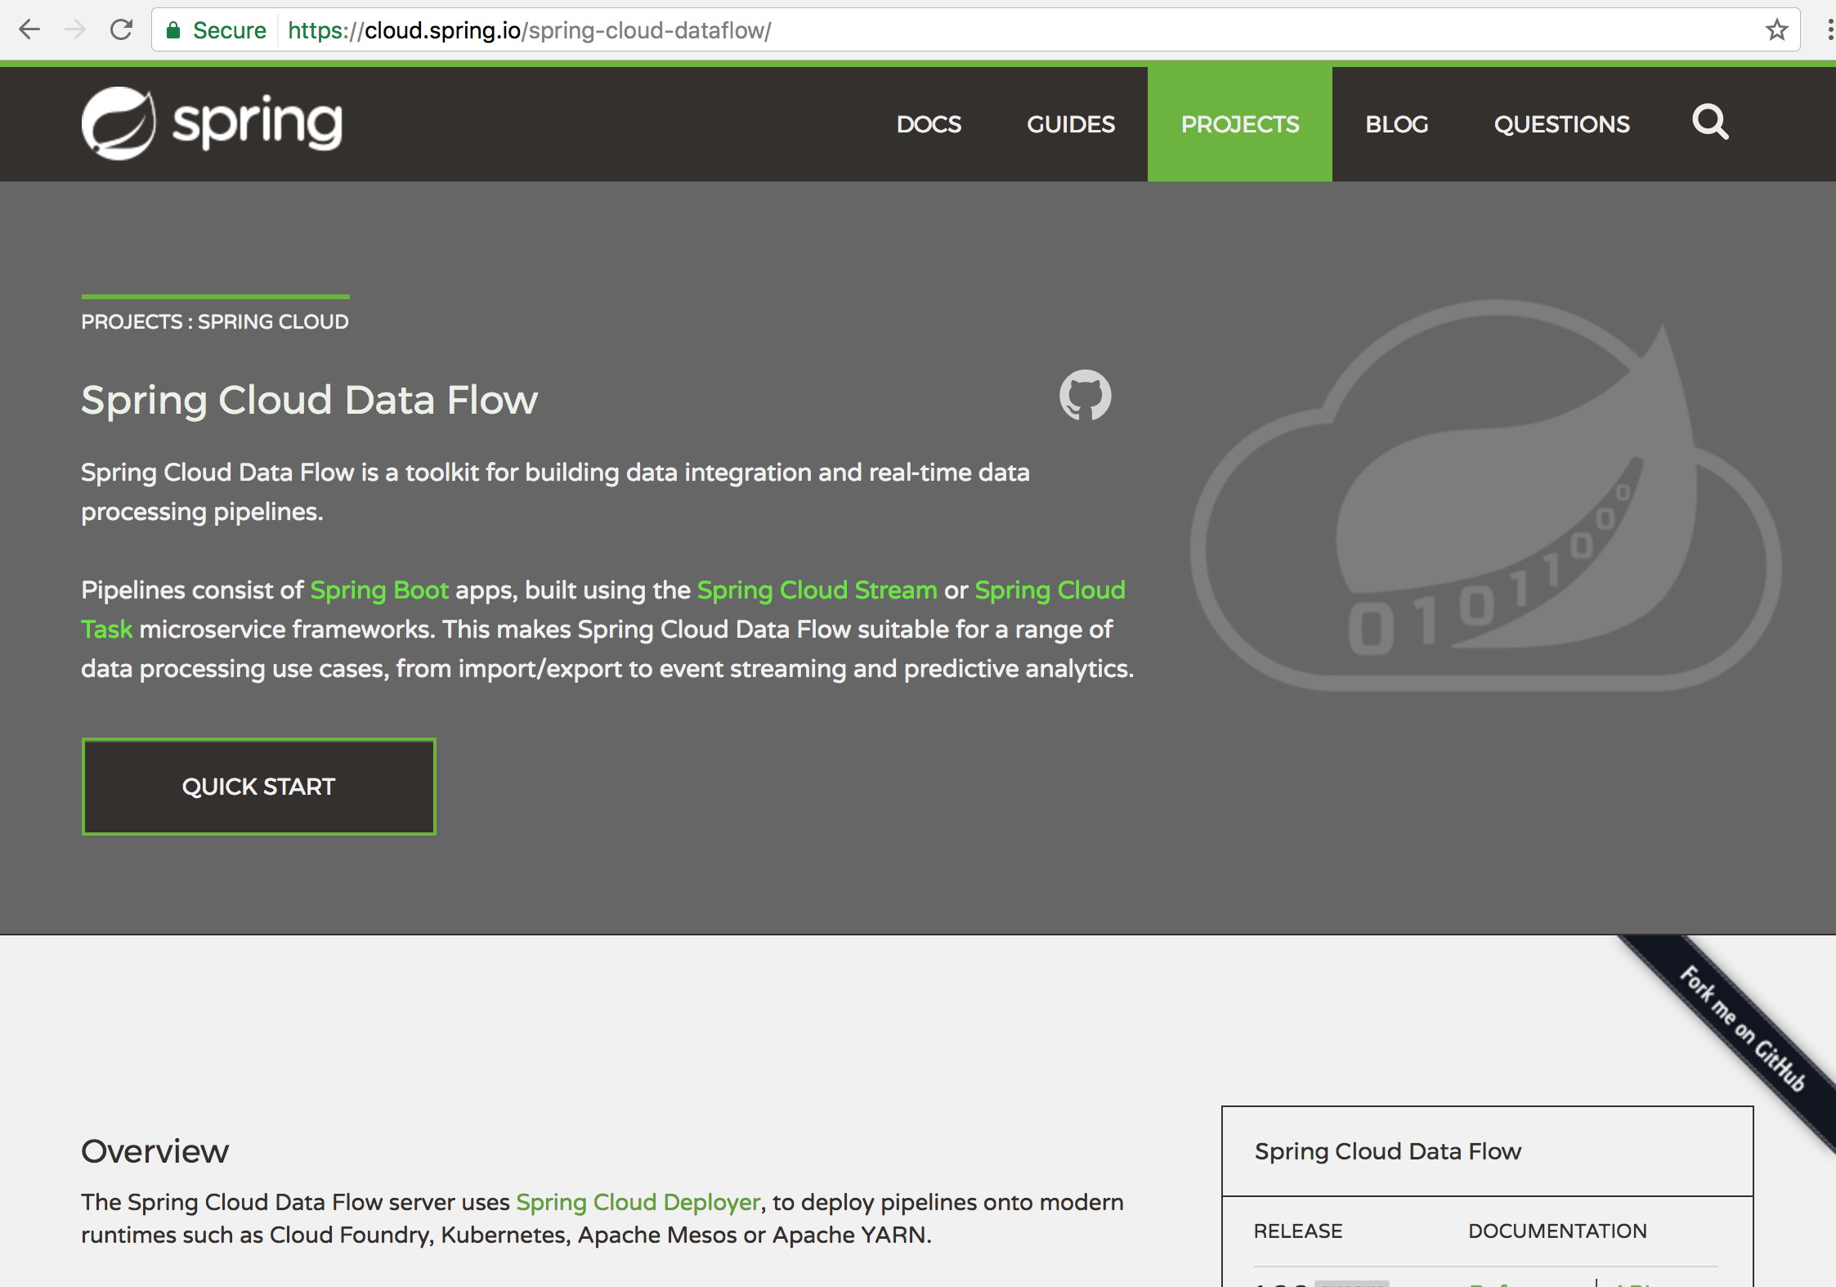
https://cloud.spring.io/spring-cloud-dataflow

Slide 12
Thank you!

