Slide 1
Informatics Precourse
Student Council TUM SOM X TUM School of Management
18-19.04.2026

Slide 2
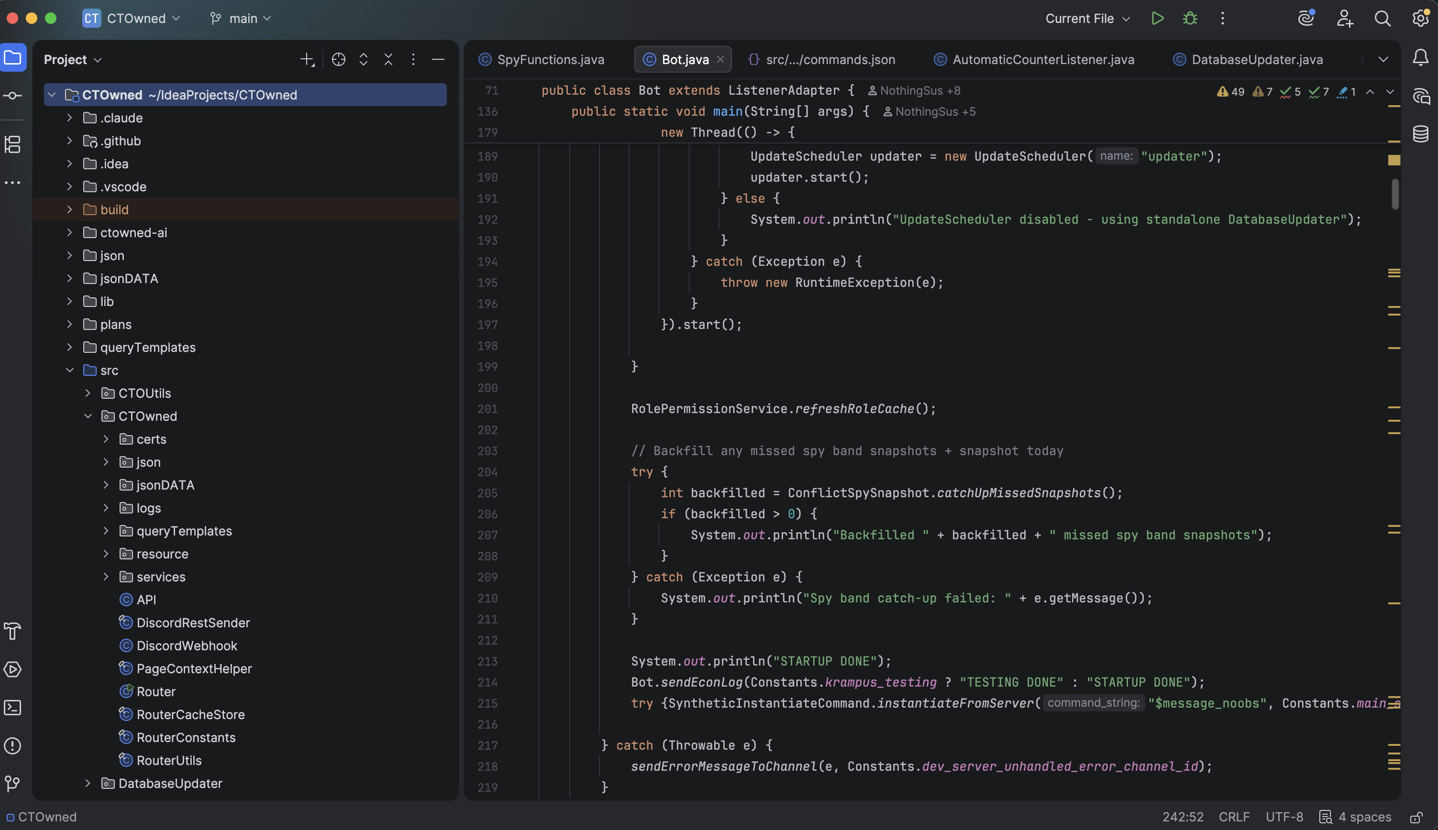

Slide 3
Tutor Team:

Slide 4
Agenda
Day 1:
Technical specialisations:
Informatics
Computer Engineering
Getting started with Java
Data types in Java
Booleans, if, else
Loops
Day 2:
Working with Arrays
Basics of Object Oriented Programming

Slide 5
Technical Specialisations

Slide 6
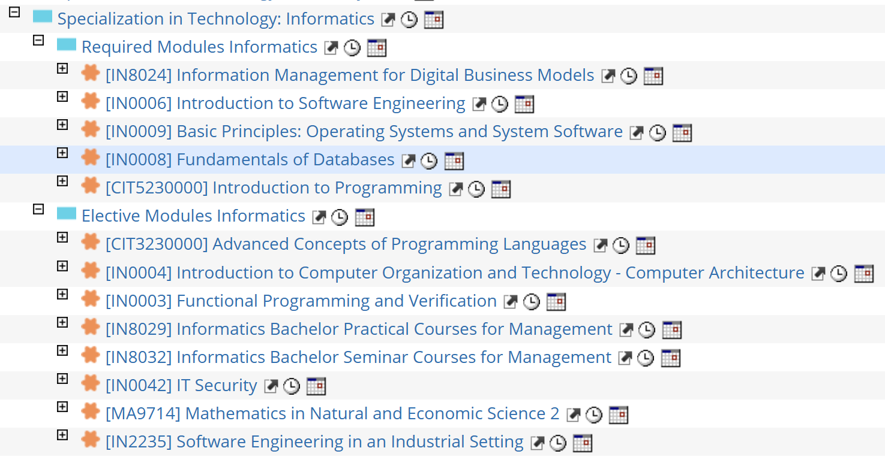
Modules in Informatics
36 ECTS mandatory subjects + 6 ECTS electives

Slide 7
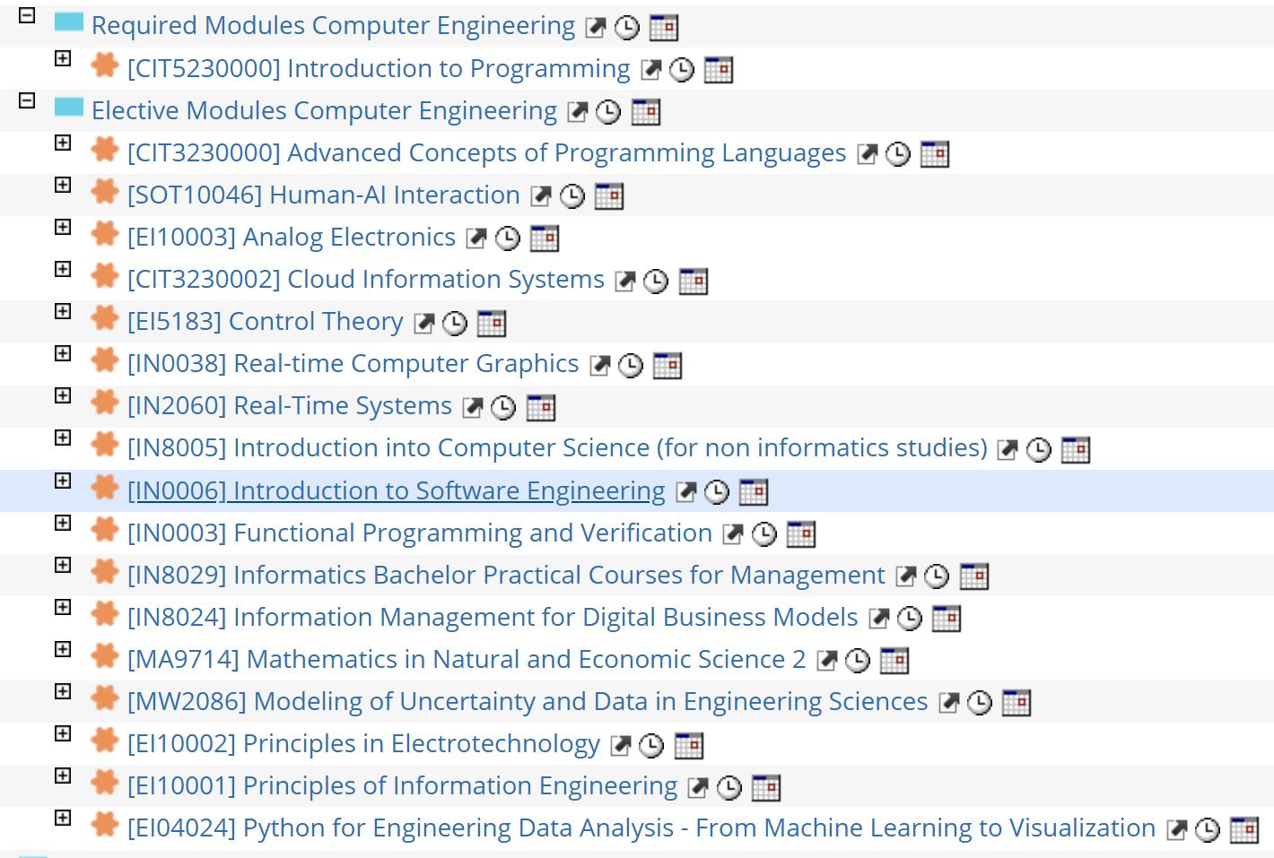
Modules in Computer Engineering
12 ECTS mandatory subjects + 30 ECTS electives

Slide 8
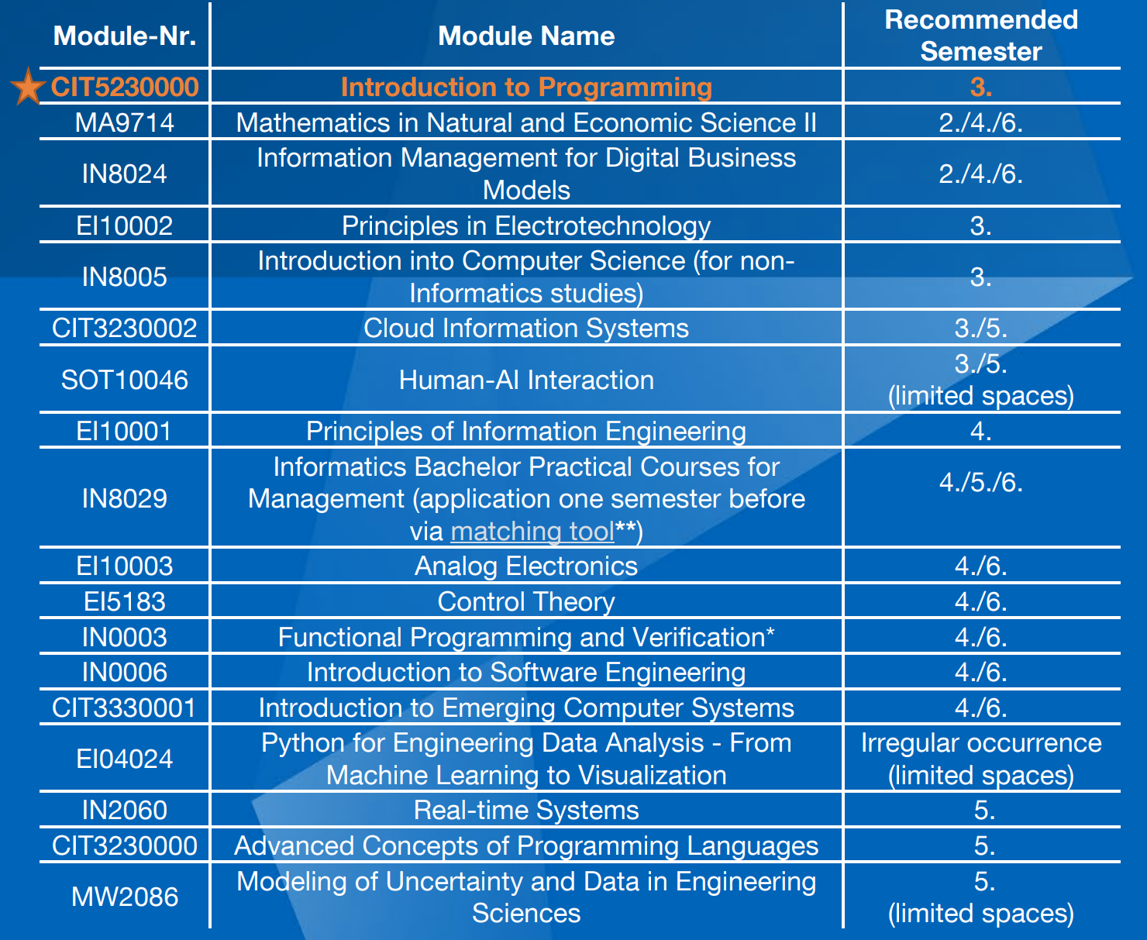

Slide 9
Module introductions
Mandatory subjects and overlapping electives (Please keep in mind that these modules are not exhaustive: Refer to TUMonline for complete information.)
Source: TUMonline, module descriptions

Slide 10
Courses that overlap
Introduction to Programming (12 ECTS) => Mandatory for all
Introduction to Software Engineering (6ECTS) => Mandatory for Inf, Elective for CS
Mathematics 2 (6 ECTS) => Elective
Information Management for Digital Business Models (6 ECTS) => Elective for CS, mandatory for Inf.
Informatics Bachelor Practical Courses for Management => Elective
Functional Programming and Verification => Elective
Advanced Concepts of Programming Languages => Elective

Slide 11
Introduction to Programming
=> Essential concepts of CS on basic, practical (but scientific) level => Solve algorithmic problems and implement Java apps
Interactive lecture with exercises + Tutorials + Homework
30% x2 exams, 30% project, 10% presentation (+ grade bonus)
Contents:
Object-oriented programming, functional programming
Data structures, recursion syntax and semantics
Graphical User Interfaces

Slide 12
Introduction to Software Engineering
=> Master the project lifecycle, apply engineering principles, analyze and evaluate challenges
Interactive lecture with quizzes and exercises + tutorials + presentations + homework
Content:
Design and architecture of projects
Testing projects & quality assurance
Lifecycle management & deployment
Process & organisation
You should have passed ITP + very high failure rate

Slide 13
Mathematics 2
=> Mathematical foundations for advanced concepts or engineering
Lecture + exercises (similar to Mathematics 1)
Contents:
Differential equations and eigenvalues
Multiple integrals
Vector calculus and line integrals
Integral theorems (Green, Gauss, Stokes)

Slide 14
Information Management for Digital Business Models
=> Information management models and concepts
Lecture with exercises
Contents
Information demand and supply
Information systems and ICT management
Organisation and strategy of information
Economic aspects of information

Slide 15
Informatics Bachelor Practical Courses…
10ECTS
Working as an ITP tutor + developer for Artemis
Working with partners of the chair to work on projects etc

Slide 16
Functional Programming and Verification
=> Master functional programming and apply formal verification methods
Lectures + Assignments
Contents:
Verification methods (logic and semantics)
Functional foundations (Patterns and functions)
Functional correctness and semantics

Slide 17
Advanced Concepts of Programming Lang.
=> Semantics and compiler-lvl implementation of programming languages.
Flipped classroom + Exercises
Contents:
Advanced concurrency
Control flow and execution
Paradigms and architecture of programming languages
Extensibility

Slide 18
Operating Systems and System Software
=> Understand OS and current developments.
90min written exam; Lectures, exercises and assignments
Contents:
Process, storage and memory management
Concurrency
Machine-oriented programming
Low-level programming

Slide 19
Fundamentals of Databases
=> Concepts of relational database systems, conceptual design to implementation
Contents:
SQL
Data integrity
Queries and transactions
Database security

Slide 20
Reminder
Many technical specialisation courses are courses for informatics students
They have a different curriculum
You will have to teach yourself in some areas; They might assume you know some aspects not handled in previous courses.

Slide 21
Getting started with Java

Slide 22




What you need to start programming
Java: Formal syntax and set of rules to write instructions. Provides logic and vocabulary
JDK: Software required to build and run Java: Contains compiler, runtime environment
IDE: Application used to write the code. Combines tools named above to create single cohesive interface

Slide 23
Essential vocabulary and syntax
Class | A structural blueprint used to create objects, defining their specific data (variables) and behaviors (methods).
Scope | The specific region of code (usually defined by { } brackets) where a variable is visible and accessible to the program
Variable | A named memory location assigned by the programmer to store a specific type of data.
Package | A namespace mechanism used to organize logically related classes and prevent naming conflicts in large projects.
Main | The mandatory entry-point method (public static void main) that the Java Virtual Machine executes to start the program.
"static" | Keyword: The variable belongs to the class itself and not to an object

Slide 24
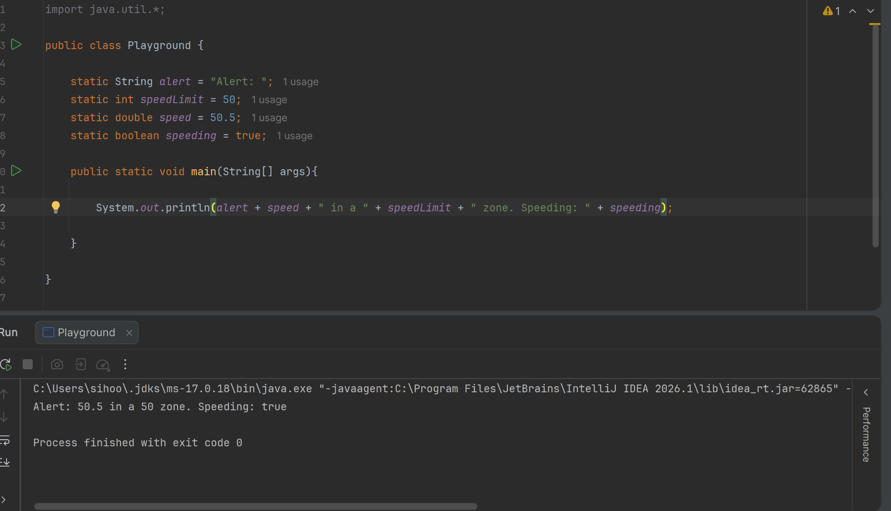
Essential vocabulary and syntax
Class “Playground”
Variables
Main function

Slide 25
Working with errors
Errors are frustrating! Here are common mistakes you might want to check:
The Artemis autograder wants an output in a specific format. Check that your code meets the requirements exactly. E.g. Error vs error.
Check the error messages in your IDE! They will help you to find the type of error made. You could have forgotten a “;”
The Artemis autograder will also provide feedback on what the problem was! Read the stack trace.
=> If you don’t know: ASK! We are here to help.

Slide 26
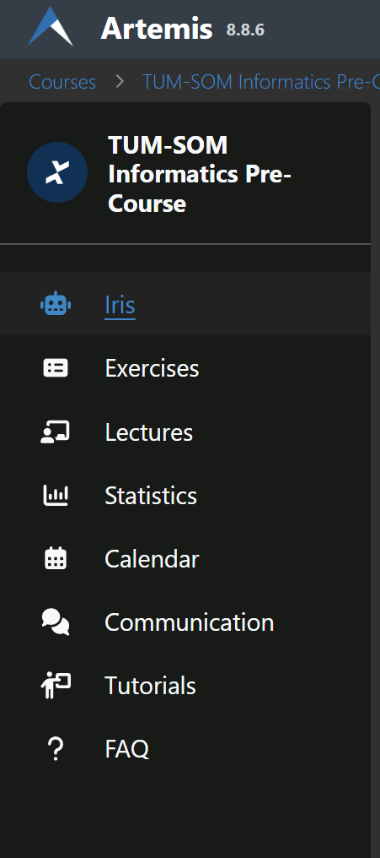

Use of GenAI in Programming
Nowadays widely spread usage (vibecoding, generation, debugging…)
You don’t have AI in the exam
Important to understand the logic behind the content
=> Use IRIS
Integrated into Artemis
Knows the lecture content and your submissions
Will help you get to the solution

Slide 27
Data types in Java

Slide 28
Common Data Types
Data type | Used when? | Example
String | A sequence of characters. NOT a primitive data type | String greeting = "Hello"
int | Whole numbers | int i = 4
double | Real numbers (with decimal) | double p = 30.3
boolean | True or false | boolean completed = false
char | A single character. | char a = 'a'
When adding a new variable, you need to declare them!
Remember that int does NOT have an unlimited size!

Slide 29
Working with Strings
Strings are formatted using "".
By using "+" you can concatenate a string.
String first = "abc";
String second = "def";
String concat = first + second;
System.out.println(concat);
>>> abcdef

Slide 30
Working with Numbers (int, double)
You can + - * / with all numerical classes
% “Modulo” : Remainder
When dividing int, Java will truncate the result
But: If a double involved, it converts automatically
int first = 3;
int second = 2;
double third = 5.5;
System.out.println(first+third);
>>> 7.5
System.out.println(first/second);
>>> 1 // 3/2 = 1.5, but the 0.5 is truncated
System.out.println(third/second);
>>> 2.75
System.out.println (first%second); >>> 1

Slide 31
Using Scanner
Helper class to help read input from keyboard
Not loaded by default => Import!
You can use methods of Scanner to process input
Be careful that the correct type is entered!
import java.util.Scanner; // Step 1: Import at the very top of the file
public class UserInput {
public static void main(String[] args) {
// Step 2: Initialize the Scanner
Scanner scanner = new Scanner(System.in);
}
}
scanner.nextLine() => String scanner.nextInt() => Int scanner.nextDouble() => Double

Slide 32
Scanner bug
When using multiple inputs: Scanner behaves erratically
Reason: The “enter” remains in the system, tricking the system into thinking that it is the next input.
=> Fix: After an e.g. scanner.nextInt(), clear the input by using scanner.nextLine()

Slide 33
Exercise Block 1
Quiz 1: Data Types in Java
E00 Hello World
Create variables of different types
Learn to interact with the system and input
E01 Quiz Data Types
Verify your understanding of data types and when to use them

Slide 34
Booleans, if and else

Slide 35
Booleans
Either true or false
Either a variable or a statement! We use logical operators for the statements.
public class Playground { static int z = 5; static boolean goodWeather = true;
public static void main(String[] args){ System.out.println(z == 6); System.out.println(goodWeather); } }
>>> false >>> true

Slide 36
Overview Logical Operators
Operator | Meaning | Example
== | True if both equal, else false | var1 == var2
<=, >= | If larger(smaller) or equal to, then true, else false | x >= 4 y <= 10
<, > | If larger (smaller) then true, else false | x > 4 y < 10
&& | True both fulfilled, false otherwise | var1 == var2 && x > 4
|| | True if one of the two are fulfilled | var1 == var2 || x > 4
! | True if opposite of what follows is true | !isSunny
COMMON MISTAKE: “==” -> Boolean. “=” -> Assigns value!!!

Slide 37
if
Example:
boolean playVolleyball = false; boolean goodWeather = true; if(goodWeather == true){ playVolleyball = true; }
// We decide to play volleyball if the weather is nice!
if (condition) {
execute if true
}
condition
true?
false?
Code

Slide 38
if-else
if (condition) {
execute if true
} else { Execute if not true }
Example:
boolean goodWeather = true; boolean playVolleyball = false; boolean studyDay = false; if(goodWeather == true){ playVolleyball = true; } else { studyDay = true; }
// We decide to play volleyball if the weather is nice! But, if the weather is not nice we decide to study instead
condition
true?
false?
Code
Code

Slide 39
Nested if/else
Often, logic and algorithmic problems can get complex! In that case, nested if-statements are often used.
public static void main(String[] args) {
int number = 5;
if (number < 10) {
if (number % 2 == 0) {
System.out.println("Number is smaller than 10 and even");
} else {
System.out.println("Number is smaller than 10 and odd");
}
} else if (number == 10) {
System.out.println("Number is equal 10");
} else {
if (number % 2 == 0) {
System.out.println("Number is bigger than 10 and even");
} else {
System.out.println("Number is bigger than 10 and odd");
}
}
}
How else could the code on the right be written?

Slide 40
Exercise Block 2
E02 Weekdays
Implement a simple program that returns a weekday from an integer input.
This exercise uses MiniJava; A toolkit built into the exercise. Pay attention to the exercise instructions!
E03 Four Seasons
Using nested if statements, determine the season based on the month and day.

Slide 41
Loops

Slide 42
while
Run a block of code again and again until terminating condition met.
Remember to make sure that your loop will somehow terminate!
while(condition == true){ Code to run; }

Slide 43
for
for(int i = 0; i < 5; i++){ System.out.println(i); }
Declare a “counter”. Determine a condition when the loop is active. Increment the counter. This ensures that somehow, the terminating condition is met!
Example:
The factorial of a number n (n!)
int n = 5; int result = 1;
for(int i=2; i<=n; i++){ result = result * i; }
System.out.println(result);

Slide 44
Exercise Block 3
E04 Sum Up
Use a while loop to sum up several inputs until a condition is met.
E05 Sum Up to N
Use a combination of loops to compute the sum of all integers smaller or equal to the integer given.
E08 Prime Factors
Write an algorithm to find all prime factors of a number.

Slide 45
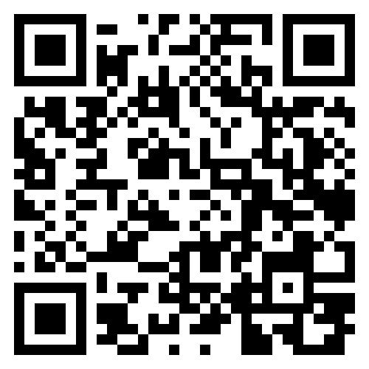
Day 1: Student Feedback Survey

Slide 46
Arrays

Slide 47
Arrays
= fixed-size collections of elements of the same data type
int[] numbers = new int[3];
=> We have created an array of integers, of the fixed size 3.
numbers[0]=2; numbers[1]=3; numbers[2]=5;
System.out.println(numbers[2]); >>> 5
numbers.length >>> 3
Remember:
The index starts from 0
The length of the array cannot be modified
You can get the length of the array by using arrayname.length;

Slide 48
Uses of arrays
No need to declare countless variables if they are part of a set; Just declare it once.
Quick to read and modify
Are the foundation for other data structures (e.g. ArrayLists)
You can use arrays to model a matrix:
int[][] matrix = new int[i][j] // An ixj-matrix.
CRUCIAL: Do NOT modify an array WHILE accessing it.

Slide 49
Loops and Arrays
Frequently, when manipulating an array or reading data, you need to access all => Use for loops.
In this example, the average of the values of an int[] array is calculated
public class ArrayAverage {
public static void main(String[] args) {
int[] scores = {85, 90, 77, 92, 88};
int sum = 0;
// 3. Iterate through the array
for (int i = 0; i < scores.length; i++) {
sum = sum + scores[i];
}
double average = (double) sum / scores.length;
System.out.println("The total sum is: " + sum);
System.out.println("The calculated average is: " + average);
}
}

Slide 50
Exercise Block 4
E07 Numerical Properties
Implement helper methods for integer arrays.

Slide 51
Methods

Slide 52
Why methods?
Don’t Repeat Yourself: Write code once and reuse it by calling the method
Methods help divide a problem into smaller chunks: Helps with understanding

Slide 53
Components of a method
String greetUser (String user){ System.out.println(Hello " + user + "!"); return "Greeted " + user; }
Return type: What type of data does it return? (Note: If no return type, it is “void”)
Method name: Always make sure it is clear what the method does.
Input: What goes into the method?
Code block: What is executed when method is called.
return: Return the return type specified above. Terminates the method

Slide 54
Static methods
“Utility helpers”: Take input, process it, and throw it out
Can only interact with other static variables or variables passed into them
Examples:
Math.max(a,b) // Returns the largest of the input variables Integer.parseInt(String i) // Takes in a string and returns integer Arrays.sort(int[] a) // Takes array of int, returns sorted array

Slide 55
Calling a method
Within your code, write methodname(input)in place of where the code should be.
Make sure that the return type matches what should be at that place!
static String sayHi(int languageOption){
if(languageOption == 1){
return "hola";
} else {
return "Hello";
}
}
public static void main (String[] args){
int languageOption = 3;
sayHi(languageOption);
}
>>> hello

Slide 56
Common errors
Return type violations (wrong type, or forgot “return”)
“return” too early: The code terminates at return
Wrong method call (incorrect arguments etc)
Scope misunderstandings
String countNumbers (int[] numbers){
int sum = 0;
for(int number : numbers){
sum += number;
}
return sum;
String.valueOf(sum);
}
//Can you find the errors?
Tip: for( … : … ) is called an enhanced for-loop (the easier version). It iterates through the collection without using an index!

Slide 57
Exercise Block 5
E06 Calculator
Create a straightforward calculator in Java
Implementing helper methods
Implementing simple UI
E09 Quiz Gaps in the Program

Slide 58
Object Oriented Programming

Slide 59
So what is OOP?
Code is organised around entities (e.g. car, door, driver etc)
Used to model real world entities and relationships, attributes and behaviours.
The attributes can be implemented in different ways
public class Car {
private Engine engine;
private Door door1;
private Door door2;
private Seat seat;
private Driver driver;
public Car (Engine engine, Door[] doors, Driver driver){
this.engine = engine;
this.door1 = doors[0];
this.door2 = doors[1];
this.seat = new Seat("default");
this.driver = driver;
}
}

Slide 60
Classes
Java has some pre-defined classes (e.g. String, int, etc)
Custom classes can be created
A class has its attributes and its methods
=> Tells Java what the object is

Slide 61
Access modifiers
=> Defined when declaring the variable
private: The variable is only visible within this class.
public: The variable is visible everywhere.

Slide 62
What an object has:
Attributes
=> What properties are given about the object?
Normally, use the private keyword
Either initialize the attributes directly or in the constructor
public class Car {
private Engine engine;
private Door door1;
private Door door2;
private Seat seat;
private Driver driver;
Private int fuelLvl = 100;

Slide 63
What an object has:
Constructor
=> How to initialize the object
public Car (Engine engine, Door[] doors, Driver driver){
this.engine = engine;
this.door1 = doors[0];
this.door2 = doors[1];
this.seat = new Seat("default");
this.driver = driver;
}

Slide 64
What an object has:
Getters and Setters
Getters: public methods that retrieve private attributes from outside the class.
Setters: methods that change (set) private attributes of the class.
…
public Engine getEngine(){ return engine; }
public void setDriver(Driver driver){ this.driver = driver; }

Slide 65
What an object has:
…
public boolean drive(int age){
if(age >= 18 && fuelLvl > 0){
System.out.println("Welcome " + driver.getName());
this.fuelLvl --;
door1.setStatus(closed);
door2.setStatus(closed);
return true;
}
else {
System.out.println("not permitted to drive");
return false;
}
} }
…
Custom methods
We can implement our own custom methods to the class, to manipulate its attributes, or to execute processes.
Methods describe the behavior of an object of the class.

Slide 66
Working with objects
An object must be created!
It must be initialized with attributes. Car porsche = new Car(Engine abc, Door[] def, Driver ben);
We can interact with objects by using their class methods. car.setEngine(xyz); t1.drive(24);

Slide 67
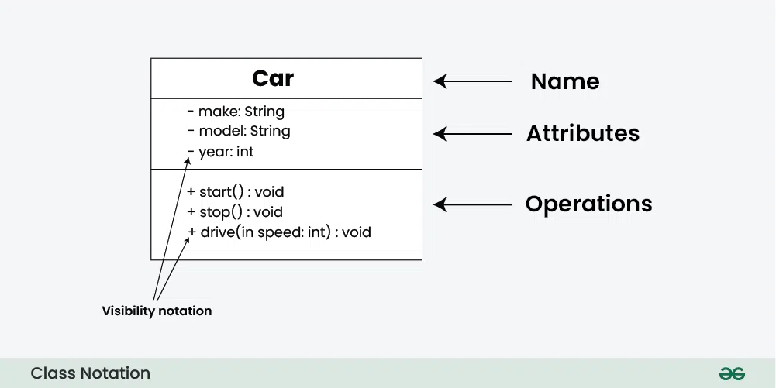
Modelling OOP with UML diagrams
Modelling OOP with UML diagrams
Source: GeeksForGeeks

Slide 68
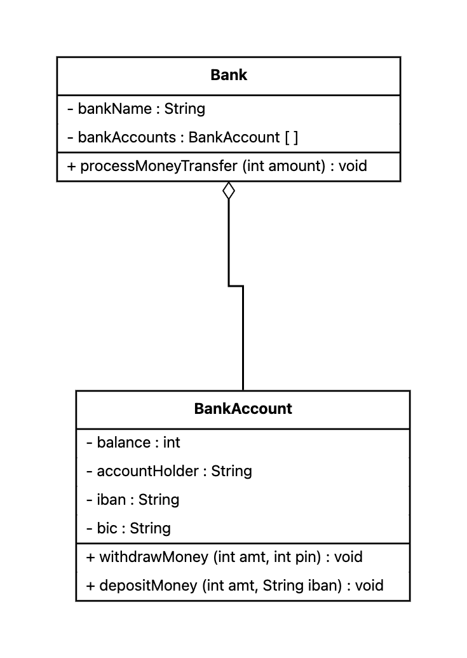
Modelling OOP with UML diagrams

Slide 69
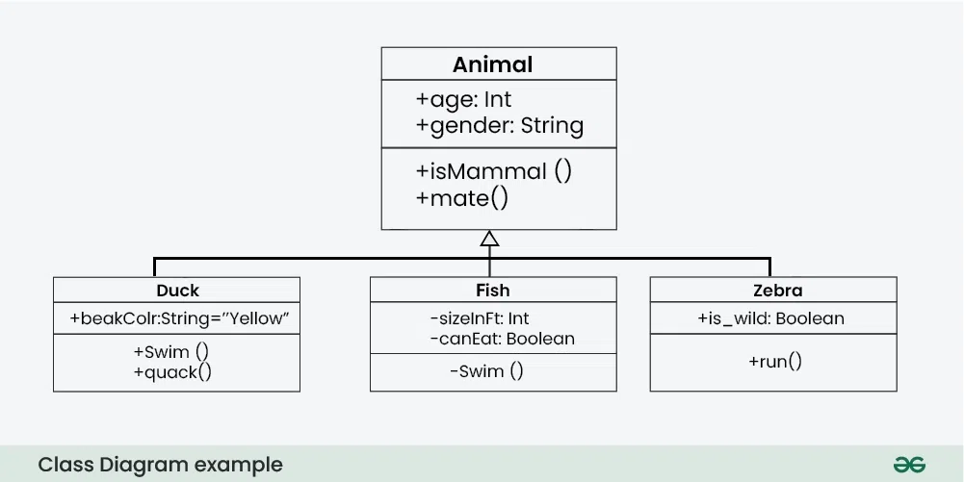
Modelling OOP with UML diagrams
This concept is called inheritance: Duck, fish and zebra are all animals with their own attributes and methods too.
Source: GeeksForGeeks

Slide 70
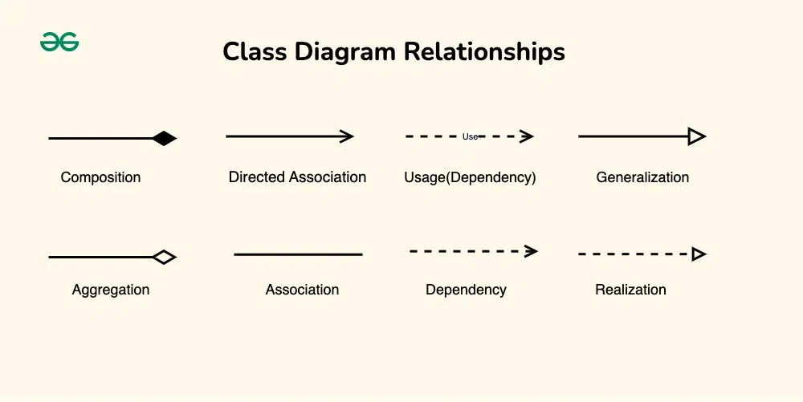
Source: GeeksForGeeks

Slide 71
Exercise Block 6
E10 OOP Quiz
Verify your understanding of OOP.
E11 Bank Account
Model a bank account’s attributes and behaviors.
E12 Quiz Data Types (Advanced)
Test your understanding of usage of data types.

Slide 72
Project Block

Slide 73
Project Block
We have handled the essentials of Java coding and OOP => Time to implement all skills together!
Choose one of the following projects:
E03O1: Hotel E05O1: Festival E07O1: Library
Once you are done, check out E13: These are problems to test your algorithmic thinking!

Slide 74
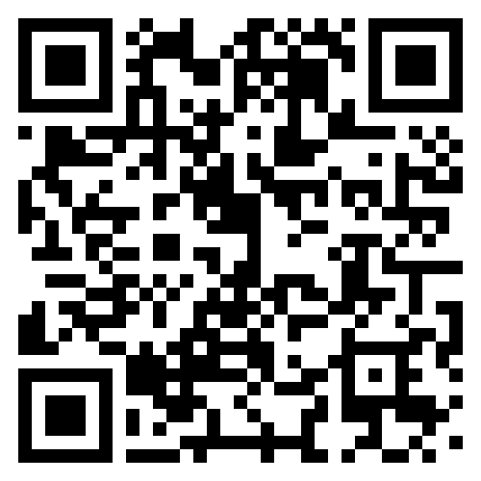
Final Survey

Slide 75
THANK YOU FOR YOUR PARTICIPATION!!!

