Slide 1
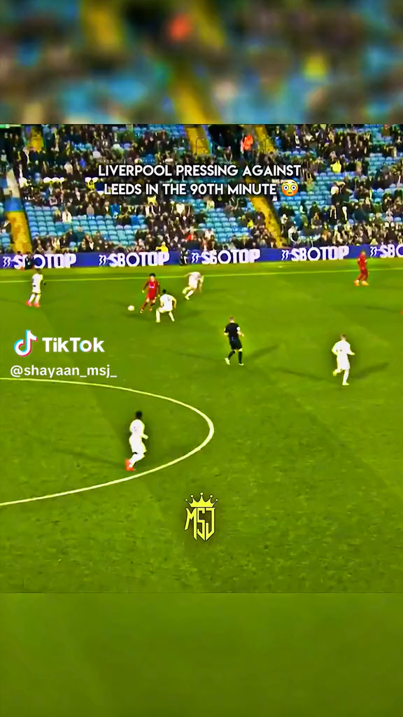
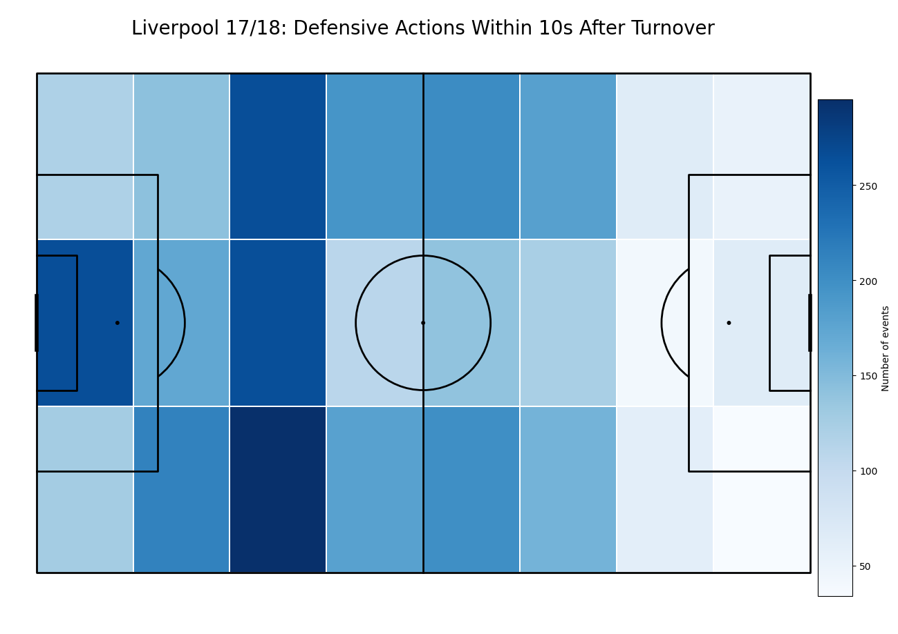
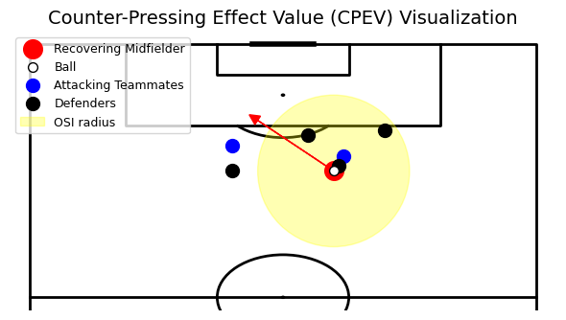
Counter-Pressing Effect Value (CPEV)
How can Midfielders Create Danger through Counter Pressing
Measures how dangerous a midfielder is immediately after regaining the ball.
Three key factors:
  • Location of the regain – central recoveries closer to goal are most dangerous.
  • Opponent disorganization – stretched defenses increase threat.
  • Immediate action – progressive passes, dribbles, or carries.
Each recovery is scored based on whether it leads to a shot inside the penalty area within 10 seconds.
Aggregated over a player’s minutes to evaluate overall effectiveness.

Slide 2
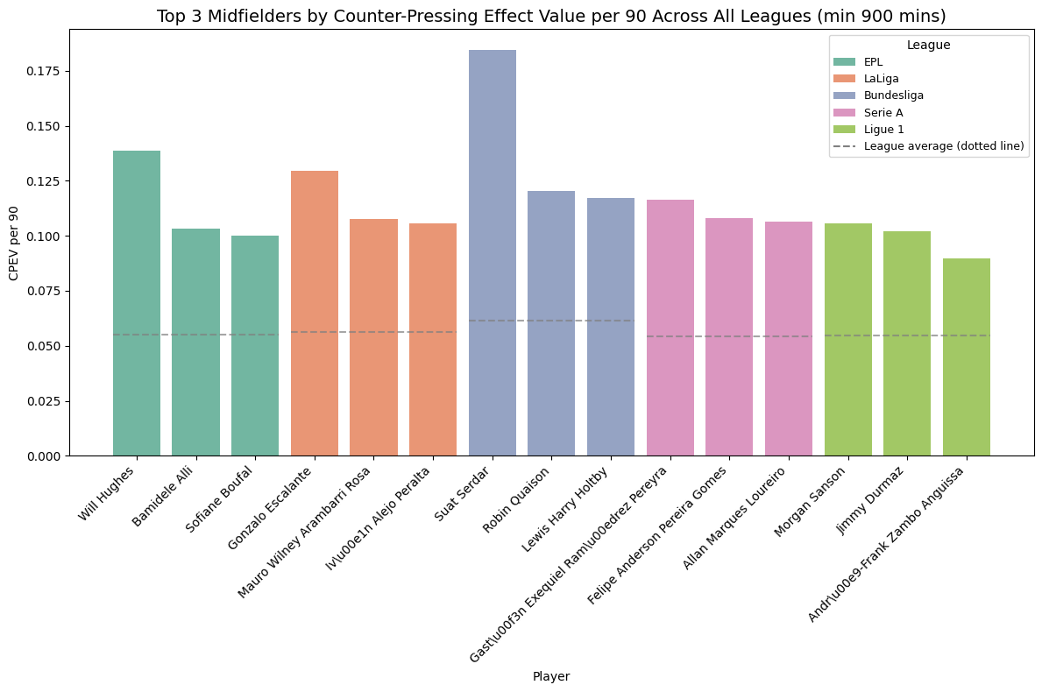
Top Midfielders by Counter-Pressing Effect Value per 90
🔴 Recommendation: Suat Serdar (FC Schalke 04)
Why he’s the ideal signing for Liverpool:
🥇 High Counter-Pressing Effect Value (CPEV) – ranked 1st among all midfielders across Europe’s top five leagues, showing elite ability to regain possession and generate attacking threat.
🇩🇪 Bundesliga proven – experienced in a physically intense and tactically demanding league, similar in tempo and style to the Premier League.
🧠 Young, with potential upside – at 21 years old, Serdar still has significant room to grow tactically and technically under Klopp’s coaching.
💰 Financially sustainable target – with a market value around £10 million, he fits Liverpool’s recruitment model of acquiring high-potential players before they reach peak market price.

