Slide 1

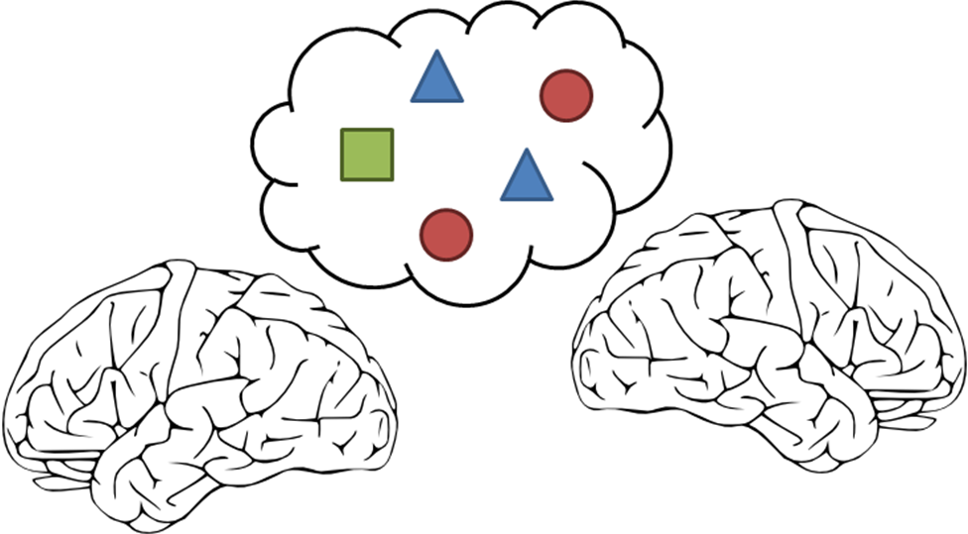

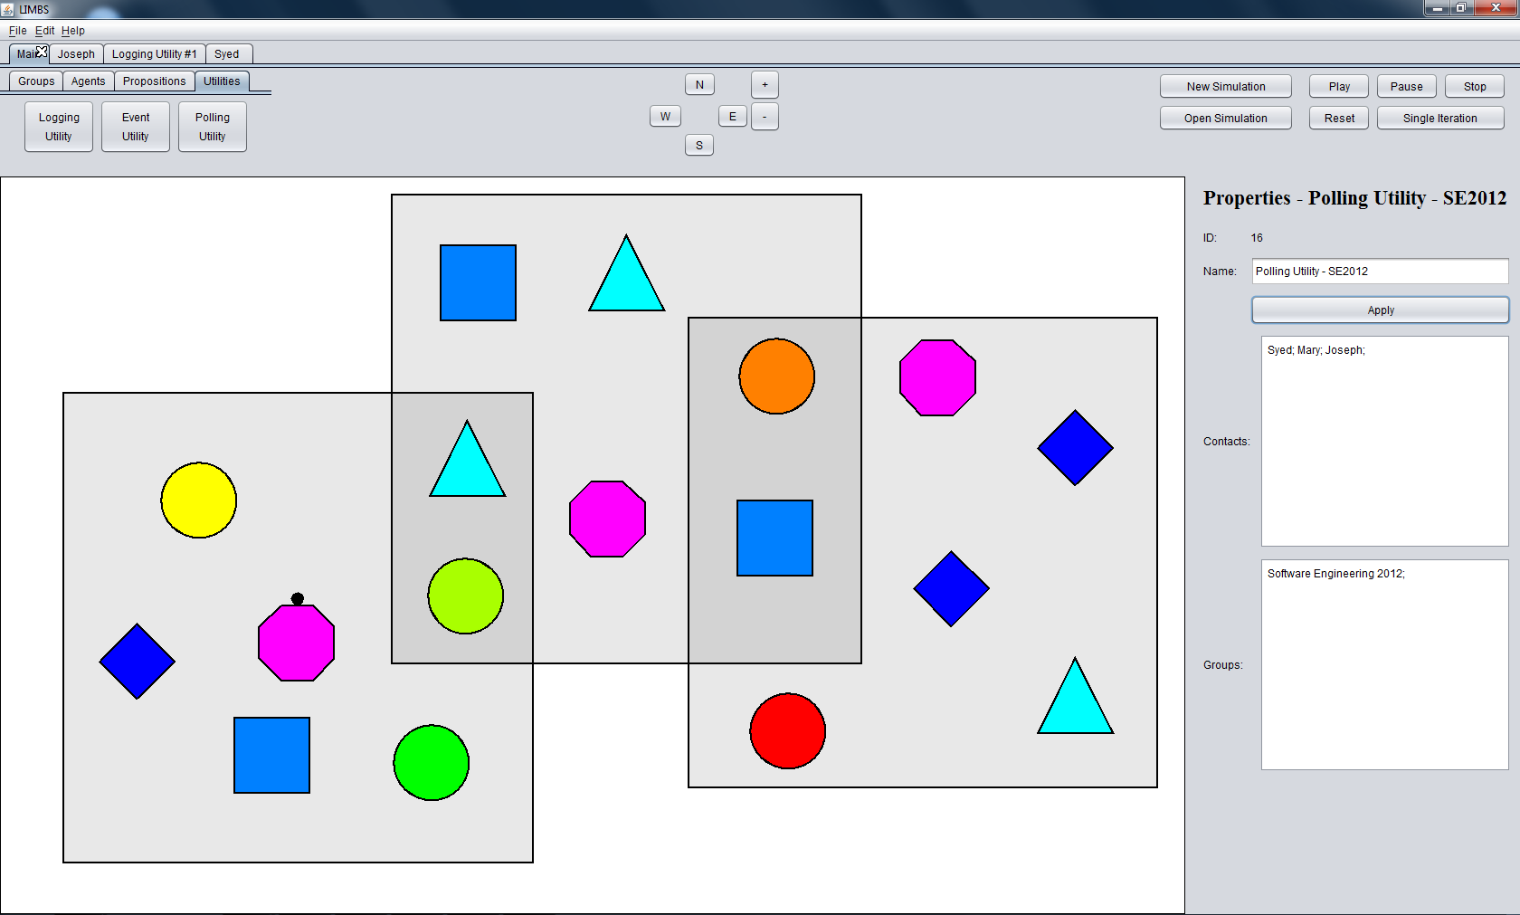
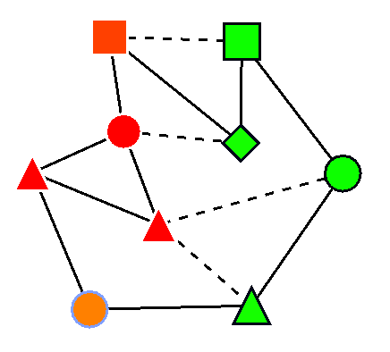
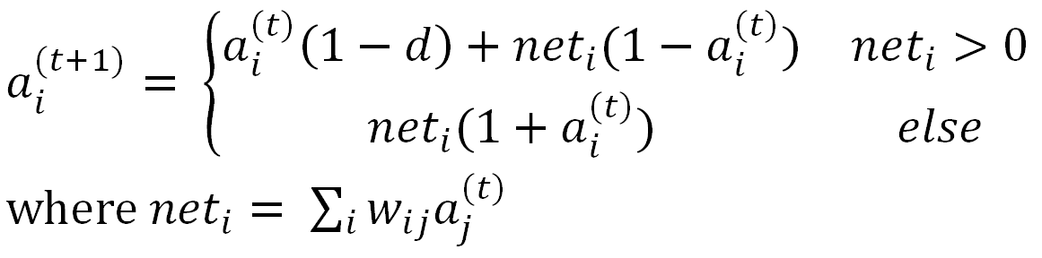
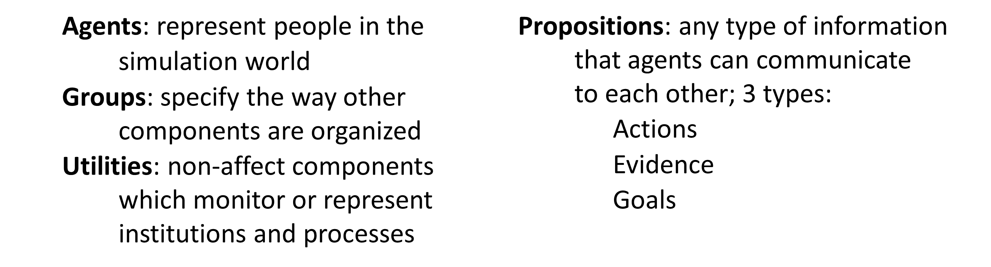
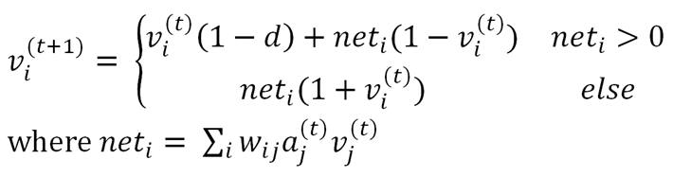


L. I. M. B. S.
Locally Integrated Multi-Brain Systems
LIMBS models people – the way they interact, make decisions,
and react to information within their environment
What is it?
Why?
HOTCO
LIMBS is a framework for modeling psychologically plausible people in social situations.
HOTCO (hot coherence) is a numeric framework for modeling a person based on a recurrent neural network where nodes represent concepts and edges represent the coherence or lack thereof between concepts.
Artificial Intelligence is hard. LIMBS makes it easier to produce complex models, providing a friendly interface where users can produce socio-cognitive models, without needing to know any programming languages.
The agent’s state is updated each iteration by the following equations until the system is stable.
Simulation
Each component is contained within its own thread, leading to higher performance across heterogeneous components. Simulations contain iterations of communication and coherence phases. To communicate, components send messages to each other containing aspects of their internal state. In the coherence phase, the internal state is updated according to the messages received, all done in parallel.
Model Structure
Models consist of different types of components:
After the agent has reached a stable, coherent state, it can send messages to other agents, and absorb other agents’ beliefs into its own state.
Architecture
Cross-Cutting Utilities
Social Level
Iteration 1
Iteration 2
Iteration 3
Iteration 4
The architecture of the LIMBS framework had two major goals: easy-to-use core facilities, and an easy-to-extend cognitive level. This is achieved through creating an easily extendable cognitive layer, with cross-cutting utilities that are agnostic to the structure of that layer.
Simulation
Propositions
Group
represent
Widgets
Info
Pane
Who are we?
Agent 1
Save/Load
Manager
Agent
Menus
Agent 2
Impl’m
access
Danielle Grenier
Kevin Veloso
John Stevenson
John S. H. Baxter
Communicate
Communicate
Communicate
Cognitive Level
Coherence
Coherence
Communicate
Coherence
Agent 3
Coherence
HOTCO Agent
Info Pane
Undo/Redo Manager
HOTCO
Link
represent
Widgets
HOTCO
Node
Agent 4
Com’n Rule
Rule Int’f
SPONSORED BY

