Slide 1
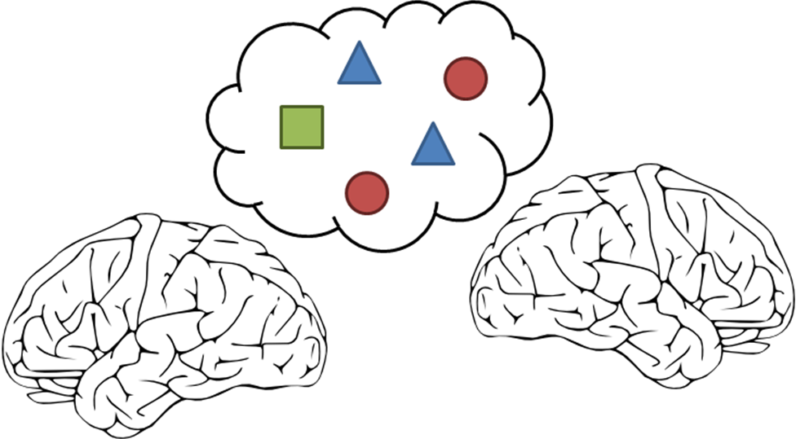

LIMBS
By

Slide 2
What is it? What does it do?
LIMBS: Locally Integrated Multi-Brain Systems Modeling Software
It models people – the way they interact, make decisions, and react to information within their environment

Slide 3

Why?
To provide a friendly interface for users to produce socio-cognitive models, without needing to know a programming language
To make producing complex models easier

Slide 4
Model Structure
Models consist of different types of components:
Agents
Propositions (Actions, Evidence, Goals)
Groups
Utilities (Event Scheduler, Poller, Logger)
Agents communicate with other agents in their group about propositions in their group

Slide 5


Model Structure
Agents based on “hot coherence” paradigm to model both cognitive and emotional decision making

Slide 6
Model Structure
Utilities monitor or affect the model at a specific time in the simulation
The Event Scheduler injects external events into the simulation
The Poller queries agents for their “thoughts” regarding a particular subject
The Logger records messages in the simulation

Slide 7





Technology

Slide 8


Design Challenges
Accessibility to a wide range of users

Slide 9

Design Challenges
Designing for extendibility
Ideally, we want future developers to be able to just plug-and-play with their components

Slide 10
System Structure
Cross-Cutting Utilities
Social Level
Simulation
Group
Details
Pane
Propositions
Widgets
represent
Agent
Menus
Save/Load
Manager
Impl’m
access
Cognitive Level
HOTCO Agent
Details
Pane
Undo/Redo Manager
Widgets
represent
HOTCO Link
HOTCO Node
HOTCO Com’n Rule
Rule Int’f

Slide 11
System Structure
Cross-Cutting Utilities
Social Level
Simulation
Group
Details
Pane
Propositions
Widgets
represent
Agent
Menus
Save/Load
Manager
Impl’m
access
Cognitive Level
HOTCO Agent
Details
Pane
Undo/Redo Manager
Widgets
represent
HOTCO Link
HOTCO Node
HOTCO Com’n Rule
Rule Int’f

Slide 12
Design Challenges
Undo / redo
Don’t know how the cognitive level handles social events
Swarm of commands used for easily extendibility
Save / load
Interface not easily savable
Easily extendable structures for separation of data and interface
xpp3 used for saving models as XML files

Slide 13
More info…
Thagard, P. “EMPATHICA: A Computer Support System with Visual Representations for Cognitive Affective Mapping.” AAAI Publications, Workshops at the Twenty-Fourth AAAI Conference on Artificial Intelligence. 2010.
Sahdra, B; Thagard, P. “Self-Deception and Emotional Coherence”. Mind and Machines. Vol 13. 2003.
Thagard, P. Coherence in Thought and Action. Cambrige, MA: MIT Press, 2000.
Thagard, P. “Explaining Economic Crises: Are There Collective Representations?”. Episteme, the Journal of Social Epistemology. Vol 7, Iss 3. October, 2010.
Thagard, P. Hot Thought: Mechanisms and Applications of Emotional Cognition. Cambridge, MA: MIT Press. 2006.

Slide 14
Summary
LIMBS models people – the way they interact, make decisions, and react to information within their environment
Stand alone Java application designed for immediate use and easy extendibility

