Slide 1
Quantitative analyses using RNA-seq data

Slide 2
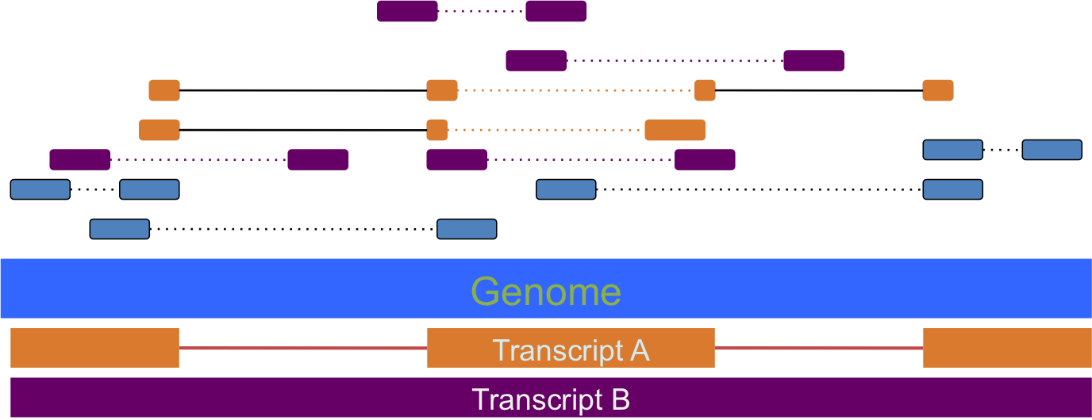
Classic quantification of gene expression using RNA-seq
Mapping
Alignment to genome
-Hisat2
-STAR
Counts reads per transcript
Normalization
Read counts tables
FPKM
TPM

Slide 3
Normalised expression values
For gene/isoform length
Gene A
Gene B
Gene | Raw reads | Length | Normalised Reads
A | 10 | 2 | 5
B | 5 | 1 | 5
Notes:
a minimal set of paths that cover all the fragments in the overlap graph by finding the largest set of reads with the property that no two could have originated from the same isoform.
Cufflinks estimates transcript abundances using a statistical model in which the probability of observing each fragment is a linear function of the abundances of the transcripts from which it could have originated. Because only the ends of each fragment are sequenced, the length of each may be unknown. Assigning a fragment to different isoforms often implies a different length for it. Cufflinks incorporates the distribution of fragment lengths to help assign fragments to isoforms.
it uses a negative binomial model estimated from data to obtain variance estimates from which p-values are computed.

Slide 4
Normalised expression values
For total number of mapped reads
Gene A
Condition | Raw reads | Total mapped reads | Normalised Reads
x | 10 | 1000 | 0.01
z | 5 | 500 | 0.01
Condition x
Condition z
Gene A
Notes:
a minimal set of paths that cover all the fragments in the overlap graph by finding the largest set of reads with the property that no two could have originated from the same isoform.
Cufflinks estimates transcript abundances using a statistical model in which the probability of observing each fragment is a linear function of the abundances of the transcripts from which it could have originated. Because only the ends of each fragment are sequenced, the length of each may be unknown. Assigning a fragment to different isoforms often implies a different length for it. Cufflinks incorporates the distribution of fragment lengths to help assign fragments to isoforms.
it uses a negative binomial model estimated from data to obtain variance estimates from which p-values are computed.

Slide 5
FPKM (Fragment Per Kilobase Million)
I STEP: normalize by depth
GENE | REP1 | REP2 | REP3
A1 (2kb) | 10 | 12 | 30
A2 (4kb) | 20 | 25 | 60
A3 (1kb) | 5 | 8 | 15
A4 (10kb) | 0 | 0 | 1
Notes:
a minimal set of paths that cover all the fragments in the overlap graph by finding the largest set of reads with the property that no two could have originated from the same isoform.
Cufflinks estimates transcript abundances using a statistical model in which the probability of observing each fragment is a linear function of the abundances of the transcripts from which it could have originated. Because only the ends of each fragment are sequenced, the length of each may be unknown. Assigning a fragment to different isoforms often implies a different length for it. Cufflinks incorporates the distribution of fragment lengths to help assign fragments to isoforms.
it uses a negative binomial model estimated from data to obtain variance estimates from which p-values are computed.

Slide 6
FPKM (RPKM)
I STEP: normalize by depth
GENE | REP1 | REP2 | REP3
A1 (2kb) | 10 | 12 | 30
A2 (4kb) | 20 | 25 | 60
A3 (1kb) | 5 | 8 | 15
A4 (10kb) | 0 | 0 | 1
Sum all the counts
Scale by 1M (10)
35 45 106
3.5 4.5 10.6
Notes:
a minimal set of paths that cover all the fragments in the overlap graph by finding the largest set of reads with the property that no two could have originated from the same isoform.
Cufflinks estimates transcript abundances using a statistical model in which the probability of observing each fragment is a linear function of the abundances of the transcripts from which it could have originated. Because only the ends of each fragment are sequenced, the length of each may be unknown. Assigning a fragment to different isoforms often implies a different length for it. Cufflinks incorporates the distribution of fragment lengths to help assign fragments to isoforms.
it uses a negative binomial model estimated from data to obtain variance estimates from which p-values are computed.

Slide 7
FPKM (RPKM)
II STEP: divide counts by scaling factor
3.5 4.5 10.6
SCALING FACTOR
GENE | REP1 | REP2 | REP3
A1 (2kb) | 2.86 | 2.67 | 2.83
A2 (4kb) | 5.71 | 5.56 | 5.66
A3 (1kb) | 1.43 | 1.78 | 1.43
A4 (10kb) | 0 | 0 | 0.09
COUNTS -> FPM
Notes:
a minimal set of paths that cover all the fragments in the overlap graph by finding the largest set of reads with the property that no two could have originated from the same isoform.
Cufflinks estimates transcript abundances using a statistical model in which the probability of observing each fragment is a linear function of the abundances of the transcripts from which it could have originated. Because only the ends of each fragment are sequenced, the length of each may be unknown. Assigning a fragment to different isoforms often implies a different length for it. Cufflinks incorporates the distribution of fragment lengths to help assign fragments to isoforms.
it uses a negative binomial model estimated from data to obtain variance estimates from which p-values are computed.

Slide 8
FPKM (RPKM)
III STEP: divide counts by length (kb)
GENE | REP1 | REP2 | REP3
A1 (2kb) | 1.43 | 1.33 | 1.42
A2 (4kb) | 1.43 | 1.39 | 1.42
A3 (1kb) | 1.43 | 1.78 | 1.42
A4 (10kb) | 0 | 0 | 0.009
FPM -> FPKM
Notes:
a minimal set of paths that cover all the fragments in the overlap graph by finding the largest set of reads with the property that no two could have originated from the same isoform.
Cufflinks estimates transcript abundances using a statistical model in which the probability of observing each fragment is a linear function of the abundances of the transcripts from which it could have originated. Because only the ends of each fragment are sequenced, the length of each may be unknown. Assigning a fragment to different isoforms often implies a different length for it. Cufflinks incorporates the distribution of fragment lengths to help assign fragments to isoforms.
it uses a negative binomial model estimated from data to obtain variance estimates from which p-values are computed.

Slide 9
TPM (Transcripts Per Million)
TPM is similar to FPKM and RPKM but it is calculated in a
different order
GENE | REP1 | REP2 | REP3
A1 (2kb) | 10 | 12 | 30
A2 (4kb) | 20 | 25 | 60
A3 (1kb) | 5 | 8 | 15
A4 (10kb) | 0 | 0 | 1
Notes:
a minimal set of paths that cover all the fragments in the overlap graph by finding the largest set of reads with the property that no two could have originated from the same isoform.
Cufflinks estimates transcript abundances using a statistical model in which the probability of observing each fragment is a linear function of the abundances of the transcripts from which it could have originated. Because only the ends of each fragment are sequenced, the length of each may be unknown. Assigning a fragment to different isoforms often implies a different length for it. Cufflinks incorporates the distribution of fragment lengths to help assign fragments to isoforms.
it uses a negative binomial model estimated from data to obtain variance estimates from which p-values are computed.

Slide 10
TPM (Transcripts Per Million)
I STEP: normalize by gene length
GENE | REP1 | REP2 | REP3
A1 (2kb) | 5 | 6 | 15
A2 (4kb) | 5 | 6.25 | 15
A3 (1kb) | 5 | 8 | 15
A4 (10kb) | 0 | 0 | 0.1
COUNTS -> FPK
Notes:
a minimal set of paths that cover all the fragments in the overlap graph by finding the largest set of reads with the property that no two could have originated from the same isoform.
Cufflinks estimates transcript abundances using a statistical model in which the probability of observing each fragment is a linear function of the abundances of the transcripts from which it could have originated. Because only the ends of each fragment are sequenced, the length of each may be unknown. Assigning a fragment to different isoforms often implies a different length for it. Cufflinks incorporates the distribution of fragment lengths to help assign fragments to isoforms.
it uses a negative binomial model estimated from data to obtain variance estimates from which p-values are computed.

Slide 11
TPM (Transcripts Per Million)
II STEP: normalize by sequencing depth
GENE | REP1 | REP2 | REP3
A1 (2kb) | 5 | 6 | 15
A2 (4kb) | 5 | 6.25 | 15
A3 (1kb) | 5 | 8 | 15
A4 (10kb) | 0 | 0 | 0.1
Sum all the FPKs
Scale by 1M (10)
15 20.25 45.1
1.5 2.025 4.51
Notes:
a minimal set of paths that cover all the fragments in the overlap graph by finding the largest set of reads with the property that no two could have originated from the same isoform.
Cufflinks estimates transcript abundances using a statistical model in which the probability of observing each fragment is a linear function of the abundances of the transcripts from which it could have originated. Because only the ends of each fragment are sequenced, the length of each may be unknown. Assigning a fragment to different isoforms often implies a different length for it. Cufflinks incorporates the distribution of fragment lengths to help assign fragments to isoforms.
it uses a negative binomial model estimated from data to obtain variance estimates from which p-values are computed.

Slide 12
TPM (Transcripts Per Million)
II STEP: normalize by sequencing depth
GENE | REP1 | REP2 | REP3
A1 (2kb) | 3.33 | 2.96 | 3.326
A2 (4kb) | 3.33 | 3.09 | 3.326
A3 (1kb) | 3.33 | 3.95 | 3.326
A4 (10kb) | 0 | 0 | 0.02
FPK -> TPM
Notes:
a minimal set of paths that cover all the fragments in the overlap graph by finding the largest set of reads with the property that no two could have originated from the same isoform.
Cufflinks estimates transcript abundances using a statistical model in which the probability of observing each fragment is a linear function of the abundances of the transcripts from which it could have originated. Because only the ends of each fragment are sequenced, the length of each may be unknown. Assigning a fragment to different isoforms often implies a different length for it. Cufflinks incorporates the distribution of fragment lengths to help assign fragments to isoforms.
it uses a negative binomial model estimated from data to obtain variance estimates from which p-values are computed.

Slide 13
FPKM VS TPM
GENE | REP1 | REP2 | REP3
A1 (2kb) | 1.43 | 1.33 | 1.42
A2 (4kb) | 1.43 | 1.39 | 1.42
A3 (1kb) | 1.43 | 1.78 | 1.42
A4 (10kb) | 0 | 0 | 0.009
FPKM
TPM
4.29 4.5 4.25
GENE | REP1 | REP2 | REP3
A1 (2kb) | 3.33 | 2.96 | 3.326
A2 (4kb) | 3.33 | 3.09 | 3.326
A3 (1kb) | 3.33 | 3.95 | 3.326
A4 (10kb) | 0 | 0 | 0.02
10 10 10
Notes:
a minimal set of paths that cover all the fragments in the overlap graph by finding the largest set of reads with the property that no two could have originated from the same isoform.
Cufflinks estimates transcript abundances using a statistical model in which the probability of observing each fragment is a linear function of the abundances of the transcripts from which it could have originated. Because only the ends of each fragment are sequenced, the length of each may be unknown. Assigning a fragment to different isoforms often implies a different length for it. Cufflinks incorporates the distribution of fragment lengths to help assign fragments to isoforms.
it uses a negative binomial model estimated from data to obtain variance estimates from which p-values are computed.

Slide 14

Defying the paradigm of transcript quantification
Notes:
Quasi-mapping -> Quantification
Regular Mapping -> Quantification
Mapping to the transcriptome
Simple and fast - > Diferential expesion with DESeq2, edgeR, limma or sleuth.

Slide 15
Classic quantification of gene expression using RNA-seq
Mapping
Salmon
Alignment to genome
Quasi-mapping to transcriptome
-Hisat2
-STAR
Counts reads per transcript
Bias correction and Quantification
Normalization
Read counts tables
TPM
TPM

Slide 16
Quasi-mapping: Let speed up!
In many cases all the information provided for the alignment is not necessary.
Base-to-base alignment is slow and to quantify we just need to know the position where the reads map.
Quasi-mapping (RapMap)
Faster!!!
Produces mapping that meet or exceed the accuracy of existing popular aligners

Slide 17
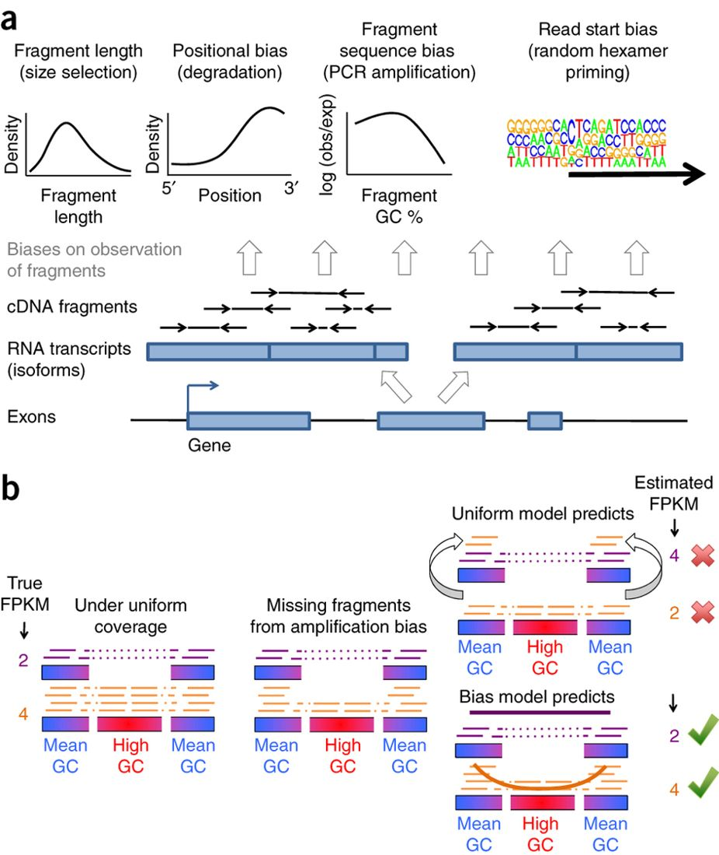
RNA-seq biases
Love et al. (2016) Nature Biotechnology

Slide 18
Salmon: Accounting for fragment sequence bias
Love et al. (2016) Nature Biotechnology
[Salmon] “It is the first transcriptome-wide quantifier to correct for fragment GC-content bias”
Patro et al. (2017) Nature Methods

Slide 19
Notes:
Onlina phase that estimates:
-initial expression levesls
-Auxiality parametes
-Foreground bias modeles
-construct equivalence clases over impit fragments
offline pahse:
-Refines these expressione stimates
Online and offline phases optimize the estimates of transcript abunances
Online – Collapsed variational bayesian inference
Offiline – EM algorithm

