Slide 1
Foxtrot
Wil – Simon – rowan – Yusairah – Sebastian – meheraj – Zachary – loy

Slide 2
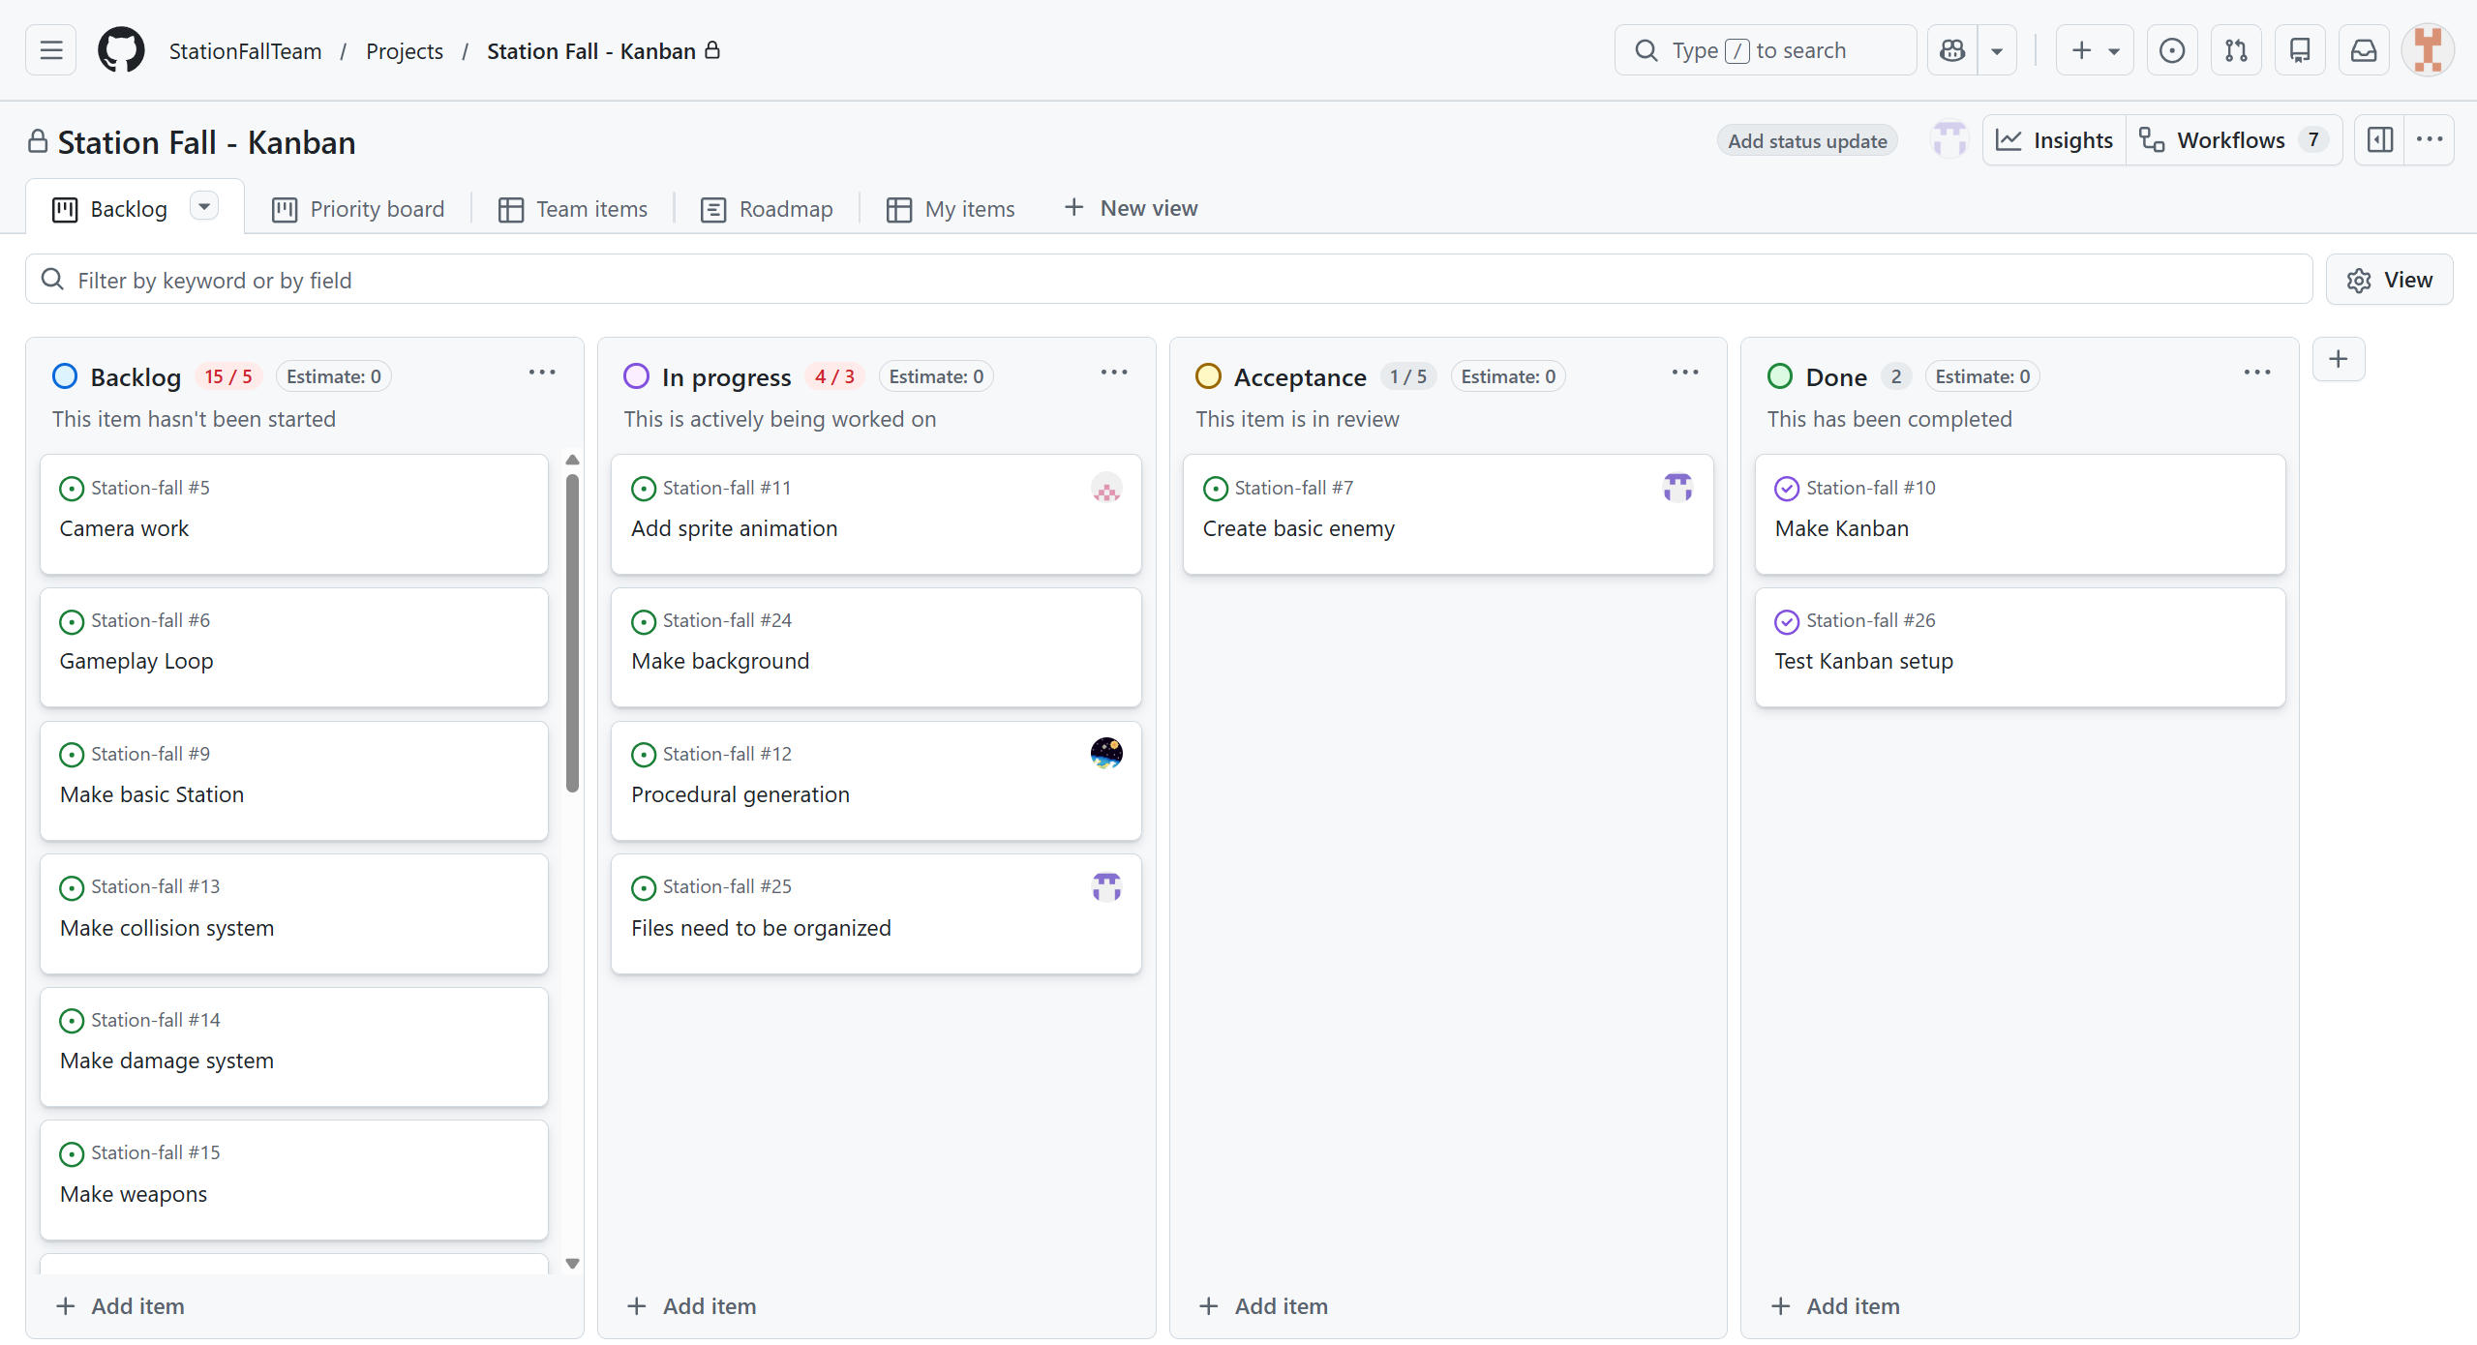
Kanban

Slide 3
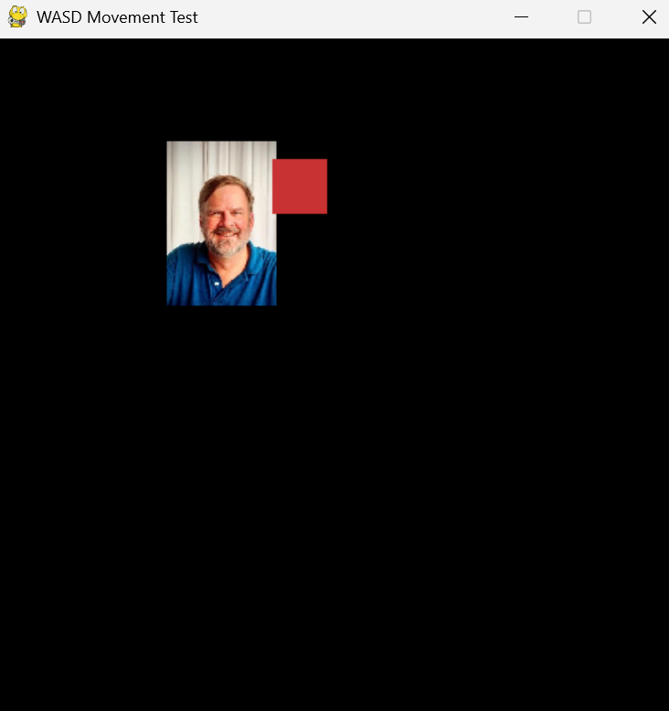
Basic Movement

Slide 4
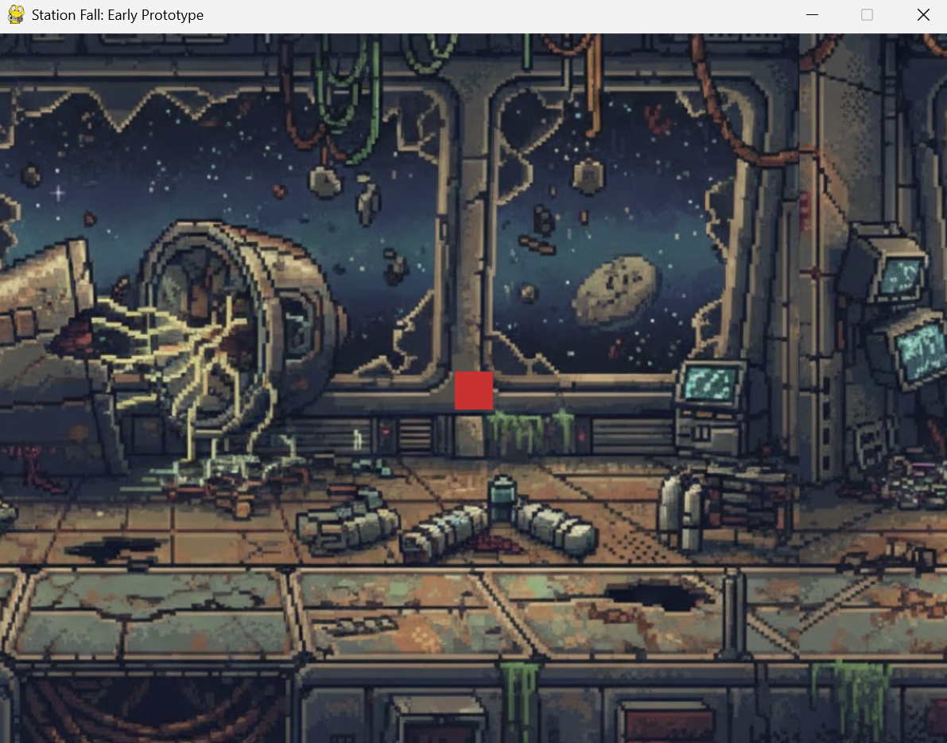
Background

Slide 5
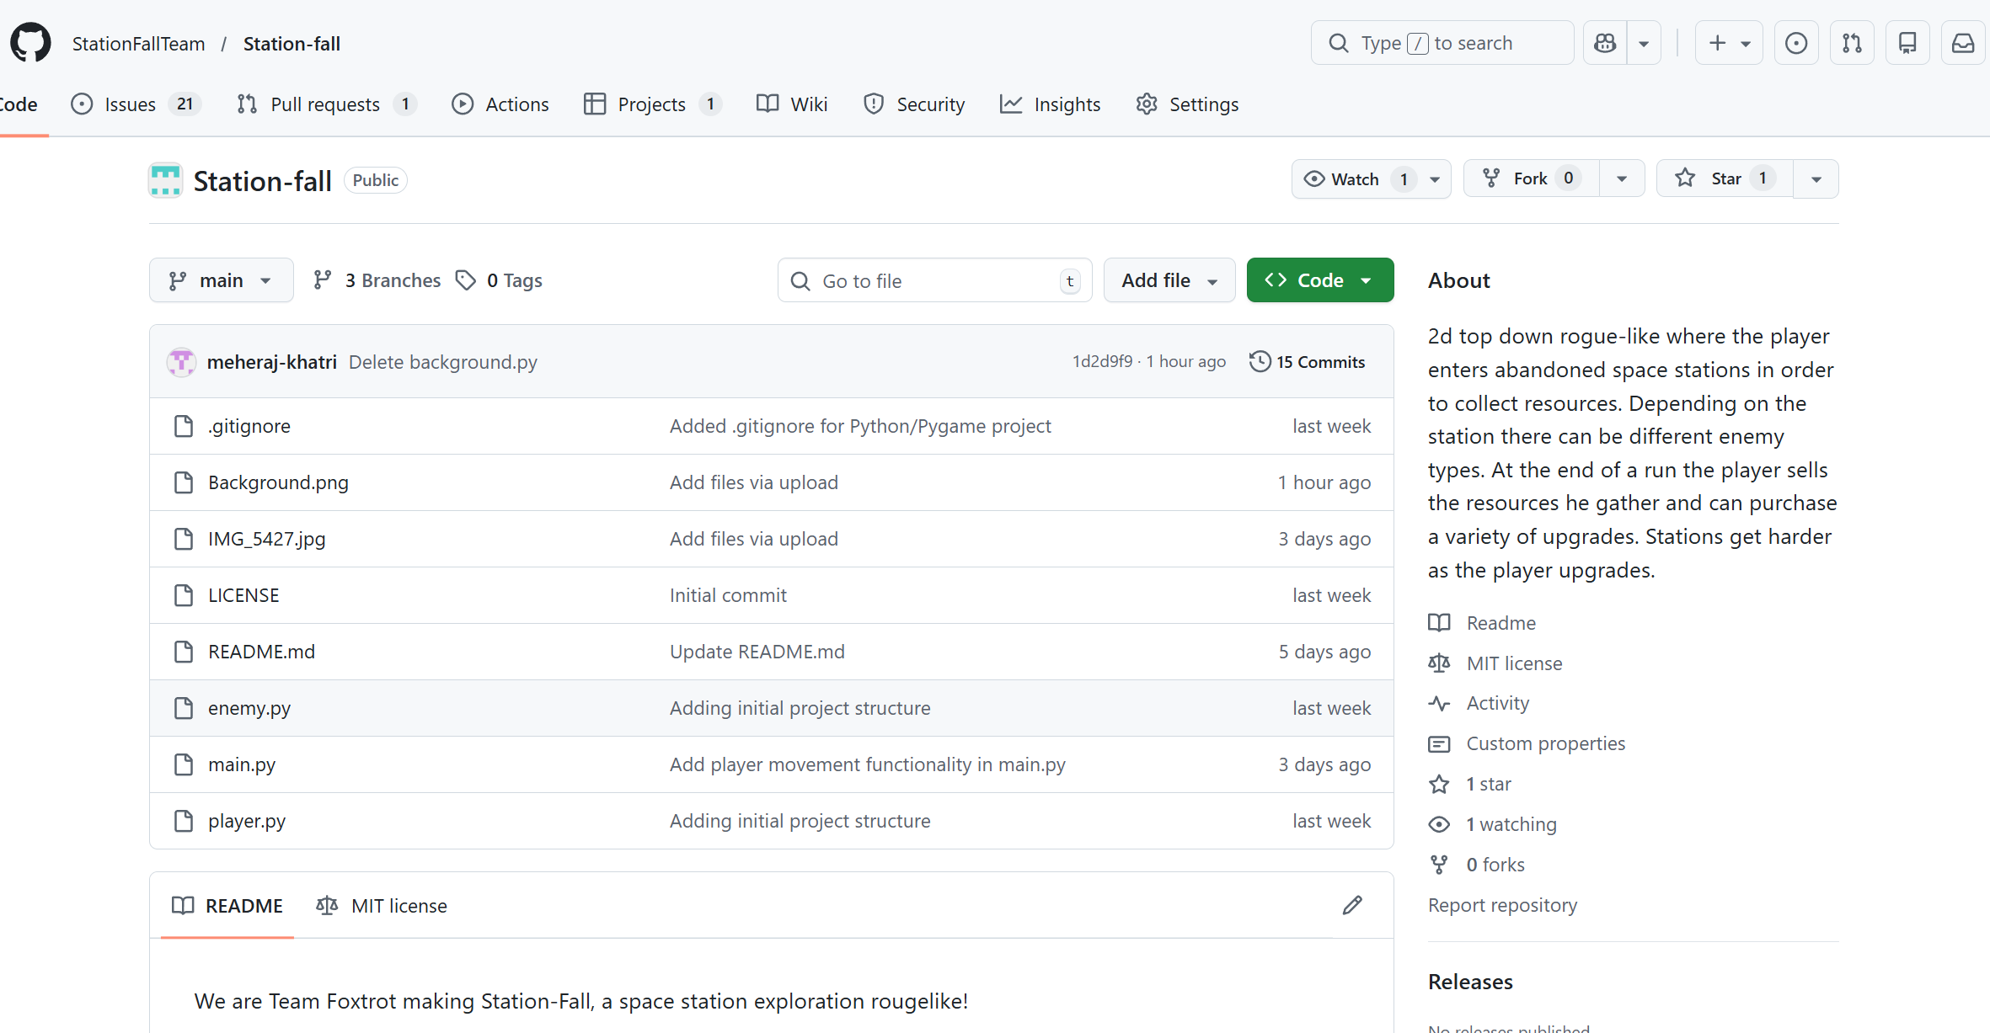
GitHub Setup

