Slide 1

Does Age Impact the Number of Hours Worked Per Week? Rashmi Gongireddy DSC530 Data Exploration and Analysis 11/16/2024

Slide 2
Agenda
Dataset overview and Variables
Histogram
Handling outliers
Descriptive Statistics
PMF usefulness in analysis
Comparing CDF's
Analysis of Scatter Plot comparing two variables
Regression Summary
Conclusion

Slide 3
Dataset Overview and Variables
Dataset Overview: This dataset includes demographic information such as age, education level, work experience, and income. The goal is to explore how these factors relate to whether an individual earns above or below $50K.
Five Variables for Analysis:
Age: The age of the individual.
Education Level: The highest education level attained (e.g., HS-grad, Bachelors, Masters).
Hours Worked per Week: Number of hours the individual works per week.
Occupation: The individual's job type (e.g., Support, Sales, Executive).
Income: The target variable indicates whether the individual earns more than $50K/year (binary: ">50K" or "<=50K").

Slide 4
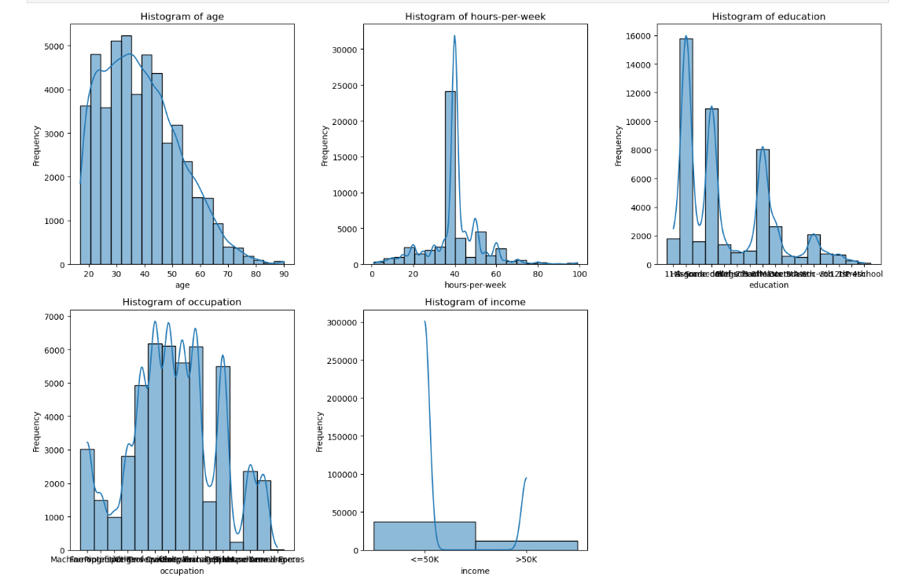
Histogram of 5 variables

Slide 5
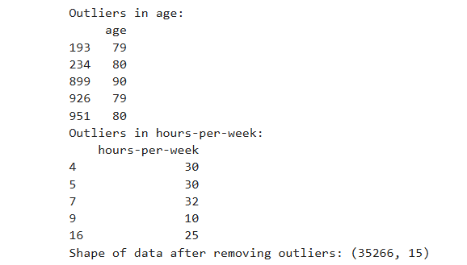
Handling Outliers
AGE:
Outliers: Encounter extreme values (e.g., ages under 18 or over 100). These could be data entry errors or extreme but valid cases.
Handling: If the outliers are errors (e.g., age 150), they should be removed. If they are valid extreme cases (e.g., elderly people working), they might be retained.

Slide 6
​
Hours Worked per Week:​
Outliers: Outliers included extremely high values (e.g., 100+ hours/week) or very low values (e.g., 0 hours). High hours could indicate overtime work or data entry errors.​
Handling: Can remove these outliers if they are unrealistic or cap them to a reasonable threshold (e.g., 80 hours).

Slide 7
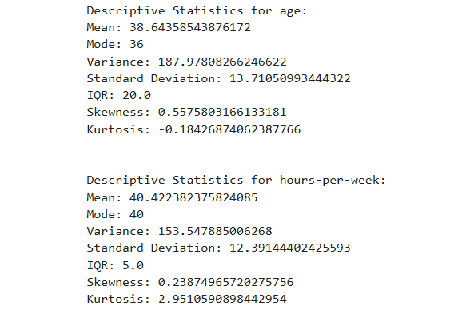
Mean:
A high mean suggests that most of the data points are on the higher side of the scale, and a low mean suggests they are on the lower side.
Mode:
The mode helps you identify the most common value in the dataset. If the dataset is multimodal, it indicates that there are multiple peaks in the distribution.
Spread (Variance, Standard Deviation, IQR):
Variance and Standard Deviation give you an idea of how spread out the data is. A high variance means the data points are more spread out from the mean, while a low variance means they are closer.
The IQR is a good way to measure the spread of the central portion of the data, as it focuses on the middle 50% of the data. A large IQR indicates more spread, while a small IQR indicates that the data is concentrated in a small range.
Tails (Skewness and Kurtosis):
Skewness tells you if the distribution is symmetrical or if it has a longer tail on one side. A positive skew indicates a tail on the right, while a negative skew indicates a tail on the left.
Kurtosis describes the peakedness and tails of the distribution. High kurtosis means the data has heavy tails or outliers, while low kurtosis indicates light tails.

Slide 8
PMF Usefulness in Analysis
The PMF comparison provides insights into how working hours differ between young and older adults.
The young adult group is more diverse regarding hours worked per week, possibly due to part-time work, freelancing, or lower job stability.
The older adult group is more likely to work full-time hours, with fewer individuals working part-time or being unemployed.
This comparison helps you understand how age impacts work patterns and can inform potential further analysis, such as whether the hours worked correlate with income, occupation, or other factors.

Slide 9
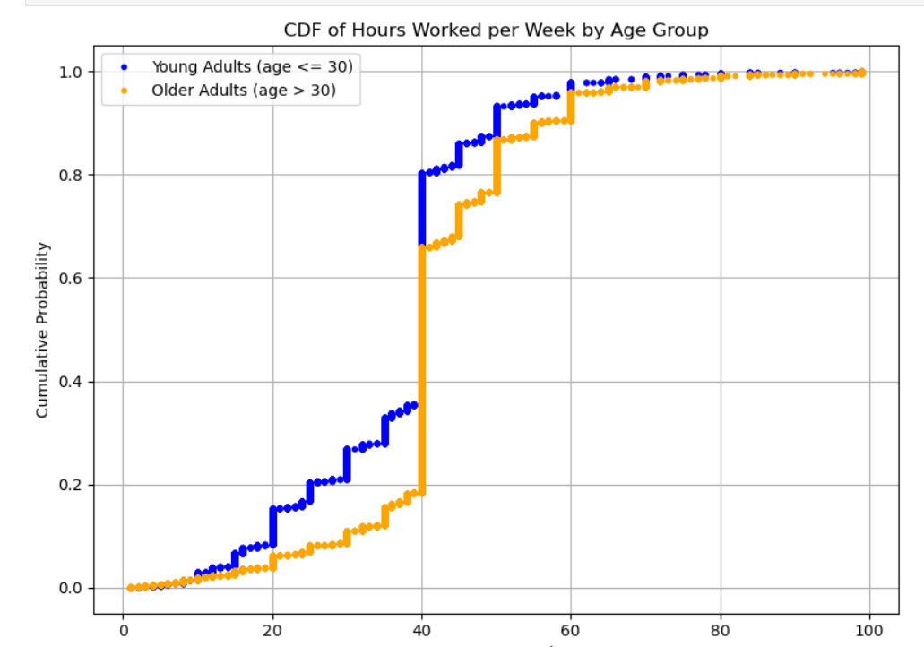
Comparing The CDF’s
The CDF helps in understanding the distribution and cumulative nature of the number of hours worked in different groups. When answering the question of whether age impacts the number of hours worked per week, comparing the CDFs for young adults and older adults gives you a clear visualization of how age influences work patterns.
A shift in the CDF for older adults towards higher work hours (e.g., 40+ hours) compared to younger adults can show that older adults tend to work more hours.
A wider CDF for young adults may indicate that their work hours vary more, possibly due to part-time work or a mix of employment types.

Slide 10
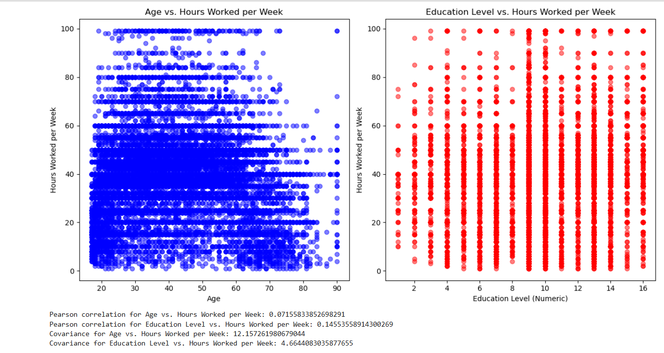
Analysis of Scatter plot comparing two variables
1. Age vs. Hours Worked per Week:
Pearson Correlation: The Pearson correlation between age and hours worked per week is positive that suggest positive, that people in middle adulthood (e.g., 30-50 years old) tend to work more hours, likely due to full-time work or career-related factors.
Covariance: A positive covariance indicates that as age increases, the number of hours worked tends to increase as well, or vice versa.
2. Education Level vs. Hours Worked per Week:
Pearson Correlation: The correlation between education and hours worked could show , that people with higher education levels may have higher-paying jobs that require more hours (e.g., professionals), while those with lower education levels may work fewer hours or in lower-paying jobs.
Covariance: Covariance is positive, it suggests that more educated individuals tend to work more hours on average.

Slide 11
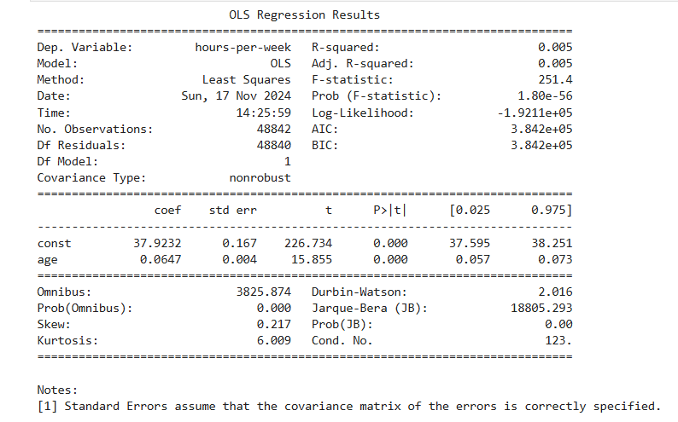
Regression Summary
Interpretation:
The coefficient for age:
The coefficient for age is 0.0647 which suggests that for each additional year of age, the number of hours worked per week increases by about 0.06 hours.
This relationship is quite small, but it is statistically significant.
p-value for age:
The p-value for age is 0.000, which is less than 0.05. This means we reject the null hypothesis and conclude that there is a statistically significant relationship between age and hours worked per week.
R-squared:
The R-squared value is 0.005, which means that only about 0.5% of the variance in hours worked per week is explained by age. While age is statistically significant, it is not a very strong predictor of hours worked.

Slide 12
Conclusion
In conclusion, the analysis found that age has a statistically significant relationship with hours worked per week, but the effect is modest. The R-squared value suggested that age alone does not explain much of the variance in work hours. To refine the model, additional variables such as education, occupation, and income should be included, and more advanced techniques (e.g., non-linear regression) should be considered to capture the complexities of the relationship. Handling outliers and addressing the assumptions of linearity would also improve the model's accuracy.

