Slide 1
Network dynamics of the brain and influence of the epileptic seizure onset zone
Samuel P. Burns, Sabato Santaniello, Robert B. Yaffe, Christophe C. Jouny, Nathan E. Crone, Gregory K. Bergey, William S. Anderson, Sridevi V. Sarma
Presenters: Michele Lohr & Allen Kim
April 28, 2015

Slide 2
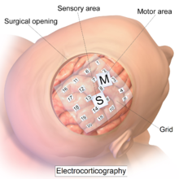
Definitions
Ictal (SZ) = seizure
Preictal (Pre) = pre-seizure
Postictal (Post) = post seizure
Periictal = Pre+SZ+Post
Interictal (II) = between seizures
EEG = electroencephalogram
ECoG = electrocorticography, or intracranial EEG (iEEG)
S = subdural grid electrodes
D = depth electrodes
DRE = drug resistant epilepsy
PS = simple partial seizure
CPS = complex partial seizure
GTC = secondarily generalized tonic-clonic seizure
Seizure onset zone (SOZ) = the area of the brain thought to be capable of initiating a seizure in a particular patient

Slide 3
Definitions
Clinically annotated focus = region that is clinically identified as the SOZ and subsequently surgically resected
Surgical resection = removal of abnormal tissue, e.g., in the case of DRE patients, the entire seizure onset zone or clinically annotated focus
FL, OL, PL, TL = lobectomies: frontal, occiptal, parietal, temporal
AMG, HIPP = amygdalectomy, hippocampectomy
IF state = isolated focus state
CF state = connected focus state
Eigenvector centrality (EVC) = metric capturing the importance of each electrode (node) in the corresponding connectivity matrix or graph, i.e., 1st eigenvector of the adjacency matrix

Slide 4
Overview or Significance
Hypothesis: A brain state space model, based on ECoG recordings and graph-theoretic techniques, can help localize seizure onset zone, and ultimately optimize surgical resection in DRE patients.

Slide 5
Challenge
To date:
Clinicians typically visually inspect seizures recorded from ECoG data to localize seizures
Time consuming process
Not always successful, i.e., definitive localization does not always occur
Brain connectivity has been studied in either interictal or ictal periods using ECoG recordings over short temporal intervals (tens to hundreds of seconds)
Neuronal ensembles have been studied in vitro
Only a handful of studies have investigated the role of the clinically annotated focus in brain networks over time
It is unknown whether or not a consistent structure in brain functional networks emerges over time during interictal and ictal periods, which could lead to a state space model to help localize the SOZ in ECoG recordings
It is unknown whether or not a consistent structure in brain functional networks emerges over time during interictal and ictal periods, which could lead to a state space model to help localize the SOZ in ECoG recordings

Slide 6
Action
Continuous ECoG recordings made of patients undergoing presurgical evaluations
Functional brain connectivity computed continuously over time (one matrix or EVC per each second), clustering into a finite set of distinct networks or brain states
Using post resection surgery results, transitions between these states investigated and used to assess connectivity of the SOZ throughout seizure
Centroid connectivity of each state is then used to predict the SOZ, and performance assessed over all patients and seizures

Slide 7
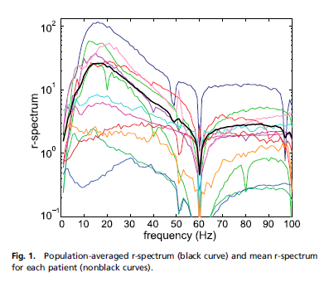



Measurements and Network Analysis
ECoG recordings of patients undergoing presurgical evaluations
12 DRE patients
88 ± 22 (μ ± σ) electrodes per patient
5.4 ± 1.7 days of continuous measurements per patient
3.5 ± 1.51 seizures per patient (42 seizures total across all 12 patients)
Measurements during all phases: interictal, periictal, and ictal periods
Functional brain connectivity computed over time
Network analysis
One connectivity matrix per second (3-s window, 2-s overlap)
Each graph node = one electrode
Edges = weighted by average normalized coherence in a fixed frequency band
Network connectivity at each second summarized by eigenvector centrality (EVC) of the nodes from the corresponding connectivity matrix

Slide 8

Brain State Clustering and SOZ Prediction
EVCs clustered into brain network states, separately for interictal periods, ictal periods, and preictal and postictal epochs
Unsupervised k-means clustering
Connectivity of the SOZ throughout seizure assessed and patterns noted
Statistical testing of seizure state progression
The centroid connectivity of each state is used to predict the SOZ
ROC Curve Analysis using post resection surgery results
Statistical testing of ROC Analysis

Slide 9
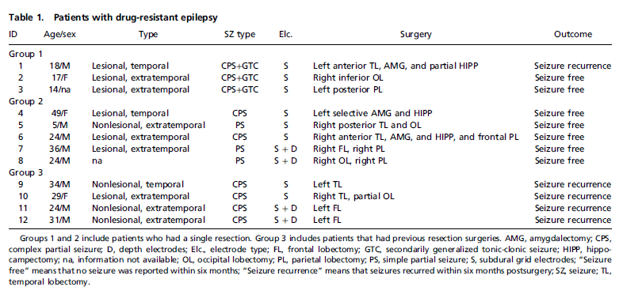
Resolution
DRE Patients in Study
(Resected Region)

Slide 10
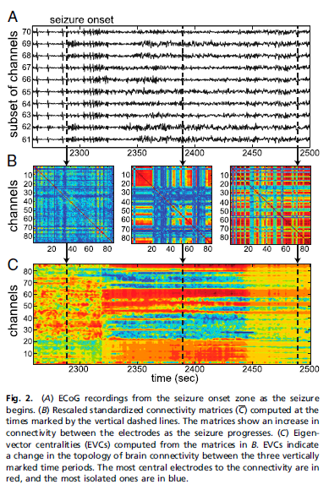
Network Analysis
Connectivity matrices and EVCs show consistent pattern around seizures
Lowest connectivity at electrographic onset time of seizure
A connected subnetwork of channels developed at 100s and grew until most electrodes were strongly connected at 200s after onset

Slide 11
Brain States
Brain states and state evolution patient specific and consistent across multiple seizures
Patient 1 with CPS+GTC (next slide left)
All seizures progressed through same set of states (4 → 6 → 8 → 7 → 5 → 9) ending at state 10 after termination
Patient 4 with CPS (next slide right)
Seizure brain state progression showed consistent structure (4 → 6 → 7 → 5 → 7) ultimately toggling between states 5 and 7 and then revisiting state 4 before ending at state 10 after termination
Each patient
Fewer interictal states (3) than non-interictal states
State changes during interictal periods did not follow regular progression
Clinically annotated focus denoted by red arrow

Slide 12
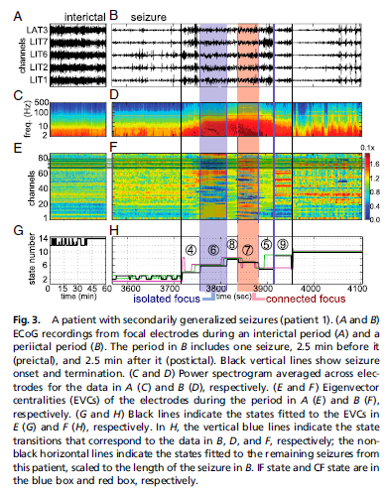
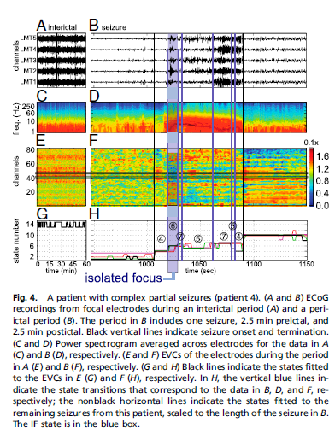
Brain States
Patient 1 Patient 4

Slide 13
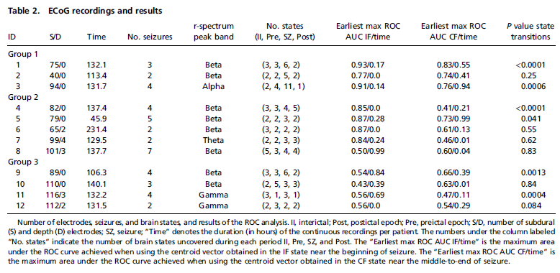
ECoG Recordings and Brain State Results

Slide 14
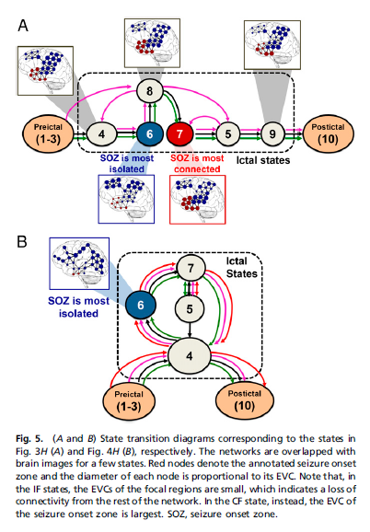
Relationship between Brain States and SOZ
Patient 1 (Fig. 3H)
In all successful resections, SOZs or focal areas were least connected shortly after seizure onset time: this state denoted the IF state
Patient 4 (Fig. 4H)

Slide 15
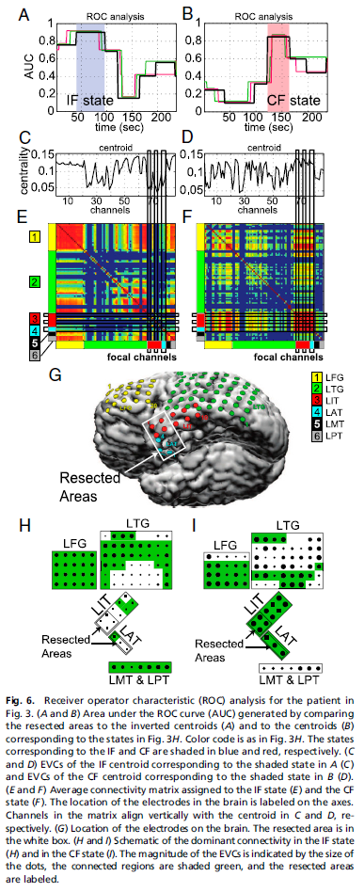
Determination of SOZ by IF State
Hypothesis: IF state → the SOZ or focal area
Test via ROC analysis
Resection indicator (RI) vector with 1’s for electrodes corresponding to SOZ and 0’s for all other electrodes
For each patient and each identified ictal state, compare state’s EVC centroid vector with RI vector, and any centroid EVC below (above) a threshold value is identified as SOZ for IF (CF) analysis
Patient 1

Slide 16
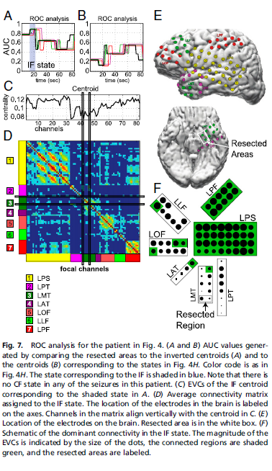
Determination of SOZ by IF State
Patient 4

Slide 17
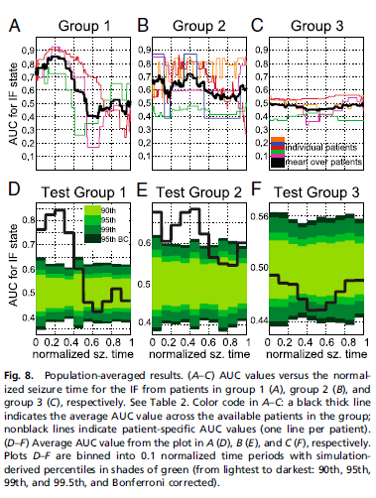
Population Statistics
Results over 42 seizures from 12 patients
Group 1: CPS+GTC, single surgery
Group 2: CPS or PS, single surgery
Group 3: CPS, multiple surgeries
Group 1:
SOZ of GTC seizures significantly isolated from remaining areas at onset time through early ictal stages, and connectedness significantly increased during later stages for 2 out of 3 patients
Group 2:
SOZ of partial seizures significantly isolated from remaining areas at onset time and midseizure
Group 3:
AUC values close to chance level indicating possible misalignment of resected areas with the SOZ

Slide 18
Results and Future
Results
Brain activity recorded through ECoG measurements from 12 DRE patients can be described by a small number of discrete connectivity states
Interictal stages (2-5 states), ictal stages (2-11), and the pre/postictal epochs (1-5)
Consistent progression of states during seizures
Combining post-op follow-up info about the SOZ, the SOZ is significantly isolated at beginning of ictal event, which can be used for SOZ prediction
Impact
May be able to assist clinicians either in identifying a ROI that likely contains the SOZ or in suggesting that electrode coverage may be inadequate
Future
Resected areas (as used in ROC-based RI vector) may be smaller or larger than SOZ for cases of recurrence or multiple resections, respectively, skewing results
A finite-state, data-driven model (e.g., hidden Markov model) may be useful to capture the brain dynamics and study brain activity

Slide 19
Acknowledgments
We would like to thank Dr. Sridevi Sarma and her colleagues for writing this paper, and Dr. Sarma for explaining the methodology.

Slide 20
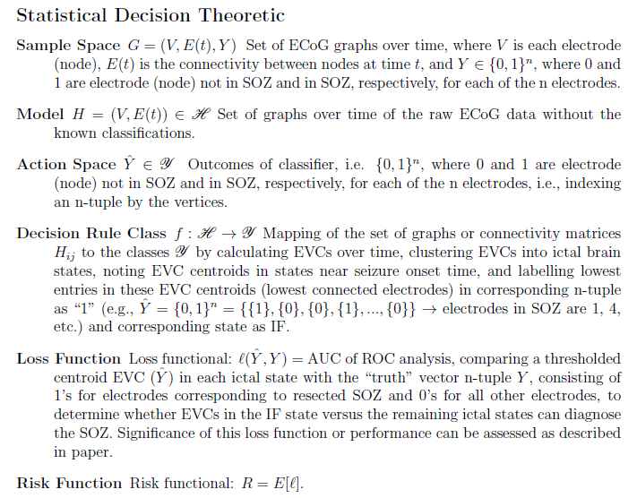
Statistical Decision Theoretic

