Slide 1
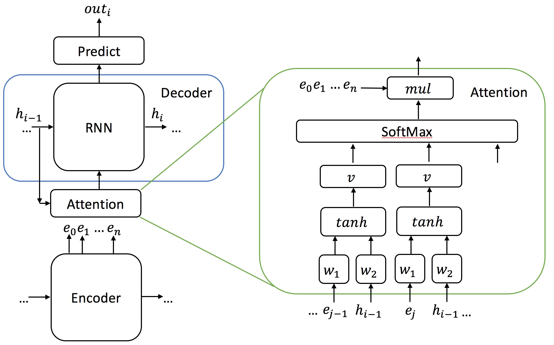
seq2seq: Attention
Advantage of using attention
- memory
- accuracy
How attention works
1) attention weights
feed-forward layer:
encoder’s output and decoder’s output hidden state
as inputs

Slide 2
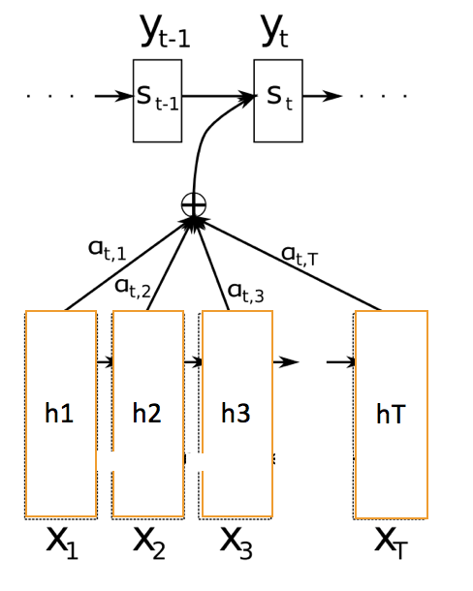
seq2seq: Attention
How attention works
2) multiplied by encoder output vectors

Slide 3
Future Works:
seq2seq: Beam Search
Evaluation
- Human-based study
- Multiple high-quality reference texts
Different Corpus

Slide 4
seq2seq: Beam Search
Problem:
- word with highest score at time t not necessarily giving you the sentence with highest probability
Beam Search:
- width of m
- At each time step, taking the top m proposal, decoding with each one of them

